Slide 1

Quantum Computing
Christian Schaffner
Research Center for Quantum Software
University of Amsterdam
Informatics Institute (IvI)
Theory of Computer Science (TCS) group
Leve De Wiskunde! 19 April 2024

Slide 2
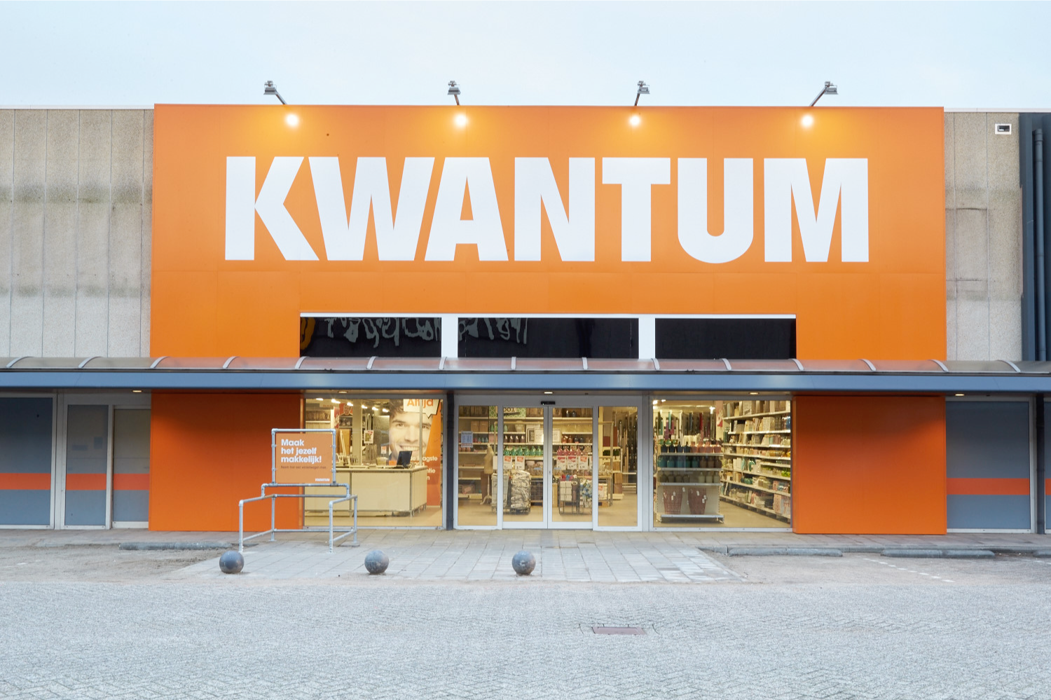

Notes:
Kwantum kennen die jongens natuurlijk niet,
Maar Britten houden vast van James Bond en hun eigen Britse merk sport cars, Quantum Sports Cars, QSC, Hier afgebeeld de sexy sunrunner https://en.wikipedia.org/wiki/Quantum_Sports_Cars

Slide 3

Quantum Physics

Slide 4
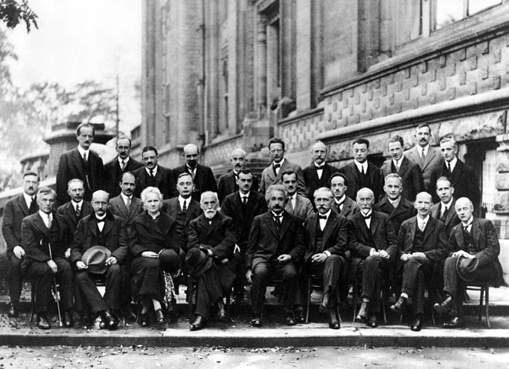
Solvay conference Brussels 1927
Dirac
Schrödinger
Pauli
Heisenberg
Planck
Curie
Lorentz
Einstein
Bohr
Notes:
Fifth Conference[edit]
Perhaps the most famous conference was the October 1927 Fifth Solvay International Conference on Electrons and Photons, where the world's most notable physicists met to discuss the newly formulated quantum theory. The leading figures were Albert Einstein and Niels Bohr. 17 of the 29 attendees were or became Nobel Prize winners, including Marie Curie, who alone among them, had won Nobel Prizes in two separate scientific disciplines.^{[3]}
This conference was also the culmination of the struggle between, on one side, Einstein and other scientific realists -- who wanted strict rules of scientific method as laid out by Charles Peirce and Karl Popper -- and on the other, Bohr and other instrumentalists, who wanted looser rules based on outcomes.^{[vague]} Starting at this point, the instrumentalists won, instrumentalism having been seen as the norm ever since,^{[4]} although the debate has been actively continued by the likes of Alan Musgrave.

Slide 5
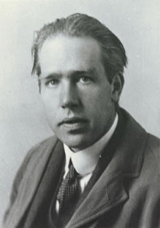
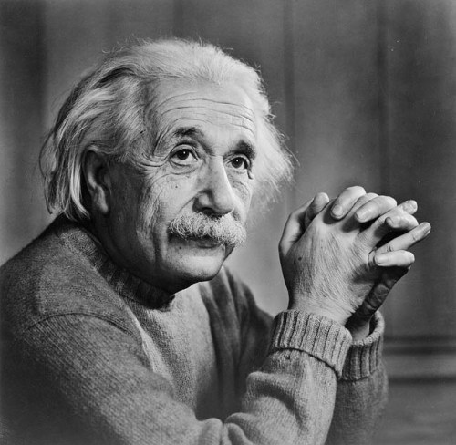
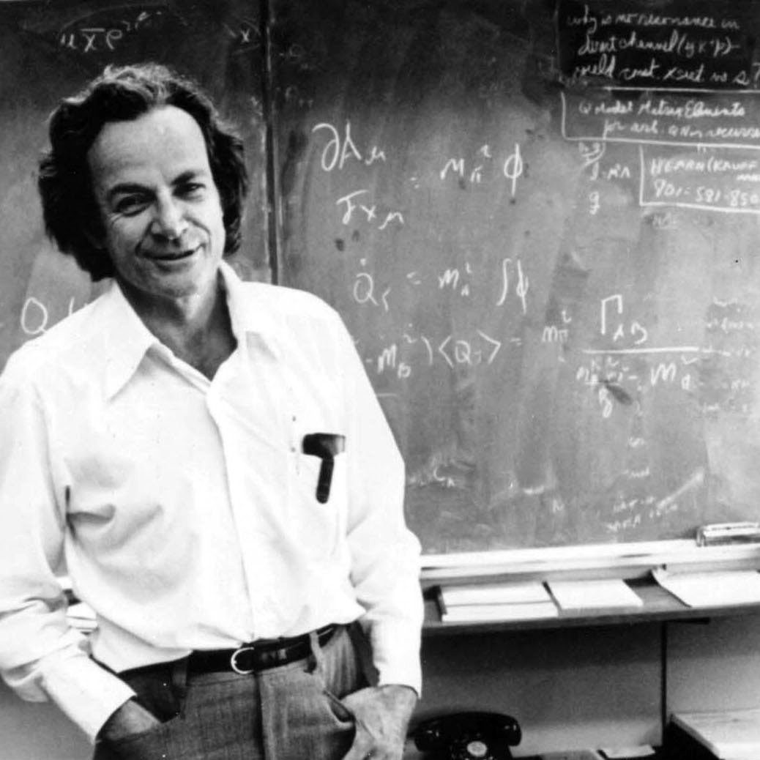
Quantum Physics
Niels Bohr:
“If quantum physics hasn’t profoundly
shocked you, you haven’t understood it yet.”
Albert Einstein:
“God does not play dice.”
Richard Feynman:
“I think I can safely say that nobody understands
quantum physics.”

Slide 6
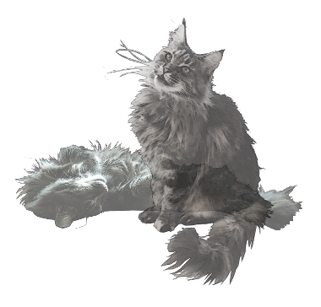
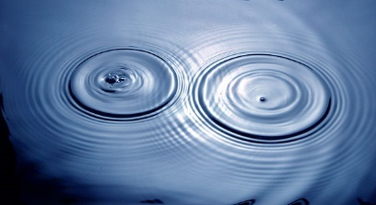
Quantum Physics
Superposition:
  Of different states
Interference:
  Of states
Entanglement:
  Of two or more physical systems

Slide 7
Quantum Physics
Superposition:
  Of different states
Interference:
  Of states
Entanglement:
  Of two or more physical systems

Slide 8
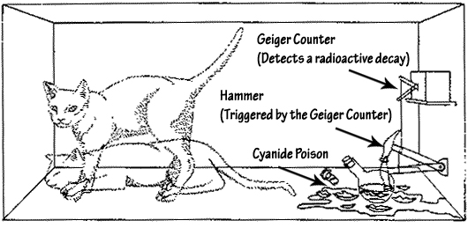
Superposition
An object in different states simultaneously:
- A photon can be at two positions at the same time
- Schrödinger’s cat: dead and alive
Experimentally verified:
- Small systems, such as photons
- Bigger systems, molecules…
April 2023: Fat quantum cats at ETH Zurich: 16 micrograms!
Notes:
Fat Quantum Cats: https://ethz.ch/en/news-and-events/eth-news/news/2023/04/fat-quantum-cats.html

Slide 9
“About your cat Mister Schrödinger…
I’ve got good and bad news.”

Slide 10
Superposition:
An experiment

Slide 11
Quantum Bit: Polarization of a Photon

Slide 12
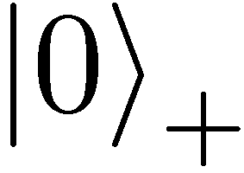
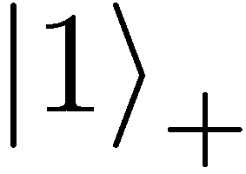
Qubit: Rectilinear/Computational Basis

Slide 13
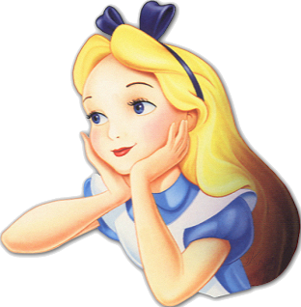

Detecting a Qubit
No photons: 0
Alice
Bob

Slide 14
Measuring a Qubit
No photons: 0
Photons: 1
Alice
Bob
Measurement:
with prob. 1 yields 1
0/1

Slide 15
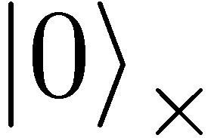
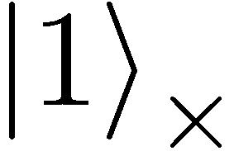

Diagonal Basis
Measurement:
with prob. ½ yields 0
=
0/1
with prob. ½ yields 1

Slide 16
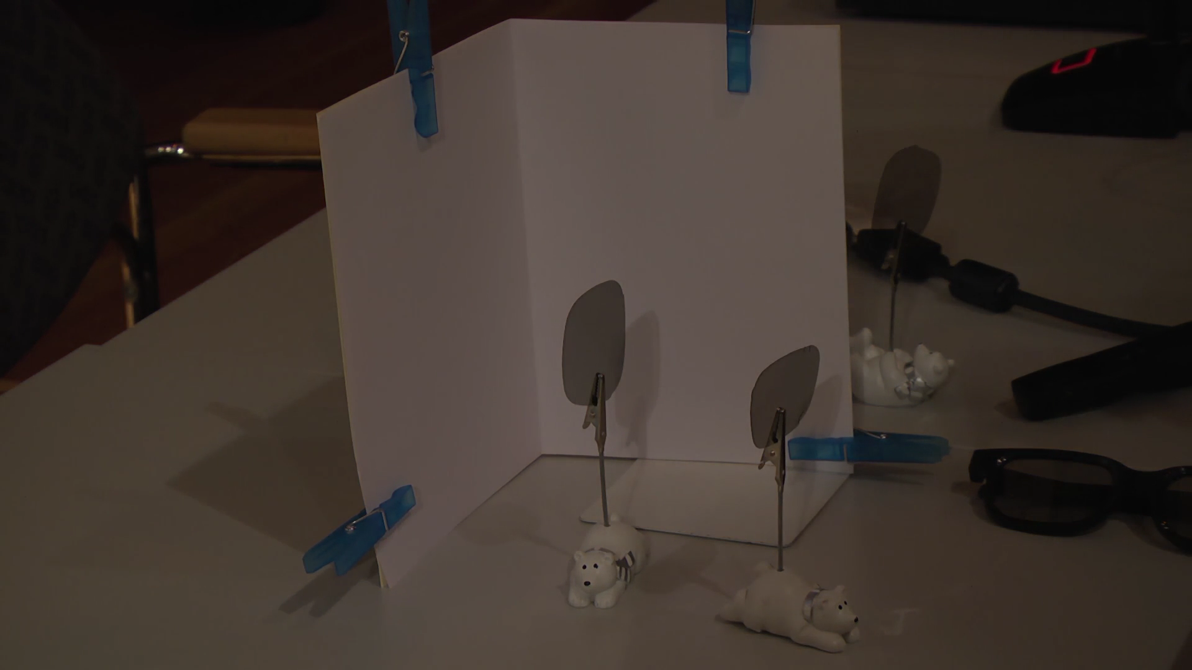
Video

Slide 17
Measuring Collapses the State
Measurement:
with prob. ½ yields 0
=
with prob. ½ yields 1
0/1

Slide 18
Measuring Collapses the State
=
=

Slide 19
Quantum Physics
Superposition:
  Of different states
  Observation: collapse of the superposition
Interference
  Of an object in superposition
Entanglement
  Of two or more physical systems

Slide 20
detector 1
no superposition but: beamsplitter reflects 50% and transmits 50%?
detector 0

Slide 21
Mach-Zehnder interferometer
detector 1
50% detector 0 clicks
50% detector 1 clicks
mirror
detector 0
50%-50%
beamsplitter
mirror
classical reasoning

Slide 22
Mach-Zehnder interferometer
detector 1
detector 0
clicks
ALWAYS !!!
mirror
detector 0
mirror
When you perform the experiment

Slide 23
detector 1
detector 0
clicks
ALWAYS !!!
mirror
detector 0
superposition
interference
mirror
According to quantum mechanics

Slide 24
Quantum Physics
Superposition
  Of different states
  Observation: collapse of the superposition
Interference:
  Of an object in superposition
Entanglement:
  Of two or more physical systems

Slide 25
Quantum Computers

Slide 26
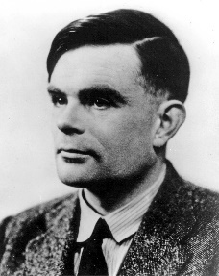
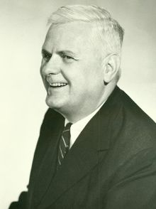
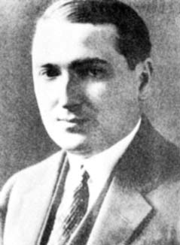
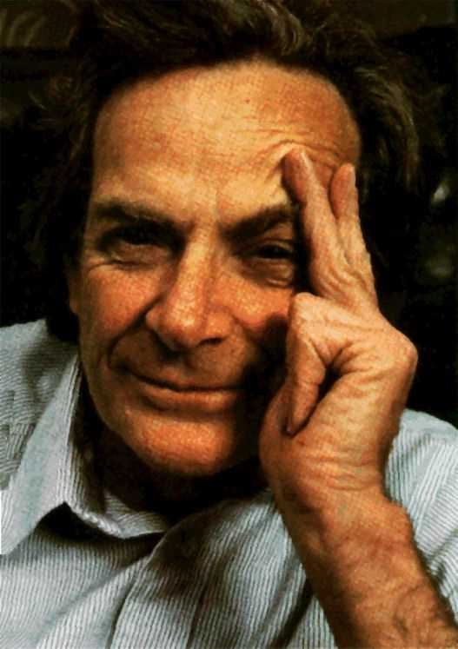
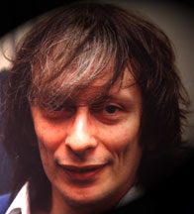
Quantum Physics
Computer Science
Alan
Turing
+
Alonzo
Church
Emile
Post
=
Quantumcomputer
Feynman
Deutsch

Slide 27

Quantum Bit
detector 1
Classical bit:
0 or 1
Quantum bit:
superposition of 0 and 1
or
detector 0
detector 1
superposition
detector 0

Slide 28



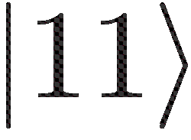
More qubits
1 qubit superposition of 2 states
2 qubits superposition of 4 states
3 qubits superposition of 8 states
4 qubits superposition of 16 states
5 qubits superposition of 32 states
6 qubits superposition of 64 states
300 qubits superposition of 2³⁰⁰ states
=

Slide 29
Quantum software:
fundamentally different
Qubit: superposition of 0 and 1
300 qubits: astronomical amount of parallel computation
How to get the answer out??
  - Measuring destroys computation!!
Quantum Program
  Use interference to cancel undesired
  computations
Does not always work!
Our focus: how can we optimally use the extra power!

Slide 30
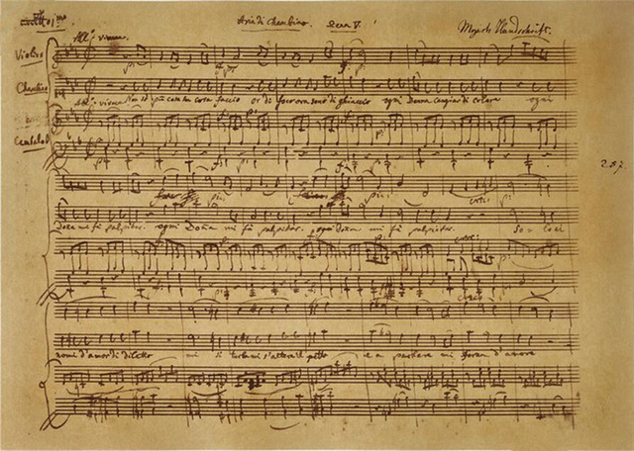
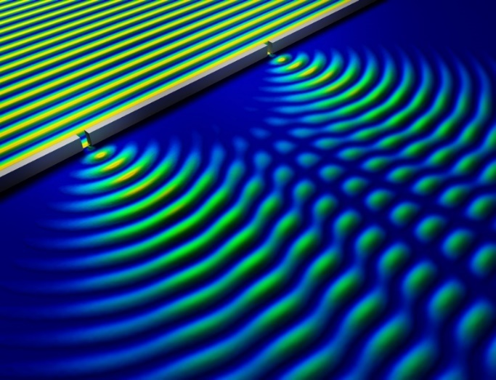
Quantum Programming is like Composing
Music
- Sound waves interfere
- Composer creates ‘beautiful’
interference of sound waves
Quantum Computer
- Qubits in superposition interfere
- Quantum programmer ensures
useful interference of qubit states
Notes:
https://phys.org/news/2014-05-nondestructive-method-quantum.html
Bron

Slide 31
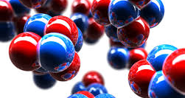
What can you do with it?
Factor big numbers [Shor]
  Breaks frequently used cryptography
Quantum cryptography [Bennett-Brassard-Ekert]
  Quantum-proof cryptography
Efficient communication
  Quantum internet, entanglement etc.
Simulation of nature
  Chemistry, material design, new medicines..
??????

Slide 32
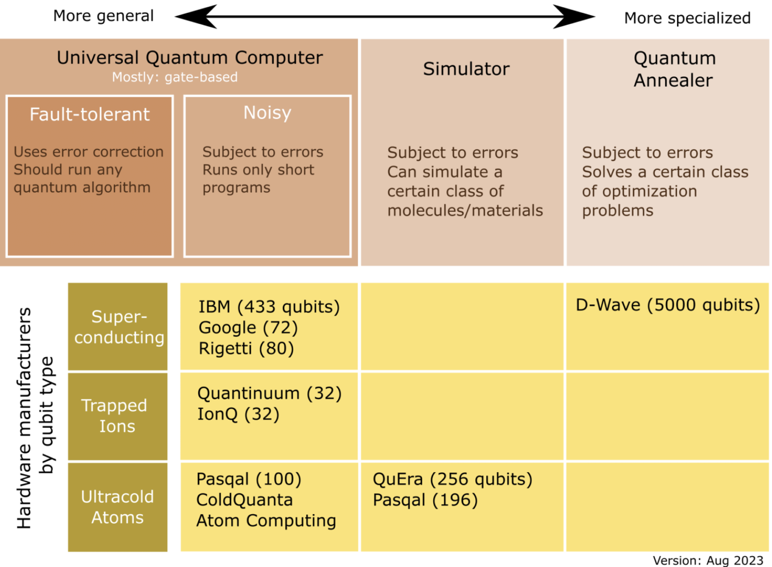
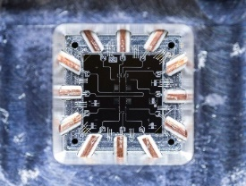
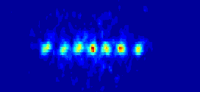
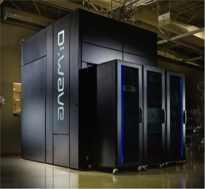
Progress in Building Qubits

Slide 33

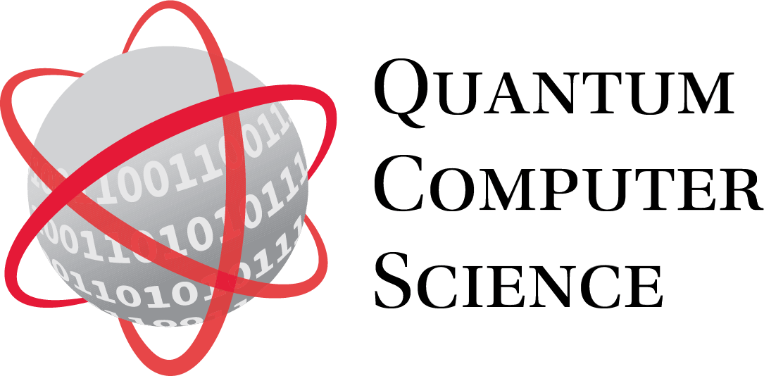
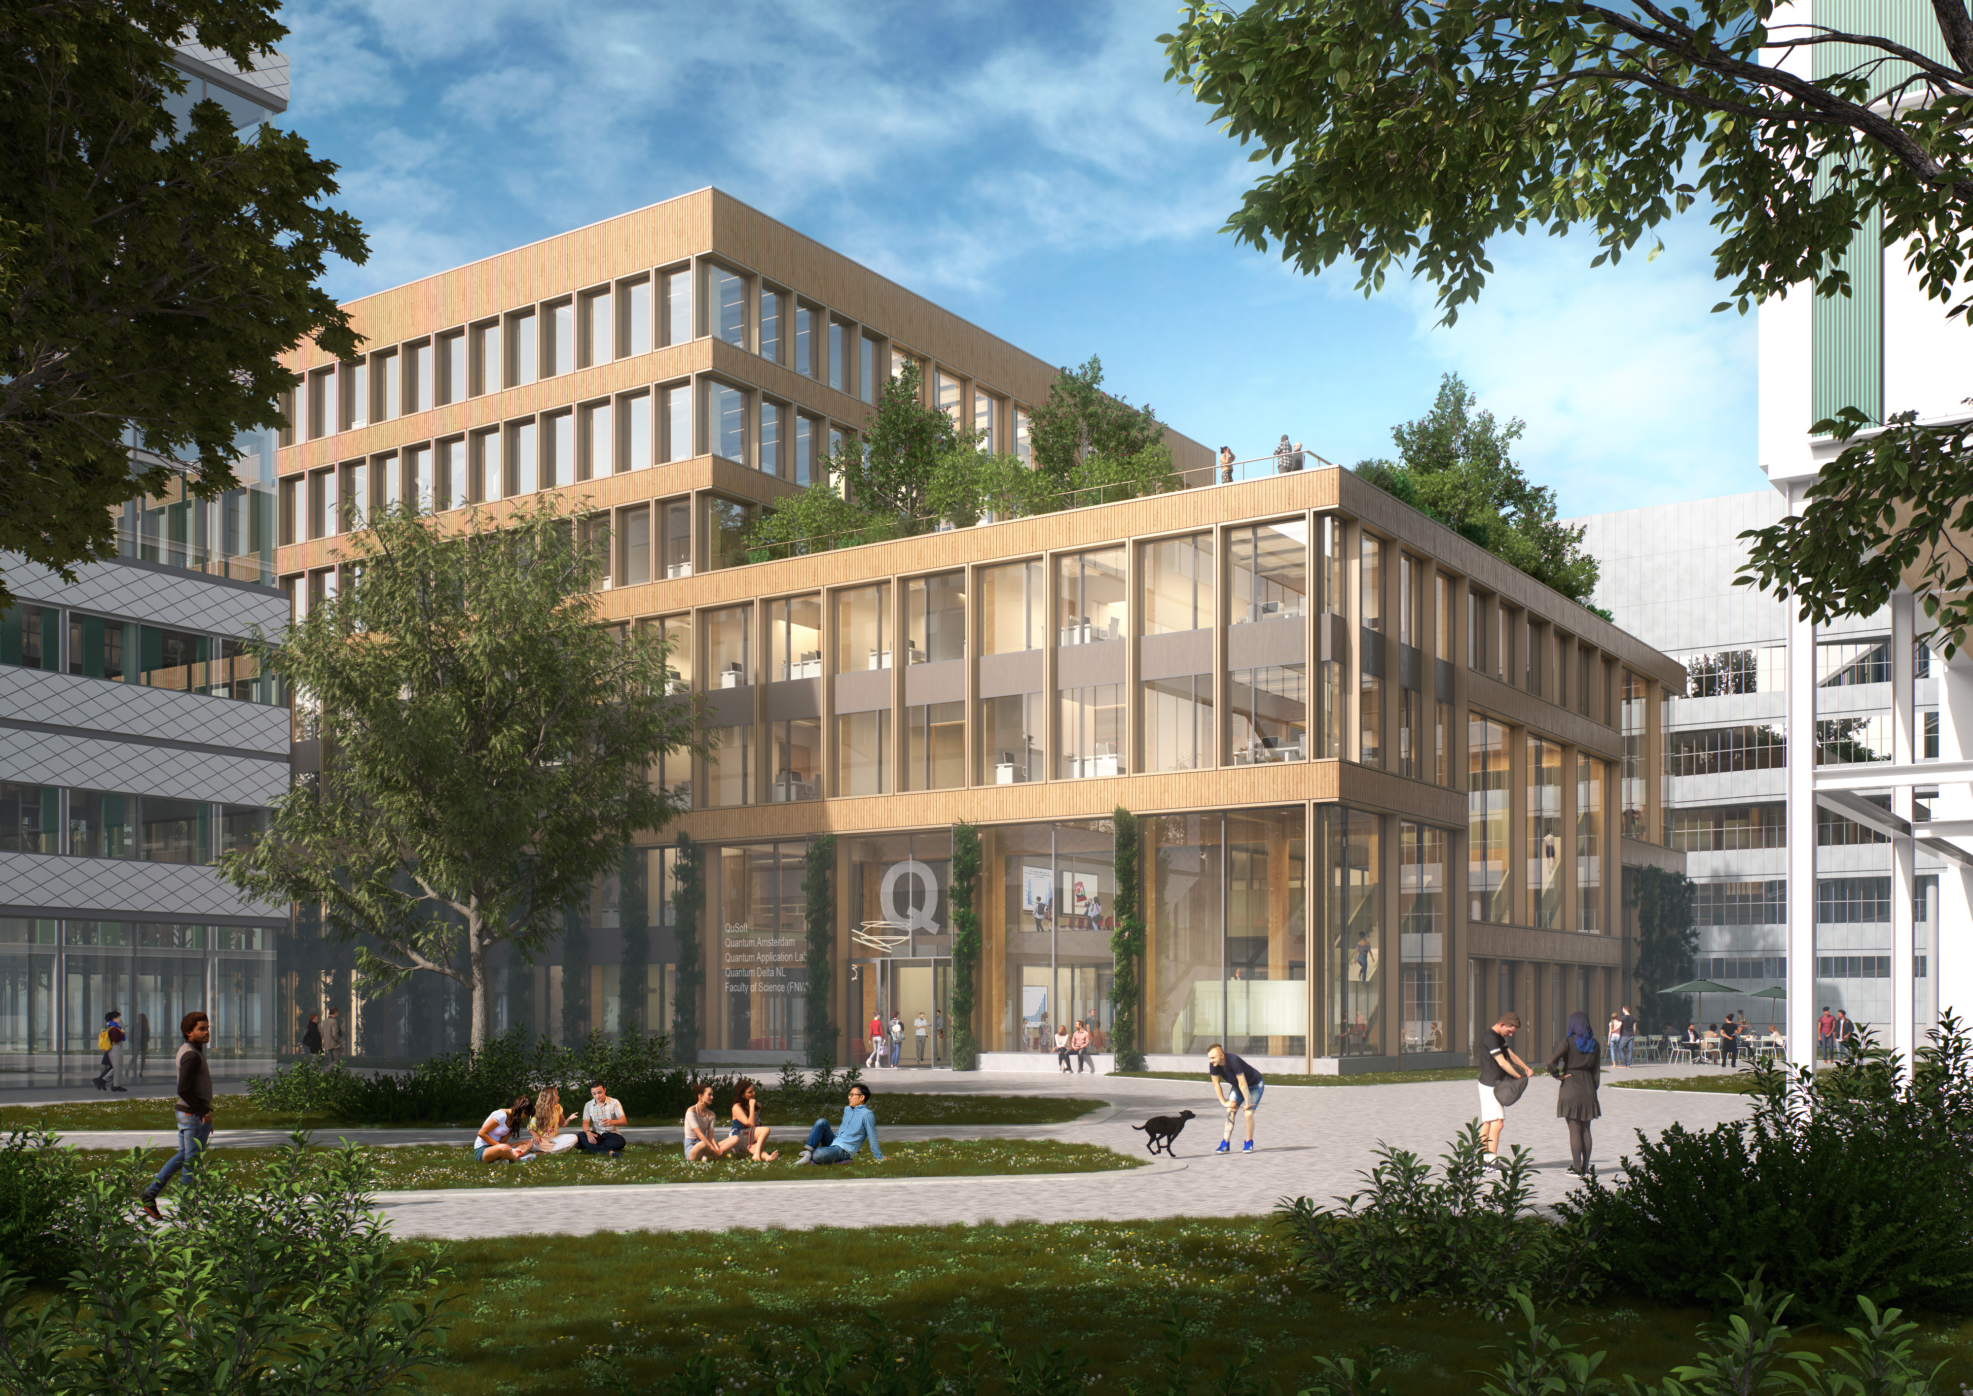
The Future is Quantum
2015: Launch research center for quantum software
2020: launch network organization
2021: 615M€ for 7y for
2024/25: start of UvA MSc Quantum Computer Science
2027: new UvA quantum building

Slide 34
About the MSc programme
Research-based programme
  Very strong connection with active research in QuSoft
    All lecturers are QuSoft members!
  Much of industry is research based as well
  Focus on Theoretical Aspects
  Not an engineering programme!
  No practical lab sessions
  Focus on theoretical physics, mathematics,
  algorithms and programming
  Interdisciplinary
  Recommended BSc program: BSc mathematics!

Slide 35
Questions?
Nationale Quantum Cursus: https://quantum-cursus.nl/
Quantum Quest: https://www.quantum-quest.org/
The Professional’s guide to Quantum Technology: https://www.quantum.amsterdam/guide-to-quantum/

