Slide 1
(Unclonable Cryptography and)
Local Simultaneous State Discrimination
Christian Schaffner
Institute for Logic, Language and Computation (ILLC)
University of Amsterdam
Research Center for Quantum Software
Illinois Q Information Science & Technology Center (IQUIST) seminar
Tuesday, 2 Nov 2021

Slide 2
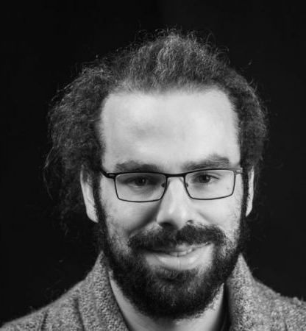
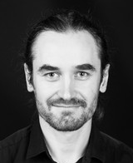
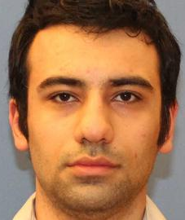
Joint work with
Christian Majenz
Maris Ozols
Mehrdad Tahmasbi
Technical University of Denmark
University of Amsterdam
Centrum Wiskunde & Informatica (CWI)
https://arxiv.org/abs/2103.14510 and https://arxiv.org/abs/2111.01209 ,
submitted to QIP 2022

Slide 3
What will you learn from this Talk?
Unclonable Cryptography
Generic Cloning Attack
Local Simultaneous State Discrimination
Results

Slide 4
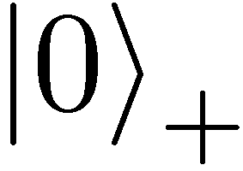
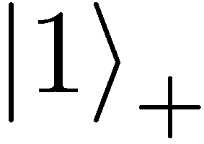
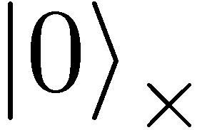
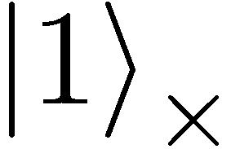

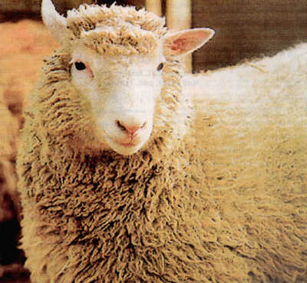
Quantum No-Cloning Theorem
[Park ‘70; Dieks & Wootters-Zurek ‘82]
U
Quantum operations:
Proof: copying is a non-linear operation
Notes:
information vs disturbance trade-off

Slide 5
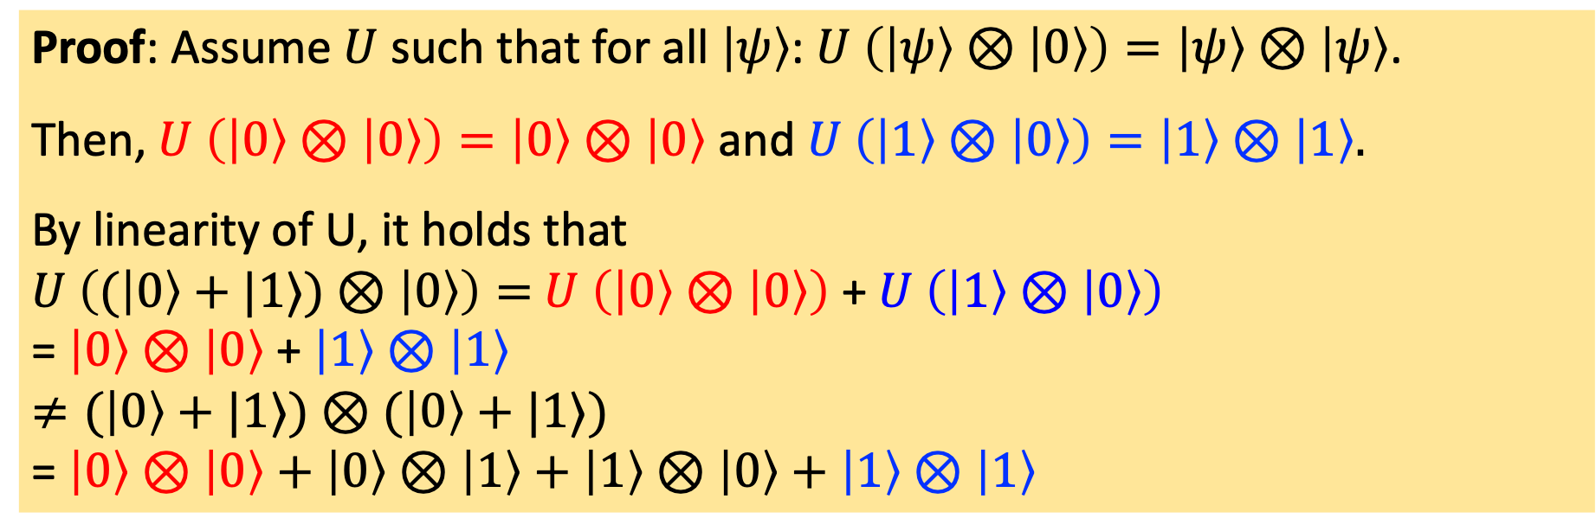
Proof of Quantum No-Cloning Theorem
Proof: Assume $U$ such that for all $\left|ψ\right\rangle$: $U \left(\left|ψ\right\rangle ⊗\left|0\right\rangle \right)=\left|ψ\right\rangle ⊗\left|ψ\right\rangle$.
Then, $U \left(\left|0\right\rangle ⊗\left|0\right\rangle \right)=\left|0\right\rangle ⊗\left|0\right\rangle$ and $U \left(\left|1\right\rangle ⊗\left|0\right\rangle \right)=\left|1\right\rangle ⊗\left|1\right\rangle .$
By linearity of U, it holds that
$U \left((\left|0\right\rangle +|1⟩)⊗\left|0\right\rangle \right)=$ $U \left(\left|0\right\rangle ⊗\left|0\right\rangle \right)$ + $U \left(\left|1\right\rangle ⊗\left|0\right\rangle \right)$
= $\left|0\right\rangle ⊗\left|0\right\rangle$ + $\left|1\right\rangle ⊗\left|1\right\rangle$
$≠(\left|0\right\rangle +|1⟩)⊗$ $(\left|0\right\rangle +|1⟩)$
= $\left|0\right\rangle ⊗\left|0\right\rangle +$ $\left|0\right\rangle ⊗\left|1\right\rangle +$ $\left|1\right\rangle ⊗\left|0\right\rangle +$ $\left|1\right\rangle ⊗\left|1\right\rangle$
Proof: copying is a non-linear operation
Contradiction!
Notes:
information vs disturbance trade-off

Slide 6
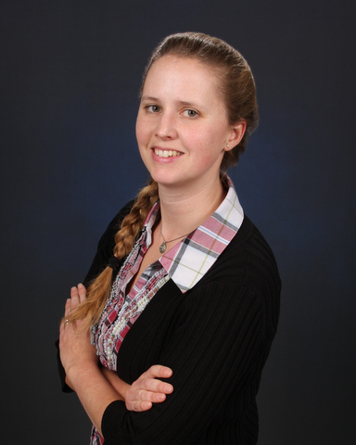
Unclonable Cryptography
Must inherently be quantum!
Quantum Money [Wiesner 68, Molina Vidick Watrous 13, ...]
Quantum Key Distribution [Bennett Brassard 84, Ekert 91, ...]
Certified Deletion [Broadbent Islam 20, ...]
Unclonable Encryption [Gottesman 02, Broadbent Lord 20, ...]
Unclonable Decryption [Georgiou Zhandry 20, ...]
Copy Protection [Aaronson 09, ...]
Secure Software Leasing [Ananth LaPlaca 20, ...]
...
See Anne Broadbent’s awesome tutorial talk on “Quantum Unclonability“ at QCrypt 2021

Slide 7






Quantum Encryption of Classical Messages
KeyGen: $k←𝒦$ according to $P_{K}$
$$m∈{\left\{0,1\right\}}^{n}$$
$$\left|ψ\right\rangle ={\text{Enc}}_{k}(m)$$
$$m={\text{Dec}}_{k}(|ψ⟩)$$
Perfect correctness: $∀k ∀m :\operatorname{Pr}\left[{\text{Dec}}_{k}\left( {\text{Enc}}_{k}\left(m\right)\right)=m\right]=1.$

Slide 8








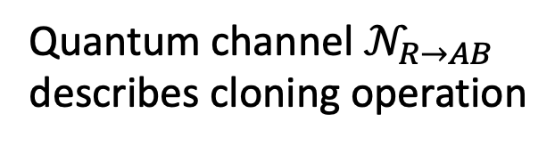

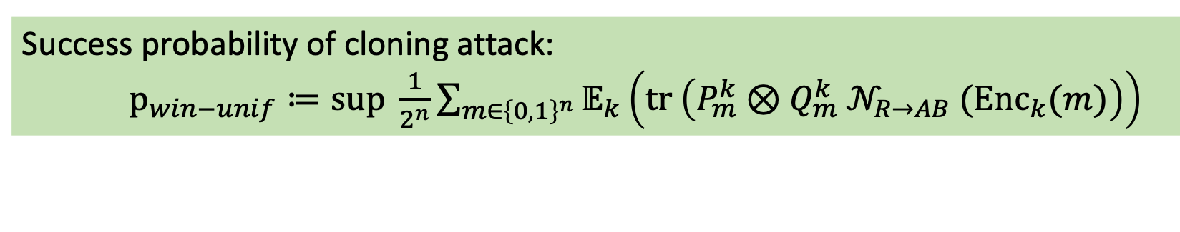



Cloning Attack
[Broadbent Lord 20]
KeyGen: $k←𝒦$ according to $P_{K}$
$$k$$
$${\left\{P_{m}^{k}\right\}}_{m∈ℳ}$$
$$m←{\left\{0,1\right\}}^{n}$$
Quantum channel $𝒩_{R→AB}$ describes cloning operation
$$𝒩_{R→AB}$$
$${\left|ψ\right\rangle }_{R}={\text{Enc}}_{k}(m)$$
$$k$$
$${\left\{Q_{m}^{k}\right\}}_{m∈ℳ}$$
Success probability of cloning attack:
$p_{win−unif}≔\text{sup} \frac{1}{2^{n}}\sum_{m∈{\left\{0,1\right\}}^{n}}{𝔼_{k}\left(\text{tr} \left(P_{m}^{k}⊗Q_{m}^{k}{ 𝒩}_{R→AB} ({\text{Enc}}_{k}(m)\right)\right)}$

Slide 9


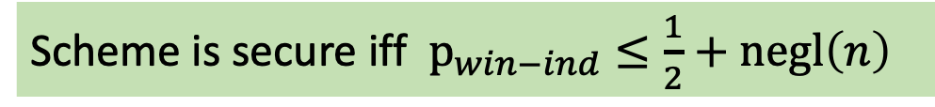

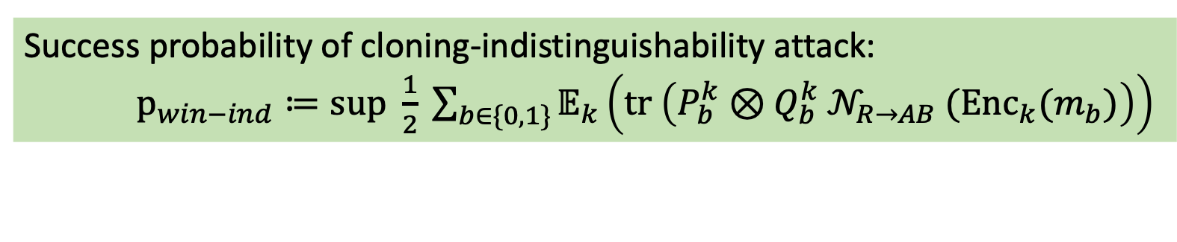


Cloning-Indistinguishability Attack
[Broadbent Lord 20]
KeyGen: $k←𝒦$ according to $P_{K}$
$$k$$
$${\left\{P_{b}^{k}\right\}}_{b∈\{0,1\}}$$
$$m_{0}=0^{n}$$
$$m_{1}∈{\left\{0,1\right\}}^{n}$$
Quantum channel $𝒩_{R→AB}$ describes cloning operation
$$𝒩_{R→AB}$$
$${\left|ψ\right\rangle }_{R}={\text{Enc}}_{k}(m_{b})$$
$$k$$
$${\left\{Q_{b}^{k}\right\}}_{b∈\{0,1\}}$$
Success probability of cloning-indistinguishability attack:
$p_{win−ind}≔\text{sup} \frac{1}{2} \sum_{b∈\{0,1\}}{𝔼_{k}\left(\text{tr} \left(P_{b}^{k}⊗Q_{b}^{k}{ 𝒩}_{R→AB} ({\text{Enc}}_{k}(m_{b})\right)\right)}$
Scheme is secure iff $p_{win−ind}≤\frac{1}{2}+negl\left(n\right)$

Slide 10



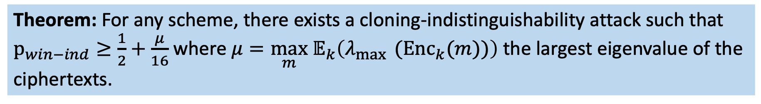


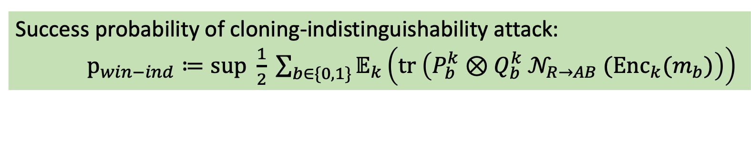


Theorem: Generic Cloning Attack
KeyGen: $k←𝒦$ according to $P_{K}$
$$k$$
$${\left\{P_{b}^{k}\right\}}_{b∈\{0,1\}}$$
$$m_{0}=0^{n}$$
$$m_{1}∈{\left\{0,1\right\}}^{n}$$
$$𝒩_{R→AB}$$
$${\left|ψ\right\rangle }_{R}={\text{Enc}}_{k}(m_{b})$$
$$k$$
$${\left\{Q_{b}^{k}\right\}}_{b∈\{0,1\}}$$
Success probability of cloning-indistinguishability attack:
$p_{win−ind}≔\text{sup} \frac{1}{2} \sum_{b∈\{0,1\}}{𝔼_{k}\left(\text{tr} \left(P_{b}^{k}⊗Q_{b}^{k}{ 𝒩}_{R→AB} ({\text{Enc}}_{k}(m_{b})\right)\right)}$
Theorem: For any scheme, there exists a cloning-indistinguishability attack such that
$p_{win−ind}≥\frac{1}{2}+\frac{μ}{16}$ where $μ=\max_{m}{ 𝔼}_{k}\left(λ_{\max{ }}({\text{Enc}}_{k}(m))\right)$ the largest eigenvalue of the ciphertexts.

Slide 11
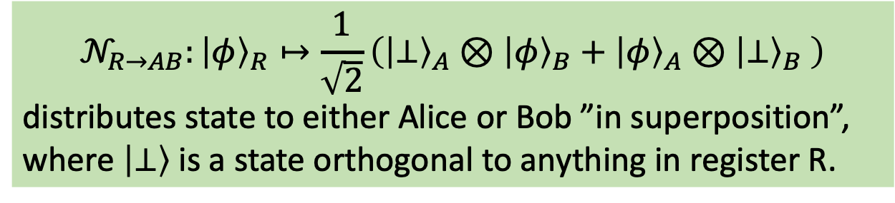
Generic Cloning Attack
KeyGen: $k←𝒦$ according to $P_{K}$
$$k$$
$${\left\{P_{b}^{k}\right\}}_{b∈\{0,1\}}$$
$$m_{0}=0^{n}$$
$$m_{1}∈{\left\{0,1\right\}}^{n}$$
$$𝒩_{R→AB}$$
$${\left|ψ\right\rangle }_{R}={\text{Enc}}_{k}(m_{b})$$
$$k$$
$${\left\{Q_{b}^{k}\right\}}_{b∈\{0,1\}}$$
$$𝒩_{R→AB}:{\left|φ\right\rangle }_{R}↦\frac{1}{\sqrt{2}}\left({\left|⊥\right\rangle }_{A}⊗{\left|φ\right\rangle }_{B}+{\left|φ\right\rangle }_{A}⊗{\left|⊥\right\rangle }_{B} \right)$$
distributes state to either Alice or Bob ”in superposition”,
where $\left|⊥\right\rangle$ is a state orthogonal to anything in register R.

Slide 12

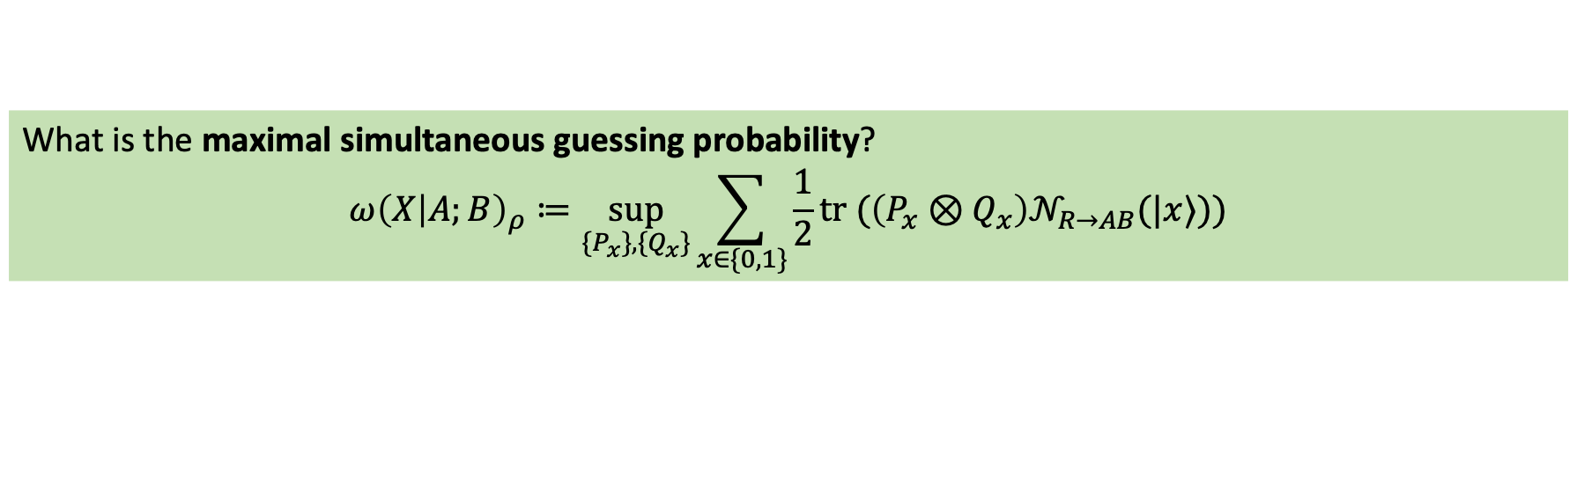




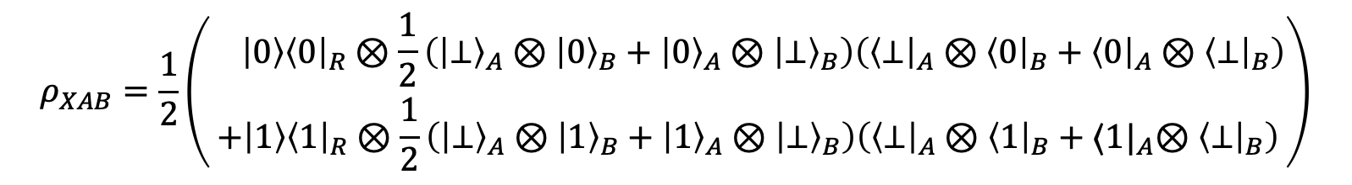
Generic Cloning Attack: Analysis
$${\left\{P_{x_{A}}\right\}}_{x_{A}∈\{0,1\}}$$
$$x←\{0,1\}$$
$$𝒩_{R→AB}$$
$${\left|φ\right\rangle }_{R}=|x⟩$$
$${\left\{Q_{x_{B}}\right\}}_{x_{B}∈\{0,1\}}$$
$𝒩_{R→AB}:{\left|φ\right\rangle }_{R}↦\frac{1}{\sqrt{2}}\left({\left|⊥\right\rangle }_{A}⊗{\left|φ\right\rangle }_{B}+{\left|φ\right\rangle }_{A}⊗{\left|⊥\right\rangle }_{B} \right)$distributes state to either Alice or Bob ”in superposition”
Example for a single bit $x: 𝒩_{R→AB}:{\left|x\right\rangle }_{R}↦\frac{1}{\sqrt{2}}\left({\left|⊥\right\rangle }_{A}⊗{\left|x\right\rangle }_{B}+{\left|x\right\rangle }_{A}⊗{\left|⊥\right\rangle }_{B} \right)$
$$ρ_{XAB}=\frac{1}{2}\left(\begin{aligned} \left|0\right\rangle {\left\langle 0\right|}_{R}⊗\frac{1}{2}\left({\left|⊥\right\rangle }_{A}⊗{\left|0\right\rangle }_{B}+{\left|0\right\rangle }_{A}⊗{\left|⊥\right\rangle }_{B}\right)\left({\left\langle ⊥\right|}_{A}⊗{\left\langle 0\right|}_{B}+{\left\langle 0\right|}_{A}⊗{\left\langle ⊥\right|}_{B}\right) \\ +\left|1\right\rangle {\left\langle 1\right|}_{R}⊗\frac{1}{2}\left({\left|⊥\right\rangle }_{A}⊗{\left|1\right\rangle }_{B}+{\left|1\right\rangle }_{A}⊗{\left|⊥\right\rangle }_{B}\right)\left({\left\langle ⊥\right|}_{A}⊗{\left\langle 1\right|}_{B}+{⟨1|}_{A}⊗{\left\langle ⊥\right|}_{B}\right)\end{aligned}\right)$$
What is the maximal simultaneous guessing probability?
$$ω{\left(X | A;B\right)}_{ρ}≔\sup_{{\{P}_{x}\}, \{Q_{x}\}}\sum_{x∈\{0,1\}}{\frac{1}{2}tr (\left(P_{x}⊗Q_{x}\right)𝒩_{R→AB}(|x⟩))}$$

Slide 13
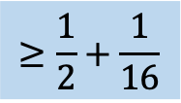
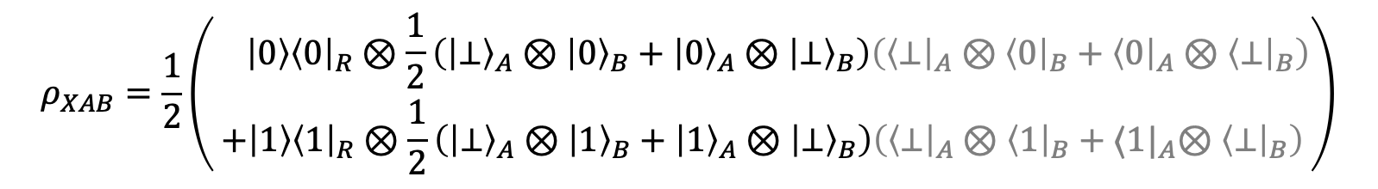
Generic Cloning Attack: Analysis
$${\left\{P_{x_{A}}\right\}}_{x_{A}∈\{0,1\}}$$
$$x←\{0,1\}$$
$$𝒩_{R→AB}$$
$${\left|φ\right\rangle }_{R}=|x⟩$$
$${\left\{Q_{x_{B}}\right\}}_{x_{B}∈\{0,1\}}$$
$𝒩_{R→AB}:{\left|φ\right\rangle }_{R}↦\frac{1}{\sqrt{2}}\left({\left|⊥\right\rangle }_{A}⊗{\left|φ\right\rangle }_{B}+{\left|φ\right\rangle }_{A}⊗{\left|⊥\right\rangle }_{B} \right)$distributes state to either Alice or Bob ”in superposition”
Example for a single bit $x: 𝒩_{R→AB}:{\left|x\right\rangle }_{R}↦\frac{1}{\sqrt{2}}\left({\left|⊥\right\rangle }_{A}⊗{\left|x\right\rangle }_{B}+{\left|x\right\rangle }_{A}⊗{\left|⊥\right\rangle }_{B} \right)$
$$ρ_{XAB}=\frac{1}{2}\left(\begin{aligned} \left|0\right\rangle {\left\langle 0\right|}_{R}⊗\frac{1}{2}\left({\left|⊥\right\rangle }_{A}⊗{\left|0\right\rangle }_{B}+{\left|0\right\rangle }_{A}⊗{\left|⊥\right\rangle }_{B}\right)\left({\left\langle ⊥\right|}_{A}⊗{\left\langle 0\right|}_{B}+{\left\langle 0\right|}_{A}⊗{\left\langle ⊥\right|}_{B}\right) \\ +\left|1\right\rangle {\left\langle 1\right|}_{R}⊗\frac{1}{2}\left({\left|⊥\right\rangle }_{A}⊗{\left|1\right\rangle }_{B}+{\left|1\right\rangle }_{A}⊗{\left|⊥\right\rangle }_{B}\right)\left({\left\langle ⊥\right|}_{A}⊗{\left\langle 1\right|}_{B}+{⟨1|}_{A}⊗{\left\langle ⊥\right|}_{B}\right)\end{aligned}\right)$$
What is the maximal simultaneous guessing probability?
$$ω{\left(X | A;B\right)}_{ρ}≔\sup_{{\{P}_{x}\}, \{Q_{x}\}}\sum_{x∈\{0,1\}}{\frac{1}{2}tr (\left(P_{x}⊗Q_{x}\right)𝒩_{R→AB}(|x⟩))}$$
$$≥\frac{1}{2}+\frac{1}{16}$$

Slide 14
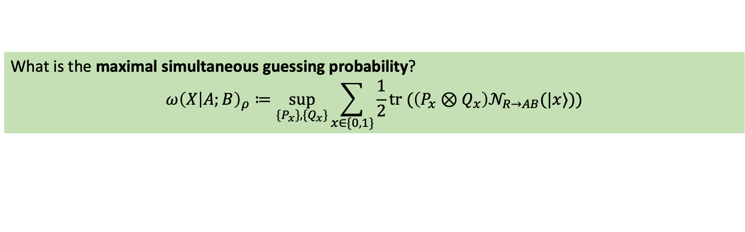
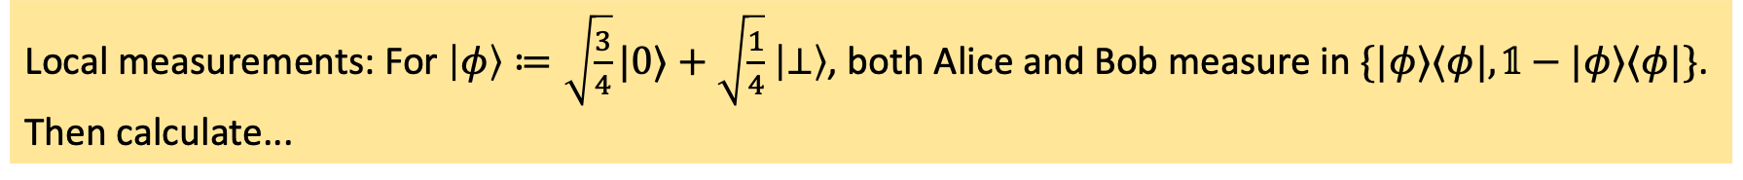
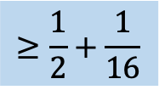
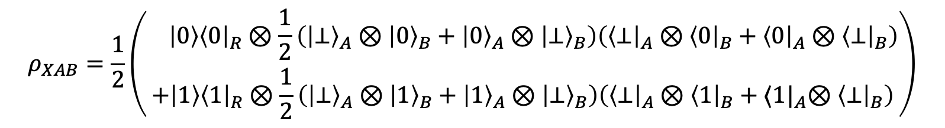
Generic Cloning Attack: Analysis
$𝒩_{R→AB}:{\left|φ\right\rangle }_{R}↦\frac{1}{\sqrt{2}}\left({\left|⊥\right\rangle }_{A}⊗{\left|φ\right\rangle }_{B}+{\left|φ\right\rangle }_{A}⊗{\left|⊥\right\rangle }_{B} \right)$distributes state to either Alice or Bob ”in superposition”
Example for a single bit $x: 𝒩_{R→AB}:{\left|x\right\rangle }_{R}↦\frac{1}{\sqrt{2}}\left({\left|⊥\right\rangle }_{A}⊗{\left|x\right\rangle }_{B}+{\left|x\right\rangle }_{A}⊗{\left|⊥\right\rangle }_{B} \right)$
$$ρ_{XAB}=\frac{1}{2}\left(\begin{aligned} \left|0\right\rangle {\left\langle 0\right|}_{R}⊗\frac{1}{2}\left({\left|⊥\right\rangle }_{A}⊗{\left|0\right\rangle }_{B}+{\left|0\right\rangle }_{A}⊗{\left|⊥\right\rangle }_{B}\right)\left({\left\langle ⊥\right|}_{A}⊗{\left\langle 0\right|}_{B}+{\left\langle 0\right|}_{A}⊗{\left\langle ⊥\right|}_{B}\right) \\ +\left|1\right\rangle {\left\langle 1\right|}_{R}⊗\frac{1}{2}\left({\left|⊥\right\rangle }_{A}⊗{\left|1\right\rangle }_{B}+{\left|1\right\rangle }_{A}⊗{\left|⊥\right\rangle }_{B}\right)\left({\left\langle ⊥\right|}_{A}⊗{\left\langle 1\right|}_{B}+{⟨1|}_{A}⊗{\left\langle ⊥\right|}_{B}\right)\end{aligned}\right)$$
What is the maximal simultaneous guessing probability?
$$ω{\left(X | A;B\right)}_{ρ}≔\sup_{{\{P}_{x}\}, \{Q_{x}\}}\sum_{x∈\{0,1\}}{\frac{1}{2}tr (\left(P_{x}⊗Q_{x}\right)𝒩_{R→AB}(|x⟩))}$$
$$≥\frac{1}{2}+\frac{1}{16}$$
Local measurements: For $\left|φ\right\rangle ≔\sqrt{\frac{3}{4}}|0⟩+\sqrt{\frac{1}{4}}$ $\left|⊥\right\rangle$, both Alice and Bob measure in $\{|φ⟩⟨φ|,𝟙−|φ⟩⟨φ|\}$.
Then calculate...
Intuitively, Alice and Bob can use the quantum coherence to do better than “not knowing” when they are in the $⊥$-branch of the superposition.

Slide 15
Theorem: Generic Cloning Attack
KeyGen: $k←𝒦$ according to $P_{K}$
$$k$$
$${\left\{P_{b}^{k}\right\}}_{b∈\{0,1\}}$$
$$m_{0}=0^{n}$$
$$m_{1}∈{\left\{0,1\right\}}^{n}$$
$$𝒩_{R→AB}$$
$${\left|ψ\right\rangle }_{R}={\text{Enc}}_{k}(m_{b})$$
$$k$$
$${\left\{Q_{b}^{k}\right\}}_{b∈\{0,1\}}$$
Success probability of cloning-indistinguishability attack:
$p_{win−ind}≔\text{sup} \frac{1}{2} \sum_{b∈\{0,1\}}{𝔼_{k}\left(\text{tr} \left(P_{b}^{k}⊗Q_{b}^{k}{ 𝒩}_{R→AB} ({\text{Enc}}_{k}(m_{b})\right)\right)}$
Theorem: For any scheme, there exists a cloning-indistinguishability attack such that
$p_{win−ind}≥\frac{1}{2}+\frac{μ}{16}$ where $μ=\max_{m}{ 𝔼}_{k}\left(λ_{\max{ }}({\text{Enc}}_{k}(m))\right)$ the largest eigenvalue of the ciphertexts.

Slide 16
What will you learn from this Talk?
Unclonable Encryption
Generic Cloning Attack
Local Simultaneous State Discrimination
Results

Slide 17

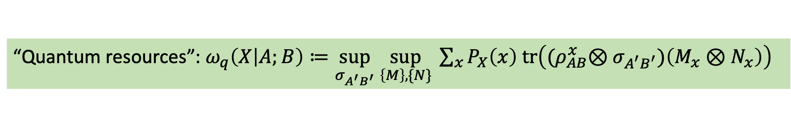

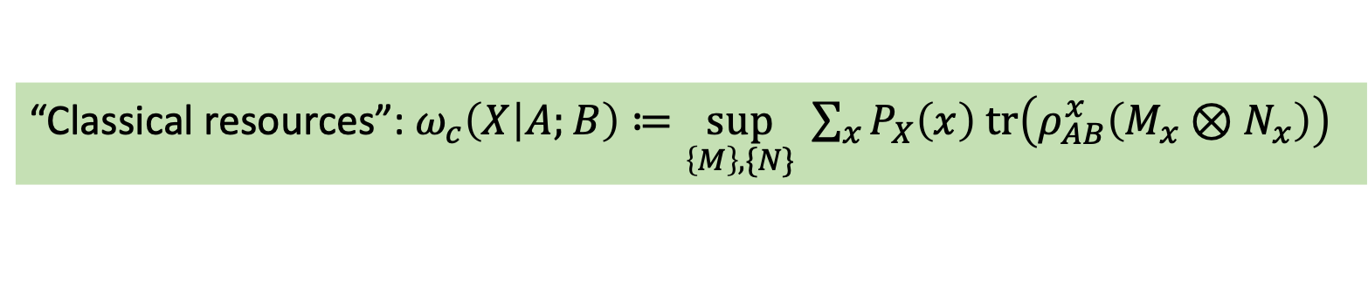
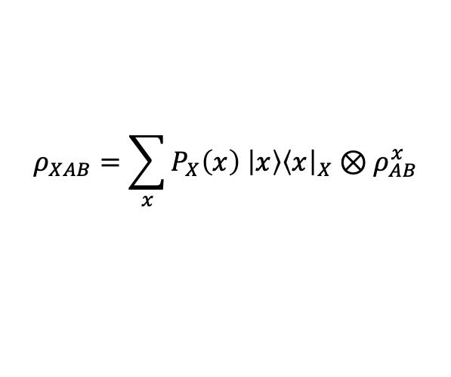
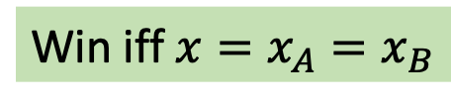


Local Simultaneous State Discrimination: Task
$${\left\{M_{x_{A}}\right\}}_{x_{A}}$$
$$x←P_{X}$$
Win iff $x=x_{A}=x_{B}$
$$ρ_{AB}^{x}$$
$${\left\{N_{x_{B}}\right\}}_{x_{B}}$$
$$ρ_{XAB}=\sum_{x}{P_{X}\left(x\right) \left|x\right\rangle {\left\langle x\right|}_{X}⊗ρ_{AB}^{x}}$$
“Classical resources”: $ω_{c}\left(X | A;B\right)≔\sup_{\left\{M\right\},\{N\}} \sum_{x}{P_{X}\left(x\right) tr\left(ρ_{AB}^{x}\left(M_{x}⊗N_{x}\right)\right)}$
“Quantum resources”: $ω_{q}\left(X | A;B\right)≔\sup_{σ_{A^{′}B^{′}}} \sup_{\left\{M\right\},\{N\}} \sum_{x}{P_{X}\left(x\right) tr\left({(ρ}_{AB}^{x}⊗σ_{A^{′}B^{′}})\left(M_{x}⊗N_{x}\right)\right)}$

Slide 18
Local Simultaneous State Discrimination: Task
$${\left\{M_{x_{A}}\right\}}_{x_{A}}$$
$$x←P_{X}$$
Win iff $x=x_{A}=x_{B}$
$$ρ_{AB}^{x}$$
$${\left\{N_{x_{B}}\right\}}_{x_{B}}$$
$$ρ_{XAB}=\sum_{x}{P_{X}\left(x\right) \left|x\right\rangle {\left\langle x\right|}_{X}⊗ρ_{AB}^{x}}$$

Slide 19
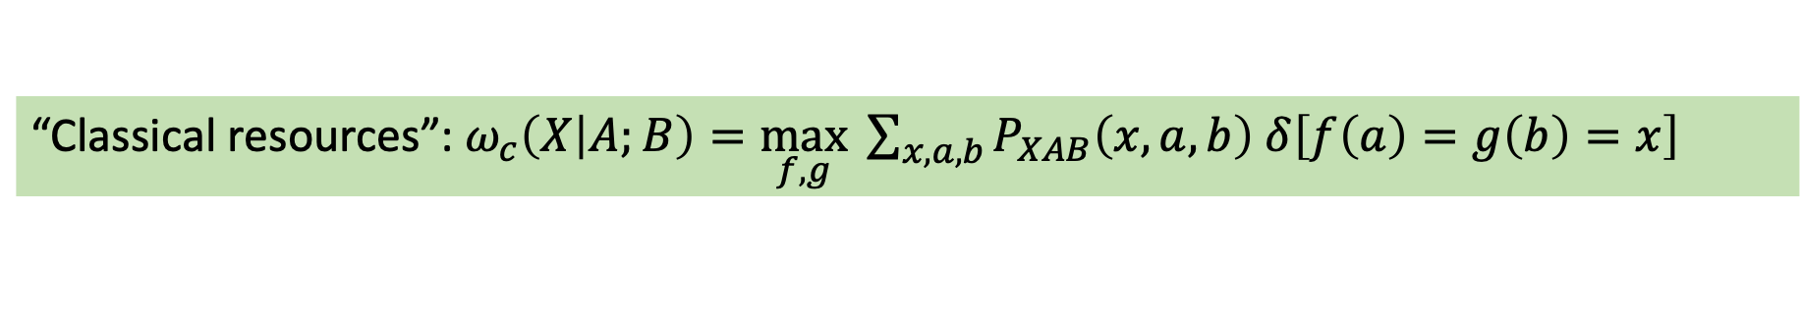


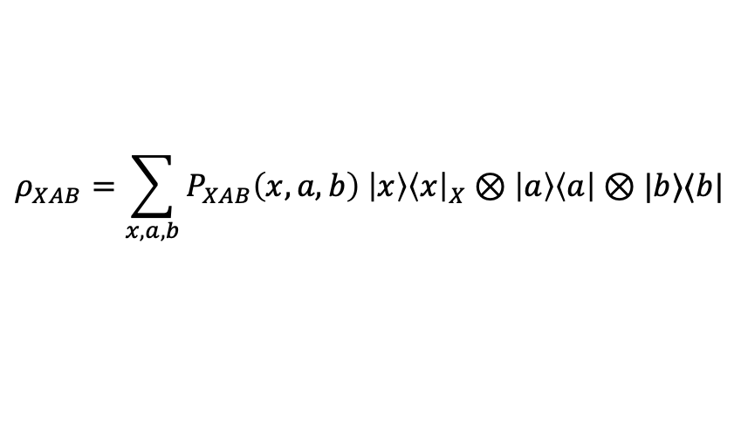

LSSD with Classical Input States
$${\left\{M_{x_{A}}\right\}}_{x_{A}}$$
$$(x,a, b)←P_{XAB}$$
$$a$$
Win iff $x=x_{A}=x_{B}$
$$b$$
$$ρ_{XAB}=\sum_{x,a,b}{P_{XAB}\left(x,a,b\right) \left|x\right\rangle {\left\langle x\right|}_{X}⊗\left|a\right\rangle \left\langle a\right|⊗|b⟩⟨b|}$$
$${\left\{N_{x_{B}}\right\}}_{x_{B}}$$
“Classical resources”: $ω_{c}\left(X | A;B\right)=\max_{f,g} \sum_{x,a,b}{P_{XAB}\left(x,a,b\right) δ\left[f\left(a\right)=g\left(b\right)=x\right]}$
Observation: As for non-local games, shared classical randomness does not help the players in LSSD
Proof: The players can fix the shared randomness to the one that works best for them.
Notes:
Shared randomness does not help!

Slide 20
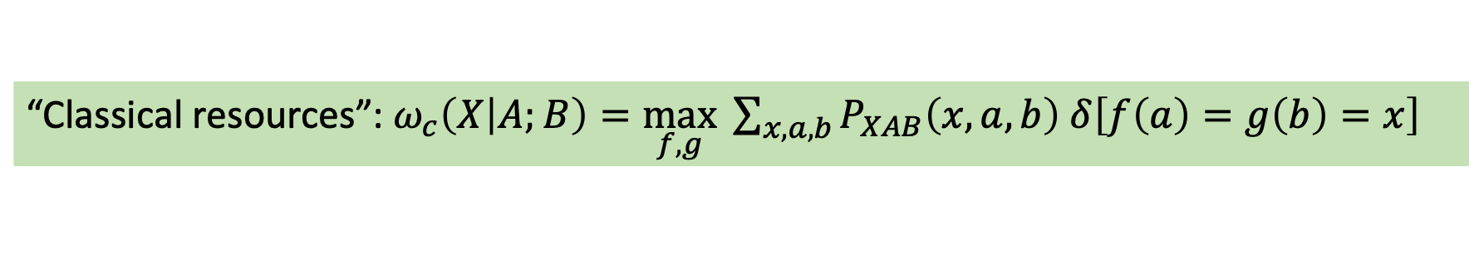
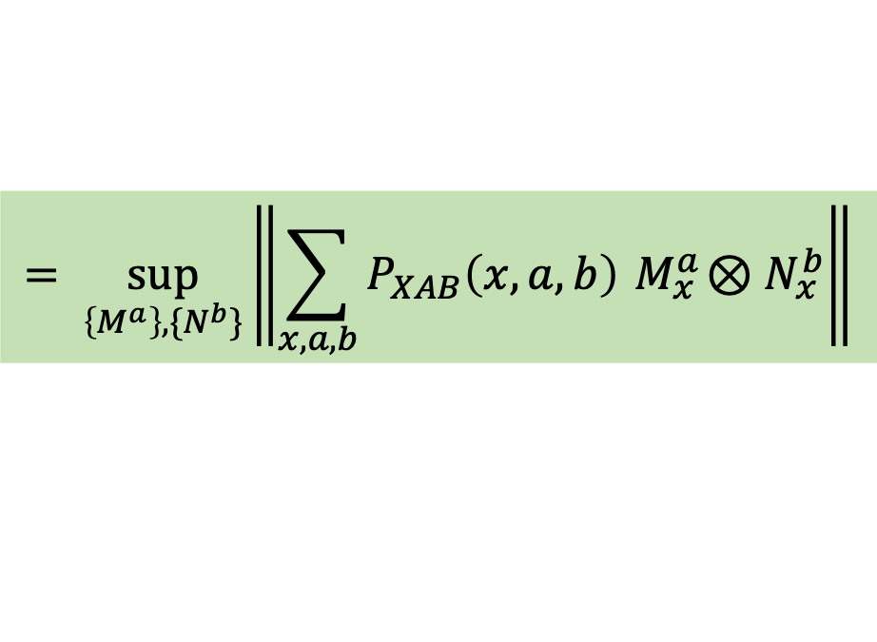
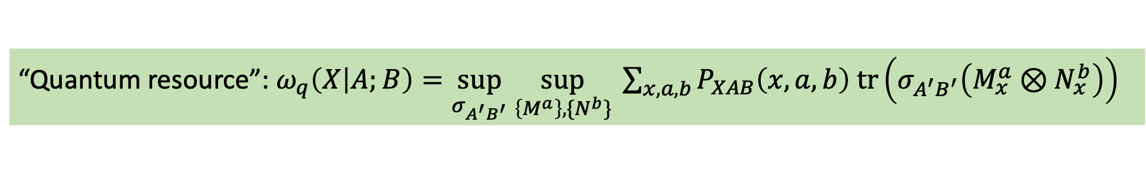
LSSD with Classical Input States
$${\left\{M_{x_{A}}\right\}}_{x_{A}}$$
$$(x,a, b)←P_{XAB}$$
$$a$$
Win iff $x=x_{A}=x_{B}$
$$b$$
$$ρ_{XAB}=\sum_{x,a,b}{P_{XAB}\left(x,a,b\right) \left|x\right\rangle {\left\langle x\right|}_{X}⊗\left|a\right\rangle \left\langle a\right|⊗|b⟩⟨b|}$$
$${\left\{N_{x_{B}}\right\}}_{x_{B}}$$
“Classical resources”: $ω_{c}\left(X | A;B\right)=\max_{f,g} \sum_{x,a,b}{P_{XAB}\left(x,a,b\right) δ\left[f\left(a\right)=g\left(b\right)=x\right]}$
“Quantum resource”: $ω_{q}\left(X | A;B\right)=\sup_{σ_{A^{′}B^{′}}} \sup_{\left\{M^{a}\right\},\{N^{b}\}} \sum_{x,a,b}{P_{XAB}\left(x,a,b\right) tr\left(σ_{A^{′}B^{′}}\left(M_{x}^{a}⊗N_{x}^{b}\right)\right)}$
$$= \sup_{\left\{M^{a}\right\},\{N^{b}\}}\left\|\sum_{x,a,b}{P_{XAB}\left(x,a,b\right){ M}_{x}^{a}⊗N_{x}^{b}}\right\|$$
Notes:
Shared randomness does not help!

Slide 21
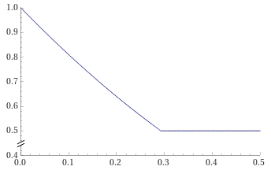

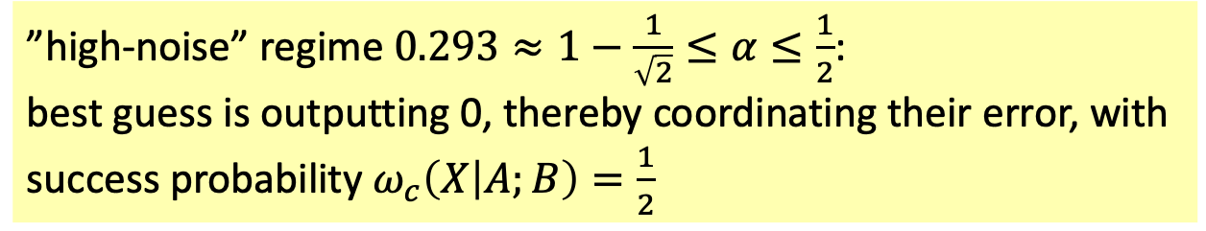


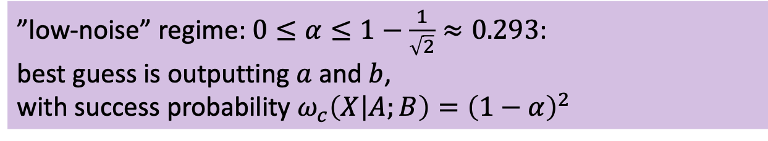
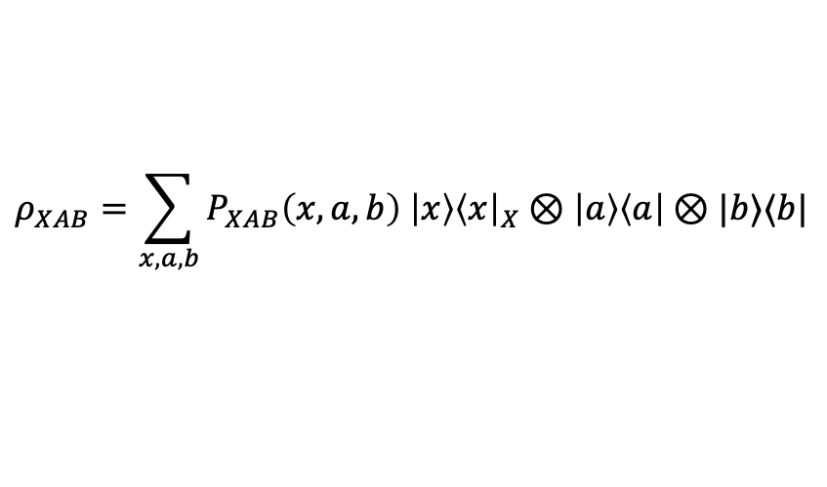


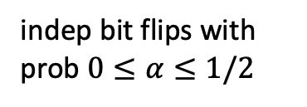



Example
indep bit flips with prob $0≤α≤1/2$
$${\left\{M_{x_{A}}\right\}}_{x_{A}}$$
$$x←\{0,1\}$$
$$a≔x⊕y$$
Win iff $x=x_{A}=x_{B}$
$$b≔x⊕z$$
$$ρ_{XAB}=\sum_{x,a,b}{P_{XAB}\left(x,a,b\right) \left|x\right\rangle {\left\langle x\right|}_{X}⊗\left|a\right\rangle \left\langle a\right|⊗|b⟩⟨b|}$$
$${\left\{N_{x_{B}}\right\}}_{x_{B}}$$
$$ω_{c}(X|A;B)$$
”low-noise” regime: $0≤α≤1−\frac{1}{\sqrt{2}}≈0.293$:
best guess is outputting $a$ and $b$,
with success probability $ω_{c}\left(X | A;B\right)={\left(1−α\right)}^{2}$
”high-noise” regime $0.293≈1−\frac{1}{\sqrt{2}}≤α≤\frac{1}{2}$:
best guess is outputting 0, thereby coordinating their error, with success probability $ω_{c}\left(X | A;B\right)=\frac{1}{2}$
$$α$$
See [Chitambar Mančinska 21] for an example of LSSD with quantum states with this 2-regime behavior

Slide 22
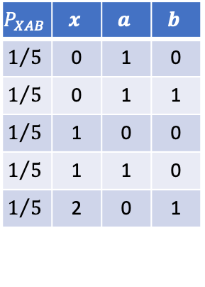
Summary of Contributions
Local Simultaneous State Discrimination:
Example with two-regime behavior
Separating example
Binary inputs:
NP-hardness of 3-party LSSD
$$P_{XAB}$$ | $$x$$ | $$a$$ | $$b$$
$$1/5$$ | 0 | 1 | 0
$$1/5$$ | 0 | 1 | 1
$$1/5$$ | 1 | 0 | 0
$$1/5$$ | 1 | 1 | 0
$$1/5$$ | 2 | 0 | 1
Theorem: $∃P_{XAB}$ such that $ω_{c}\left(X | A;B\right)<ω_{q}\left(X | A;B\right)<ω_{ns}\left(X | A;B\right)$
Theorem: For binary $X,A,B$, we have$ω_{c}\left(X | A;B\right)=ω_{q}\left(X | A;B\right)=ω_{ns}\left(X | A;B\right)$
Theorem: For some $P_{XABC},$ computing $ω_{c}\left(E | A;B;C\right)$ is NP-hard.

Slide 23


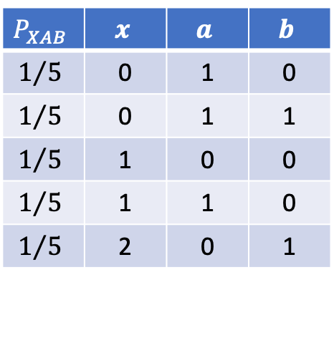

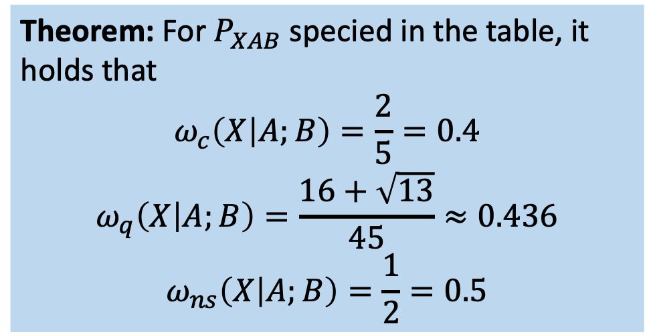


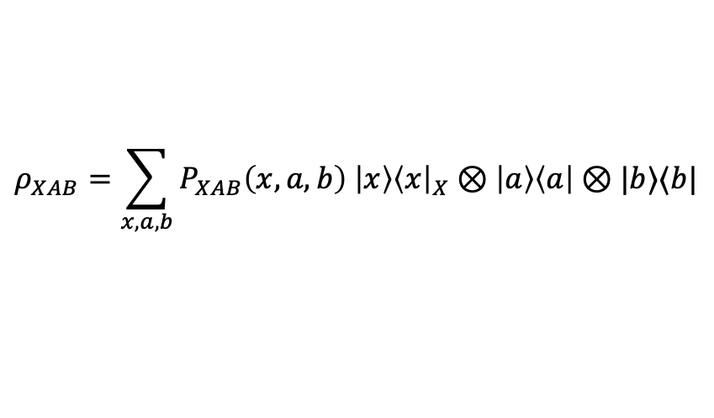

Separating Example
$${\left\{M_{x_{A}}\right\}}_{x_{A}}$$
$$(x,a, b)←P_{XAB}$$
$$a$$
Win iff $x=x_{A}=x_{B}$
$$b$$
$$ρ_{XAB}=\sum_{x,a,b}{P_{XAB}\left(x,a,b\right) \left|x\right\rangle {\left\langle x\right|}_{X}⊗\left|a\right\rangle \left\langle a\right|⊗|b⟩⟨b|}$$
$${\left\{N_{x_{B}}\right\}}_{x_{B}}$$
Theorem: For $P_{XAB}$ specied in the table, it holds that
$$ω_{c}\left(X | A;B\right)=\frac{2}{5}=0.4$$
$$ω_{q}\left(X | A;B\right)=\frac{16+\sqrt{13}}{45}≈0.436$$
$$ω_{ns}\left(X | A;B\right)=\frac{1}{2}=0.5$$
$$P_{XAB}$$ | $$x$$ | $$a$$ | $$b$$
$$1/5$$ | 0 | 1 | 0
$$1/5$$ | 0 | 1 | 1
$$1/5$$ | 1 | 0 | 0
$$1/5$$ | 1 | 1 | 0
$$1/5$$ | 2 | 0 | 1

Slide 24
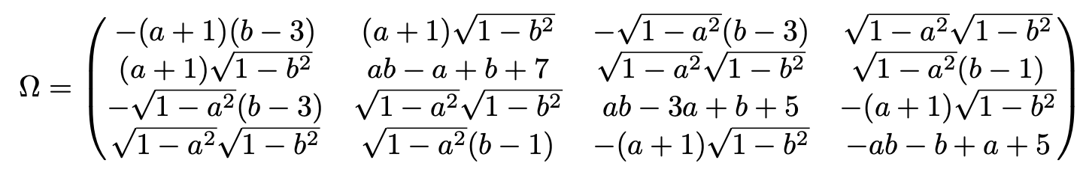
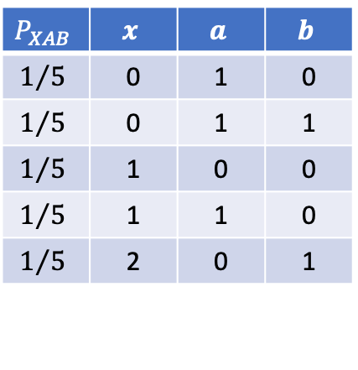

Proof Outline
Theorem: For $P_{XAB}$ specied in the table, it holds that
$$ω_{c}\left(X | A;B\right)=\frac{2}{5}=0.4$$
$$ω_{q}\left(X | A;B\right)=\frac{16+\sqrt{13}}{45}≈0.436$$
$$ω_{ns}\left(X | A;B\right)=\frac{1}{2}=0.5$$
$$P_{XAB}$$ | $$x$$ | $$a$$ | $$b$$
$$1/5$$ | 0 | 1 | 0
$$1/5$$ | 0 | 1 | 1
$$1/5$$ | 1 | 0 | 0
$$1/5$$ | 1 | 1 | 0
$$1/5$$ | 2 | 0 | 1
Lemma: $ω_{c}\left(X | A;B\right)=\max_{s≠t}{\max\left\{P_{X}\left(s\right),P_{XAB}\left(t,0,0\right)+P_{XAB}\left(t,1,1\right), P_{XAB}\left(s,0,1\right)+P_{XAB}\left(t,1,0\right)\right\}}$
$P_{X}\left(0\right)=P_{X}\left(1\right)=\frac{2}{5}, P_{X}\left(2\right)=\frac{1}{5}$, and $P_{XAB}\left(x,a,b\right)≤\frac{1}{5}$ for all $x,a,b$.
More complicated characterisation and explicit strategies for $ω_{ns}(X|A;B)$.
$ω_{q}\left(X | A;B\right)=\frac{16+\sqrt{13}}{45}=t_{∗}$ can be achieved with an explicit state and measurement with one qubit each.
Strategy is optimal if shared entangled state has local dimension 2, and projective measurements:
Parametrizing the problem, we have to show that $\left\|Ω\right\|≤t_{∗}$ for all $a,b∈[0,1]$ and
General strategy reduces to the above using Jordan’s lemma.

Slide 25
Summary of Contributions
Local Simultaneous State Discrimination:
Example with two-regime behavior
Separating example
Binary inputs:
NP-hardness of 3-party LSSD
$$P_{XAB}$$ | $$x$$ | $$a$$ | $$b$$
$$1/5$$ | 0 | 1 | 0
$$1/5$$ | 0 | 1 | 1
$$1/5$$ | 1 | 0 | 0
$$1/5$$ | 1 | 1 | 0
$$1/5$$ | 2 | 0 | 1
Theorem: $∃P_{XAB}$ such that $ω_{c}\left(X | A;B\right)<ω_{q}\left(X | A;B\right)<ω_{ns}\left(X | A;B\right)$
Theorem: For binary $X,A,B$, we have$ω_{c}\left(X | A;B\right)=ω_{q}\left(X | A;B\right)=ω_{ns}\left(X | A;B\right)$
Theorem: For some $P_{XABC},$ computing $ω_{c}\left(E | A;B;C\right)$ is NP-hard.

Slide 26
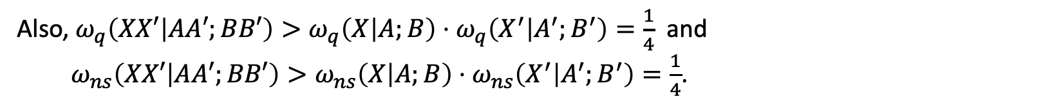
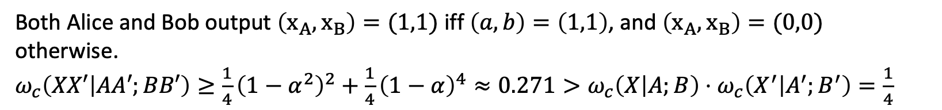
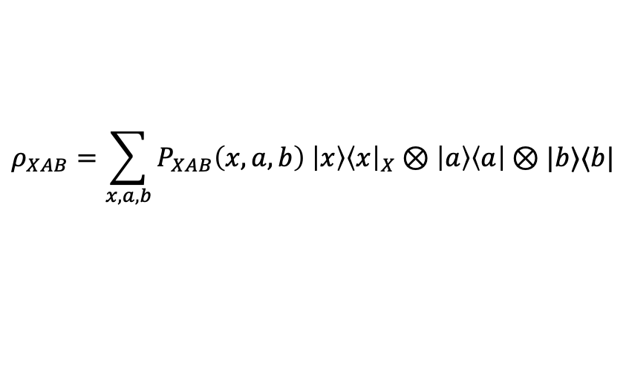

Example (continued)
$${\left\{M_{x_{A}}\right\}}_{x_{A}}$$
$$x←\{0,1\}$$
$$a≔x⊕y$$
Win iff $x=x_{A}=x_{b}$
$$b≔x⊕z$$
$$ρ_{XAB}=\sum_{x,a,b}{P_{XAB}\left(x,a,b\right) \left|x\right\rangle {\left\langle x\right|}_{X}⊗\left|a\right\rangle \left\langle a\right|⊗|b⟩⟨b|}$$
$${\left\{N_{x_{B}}\right\}}_{x_{B}}$$
Theorem: For binary $X,A,B$, we have$ω_{c}\left(X | A;B\right)=ω_{q}\left(X | A;B\right)=ω_{ns}\left(X | A;B\right)$
Set $α≔1−\frac{1}{\sqrt{2}}≈0.293$, so $ω_{c}\left(X | A;B\right)=\frac{1}{2}$ .
Let $\left(X^{′},A^{′},B^{′}\right)$ and independent copy of $\left(X,A,B\right)$. What is $ω_{c}\left(XX′ | AA′;BB′\right)$?
Both Alice and Bob output $\left(x_{A},x_{B}\right)=(1,1)$ iff $\left(a,b\right)=\left(1,1\right)$, and $\left(x_{A},x_{B}\right)=(0,0)$ otherwise.
$ω_{c}\left(XX′ | AA′;BB′\right)≥\frac{1}{4}{\left(1−α^{2}\right)}^{2}+\frac{1}{4}{\left(1−α\right)}^{4}≈0.271>ω_{c}\left(X | A;B\right)⋅ω_{c}\left(X^{′} | A^{′};B^{′}\right)=\frac{1}{4}$
Also, $ω_{q}\left(XX′ | AA′;BB′\right)>ω_{q}\left(X | A;B\right)⋅ω_{q}\left(X^{′} | A^{′};B^{′}\right)=\frac{1}{4}$ and
$ω_{ns}\left(XX′ | AA′;BB′\right)>ω_{ns}\left(X | A;B\right)⋅ω_{ns}\left(X^{′} | A^{′};B^{′}\right)=\frac{1}{4}$.

Slide 27


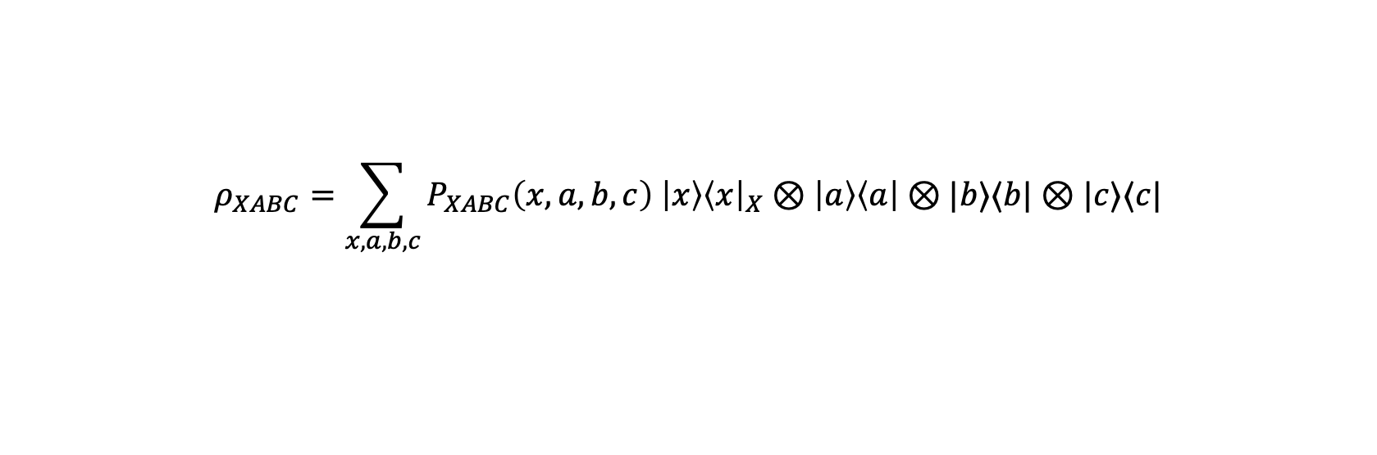






Multipartite LSSD is NP-hard
$$a$$
$${\left\{M_{x_{A}}\right\}}_{x_{A}}$$
Win iff $x=x_{A}=x_{B}=x_{C}$
$$\left(x,a,b,c\right)←P_{XABC}$$
$$b$$
$${\left\{N_{x_{B}}\right\}}_{x_{B}}$$
$$c$$
$${\left\{L_{x_{C}}\right\}}_{x_{C}}$$
$$ρ_{XABC}=\sum_{x,a,b,c}{P_{XABC}\left(x,a,b,c\right) \left|x\right\rangle {\left\langle x\right|}_{X}⊗\left|a\right\rangle \left\langle a\right|⊗|b⟩⟨b|⊗|c⟩⟨c|}$$

Slide 28



Graphs and Matchings
https://en.wikipedia.org/wiki/3-dimensional_matching
$G=(𝒱,ℰ)$: hyperedges in $ℰ$ are non-empty subsets of $𝒱$
3-partite hypergraph: each hyperedge contains exactly one vertex from each part
Matching: subset $ℳ⊂ℰ$of mutually disjoint hyperedges
Example above: ${\{e}_{1},e_{4}\}$ or $\{e_{3},e_{4}\}$ are matchings,
But $\{e_{1},e_{3}\}$ is not, as $e_{1}∩e_{3}=v_{3}$
Def: $ν\left(G\right)$ is the maximum cardinality of a matching of $G.$

Slide 29

Hypergraphs and Matchings
https://en.wikipedia.org/wiki/3-dimensional_matching
$G=(𝒱,ℰ)$: hyperedges in $ℰ$ are non-empty subsets of $𝒱$
3-partite hypergraph: each hyperedge contains exactly one vertex from each part
Matching: subset $ℳ⊂ℰ$ of mutually disjoint hyperedges
Example above: ${\{e}_{1},e_{4}\}$ or $\{e_{3},e_{4}\}$ are matchings,
But $\{e_{1},e_{3}\}$ is not, as $e_{1}∩e_{3}=v_{3}$
Def: $ν\left(G\right)$ is the maximum cardinality of a matching of $G.$
Theorem [Karp ‘72]: computing $ν\left(G\right)$ in 3-partite hypergraphs is NP-complete

Slide 30














Multipartite LSSD is NP-hard
$$a$$
$${\left\{M_{x_{A}}\right\}}_{x_{A}}$$
Win iff $x=x_{A}=x_{B}=x_{C}$
$$\left(e,a,b,c\right)←P_{XABC}$$
$$b$$
$${\left\{N_{x_{B}}\right\}}_{x_{B}}$$
$$ρ_{XABC}=\sum_{x,a,b,c}{\begin{aligned}P_{XABC}\left(x,a,b,c\right) \left|x\right\rangle {\left\langle x\right|}_{X}⊗ \\ \left|a\right\rangle \left\langle a\right|⊗|b⟩⟨b|⊗|c⟩⟨c|\end{aligned}}$$
$$c$$
$${\left\{L_{x_{C}}\right\}}_{x_{C}}$$
$$𝒜$$
$$ℬ$$
$$𝒞$$
Let $G$ be a 3-partite hypergraph:
Theorem: For the hypergraph LSSD problem:
$$ω_{c}\left(E | A;B;C\right)=\frac{ν(G)}{|ℰ|}$$
$e←ℰ$ uniform hyperedge
$a,b,c∈e$ the according red, blue, green vertices
Intuition:
Theorem [Karp ‘72]: computing $ν\left(G\right)$ in 3-partite hypergraphs is NP-complete

Slide 31

What have you learned from this Talk?
Unclonable Encryption
Generic Cloning Attack
Local Simultaneous State Discrimination
Results
$$𝒩_{R→AB}:{\left|φ\right\rangle }_{R}↦\frac{1}{\sqrt{2}}\left({\left|⊥\right\rangle }_{A}⊗{\left|φ\right\rangle }_{B}+{\left|φ\right\rangle }_{A}⊗{\left|⊥\right\rangle }_{B} \right)$$
distributes state to either Alice or Bob ”in superposition”,
where $\left|⊥\right\rangle$ is a state orthogonal to anything in register R.
Theorem: $∃P_{XAB}$ such that $ω_{c}\left(X | A;B\right)<ω_{q}\left(X | A;B\right)<ω_{ns}\left(X | A;B\right)$
Theorem: For binary $X,A,B$, we have$ω_{c}\left(X | A;B\right)=ω_{q}\left(X | A;B\right)=ω_{ns}\left(X | A;B\right)$
Theorem: For some $P_{XABC},$ computing $ω_{c}\left(E | A;B;C\right)$ is NP-hard.

Slide 32


Thank you for your attention!
Questions

