Slide 1
WebDAV follow-up
Onno Zweers
dCache Workshop, Madrid, May 2019

Slide 2
Following up on:
https://www.dcache.org/manuals/workshop-2018-05-28-DESY/onno.pdf

Slide 3
No longer true
WebDAV redirects are not encrypted
They can be, if well configured!
Enforcing Perfect Forward Secrecy not possible – no A rating
It is possible!

Slide 4
How to redirect to HTTPS
Two config settings
webdav.redirect.allow-https=true
pool.enable.encrypted-transfers=true
All pools need host certificates
You can use a chain (as in WebDAV doors, see WebDAV talk last year)
pool.mover.https.hostcert.cert=/etc/grid-security/chain.pem

Slide 5
Why redirecting WebDAV
Pros
Load balancing
With redirection, data does not have to go through the door.
Cons
All pools nodes need a host certificate

Slide 6
Enforcing Perfect Forward Secrecy
This is possible
It’s the only way to get an A rating in https://www.ssllabs.com/ssltest/
How?
Test your WebDAV door in the Qualys SSL test
Then list all “weak” ciphers at jdk.tls.disabledAlgorithms in java.security
jdk.tls.disabledAlgorithms = SSLv2Hello, SSLv3, TLSv1, TLSv1.1, \
DES, DESede, RC4, MD5withRSA, DH keySize < 1024, \
EC keySize < 224, DES40_CBC, RC4_40, \
TLS_RSA_WITH_AES_256_CBC_SHA256, TLS_RSA_WITH_AES_256_CBC_SHA, \
TLS_RSA_WITH_AES_128_CBC_SHA256, TLS_RSA_WITH_AES_128_CBC_SHA, \
TLS_RSA_WITH_AES_256_GCM_SHA384, TLS_RSA_WITH_AES_128_GCM_SHA256, \
TLS_ECDHE_RSA_WITH_AES_256_CBC_SHA, TLS_DHE_RSA_WITH_AES_256_CBC_SHA, \
TLS_ECDHE_RSA_WITH_AES_128_CBC_SHA, TLS_DHE_RSA_WITH_AES_128_CBC_SHA

Slide 7
Enforce Perfect Forward Secrecy, per domain
Perhaps you need some components to be backwards compatible…
[root@dolphin12 /etc/dcache]# cat maximum.java.security
jdk.tls.disabledAlgorithms = SSLv2Hello, SSLv3, TLSv1, TLSv1.1, \
DES, DESede, RC4, MD5withRSA, DH keySize < 1024, \
EC keySize < 224, DES40_CBC, RC4_40, \
TLS_RSA_WITH_AES_256_CBC_SHA256, TLS_RSA_WITH_AES_256_CBC_SHA, \
TLS_RSA_WITH_AES_128_CBC_SHA256, TLS_RSA_WITH_AES_128_CBC_SHA, \
TLS_RSA_WITH_AES_256_GCM_SHA384, TLS_RSA_WITH_AES_128_GCM_SHA256, \
TLS_ECDHE_RSA_WITH_AES_256_CBC_SHA, TLS_DHE_RSA_WITH_AES_256_CBC_SHA, \
TLS_ECDHE_RSA_WITH_AES_128_CBC_SHA, TLS_DHE_RSA_WITH_AES_128_CBC_SHA
[root@dolphin12 /etc/dcache]# grep dcache.java.options.extra -A2 layouts/dolphin12.conf
dcache.java.options.extra = \
-Djava.security.properties=/etc/dcache/maximum.java.security \
-Djdk.tls.ephemeralDHKeySize=2048

Slide 8
A note on java.security.properties
-Djava.security.properties==
Replaces the java.security file
-Djava.security.properties=
Appends to the java.security file

Slide 9
More information
The Book now has a chapter about Transport Security.
https://github.com/dCache/dcache/blob/master/docs/TheBook/src/main/markdown/cookbook-transport-security.md

Slide 10
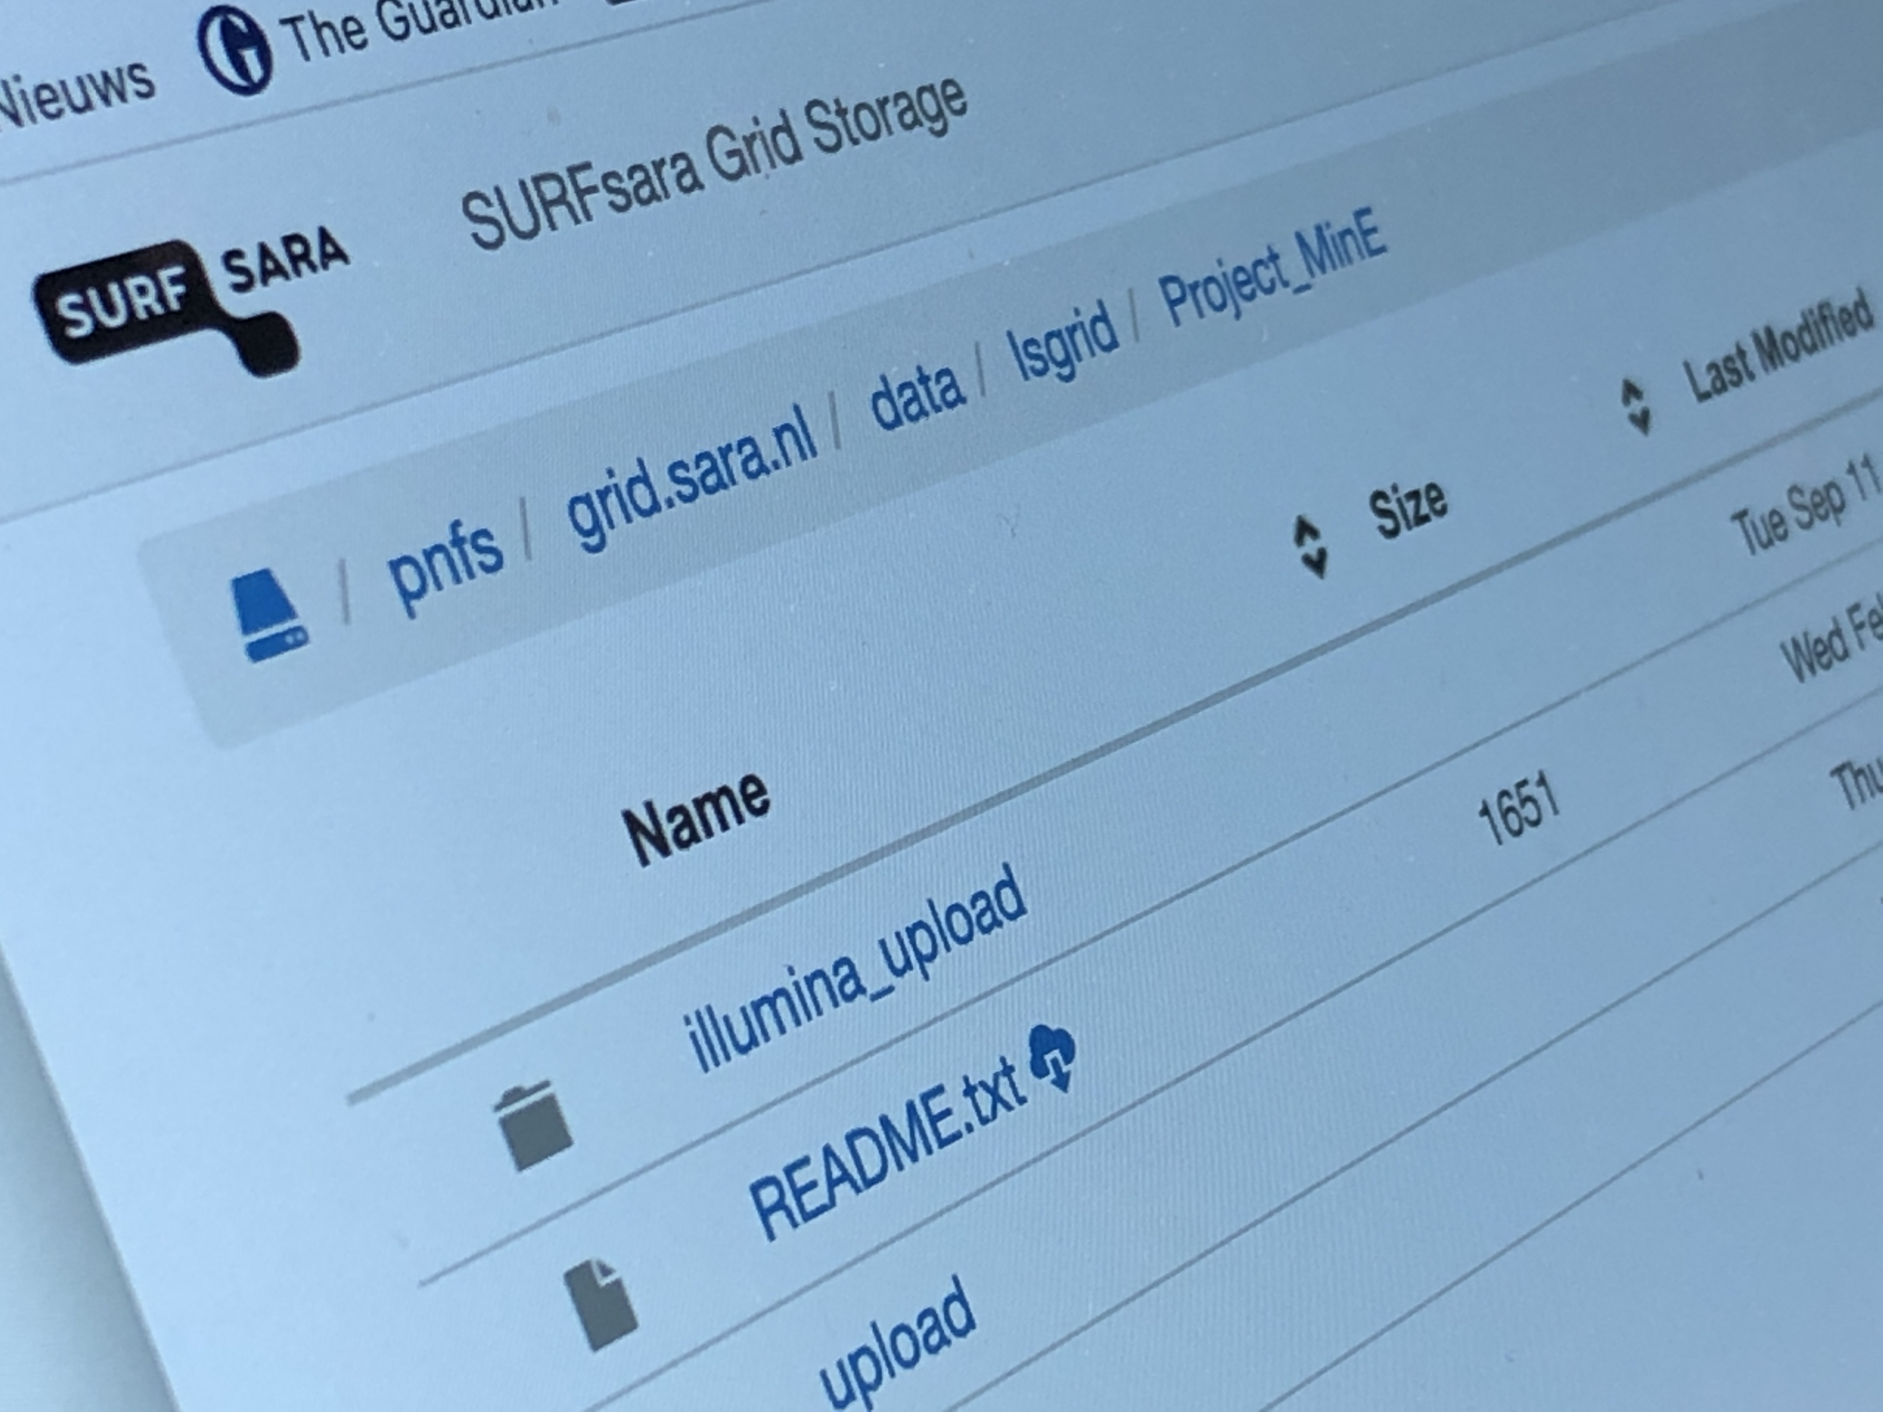
Thanks for listening!
Onno Zweers
E-mail: onno.zweers@surfsara.nl
www.surf.nl

