Slide 1
The impact of syn-depositional compaction on delta morphodynamics
Ayunda Aulia Valencia, Joep Storms, Helena van der Vegt, Bert Jagers
A.A.Valencia@tudelft.nl

Slide 2
Overview
Background
Model Design
Modelling Results
Discussion and Interpretation

Slide 3
1. Background
Compaction is a natural process, occurring syn- and post-depositional, imposing subsidence to sediment bed.
Very little is known about the impact of syn-depositional compaction on the delta development, due to a lack of field measurements and limited possibilities to acquire such measurements considering the spatial (> 10³ km²) and temporal (> 10³ years) scale of delta evolution
The available compaction data from field studies was measured post-deposition in limited spatial and temporal scales.
Moreover, laboratory data only provides a first-order approximation of compaction behavior because it does not account for the complexity of various sedimentary environments encountered in deltas, nor does it account for local erosion processes.
We propose to study the link between syn-sedimentary compaction and delta-scale morphodynamics by including compaction in simulation models as an alternative to field and laboratory data.

Slide 4
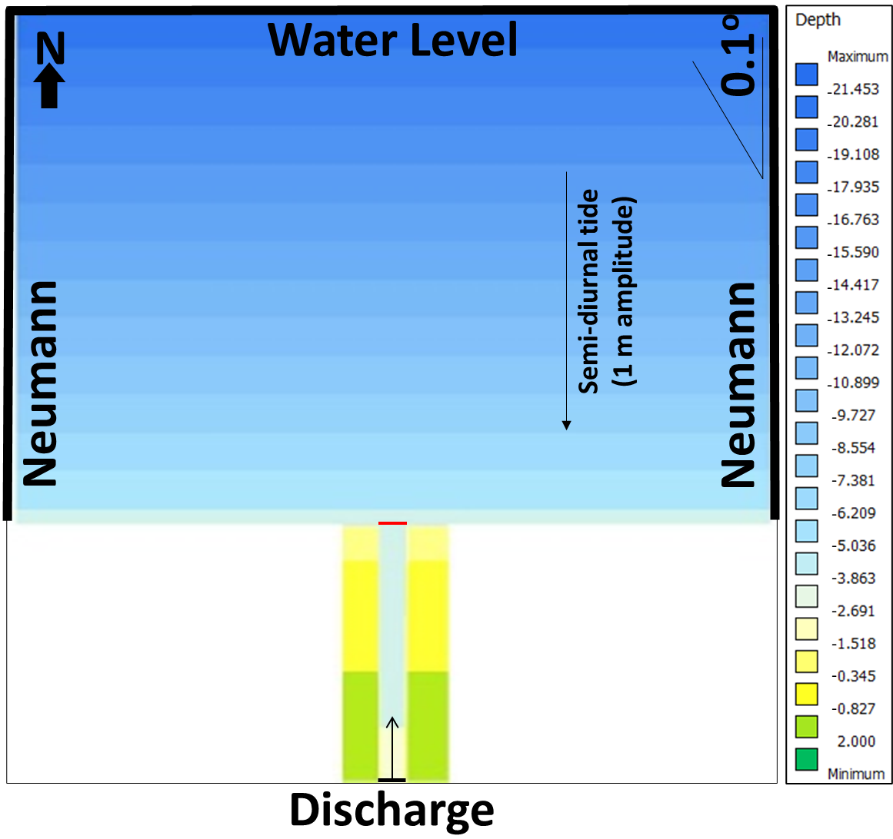
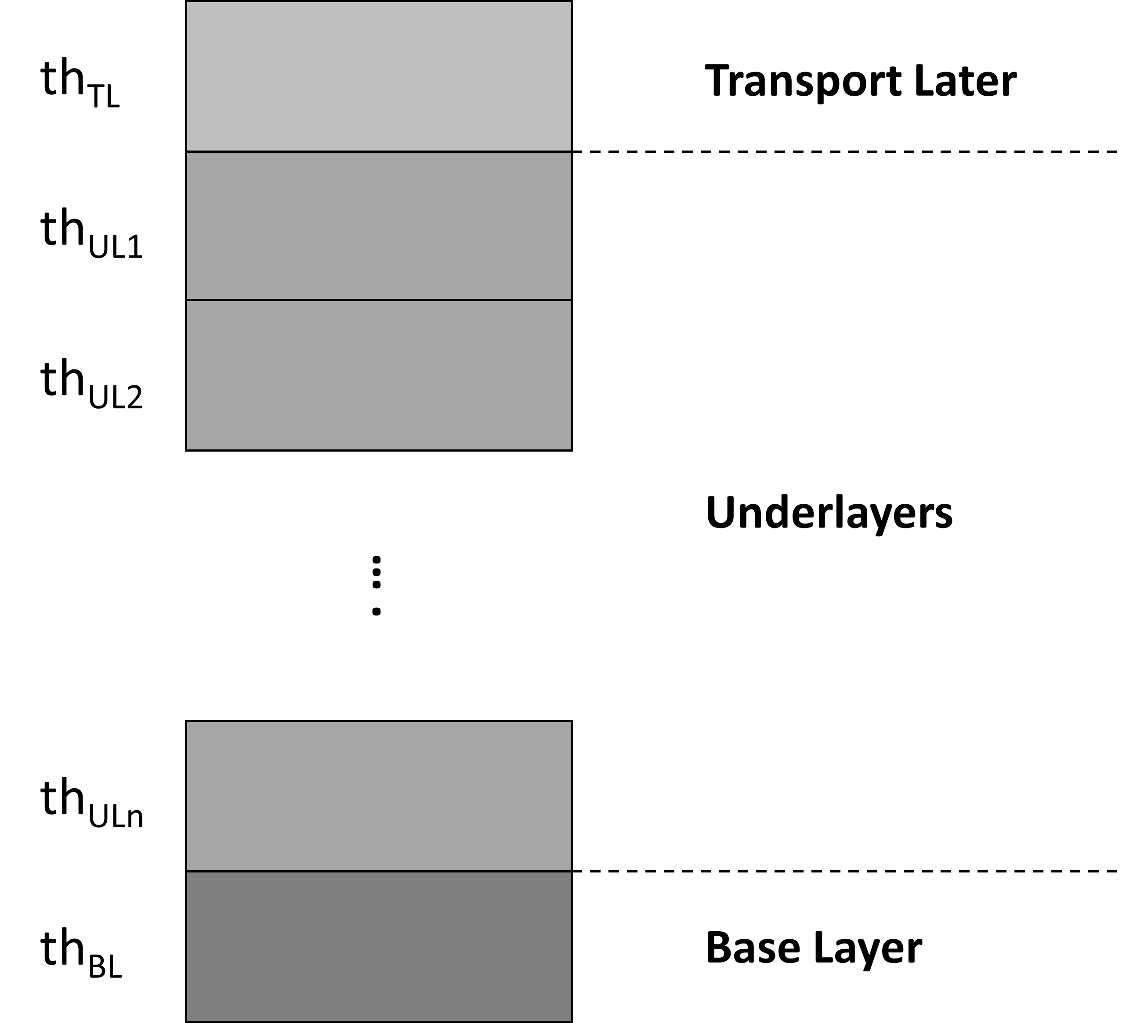
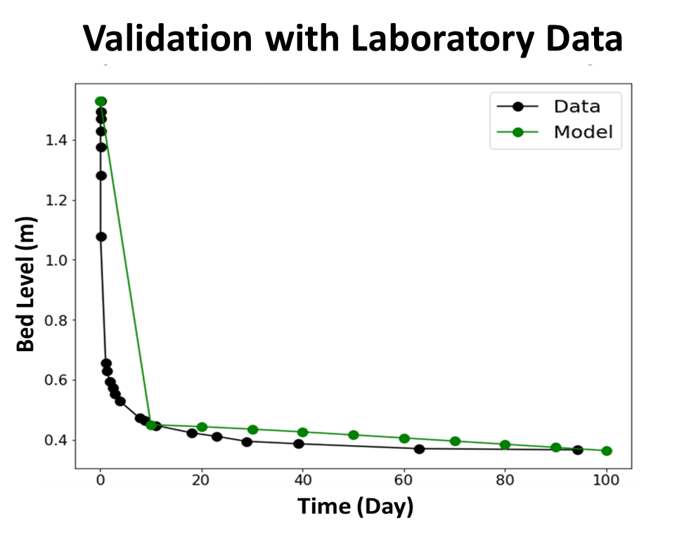
2. Model Design
#1
Compaction Formula
Derivation
#2
Compaction Implementation
Into Delft3D
#3
Delft3D Simulation
Primary
Compaction
Secondary
Compaction
Validation with
Laboratory Data
Compaction
Initial Model
Geometry
primary
Delft3D Stratigraphic
Layer
Simulation Scenario:
Sediment supply: mud- and sand-rich)
Compaction scenario (Cr): 0 – 0.01 m/yr
secondary

Slide 5
Modelling Parameters

Slide 6
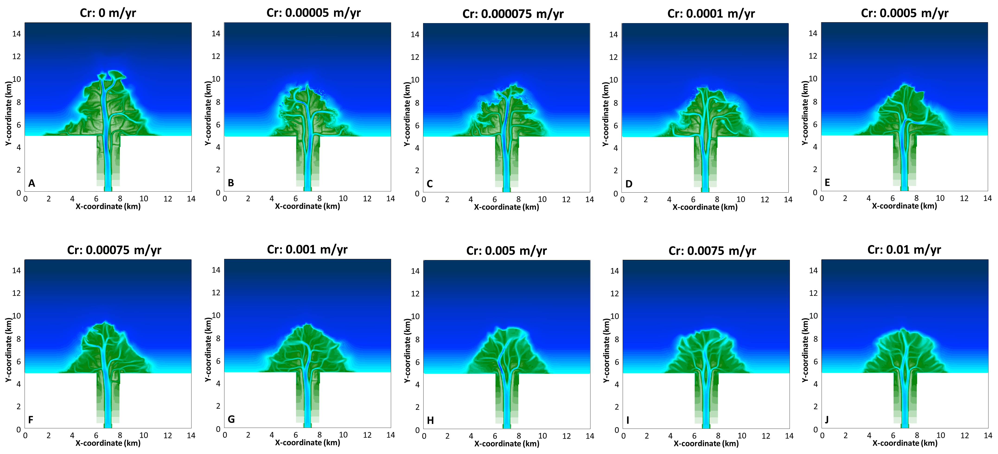
Mud-rich Deltas

Slide 7
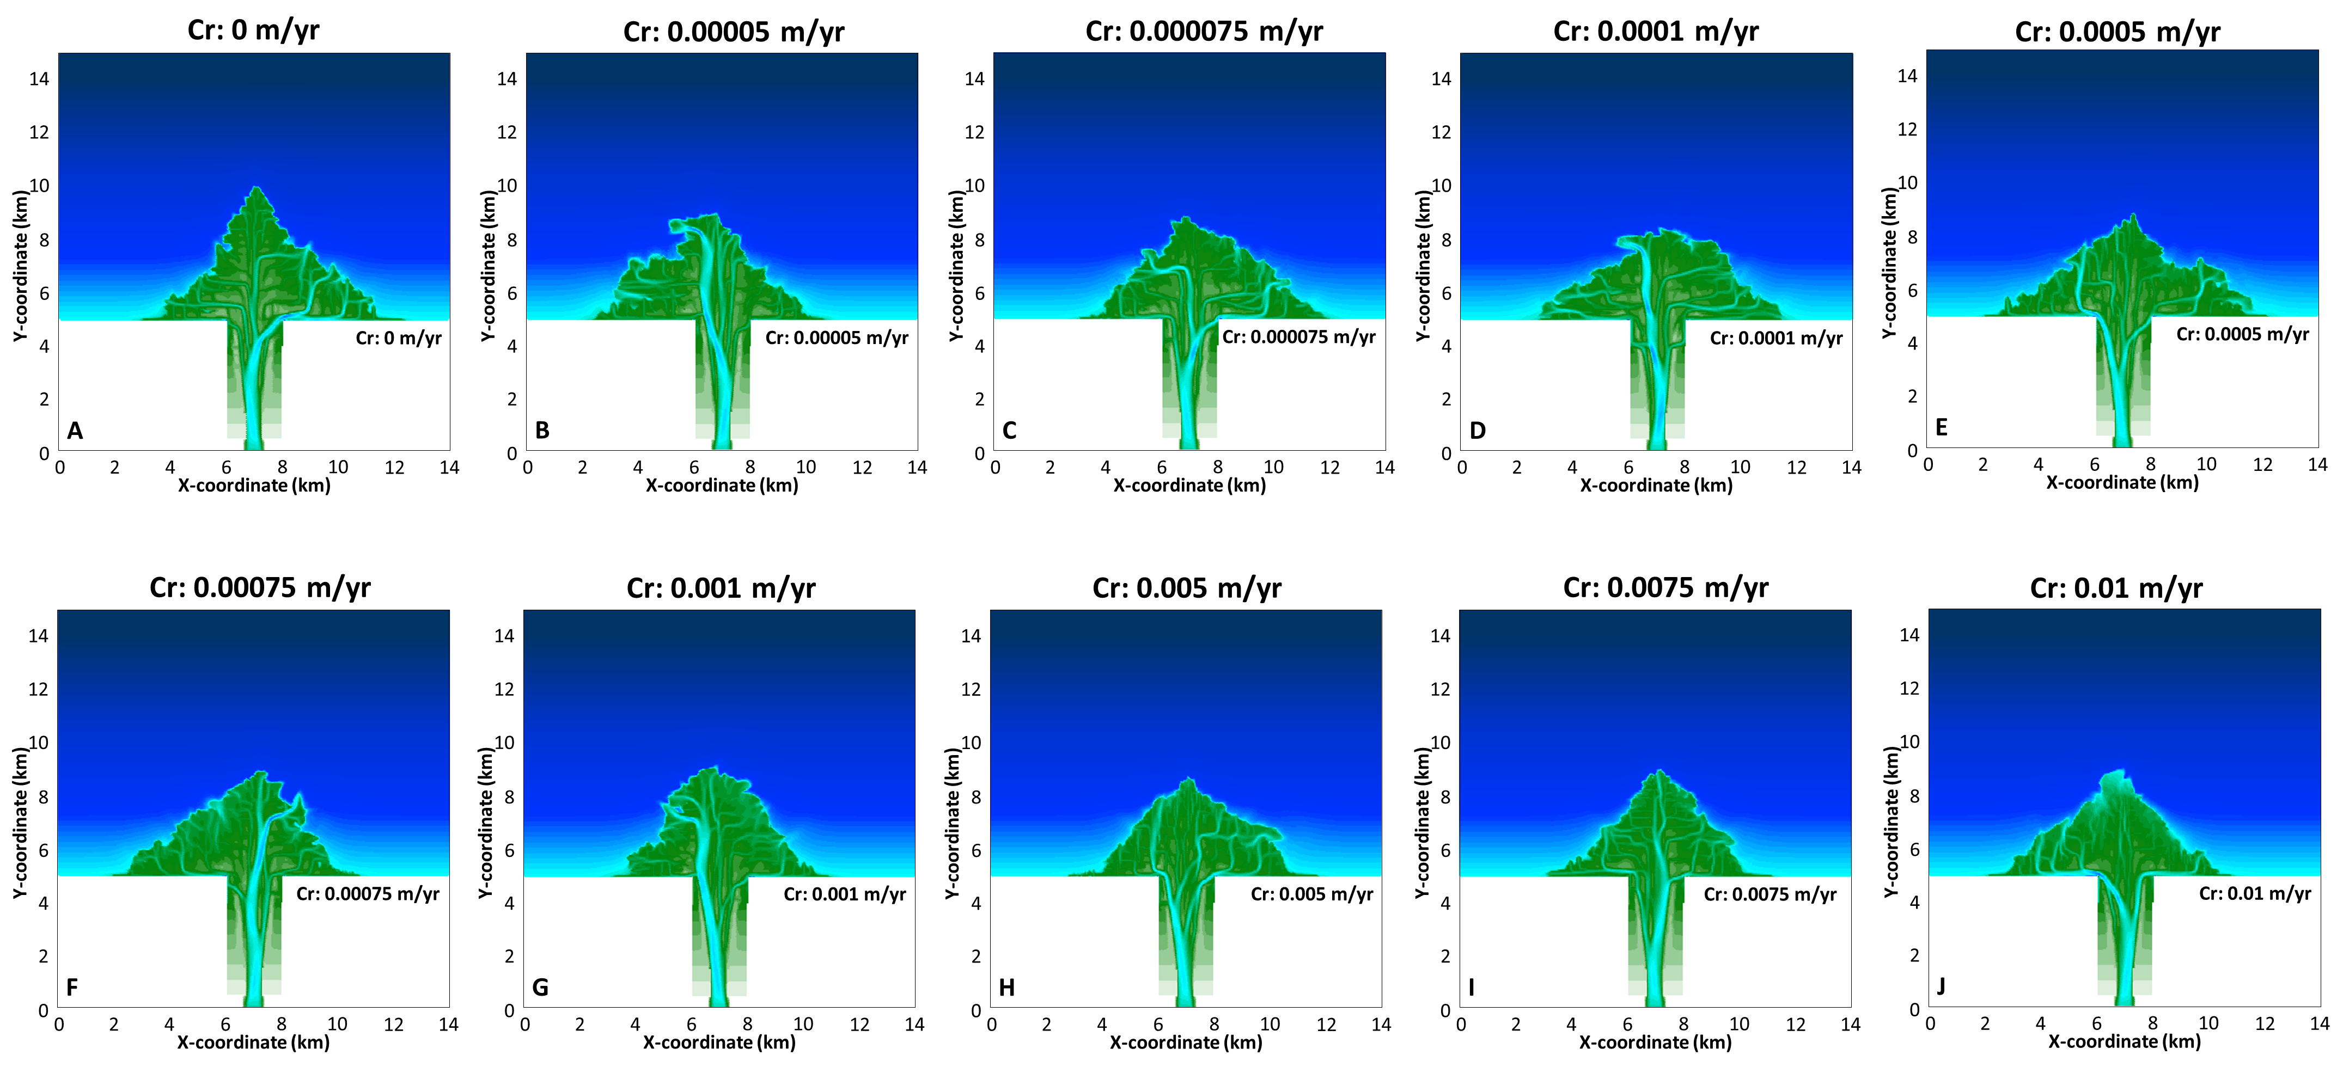
Sand-rich Deltas

Slide 8
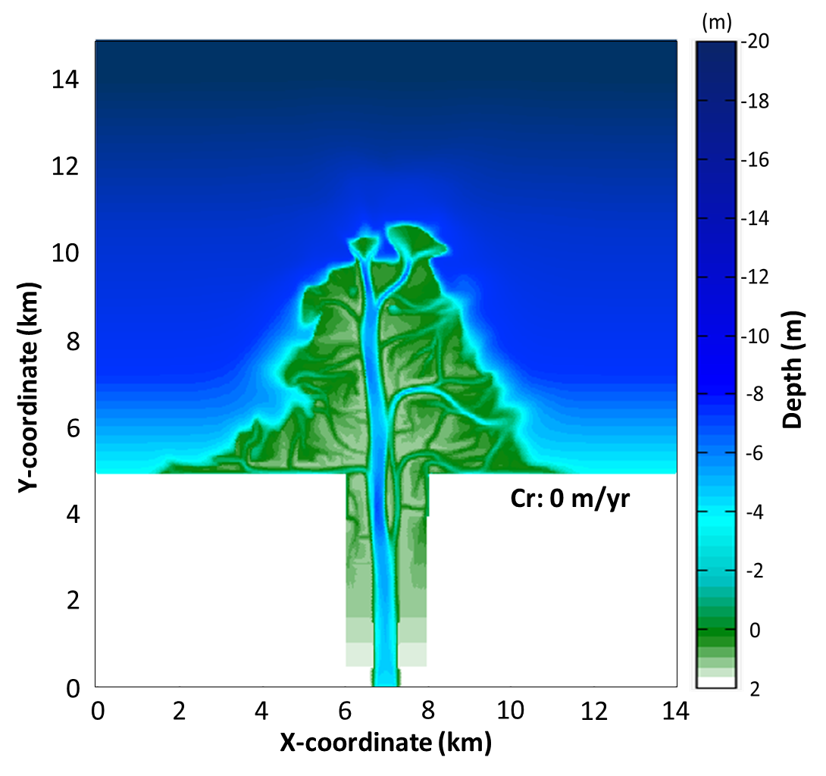
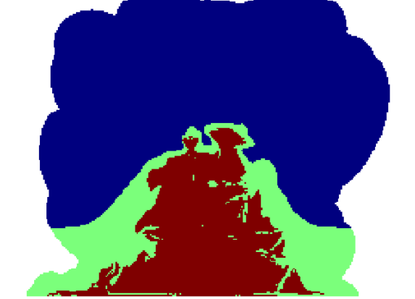
3.Modelling Results
Accommodation
Water Depth
Delft3D Output
Sediment
Distribution
Deposited Mass Alongshore
Deposited Mass at the Delta Top
Area
Morphology
Rugosity
Aspect Ratio
Notes:
Mud-rich deltas experience more efficient compaction than sand-rich deltas, leading to larger accommodation.
Accommodation increases as compaction scenario increases.
Deposited mass at the delta top increases as compaction scenario increases.
Sediment is more evenly distributed alongshore as compaction scenario increases.
Compacted scenarios have smaller area than non-compacted scenario.
The area increase over time occurs with a slower rate as compaction scenario increases.
Aspect ratio increases as compaction scenario increases
Rugosity decreases as compaction scenario increases.

Slide 9
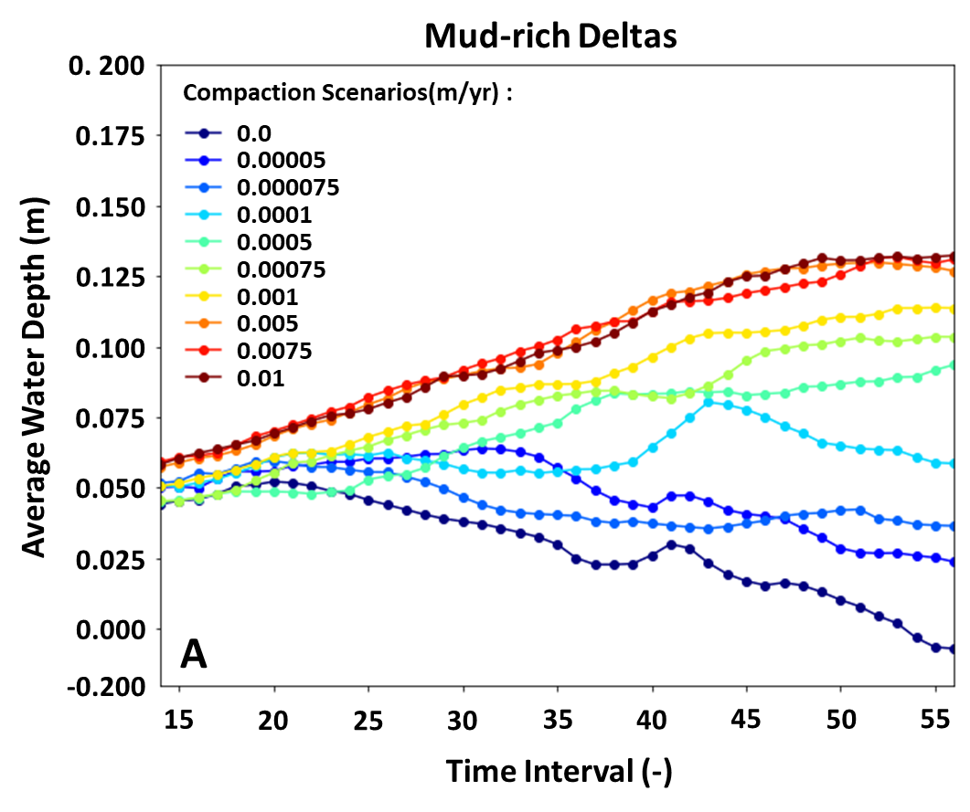
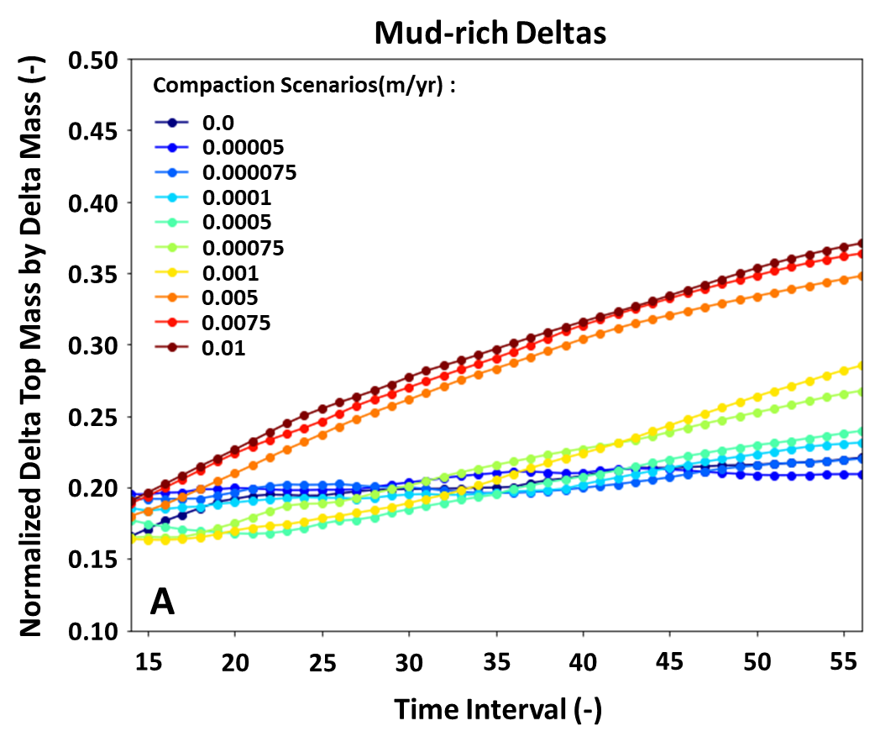
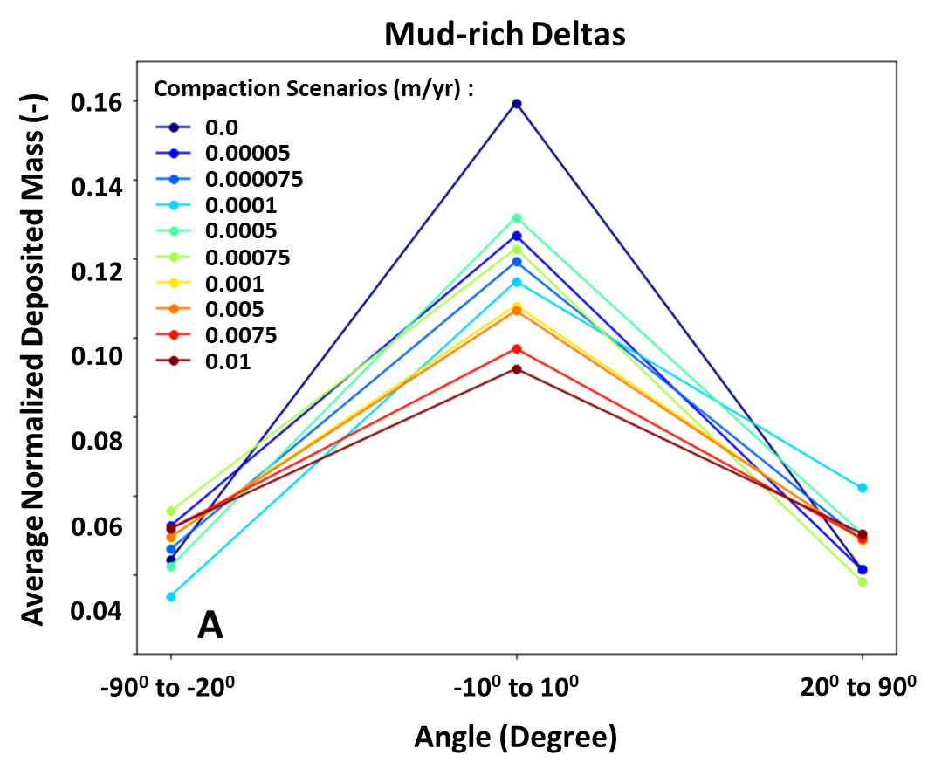
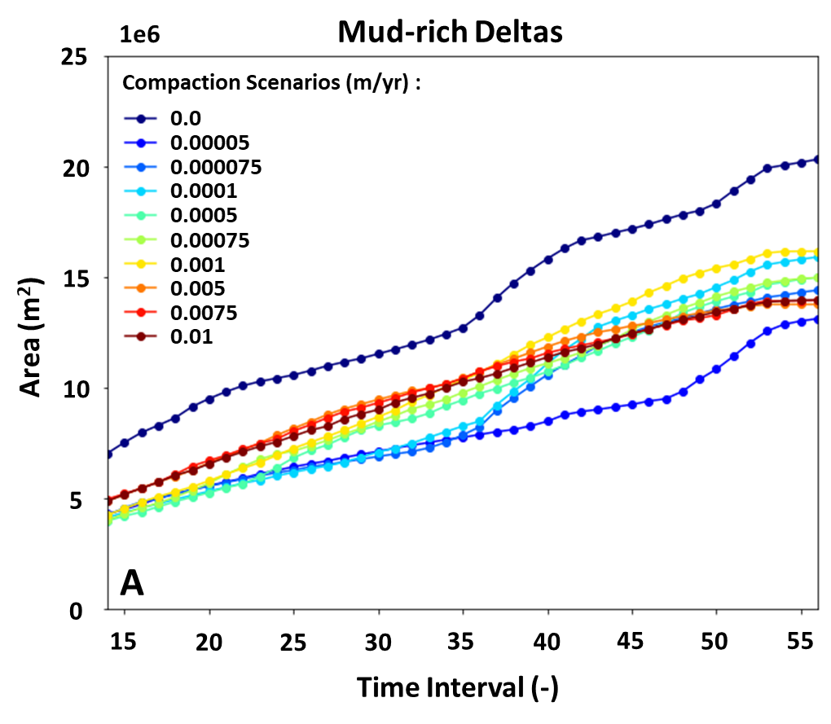
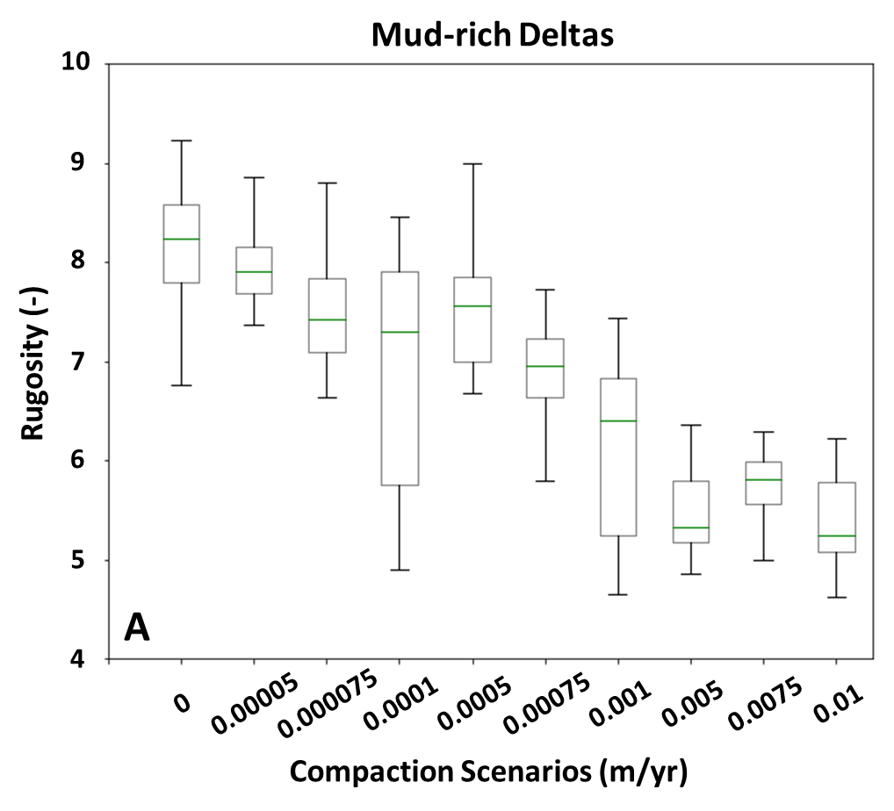
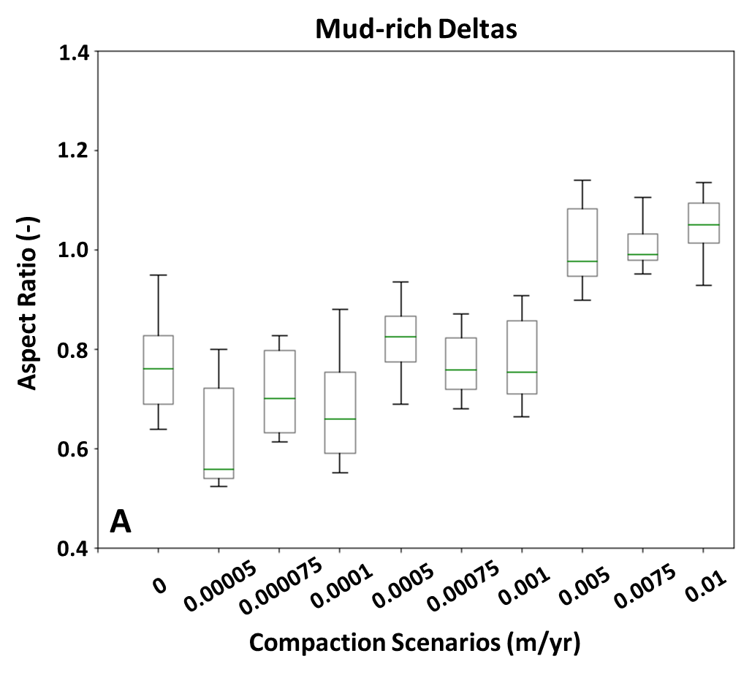
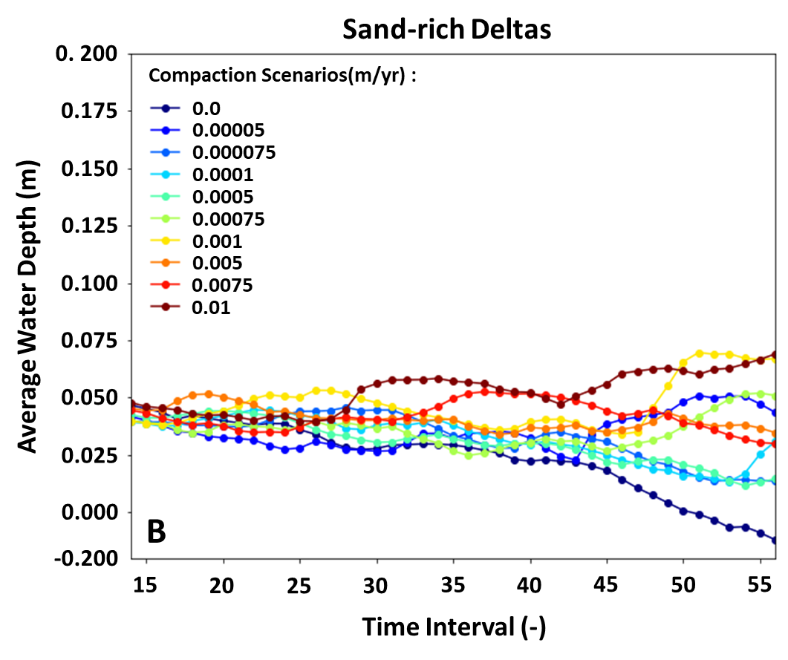
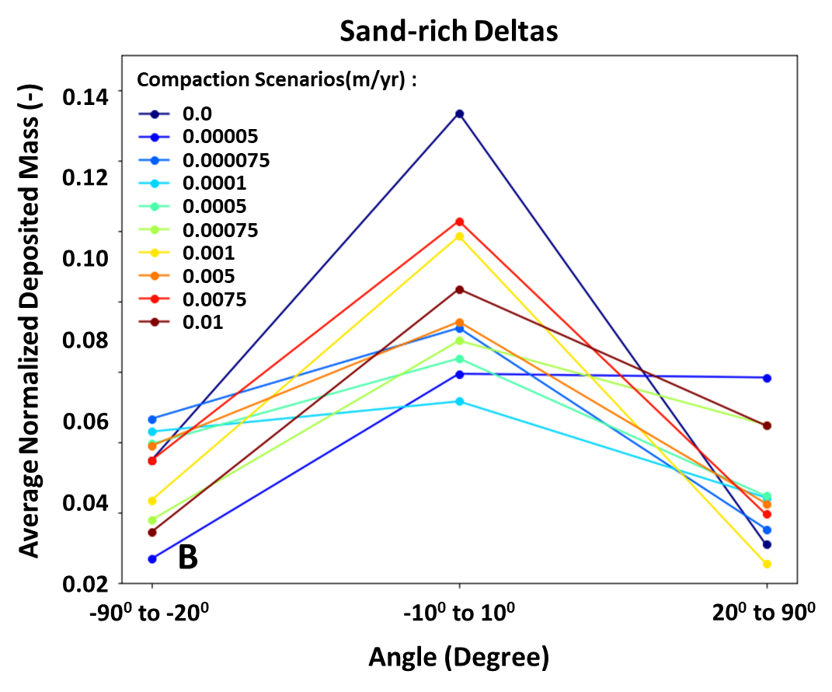
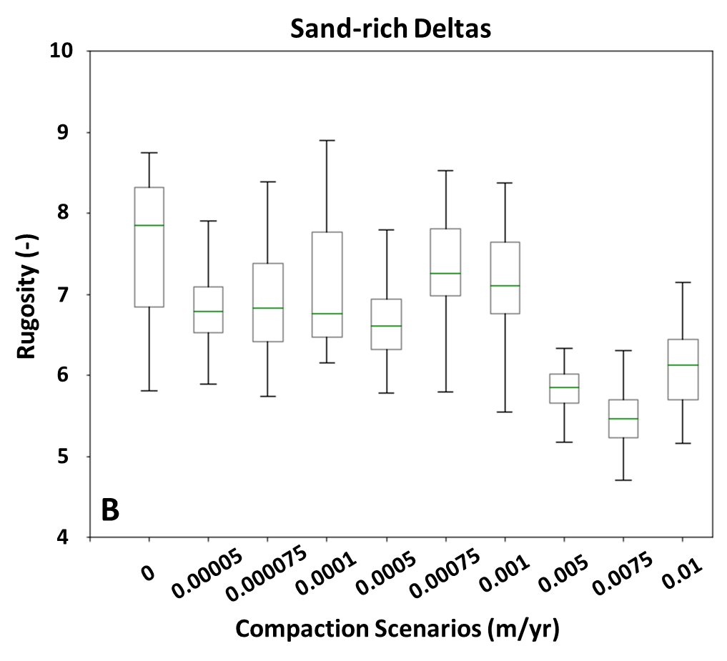
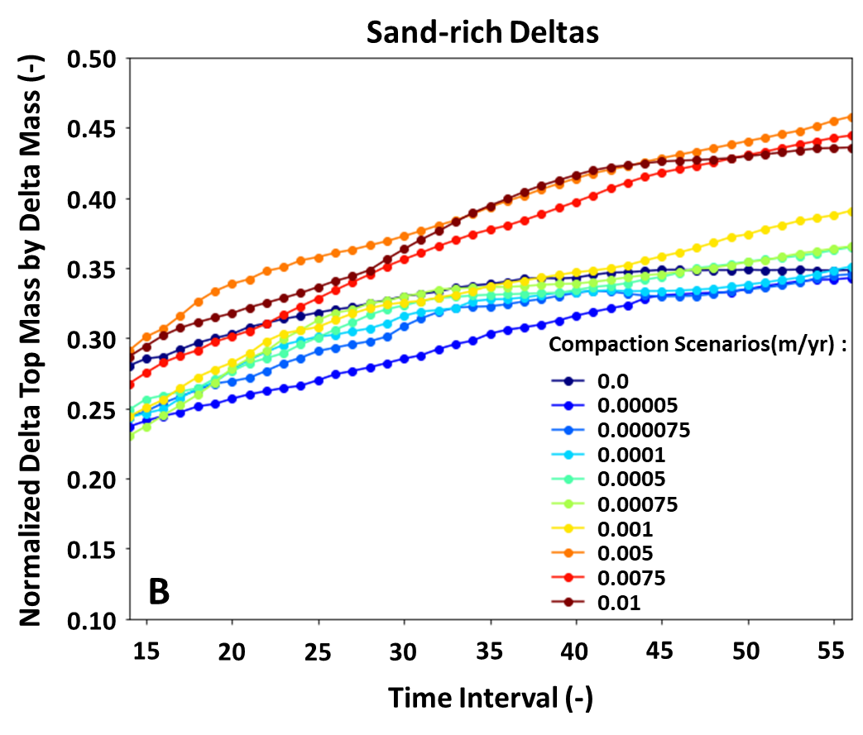
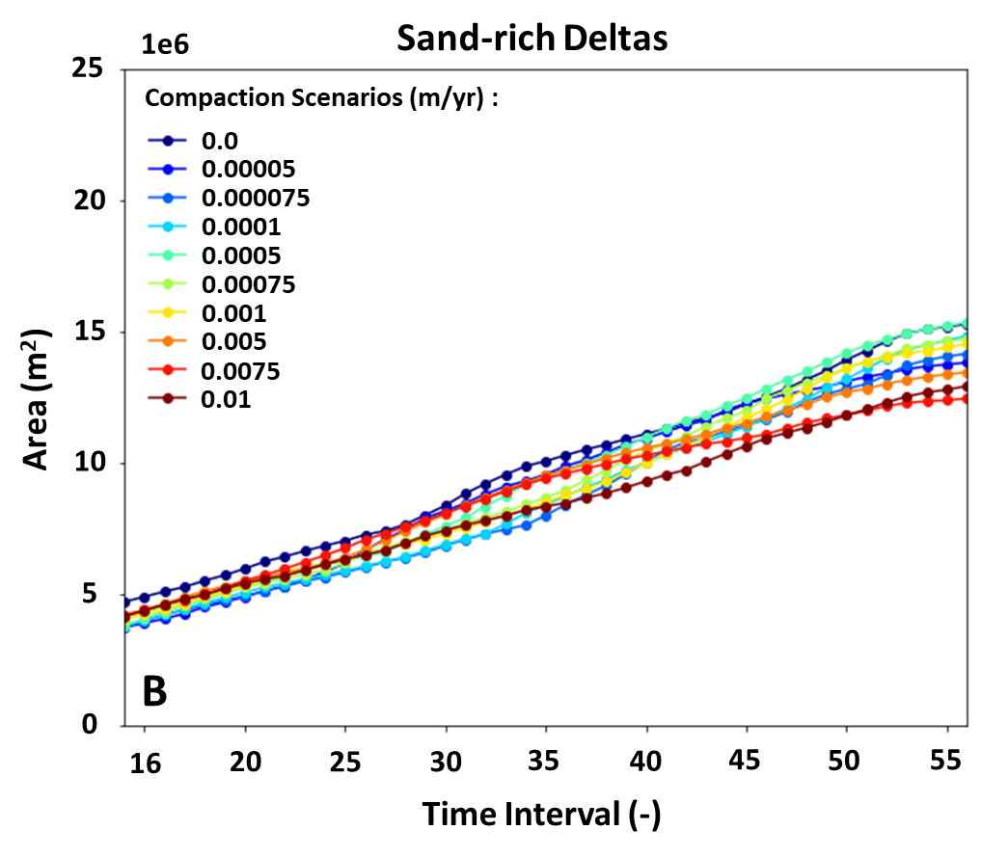
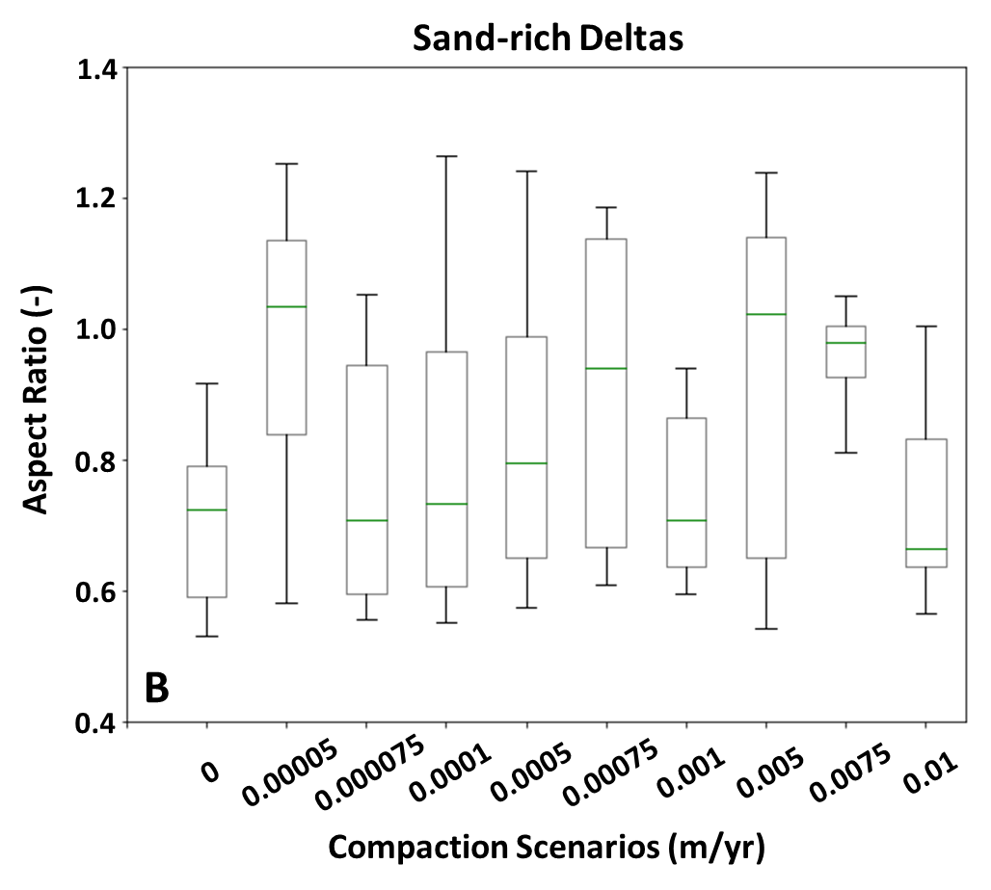
3.Modelling Results
#1
Accommodation
#2
Sediment Distribution
#3
Morphology
Water Depth
Deposited Mass at Delta Top
Area
Deposited Mass alongshore
Aspect Ratio
Rugosity
Notes:
Mud-rich deltas experience more efficient compaction than sand-rich deltas, leading to larger accommodation.
Accommodation increases as compaction scenario increases.
Deposited mass at the delta top increases as compaction scenario increases.
Sediment is more evenly distributed alongshore as compaction scenario increases.
Compacted scenarios have smaller area than non-compacted scenario.
The area increase over time occurs with a slower rate as compaction scenario increases.
Aspect ratio increases as compaction scenario increases
Rugosity decreases as compaction scenario increases.

Slide 10
Interpretation and Discussion
The accommodation at the delta top increases over compaction scenarios, driving morphological variability observed in the simulated deltas.
The increasing accommodation at the delta top leads to more delta top deposition, resulting in a smaller delta top area. Moreover, sediment distribution occurs more evenly alongshore, leading to a smoother coastline and wider delta top.
The change in the delta top geometric characteristics is more apparent in mud-rich deltas, caused by larger accommodation than sand-rich deltas.
The impact of compaction on the simulated deltas cannot be validated, as we would require data of millennia-long record of subsidence across the whole delta, which does not exist.
The strength of this study is to show that syn-sedimentary compaction does affect delta evolution and that it is essential to be included in simulation studies targeting long-timescale evolution. It is also important to better understand the possible ranges of compaction rates as they impact how delta evolves.
Notes:
Having seen the simulation results, it shows the important of accommodation in driving..

Slide 11
Thank you

