Slide 1

A cryptographic view on Computer Science
UvA inaugural lecture by Christian Schaffner
Friday, 30 September 2022

Slide 2
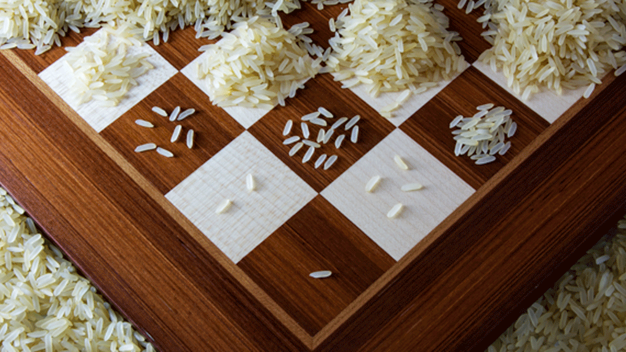

Slide 3
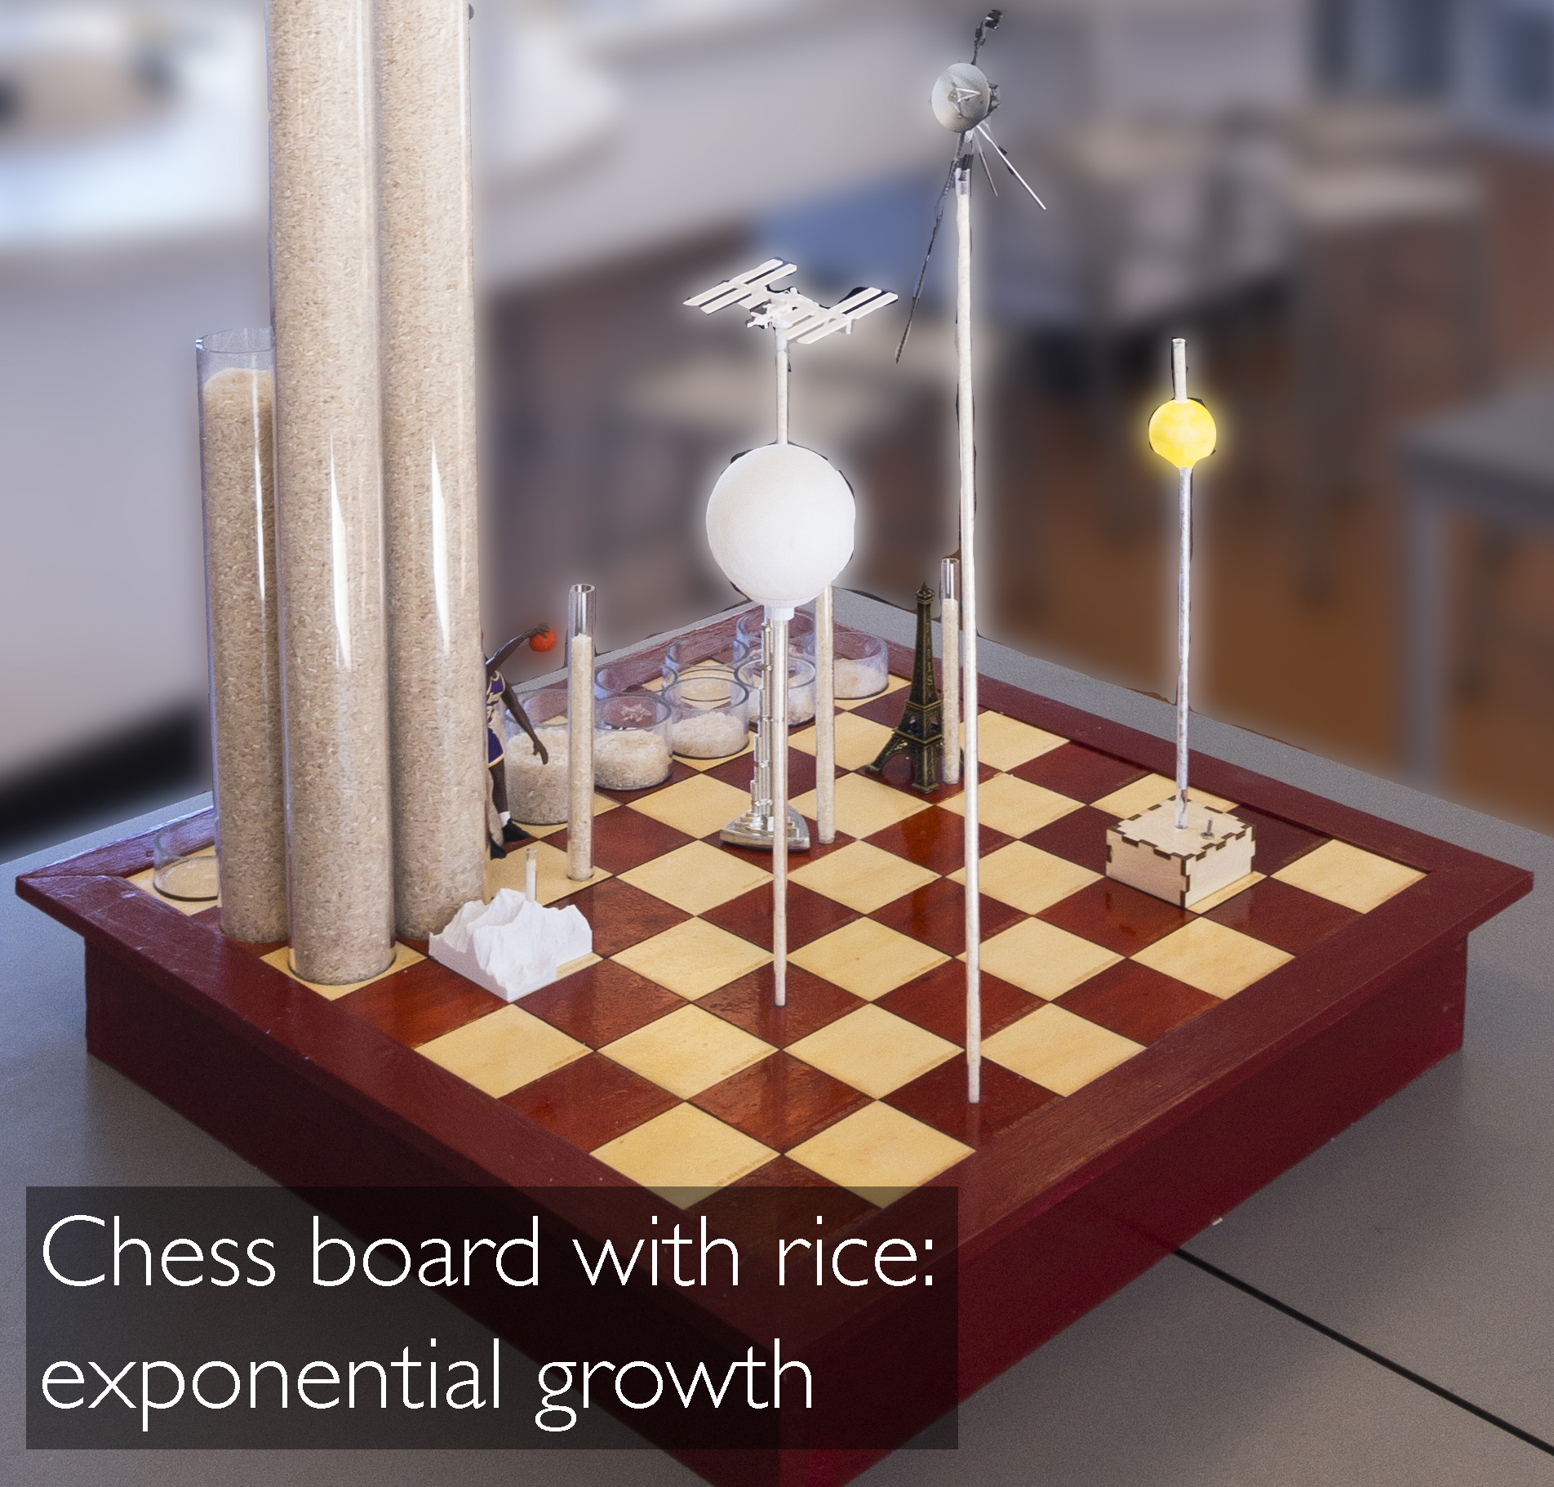
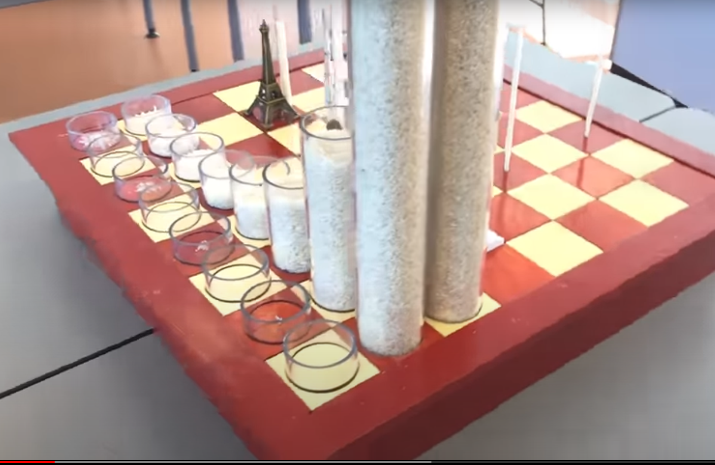
Notes:
Arjan van der Meij:
Field 26: Eiffel tower
Field 31: Mount Everest
Field 62: Voyager 1 (farthest human object in space)

Slide 4
Take-Home Messages
Modern cryptography is a fascinating field of research.
It is naturally linked with fundamental questions in Theoretical Computer Science.

Slide 5

Theoretical Computer Science
Complexity Theory
Information Theory
Discrete Mathematics
Quantum Computing
…
cryptography

Slide 6
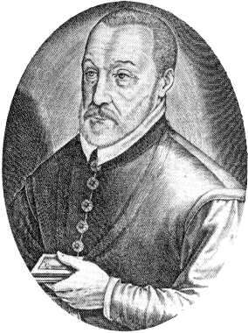
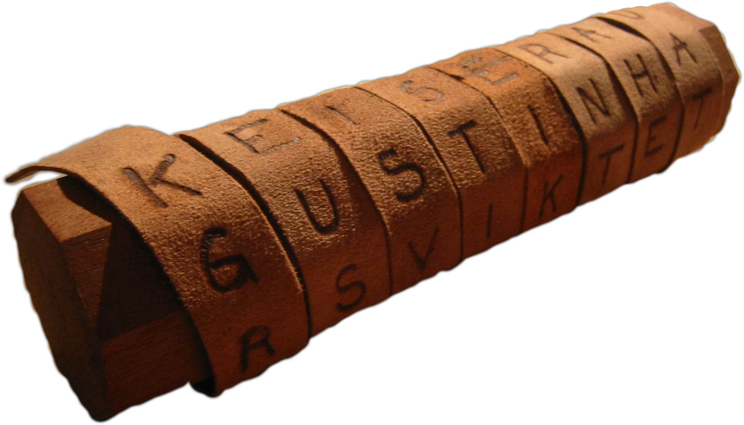
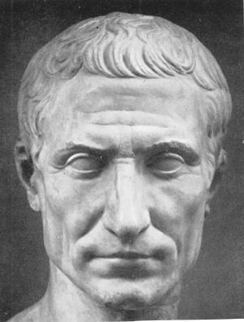

Ancient Cryptography
Giovan Battista Bellaso
(Blaise de Vigenère)
Scytale
50 BC
1000 AD
2015 AD
500 BC
500 AD
1500 AD
Caesar Cipher

Slide 7
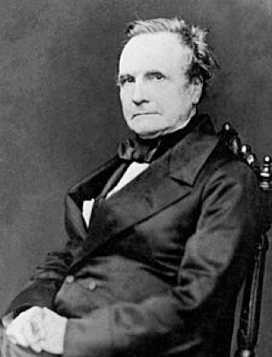
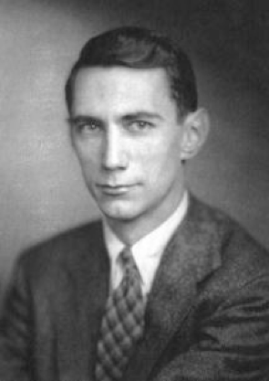
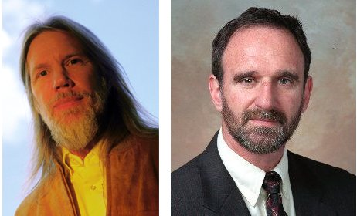
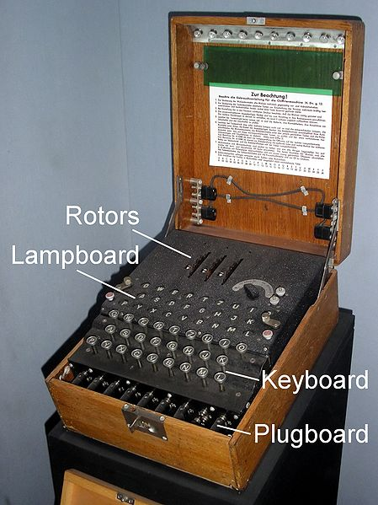
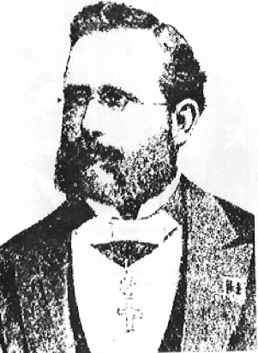
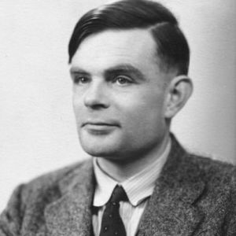

Ancient Computer Science and Cryptography
Charles Babbage
Claude Shannon
Diffie / Hellman
1850
1950
2015
1800
1900
1976
“a cryptographic system should be secure even if everything but the key is known to the adversary”
Enigma
Alan Turing
(The Imitation Game)
Auguste Kerckhoffs
Notes:
een systeem van versleuteling moet even veilig zijn, zelfs als alles behalve de sleutel over het systeem publiek bekend is

Slide 8
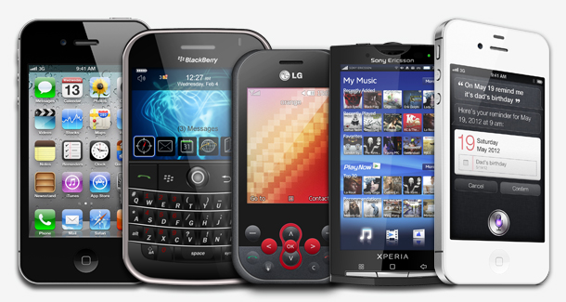
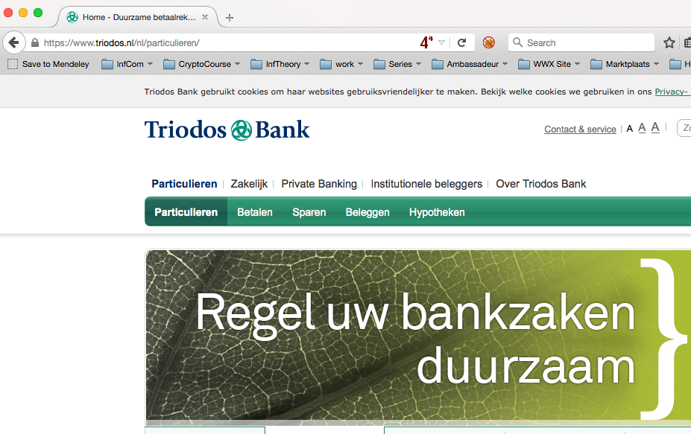
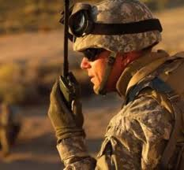
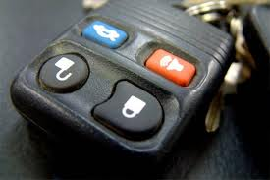

Modern Cryptography
is everywhere!
is concerned with all settings where people do not trust each other

Slide 9
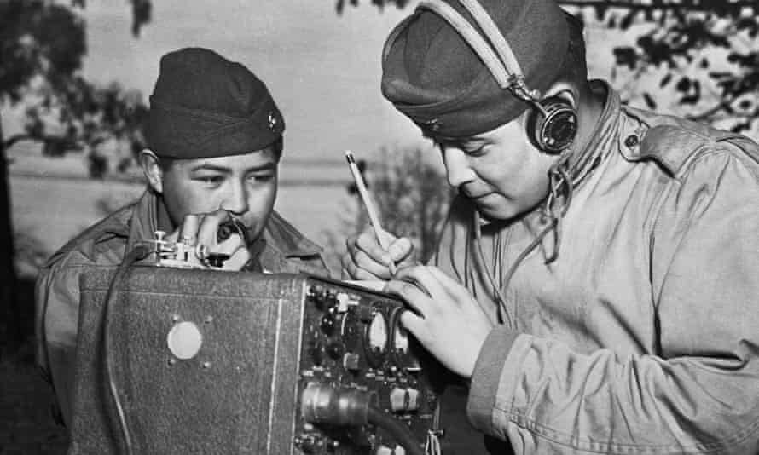


Establishing Secure Channels

Slide 10
A
B
C
D
E
F
G
H
I
J
K
L
M
N
O
P
Q
R
S
T
U
V
W
X
Y
Z
Examples:
D + 4 = 3 + 4 = 7 = = H
T + 10 = 19 + 10 = 29 = 3 = D
D - 10 = 3 – 10 = -7 = 19 = T
0
2
3
4
5
6
7
8
9
10
11
12
13
14
15
16
17
18
19
20
21
22
23
24
25
1
“modulo 26”

Slide 11



Secure Encryption
A | 0
B | 1
C | 2
D | 3
E | 4
F | 5
G | 6
H | 7
I | 8
J | 9
K | 10
L | 11
M | 12
N | 13
O | 14
P | 15
Q | 16
R | 17
S | 18
T | 19
U | 20
V | 21
W | 22
X | 23
Y | 24
Z | 25
m = T E S T
c = D R O P
c = m + k = D R O P
k = 10 13 22 22
k = 10 13 22 22
c = m + k = D R O P
m = c - k = T E S T
Alice
Bob
Notes:
19 04 18 19 = T E S T
10 13 22 22 = K N S S

Slide 12

Perfectly Secure Encryption
A | 0
B | 1
C | 2
D | 3
E | 4
F | 5
G | 6
H | 7
I | 8
J | 9
K | 10
L | 11
M | 12
N | 13
O | 14
P | 15
Q | 16
R | 17
S | 18
T | 19
U | 20
V | 21
W | 22
X | 23
Y | 24
Z | 25
m = ? ? ? ?
c = D R O P
c = m + k = D R O P
k = ? ? ? ?
k = ? ? ? ?
c = m + k = D R O P
m = c - k = ? ? ? ?
Alice
k = ?
Bob
Eve
Given that c = D R O P = 3 17 14 15,
  is it possible that m = T E S T = 19 04 18 19 ?
    Yes, if k = 10 13 22 22
  is it possible that m = D R O P = 3 17 14 15 ?
    Yes, if k = 0 0 0 0
  it is possible that m = N I C E = 13 8 2 4 ?
    Yes, if k = 16 9 12 11

Slide 13

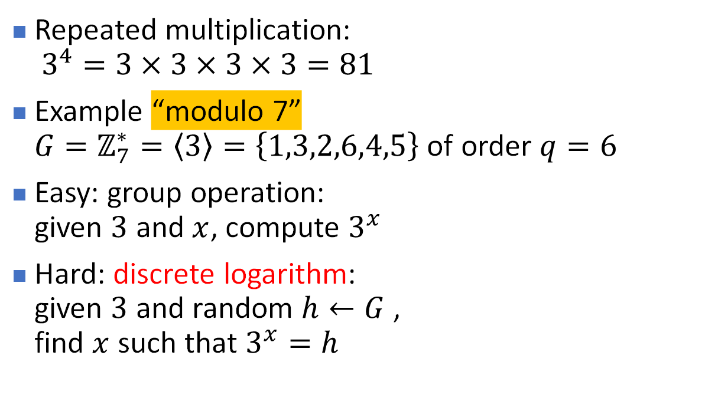




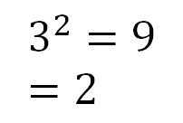
Basic Discrete Mathematics
[Diffie Hellman 76]
Alice
Bob
$$3^{6}=1=3^{0}$$
Repeated multiplication:
$3^{4}=3×3×3×3=81$
Example “modulo 7”
${G=ℤ}_{7}^{∗}=\left\langle 3\right\rangle =\left\{1,3,2,6,4,5\right\}$ of order $q=6$
Easy: group operation:
given $3$ and $x$, compute $3^{x}$
Hard: discrete logarithm:
given $3$ and random $h←G$ ,
find $x$ such that $3^{x}=h$
$$3^{5}=5$$
$$3^{1}=3$$
$$3^{4}=4$$
$$3^{2}=9=2$$
$$3^{3}=6$$

Slide 14


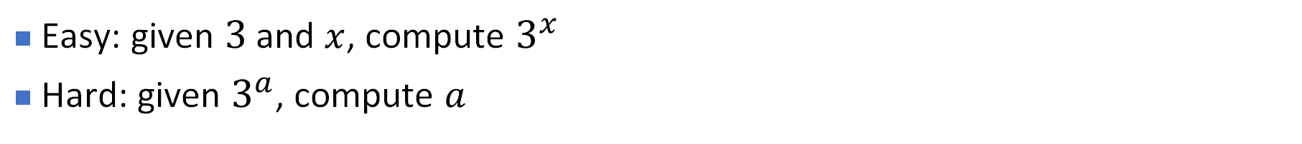
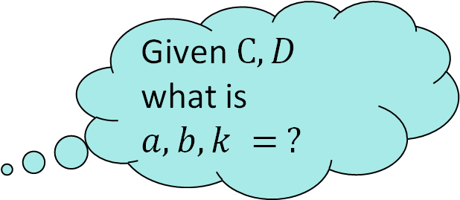



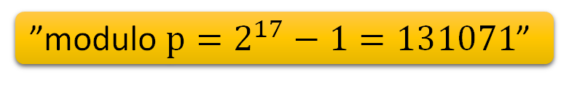

Diffie-Hellman Key Exchange
[Diffie Hellman 76]
”modulo $p=2^{17}−1=131071$”
Alice
$${C=3}^{a}=278$$
$$a←\{0,1, …, 131070\}$$
Bob
$${D=3}^{b}=23115$$
$$b←\{0,1, …,131070\}$$
Given $C, D$ what is $a,b, k = ?$
$${k=D}^{a}={23115}^{a}=3^{ba}$$
$${k=C}^{b}={278}^{b}=3^{ab}$$
Eve
Easy: given $3$ and $x$, compute $3^{x}$
Hard: given $3^{a}$, compute $a$
Notes:
https://www.wolframalpha.com/input?i2d=true&i=MultiplicativeOrder%5C%2891%293%5C%2844%29Power%5B2%2C17%5D-1%5C%2844%29+23115%5C%2893%29
MultiplicativeOrder[3,Power[2,17]-1, 278] = 38248 = a
MultiplicativeOrder[3,Power[2,17]-1, 23115] = 74250 = b
https://www.wolframalpha.com/input?i=23115%5E38248+mod+2%5E17-1
https://www.wolframalpha.com/input?i=278%5E74250+mod+2%5E17-1
k=67219

Slide 15
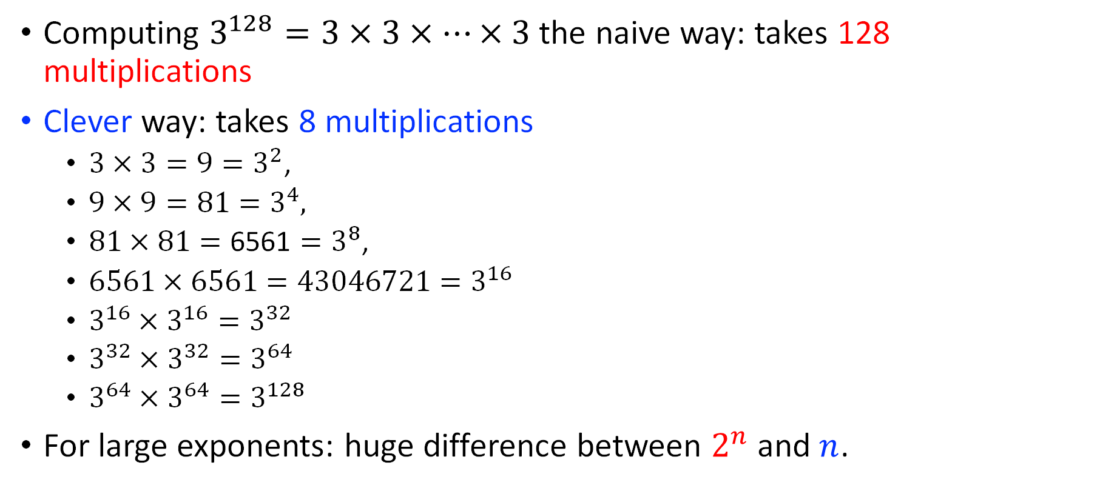
Polynomial vs exponential time
Computing $3^{128}=3×3×⋯×3$ the naive way: takes 128 multiplications
Clever way: takes 8 multiplications
  $3×3=9=3^{2}$,
  $9×9=81=3^{4},$
  $81×81=\text{6561}=3^{8}$,
  $6561×6561=43046721=3^{16}$
  $3^{16}×3^{16}=3^{32}$
  $3^{32}×3^{32}=3^{64}$
  $3^{64}×3^{64}=3^{128}$
For large exponents: huge difference between $2^{n}$and $n$.

Slide 16
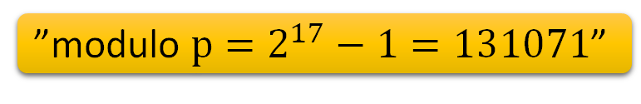
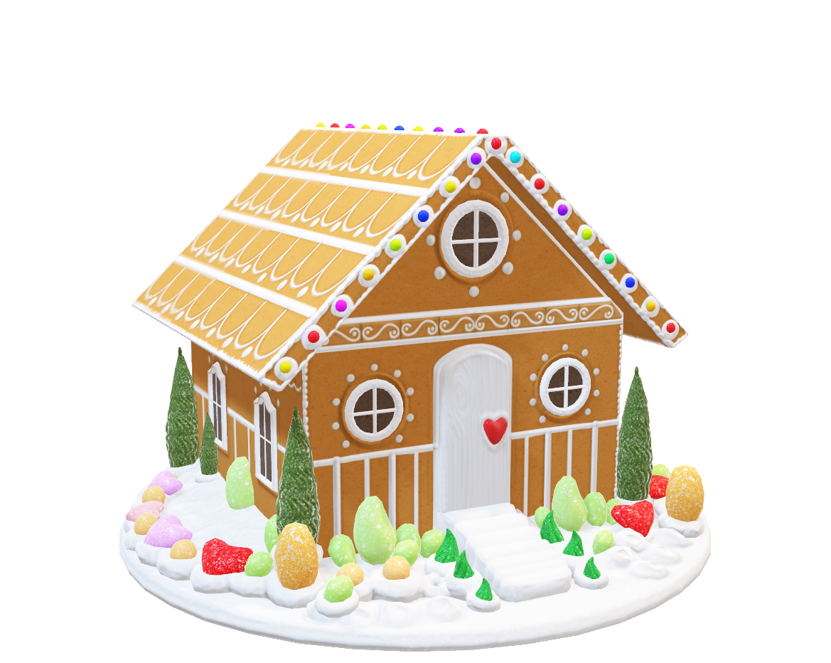
Diffie-Hellman Key Exchange
[Diffie Hellman 76]
”modulo $p=2^{17}−1=131071$”
Alice
$${C=3}^{a}=278$$
$$a←\{0,1, …, 131070\}$$
Bob
Theoretical Computer Science (TCS)
Complexity Theory
Information Theory
Discrete Mathematics
…
$${D=3}^{b}=23115$$
$$b←\{0,1, …,131070\}$$
Given $C, D$ what is $a,b, k = ?$
$${k=D}^{a}={23115}^{a}=3^{ba}$$
$${k=C}^{b}={278}^{b}=3^{ab}$$
Eve
Easy: given $3$ and $x$, compute $3^{x}$
Hard: given $3^{a}$, compute $a$
Notes:
https://www.wolframalpha.com/input?i2d=true&i=MultiplicativeOrder%5C%2891%293%5C%2844%29Power%5B2%2C17%5D-1%5C%2844%29+23115%5C%2893%29
MultiplicativeOrder[3,Power[2,17]-1, 278] = 38248 = a
MultiplicativeOrder[3,Power[2,17]-1, 23115] = 74250 = b
https://www.wolframalpha.com/input?i=23115%5E38248+mod+2%5E17-1
https://www.wolframalpha.com/input?i=278%5E74250+mod+2%5E17-1
k=67219

Slide 17


Notes:
https://quantumfrontiers.com/2013/08/22/the-most-awesome-animation-about-quantum-computers-you-will-ever-see/

Slide 18

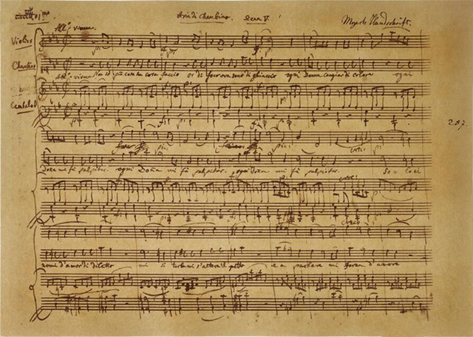
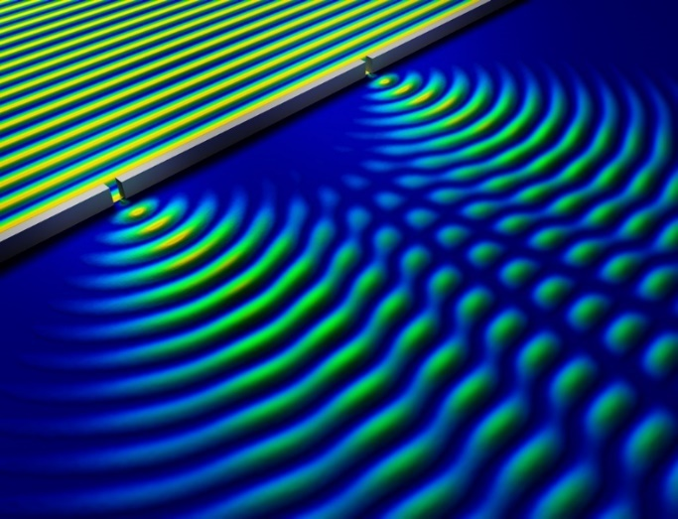

Notes:
https://phys.org/news/2014-05-nondestructive-method-quantum.html
Bron

Slide 19
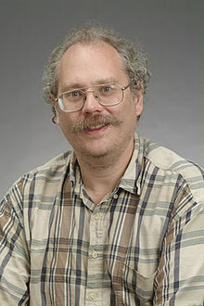
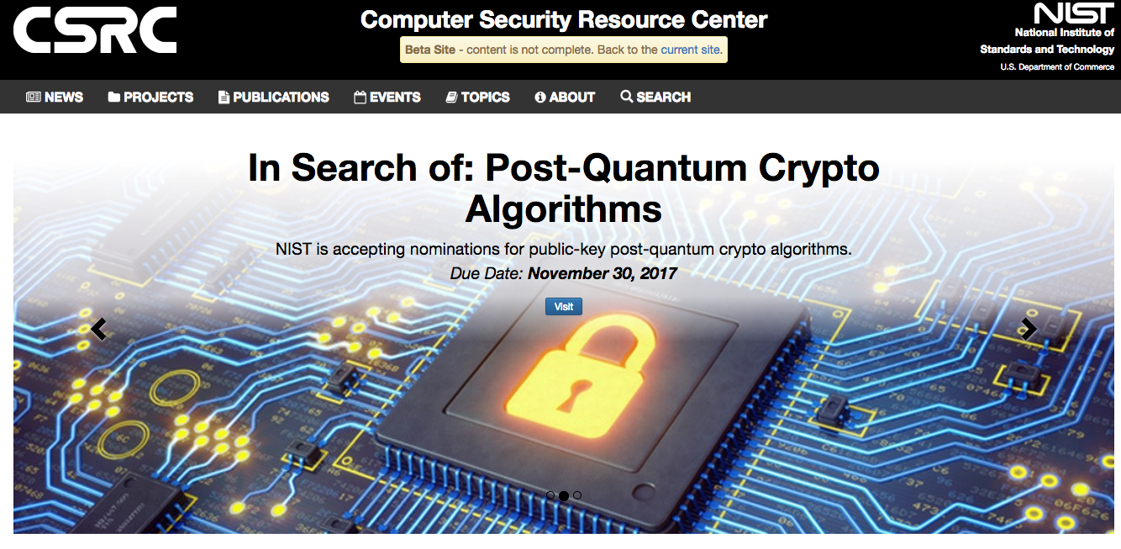
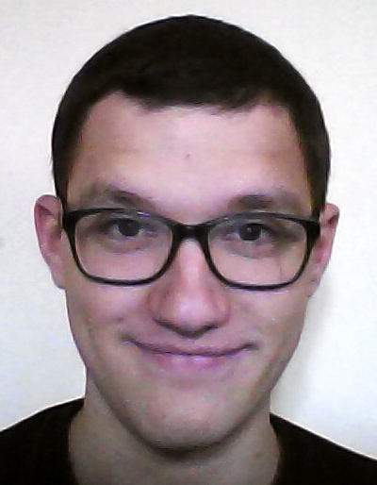
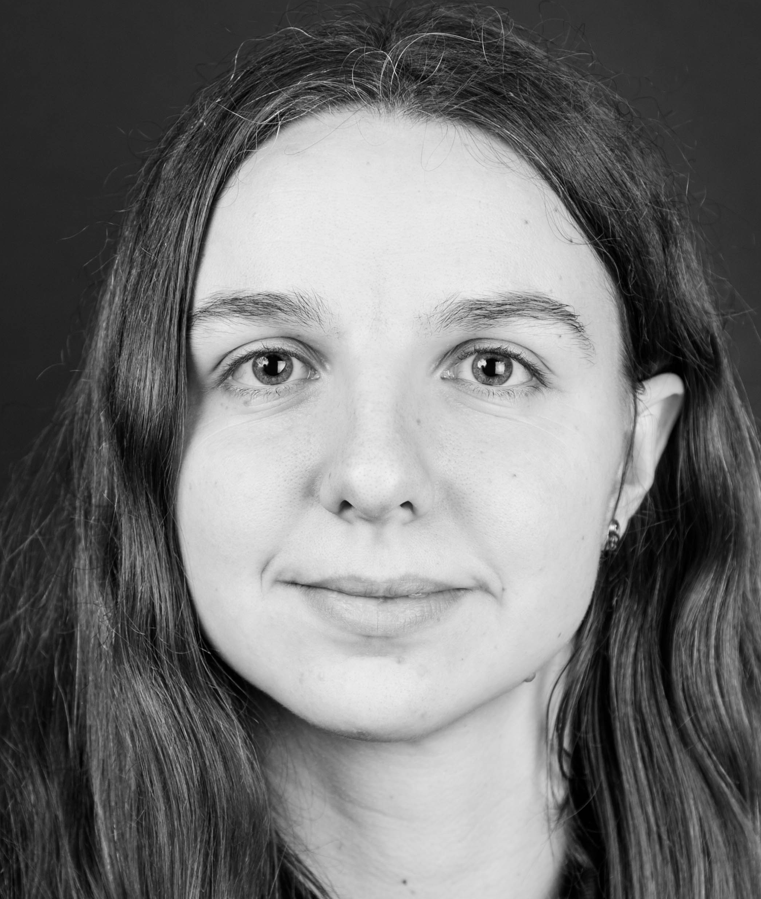
Quantum Computer breaks Public-Key Crypto
Polynomial-time quantum algorithm for factoring integer numbers & taking discrete logarithms
[Diffie Hellman 76]
[Shor 94]
  Consequence: Large enough quantum computers break all currently used public-key cryptosystems!!!
Jan Czajkowski
Jana Sotáková
Notes:
Definition of the Quantum Random-Oracle Model (QROM)
[Boneh Dagdalen Fischlin Lehmann Schaffner Zhandry 10]
Post-quantum security notions for encryption [Gagliardoni Hülsing Schaffner 16]
[PhD Czajkowski 21]: indifferentiability of sponges
Post-quantum security of Fiat-Shamir signatures
[Don Fehr Majenz Schaffner 19,20,21]
[PhD Sotáková 23]: isogeny-based cryptography

Slide 20
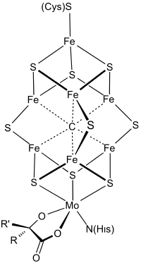
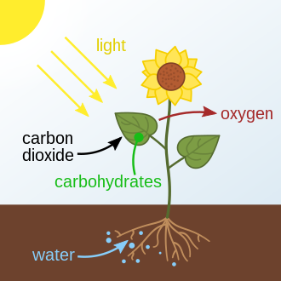
Positive Impact of Quantum Computing

Slide 21

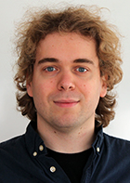
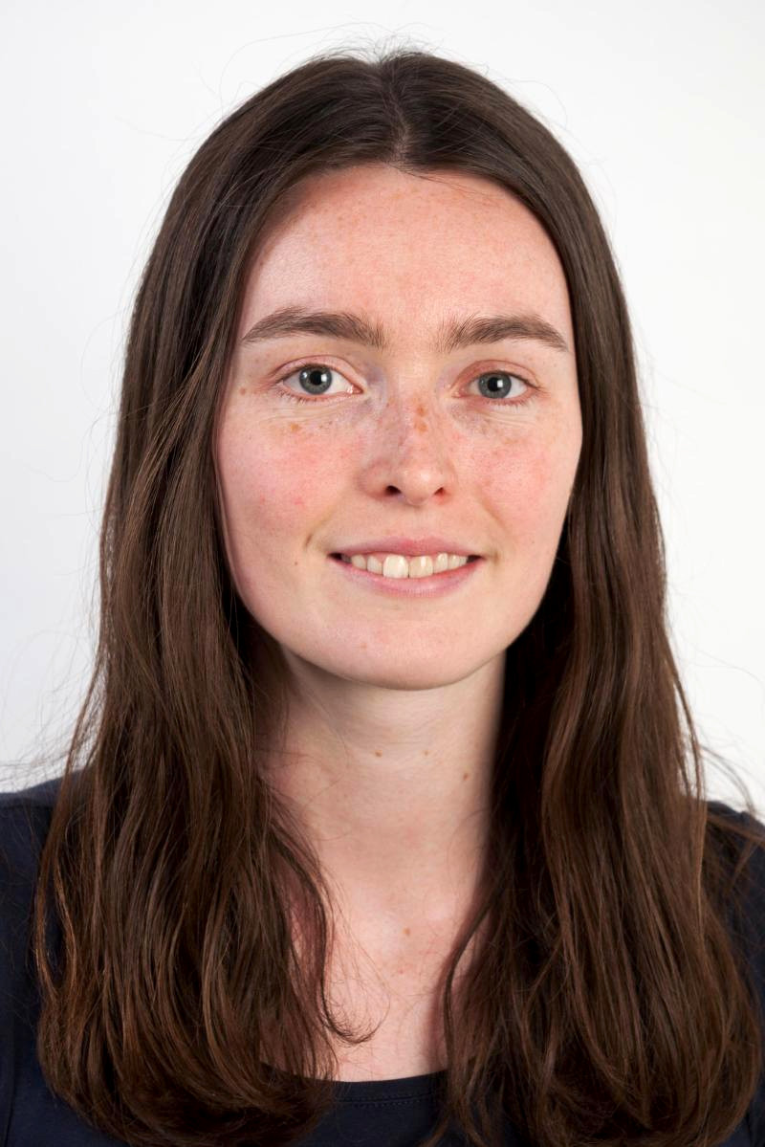
Quantum Technology & Quantum Networks
Run quantum cryptography
Distributed quantum computing
secure delegated quantum computation
Florian Speelman
Yfke Dulek

Slide 22

Theoretical Computer Science
Complexity Theory
Information Theory
Discrete Mathematics
Quantum Computing
…
cryptography

Slide 23
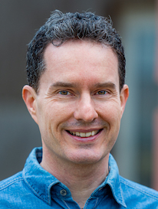
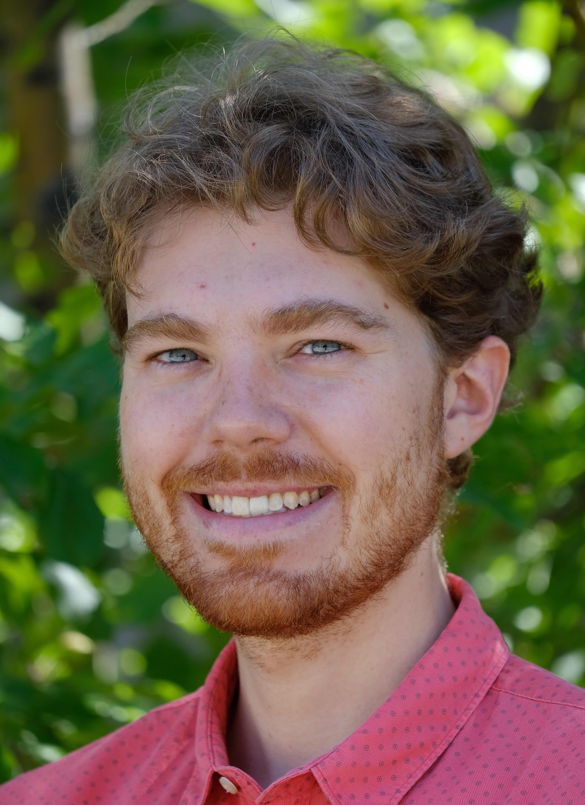
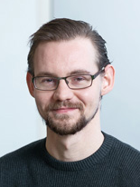
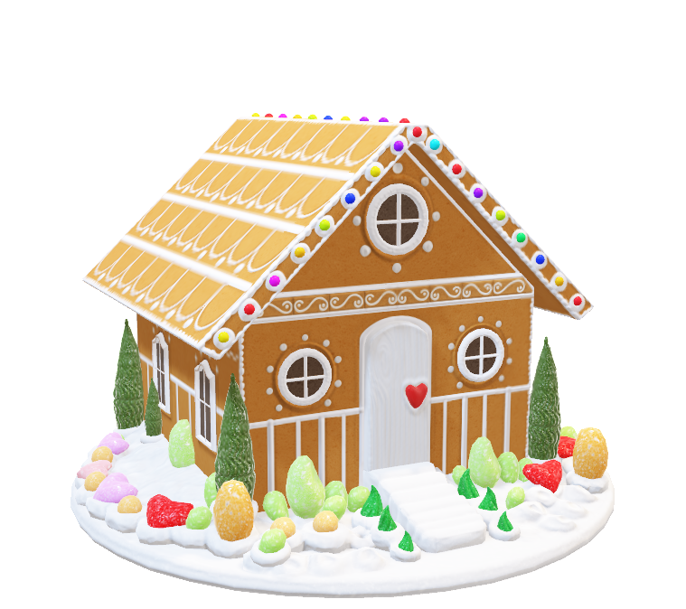
Research Vision of IvI TCS Group
TCS
Complexity Theory
Information Theory
Discrete Mathematics
Quantum Computing
…
Nicolas Resch
John van de Wetering

Slide 24
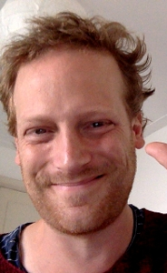

Education Vision of IvI TCS Group
TCS
Complexity Theory
Information Theory
Discrete Mathematics
Quantum Computing
…
Nicolas Resch
John van de Wetering
Steven de Rooij
New MSc in “Quantum Computer Science”

Slide 25


Knowledge Transfer Vision
TCS
Complexity Theory
Information Theory
Discrete Mathematics
Quantum Computing
…

Slide 26
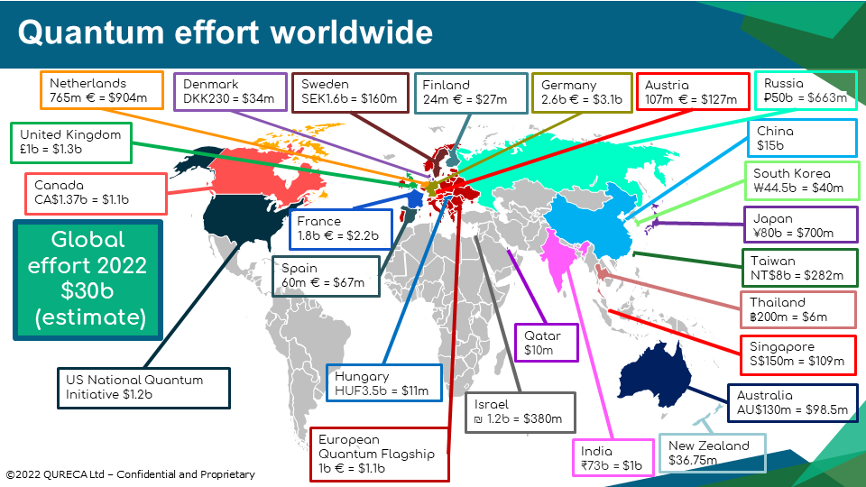
Notes:
https://qureca.com/overview-on-quantum-initiatives-worldwide-update-2022/

Slide 27

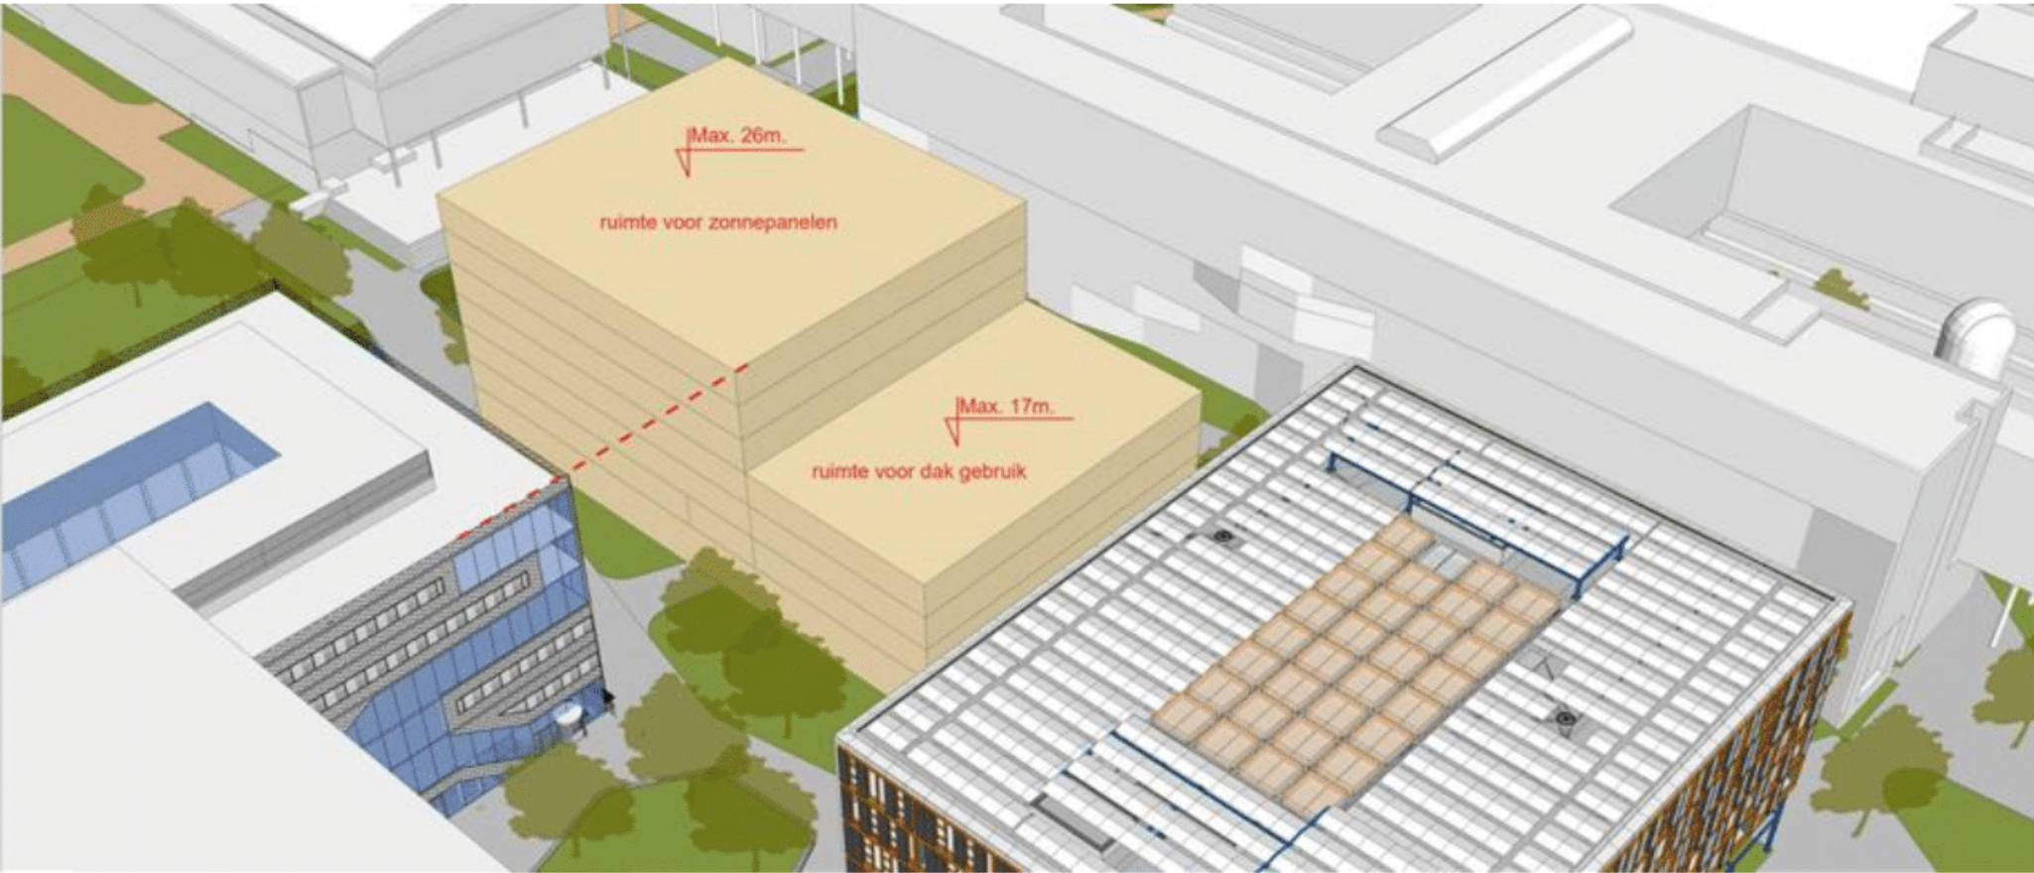



The Future is Quantum (or not)

Slide 28













Notes:
https://clipart.world/road-clipart/winding-road-clipart-transparent-2/

Slide 29

Acknowledgements

