Slide 1
The Quantum-Random-Oracle Model
Christian Schaffner
Research Center for Quantum Software & Technology Amsterdam
Theory of Computer Science (TCS) group
Informatics Institute of University of Amsterdam
Quantum Computing meets Cyber Security
Friday, 12 May 2023, Munich Quantum Valley

Slide 2
What will you Learn from this Talk?
Take-Home Message: Securing cryptography against quantum attackers requires more than switching mathematical assumptions.
Classical Random-Oracle Model
Quantum Access
Techniques

Slide 3

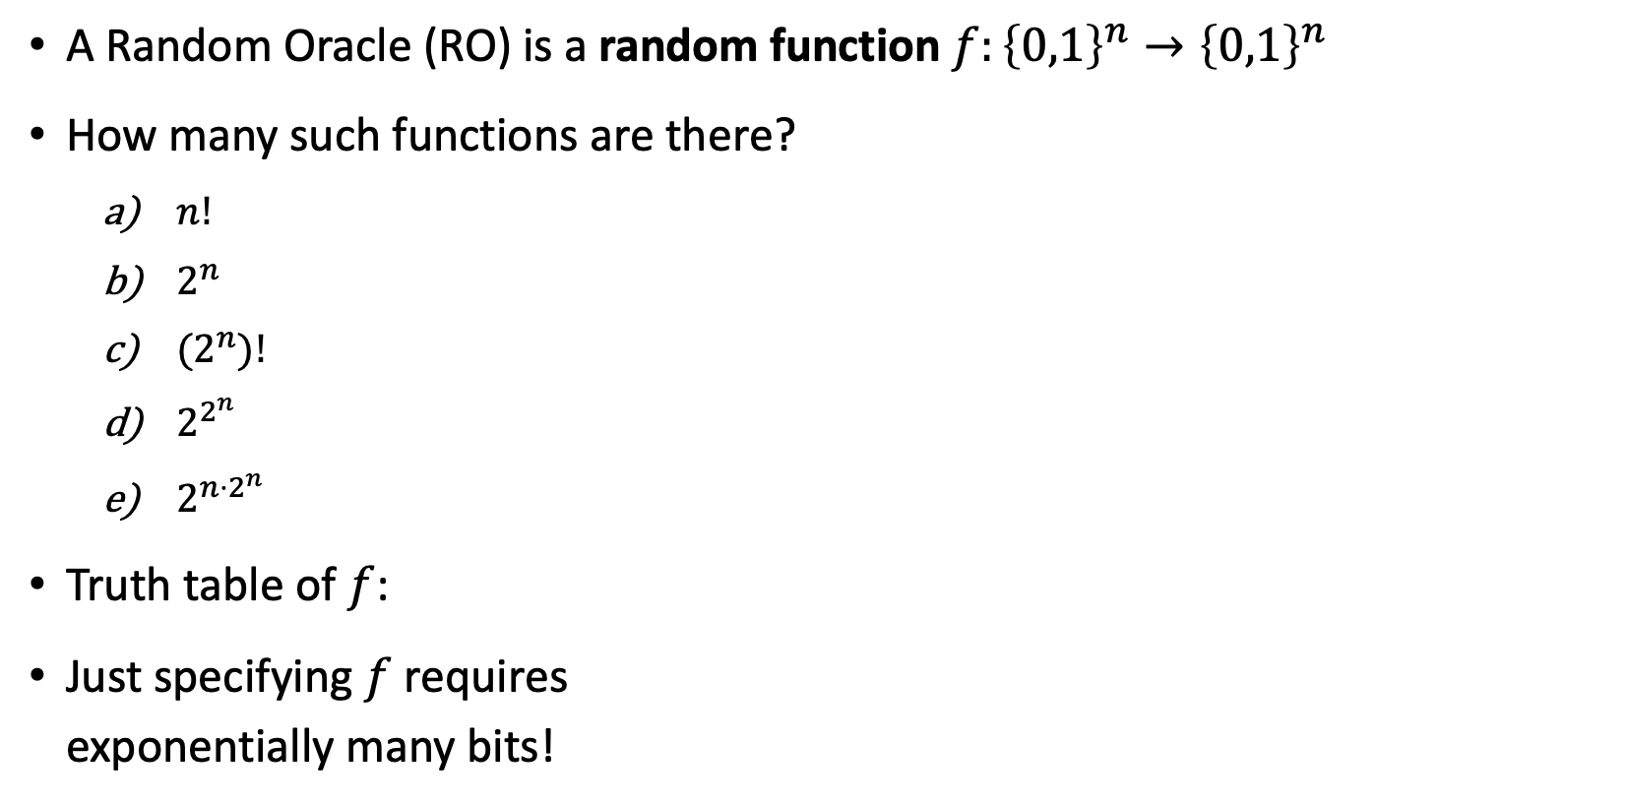

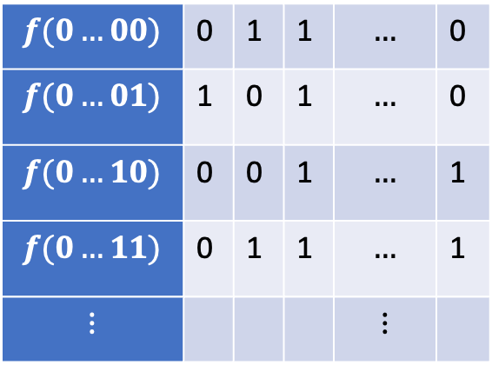
Random Oracle (RO)
A Random Oracle (RO) is a random function $f:{\left\{0,1\right\}}^{n}→{\left\{0,1\right\}}^{n}$
How many such functions are there?
  $n!$
  $2^{n}$
  ${(2}^{n})!$
  $2^{2^{n}}$
  $2^{n⋅2^{n}}$
Truth table of $f$:
Just specifying $f$ requires
exponentially many bits!
$n$ columns
$$f(0…00)$$ | 0 | 1 | 1 | $$…$$ | 0
$$f(0…01)$$ | 1 | 0 | 1 | $$…$$ | 0
$$f(0…10)$$ | 0 | 0 | 1 | $$…$$ | 1
$$f(0…11)$$ | 0 | 1 | 1 | $$…$$ | 1
$$⋮$$ |  |  |  | $$⋮$$
$2^{n}$ rows
Notes:
For n=6, 6*2^6 = 384, already more functions than atoms in the universe

Slide 4


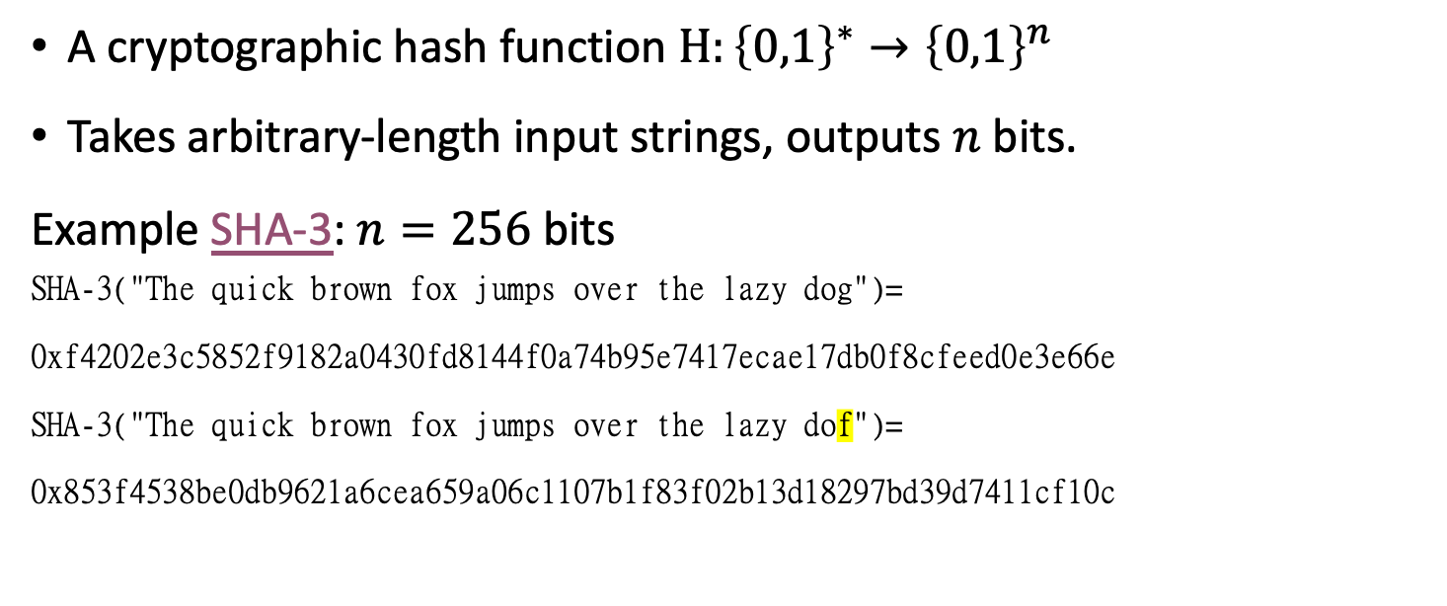
Hash Functions
A cryptographic hash function $H:{\left\{0,1\right\}}^{∗}→{\left\{0,1\right\}}^{n}$
Takes arbitrary-length input strings, outputs $n$ bits.
Example SHA-3: $n=256$bits
SHA-3("The quick brown fox jumps over the lazy dog")=
0xf4202e3c5852f9182a0430fd8144f0a74b95e7417ecae17db0f8cfeed0e3e66e
SHA-3("The quick brown fox jumps over the lazy dof")=
0x853f4538be0db9621a6cea659a06c1107b1f83f02b13d18297bd39d7411cf10c
$$H$$
Hash functions have (infinitely many) collisions, but they should be hard to find
An ideal hash function should behave as random oracle

Slide 5
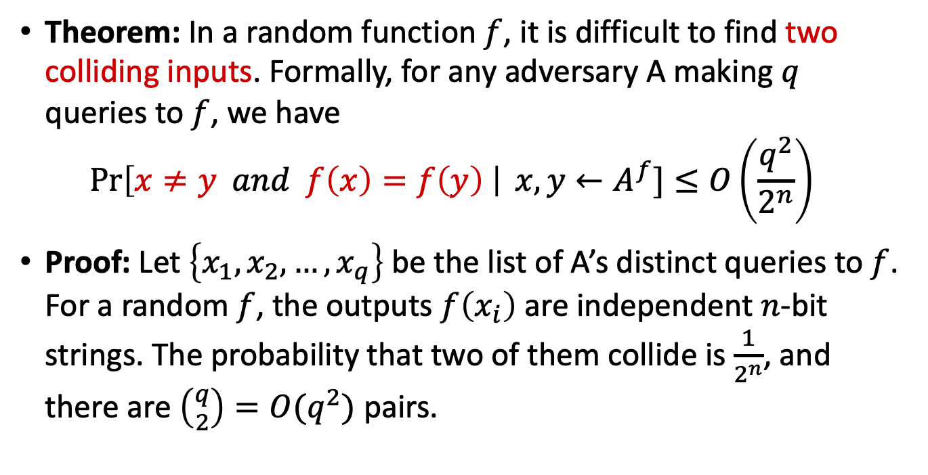

Hash Functions As Random Oracles
Hash functions have (infinitely many) collisions, but they should be hard to find
An ideal hash function should behave as random oracle
Theorem: In a random function $f$, it is difficult to find two colliding inputs. Formally, for any adversary A making $q$ queries to $f$, we have
$\operatorname{Pr}\left[x≠y and f\left(x\right)=f\left(y\right) \right| x,y←A^{f}]≤O\left(\frac{q^{2}}{2^{n}}\right)$
Proof: Let $\left\{x_{1},x_{2}, …, x_{q}\right\}$ be the list of A’s distinct queries to $f$. For a random $f$, the outputs $f\left(x_{i}\right)$ are independent $n$-bit strings. The probability that two of them collide is $\frac{1}{2^{n}}$, and there are $\left({q \atop 2}\right)=O(q^{2})$ pairs.
$$H$$
Notes:
(infinitely) many collisions exist in hash functions, but they are hard to find

Slide 6




Digital Signatures
Alice
Bob
public key
Eve
secret key
Only secret-key holder can sign, but everyone can verify signatures using the public-key.

Slide 7
Digital Signatures
Alice
Bob
public key
Eve
secret key
Only secret-key holder can sign, but everyone can verify signatures using the public-key.
Very widely used:
Problems: expensive,
insecure against quantum attacks
[Bart Preneel @QCrypt 2014]
Notes:
Post-quantum crypto tries to solve the second problem by making it even more expensive!

Slide 8
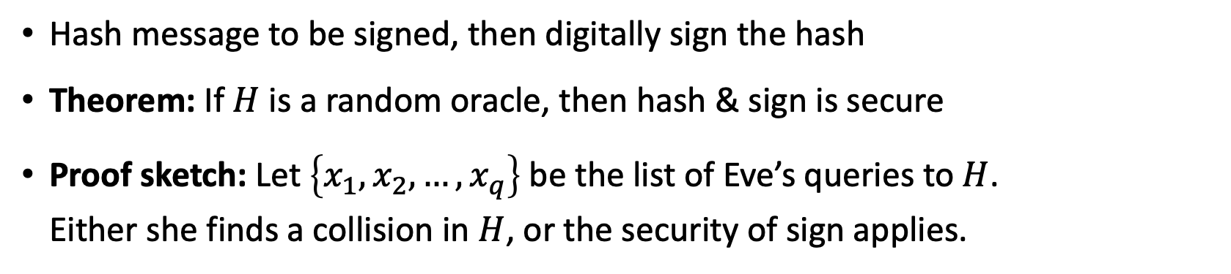

Hash & Sign
$$H$$
Alice
Bob
public key
Eve
secret key
Hash message to be signed, then digitally sign the hash
Theorem: If $H$ is a random oracle, then hash & sign is secure
Proof sketch: Let $\left\{x_{1},x_{2}, …, x_{q}\right\}$ be the list of Eve’s queries to $H$.
Either she finds a collision in $H$, or the security of sign applies.
Notes:
Post-quantum crypto tries to solve the second problem by making it even more expensive!

Slide 9

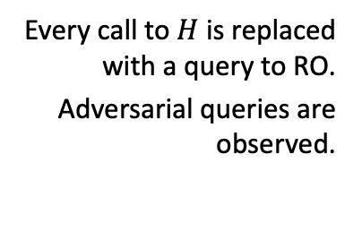


Random-Oracle Model (ROM)
Heuristic to model hash functions in cryptographic proofs
“knows $H$”
protocol
$$H$$
Informal description:
$$H:{\left\{0,1\right\}}^{∗}→{\left\{0,1\right\}}^{n}$$
protocol
Every call to $H$ is replaced with a query to RO.
Adversarial queries are observed.
Formal random-oracle model:
[Bellare Rogaway 93, slide by Dziembowski]
Notes:
Having an oracle is convenient, so that players do not need to be given access to an exponentially large random object
As long as adversary has not queried a particular input x, H(x) is independent and uniform

Slide 10

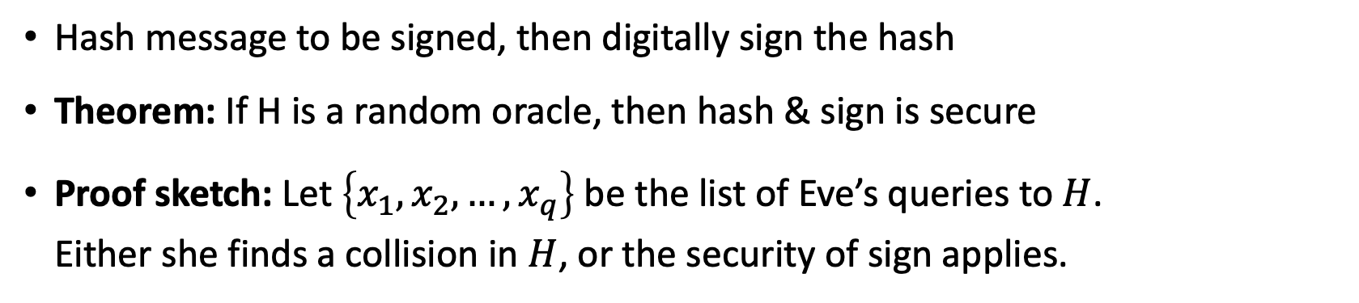
Hash & Sign in the Random Oracle Model
$$H$$
Alice
Bob
public key
Eve
secret key
Hash message to be signed, then digitally sign the hash
Theorem: If H is a random oracle, then hash & sign is secure
Proof sketch: Let $\left\{x_{1},x_{2}, …, x_{q}\right\}$ be the list of Eve’s queries to $H$.
Either she finds a collision in $H$, or the security of sign applies.
$$H:{\left\{0,1\right\}}^{∗}→{\left\{0,1\right\}}^{n}$$
Notes:
Post-quantum crypto tries to solve the second problem by making it even more expensive!

Slide 11



Criticism of the Random-Oracle Model (ROM)
There exists a digital signature scheme that is
secure in the ROM, but
not secure if RO is instantiated with any real hash function.
Very “artificial” example, no ”realistic” examples known
Common view: ROM proof is better than no proof
[Canetti Goldreich Halevi 98, slide by Dziembowski]
[Matthew Green: https://blog.cryptographyengineering.com/2011/11/02/what-is-random-oracle-model-and-why/ ]

Slide 12



Classical Random-Oracle Model in Practice
Digital Signatures: Fiat-Shamir Heuristic used by
CRYSTALS-Dilithium, FALCON
Public-Key Encryption: KEMs are often built using the Fujisaki-Okamoto transform
like in CRYSTALS-Kyber
Indifferentiability proofs
many more use cases
Notes:
Post-quantum crypto tries to solve the second problem by making it even more expensive!

Slide 13
What will you Learn from this Talk?
Take-Home Message: Securing cryptography against quantum attackers requires more than switching mathematical assumptions.
Classical Random-Oracle Model
Quantum Access
Techniques

Slide 14


Quantum-Random-Oracle Model (QROM)
Post-quantum cryptography or quantum-safe cryptography studies quantum attackers on classical crypto.
Attacker can look up description of hash function on Wikipedia, then run it in superposition on her quantum computer
We need to allow attacker quantum (superposition) access to the random oracle
“knows $H$”
$$H:{\left\{0,1\right\}}^{∗}→{\left\{0,1\right\}}^{n}$$
[Boneh Dagdelen Fischlin Lehmann Schaffner Zhandry 11]

Slide 15

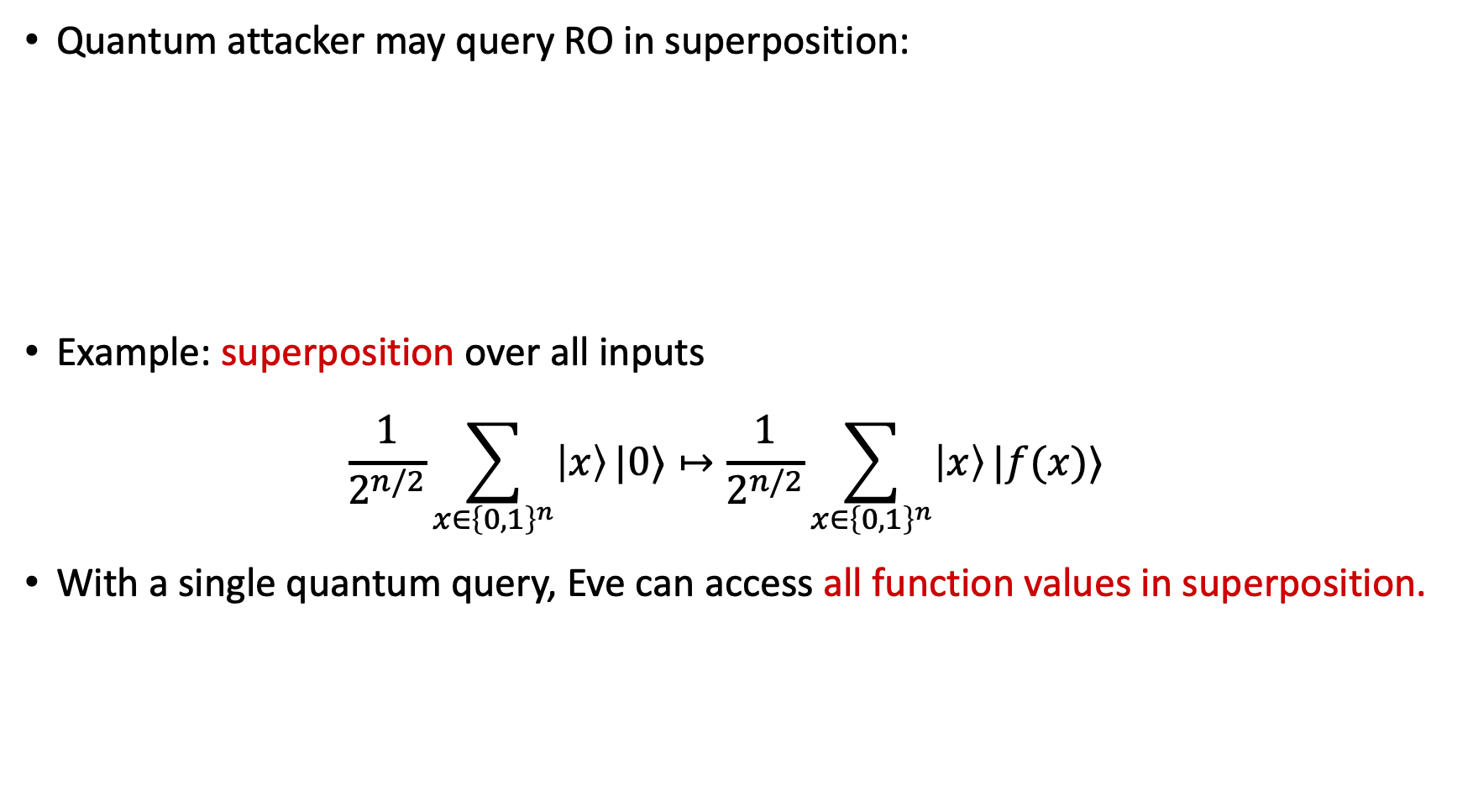





Quantum Superposition Access
Quantum attacker may query RO in superposition:
Example: superposition over all inputs
$\frac{1}{2^{n/2}}\sum_{x∈{\left\{0,1\right\}}^{n}}{\left|x\right\rangle }|0⟩↦\frac{1}{2^{n/2}}\sum_{x∈{\left\{0,1\right\}}^{n}}{\left|x\right\rangle }|f(x)⟩$
With a single quantum query, Eve can access all function values in superposition.
Standard oracle: ${\left|x\right\rangle }_{X}{\left|y\right\rangle }_{Y}↦{\left|x\right\rangle }_{X}{\left|y⊕f\left(x\right)\right\rangle }_{Y}$
$$H:{\left\{0,1\right\}}^{∗}→{\left\{0,1\right\}}^{n}$$
$$|x⟩$$
$$|x⟩$$
$$O_{f}$$
$$|y⟩$$
$$|y⊕f(x)⟩$$

Slide 16
Trouble in the QROM
Many classical ROM proofs break down in the QROM
Efficient simulation: how to emulate a ROM towards an adversary
Adaptive programmability: depending on the adversary’s queries,
plant a challenge in the answer
Extractability: Simulator learns pre-images of adversary’s queries
Rewinding: replaying some hash values but changing some outputs
$$H:{\left\{0,1\right\}}^{∗}→{\left\{0,1\right\}}^{n}$$
protocol
[Boneh Dagdelen Fischlin Lehmann Schaffner Zhandry 11]

Slide 17
What will you Learn from this Talk?
Take-Home Message: Securing cryptography against quantum attackers requires more than switching mathematical assumptions.
Classical Random-Oracle Model
Quantum Access
Techniques

Slide 18



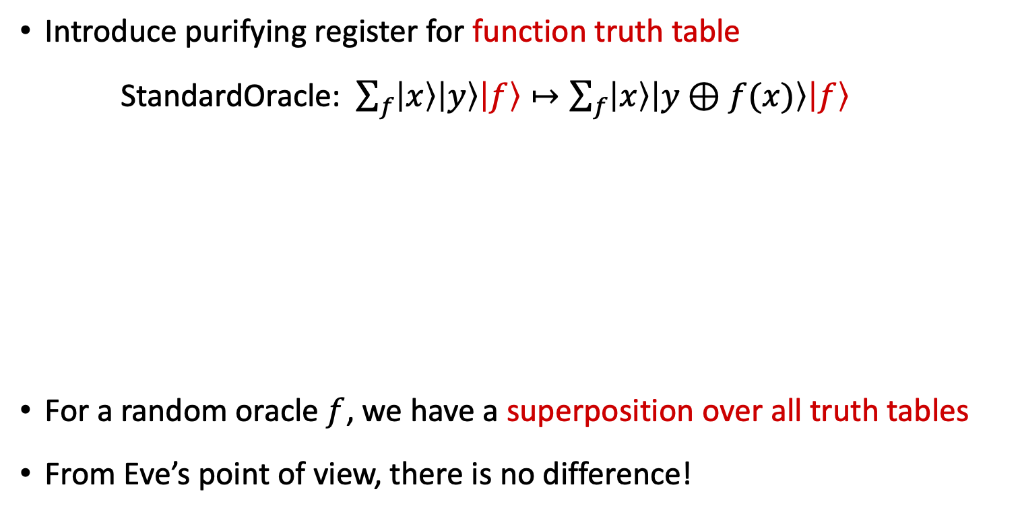














Crucial Insight I: Purification
Introduce purifying register for function truth table
StandardOracle: $\sum_{f}{\left|x\right\rangle \left|y\right\rangle \left|f\right\rangle }↦\sum_{f}{\left|x\right\rangle \left|y⊕f(x)\right\rangle \left|f\right\rangle }$
For a random oracle $f$, we have a superposition over all truth tables
From Eve’s point of view, there is no difference!
$$O_{f}$$
$$|x⟩$$
$$|x⟩$$
$$|x⟩$$
$$x=0$$
$$x=1$$
$$|x⟩$$
$$|y⟩$$
$$O_{f}$$
$$|y⊕f(x)⟩$$
$$|y⟩$$
$$|y⊕f(x)⟩$$
$$|f⟩$$
$$|f⟩$$
$$|f(0)⟩$$
$$|f(0)⟩$$
$$|f(1)⟩$$
$$|f(1)⟩$$
[Mark Zhandry 2018: How to Record Quantum Queries]

Slide 19




























Crucial Insight II: Change of Viewpoint
Standard Oracle
Fourier Oracle
$$x=0$$
$$x=1$$
$$|x⟩$$
$$x=0$$
$$x=1$$
$$|x⟩$$
$$|x⟩$$
$$x=0$$
$$x=1$$
$$|x⟩$$
$$|x⟩$$
$$|y⟩$$
$$H$$
$$H$$
$$H$$
$$H$$
$$|y⊕f(x)⟩$$
$$|η⟩$$
$$|η⟩$$
$$|η⟩$$
$$|f(0)⟩$$
$$H$$
$$H$$
$$|f(0)⟩$$
$$|0⟩$$
$$|η⟩$$
$$|0⟩$$
$$|f(1)⟩$$
$$H$$
$$H$$
$$|f(1)⟩$$
$$|0⟩$$
$$|0⟩$$
$$|η⟩$$
By making a query, Eve entangles herself with the truth table in a very clean way, when observed in the Fourier basis!
[Mark Zhandry 2018: How to Record Quantum Queries]

Slide 20
QROM Techniques & Results
Intuition: The quantum queries are recorded in the database, an adversary can only learn about the function what is recorded there.
Using newer tools, such reasoning can be made almost classical.
As consequence, most classical ROM results can be recovered in the QROM, albeit with some loss in security parameters, making post-quantum cryptography less efficient.
Generic security upgrade from ROM to QROM is impossible.
[Mark Zhandry 2018: How to Record Quantum Queries, Chung, Fehr, Huang, Liao 2021,
Yamakawa, Zhandry 2021 & 2022]

Slide 21

Summary
Take-Home Message: Securing cryptography against quantum attackers requires more than switching mathematical assumptions.
Classical Random-Oracle Model
Quantum Access
Techniques
$$H:{\left\{0,1\right\}}^{∗}→{\left\{0,1\right\}}^{n}$$
$$H$$

Slide 22


Thank you for your attention!
Questions

Slide 23
Numerous Applications
Query lower bounds for searching and (multi-)collisions in random functions
Fujisaki-Okamoto transformation (to build public-key encryption)
Fiat-Shamir transform (for digital signatures)
Indifferentiability
4-round Luby-Rackoff/Feistel construction
Succinct arguments
Separations between ROM and QROM
Adaptive reprogramming
…

