Slide 1
SURFsara site report
Onno Zweers, Hepix Barcelona, October 2018

Slide 2
Contents
Introduction
Grid developments
Interesting non-WLCG users
dCache
Compute
RCauth (proxy without certificate)
Other
Non-Grid developments

Slide 3
Introduction
SURFsara is a Dutch supercomputing center.
Founded as SARA in 1971.
Since 2013 part of SURF, hence SURFsara. Since then officially the Dutch national supercomputing center.
Moved to new datacenter in 2016.
NL-T1 with neighbor NIKHEF.
First time at Hepix, yay!

Slide 4
Introduction SURFsara systems & services
Cartesius, Dutch national supercomputer
Lisa compute cluster
Central archive (tape)
Grid
Gina - Grid compute cluster
Grid Services Cluster (FTS, VOMS, UIs)
dCache - Grid storage
Hadoop MapReduce / Spark / Elastic search
Swift object storage
HPC Cloud - OpenNebula with CEPH storage; includes GPUs
SURFdrive - sync & share based on OwnCloud
ResearchDrive – sync & share for research teams
Visualisation services, augmented reality, 3d printing
iRods
EUdat - research data services (b2safe, b2drop)
Data Persistent Identifiers
Data ingest service
…
More info: helpdesk@surfsara.nl

Slide 5
Grid developments
Interesting non-WLCG users

Slide 6
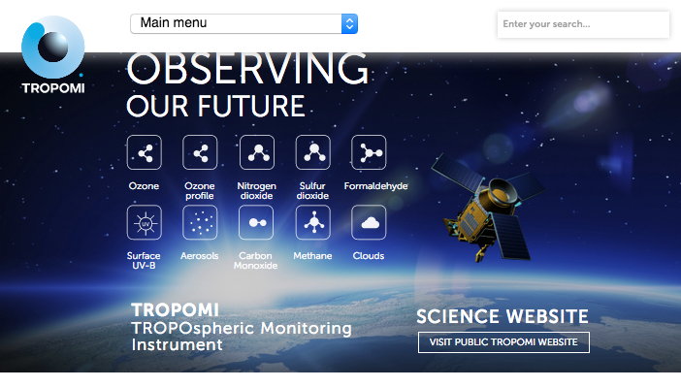
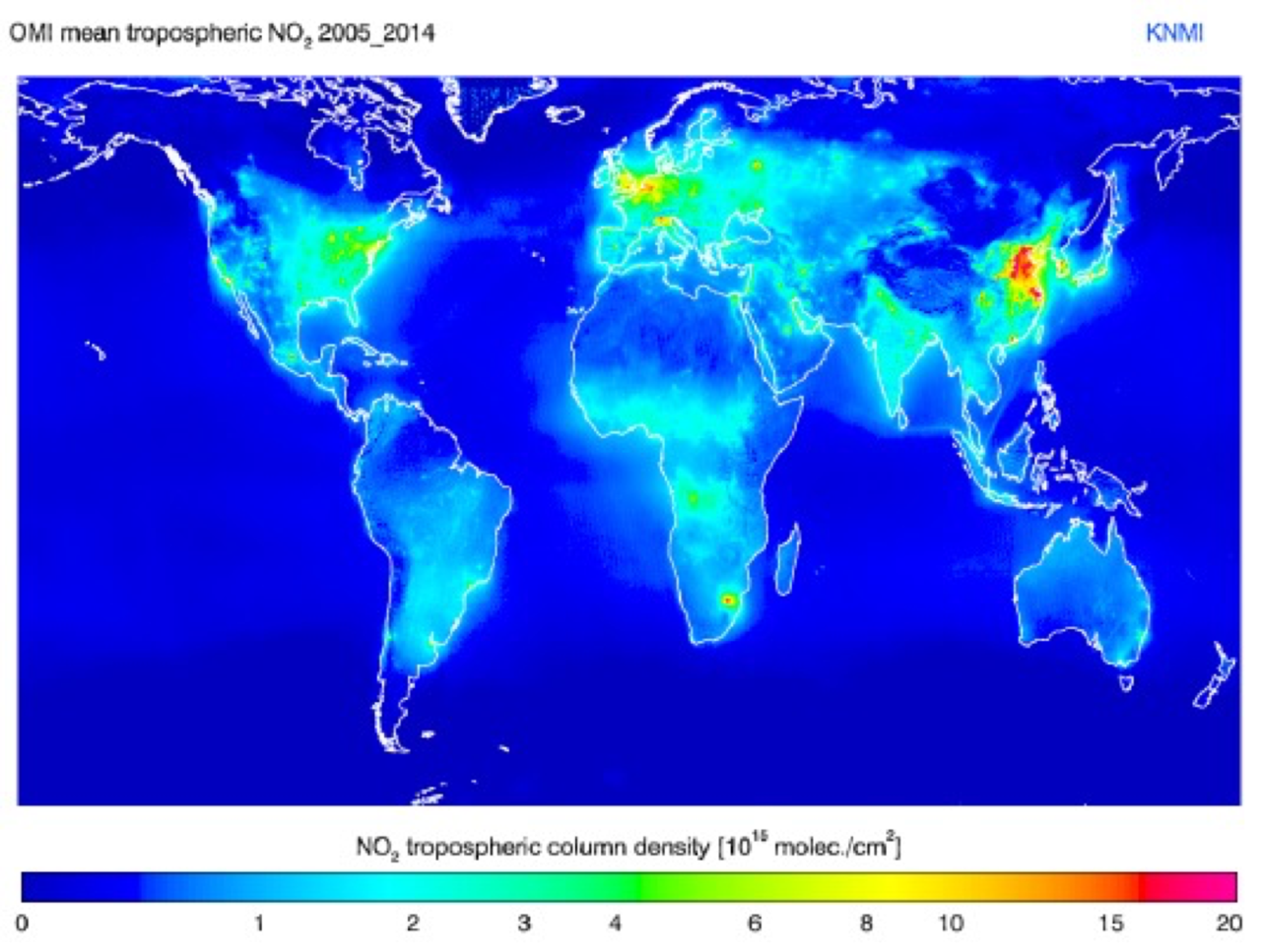
Interesting non-WLCG users Tropomi / Sentinel 5P
Measures air pollution in great detail. Makes it possible to identify polluters: https://www.bbc.com/news/science-environment-44705268

Slide 7
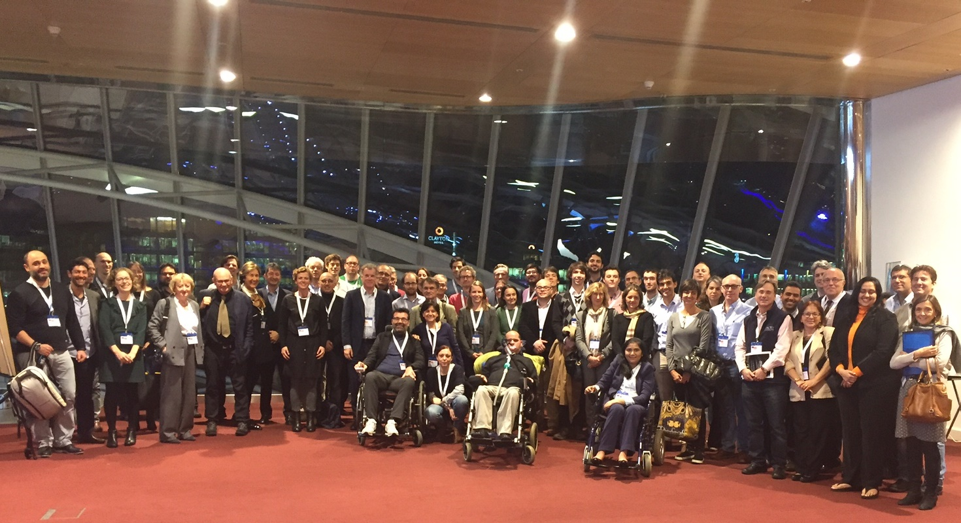
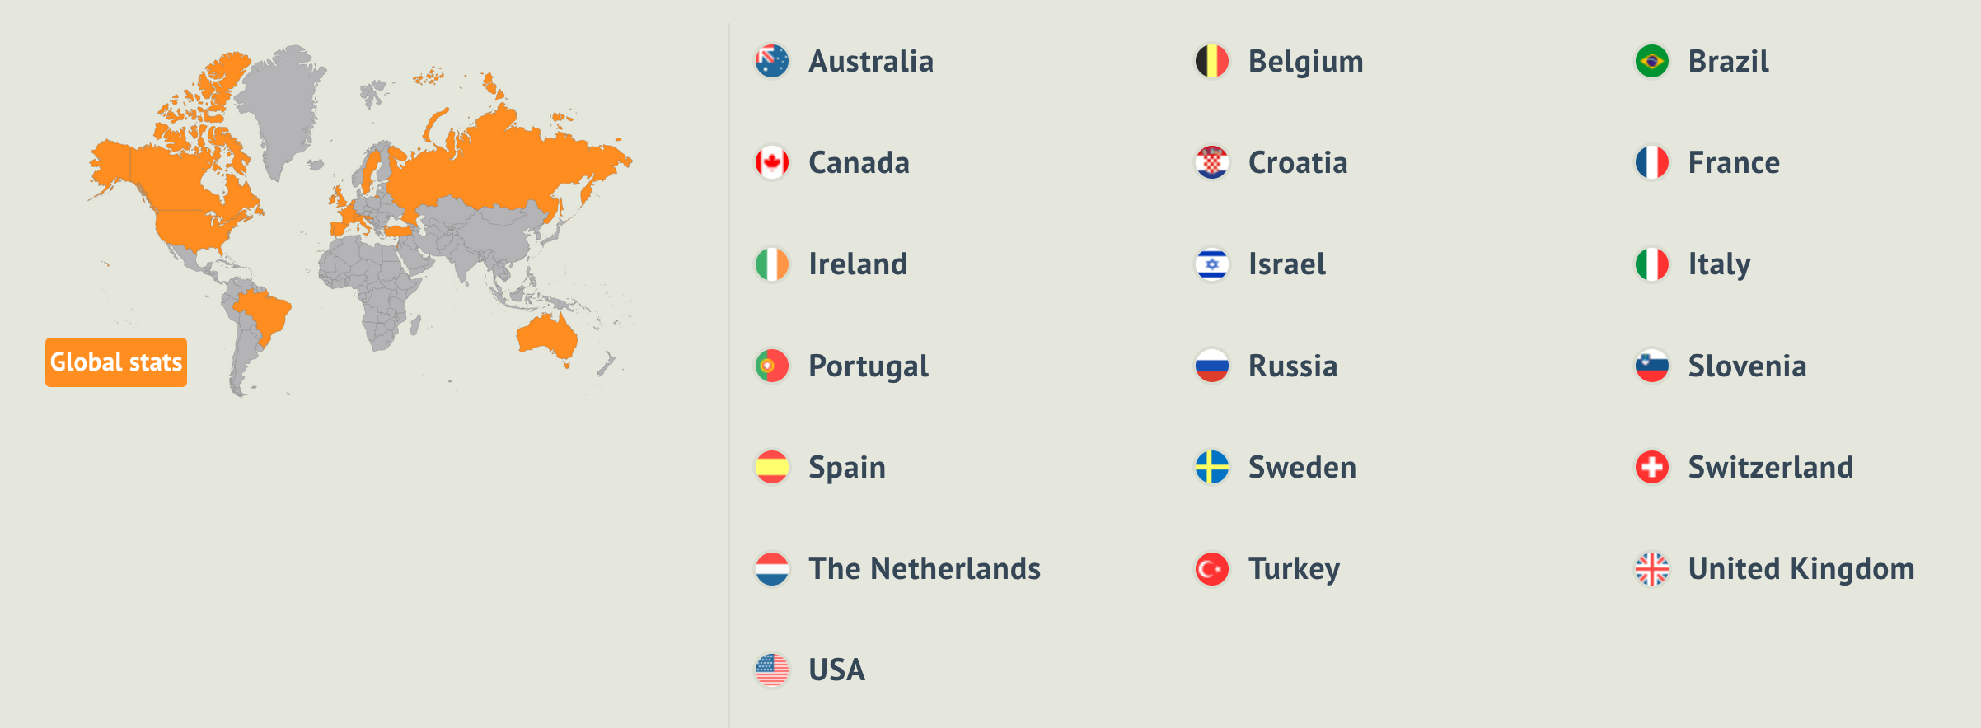
Interesting non-WLCG users Project MinE ALS research
Searching for the genes that cause
ALS (Motor Neuron Disease)

Slide 8
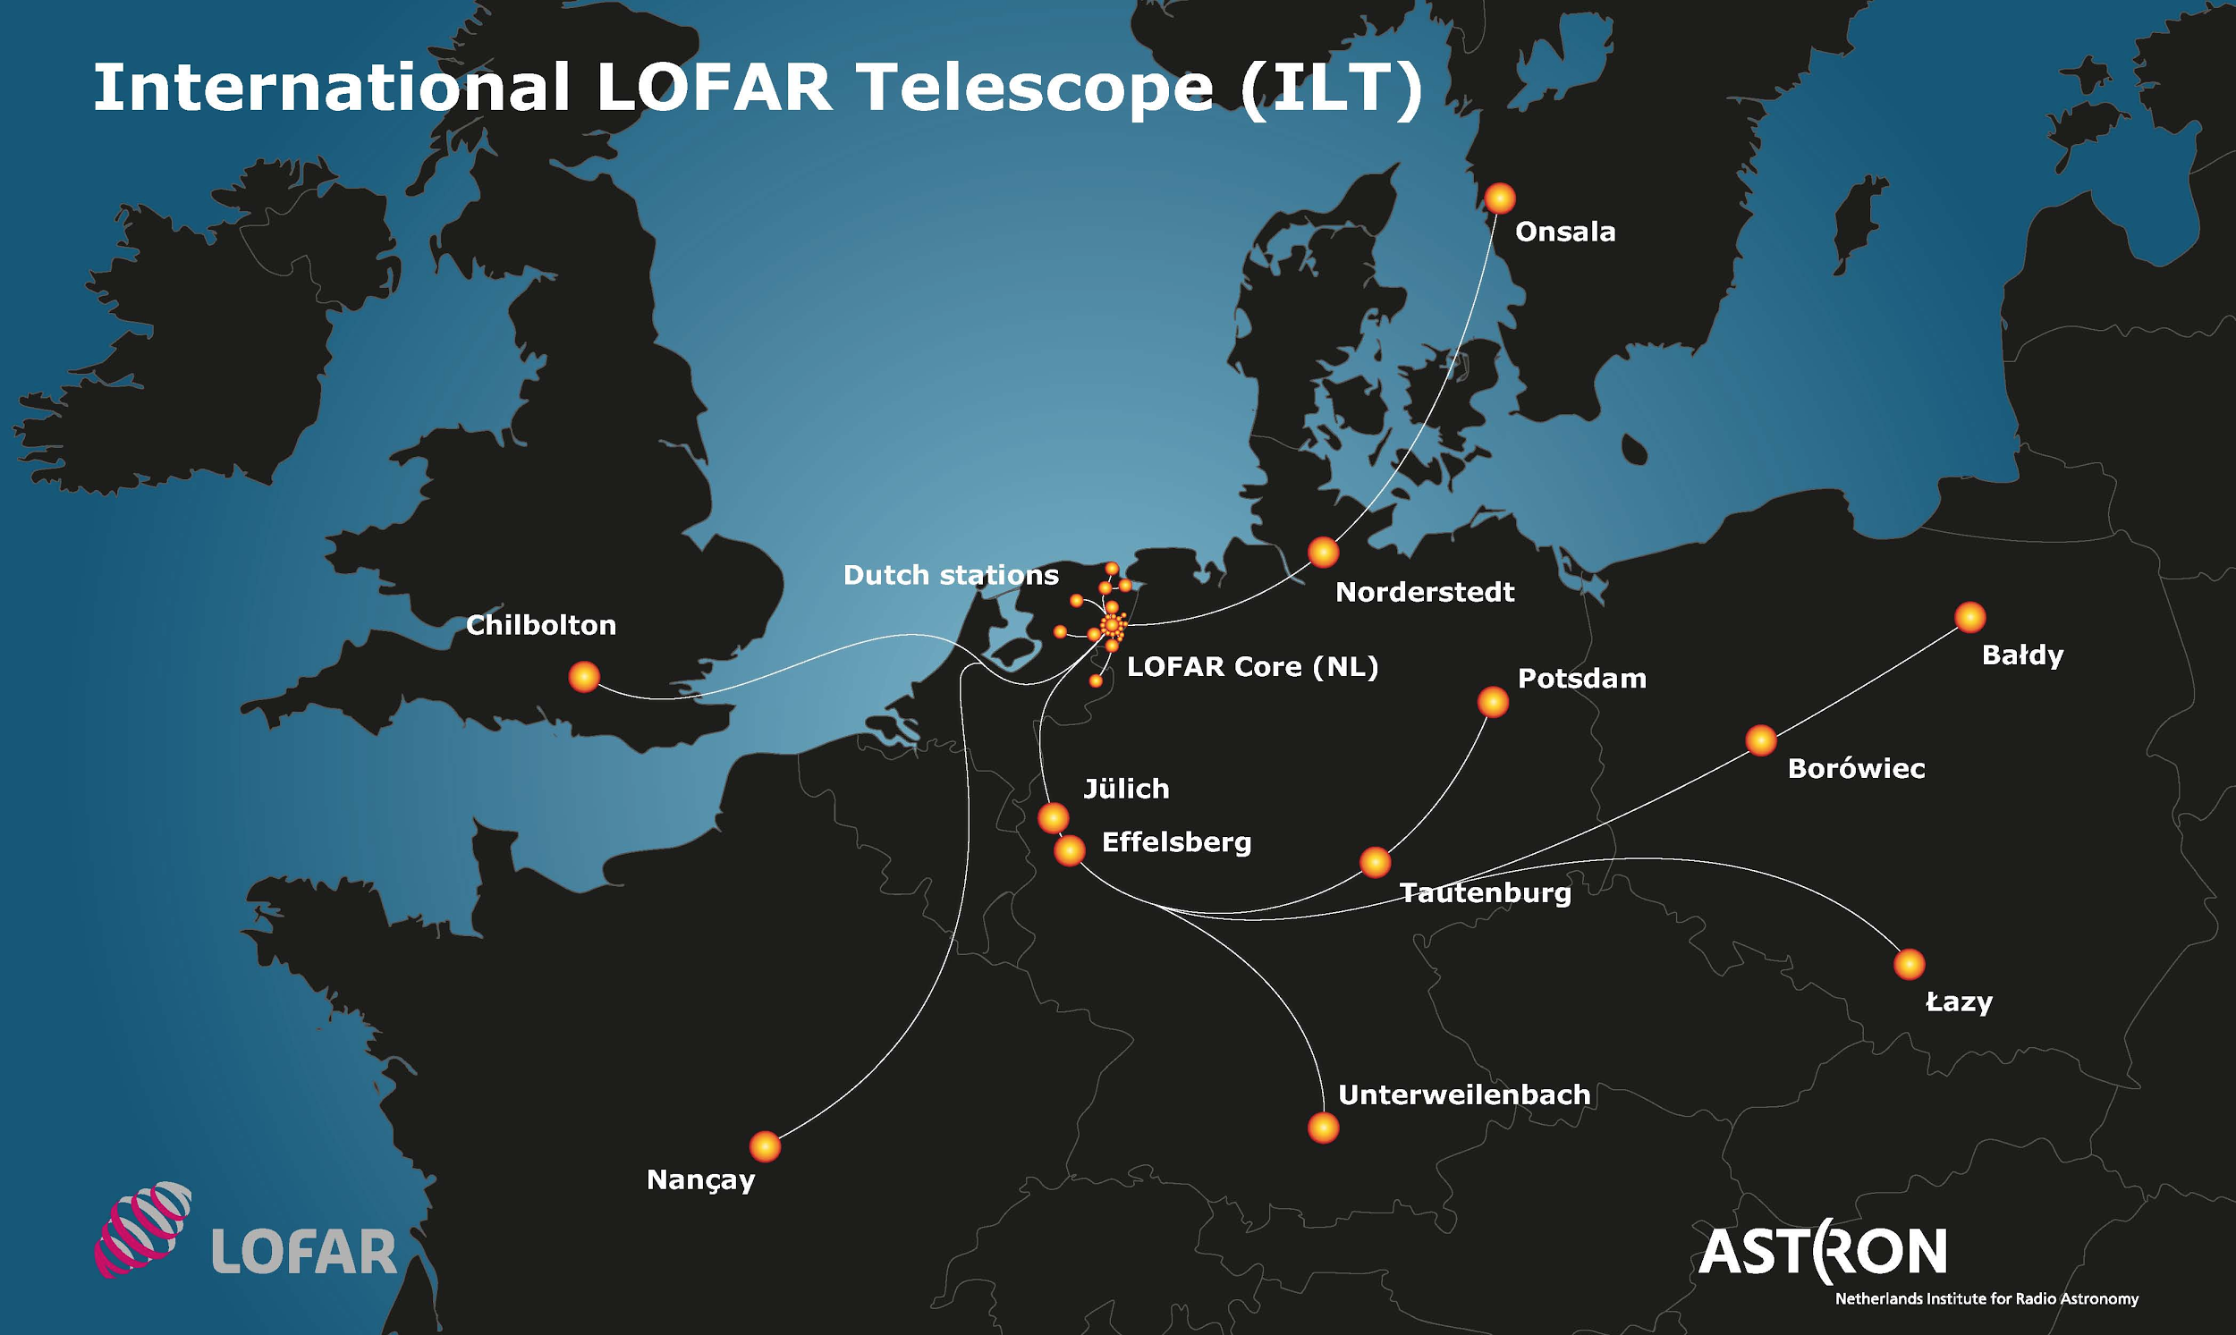
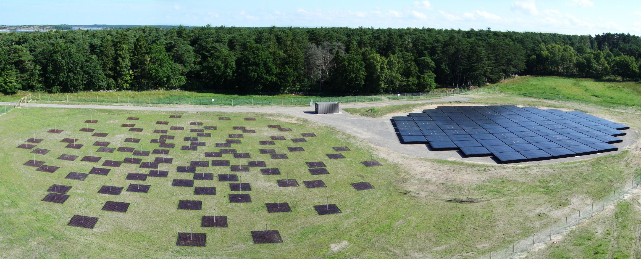
Interesting non-WLCG users LOFAR Low Frequency Array radio telescope
Long Term Archive: 23 petabyte at SURFsara - more than we store for Atlas, LHCb and Alice combined. Part of the data stored at Jülich & Poznan.
Largest astronomy archive in the world.
But looking forward to SKA ☺

Slide 9
Interesting non-WLCG users Other users
SKA https://www.skatelescope.org/
Virgo - gravitational wave detector http://www.virgo-gw.eu/
Xenon - dark matter search http://www.xenon1t.org/
e-Ecolidar https://www.esciencecenter.nl/project/eecolidar
Brugada syndrome research, AMC
Phosphoproteomics research http://oncoproteomics.nl/research/
…

Slide 10
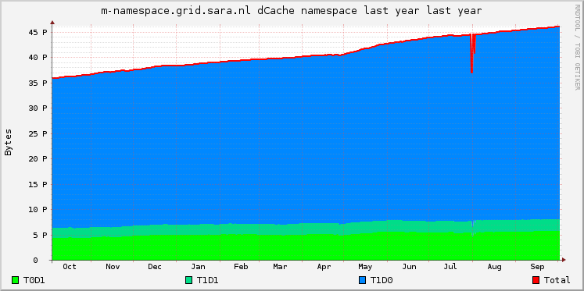
Grid developments Grid storage growth (all projects)

Slide 11
Grid developments Macaroons
Macaroons are bearer tokens that authorize anyone to access (some) data through WebDAV.
Easy sharing.
Invented by Google, adopted by the dCache team (esp. Paul Millar).
https://www.dcache.org/manuals/workshop-2018-05-28-DESY/macaroons.pdf
Several users are testing it.
Works great, but revocation may be challenge.
Next step: SciTokens?

Slide 12
Grid developments WebDAV security
Project MinE (ALS research) collects 22,000 DNA scans.
GDPR law requires this data to be handled carefully.
dCache GridFTP does not encrypt data (not even when you ask nicely with globus-url-copy -dcpriv)
Uploading & downloading through dCache WebDAV, to use TLS protocol.
https://www.dcache.org/manuals/workshop-2018-05-28-DESY/onno.pdf

Slide 13
Grid developments dCache & CEPH
Disk data in dCache is on RAID 60 arrays.
RAID controller failure can be fatal.
dCache now supports CEPH as a disk storage backend.
Just started testing.
https://www.dcache.org/manuals/workshop-2017-05-29-Umea/000-Final/tigran-dcache+ceph.pdf

Slide 14
Grid developments Compute virtualisation
SURFsara’s grid compute cluster (Gina) will be virtualised.
Private cloud platform based on OpenStack.
Enables sharing and shifting hardware resources between several compute & service clusters (including Hadoop & Spark).
A new High Throughput Platform will accommodate some non-HEP users.
Transition should be transparent.

Slide 15
Grid developments RCauth, proxies without certificate
Project MinE comprises 20 countries, and growing.
In each country, procedure for getting grid certificate is different. In some countries it’s impossible.
WebDAV with username/password is good for uploading and downloading data. But compute?
RCauth gives users a grid proxy after authentication in a portal with username/password.
RCauth is a service created by NIKHEF, our NL-T1 partner. Modeled after CIlogon.
https://rcauth.eu/

Slide 16
Grid developments EU datalake
Participating in pilot.
Installed EOS on 3 nodes on top of dCache storage.

Slide 17
Contents (reminder)
Introduction
Grid developments
Interesting non-WLCG users
dCache
Compute
Rcauth (proxy without certificate)
Other
Non-Grid developments

Slide 18
Dutch national supercomputer replacement

Slide 19
Non-Grid developments SURFdrive
Sync & share service like Dropbox
Based on ownCloud & Galera & Scality
Data 100% in the Netherlands
38000 users from 81 institutes, 270m files
First ownCloud site to run into max int bug: https://github.com/owncloud/core/issues/26901#issuecomment-313918061
https://www.surfdrive.nl/en

Slide 20
Non-Grid developments ResearchDrive
Sync & share service for research data
Based on ownCloud & Galera & Swift
Data 100% in the Netherlands
Hugely popular with research teams
https://userinfo.surfsara.nl/systems/researchdrive

Slide 21
Non-Grid developments Swift
Highly scalable object store, 3 replicas & erasure coding (8+4 and 15+4)
28 million objects
255 TB
2 PB raw storage
Useful for scientific tools that speak S3 protocol
https://www.surf.nl/en/services-and-products/object-store/index.html

Slide 22
Non-Grid developments Other activities
Machine learning
Quantum computing
Internet of Things

Slide 23
Thank you!
Onno Zweers
E-mail: onno.zweers@surfsara.nl
E-mail: helpdesk@surfsara.nl
www.surfsara.nl

