Slide 1
SURF national e-infrastructure for research
Jan Bot & Paul van Dijk
Notes:
what surf can do (INTRO) SOS = SURF outline of ICT services
Goal to present which ICT facilities are available and to help you to find your way through the jungle of storage, compute, network and collaboration solutions…
Integraal overzicht

Slide 2
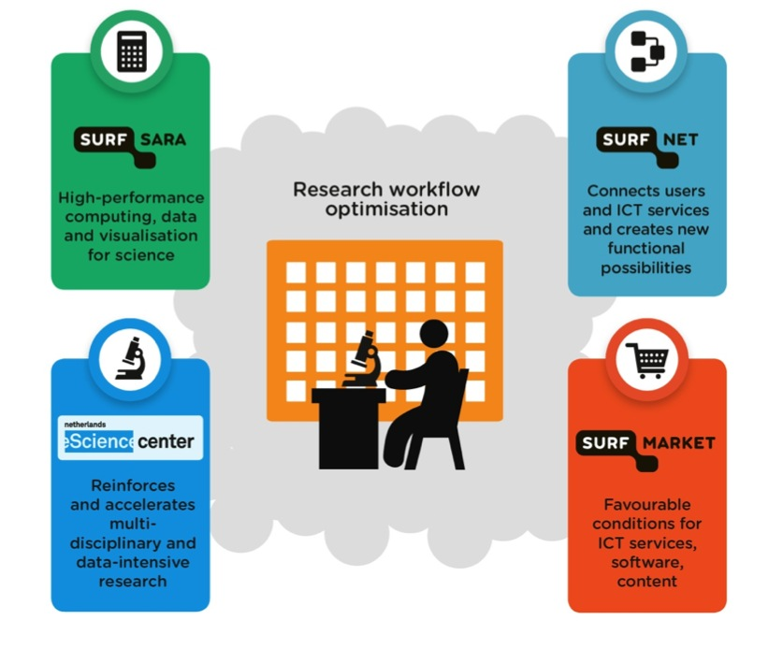
About SURF

Slide 3

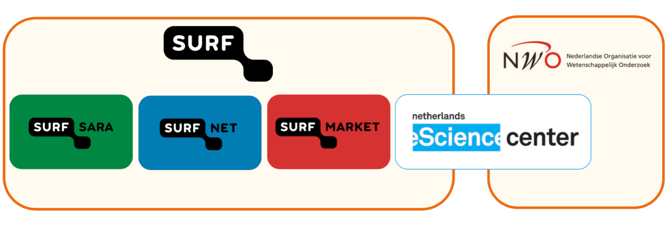

Slide 4
Research data life cycle
Creating
data
Reusing
data
Processing
data
Giving access to data
Analyzing
data
Preserving
data
Notes:
[Optional slide] This looks pretty much like you’re need solutions for every step in this (modified) life cycle.

Slide 5
Research data life cycle
Creating
data
Enter a new
Cycle, develop a workplan and apply ICT solutions
Lichtpaden, Netherlight
Bandwidth on Demand
Data Ingest Service
Storage (raw data)
Reusing
data
Processing
data
supporting the
research data
life cycle
SURFmarket licences/brokering
Authentication
Authorization
collaboration tools
(e.g. FileSender)
Cluster, Supercomputing
GRID Cloud computing
HADOOP
Giving access to data
Analyzing
data
NLeScience center
Digitally enhanced science
Trusted Digital Repository
B2SAFE/B2SHARE (EUDAT),
Persistent Identifier services
Archiving @ Research data NL
Visualisation services,
Remote clusters & GPU
Collaboratorium, Support
Preserving
data
Notes:
[Optional slide] This looks pretty much like you’re need solutions for every step in this (modified) life cycle.
Analyzing and interpreting data

Slide 6
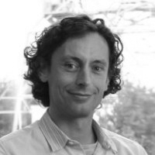
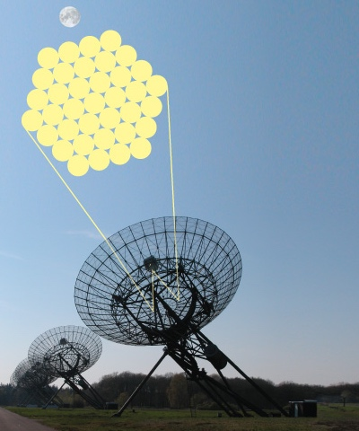
Show Case
Project Pulsar Surveys
Joeri van Leeuwen
Astrophysicist
ASTRON & University of Amsterdam
The challenge
Analysis and visualization of large amounts of space data from
pulsars on super computers (Astron, RuG, SURFsara) from different
work locations
e-Infrastructure needed
Superfast connections for reliable transfer of large amounts of data
Solution(s)
10 Gbit/s light path
‘private computing superhighway’
Notes:
SURFsara and SURFnet facilitate access to GO-NL data
In 2010 the Netherlands Genome (GO-NL) Project, part of the Biobanking and Biomolecular Research Infrastructure (BBMRI-NL), was initiated to map genetic variation in the Netherlands by sequencing the genomes of 250 couples and their offspring. The project is unique in its design in that it uses information from both the parental genomes and their offspring to discern genetic variations. Data collected from biobanks in Amsterdam, Rotterdam, Groningen and Leiden provides detailed information about the genetic variation in the Dutch indigenous population and offers unique opportunities for science and the development of therapeutic strategies.
Many scientists throughout The Netherlands are using this data for their specific research questions. But how to share and use 750+ files with over 100TB of data in an efficient and scalable manner that is easily accessible from multiple locations?
In this specific case, the group from Paul de Bakker at the UMC Utrecht wants to analyze (subsets) of the GO-NL data at the local High-performance Computing (HPC) cluster . First, data needs to be synchronized between UMC Groningen and the GRID storage at SURFsara. This was done using the existing 10Gb lightpath connection between LOFAR in Groningen and SURFsara in Amsterdam ensuring a fast and reliable transfer of approximately 60TB of data. The data then needs to be split up in smaller chunks, so that subsets can more easily be downloaded and used at the local HPC cluster. This last step is currently in progress. An additional 60TB of GRID storage has been made available by SURFsara and together with people from SURFsara, we are implementing a custom solution that uses grid facilities to split the data in smaller chunks. For all of these steps, the support from SURFsara and SURFfnet has been critical, both in terms of providing resources (storage, high-speed connections and compute power) as well as providing expert knowledge about the design and implementation of the solution.
For more information about:
The Genome of The Netherlands: http://www.nlgenome.nl
BBMRI-NL: http://www.bbmri.nl
SurfSara: http://www.surfsara.nl
Surfnet: http://www.surfnet.nl
Waarom? In de titel graag iets over de toepassing
In de inleiding moet in een paar zinnen duidelijk worden wat de boodschap is van dit bericht. In de inhoud daaronder meer uitleg over de inhoud,, Niet met 2010 beginnen dat is 3 jaar geleden!! Het gaat om nu, wat is er zo interessant? Dat meteen in de inleiding.
Wat dan precies?
Wie zijn dat?
Waarom willen ze dat?
Borstklopperij.. niet interessant

Slide 7
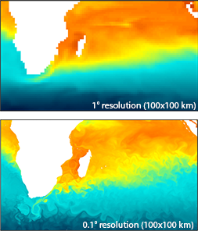
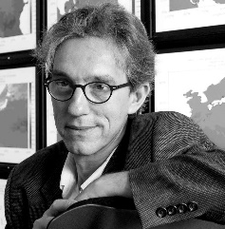
Show Case
Project eSalsa
Henk Dijkstra
Institute for Marine and Atmospheric Research Utrecht
Utrecht University
The challenge
Large-scale global climate simulations to see effect of changing
ocean circulations on local sea levels
e-Infrastructure needed
Large amounts of compute power, single supercomputer not sufficient
More precise calculations and better resolution
Solution(s)
Connecting supercomputer Cartesius at SURFsara with supercomputers in Germany, UK and US
with 10 Gbit/s light paths
Notes:
SURFsara and SURFnet facilitate access to GO-NL data
In 2010 the Netherlands Genome (GO-NL) Project, part of the Biobanking and Biomolecular Research Infrastructure (BBMRI-NL), was initiated to map genetic variation in the Netherlands by sequencing the genomes of 250 couples and their offspring. The project is unique in its design in that it uses information from both the parental genomes and their offspring to discern genetic variations. Data collected from biobanks in Amsterdam, Rotterdam, Groningen and Leiden provides detailed information about the genetic variation in the Dutch indigenous population and offers unique opportunities for science and the development of therapeutic strategies.
Many scientists throughout The Netherlands are using this data for their specific research questions. But how to share and use 750+ files with over 100TB of data in an efficient and scalable manner that is easily accessible from multiple locations?
In this specific case, the group from Paul de Bakker at the UMC Utrecht wants to analyze (subsets) of the GO-NL data at the local High-performance Computing (HPC) cluster . First, data needs to be synchronized between UMC Groningen and the GRID storage at SURFsara. This was done using the existing 10Gb lightpath connection between LOFAR in Groningen and SURFsara in Amsterdam ensuring a fast and reliable transfer of approximately 60TB of data. The data then needs to be split up in smaller chunks, so that subsets can more easily be downloaded and used at the local HPC cluster. This last step is currently in progress. An additional 60TB of GRID storage has been made available by SURFsara and together with people from SURFsara, we are implementing a custom solution that uses grid facilities to split the data in smaller chunks. For all of these steps, the support from SURFsara and SURFfnet has been critical, both in terms of providing resources (storage, high-speed connections and compute power) as well as providing expert knowledge about the design and implementation of the solution.
For more information about:
The Genome of The Netherlands: http://www.nlgenome.nl
BBMRI-NL: http://www.bbmri.nl
SurfSara: http://www.surfsara.nl
Surfnet: http://www.surfnet.nl
Waarom? In de titel graag iets over de toepassing
In de inleiding moet in een paar zinnen duidelijk worden wat de boodschap is van dit bericht. In de inhoud daaronder meer uitleg over de inhoud,, Niet met 2010 beginnen dat is 3 jaar geleden!! Het gaat om nu, wat is er zo interessant? Dat meteen in de inleiding.
Wat dan precies?
Wie zijn dat?
Waarom willen ze dat?
Borstklopperij.. niet interessant

Slide 8
SURF - research service portfolio overview
Compute: high-end solutions 1000 times more powerful than your PC
data services: easily accessible storage on disk or tape
Visualize: advanced solutions and support to create visualisations
Connectivity: fast end-to-end connections tailored to your research needs
Collaboration INFRA: single sign-on access to many services
DIGITALLY ENHANCED SCIENCE: digital tools tailored for the specific needs of researchers
MARKET: reseller of content, cloud solutions, software and hardware (via partnershops)
Notes:
In the next few slides I will get into more details about the services we offer. We have two options there, I can walk through every solution but that will probably take a lot of time and might become a bit boring…. OR you pick some of the solutions you are particularly interested in.. It’s up to you.

Slide 9
Compute
?
It takes months to process my data!
I wish I could scale out and have access to as many compute cores as needed
High-end solutions 1000 to 10.000 more powerful than your PC Compute resources come in different flavors:
            Supercomputer – HPC Cartesius
            LISA – National Cluster
            GRID computing
            HPC Cloud
            HADOOP
Notes:
kiezen levellen naar behoefte expertise.....
doorlooptijd HPC 2wkn, laagdrempelig....
High performance computing
Whether you are in humanities to explore social media data, higher energy physics to proof the existence of the Higgs particle or a researcher in life sciences to study which genetic factors are linked to diabetes, you probably need more computing power to be able to find new patterns and to unravel complex relationships. SURFsara offers high-end solutions 1000 to 10.000 more powerful than your laptop! Supercomputers, Grids, HPC cloud and Hadoop, it is all there!

Slide 10
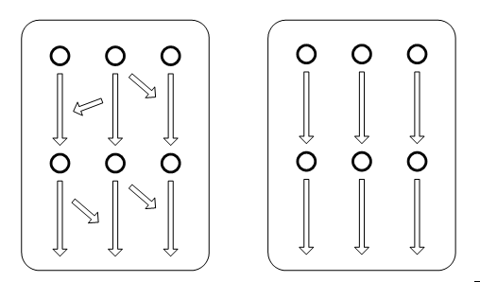
Parallel computing
Supercomputing Cluster Grid
Cloud Hadoop
Cloud

Slide 11
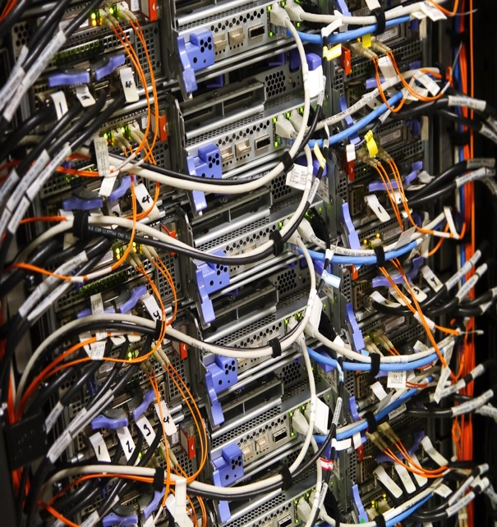
Compute
Which flavour for your task?
=> Scale up workstation loads and complex work flows
Cloud computing
Dynamic and flexible
Self-service
Define your own working environment
Cluster computing
Directly scalable
Serviced environment
Grid computing
High-end scalability
Serviced platform

Slide 12
Compute
Which flavour for your task?
Omics & clinical research studies
Specific requirements
Population studies
Next-generation sequencing
Imaging
Modelling & mining studies
Structural modeling
Systems biology
Big data analytics
HPC Cloud, LISA cluster computing*
Life Science Grid*, Grid* (EU)
Supercomputing*, LISA cluster computing*, Hadoop*
* includes biomedical research software & tools

Slide 13
Data Services
?
How to share data with colleagues?
How to manage and store my data?
Research data storage, Data access & repository services (B2SHARE/B2SAFE), Beehub, SURFdrive, Filesender..
Storage on disk or tape, short term or long term storage
Supporting several file transfer protocols
Data ingest service available
Direct interfaces with our compute and network services
Collaboration with national (DANS, 3TUdatacentrum) and international ICT infrastructure partners (PRACE, EUDAT, EGI)
Notes:
Data services
Are you trying to find ways to store data in an efficient manner, to make them easily accessible for use by you and your colleagues? For that purpose we provide an infrastructure that combines very fast data connections with a wealth of storage space on tape or disk, for short-term or long-term preservation. We work closely together with several partners in a wide range of national, European and global scientific projects
(e.g. PRACE, WLCG/LHC, EUDAT, LOFAR) and support scientific communities or individual scientists in handling their growing data challenges.
Data Services (From SURFsara website)
Petabytes of scientific data
In the current era of Petascale supercomputers, in which scientific machines generate Petabytes of scientific data on a yearly basis, handling fast growing data sets is becoming a challenge for the scientific community. Scientists frequently use complex measuring tools that generate huge amounts of data. Examples include the experiments with the Large Hadron Collider at CERN and LOFAR, an astronomy research project using antennas. Research in life sciences also generates enormous data files (such as in DNA sequencing).
Data storage and analysis
The great challenge is to find ways of storing these Petabytes of data in an efficient manner so as to make them easily accessible for use by researchers. To that end we have set up an infrastructure that combines very fast data connections with a wealth of storage space on tape or disk. More and more data storage as well as analysis involve complex and/or unstructured data. For these types of data SURFsara also off ers interesting infrastructures. The Hadoop cluster for instance, which can be used for the fast analysis of extremely big data sets. The spectrum of applications is very broad, typically including indexation, storage and search functions.
SURFsara's support
SURFsara’s Data Services group provides services to the scientific user community in handling the scientific data explosion and long-term data preservation scientific data sets. We work closely together with all groups within SURFsara, participate in a wide range of national, European and global scientific projects (e.g. PRACE, WLCG, Lofar) and support scientific communities or individual scientists in handling their growing data challenges.
Two facilitites
To manage all this data the Data Services group manages two facilities for long-term data preservation:
HPC Central Data Archive
Grid Permanent Data Storage

Slide 14
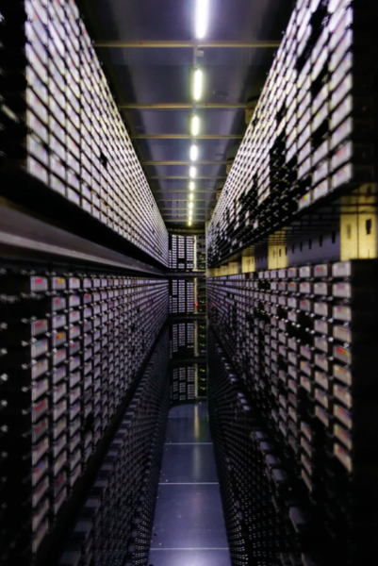
Research data storage
Single copy storage
cache, access to compute services
Central data storage:
dual copies: stored on tape on two geographically separated locations (Amsterdam and Almere).
Consultancy data storage and transfers, data management plan

Slide 15





SURFdrive.surf.nl
The SURF DropBox replacement
  100 GB per user
  Access via SURFconext
  Privacy & security
  Guest usage
  Institutional subscription ~
SURFdrive@SURF
surfdrive.nlSURFdrie://surfdrive.surf.nl/

Slide 16
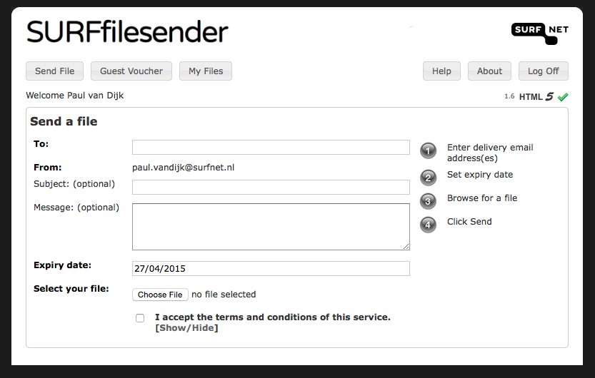
Filesender.surf.nl
File Transport
not
File Storage (!)
200GB files? no problem!
Safe and Trusted
End-to-end encryption (250MB)

Slide 17




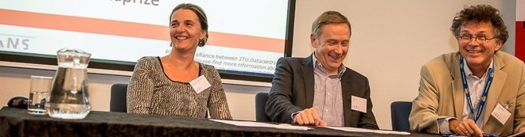
RDNL
Research Data Netherlands
RDNL: 3 Organisations
researchdata.nl/en
Three organisations serving different research disciplines.
Annemiek van der Kuil |PhotoA.nl

Slide 18


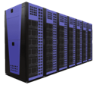

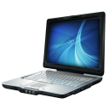



EUDAT services overview
B2FIND
AAI
PID
Aggregated EUDAT metadata domain Data inventory
Network of trust among authentication and authorization actors
Identity
Integrity
Authenticity
Locations
B2SAFE
B2STAGE
B2SHARE
Data curation and access optimization
Dynamic replication to HPC workspace for processing
Researcher data store (simple upload, share and access)
B2DROP
Easy sharing
Local syncing
Notes:
B2FIND: Metadata harvester and search catalogue within the EUDAT domain and community repositories
B2DROP: Dropbox-like storage; equivalent to SURFdrive
B2SHARE: Data publishing platform; directed towards "long tail data" and citizen scientists
B2SAFE: Data Replication tool; iRODS extension + PID service; directed towards data centres
B2STAGE: Data Staging tool; employs gridFTP

Slide 19


Research Timeline
Before
During
After
Data Ingest Service
B2DROP / SURFdrive
BEEHUB
B2FIND
B2STAGE
B2SAFE
B2SHARE
EPIC PID
GRID SE
Central Archive
Trusted Digital Repository
Research Data Storage
Notes:
Generic timeline of research projects
Before: start searching information
During: upload raw data, processed data. Share data with collaborators
After: share results data, publish data, reference data in publications
Long-term storage of long tail data in TDR

Slide 20
Connectivity
SURFnet7 network
?
How do I transfer my TBs of data?
It needs to be superfast and safe!
IP, Multi Service Port, Lichtpad and Netherlight
...several solutions for:
Large bandwidth (1, 10 or even more Gbit/s)
Secure
Static or dynamic connections
National and International connections
Low latency
Notes:
High speed data transfer
Enter the world of ultra fast and secure data transfer. Your research institute already profits from an excellent research network offered by SURFnet but you may need even higher speeds and secure end-to-end connections. SURFlichtpaden (lightpaths) are tailored to such needs. Sending a 100 terabyte file to another institution within one day? It is possible. Even for international transfer or sharing of data, our solutions may well fit your use case.

Slide 21
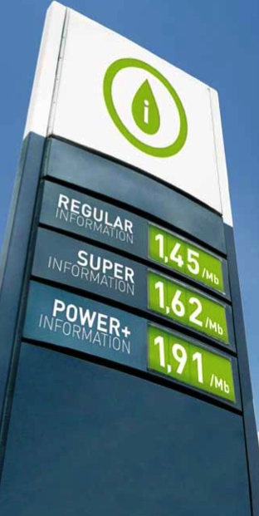
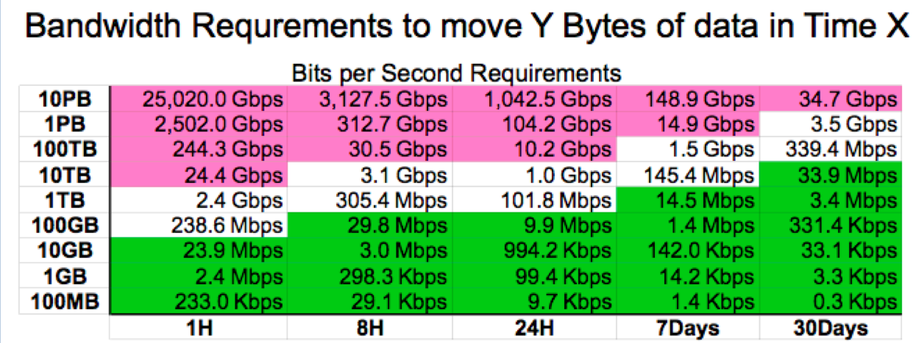
Connectivity
Fast, faster...

Slide 22
Why lightpaths
Guaranteed bandwidth
Low latency
Separated from the Internet
  Not vulnerable, no DDOS-attacks
  Better protection against eavesdropping
Layer 2 connection,
  Integrated in own network
  Flexibility
22
Notes:
Niet voor elke cloud provider zal dit van toepassing zijn, maar belangrijk te weten is dat dit kan.

Slide 23
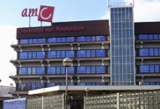
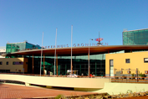
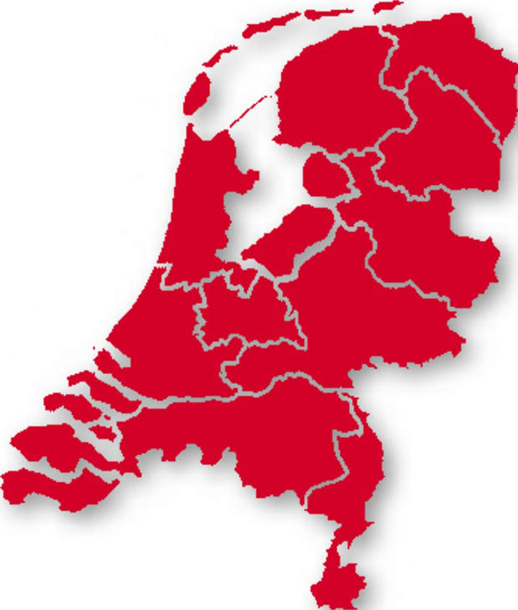


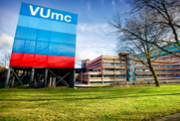




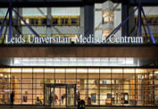

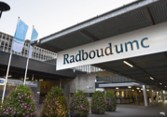
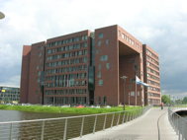
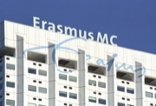
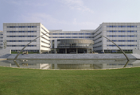


Connectivity
Multi Service Port - Lightpaths
MSP
10TB genome data
at 5Gbit/s
MSP
International
Partner
filetransfers radiology
at 3Gbit/s
MSP
MSP
MSP
2TB BAM files
at 2Gbit/s
MSP
Sequencing service provider
MSP
MSP
MSP
MSP
Notes:
Straks MSP dynamisch
e-lan nodig om alle UMCs met elkaar te verbinden
voor life science clusters doet Sander Boele nu het nummerplan..
PerSonar ronald van de pol installatie bij SN en verschillende andere lokaties wereldwijd voor klimaatonderzoek (zou bij het research cluster moeten).
UMCs 1Gb
end to end – privaat
we belichten het zelf (ons eigen apparatuur)
SURFsara nu 10Gb

Slide 24
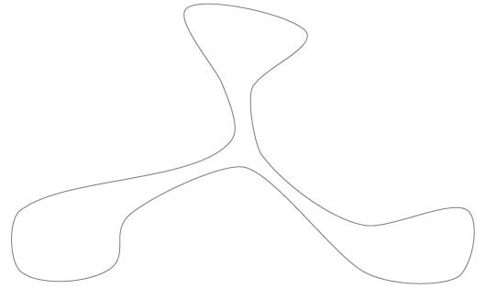
Connectivity
Multi Service Port - Lightpaths
E-LAN
Notes:
Straks MSP dynamisch
e-lan nodig om alle UMCs met elkaar te verbinden
voor life science clusters doet Sander Boele nu het nummerplan..
PerSonar ronald van de pol installatie bij SN en verschillende andere lokaties wereldwijd voor klimaatonderzoek (zou bij het research cluster moeten).
UMCs 1Gb
end to end – privaat
we belichten het zelf (ons eigen apparatuur)
SURFsara nu 10Gb

Slide 25
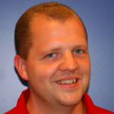
Connectivity
Showcase Lightpaths
Patrick Kemmeren
A Assistant Professor
Department of Molecular Cancer Research
UMC Utrecht
The challenge
The Netherlands Genome (GO-NL) Project
Data from Amsterdam, Rotterdam, Groningen & Leiden
Share +750 files, +100TB
e-Infrastructure needed
Fast, reliable and secure data transfer
A fast HPC cluster to analyse data
Solution(s)
10GB Lightpath
HPC cluster at SURFsara
Lifescience support
MSP
MSP
MSP
Notes:
SURFsara and SURFnet facilitate access to GO-NL data
In 2010 the Netherlands Genome (GO-NL) Project, part of the Biobanking and Biomolecular Research Infrastructure (BBMRI-NL), was initiated to map genetic variation in the Netherlands by sequencing the genomes of 250 couples and their offspring. The project is unique in its design in that it uses information from both the parental genomes and their offspring to discern genetic variations. Data collected from biobanks in Amsterdam, Rotterdam, Groningen and Leiden provides detailed information about the genetic variation in the Dutch indigenous population and offers unique opportunities for science and the development of therapeutic strategies.
Many scientists throughout The Netherlands are using this data for their specific research questions. But how to share and use 750+ files with over 100TB of data in an efficient and scalable manner that is easily accessible from multiple locations?
In this specific case, the group from Paul de Bakker at the UMC Utrecht wants to analyze (subsets) of the GO-NL data at the local High-performance Computing (HPC) cluster . First, data needs to be synchronized between UMC Groningen and the GRID storage at SURFsara. This was done using the existing 10Gb lightpath connection between LOFAR in Groningen and SURFsara in Amsterdam ensuring a fast and reliable transfer of approximately 60TB of data. The data then needs to be split up in smaller chunks, so that subsets can more easily be downloaded and used at the local HPC cluster. This last step is currently in progress. An additional 60TB of GRID storage has been made available by SURFsara and together with people from SURFsara, we are implementing a custom solution that uses grid facilities to split the data in smaller chunks. For all of these steps, the support from SURFsara and SURFfnet has been critical, both in terms of providing resources (storage, high-speed connections and compute power) as well as providing expert knowledge about the design and implementation of the solution.
For more information about:
The Genome of The Netherlands: http://www.nlgenome.nl
BBMRI-NL: http://www.bbmri.nl
SurfSara: http://www.surfsara.nl
Surfnet: http://www.surfnet.nl
Waarom? In de titel graag iets over de toepassing
In de inleiding moet in een paar zinnen duidelijk worden wat de boodschap is van dit bericht. In de inhoud daaronder meer uitleg over de inhoud,, Niet met 2010 beginnen dat is 3 jaar geleden!! Het gaat om nu, wat is er zo interessant? Dat meteen in de inleiding.
Wat dan precies?
Wie zijn dat?
Waarom willen ze dat?
Borstklopperij.. niet interessant

Slide 26
Collaboration Infrastructure
?
How can I access multiple resources with one single account?
How can I provide secure access to my shared resources?
We offer: SURFconext, step up authentication
Single Sign-On with your institutional account
For service providers -> no account management
100% verified users
Access to many (non)commercial cloud services
Guest access with social IDs (Google) via OneGini
Notes:
Online collaboration and identity management
Forget the hassle of managing multiple accounts to access shared storage, databases and tools. SURFconext offers researchers from various research institutes across Europe single sign-on access to an abundance of (non) commercial research services e.g. SURF FileSender to send and receive large research files in a secure and fast way. For research groups aiming to share their resources with colleagues elsewhere, account management can be simplified by re-using institutional credentials.

Slide 27
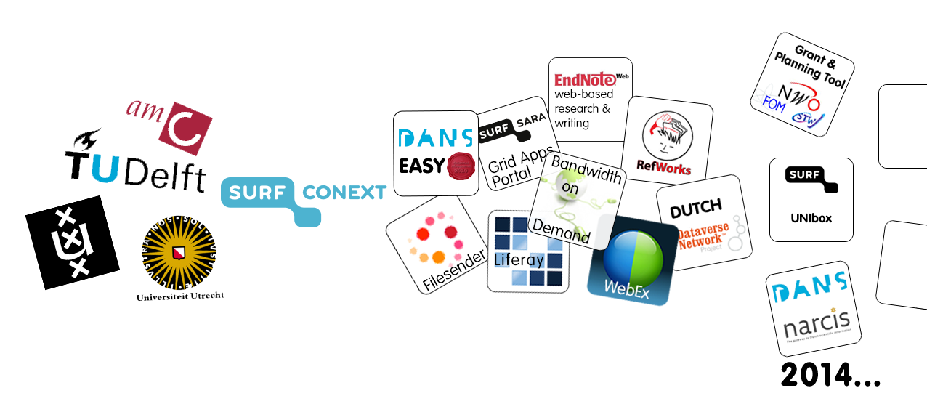



SSO access to many services

Slide 28
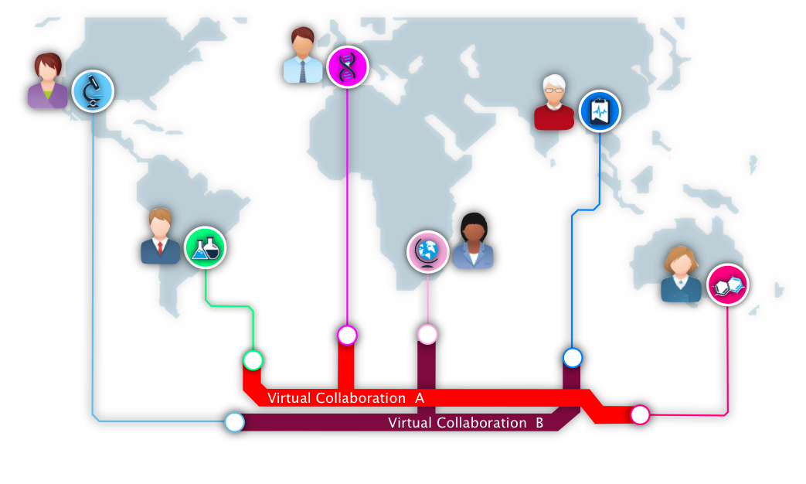
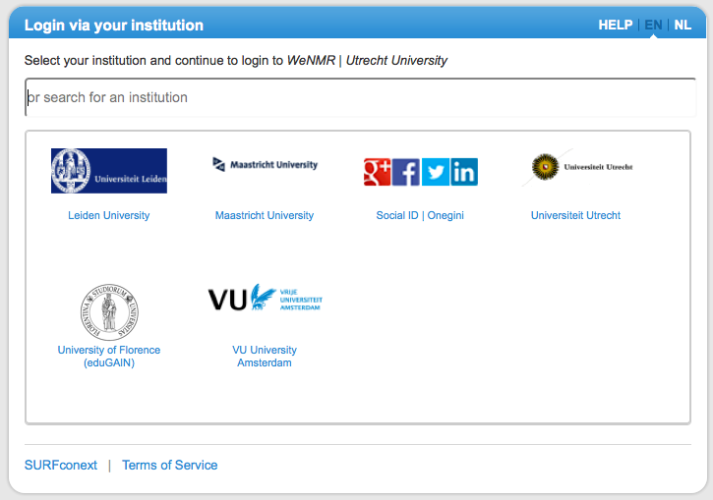

Collaboration Infrastructure
Single Sign-On
Notes:
Another important factor: Interaction, know your peers, collaborate, share data, share resources, share knowledge, publish together.....
Collaboration is the new competition.
reuse existing middleware solutions, open standards and concepts, do not re-invent the wheel

Slide 29
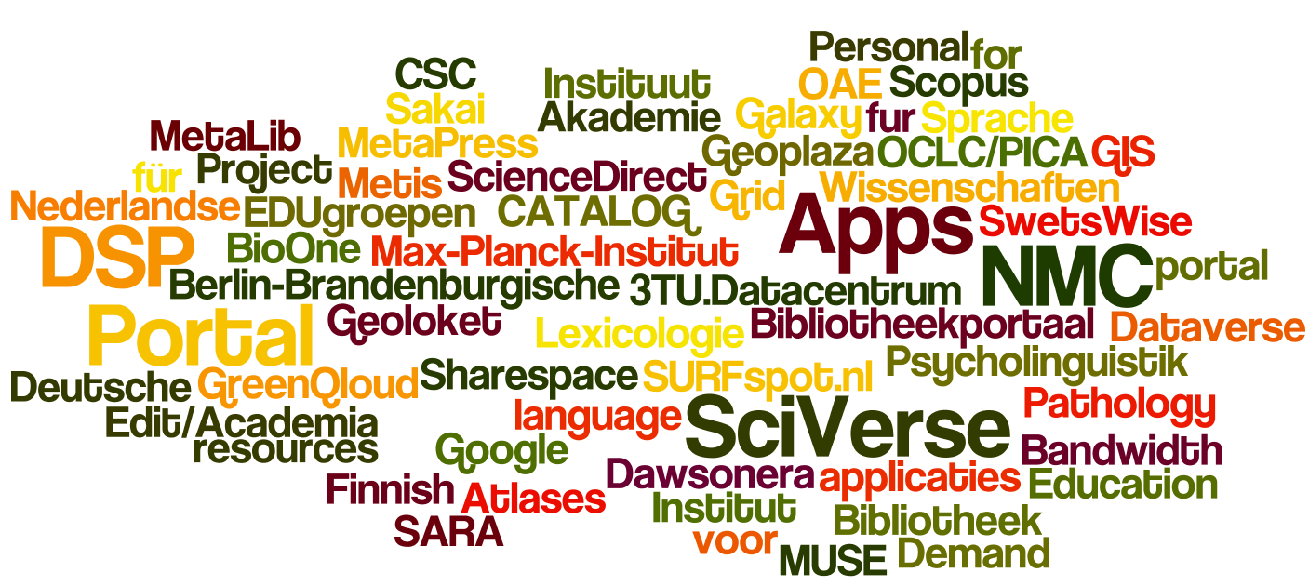
+300 SURFconext-ed services

Slide 30
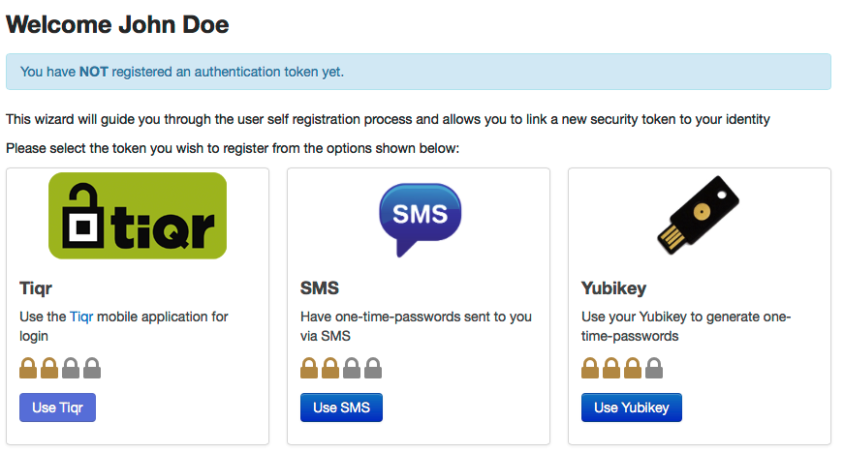
Strong authentication via SURFconext

Slide 31
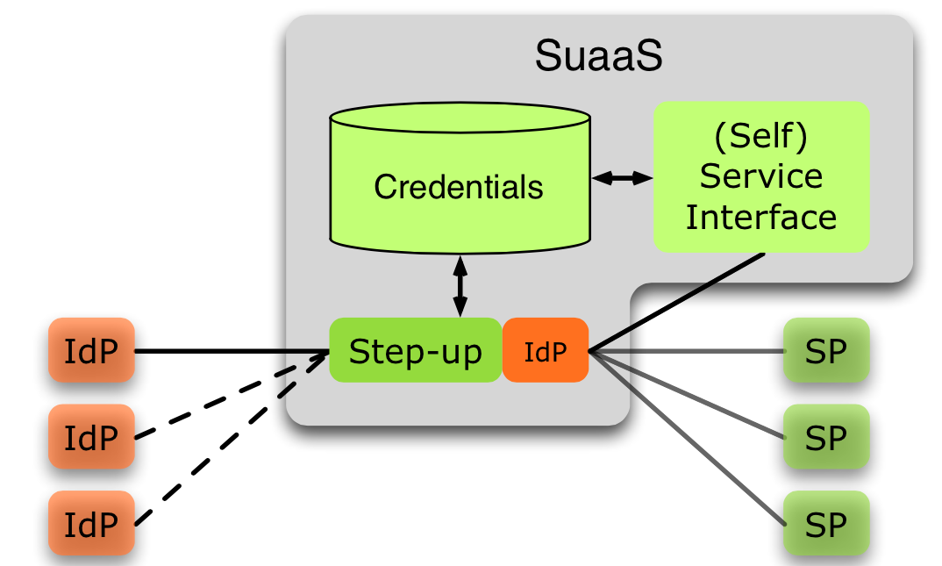
Strong authentication via SURFconext

Slide 32
Visualisation
?
How can I get more insight in my scientific datasets?
How can I better communicate my scientific results?
For classical mapping of data to pictures and movies and more exotic visualizaton tasks
Visualisation tooling en support
Collaboratorium for high-res visualizations
Dedicated visualisation clusters
Notes:
Advanced visualization
Would you like to obtain more insight in your scientific data? Our experts and advanced visualization tools will help you to identify complex patterns and unforeseen phenomena. We provide a dedicated cluster with GPUs for (interactive) visualization of large datasets, which you can access from your workplace as a remote desktop. If you have lots of data to show, try our Collaboratorium for displaying high-resolution visualizations.

Slide 33

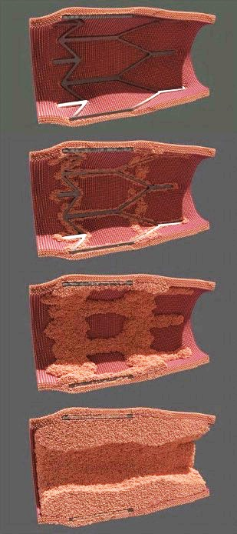
Visualisation
Showcase visualization clusters & tools
Alfons Hoekstra, Paul Melis
UvA – FNWI - Section Computational Science
What was needed?
Visualisation of in-stent restenosis simulation
Multi-scale model (cell growth, blood flow, stent placement)
800 time steps, 500.000 – 1.200.000 simulated cells
What needed to be done?
Processing simulation output to visualisation primitives
(semi-)realistic Image rendering
Solution
Elvis remote visualisation cluster
Software tools for 3D rendering
Notes:
NLeScience center - tudelft aardwetenschappen. cevil
kloppend hart – AMC -

Slide 34
Netherlands eScience center
Digitally enhanced research
?
Where can I find expertise and funding to apply digital technologies in my research?
eScience Center:
Collaboration with domain researchers (from the humanities to physics and beyond)
Reusing and tailoring digital technologies for the specific needs of researchers
Training on software carpentry
Notes:
Integration support
Your research may require specialized skills or scientific support that go beyond the standard support programme. For that purpose The Netherlands eScience Center offers dedicated support by connecting today’s technological possibilities with the inspirational thinking by scientists. The eScience methods include: cross-type data integration, data-driven simulations & multi-scale modeling, exascale (distributed) computing and data-intensive experiments and visualisation & analytics.

Slide 35
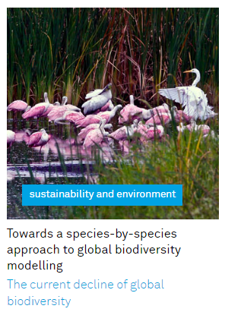
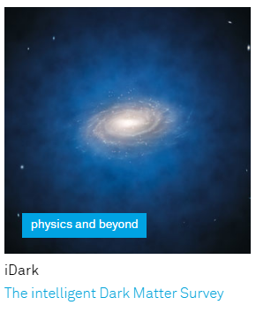
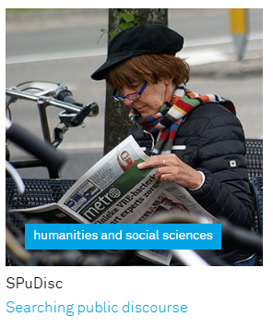
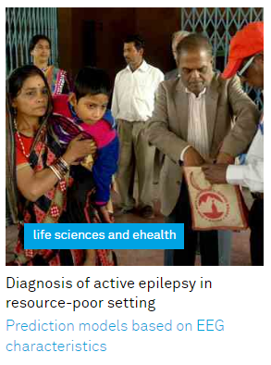
Netherlands eScience center
Showcases
Notes:
Some examples

Slide 36

The request procedure
NWO website
Compute services
HPC Cartesius
Research Capacity Compute Service
SURF request form
Storage services
Research Data Storage, Beehub
Data Ingest Service
Compute services
HPC Cloud
Grid. Life Science Grid
Big Data Services (e.g. Hadoop)
Visualisation services

Slide 37
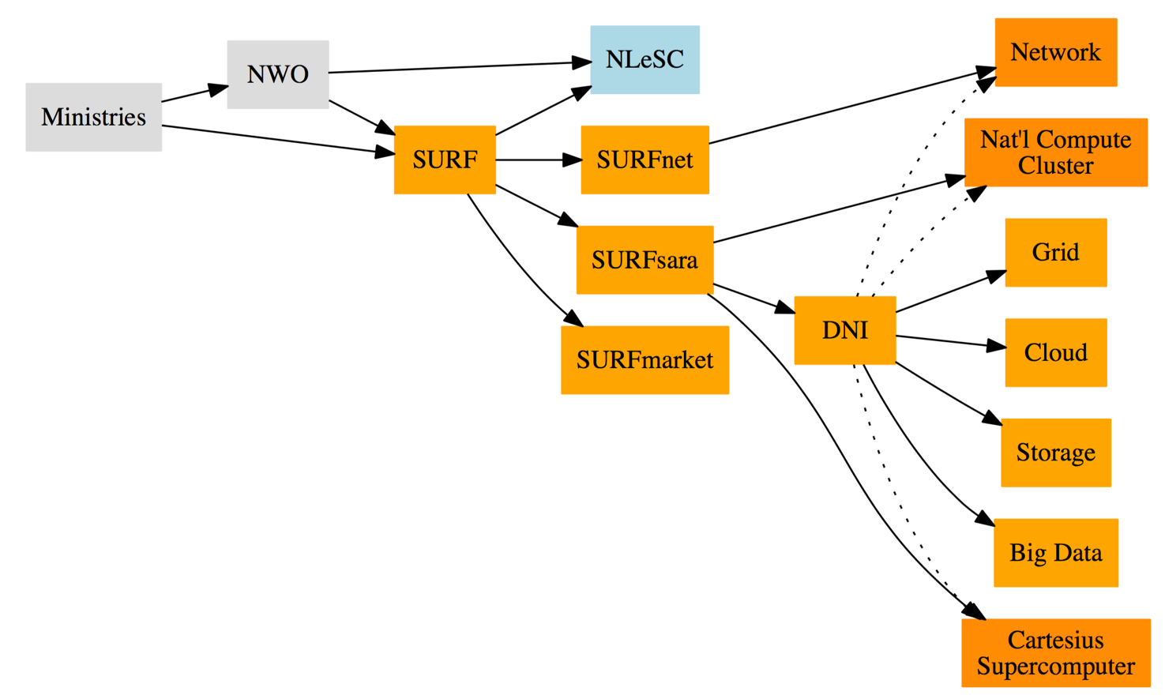

Slide 38
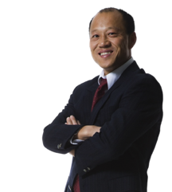
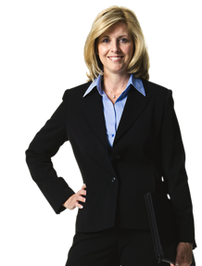

ICT support
Local ICT
support
staff
Advice, training, hands-on support
Train-the-trainer
find the best solution and
get started !
SURF
support
4research
The
scientist
Advice, training, hands-on support
Notes:
Sim three or more actors may need to be involved.
E.g. the scientist (as the customer),
the local ICT supporter as facilitator/supporter for selfhosted facilities, as faciltator to enable the use or point to 3rd solutions.
SURF representative as facilitator/supporter for SURF facilities
These three need to interact and orchestrate the whole process. (unfortunately most often there is some degree of tailoring, not run of the mill yet)

Slide 39
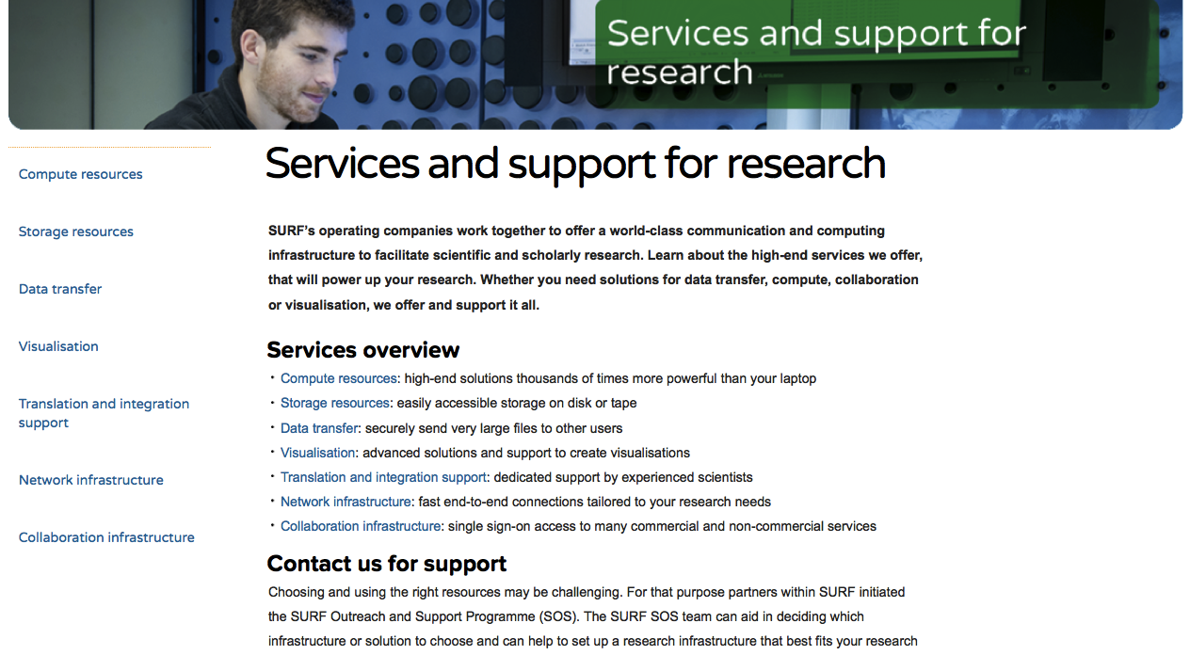
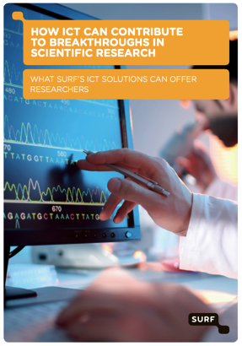
Visit: surf.nl/support4research

Slide 40
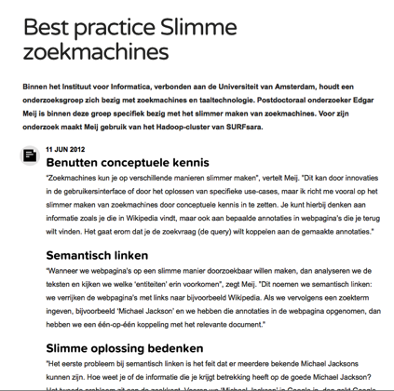
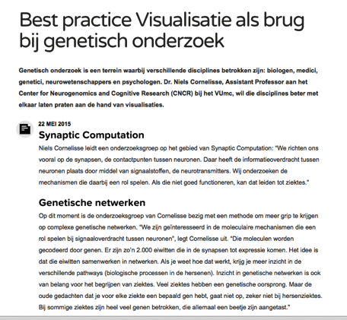
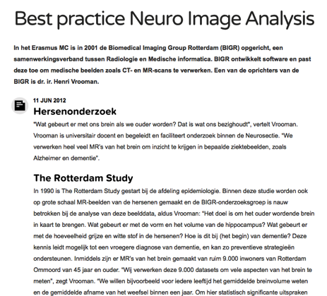
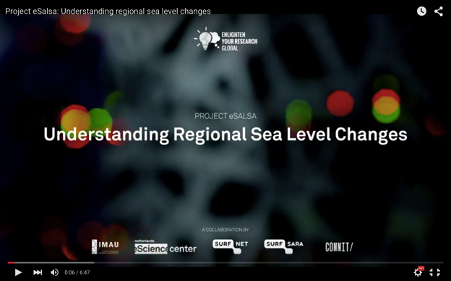
Showcases / Best Practices

Slide 41
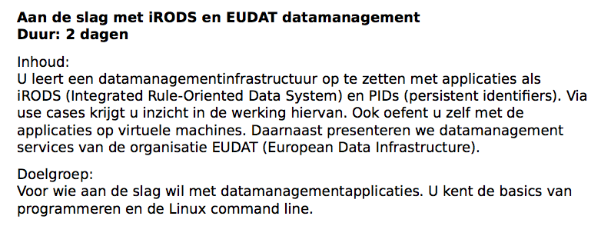
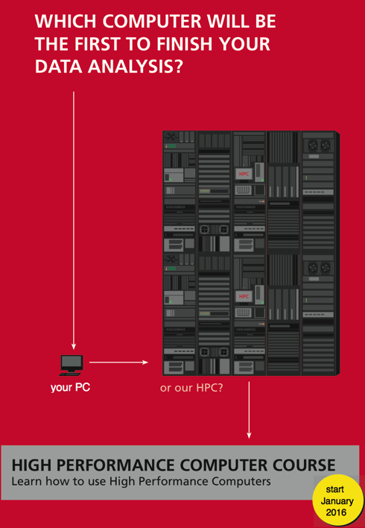
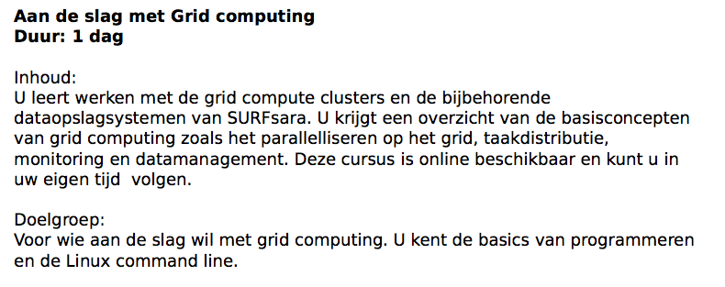
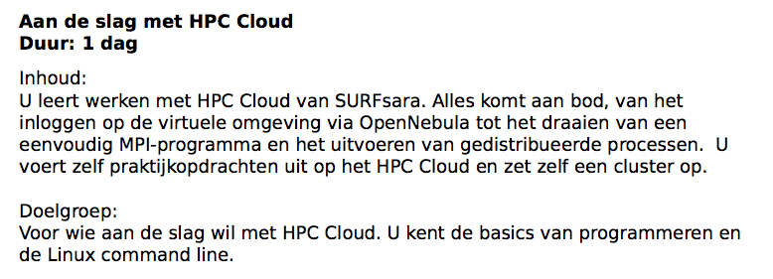


Workshops

Slide 42




Resultaten
Masterclasses, boot camps, rapport

Slide 43
SURF Research Boot Camp
10 Nov. TUDelft

Slide 44
SURF Research Boot Camp
10 Nov. TUDelft

Slide 45
Thanks!
More info?
www.surf.nl
jan.bot@surfsara.nl
paul.vandijk@surfnet.nl

Slide 46


