Slide 1
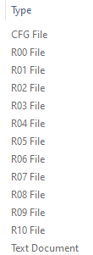
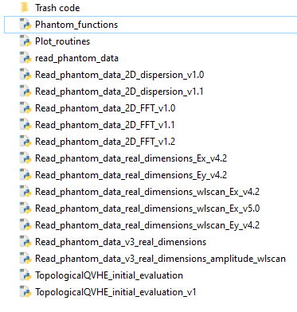
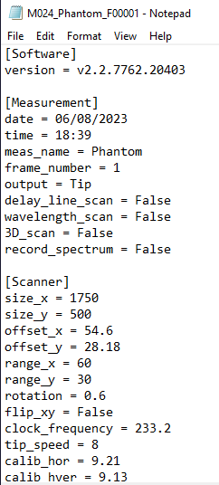
Data management challenges
Daniel Muis
Themes: Data organization, Documentation
Themes: Data organization, Documentation
Major challenge
Minor challenge
Store (and share) data
(Automatic generation of folders, .cfg and .txt files)
But: People have no access to my written lab journal
Store (and share) code
Daily practice improvement
Get started with
Naming convention and documentation
Github!
Readme files
More metadata (methodology, abbreviations, units)
Notes:
Lab journal: Tip properties, sample properties and what part of the sample (which PhC, which mode) has been measured.

