Slide 1


Quantum Cryptography Beyond QKD II
Christian Schaffner
Research Center for Quantum Software
Institute for Logic, Language and Computation (ILLC)
University of Amsterdam
Centrum Wiskunde & Informatica
All material available on https://homepages.cwi.nl/~schaffne
QCALL Summer School, Baiona, Spain
Friday, 11 May 2018

Slide 2
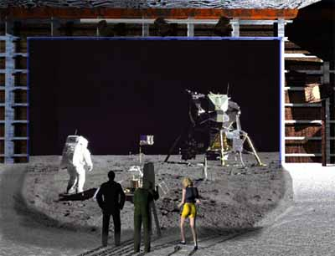
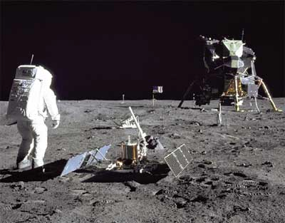
1969: Man on the Moon
The Great Moon-Landing Hoax?
NASA
How can you prove that you are at a specific location?
http://www.unmuseum.org/moonhoax.htm
Notes:
In 1969, man has first set foot on the moon, as you can see here on this picture sent around the world by NASA...
Or not? Maybe it was all just a “great moon-landing hoax”, as speculated on various conspiracy-theory websites on the internet?
One fascinating cryptographic question I want to study in my project is: “How can you prove that you are at a specific location?”
More about it later…

Slide 3
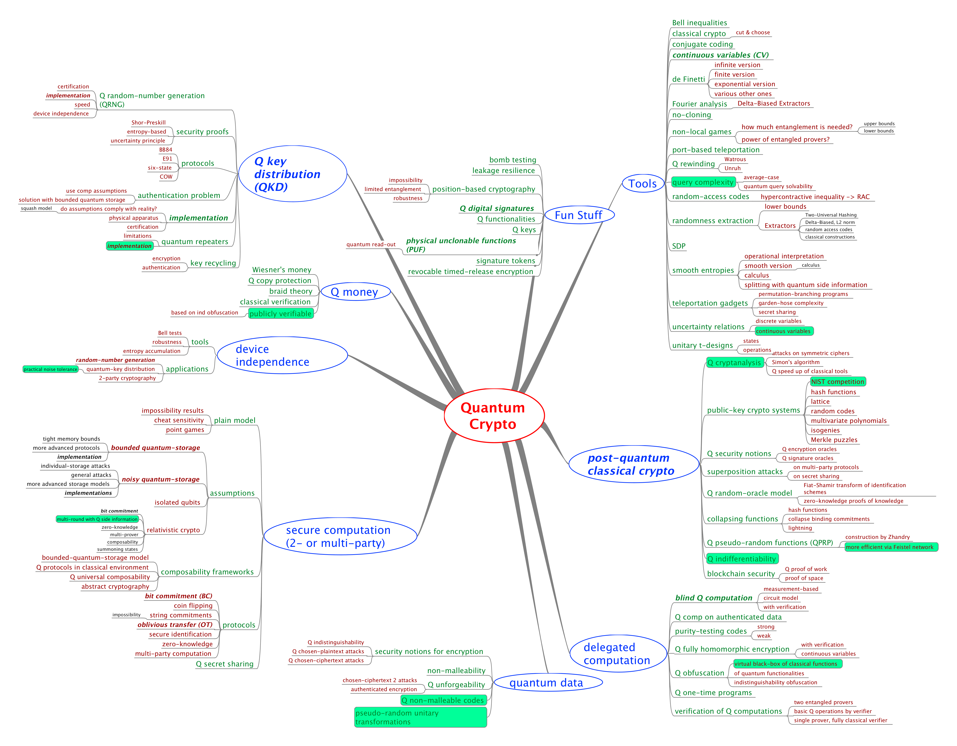
MindMap
Tools
Q advantage
experiments
Selection of
open questions
Fork me on github!
Post Q crypto
Q data
[https://github.com/cschaffner/QCryptoMindmap]

Slide 4
MindMap
Tools
Q advantage
experiments
Selection of
open questions
Fork me on github!
Post Q crypto
Q data
[https://github.com/cschaffner/QCryptoMindmap]

Slide 5
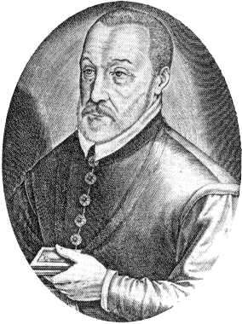
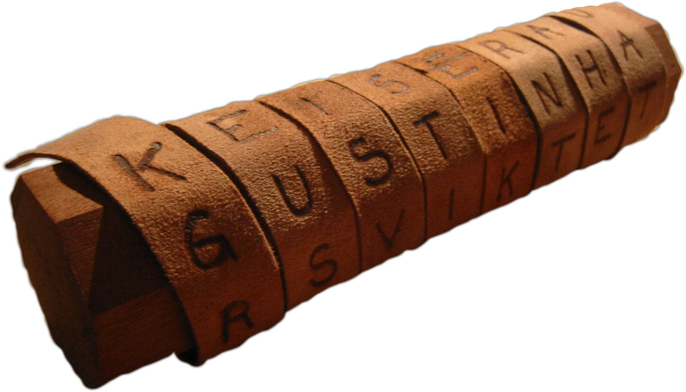
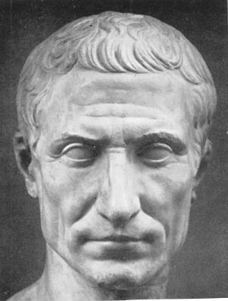

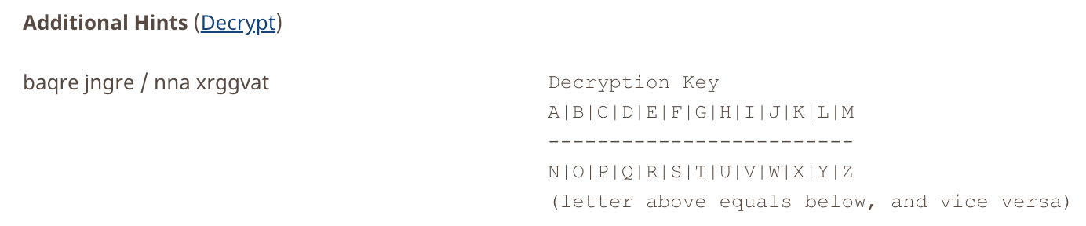
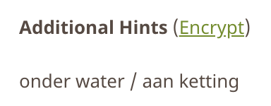
Ancient Cryptography
Blaise de Vigenère
Scytale
50 BC
1000 AD
2015 AD
500 BC
500 AD
1500 AD
Caesar Cipher (ROT4)
(variant still in use)

Slide 6
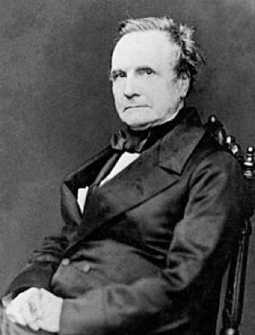
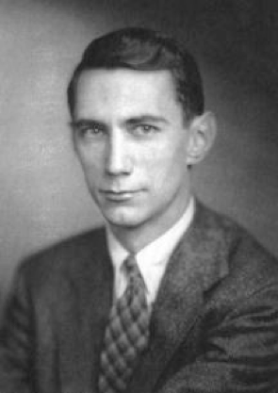
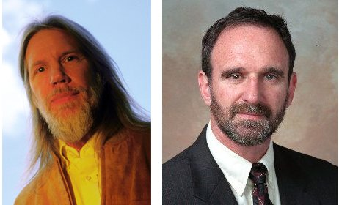
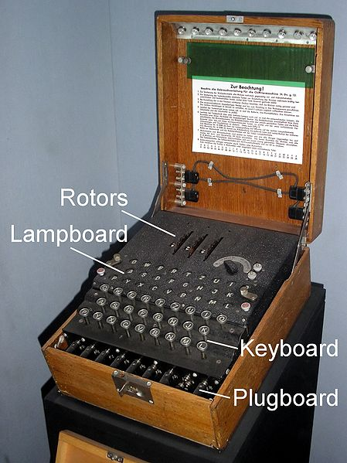
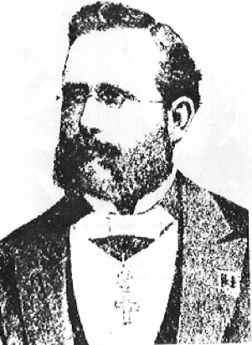
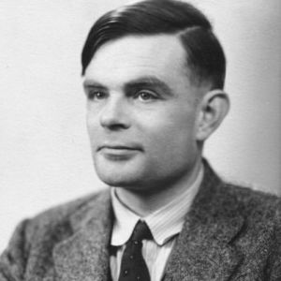

Ancient Cryptography
Charles Babbage
Claude Shannon
Diffie / Hellman
1850
1950
2015
1800
1900
1976
“a cryptographic system should be secure even if everything but the key is known to the adversary”
Enigma
Alan Turing
(The Imitation Game)
Auguste Kerckhoffs
Notes:
een systeem van versleuteling moet even veilig zijn, zelfs als alles behalve de sleutel over het systeem publiek bekend is

Slide 7
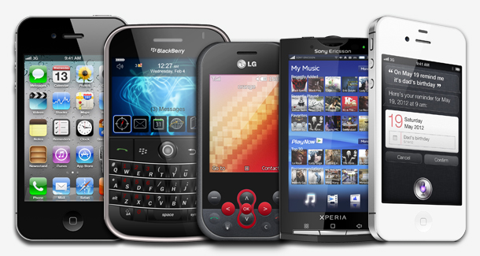
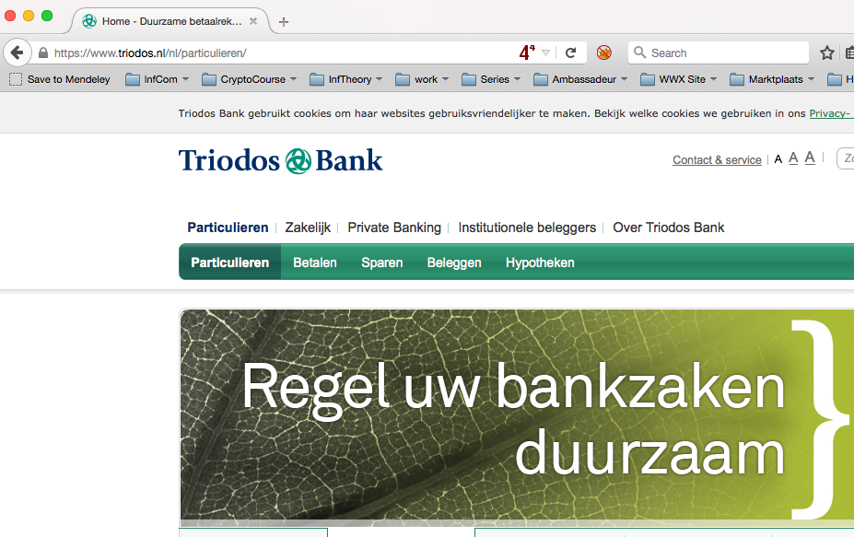
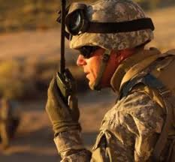
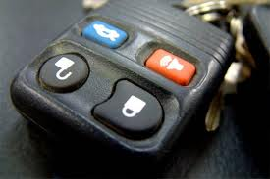
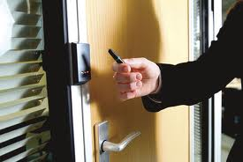
Modern Cryptography
is everywhere!
is concerned with all settings where people do not trust each other

Slide 8



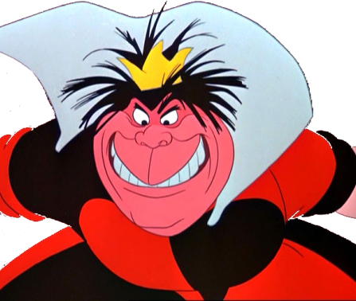
Secure Encryption
m = “I love you”
m = 0000 1111
Alice
Bob
k = ?
Eve
k = 0101 1011
k = 0101 1011
Goal: Eve does not learn the message
Setting: Alice and Bob share a secret key k

Slide 9
One-Time Pad Encryption
m = 0000 1111
c = m ⊕ k = 0101 0100
m = c ⊕ k = 0000 1111
Alice
Bob
k = ?
Eve
k = 0101 1011
k = 0101 1011
Goal: Eve does not learn the message
Setting: Alice and Bob share a key k
Recipe:
Is it secure?
x | y | x ⊕ y
0 | 0 | 0
0 | 1 | 1
1 | 0 | 1
1 | 1 | 0
m = 0000 1111
c = 0101 0100
k = 0101 1011
k = 0101 1011
c = m ⊕ k = 0101 0100
c ⊕ k = 0000 1111
c ⊕ k = m ⊕ k ⊕ k = m ⊕ 0 = m

Slide 10
Perfect Security
m = ?
c = m ⊕ k = 0101 0100
m = c ⊕ k = ?
Alice
Bob
k = ?
Eve
k = ?
k = ?
Given that c = 0101 0100,
  is it possible that m = 0000 0000 ?
    Yes, if k = 0101 0100.
  is it possible that m = 1111 1111 ?
    Yes, if k = 1010 1011.
  it is possible that m = 0101 0101 ?
    Yes, if k = 0000 0001
In fact, every m is possible.
Hence, the one-time pad is perfectly secure!
x | y | x ⊕ y
0 | 0 | 0
0 | 1 | 1
1 | 0 | 1
1 | 1 | 0

Slide 11
Problems With One-Time Pad
m = 0000 1111
c = m ⊕ k = 0101 0100
m = c ⊕ k = 0000 1111
Alice
Bob
k = ?
Eve
k = 0101 1011
k = 0101 1011
The key has to be as long as the message.
The key can only be used once, otherwise information might leak.
In practice, other encryption schemes (such as AES) are used which allow to encrypt long messages with short keys.
One-time pad does not provide authentication:
Eve can easily flip bits in the message
Notes:
for encrypting internet traffic

Slide 12
Symmetric-Key Cryptography
Alice
Bob
Eve
Encryption insures secrecy:
Eve does not learn the message, e.g. one-time pad
Authentication insures integrity:
Eve cannot alter the message
General problem: players have to exchange a key to start with

Slide 13
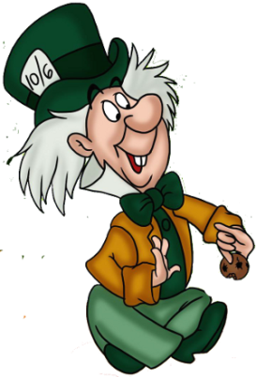
Public-Key Cryptography
Alice
Charlie
Bob
secret key
Eve
public key
Solves the key-exchange problem.
Everyone can encrypt using the public key.
Only the holder of the secret key can decrypt.
Digital signatures: Only secret-key holder can sign, but everyone can verify signatures using the public-key.

Slide 14
Quiz: RSA
Which of the following are correct?
RSA is a public-key encryption scheme.
The security of RSA encryption relies on the computational hardness of factoring large integer numbers.
The security of RSA encryption relies on the computational hardness of taking discrete logarithms in a finite field.
RSA encryption is secure against adversaries with unlimited computing power.

Slide 15
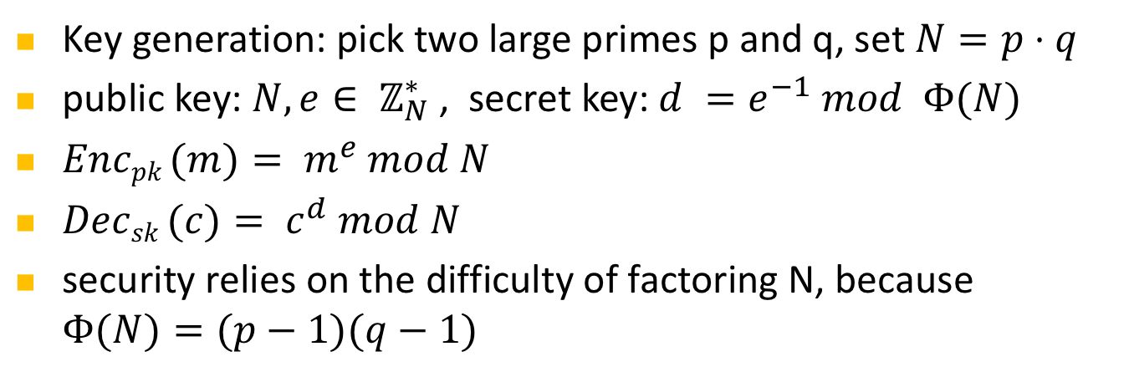
RSA Public-Key Encryption
Alice
Charlie
secret key
Eve
public key
Key generation: pick two large primes p and q, set $N=p⋅q$
public key: $N, e∈ ℤ_{N}^{∗}$, secret key: $d =e^{−1} mod Φ(N)$
$Encpk (m)= m^{e} mod N$
$Decsk (c)= c^{d} mod N$
security relies on the difficulty of factoring N, because $Φ(N)=(p−1)(q−1)$

Slide 16
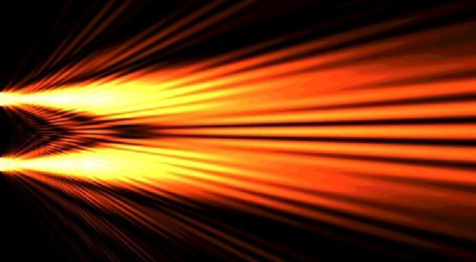

Quantum Computers
Superpositions
Interference
Entanglement
Yields a more powerful computational model:
  Shor’s algorithm allows to factor numbers
  Grover’s algorithm allows to search faster

Slide 17
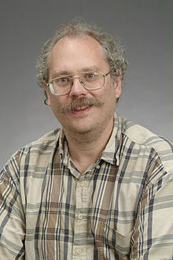
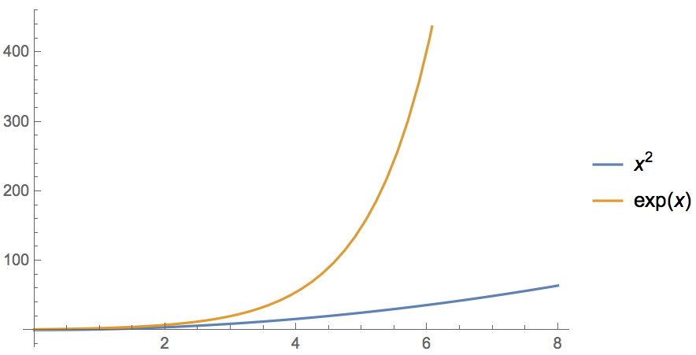
Quantum Algorithm: Factoring
[Shor ’94] Polynomial-time quantum algorithm for factoring integer numbers
Classical Computer : Exponential time
Quantum Computer : Poly-time: n²
For a 600-digit number (RSA-2048)
    Classical: age of universe
    Quantum: few minutes
What are the effects on cryptography?
Notes:
15 = 3 * 5
51 = 3 * 17
123 * 456 = 56088

Slide 18
Current Crypto under Q Attacks
Security level systems | Conventional attacks | Quantum attacks
Symmetric-key encryption (AES-256) | 256 bits of security | 128 bits
Hash functions (SHA3-256) | 128 bits | 85 bits
Public-key crypto (key exchange, digital signatures, encryption) (RSA-2048, ECC-256) | 112 bits | ~ 0 bits
Products, services, businesses relying on security either stop functioning or do not provide expected levels of security
Notes:
Ask who knows the difference between private and public key! Explain the advantage of public-key crypto

Slide 19

Do we need to worry now?
Depends on:
How long do you need to keep your secrets secure? (x years)
How much time will it take to re-tool the existing infrastructure? (y years)
How long will it take for a large-scale quantum computer to be built? (z years) Mosca: “1 in 7 to break RSA 2048 by year 2026”
Theorem (Mosca): If x + y > z, then worry.
y
x
z
secrets revealed
time
2018
2028 ?
Corollary: If x > z or y > z, you are in big trouble!
[closely based on slide by Michele Mosca]

Slide 20



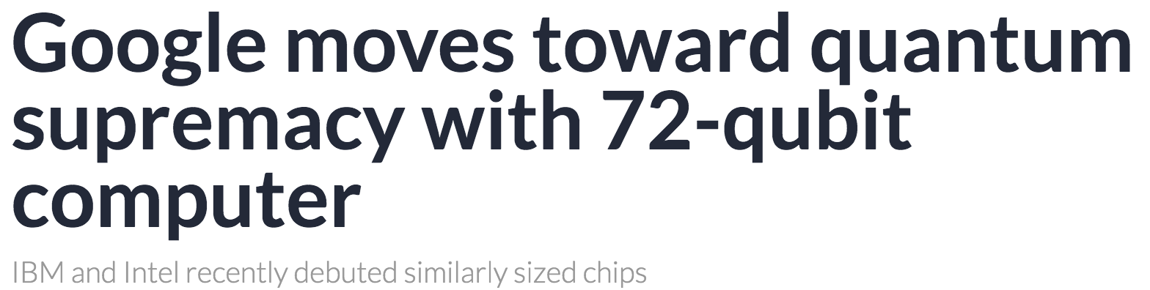
Can We Build Quantum Computers?
Possible to build in theory, no fundamental theoretical obstacles have been found yet.
Enormous technical challenge (control vs decoherence)
5 March 2018:

Slide 21
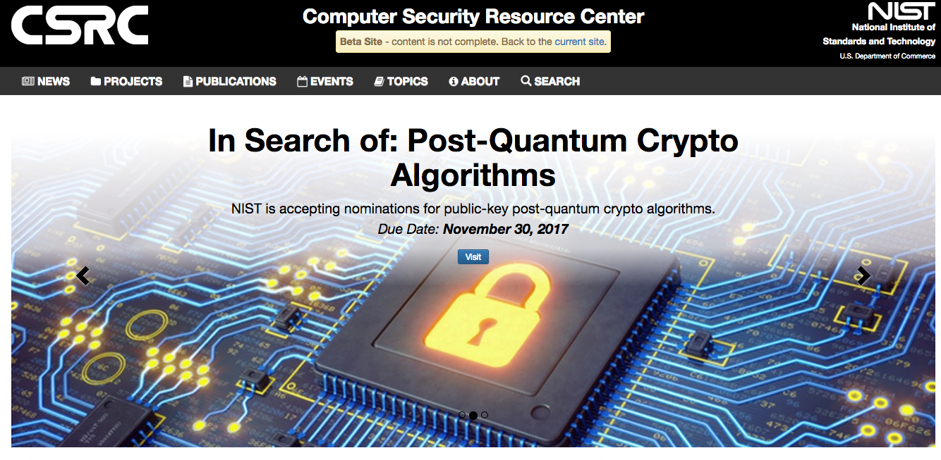

Answers to the Quantum Threat
Conventional Post-Quantum Cryptography
Can be deployed without quantum technologies
Believed to be secure against quantum attacks of the future
Quantum Cryptography
Requires some quantum technology (but no large-scale quantum computer)
Typically no computational assumptions

Slide 22
Post-Quantum Cryptography
US National Institute for Standards and Technology (NIST) is coordinating a global “competition” to find replacements for the currently used public-key schemes endangered by quantum computers
[https://csrc.nist.gov/Projects/Post-Quantum-Cryptography ]
Previous (successful) competitions for determining AES and SHA-3
This time, they do not expect to “pick a winner”

Slide 23
Post-Quantum Cryptography: Timeline
Nov 2017: Submission deadline
Apr 2018: NIST workshop – submitters’ presentations
Aug 2019: Round 2 (smaller number of submissions, small changes allowed)
2020/2021: Selection of algorithms for Round 3
2022-2024: Draft standards available
Dustin Moody: Let's Get Ready to Rumble -The NIST PQC "Competition”

Slide 24
Post-Quantum Cryptography: Scope & Criteria
Digital Signatures
Public-Key Encryption
Key establishment (KEM), like Diffie-Hellman
Security – against both classical and quantum attacks
Performance
Other properties (e.g. compatibility, resistance to side-channel attacks, simplicity & flexibility, etc.)
No clear consensus on best way to measure quantum attacks (might depend on quantum hardware)
Dustin Moody: Let's Get Ready to Rumble -The NIST PQC "Competition”

Slide 25
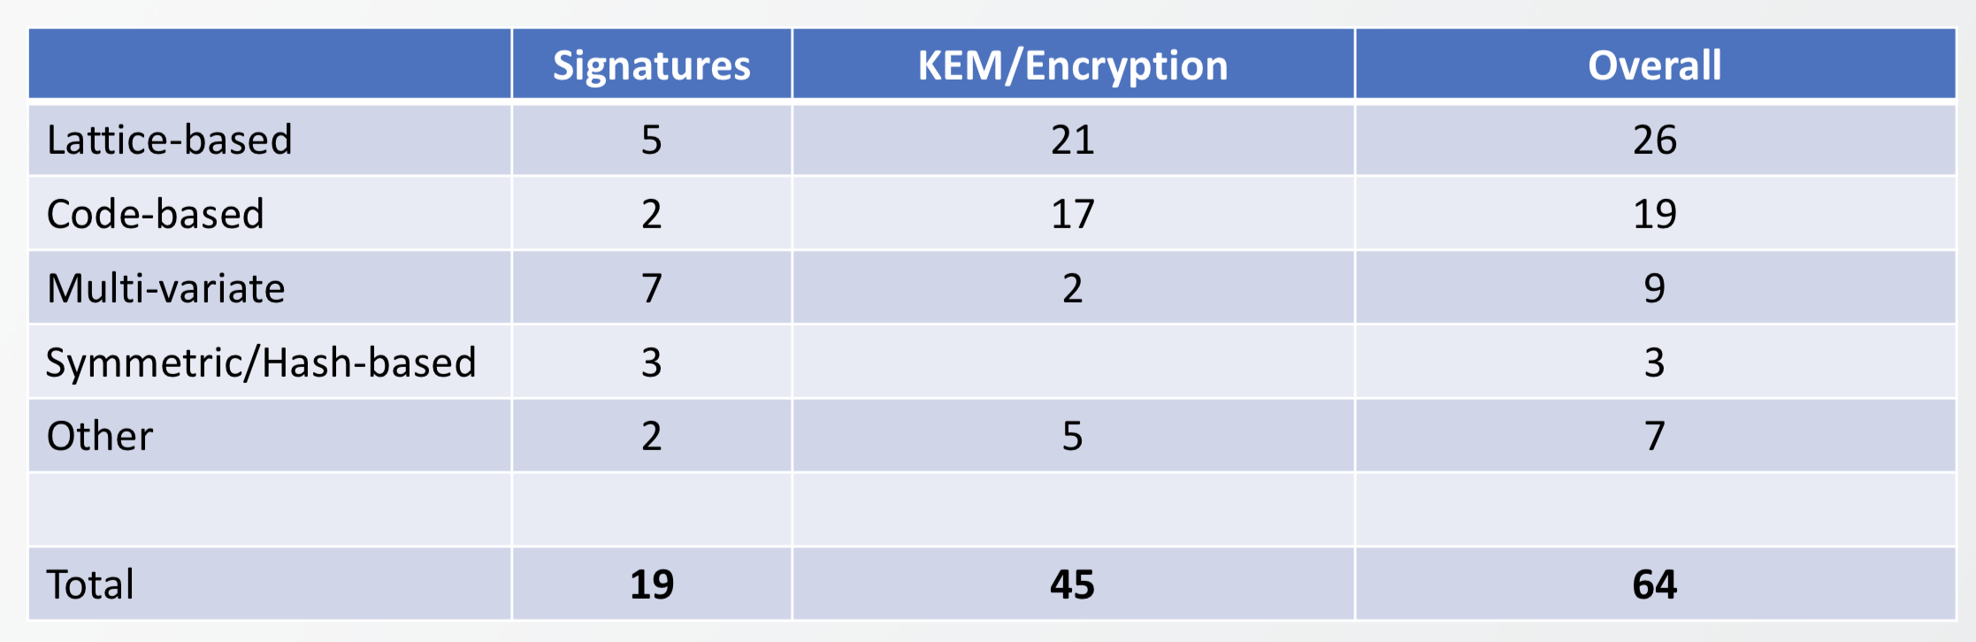
Post-Quantum Cryptography: Submissions
82 submissions, 69 accepted, 5 withdrawn
Each candidate scheme has some disadvantage
Trade-offs between pk/sk/sign sizes, speed, security etc.
Dustin Moody: Let's Get Ready to Rumble -The NIST PQC "Competition”

Slide 26

Example: Lattice-Based Cryptography
For any vectors $v1,…,vn$in $ℝn$,
the lattice spanned by $v1,…,vn$
is the set of points
$L=\{a1v1+…+anvn| ai \text{integers}\}$
Shortest Vector Problem (SVP): given a lattice $L$, find a shortest (nonzero) vector
2v₁
v₁+v₂
2v₂
v₁
v₂
2v₂-v₁
2v₂-2v₁
0

Slide 27
Example: Lattice-Based Cryptography
v₂
v₁
3v₂-4v₁
0
Shortest Vector Problem (SVP): given a lattice, find a shortest (nonzero) vector
no efficient (classical or quantum) algorithms known
public-key encryption schemes can be built on the computational hardness of SVP

Slide 28
Quantum-Safe Cryptography
Post-Quantum
Cryptography
Quantum
Key Distribution (QKD)
goal:
regain pre-quantum status quo
Protocol security:
  complexity arguments: threat of future
    classical algorithmic attacks
    quantum algorithmic attacks
Implementation security (best practise)
  local hardware / global interface attacks
  need to be exploited at time of exchange
Overall security: under threat of future technological advances but secure against known algorithms
will preserve public-key cryptography features, including signatures
global operations
no additional hardware
goal:
to deliver secret key secure against quantum computers
Protocol security:
  composable security proof under all channel attacks
Implementation security (best practise)
  local hardware/ global interface attacks
  need to be exploited at time of exchange
Overall security: not under threat of future technological advances
inherently point-to-point, needs network extension
gives keys, not signatures
change of hardware infrastructure required
[closely based on slide by Norbert Lutkenhaus, IQC]

Slide 29
How to Convince Someone of Your Presence at a Location
The Great Moon Landing Hoax
http://www.unmuseum.org/moonhoax.htm

Slide 30
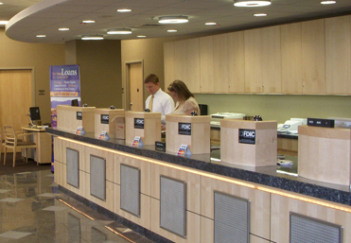
Position-Based Cryptography
Typically, cryptographic players use credentials such as
  secret information (e.g. password or secret key)
  authenticated information
  biometric features
Can the geographical location of a player be used
as cryptographic credential ?

Slide 31
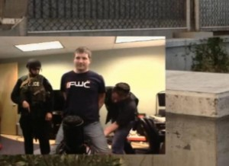
Position-Based Cryptography
Can the geographical location of a player be used as sole cryptographic credential ?
Possible Applications:
  Launching-missile command comes
  from within your military headquarters
  Talking to the correct assembly
  Pizza-delivery problem /
  avoid fake calls to emergency services
  …

Slide 32


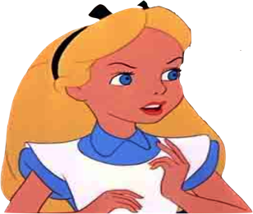

Basic task: Position Verification
Verifier1
Prover
Verifier2
Prover wants to convince verifiers that she is at a particular position
no coalition of (fake) provers, i.e. not at the claimed position, can convince verifiers
assumptions:  communication at speed of light
            instantaneous computation
            verifiers can coordinate

Slide 33




Position Verification: First Try
Verifier1
Prover
Verifier2
time
distance bounding [Brands Chaum ‘93]

Slide 34
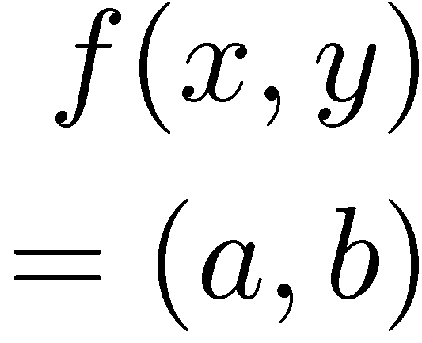


Position Verification: Second Try
Verifier1
Prover
Verifier2
position verification is classically impossible !
[Chandran Goyal Moriarty Ostrovsky: CRYPTO ’09]

Slide 35
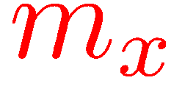



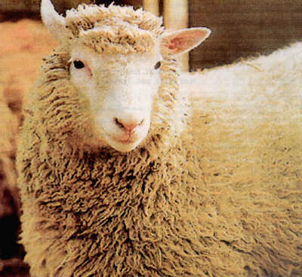
Equivalent Attacking Game
independent messages m_{x} and m_{y}
copying classical information
this is impossible quantumly

Slide 36

Position Verification: Quantum Try
?
?
?
Let us study the attacking game
[Kent Munro Spiller 03/10]

Slide 37




Attacking Game
?
?
?
?
?
impossible
but possible with entanglement!!

Slide 38

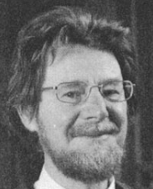



Entanglement attack
?
?
[Bell]
done if b=1
?
Notes:
appears INSTANTANEOUSLY on the other side

Slide 39

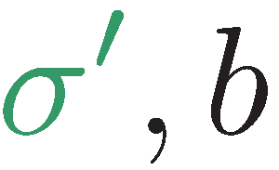
Entanglement attack
?
?
?
[Bell]
[Bell]
the correct person can reconstruct the qubit in time!
the scheme is completely broken

Slide 40
more complicated schemes?
Different schemes proposed by
  Chandran, Fehr, Gelles, Goyal, Ostrovsky [2010]
  Malaney [2010]
  Kent, Munro, Spiller [2010]
  Lau, Lo [2010]
Unfortunately they can all be broken!
  general no-go theorem [Buhrman, Chandran, Fehr, Gelles, Goyal, Ostrovsky, S 2014]

Slide 41
Most General Single-Round Scheme
U
Let us study the attacking game

Slide 42
Distributed Q Computation in 1 Round
U
using some form of back-and-forth teleportation, players succeed with probability arbitrarily close to 1
requires an exponential amount of EPR pairs
[Buhrman, Chandran, Fehr, Gelles, Goyal, Ostrovsky, Schaffner 2010] [Beigi Koenig 2011]

Slide 43



Port-Based Teleportation
?
?
no correction operation required
works only approximately
requires 2^{n} EPR pairs for teleporting n qubits
[Ishizaka Hiroshima 2008]
Notes:
no correction = correction by tracing out the other qubits

Slide 44
Using Port-Based Teleportation
[Bell]
U
U
U
U
[Beigi König ‘11]
Notes:
appears INSTANTANEOUSLY on the other side

Slide 45
Using Port-Based Teleportation
[Bell]
U
U
U
U
output:
[Beigi König ‘11]
Notes:
appears INSTANTANEOUSLY on the other side

Slide 46
No-Go Theorem
Any position-verification protocol can be broken using an exponential number of EPR-pairs
Question: is this optimal?
Does there exist a protocol such that:
  any attack requires many EPR-pairs
  honest prover and verifiers efficient

Slide 47

Experimental Considerations
?
$$b∈\{+,×\}$$
-> x
x
x
No prior entanglement model
Speed of light in fiber is lower than in vacuum
Photon loss
[Buhrman Schaffner Speelman Zbinden]

Slide 48
Thank you!
https://github.com/cschaffner/QCryptoMindmap
http://arxiv.org/abs/1510.06120
In Designs, Codes and Cryptography 2016
Thanks to all friends and colleagues that contributed to quantum cryptography and to this presentation.
Questions

Slide 50
QCrypt Conference Series
Started in 2011 by Christandl and Wehner
Steadily growing since then:
approx. 100 submissions, 30 accepted as contributions,
330 participants in Cambridge 2017. This year: Shanghai, China
goal of the conference: represent the previous year’s best results on quantum cryptography, and to support the building of a research community
Trying to keep a healthy balance between theory and experiment
Half the program consists of 4 tutorials of 90 minutes, 6-8 invited talks
[QCrypt charter, QCrypt 2017 business meetings slides]

Slide 51

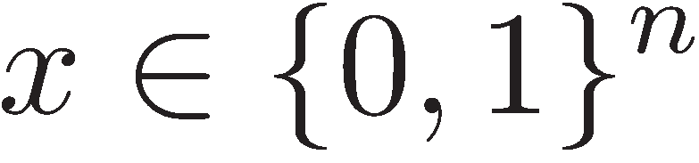
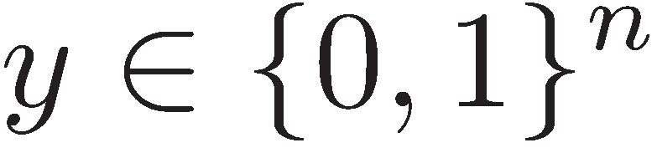
Other Single-Qubit Protocols
?
?
?
if f(x,y)=0
if f(x,y)=1
efficiently computable
[Buhrman Speelman Schaffner Zbinden]

