Slide 1
West-Life
Services overview
WP4/5
Alexandre Bonvin, Utrecht University
Madrid, May3/4 2018

Slide 2
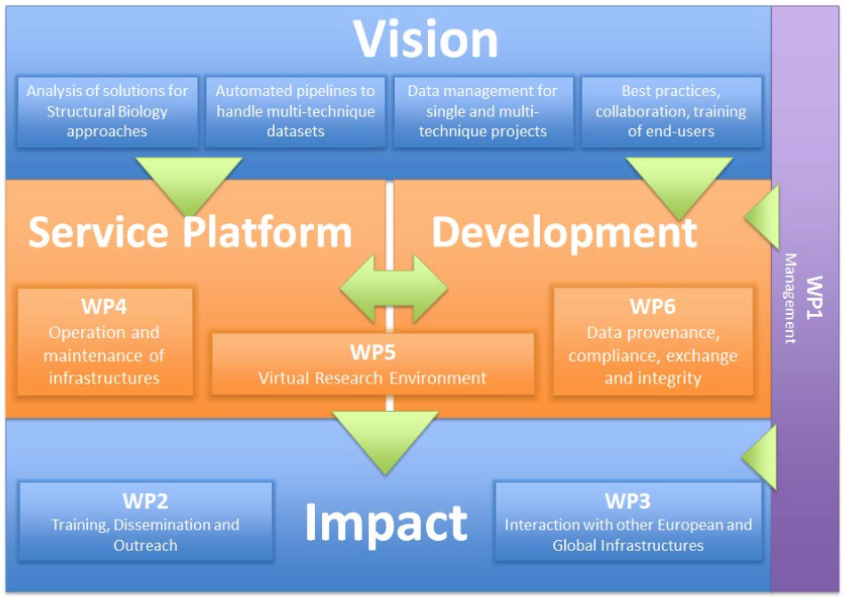

Slide 3
West-Life services benefits to end users
Seamless and transparent access to compute e-Infrastructure (grid / cloud / storage), single-sign-on solutions/implementations (WP4)
Access to user-friendly web portals that facilitates the use of complex software and workflows and guide the choices to be made and the interpretation of results (WP5)
Aggregated access at a single location to documentation and tutorials (WP5)
Support center (WP5)
Aggregated access to their data via the virtual folder mechanism (WP5/6)

Slide 4
West-Life
Operation and maintenance of the computing and data infrastructure
WP4

Slide 5
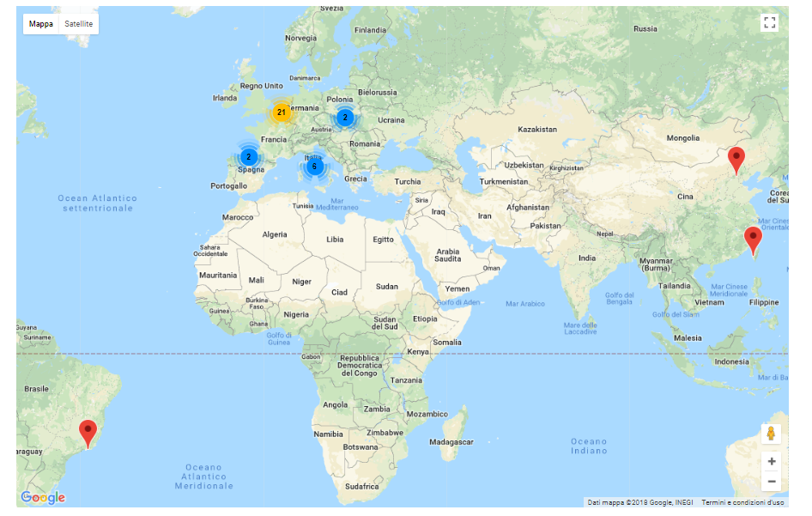
T4.1: Consolidation and operation of the infrastructure
34 grid sites (31 in EU) as taken from VAPOR monitoring tool, but currently only 24 properly accounted by EGI accounting portal

Slide 6
T4.1: Consolidation and operation of the infrastructure
Resources in EGI HTC platform (aka grid), available to enmr.eu VO
  34 sites, 90,000 CPU cores available in best effort
  SLA extended until 12/2020: 5 sites, 53 Million CPU hours (6000 CPU years), 54 TB storage
  GPU support at CIRMMP and Queen Mary University
EGI Federated Cloud resources
  support by 4 sites: INFN, CESNET/MU, IISAS, STFC
  SLA extended until 12/2020: 2 sites (INFN and CESNET/MU), up to 160 VCPUs, 3 TB storage
  GPU support at IISAS (OpenStack) and CESNET/MU (OpenNebula)
Onedata storage (14 TB) at INFN
Grid/cloud related user support via EGI GGUS (79 tickets solved)

Slide 7
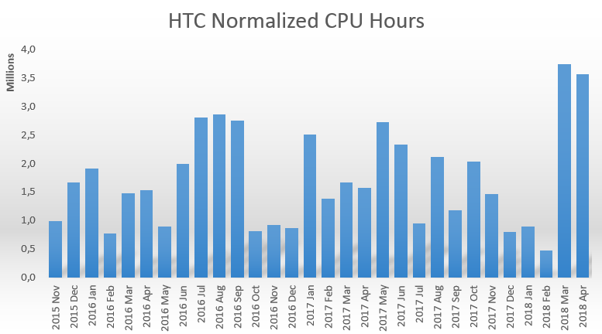
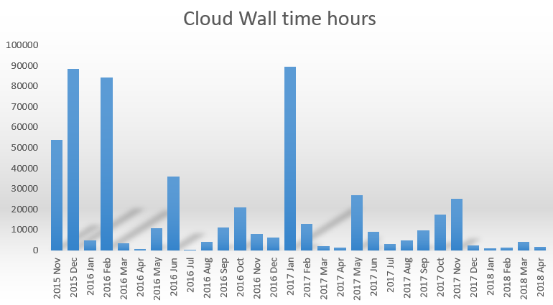
T4.1: Consolidation and operation of the infrastructure
Infrastructure usage over project duration:
HTC:
52 Million CPU hours
8.5 Million HTC jobs
Cloud
0.55 Million Wall time hours
3262 Virtual Machines

Slide 8
T4.2: Consolidation of job management mechanisms
3 portals make now use of DIRAC4EGI (HADDOCK/CS-Rosetta/AMBER)
T4.3: Programmatic Access to datasets
West-life Virtual Folder
  Service and portal components to unify access to datasets
  ARIA authentication, W-l SSO in progress
  EUDAT B2DROP integration
  Prototype Onedata integration
    Use metadata service to track directories and files
    Oneclient to mount different Oneprovider sites on local webDAV area
  Direct access to PDB and PDB-REDO
  Used by DISVIS and Scipion Web Tools

Slide 9
T4.4: Unified security and accounting model
IdP-SP proxy (auth.west-life.eu)
  Connect with identity providers (ARIA, …, Google)
  Provide consolidated identities to services
    Using Perun (CESNET+MU) identity management
  SAML and OpenID Connect protocols
16 registered services
  8 end-user portals, Openstack & Onedata (INFN), and internal/experimental services
Following technology of ELIXIR AAI
Legal and formal steps
  Fixed Acceptable Usage Policy
  User’s consent (GDPR)
Accounting support
  Leverage trust between Proxy and services
  Utilize EGI accounting schemas & tools

Slide 10
WP4 deliverables
Period I
  D4.1: Consolidated architecture of job submission and interaction with infrastructure
  D4.1 Common security model design
  D.4 Report on experience with consolidated platform and its interaction with infrastructure
  D4.4 Overview of external datasets, strategy of access methods, and implications on the portal architecture.
Period II to date
  D4.5 Report on the progress of the deployment of the consolidated platform and its interactions with infrastructure
Forthcoming
  D4.6 Final report on deployment of consolidated platform and the overall architecture

Slide 11
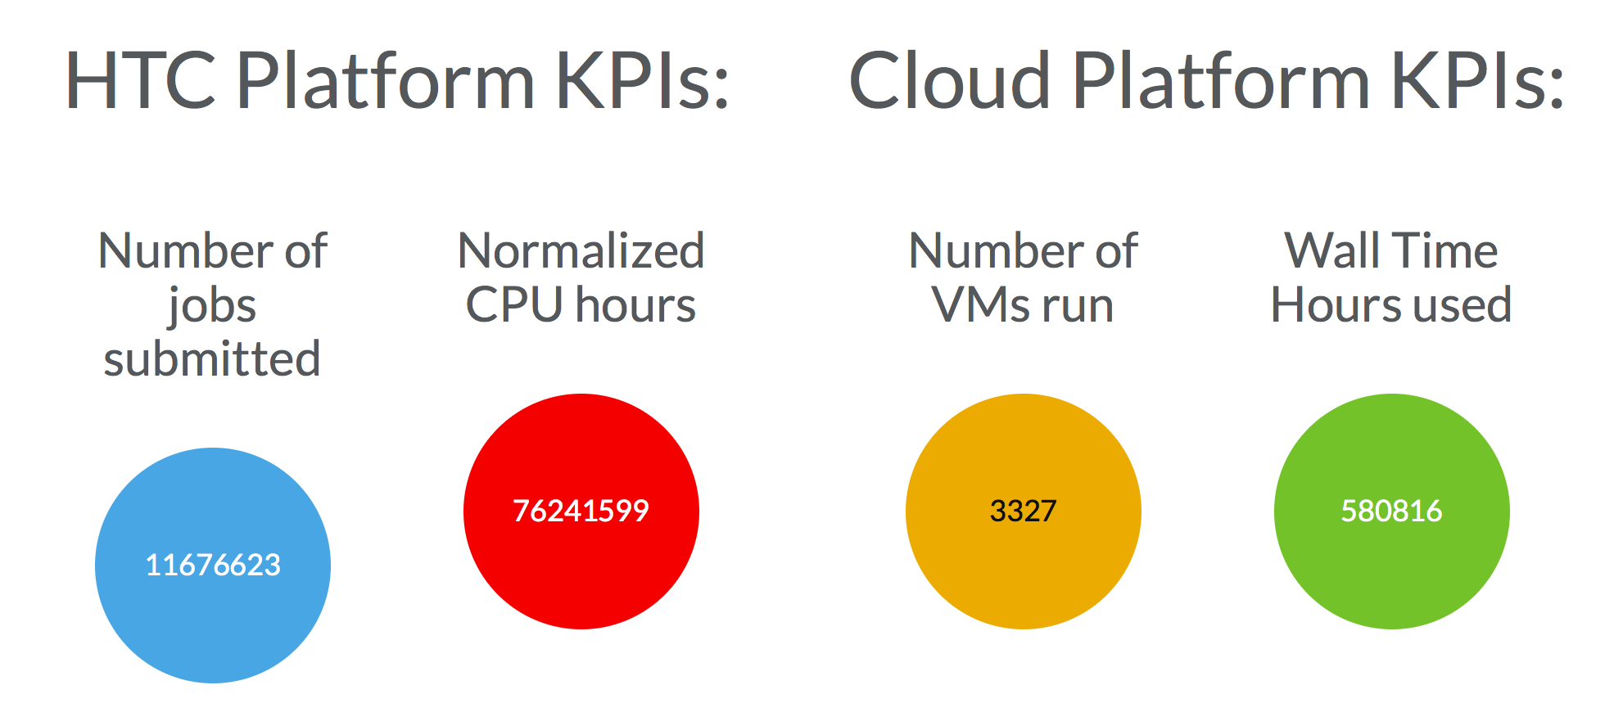
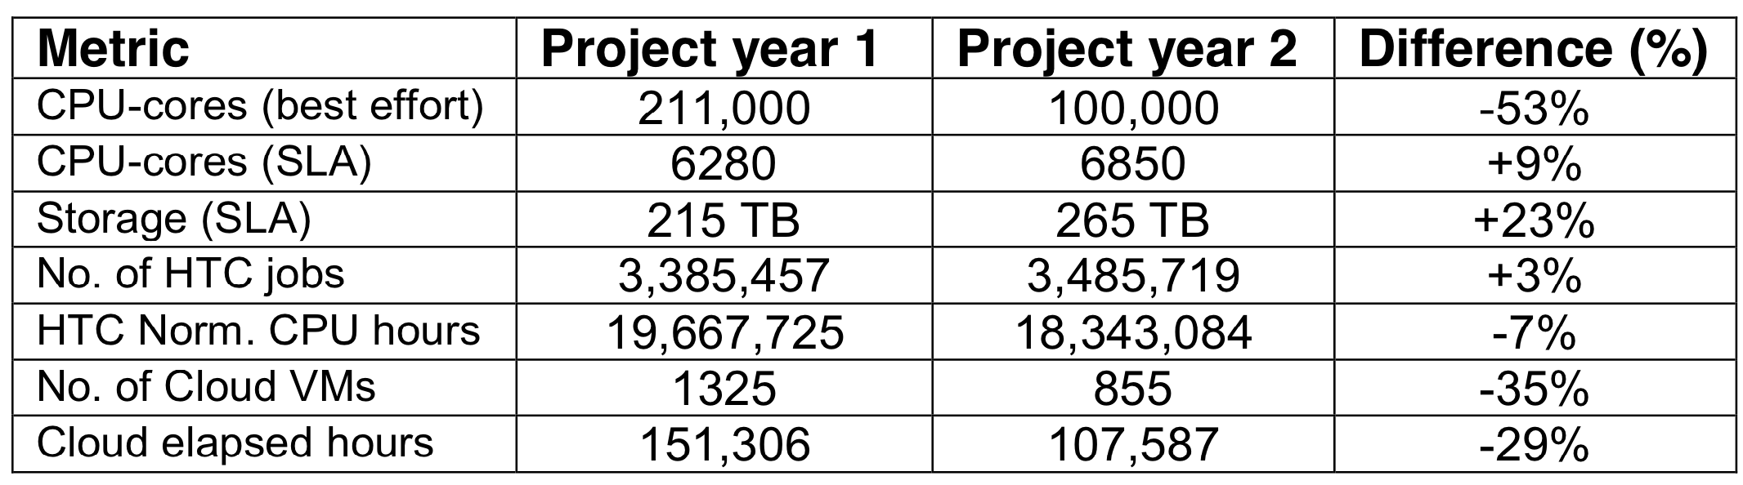
WP4 KPIs
https://about.west-life.eu/network/west-life/about/project,
at 16:40 1 May 2018

Slide 12
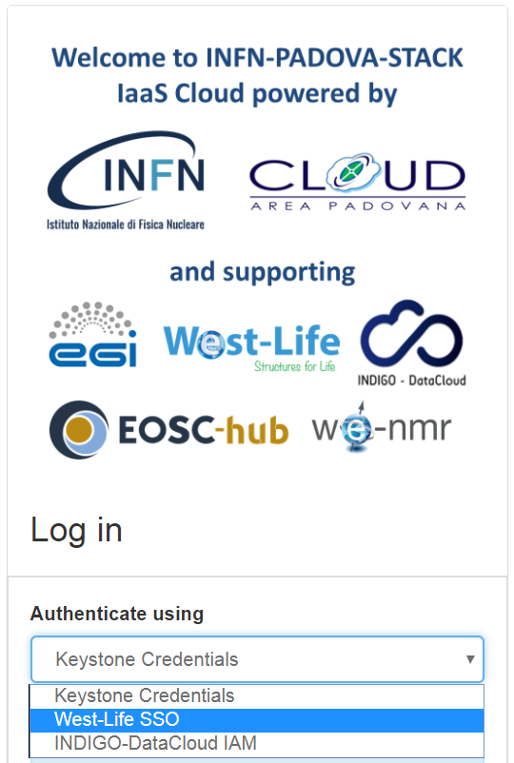
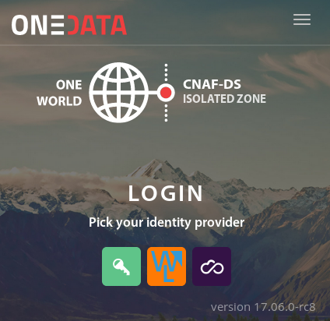
AAI infrastructure highlights
WestLife Architecture presented at DI4R in Brussels
New functions introduced
  Support for OpenId Connect protocol
  (in addition to SAML)
Integration in EGI fedcloud
Integration in Onedata

Slide 13
West-Life
Virtual Research Environment
WP5

Slide 14
WP5 – objectives
O5.1: Deployment and operation of the West-Life-VRE portal
O5.2: Establishment and operation of the West-Life-VRE support and expertise center for users and software developers, covering all VRE areas
O5.3: Provision of information and training material covering all VRE areas and offered services.
O5.4: Development and integration of new service portals.
O5.5: Provision of customized end-users VMs and/or containers for various applications.

Slide 15

T5.1
Deployment and operation of the West-Life-VRE portal
Single entry point for all our services: west-life.eu
Hosted and built on the ARIA CMS from INSTRUCT (ensures sustainability)

Slide 16
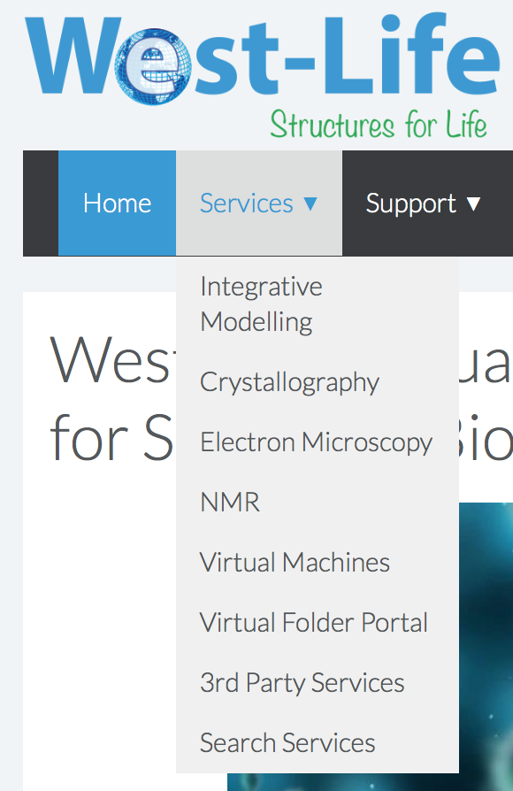
T5.1
Deployment and operation of the West-Life-VRE portal
Entry point for all our services (several inherited from WeNMR)

Slide 17
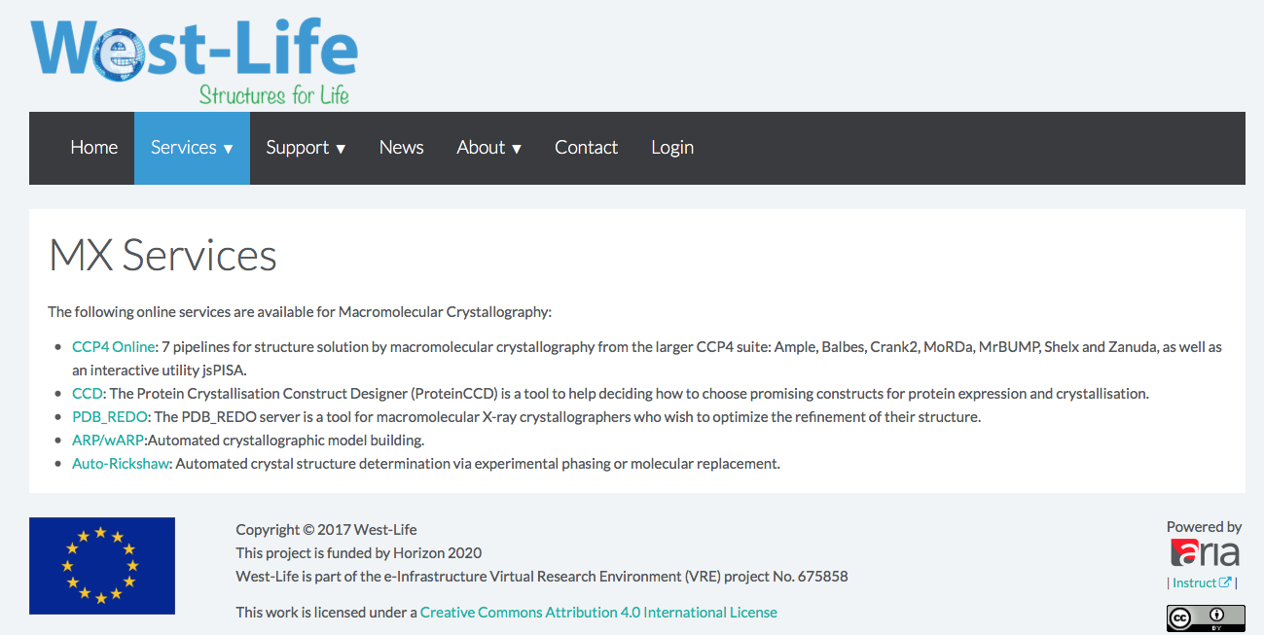
T5.1
Deployment and operation of the West-Life-VRE portal
Crystallography services

Slide 18
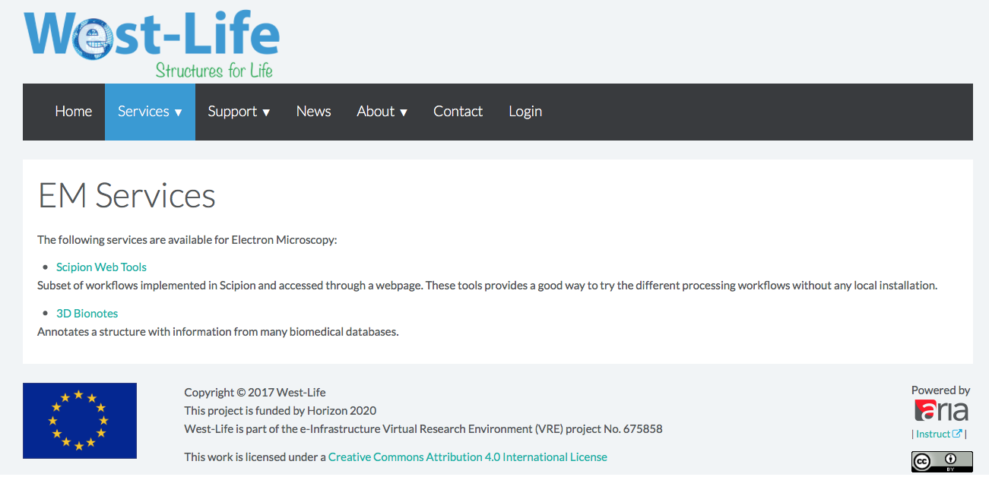
T5.1
Deployment and operation of the West-Life-VRE portal
Electron microscopy services

Slide 19
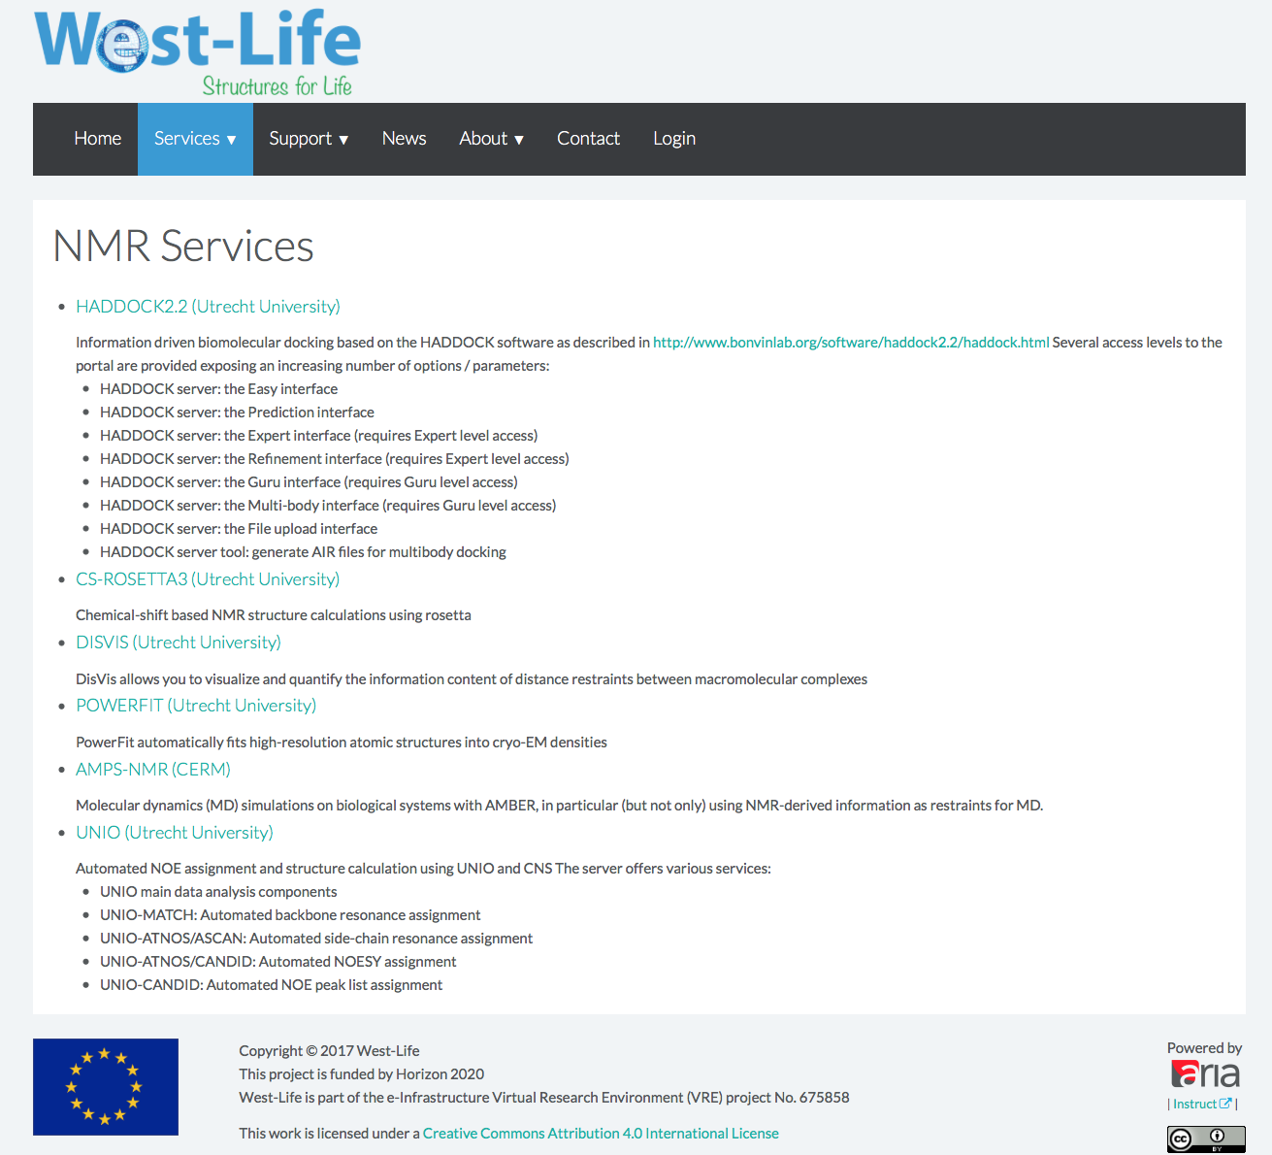
T5.1
Deployment and operation of the West-Life-VRE portal
NMR services
Most are
WeNMR legacy – in active use and maintained/
further developed

Slide 20
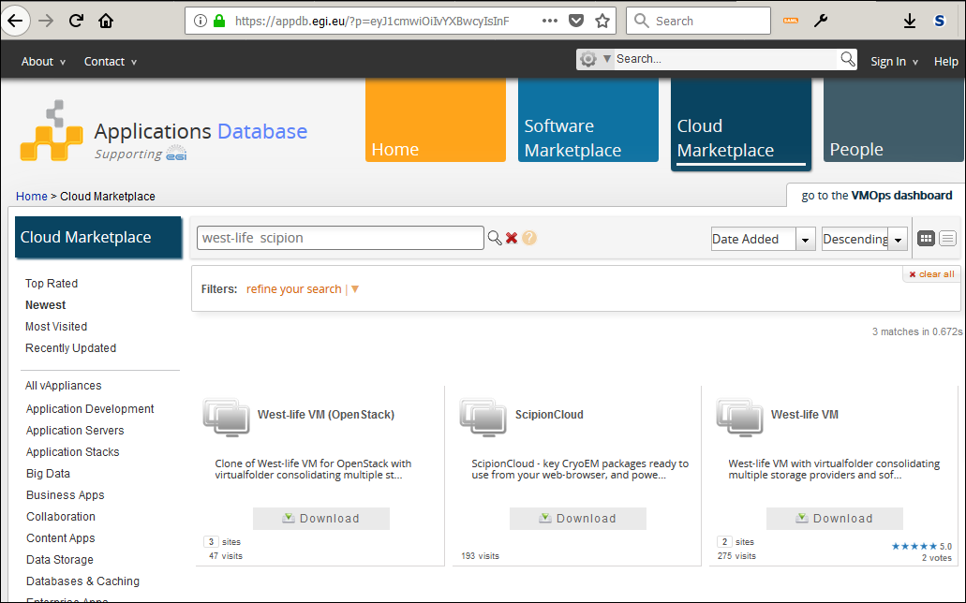
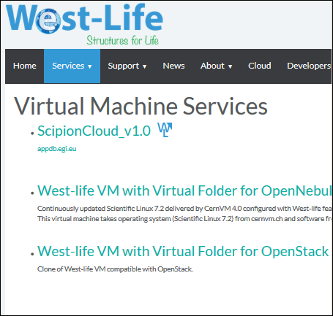
T5.1
Deployment and operation of the West-Life-VRE portal
D5.6 Virtual machines
Already used for several workshops
(INSTRUCT Utrecht Apr. 2016; NeCEN, Leiden, ISCG2017, Taipei)

Slide 21
T5.1
Deployment and operation of the West-Life-VRE portal
D5.6 Virtual machines
West-Life VM – usage of CernVM technology
  Minimalistic CernVM 4.0 image
  (18 MB)
  Operating system (Scientific Linux 7.x) and all software available via cernvmfs
  /cvmfs/west-life.egi.eu/software
  /cvmfs/wenmr.egi.eu/
  …
  Software is downloaded, cached transparently on request
  CCP4, SCIPION, WENMR
  West-Life Virtual Folder, Repository,…
Already used for several workshops
(INSTRUCT Utrecht Apr. 2016; NeCEN, Leiden, ISCG2017, Taipei)

Slide 22
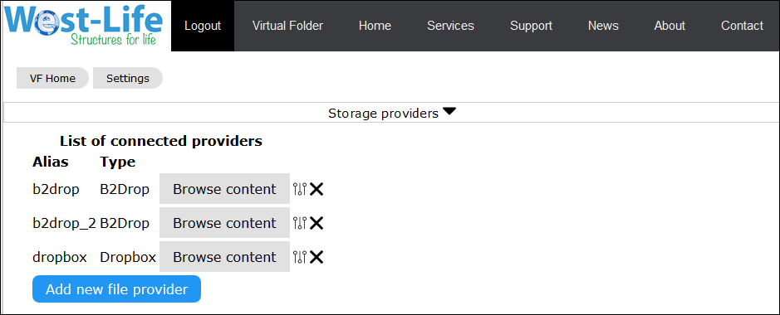
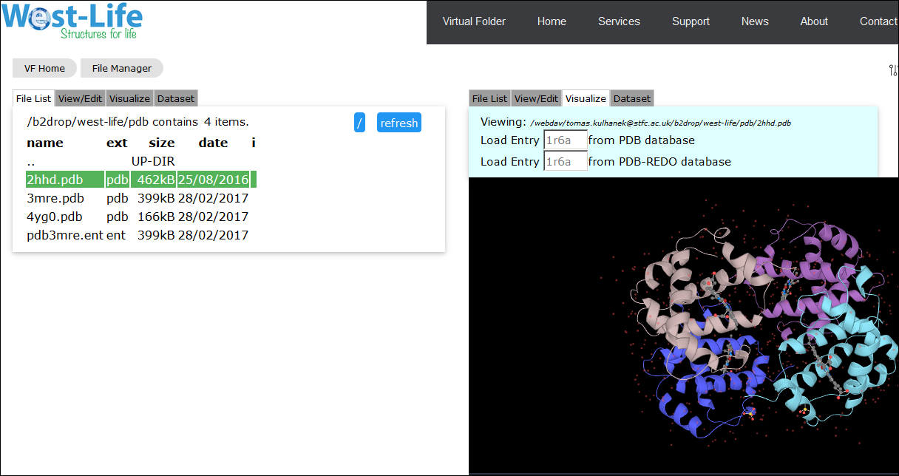
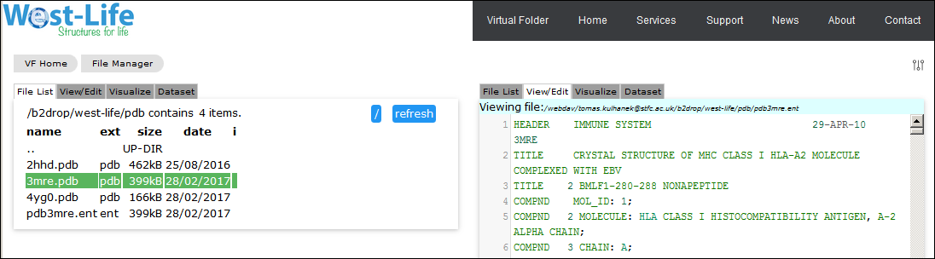
T5.1
Deployment and operation of the West-Life-VRE portal
Virtual folder portal (SSO via ARIA) – current support for B2DROP, Dropbox, WebDav services

Slide 23
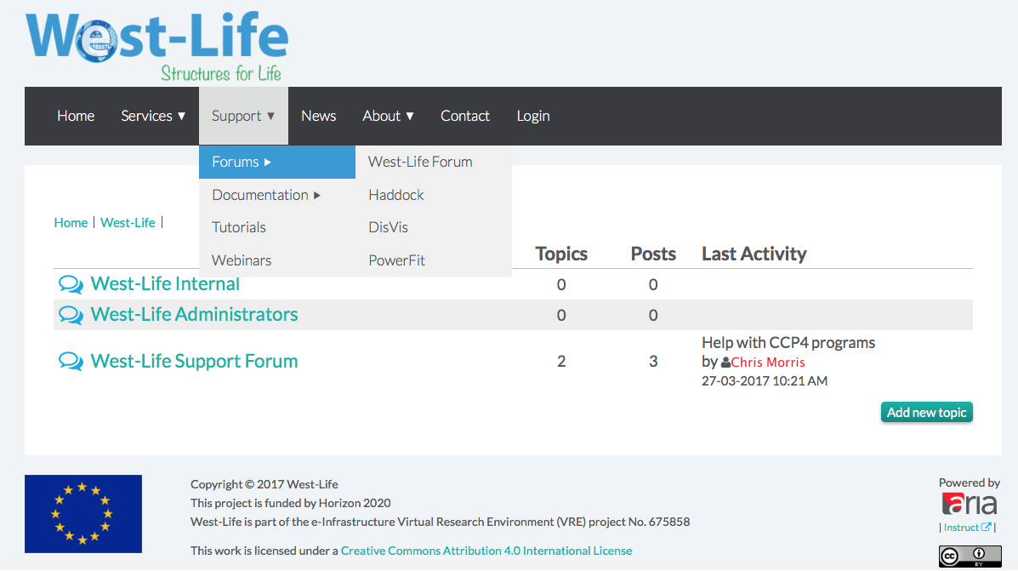
T5.2 - Knowledge and support center
The portal integrates both internal forum functionalities (a very recent development – no usage stats) and links to external forums in use

Slide 24
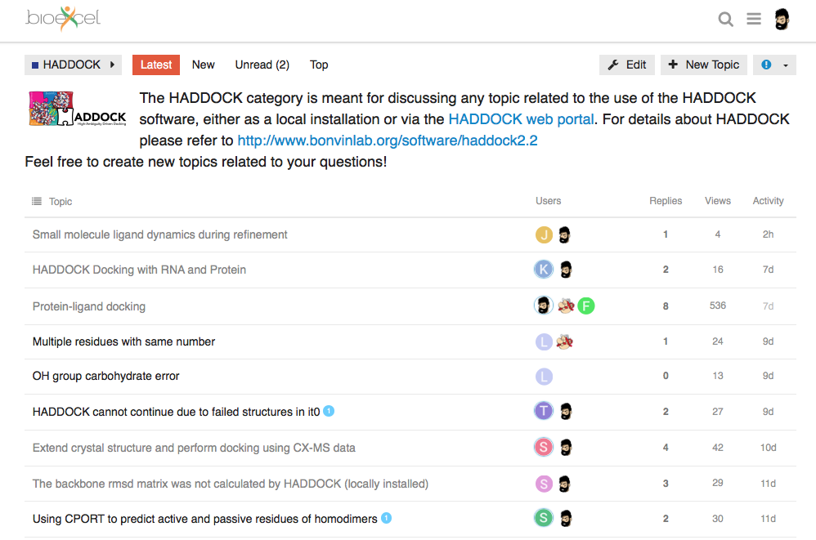
T5.2 - Knowledge and support center
HADDOCK forum in collaboration with the BioExcel CoE (ask.bioexcel.eu)

Slide 25
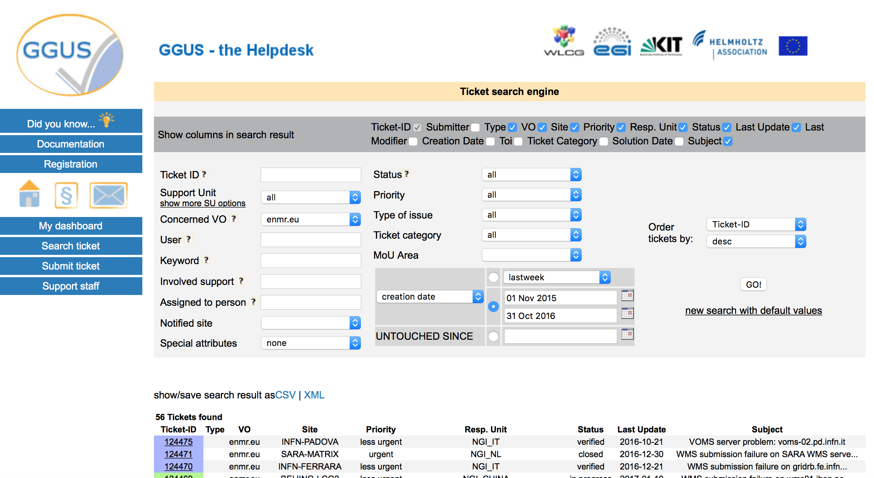
T5.2 - Knowledge and support center
For any e-infra related requests (e.g. grid or cloud-related) we use the GGUS portal
56 tickets handled in the 1st year

Slide 26
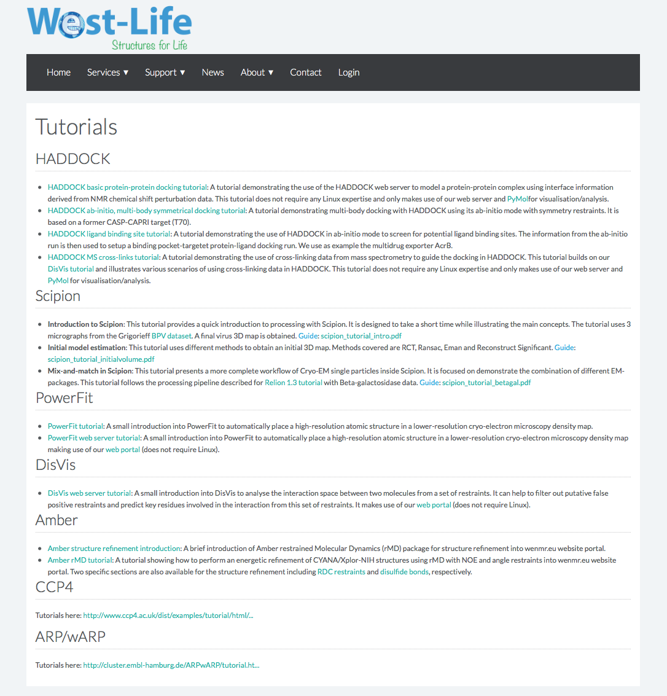
T5.2 - Knowledge and support center
Various online tutorials aggregated in the support center

Slide 27
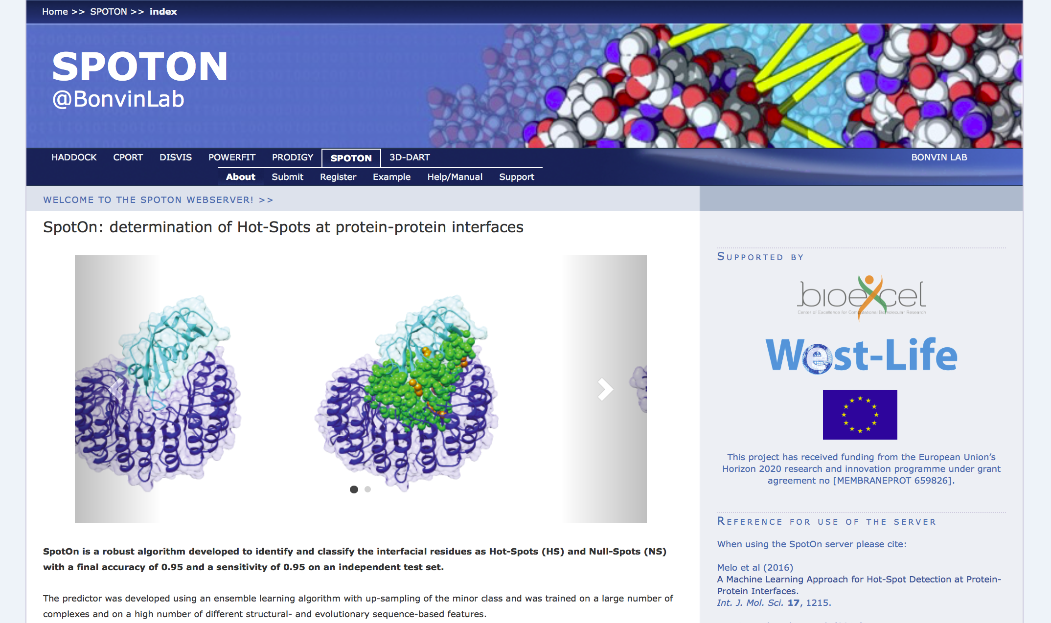
T5.3
Development and integration of new service portals
Three new portals added in 2017:
  SpotON: prediction of hot-spot residues in protein complexes
https://milou.science.uu.nl/services/SPOTON

Slide 28
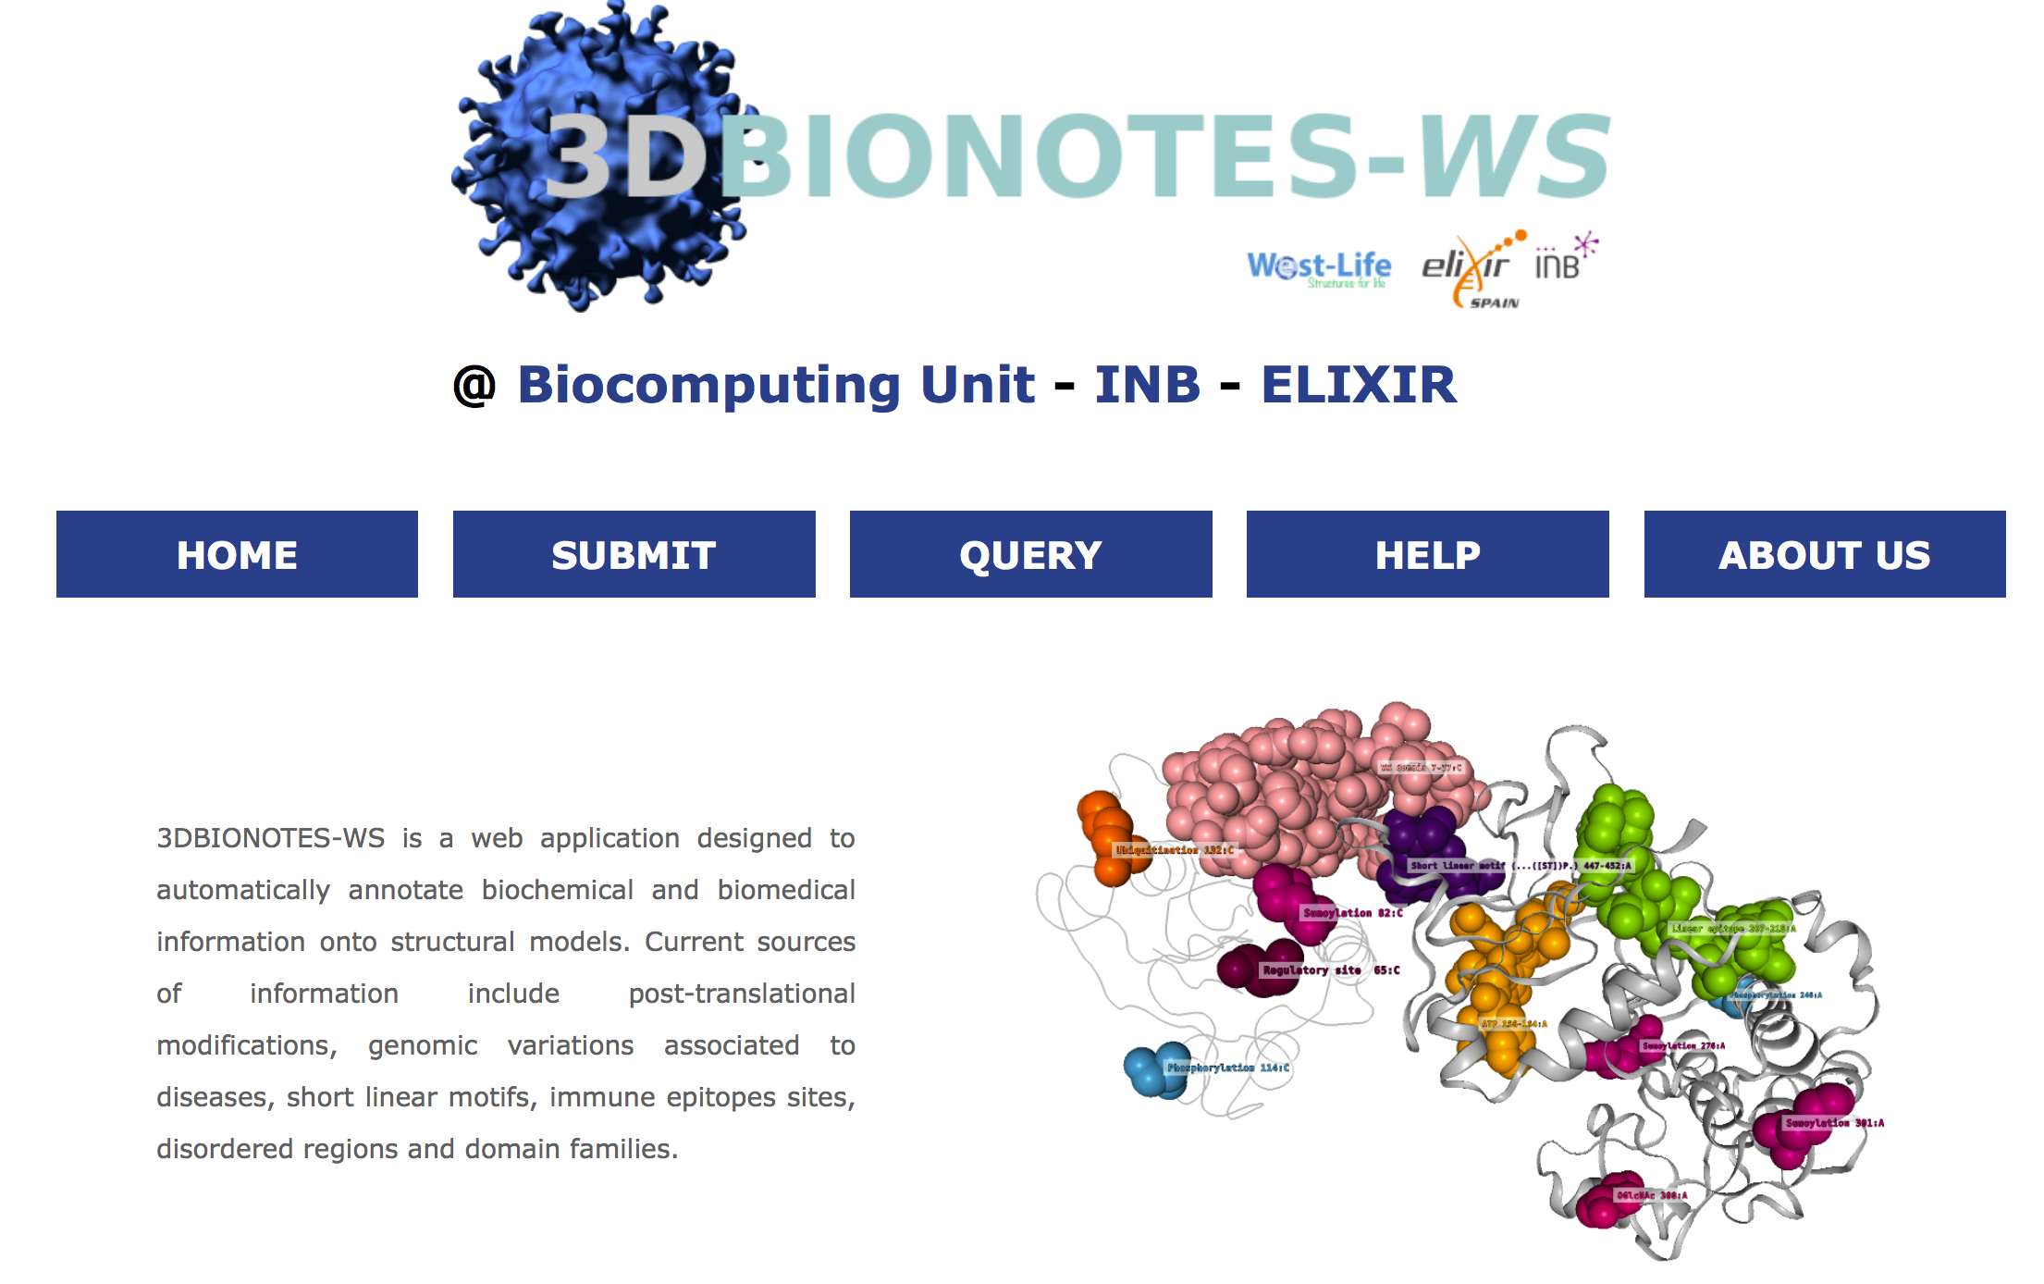
T5.3
Development and integration of new service portals
Three new portals added in 2017:
  3DBionotes: Web application to automatically annotate biochemical and biomedical information onto structural models

Slide 29
T5.3
Development and integration of new service portals
Three new portals added in 2017:
  DipCheck: A validation tool for the evaluation of protein backbone geometry
Pereira J, Lamzin VS.
IUCrJ (2017) 4, 657-670

Slide 30
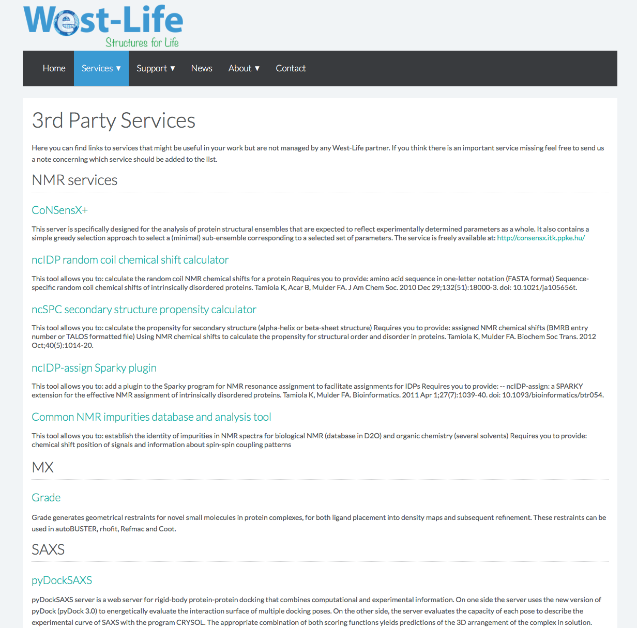
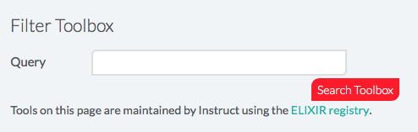
T5.3
Development and integration of new service portals
Several 3rd party services (external to the project) have been included upon request from their developers
Services have been registered in ELIXIR bio.tools (searchable from the VRE)

Slide 31
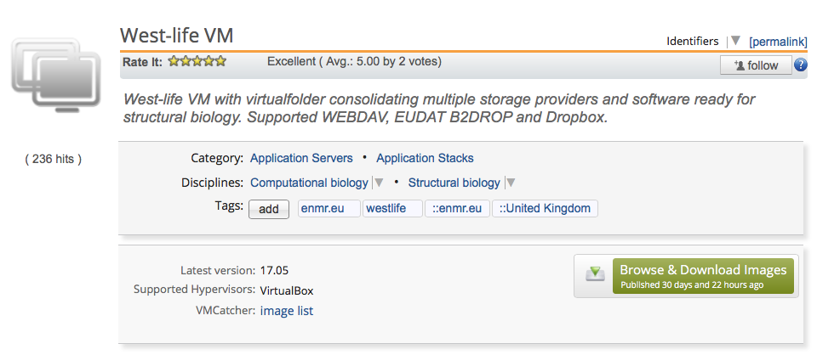
T5.4 - Customized end-users VMs
The virtual folder portal (see T5.1) is an example of customized VM
Other VMs in EGI AppDB: Scipion (see T5.1) and a standalone Virtual folder VM (more in WP6)
https://appdb.egi.eu/

Slide 32
Consolidation / update of existing portals

Slide 33
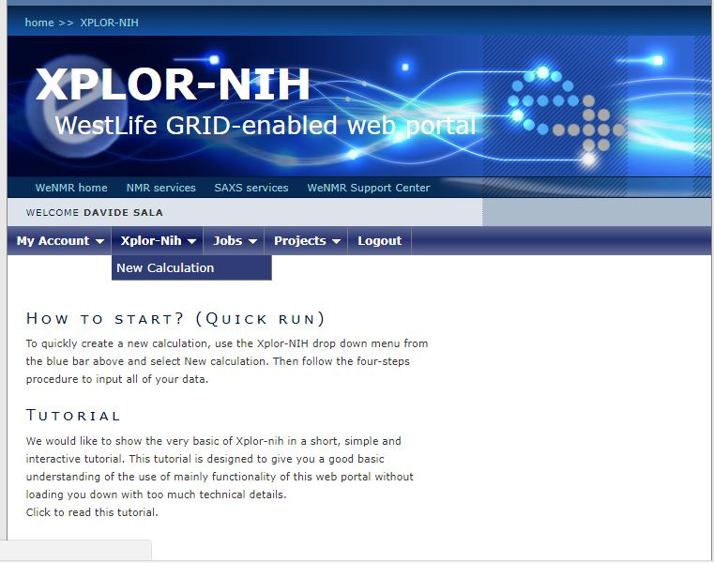
Xplor-NIH put back into production

Slide 34
AMBER
Implemented features for/with West-Life:
  consolidation of portal machinery
  connection to grid / DIRAC4EGI
  connection to data (e.g. via the VirtualFolder mechanism)

Slide 35
CCD²
Implemented features for/with West-Life:
Migration to modern development environment
New front end design with extended functionality
ARIA and West-Life login
Ability to save results locally and on shared folder

Slide 36

PDB-REDO
Implemented features for/with West-Life:
Consolidated web server and databank
mmCIF support on data in and data out
Full databank update (>100k entries; 1Mhr CPU-time)
ARIA and West-Life SSO
User-initiated databank updates (registered users or SSO)
Interfaced with CCP4 online and ARP/wARP (server)
Interfaced with 3D-Bionotes and PDBe (databank)

Slide 37

Consolidation and operation of the infrastructure - Web Portals (UU)
Migration from several standalone services to a single base server with individual services as optional modules
Portal base
  Provides general layout, styles, and utility scripts and static pages
  Central user management (Flask-Login, SSO)
    Personal User pages (Job monitoring/management, Profile management )
  Administration interface
Services
  Define custom views and forms
  Registered via portal configuration

Slide 38





Consolidation and operation of the
infrastructure - Web Portals (UU)
Migration from local provisioning to provisioning via docker-compose
Improves portability and development
Separation of the different components
Important configuration stored in docker compose file
Easy to switch between development/production configuration
Easy scaling by deploying to a docker swarm
Static content
SSL
Web portal
User database

Slide 39

User satisfaction
Implementation of a simple user satisfaction survey in a number of portals
Sample code and documentation in GitBook
  https://h2020-westlife-eu.gitbook.io/satisfaction-plugin
Some stats (Since April 8th)
  HADDOCK 4.8 (114 respondents)
  DISVIS 5.0 (2 respondents)
  PowerFit 5.0 (2 respondents)
  SpotON 4.9 (7 respondents)

Slide 40

Building bridges between services

Slide 41
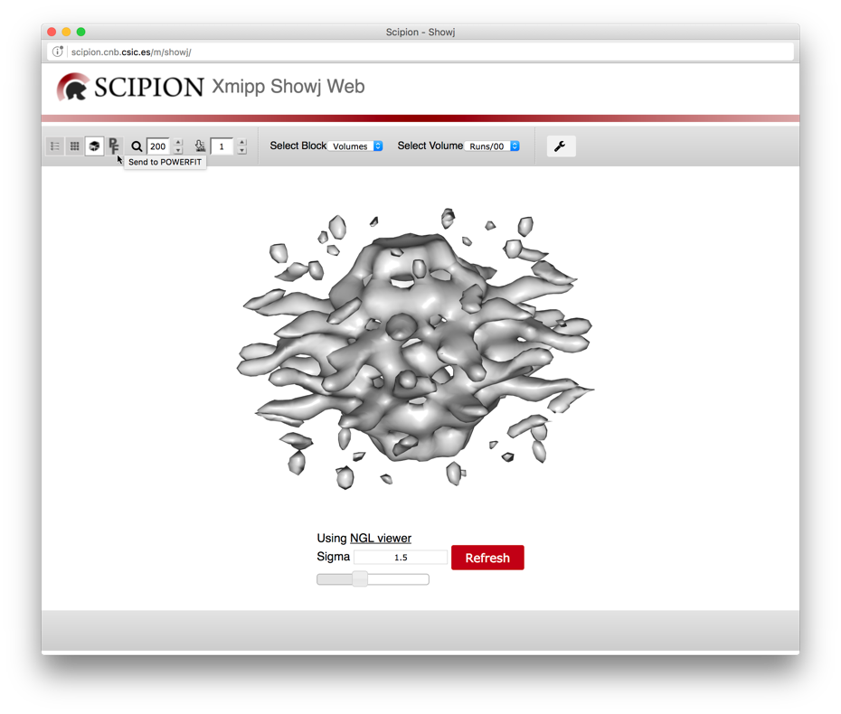

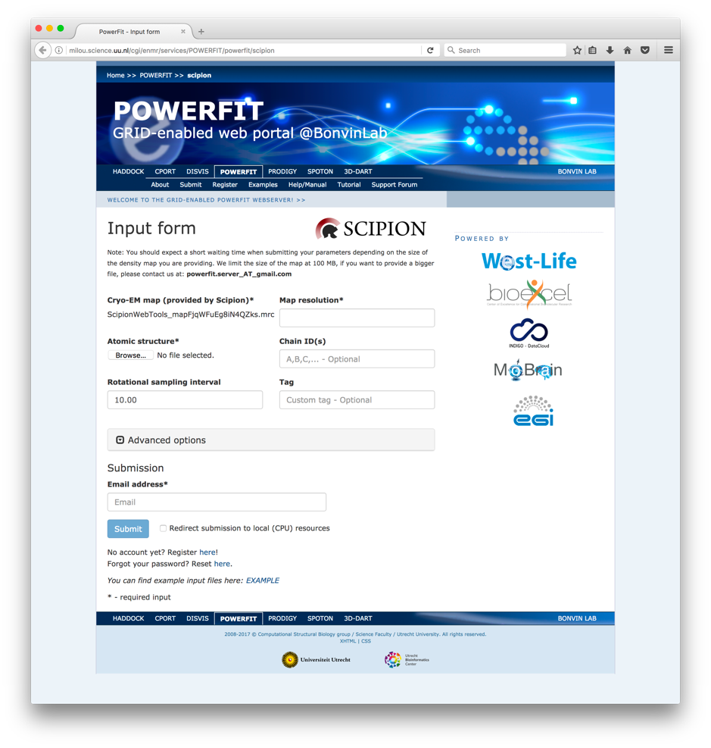
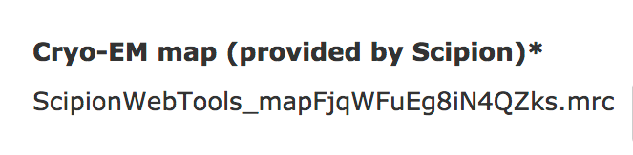
Scipion – PowerFit workflow

Slide 42
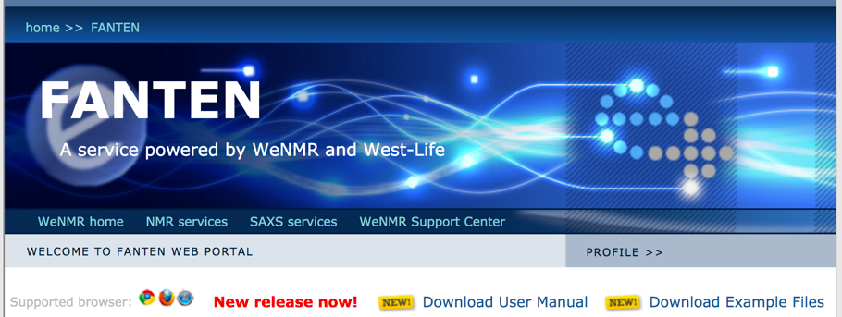
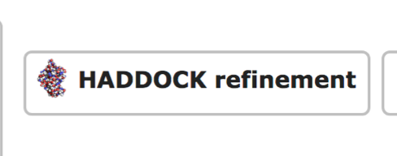
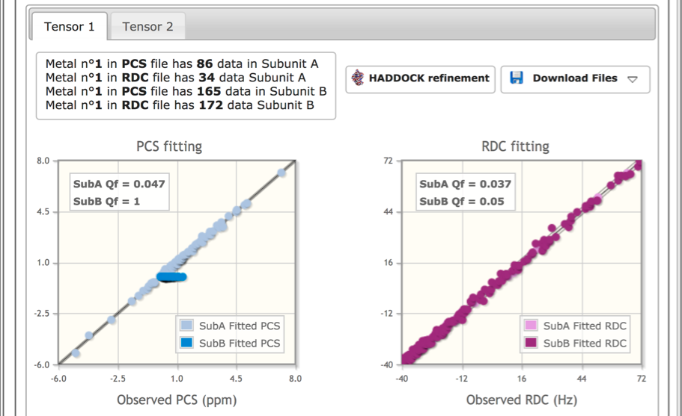
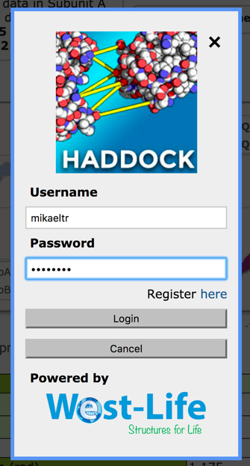
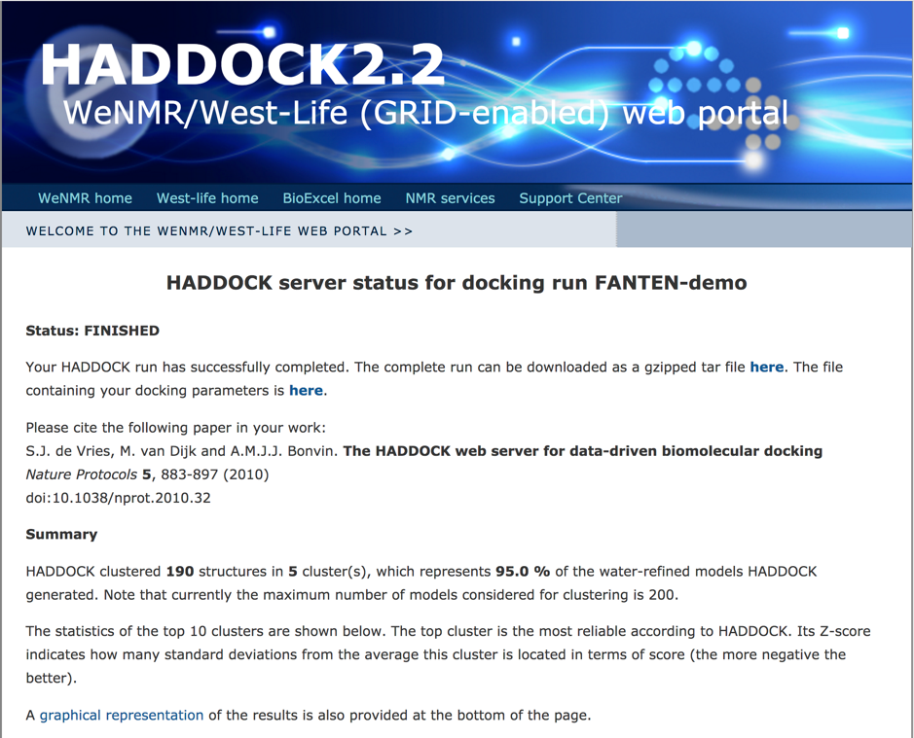
FANTEN – HADDOCK workflow

Slide 43
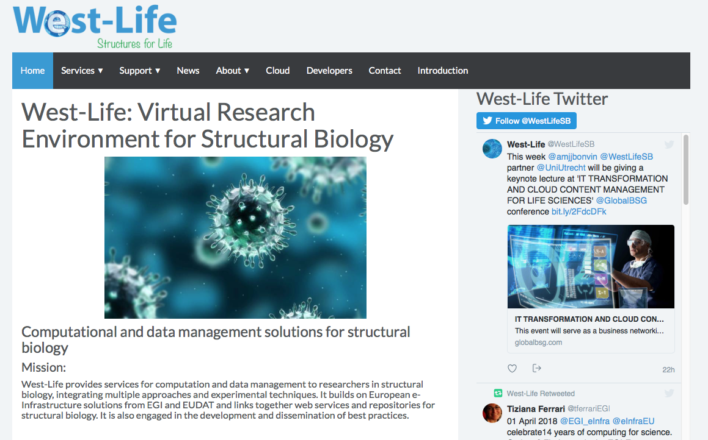
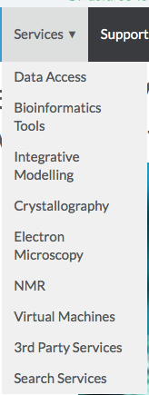
Connecting portals to data repos
west-life.eu

Slide 44
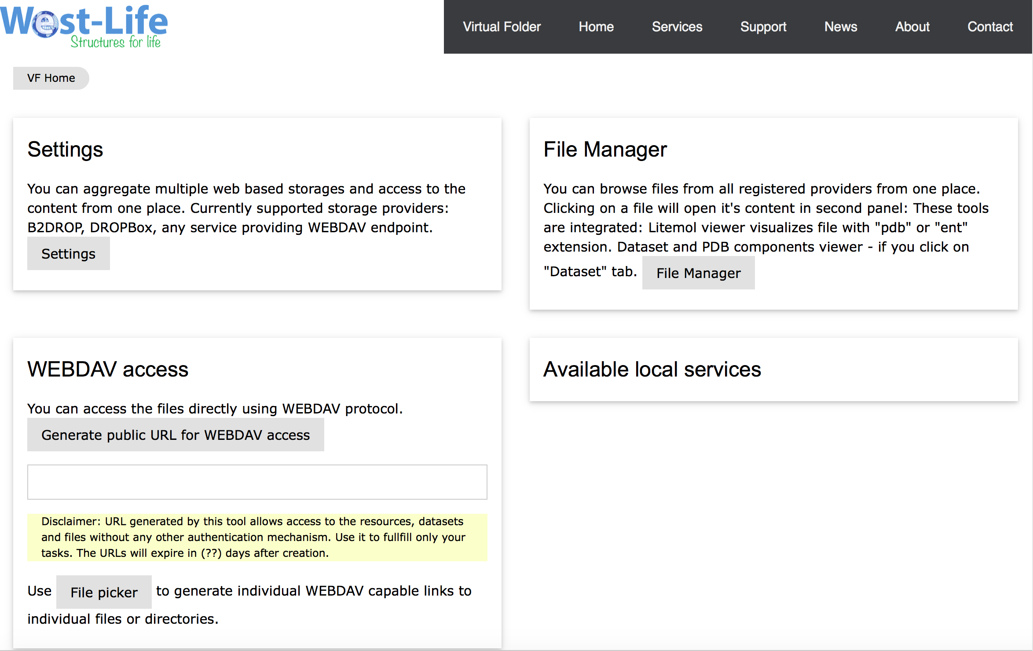
Connecting portals to data repos

Slide 45
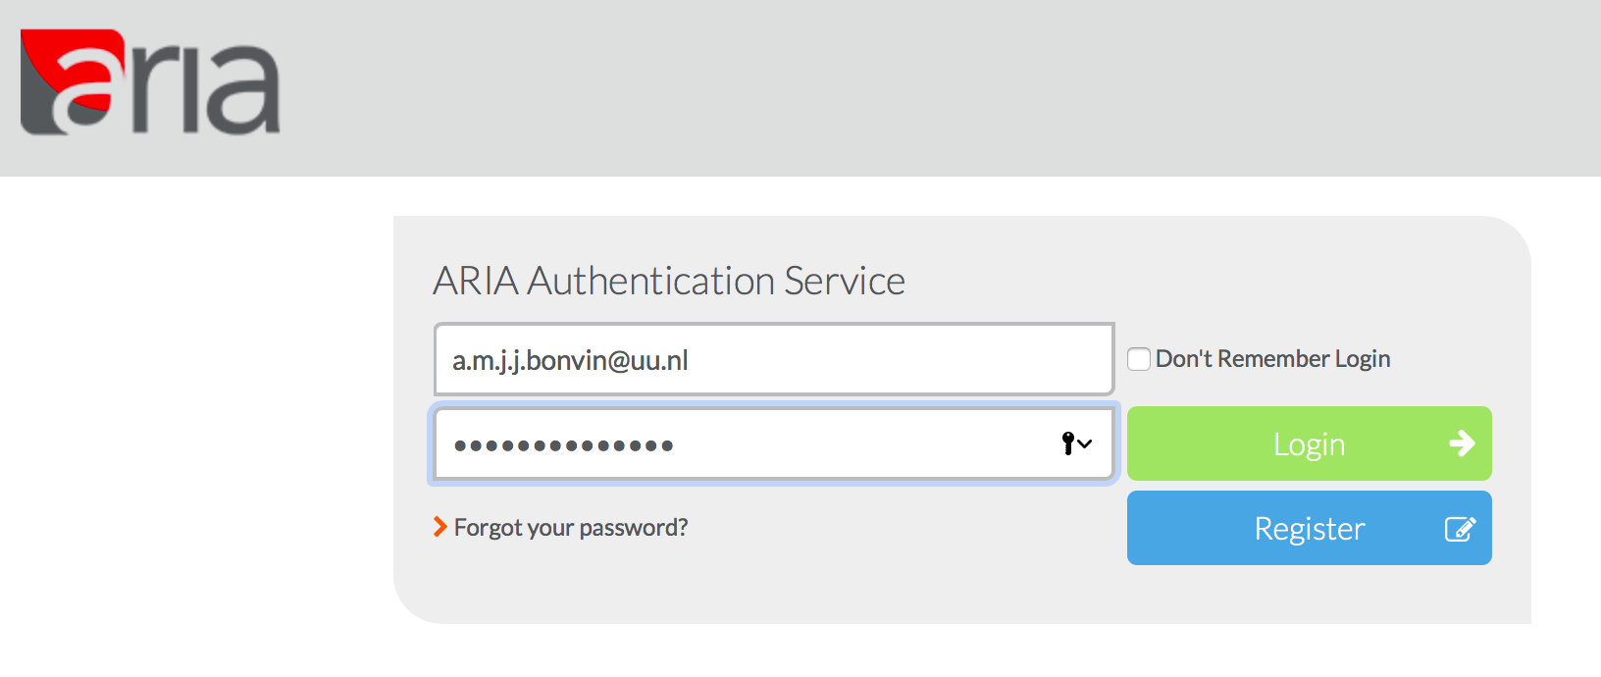
Connecting portals to data repos
SSO authentification via INSTRUCT-ERIC

Slide 46
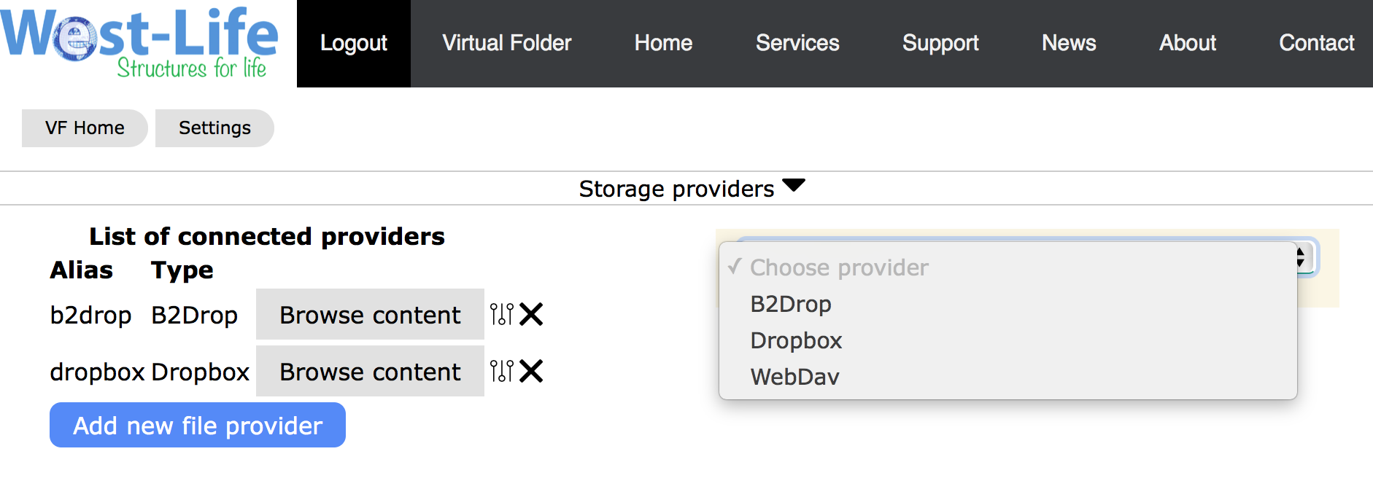
Connecting portals to data repos
Allows to aggregate storage providers

Slide 47
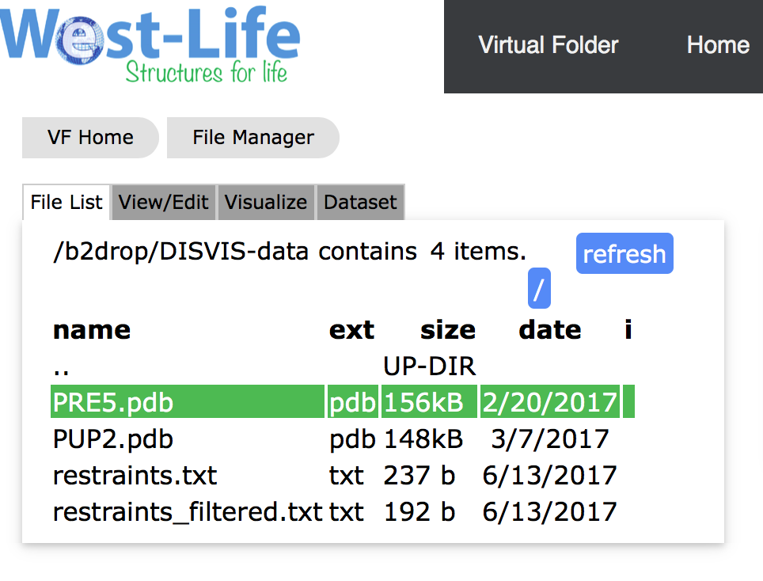
Connecting portals to data repos
Allows to browse storage

Slide 48
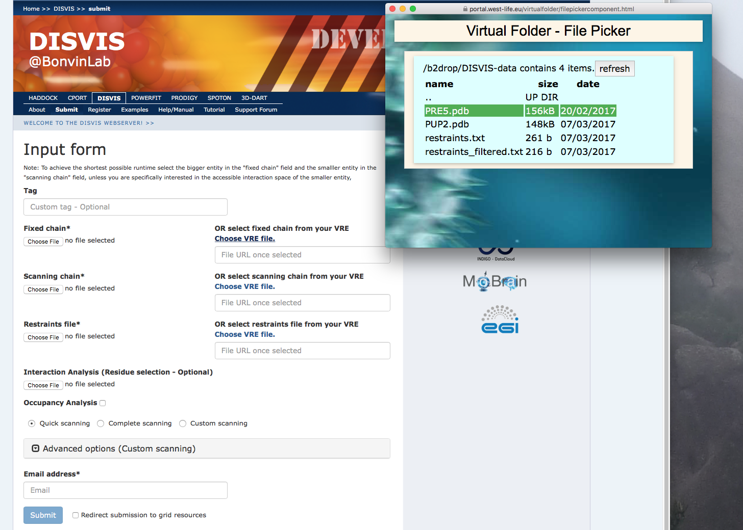
Connecting portals to data repos

Slide 49
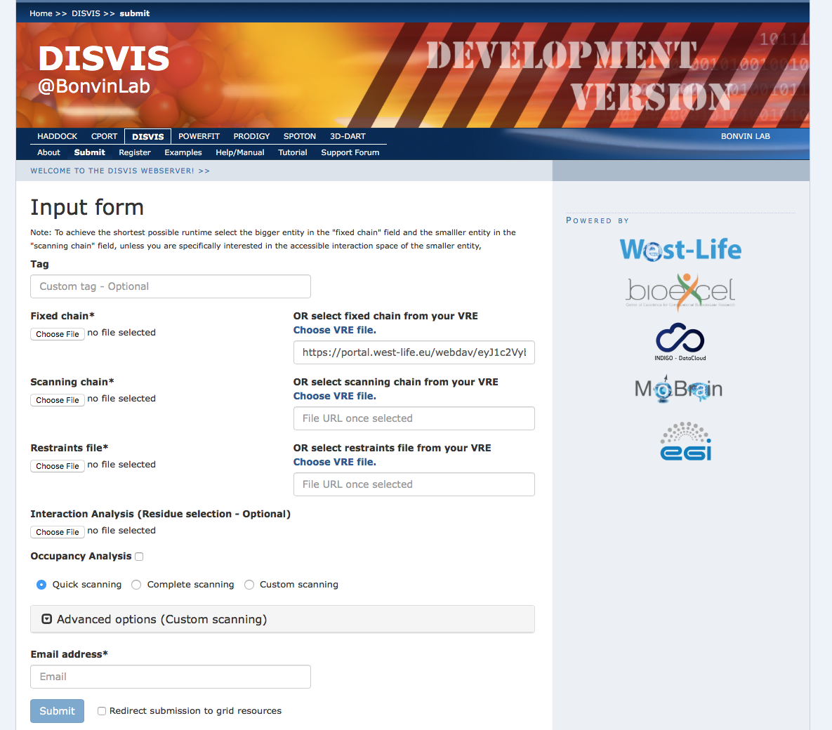
Connecting portals to data repos
Upload now also possible

Slide 50



FANTEN
SCIPION
3DBionotes
XPLOR-NIH
CCD
AMBER
PDB-REDO
CS-ROSETTA
OneData/
EUDAT/PDB
CCP4online
HADDOCK
SSO
ARP/WARP
POWERFIT
AUTORICKSSHAW
GROMACS
VICI
DISVIS
SpotON
DipCheck

Slide 51
WP5 output and KPIs

Slide 52
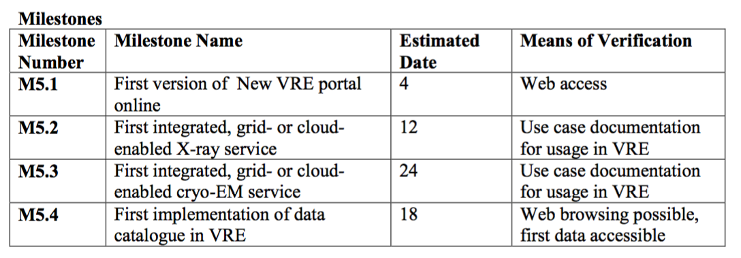

WP5 - Milestones

Slide 53
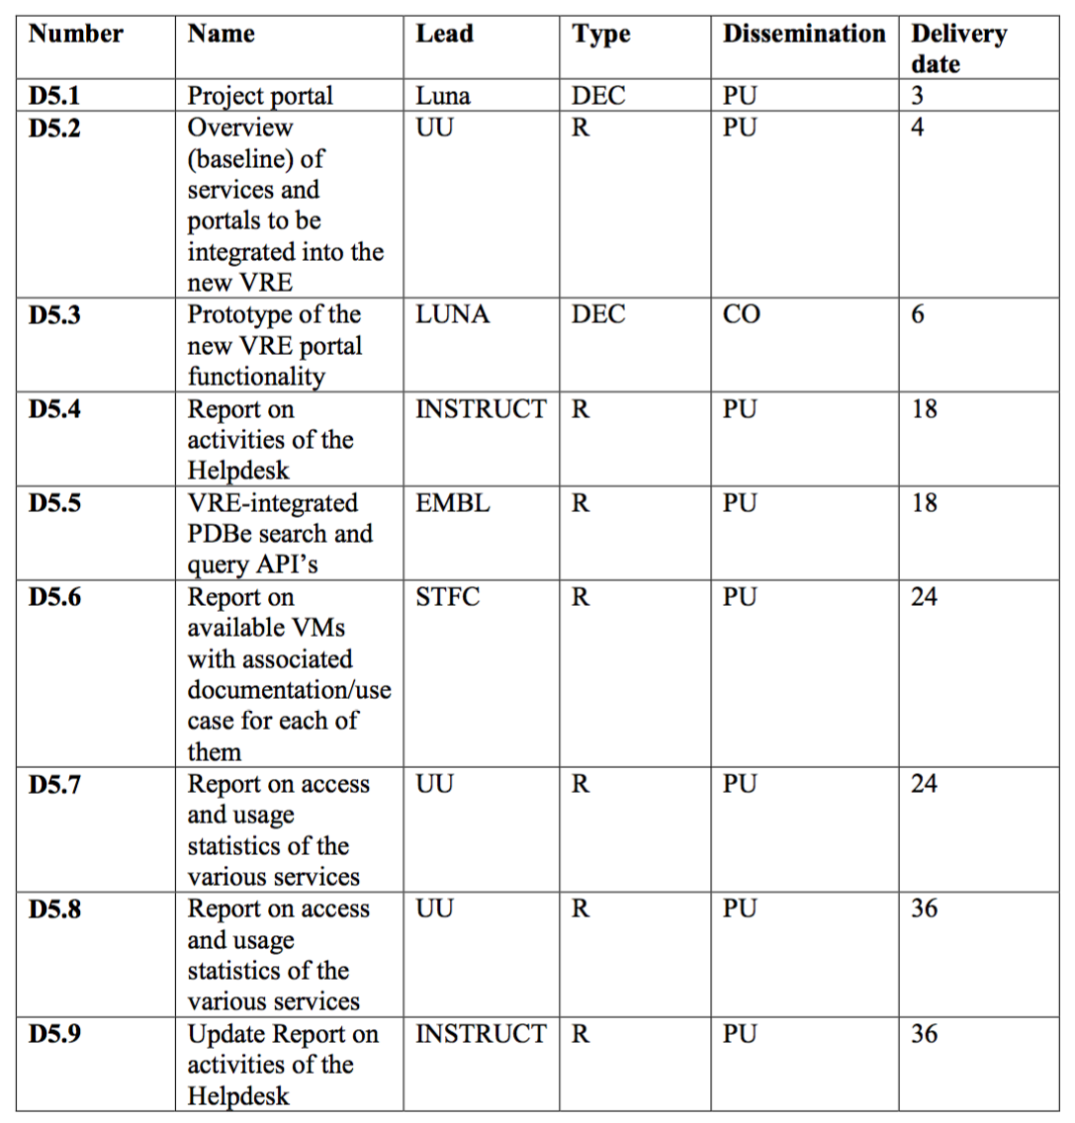
Deliverables
Notes:
" D5.4 "Report on the activities of the help desk" is also delayed. We are reviewing how best to complement the established user help resources in this field. The delay in the operational launch of the portal delayed the helpdesk planning. Identification and focused work on use cases also create the need for a targeted helpdesk approach. New staff recruitment and advancement of the portal implementation now allows us to engage with this as a priority, and we will deliver D5.4 in September."

Slide 54
KPIs for WP5
#services integrated in the VRE portal (% increase with respect to previous report)
  Previous (D5.2): 22 portals Current (D5.7): 23 +4%
#tutorials and use cases (% increase with respect to the previous report)
  Previous: 11 tutorials Current 15 +36%
  https://about.west-life.eu/network/west-life/support/tutorials

Slide 55
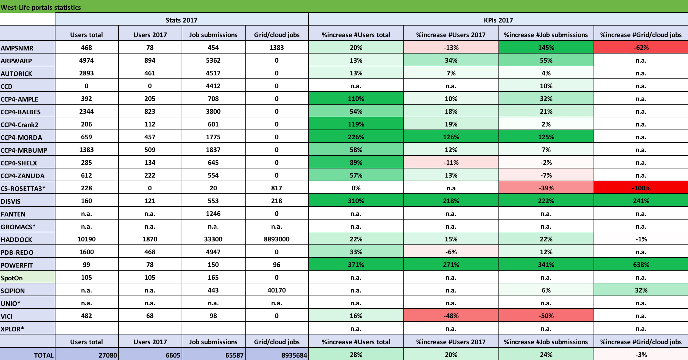
KPIs for WP5 – usage stats
* not in production in 2017

Slide 56
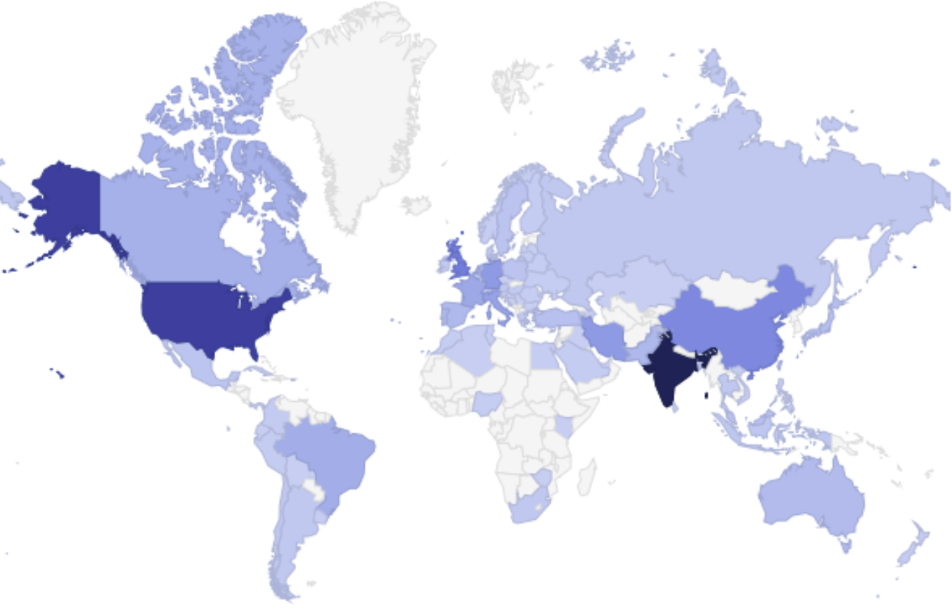
Impact: HADDOCK
Total Users: 10312
EU Users: 2201 (21.3%)
# of countries: 87

Slide 57
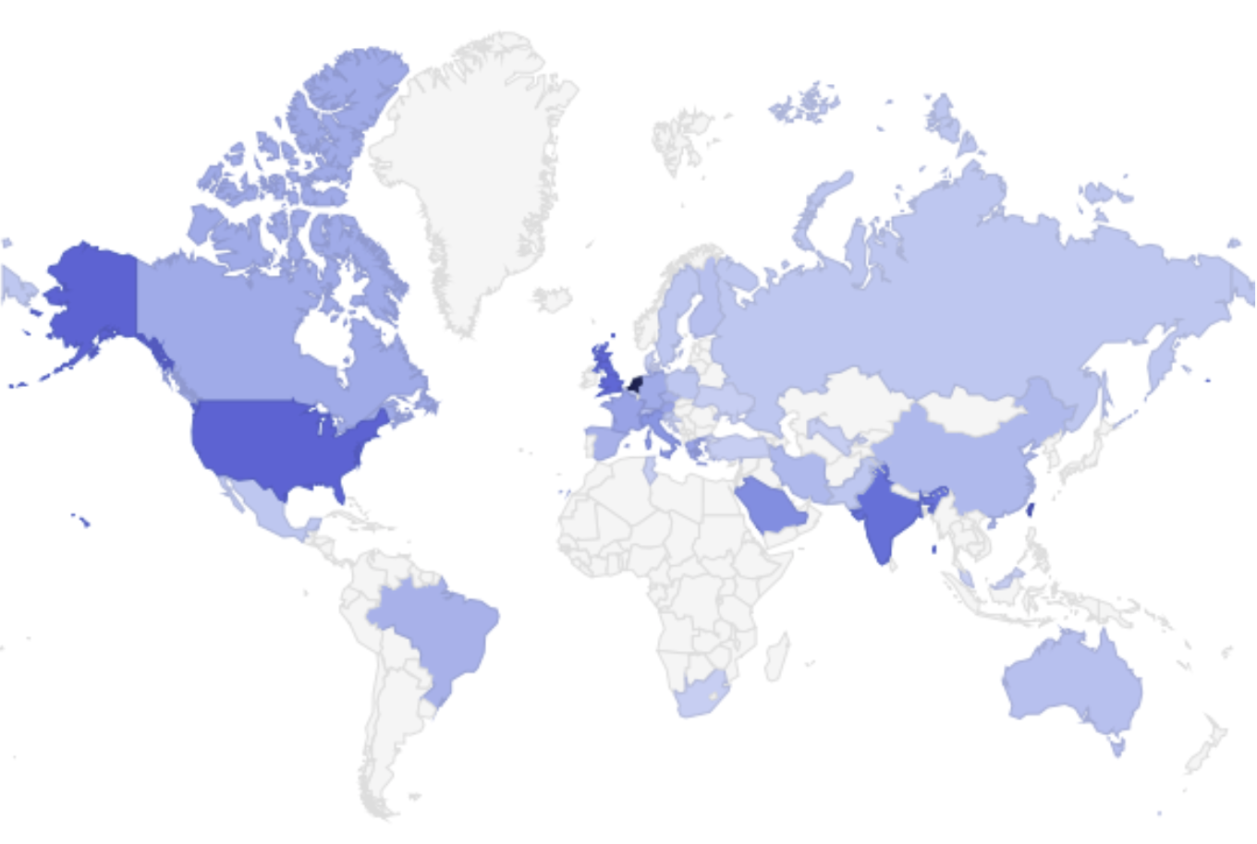
Impact: DISVIS
Total Users: 220
EU Users: 105 (47.7%)
# of countries: 36

Slide 58
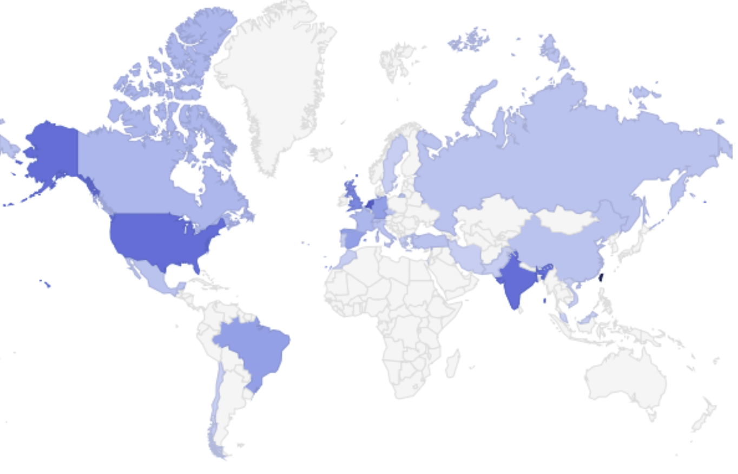
Impact: PowerFit
Total Users: 113
EU Users: 36 (31.9%)
# of countries: 30

Slide 59
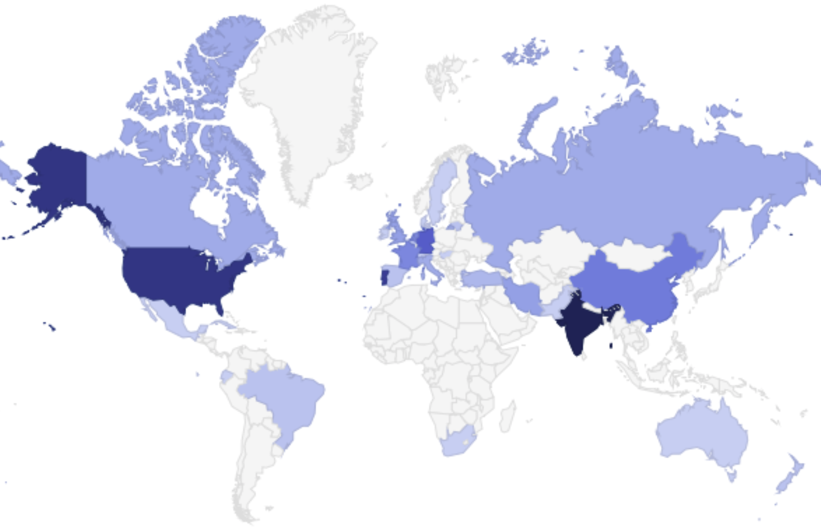
Impact: SpotON
Total Users: 153
EU Users: 60 (39.2%)
# of countries: 30

Slide 60

Impact: PDB-REDO.EU
>1800 registered users (map) and 17k unique visitors/month

Slide 61

Impact: ARP-Warp

Slide 62
WP5 - Conclusions
Very much improved branding of our entry portal
Gaining visibility: We are getting requests to integrate 3rd party services
World wide impact
New portals have been developed
Most portals are well used

Slide 63

Questions/discussion

Slide 65
AAI infrastructure summary
Standard service components
  Identity management based on Perun
    Operated by CESNET/Masaryk University
  IdP-SP-Proxy (auth.west-life.eu) providing interface to services
    Technology aligned with ELIXIR
  Follows technologies of ELIXIR AAI
Architecture presented at DI4R in Brussels

Slide 66
AAI recent development
New functions introduced
  Support for OpenId Connect protocol (in addition to SAML)
  Easier for end-services
16 portals registered with the Proxy
“Acceptable Usage Policy” fixed
The West-Life application form extended
  User’s consent (GDPR), AUP

Slide 67
AAI future work
Improved coverage of AAI
  Integration of additional end services
Support for accounting
  Leverage trust relationship between Proxy and services
  Introduce framework to collect usage records
  Utilize EGI accounting schemas/tools where possible

Slide 68
West-Life SSO in EGI Federated Cloud
The EGI Fed-Cloud site in Padova supports many authentication systems: Openstack native, Indigo IAM, West-Life SSO
The West-Life SSO pilot service is based on Secure Assertion Markup Language v.2 (SAML)
The Openstack Federated Identity API (OS-Federation) is used for both Indigo IAM and West-Life SSO
The configuration of the Openstack Identity Service (Keystone) has been changed in order to be compliant with the requirements from West-Life:
http://internal-wiki.west-life.eu/index.php/Enabling_SAML2_for_end_services
The framework Shibboleth is used for dealing with SAML handshake

Slide 69

West-Life SSO in Onedata
Federated login in Onezone is based on OpenId Connect (OIDC)
The West-Life SSO team makes available a pilot OIDC endpoint:
https://auth.west-life.eu/oidc
A pre-production installation of Onezone with the support to West-Life SSO is available at CNAF-INFN (Bologna)
Steps required for the integration:
Developed a West-Life SSO plugin for the business logic of Onezone (Erlang)
Updated the front-end (Ember.js) of Onezone with West-Life specific definitions (style-sheet, logo)

Slide 70
Integration “Virtual Folder” – Onedata /1
The integration consists of:
  A plugin for the metadata service, tracking directories and files
  An extension of the front-end, based on Aurelia framework, handling user credentials
  The oneclient, it mounts spaces from different Oneprovider sites on the local webDAV area
The credential required is the access token created by the Onezone service

Slide 71
Integration “Virtual Folder” – Onedata /2
Status
The plugin for the metadata service is quite ready
Some troubles mounting the spaces and the renewal of the access token
Front-end not yet implemented
For further details:
https://issues.infn.it/jira/browse/EOSCHUBPD-1

Slide 72
Scipion in the cloud
(Almost) contradicting requirements
  Complex software framework, many dependencies
  Resource requirements beyond usual user desktop
  Interactivity, including 3D rendering
Deployment via Cloudify
  Access the cloud resources
  Install the right software, resolve dependencies
GPU support
  Available at some EGI cloud sites, supported by OCCI
  Remote access with VirtualGL + TurboVNC
Still not so user friendly

Slide 73
Scipion in the cloud
Manage the deployment with web portal
  RESTful API keeping track of Cloudify deployments
  JS client, including noVNC remote desktop display
Scipion projects on OneData
Try at https://api-dev.scipion.ics.muni.cz/
Submitted paper to ScienceCloud2018

