Slide 1


Quantum Cryptography Beyond QKD
Christian Schaffner
Research Center for Quantum Software
Institute for Logic, Language and Computation (ILLC)
University of Amsterdam
Centrum Wiskunde & Informatica
All material available on https://homepages.cwi.nl/~schaffne
QIP 2018 Tutorial in Delft
Sunday, 14 January 2018

Slide 2
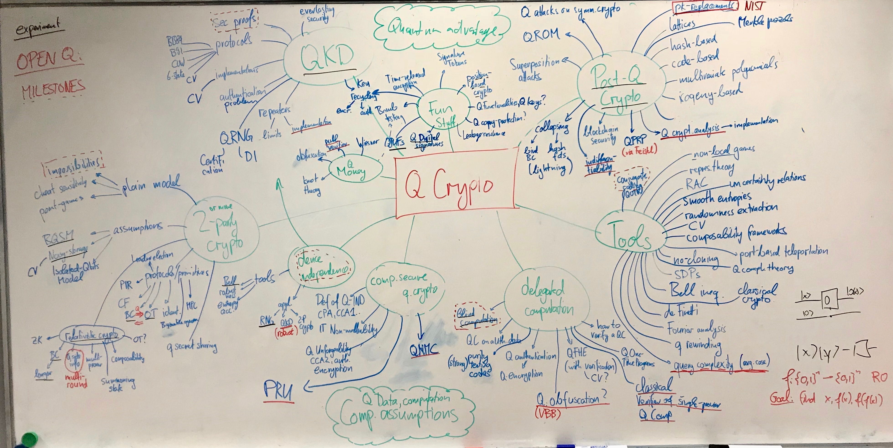
Notes:
Here’s everything I know about Q crypto

Slide 3
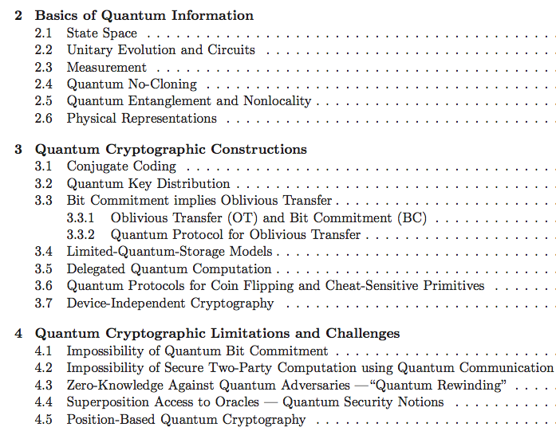
Quantum Cryptography Beyond QKD
survey article with
Anne Broadbent
aimed at classical cryptographers
http://arxiv.org/abs/1510.06120
In Designs, Codes and Cryptography 2016
[Broadbent Schaffner 16 in Designs, Codes and Cryptography]
Notes:
Why did they invite me?

Slide 4
QCrypt Conference Series
Started in 2011 by Christandl and Wehner
Steadily growing since then:
approx. 100 submissions, 30 accepted as contributions,
330 participants in Cambridge 2017. This year: Shanghai, China
It is the goal of the conference to represent the previous year’s best results on quantum cryptography, and to support the building of a research community
Trying to keep a healthy balance between theory and experiment
Half the program consists of 4 tutorials of 90 minutes, 6-8 invited talks
present some statistical observations about the last 4 editions
[QCrypt charter, QCrypt 2017 business meetings slides]

Slide 5
Overview
[thanks to Serge Fehr, Stacey Jeffery, Chris Majenz, Florian Speelman, Ronald de Wolf]
Notes:
Started from an 10-year old mindmap from 2008, right after my PhD. Added new things, more tools

Slide 6
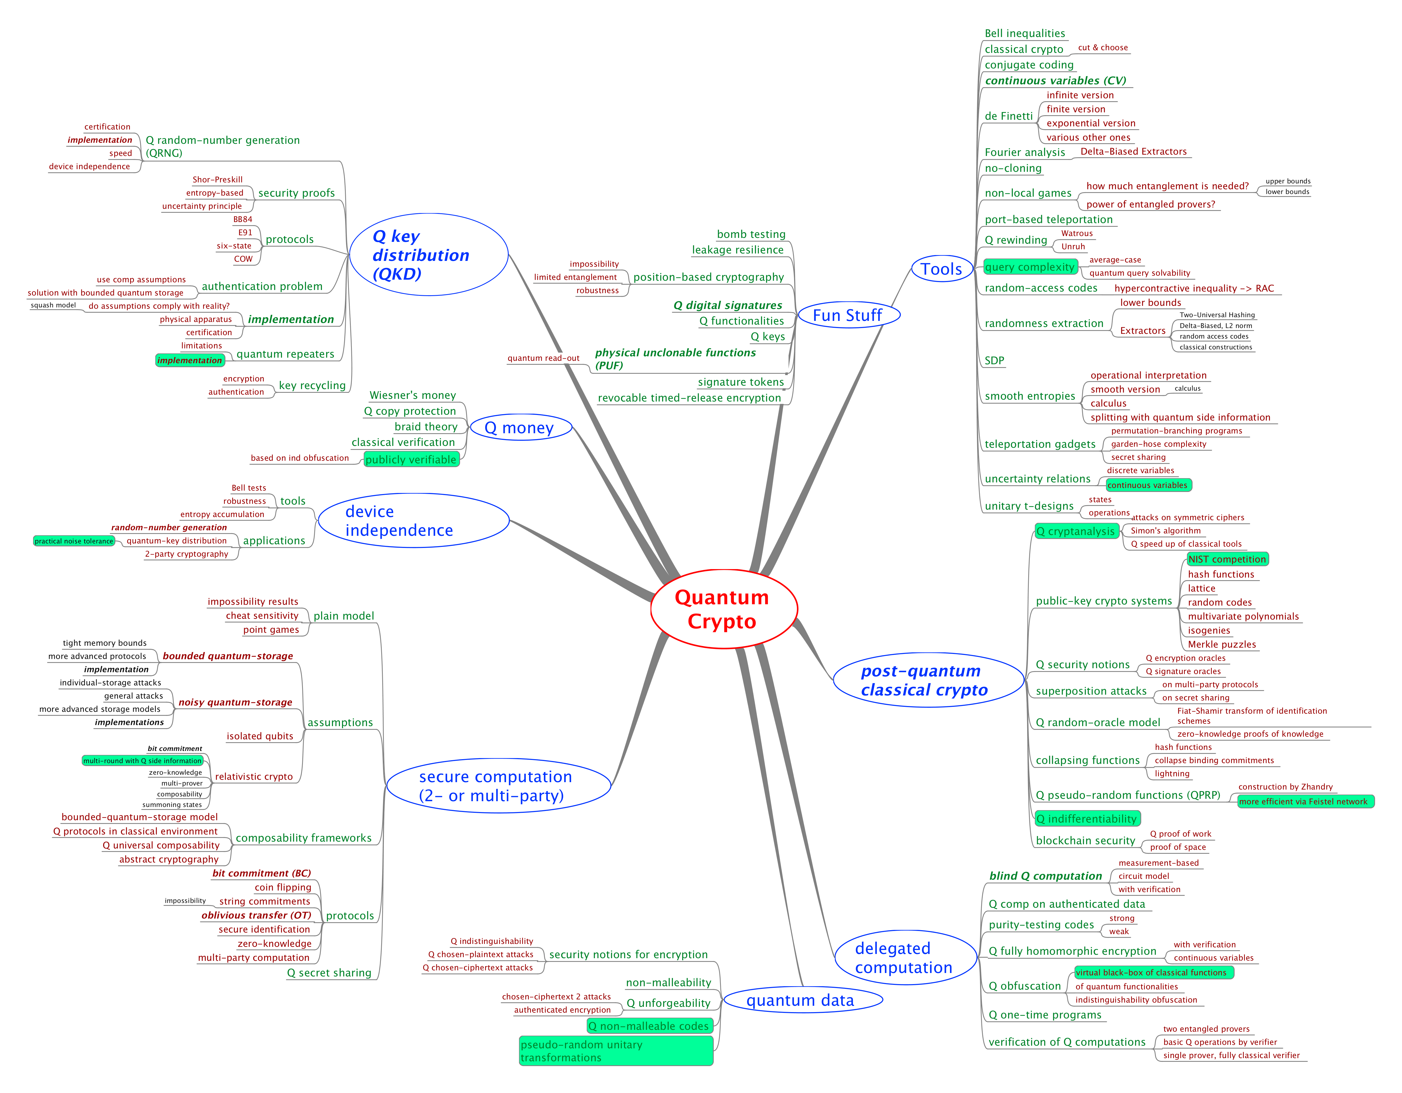
MindMap
Tools
Q advantage
experiments
Selection of
open questions
Fork me on github!
Post Q crypto
Q data
[https://github.com/cschaffner/QCryptoMindmap]

Slide 7
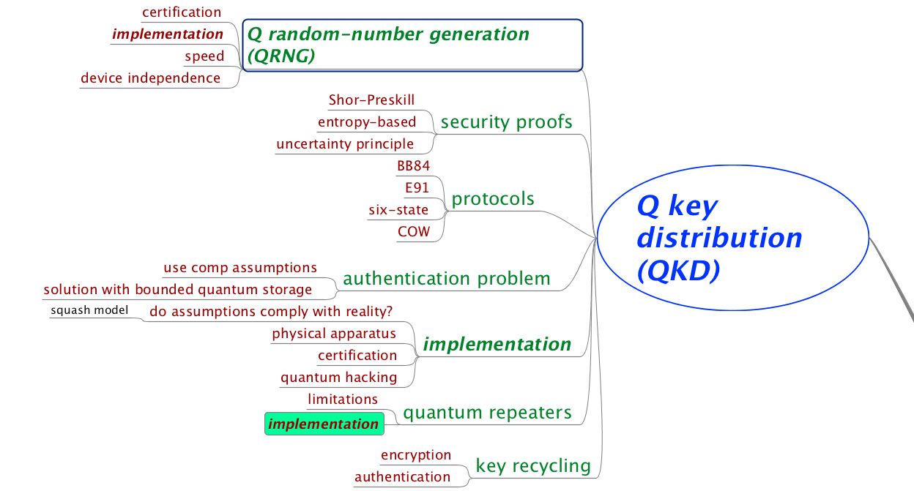
Quantum Key Distribution (QKD)

Slide 8
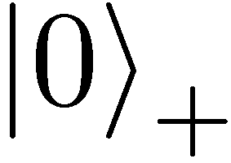
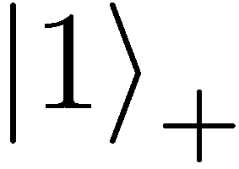
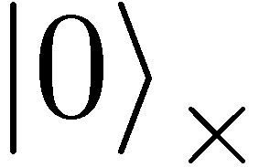
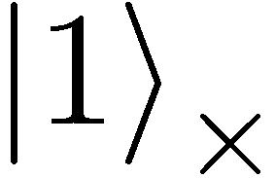
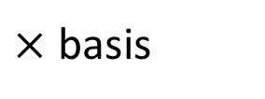
Quantum Mechanics
+ basis
$×$ basis
Measurements:
Quantum operations:
U
with prob. 1 yields 1
H
0/1
with prob. ½ yields 0
0/1
with prob. ½ yields 1

Slide 9
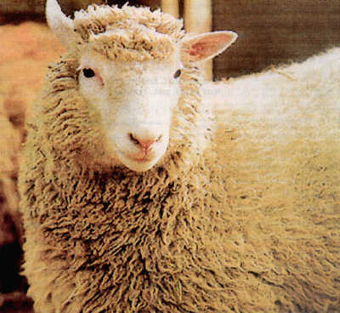
No-Cloning Theorem
U
Quantum operations:
?
?
?
Proof: copying is a non-linear operation
Notes:
information vs disturbance trade-off

Slide 10
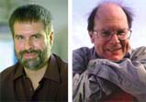


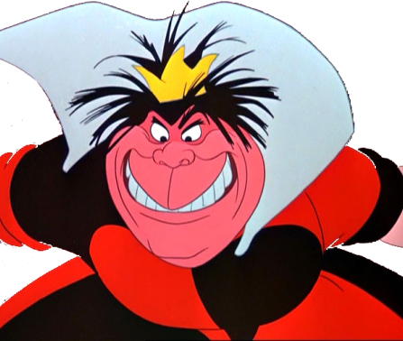
Quantum Key Distribution (QKD)
Alice
[Bennett Brassard 84]
Bob
k = ?
k = 0101 1011
Eve
k = 0101 1011
Offers an quantum solution to the key-exchange problem which does not rely on computational assumptions (such as factoring, discrete logarithms, security of AES, SHA-3 etc.)
Caveat: classical communication has to be authenticated to prevent man-in-the-middle attacks
Notes:
add link to BB84

Slide 11
Quantum Key Distribution (QKD)
0 1 1 1 0
0 0 1 1 0
k = 110
k = 110
[Bennett Brassard 84]

Slide 12
Quantum Key Distribution (QKD)
?
?
?
?
?
0 1 1 1 0
0 0 1 1 0
k = ?
k = 10
k = 10
Quantum states are unknown to Eve, she cannot copy them.
Honest players can test whether Eve interfered.
[Bennett Brassard 84]

Slide 13
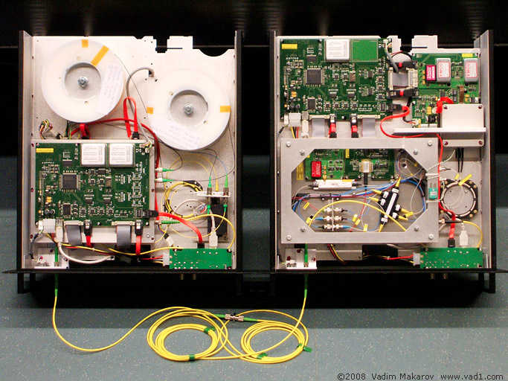

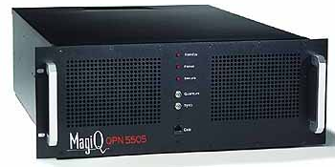
Quantum Key Distribution (QKD)
Alice
Bob
Eve
technically feasible: no quantum computer required,
only quantum communication

Slide 14

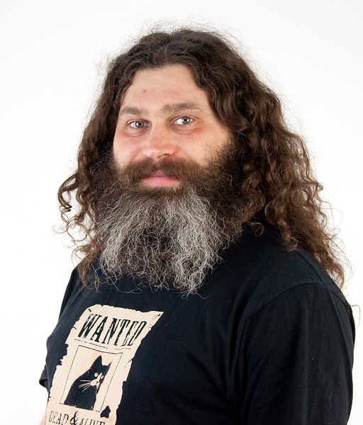
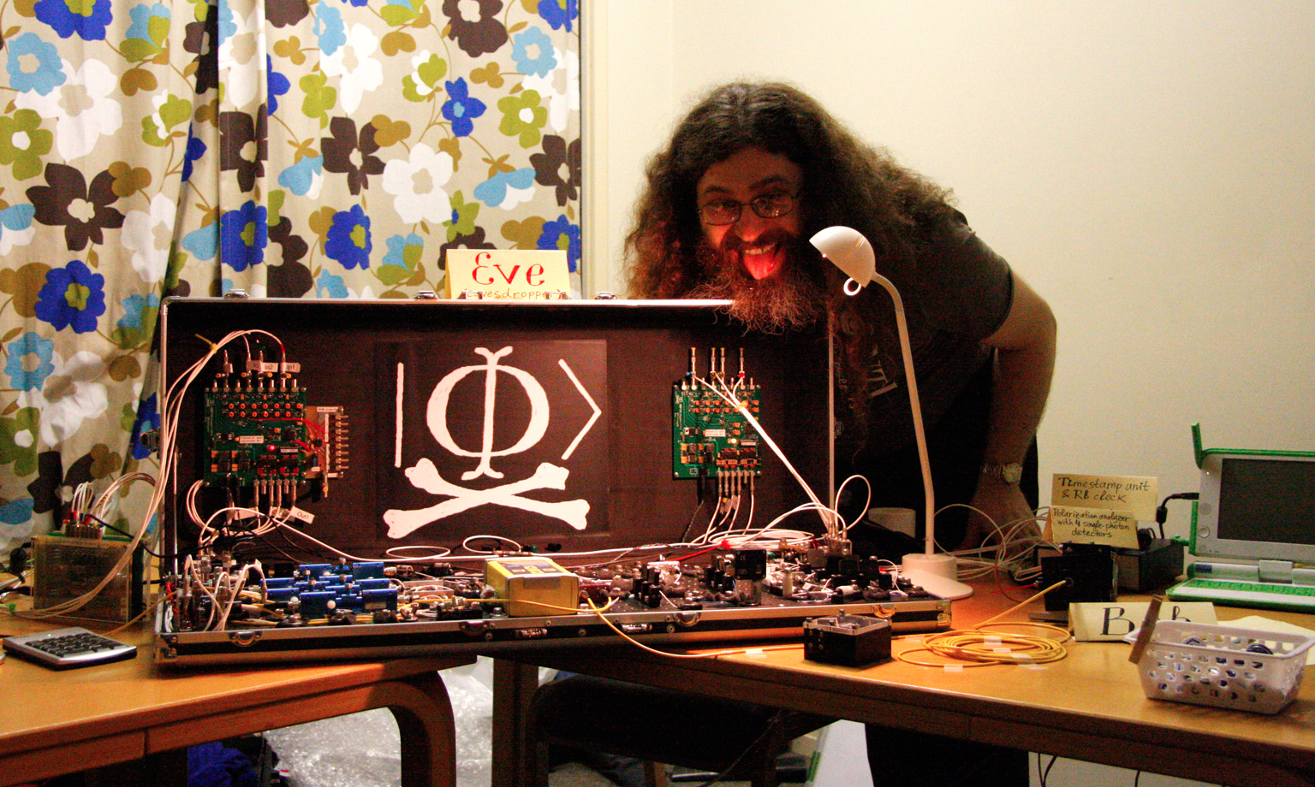
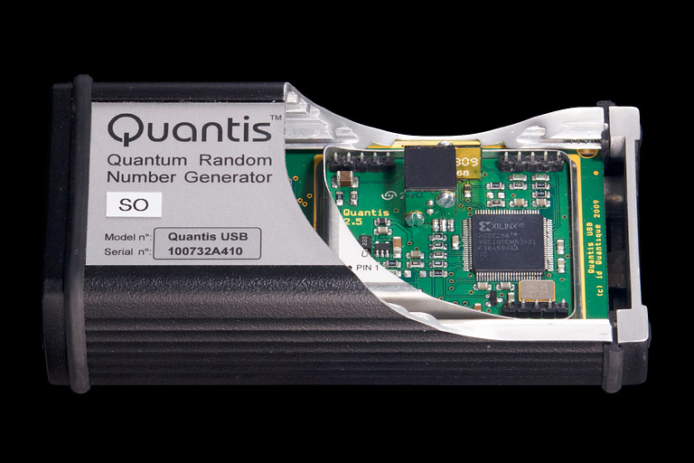
Quantum Hacking
e.g. by the group of Vadim Makarov (University of Waterloo, Canada)

Slide 15
Quantum Key Distribution (QKD)
Alice
[Bennett Brassard 84]
Bob
k = ?
k = 0101 1011
Eve
k = 0101 1011
Three-party scenario: two honest players versus one dishonest eavesdropper
Quantum Advantage: Information-theoretic security is provably impossible with only classical communication (Shannon’s theorem about perfect security)
Notes:
add link to BB84

Slide 16
Quantum Key Distribution (QKD)

Slide 17
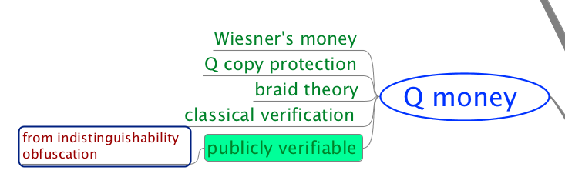
Conjugate Coding & Q Money
[Wiesner 68]
also known as quantum coding or quantum multiplexing
0 1 1 1 0
Originally proposed for securing quantum banknotes (private-key quantum money)
Adaptive attack if money is returned after successful verification
Publicly verifiable quantum money is still a topic of active research, e.g. very recent preprint by Zhandry17
[Molina Vidick Watrous 13, Brodutch Nagaj Sattath Unruh 14]
Notes:
add link to BB84

Slide 18


Computational Security of Quantum Encryption
http://arxiv.org/abs/1602.01441
at ICITS 2016
Gorjan Alagic, Copenhagen
Anne Broadbent, Ottawa
Bill Fefferman, Maryland
Tommaso Gagliardoni, Darmstadt
Michael St Jules, Ottawa
Christian Schaffner, Amsterdam
FOQUS workshop, Paris
Saturday, 29 April 2017

Slide 19
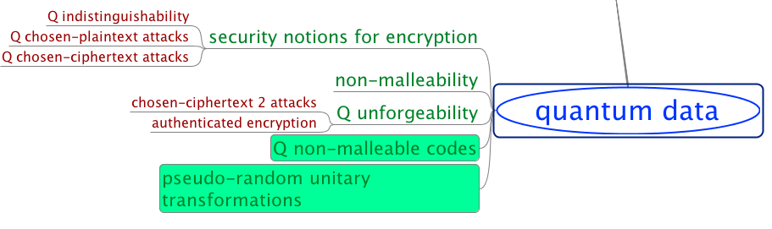
Computational Security of Quantum Encryption

Slide 20





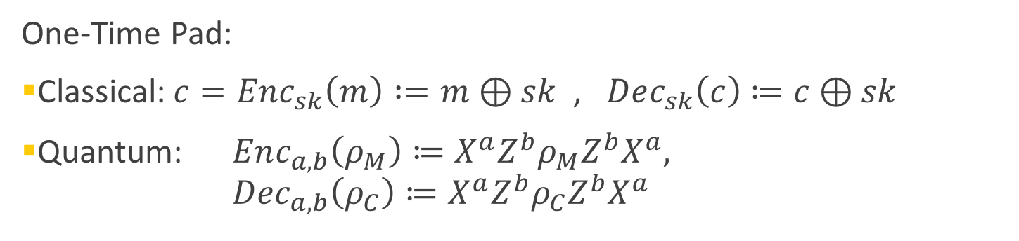



Secure Encryption
plaintext message $m$
ciphertext $c=Enc_{sk}(m)$
$$m=Dec_{sk} (c)$$
Alice
Bob
$sk$ = ?
Secret key $sk$
Eve
Secret key $sk$
One-Time Pad:
Classical: $c=Enc_{sk}\left(m\right) :=m⊕sk$ , $Dec_{sk}\left(c\right)≔c⊕sk$
Quantum: $Enc_{a,b}\left(ρ_{M}\right)≔X^{a}Z^{b}ρ_{M}{Z^{b}X}^{a},$
$Dec_{a,b}\left(ρ_{C}\right)≔X^{a}Z^{b}ρ_{C}{Z^{b}X}^{a}$
Secure
QOTP
[Miller 1882, Vernam 1919, Ambainis Mosca Tapp de Wolf 00, Boykin Roychowdhury 03]

Slide 21
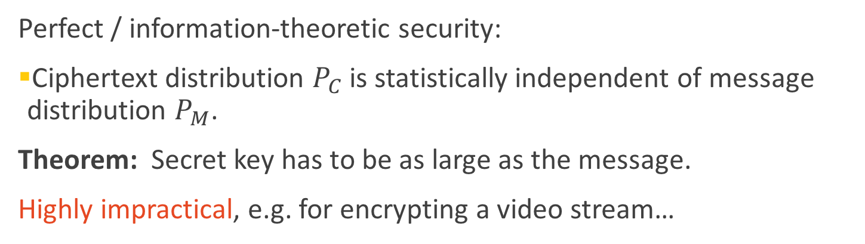
Information-Theoretic Security
plaintext message $m$
ciphertext $c=Enc_{sk}(m)$
$$m=Dec_{sk} (c)$$
Alice
Bob
$sk$ = ?
Secret key $sk$
Eve
Secret key $sk$
Secure
QOTP
Perfect / information-theoretic security:
Ciphertext distribution $P_{C}$ is statistically independent of message distribution $P_{M}$.
Theorem: Secret key has to be as large as the message.
Highly impractical, e.g. for encrypting a video stream…
[Shannon 48, Dodis 12, Ambainis Mosca Tapp de Wolf 00, Boykin Roychowdhury 03]

Slide 22
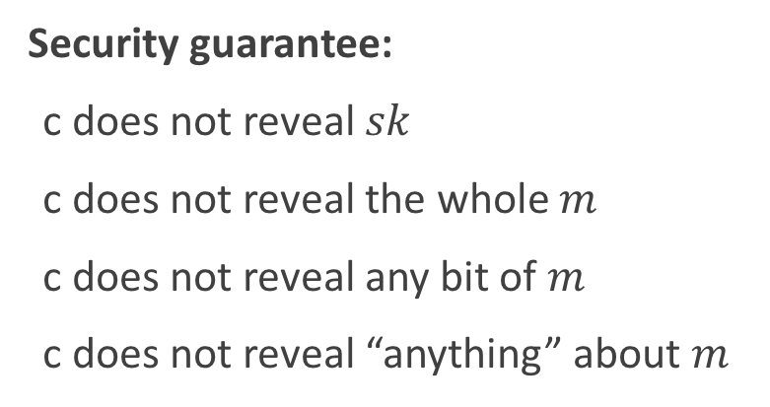
Computational Security
plaintext message $m$
ciphertext $c=Enc_{sk}(m)$
$$m=Dec_{sk} (c)$$
Alice
Bob
$sk$ = ?
Secret key $sk$
Eve
Secret key $sk$
Threat model:
Eve sees ciphertexts (eavesdropper)
Eve knows plaintext/ciphertext pairs
Eve chooses plaintexts to be encrypted
Eve can decrypt ciphertexts
Security guarantee:
c does not reveal $sk$
c does not reveal the whole $m$
c does not reveal any bit of $m$
c does not reveal “anything” about $m$

Slide 23
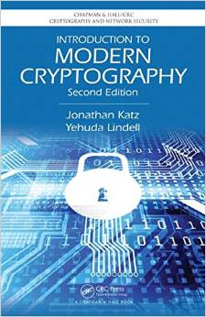
Semantic Security
plaintext message $m$
ciphertext $c=Enc_{sk}(m)$
$$m=Dec_{sk} (c)$$
Alice
Bob
$sk$ = ?
Secret key $sk$
Eve
Secret key $sk$
[Goldwasser Micali 84] leading to Turing-Award (Nobel price for CS)

Slide 24

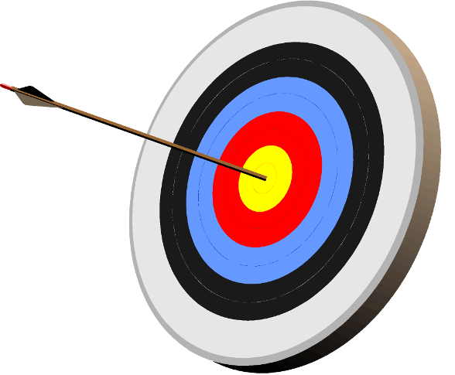
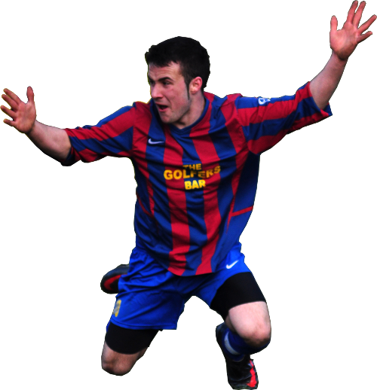

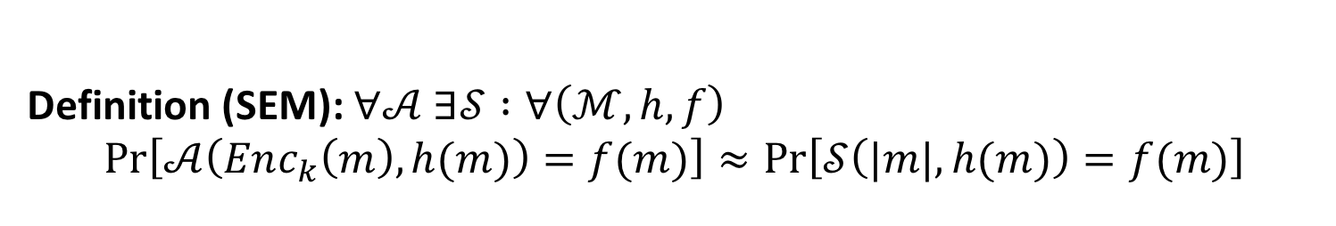




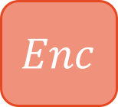

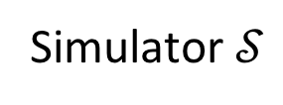
Classical Semantic Security
$$Enc$$
REAL world
$$ℳ$$
$$m$$
Adversary $𝒜$
auxiliary
$$h(m)$$
$$f(m)$$
target
$|m|$
IDEAL world
Simulator $𝒮$
Definition (SEM): $∀𝒜 ∃𝒮 :∀\left(ℳ, h,f\right)$
$$Pr\left[𝒜\left(Enc_{k}\left(m\right),h(m)\right)=f(m)\right]≈Pr\left[𝒮\left(|m|,h(m)\right)=f(m)\right]$$
[Goldwasser Micali 84] leading to Turing-Award (Nobel price for CS)

Slide 25

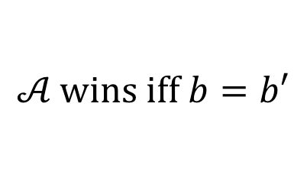
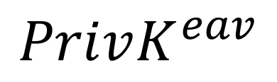
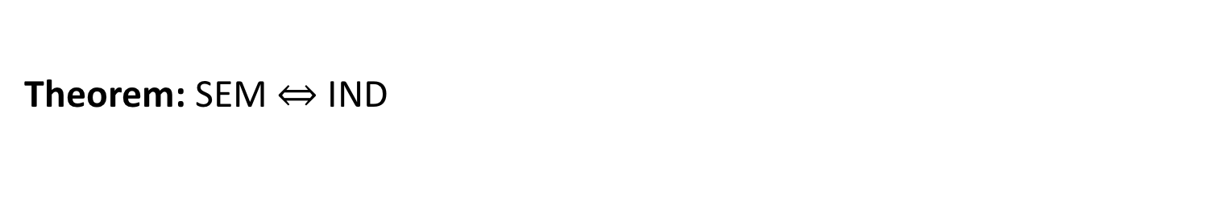



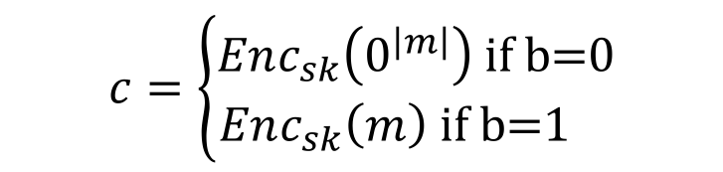


Classical Indistinguishability
$$PrivK^{eav}$$
Challenger
$$m$$
$$𝒜$$
$$b←\{0,1\}$$
$$c=\left\{\begin{aligned}Enc_{sk}\left(0^{\left|m\right|}\right) \text{if} \text{b}\text{=0} \\ Enc_{sk}\left(m\right) \text{if} \text{b}\text{=1 }\end{aligned}\right.$$
$$c$$
$$b′$$
$$𝒜 \text{wins} \text{iff} b=b′$$
Definition (IND): $∀𝒜: \operatorname{Pr}\left[𝒜 \text{wins} PrivK^{eav}\right]≤\frac{1}{2}+ negl(n)$
Theorem: SEM $⇔$IND
[Goldwasser Micali 84] leading to Turing-Award (Nobel price for CS)

Slide 26
Our Contributions
Formal definition of Quantum Semantic Security
Equivalence to Quantum Indistinguishability
Extension to CPA and CCA1 scenarios
Construction of IND-CCA1 Quantum Secret-Key Encryption from One-Way Functions
Construction of Quantum Public-Key Encryption from One-Way Trapdoor Permutations

Slide 27


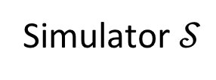
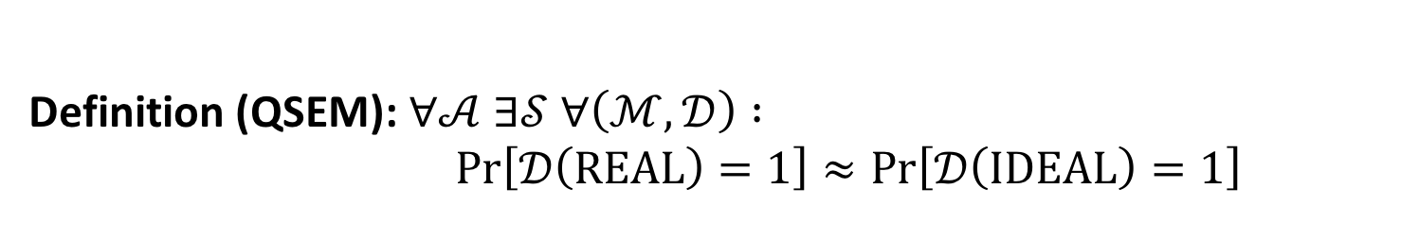
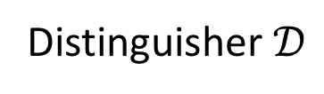

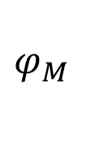



Quantum Semantic Security
$$Enc$$
REAL world
$$ℳ$$
$$φ_{M }$$
Adversary $𝒜$
$$φ_{aux}$$
$$0/1$$
$$φ_{tgt}$$
Distinguisher $𝒟$
IDEAL world
Simulator $𝒮$
Definition (QSEM): $∀𝒜 ∃𝒮 ∀\left(ℳ, 𝒟\right) :$
$Pr\left[𝒟\left(\text{REAL}\right)=1\right]≈Pr\left[𝒟\left(\text{IDEAL}\right)=1\right]$

Slide 28
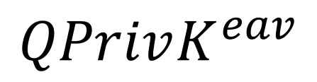


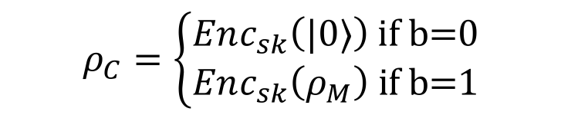

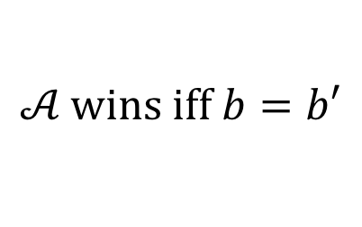
Quantum Indistinguishability
$$QPrivK^{eav}$$
Challenger
$$ρ_{M}$$
$$𝒜$$
$$b←\{0,1\}$$
$$ρ_{C}=\left\{\begin{aligned}Enc_{sk}\left(|0〉\right) \text{if} \text{b}\text{=0} \\ Enc_{sk}\left(ρ_{M}\right) \text{if} \text{b}\text{=1}\end{aligned}\right.$$
$$ρ_{C}$$
$$b′$$
$$𝒜 \text{wins} \text{iff} b=b′$$
Definition (QIND): $∀𝒜: \operatorname{Pr}\left[𝒜 \text{wins} QPrivK^{eav}\right]≤\frac{1}{2}+negl(n)$
Theorem: QSEM $⇔$ QIND
QIND: [Broadbent Jeffery 15, Gagliardoni Huelsing Schaffner 16]

Slide 29
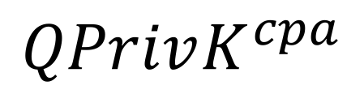



Chosen-Plaintext Attacks (CPA)
$$QPrivK^{cpa}$$
$$ρ_{M}$$
Challenger
$$Enc_{sk}(ρ_{M})$$
$$𝒜$$
$$b←\{0,1\}$$
$$ρ_{M}$$
$$ρ_{C}=\left\{\begin{aligned}Enc_{sk}\left(|0〉\right) \text{if} \text{b}\text{=0} \\ Enc_{sk}\left(ρ_{M}\right) \text{if} \text{b}\text{=1}\end{aligned}\right.$$
$$ρ_{C}$$
$$b′$$
$$𝒜 \text{wins} \text{iff} b=b′$$
Definition (QIND-CPA): $∀𝒜: \operatorname{Pr}\left[𝒜 \text{wins} QPrivK^{cpa}\right]≤\frac{1}{2}+ negl(n)$
Theorem: QSEM-CPA $⇔$ QIND-CPA
Fact: CPA security requires randomized encryption

Slide 30
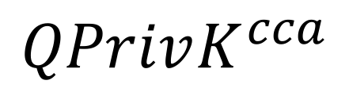



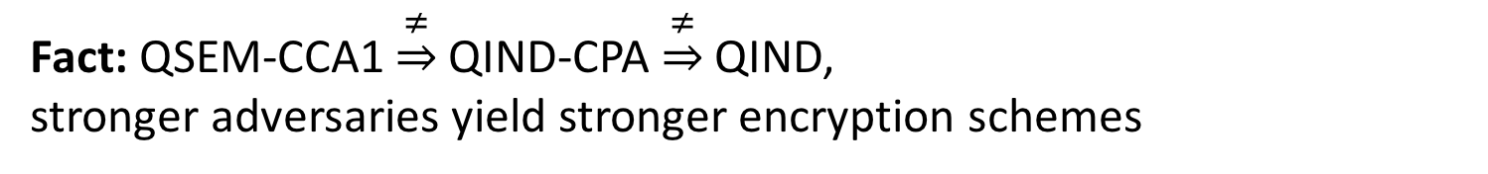


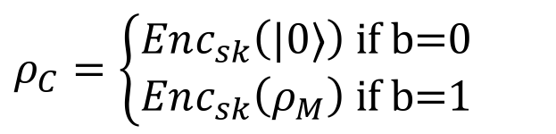
Chosen-Ciphertext Attacks (CCA1)
$$QPrivK^{cca}$$
$$ρ_{C}$$
Challenger
$$Dec_{sk}(ρ_{C})$$
$$𝒜$$
$$b←\{0,1\}$$
$$ρ_{M}$$
$$ρ_{C}=\left\{\begin{aligned}Enc_{sk}\left(|0〉\right) \text{if} \text{b}\text{=0} \\ Enc_{sk}\left(ρ_{M}\right) \text{if} \text{b}\text{=1}\end{aligned}\right.$$
$$ρ_{C}$$
$$ρ_{M}$$
$$Enc_{sk}(ρ_{M})$$
$$b′$$
$$𝒜 \text{wins} \text{iff} b=b′$$
Definition (QIND-CCA1): $∀𝒜: \operatorname{Pr}\left[𝒜 \text{wins} QPrivK^{cca}\right]≤\frac{1}{2}+ negl(n)$
Theorem: QSEM-CCA1 $⇔$ QIND-CCA1
Fact: QSEM-CCA1 $\underset{⇒}{≠}$ QIND-CPA $\underset{⇒}{≠}$ QIND,
stronger adversaries yield stronger encryption schemes

Slide 31
Our Contributions
Formal definition of Quantum Semantic Security
Equivalence to Quantum Indistinguishability
Extension to CPA and CCA1 scenarios
Construction of IND-CCA1 Quantum Secret-Key Encryption from One-Way Functions
Construction of Quantum Public-Key Encryption from One-Way Trapdoor Permutations

Slide 32


Quantum Secret-Key Encryption
Goal: build CCA1-secure quantum secret-key encryption
Ingredients:
quantum one-time pad (QOTP)
Long Key
QOTP
Plaintext
Ciphertext
Not even CPA secure, scheme is not randomized!

Slide 33
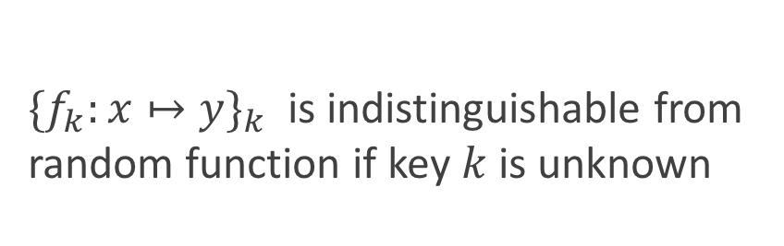


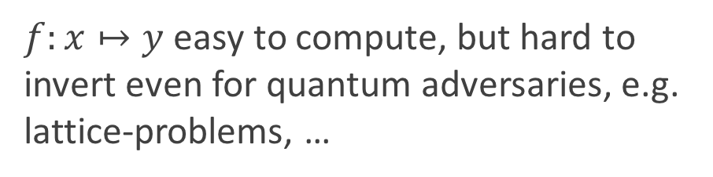


Quantum Secret-Key Encryption
Goal: build CCA1-secure quantum secret-key encryption
Ingredients:
quantum one-time pad (QOTP)
quantum-secure one-way function (OWF)
$$x$$
$f:x↦y$ easy to compute, but hard to invert even for quantum adversaries, e.g. lattice-problems, …
OWF
$$y$$
Theorem: One-Way Function $⟹$ Pseudo-Random Function
$$x$$
${{\{f}_{k}:x↦y\}}_{k}$ is indistinguishable from random function if key $k$ is unknown
PRF
$$y$$
[Hastad Impagliazzo Levin Luby 99]

Slide 34
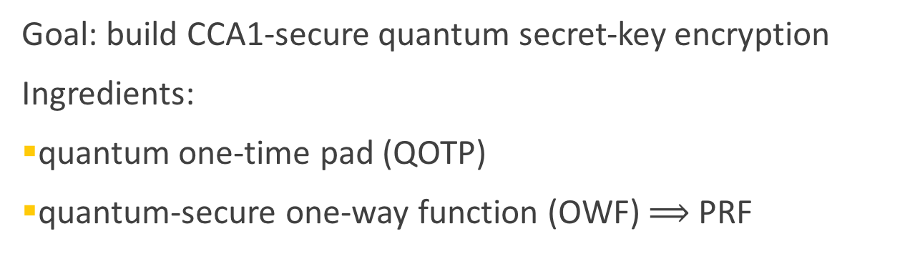

Quantum Secret-Key Encryption
Goal: build CCA1-secure quantum secret-key encryption
Ingredients:
quantum one-time pad (QOTP)
quantum-secure one-way function (OWF) $⟹$ PRF
Randomness
PRF
Long Key
QOTP
$$r$$
Plaintext
Ciphertext
Classical version: [Goldreich Goldwasser Micali 85]

Slide 35



Intuition of CCA1 security
Replace pseudo-random function with totally random function
Encryption queries result in polynomially many ciphertexts with different randomness:
With overwhelming probability the randomness of the challenge ciphertext will be different from previous r’s.
$$r_{1}$$
$$r_{q}$$
$$r^{∗}$$

Slide 36
Our Contributions
Formal definition of Quantum Semantic Security
Equivalence to Quantum Indistinguishability
Extension to CPA and CCA1 scenarios
Construction of IND-CCA1 Quantum Secret-Key Encryption
from One-Way Functions
Construction of Quantum Public-Key Encryption from One-Way Trapdoor Permutations

Slide 37
MindMap
Tools
Q advantage
experiments
Selection of
open questions
Fork me on github!
Post Q crypto
Q data
[https://github.com/cschaffner/QCryptoMindmap]

Slide 39
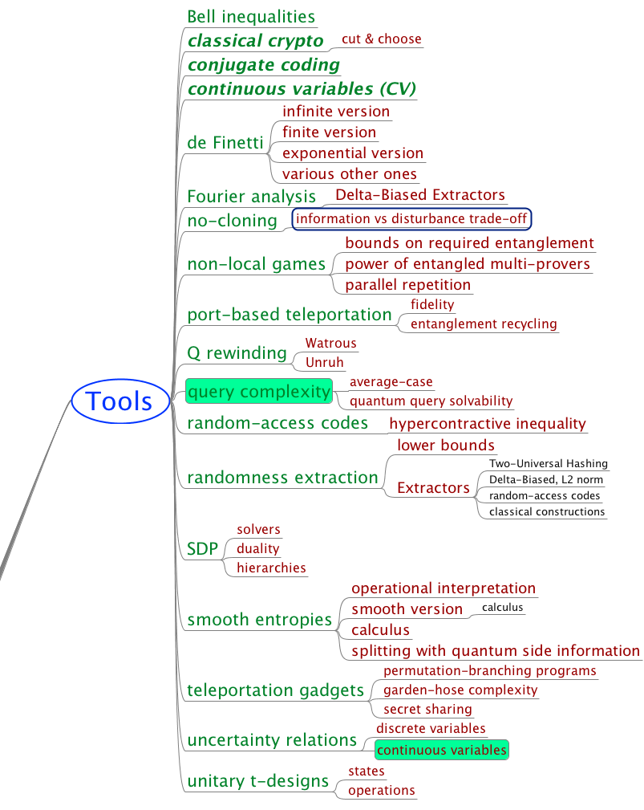
Tools

Slide 40
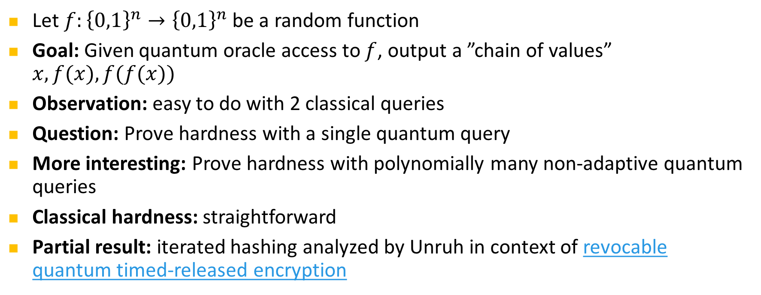
Open Query-Complexity Question
Let $f:{\left\{0,1\right\}}^{n}→{\left\{0,1\right\}}^{n}$ be a random function
Goal: Given quantum oracle access to $f$, output a ”chain of values” $x, f(x), f(f(x))$
Observation: easy to do with 2 classical queries
Question: Prove hardness with a single quantum query
More interesting: Prove hardness with polynomially many non-adaptive quantum queries
Classical hardness: straightforward
Partial result: iterated hashing analyzed by Unruh in context of revocable quantum timed-released encryption
[question by Serge Fehr 17, Unruh 13]

Slide 41

Quantum Query Solvability
Notion introduced by Mark Zhandry at QuICS workshop 2015: https://www.youtube.com/watch?v=kaS7OFAm-6M
Often, quantum query-complexity bounds are given in the form:
“$Θ\left(g(N)\right)$ queries are required to solve a problem with success probability 2/3 (in the worst case)”
For crypto, it would be way more useful to have:
“Given q quantum queries, the maximal success probability is $Θ\left(g(q,N)\right)$, in the average case”
Example: Given a function $F:\left[N\right]→\left\{0,1\right\}$, find $x$ such that $F(x)=1$.
Q query-complexity answer: $Θ\left(N^{1/2}\right)$ by (optimality of) Grover search
But is the success probability $Θ\left(q/N^{1/2}\right)$, $Θ\left(q^{2}/N\right)$, or $Θ\left(q^{4}/N^{2}\right)$ ?
Matters for efficiency when choosing crypto parameters in order to get tiny security errors
[Zhandry 15]

Slide 42
Tools

Slide 43

Post-Quantum Cryptography
Also known as: quantum-safe or quantum-resistant cryptography
Classical (i.e. conventional) cryptography secure against quantum attackers
NIST “competition”: 82 submissions
(23 signature, 59 encryption schemes or key-encapsulation mechanisms (KEM))
[https://csrc.nist.gov/Projects/Post-Quantum-Cryptography ]

Slide 44
Observations from QCrypts 2014-17
Rough classification of contributed, invited and tutorial talks
QKD is the most developed branch of Q crypto, closest to implementation
When looking at experimental talks: mostly QKD and (closely) related topics
Tools and post-quantum crypto are consistently of interest
2-party crypto was en vogue in 2014/15, not anymore in 2016/17
Taken over by delegated computation and authentication, started in 2016
2016/17: DI has made a comeback
Long tail: lots of other topics

Slide 45


Slide 46


















Secure Two-Party Cryptography
Information-theoretic security
No computational restrictions
Correctness (both honest)
usefulness
Coin-Flipping
Bit Commitment
Oblivious Transfer
2-Party Function Evaluation
Multi-Party Computation
(with dishonest majority)
$$⇒$$
$$⇏$$
Security for honest Alice
quantum usefulness
$$⇒$$
$$⇏$$
$$⇒$$
usefulness
$$s_{0}$$
OT
$$c$$
$$⇒$$
$$⇒$$
$$s_{1}$$
$$s_{c}$$
Security for honest Bob
$$⇔$$
$$x$$
$$ℱ$$
$$y$$
$$f(x,y)$$
$$g(x,y)$$
[Blum 83, Kilian 88]

Slide 47


Coin Flipping (CF)
Strong CF: No dishonest player can bias the outcome
Classically: a cheater can always obtain his desired outcome with prob 1
Quantum: [Kitaev 03] lower bounds the bias by $\frac{1}{\sqrt{2}}−\frac{1}{2}≈0.2$
[Chailloux Kerenidis 09] give optimal quantum protocol for strong CF with this bias
Weak CF (“who has to do the dishes?”): Alice wants heads, Bob wants tails
[Mochon 07] uses Kitaev’s formalism of point games to give a quantum protocol for weak CF with arbitrarily small bias $ε>0$
[Aharonov Chailloux Ganz Kerenidis Magnin 14] reduce the proof complexity from 80 to 50 pages… explicit protocol?

Slide 48
Bit Commitment (BC)
Two-phase (reactive) protocol:
a=0 or
a=1
commit
a = ?
Bob‘s
view
Hiding: even dishonest Bob does not learn a
Binding: dishonest Alice cannot change her mind
open
a
Classically: impossible
Quantum: believed to be possible in the early 90s
shown impossible by [Mayers 97, LoChau 97] by a beautiful argument (purification and Uhlmann’s theorem)
[Chailloux Kerenidis 11] show that in any quantum BC protocol, one player can cheat with prob 0.739. They also give an optimal protocol achieving this bound. Crypto application?
[Brassard Crepeau Jozsa Langlois: A quantum BC scheme provably unbreakable by both parties, FOCS 93]
Notes:
Going back to the original paper on quantum bit commitment [BCJL93], we note that a subtlety in the definition of the binding property is the origin of the false claim of security: while it is true that the protocol is such that Alice is unable to simultaneously hold messages that would unveil a commitment to b=0 and as b=1 (and thus, to be able to choose to open b=0 and b=1), this is insufficient to prove security, since in fact Alice is able to delay her choice of commitment until the very end of the protocol—at which point she can choose to open as either b = 0 or b = 1 (but not necessarily both at the same time!).

Slide 49

Bit Commitment $⇒$ Strong Coin Flipping
a=0 or
a=1
a
a
b=0 or
b=1
b
a = b
a ≠ b
[Blum 83]

Slide 50




















Oblivious Transfer (OT)
1-out-of-2 Oblivious Transfer:
Rabin OT:
(secure erasure)
$$s_{0}$$
OT
$$c$$
$$s_{1}$$
$$s_{c}$$
Dishonest Alice does not learn choice bit
Dishonest Bob can only learn one of the two messages
$$s$$
ROT
$s$ / $⊥$
These OT variants are information-theoretically equivalent (homework! 😉 )
OT is symmetric [Wolf Wullschleger at EuroCrypt 2006, only 10 pages long]
1-2 OT $⇒$ BC:
$$r_{1}$$
$$c_{1}∈_{R}\{0,1\}$$
open
OT
$${a⊕r}_{1}$$
$$s_{c_{1}}$$
commit
$$r_{2}$$
OT
$$c_{2}∈_{R}\{0,1\}$$
$a=0$ or
$$a=1$$
$${a⊕r}_{2}$$
$$s_{c_{2}}$$
$${a, r}_{1},r_{2},…$$
$$r_{3}$$
OT
$$c_{3}∈_{R}\{0,1\}$$
$${a⊕r}_{3}$$
$$s_{c_{3}}$$
[Wiesner 68, Even Goldreich Lempel 85, Rabin 81]

Slide 51











Quantum Protocol for Oblivious Transfer
$$s_{0}$$
$$c$$
OT
$$s_{1}$$
$$s_{c}$$
0 1 1 1 0
0 0 1 1 0
$$I_{0},I_{1}$$
$I_{c}=\left\{3,4,5\right\}$, $I_{1−c}=\left\{1,2\right\}$
$$f_{0},f_{1}$$
$${t_{0}=s}_{0}⊕k_{0}$$
$$t_{1}= s_{1}⊕k_{1}$$
$$k_{1}=f_{1}\left(110\right)$$
$$k_{0}=f_{0}(01)$$
$$k_{1}=f_{1}\left(110\right)$$
Correctness ✓
$$s_{1}=t_{1}⊕f_{1}\left(110\right)$$
[Wiesner 61, Bennett Brassard Crepeau Skubiszewska 91]

Slide 52
Quantum Protocol for Oblivious Transfer
$$s_{0}$$
$$c$$
OT
$$s_{1}$$
$$s_{c}$$
0 1 1 1 0
0 0 1 1 0
$$I_{0},I_{1}$$
$I_{c}=\left\{3,4,5\right\}$, $I_{1−c}=\left\{1,2\right\}$
$$f_{0},f_{1}$$
$${t_{0}=s}_{0}⊕k_{0}$$
$$t_{1}= s_{1}⊕k_{1}$$
$$k_{1}=f_{1}\left(110\right)$$
$$k_{0}=f_{0}(01)$$
$$k_{1}=f_{1}\left(110\right)$$
✓
$$s_{1}=t_{1}⊕f_{1}\left(110\right)$$
Security for honest Bob
[Wiesner 61, Bennett Brassard Crepeau Skubiszewska 91]

Slide 53




Quantum Protocol for Oblivious Transfer
$$s_{0}$$
$$c$$
OT
$$s_{1}$$
$$s_{c}$$
store all qbits
0 1 1 1 0
0 0 1 1 0
$$I_{0},I_{1}$$
$I_{c}=\left\{3,4,5\right\}$, $I_{1−c}=\left\{1,2\right\}$
$$f_{0},f_{1}$$
$$k_{1}=f_{1}\left(110\right)$$
$${t_{0}=s}_{0}⊕k_{0}$$
$$t_{1}= s_{1}⊕k_{1}$$
$$k_{1}=f_{1}\left(110\right)$$
$$k_{0}=f_{0}(01)$$
$$k_{0}=f_{0}(01)$$
Security for honest Bob ✓
Security for honest Alice
$$s_{1}=t_{1}⊕f_{1}\left(110\right)$$
$$s_{0}=t_{0}⊕f_{0}\left(01\right)$$
❌
[Wiesner 61, Bennett Brassard Crepeau Skubiszewska 91]

Slide 54











BC $⇒$ Oblivious Transfer
$$s_{0}$$
$$c$$
OT
$$s_{1}$$
$$s_{c}$$
0 1 1 1 0
0 0 1 1 0
0 0 1 1 0
0 1
$$I_{0},I_{1}$$
$I_{c}=\left\{4,5\right\}$, $I_{1−c}=\left\{2\right\}$
$$f_{0},f_{1}$$
$${t_{0}=s}_{0}⊕k_{0}$$
$$t_{1}= s_{1}⊕k_{1}$$
$$k_{1}=f_{1}\left(10\right)$$
$$k_{0}=f_{0}(1)$$
$$k_{1}=f_{1}\left(10\right)$$
$$s_{1}=t_{1}⊕f_{1}\left(10\right)$$
[Bennett Brassard Crepeau Skubiszewska 91, Damgaard Fehr Lunemann Salvail Schaffner 09, Unruh 10]

Slide 55
Limited Quantum Storage
$$s_{0}$$
$$c$$
OT
$$s_{1}$$
$$s_{c}$$
store all qbits
0 1 1 1 0
wait 1 sec
$$I_{0},I_{1}$$
$I_{c}=\left\{3,4,5\right\}$, $I_{1−c}=\left\{1,2\right\}$
$$f_{0},f_{1}$$
$${t_{0}=s}_{0}⊕k_{0}$$
$$t_{1}= s_{1}⊕k_{1}$$
$$k_{1}=f_{1}\left(110\right)$$
$$k_{0}=f_{0}(01)$$
$$k_{1}=f_{1}\left(110\right)$$
$$s_{1}=t_{1}⊕f_{1}\left(110\right)$$
[Damgaard Fehr Salvail Schaffner 05, Wehner Schaffner Terhal 09]

Slide 56













Summary of Quantum Two-Party Crypto
Information-theoretic security
No computational restrictions
Coin-Flipping
Bit Commitment
Oblivious Transfer
2-Party Function Evaluation
$$⇒$$
$$⇏$$
quantum usefulness
$$⇒$$
$$⇏$$
$$⇒$$
$$s_{0}$$
OT
$$c$$
$$⇒$$
$$⇒$$
$$s_{1}$$
$$s_{c}$$
$$x$$
$$ℱ$$
$$y$$
$$f(x,y)$$
$$g(x,y)$$
[Blum 83, Kilian 88]

Slide 58

Delegated Q Computation

Slide 59

Delegated Computation
QCloud Inc. promises to perform a BQP computation for you.
How can you securely delegate your quantum computation to an untrusted quantum prover while maintaining privacy and/or integrity?
Various parameters:
  Quantum capabilities of verifier: state preparation, measurements, q operations
  Type of security: blindness (server does not learn input), integrity (client is sure the correct computation has been carried out)
  Amount of interaction: single round (fully homomorphic encryption) or multiple rounds
  Number of servers: single-server, unbounded / computationally bounded or multiple entangled but non-communicating servers
[Childs 05, …. see e.g. Broadbent 17 or Fitzsimons 16 for overviews and references]
Image: Tremani / TU Delft

Slide 60
Classical Verification of Q Computation
QCloud Inc. promises you to perform a BQP computation
How can a purely classical verifier be convinced that this
computation actually was performed?
Partial solutions:
    Using interactive protocols with quantum communication between prover and verifier, this task can be accomplished, using a certain minimum quantum ability of the verifier. [Fitzsimons Kashefi 17, Broadbent 17, AlagicDulekSpeelmanSchaffner17]
    Using two entangled, but non-communicating provers, verification can be accomplished using rigidity results [ReichardtUngerVazirani12]. Recently made way more practical by [ColadangeloGriloJefferyVidick17]
Indications that information-theoretical blind computation is impossible [AaronsonCojocaruGheorghiuKashefi17]
[see Broadbent 17 or Fitzsimons 16 for overview and more complete references]

Slide 61
Delegated Q Computation

Slide 62
Black-Box Obfuscation
Idea: an obfuscator is an algorithm which rewrites programs, such that
efficiency is preserved;
input-output functionality is preserved;
output programs are hard to understand: “If something is efficiently learnable from reading the code, then it is also efficiently learnable purely from input-output behavior.”
“black-box obfuscation”
=
x
f(x)
x
f(x)
[Alagic Fefferman 16, slide by Gorjan Alagic, thanks a lot!]

Slide 63


Classical Obfuscation
Idea: an obfuscator is an algorithm which rewrites programs, such that
efficiency is preserved;
input-output functionality is preserved;
output programs are hard to understand: “If something is efficiently learnable from reading the code, then it is also efficiently learnable purely from input-output behavior.”
“black-box obfuscation”
Formal:
A black-box obfuscator O is an algorithm which maps circuits C to circuits O(C) such that:
efficiency-preserving:
functionality-preserving:
virtual black-box: for every poly-time A there exists a poly-time S such that
learn something by reading circuit
learn same thing from input-output
[Alagic Fefferman 16, slide by Gorjan Alagic, thanks a lot!]

Slide 64
Classical Obfuscation
Why care? Lots of applications:
Protecting IP: obfuscate before publishing (already done, but ad-hoc);
Secure patching: revealing what is being patched exposes unpatched machines;
Public-key crypto: private-key encryption → public-key encryption:
One-way functions: choose delta-function circuit, make obfuscator’s coins part of input;
FHE: encryption → fully-homomorphic encryption:
“top of the crypto scheme hierarchy”
Bad news: classical black-box obfuscation is impossible [Barak et al ’01].
Other definitions? “Computational indistinguishability” (first schemes proposed in 2013);
universal circuit
[Alagic Fefferman 16, slide by Gorjan Alagic, thanks a lot!]

Slide 65
Quantum Obfuscation
A quantum obfuscator O is a (quantum) algorithm which rewrites quantum circuits, and is:
efficiency-preserving:
functionality-preserving:
virtual black-box: for every QPT A there exists a QPT S such that
quantum polynomial-time algorithm
construct a black-box quantum obfuscator (that outputs states that cannot be reused);
construct a computational indistinguishability quantum obfuscator (that outputs circuits);
[Alagic Fefferman 16, slide by Gorjan Alagic, thanks a lot!]

Slide 66
Delegated Q Computation

Slide 67

More Fun Stuff

Slide 68
Pseudorandom Operations
[https://csrc.nist.gov/Projects/Post-Quantum-Cryptography ]

Slide 69


Pseudorandom Permutation from Function
Feistel network
If F is a (pseudo)random function, the 3-round Feistel function $H_{3}$ is a pseudo-random permutation.
Question: Show that 4-random Feistel $H_{4}$is a quantum-secure pseudo-random permutation
Partial result: Quantum attack based Simon’s algorithm can distinguish 3-round Feistel $H_{3}$from random function.
Quantum pseudo-random unitaries?
For any QPT A, we want
$|Pr\left[A^{|H_{4}>,|H_{4}^{−1}>}\left(1^{n}\right)=1\right]−\operatorname{Pr}\left[A^{|rnd>,|rnd^{−1}>}\left(1^{n}\right)=1\right]|<negl(n)$
[Kuwakado Morii 10, Ji Liu Song 17]

Slide 70
Pseudorandom Operations
[https://csrc.nist.gov/Projects/Post-Quantum-Cryptography ]

Slide 71
Thank you!
https://github.com/cschaffner/QCryptoMindmap
http://arxiv.org/abs/1510.06120
In Designs, Codes and Cryptography 2016
Thanks to all friends and colleagues that contributed to quantum cryptography and to this presentation.
Questions

