Slide 1
Akka Actor Programming
CSE2520 – Big Data Processing
2021
Burcu Kulahcioglu Ozkan

Slide 2
Akka Actor Programming
Akka is an open-source actor programming library for Scala and Java
It a general purpose framework to create reactive, distributed, parallel and resilient concurrent applications in Scala or Java.
It provides a high-level concurrency abstraction:
Multi-threaded behavior without the use of low-level concurrency constructs (atomics, locks, etc)
Transparent remote communication between components
A high-availability architecture that is elastic, scales in or out, on demand
The programmer can focus on application logic rather than programming the distributed system
Notes:
FP + OP

Slide 3
Actor Model of Concurrency [1, 2]
Actors: independent computation units with their own local state
Operate on an isolated, encapsulated state
Communicate by asynchronous message-passing
Concurrent and distributed by design
[1] Carl Hewitt, Peter Bishop, and Richard Steiger. 1973. A Universal Modular ACTOR Formalism for Artificial Intelligence.
In Advance Papers of the Conference, Vol. 3. Stanford Research Institute, 235.
[2] Gul A Agha. 1985. Actors: A model of concurrent computation in distributed systems.
Technical Report. Massachusetts Institute of Technology, Cambridge Artificial Intelligence Lab.

Slide 4
Actor Model of Concurrency
Mailbox:
Each actor has a mailbox, processes messages serially
The messages sent to an actor are handled sequentially
An actor can be used to model a Finite State Machine
Upon receipt of a message, an actor can:
Update its local state
Send messages to other actors
Create new actors
Mailbox:
Mailbox:
Notes:
Talk about method invovations vs async dispatch

Slide 5
An Example Akka Actor Program:
HelloWordMain
spawn
spawn
Greet
Greeted
HelloWordBot
HelloWord
Example from: https://doc.akka.io/docs/akka/current/typed/actors.html

Slide 6
HelloWorld
Greet
Greeted
HelloWordBot
HelloWord
object HelloWorld {
final case class Greet(whom: String, replyTo: ActorRef[Greeted])
final case class Greeted(whom: String, from: ActorRef[Greet])
def apply(): Behavior[Greet] = Behaviors.receive { (context, message) =>
context.log.info("Hello {}!", message.whom)
message.replyTo ! Greeted(message.whom, context.self)
Behaviors.same
}
}

Slide 7
HelloWorldBot
Greet
Greeted
HelloWordBot
HelloWord
object HelloWorldBot {
def apply(max: Int): Behavior[HelloWorld.Greeted] = { bot(0, max) }
private def bot(greetingCounter: Int, max: Int): Behavior[HelloWorld.Greeted] =
Behaviors.receive { (context, message) =>
val n = greetingCounter + 1
context.log.info2("Greeting {} for {}", n, message.whom)
if (n == max) {
Behaviors.stopped
} else {
message.from ! HelloWorld.Greet(message.whom, context.self)
bot(n, max)
}
}}

Slide 8
HelloWorldMain
object HelloWorldMain {
final case class SayHello(name: String)
def apply(): Behavior[SayHello] = Behaviors.setup { context =>
val greeter = context.spawn(HelloWorld(), "greeter")
Behaviors.receiveMessage { message =>
val replyTo = context.spawn(HelloWorldBot(max = 3), message.name)
greeter ! HelloWorld.Greet(message.name, replyTo)
Behaviors.same }
} }
HelloWordMain
spawn
spawn
Greet
Greeted
HelloWordBot
HelloWord

Slide 9
Running the Actor System
val system: ActorSystem[HelloWorldMain.SayHello] = ActorSystem(HelloWorldMain(), "hello")
system ! HelloWorldMain.SayHello("World")
system ! HelloWorldMain.SayHello("Akka")
14:26:33.904 [hello-akka.actor.default-dispatcher-6] INFO HelloWorld$ - Hello World!
14:26:33.905 [hello-akka.actor.default-dispatcher-6] INFO HelloWorld$ - Hello Akka!
14:26:33.906 [hello-akka.actor.default-dispatcher-5] INFO HelloWorldBot$ - Greeting 1 for World
14:26:33.906 [hello-akka.actor.default-dispatcher-3] INFO HelloWorldBot$ - Greeting 1 for Akka
14:26:33.906 [hello-akka.actor.default-dispatcher-6] INFO HelloWorld$ - Hello World!
14:26:33.906 [hello-akka.actor.default-dispatcher-5] INFO HelloWorldBot$ - Greeting 2 for World
14:26:33.906 [hello-akka.actor.default-dispatcher-6] INFO HelloWorld$ - Hello Akka!
14:26:33.906 [hello-akka.actor.default-dispatcher-5] INFO HelloWorldBot$ - Greeting 2 for Akka
14:26:33.906 [hello-akka.actor.default-dispatcher-6] INFO HelloWorld$ - Hello World!
14:26:33.906 [hello-akka.actor.default-dispatcher-5] INFO HelloWorldBot$ - Greeting 3 for World
14:26:33.906 [hello-akka.actor.default-dispatcher-6] INFO HelloWorld$ - Hello Akka!
14:26:33.906 [hello-akka.actor.default-dispatcher-6] INFO HelloWorldBot$ - Greeting 3 for Akka

Slide 10
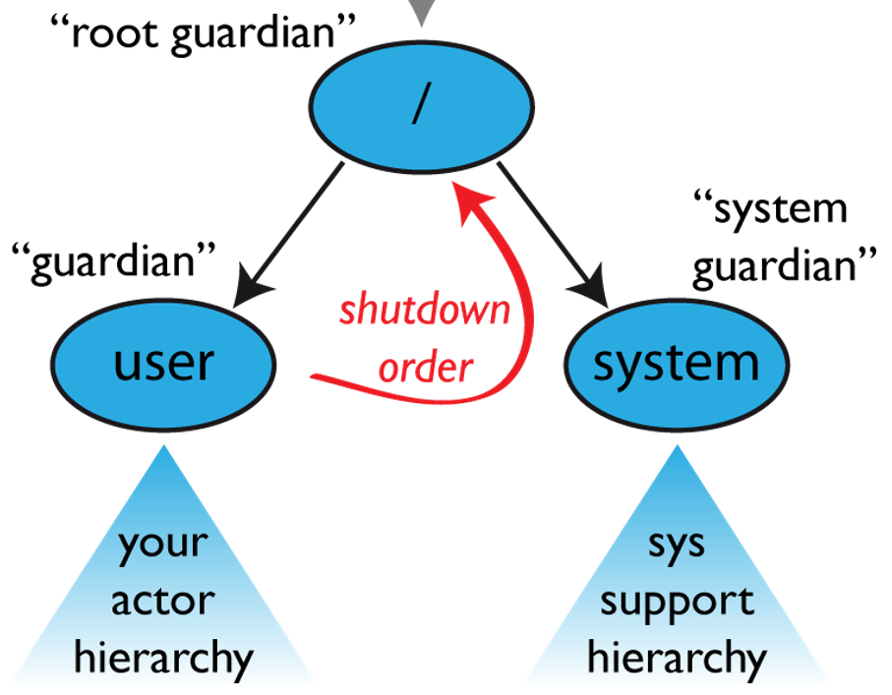
Fault Tolerance via Actor Supervision
Fault-tolerance is provided via hierarchical supervision
Actors can create child actors which they monitor for failure
They can restart actors if necessary
val behavior = Behaviors.supervise(behavior).onFailure[IllegalStateException](SupervisorStrategy.restart)
val ref = context.spawn(behavior, "my-actor")
context.watchWith(ref, ActorTerminated)
https://doc.akka.io/docs/akka/2.5.32/general/supervision.html

Slide 11
Akka Classic vs Typed
Classic – The original Akka API
Actors are untyped: Can receive and send any type of messages
Akka Typed - The new Akka Actor API with types
“Protocol-first” approach (programmer defines the protocol in terms of exchanged messages)
class HelloWorld extends Actor {
def receive: Receive = {
case Greet (whom, replyTo) =>
context.log.info("Hello {}!", message.whom)
replyTo ! Greeted(message.whom, context.self)
}}
object HelloWorld {
def apply(): Behavior[Greet] = Behaviors.receive { (context, message) =>
. . .
}}

Slide 12
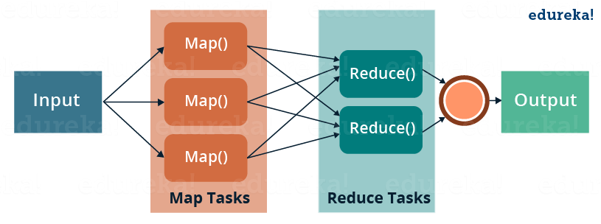
MapReduce Programming Model [3]
Takes a set of input key/value pairs, and produces a set of output key/value pairs.
The computation is expressed using two functions: Map and Reduce.
Map takes an input pair and produces a set of intermediate key/value pairs
Reduce takes an intermediate key, and a set of values for that key. It merges together these values.
[3] Jeffrey Dean and Sanjay Ghemawat, “MapReduce: Simplied Data Processing on Large Clusters”, OSDI’04
Image source: https://www.edureka.co/blog/mapreduce-tutorial/

Slide 13
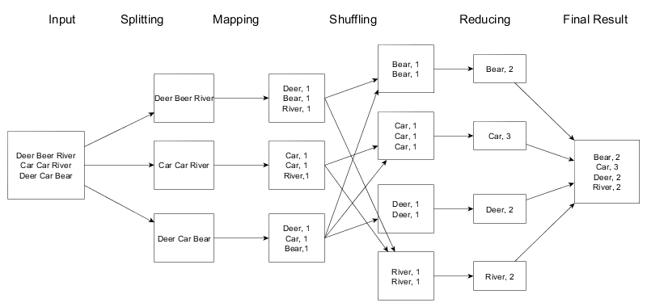
MapReduce Programming Model – WordCount Example
Image credit: http://stephanie-w.github.io/brainscribble/hadoop-word-count-explained.html
Notes:
Image credit: http://stephanie-w.github.io/brainscribble/hadoop-word-count-explained.html

Slide 14
MapReduce in Akka: An Example Implementation
ClusterMonitor
Spawns the actors
spawn
spawn
spawn
Supervisor
Distributes tasks and
supervises the mappers and reducers
Mapper-1
Reducer-1
Execute map tasks and
Write the intermediate files
Execute reduce tasks and
Write the output files
. . .
. . .
Mapper-N
Reducer-M

Slide 15
MapReduce Execution Overview
Supervisor
assign map task
assign reduce task
Mappers
Reducers
read
local
write
split 0
write
output file 0
split 1
remote
read
read
local
write
split 2
split 3
read
write
split 4
local
write
output file 1
input files
map
phase
intermediate
files
reduce
phase
output
files

Slide 16
What to communicate between the actors?
How to process messages?
How to provide fault-tolerance of mappers and reducers?
Supervisor
?
?
?
?
Mapper-1
Reducer-1
. . .
?
. . .
?
Mapper-N
Reducer-M
Notes:
Protocol-first approach

Slide 17
Actors in the MapReduce Example:
ClusterMonitor: Spawns all actors
Responds to MonitorCommand:
NodesRegistered
SupervisorNode.MapperTerminated
SupervisorNode.ReducerTerminated
SupervisorNode: Distributes tasks and supervises mappers and reducers
Responds to SupervisorCommand:
SupervisorNode.AssignNextTask
SupervisorNode.MapperResponse
SupervisorNode.ReducerResponse
SupervisorNode.MapperTerminated
SupervisorNode.ReducerTerminated
MapperNode: Performs map operation
Responds to MapperCommand:
MapperNode.StartMapper
MapperNode.ProcessNextBatch
ReducerNode: Performs reduce operation
Responds to ReducerCommand:
ReducerNode.StartReducer
ReducerNode.ReducerResponse

