Slide 1
Lecture 2
(direct) CP violation
neutral meson mixing
measuring an oscillation frequency

Slide 2
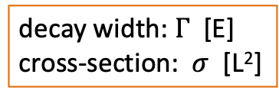
CP violation
what is it?
decay width: $Γ$ [E]
cross-section: $σ$ [L²]
why is it interesting?
  big picture: matter versus anti-matter
  small picture: precision tests of SM (electroweak symmetry breaking)

Slide 4
same size, opposite phase
same size, same phase

Slide 5
from amplitudes to counting events
(silly representation
of Fermi’s Golden Rule)
decay width proportional to amplitude-squared
consequence: no CP asymmetry if there is only a single ‘diagram’

Slide 6
CP conjugate processes
consider amplitudes for process and CP-conjugate
equal in size, but different phase
amplitudes have different phase, but not different size
conclusion: no CP violation if there is only single amplitude!

Slide 7
Interfering amplitudes
CP violation is consequence of (at least two) interfering amplitudes:
need both “CP-violating” and “CP-conserving” phases
sizable only if interfering amplitudes are of similar magnitude

Slide 8
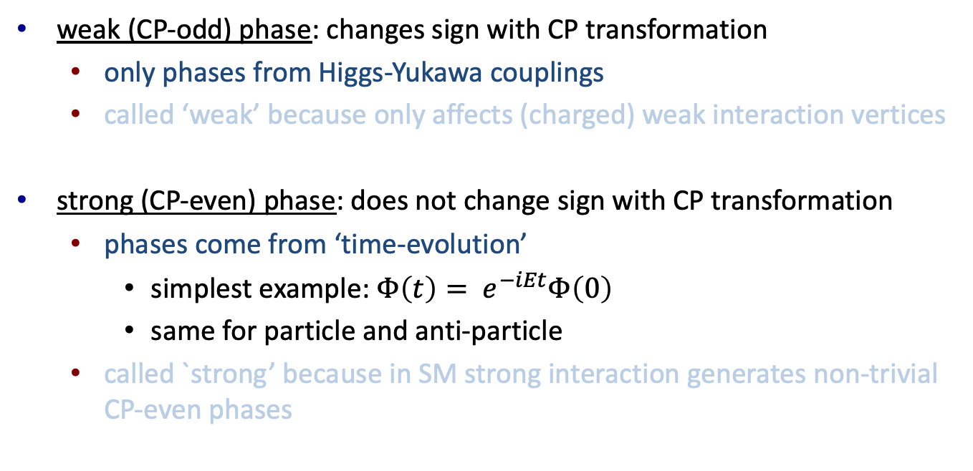
weak vs strong phases
weak (CP-odd) phase: changes sign with CP transformation
  only phases from Higgs-Yukawa couplings
  called ‘weak’ because only affects (charged) weak interaction vertices
strong (CP-even) phase: does not change sign with CP transformation
  phases come from ‘time-evolution’
    simplest example: $Φ\left(t\right)= e^{−iEt}Φ\left(0\right)$
    same for particle and anti-particle
  called `strong’ because in SM strong interaction generates non-trivial CP-even phases

Slide 9
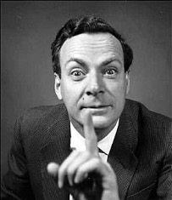






CP violation is a true quantum interference effect
$$A_{1}$$
$$\overline{A_{1}}$$
K⁺
K⁻
$$B^{0}$$
CP
$$\overline{B^{0}}$$
$$A_{2}$$
π⁻
$$\overline{A_{2}}$$
π⁺
as we shall see, there are different sources for the interference

Slide 10

Example: $B^{0}→ K^{+} π^{−}$
“CKM-suppressed tree-diagram”

Slide 11
Example: $B^{0}→ K^{+} π^{−}$
“CKM-suppressed tree-diagram”
“penguin-diagram”
penguin amplitude: ‘loop-suppressed’
tree amplitude: ‘CKM suppressed’
SM computation difficult because of ‘hadronic stuff’: A ~ -0.1
similar sized amplitudes
with different weak phases!

Slide 12
Example: B->Kpi
“penguin”
“CKM-suppressed tree”
penguin amplitude is small because of ‘loop’
competes with tree amplitude because latter is ‘CKM suppressed’
SM computation is very difficult because P and T involve ‘hadronic stuff’

Slide 13
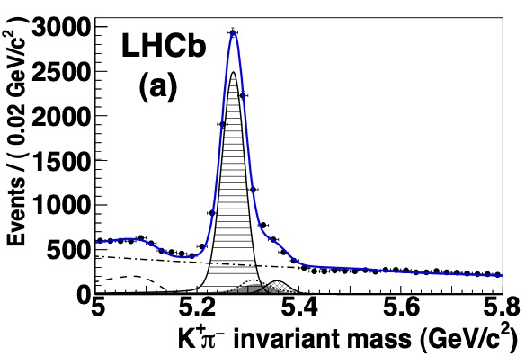
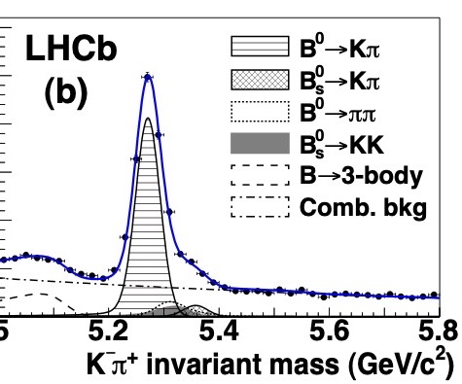
Direct CP-violation in B->Kpi
B⁰ → K⁺π⁻ decays
anti-B⁰ → K⁻π⁺ decays

Slide 14
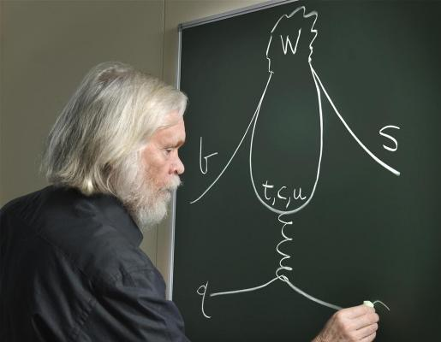
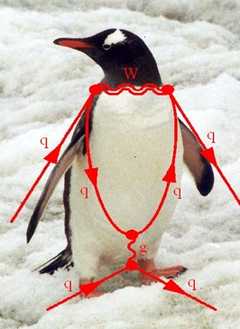

Slide 15

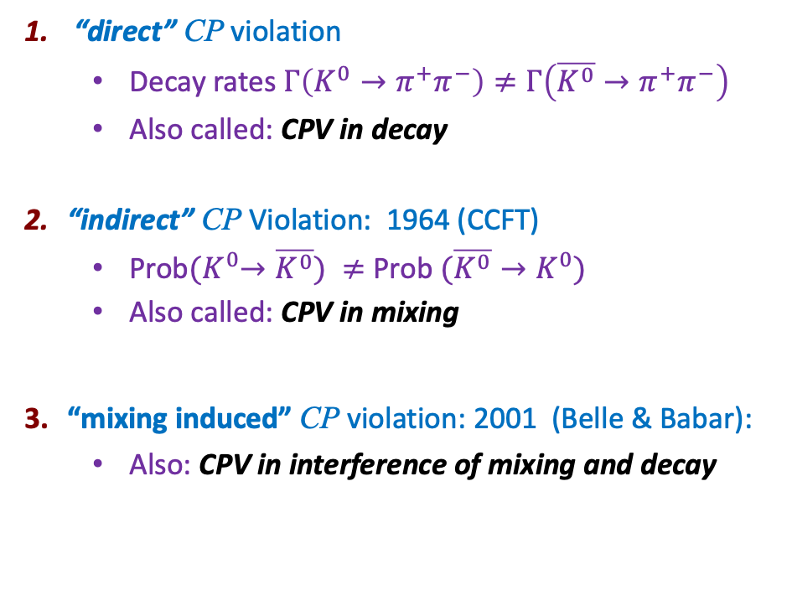

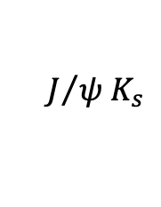


Three types of CP violation
35
  “direct” CP violation
    Decay rates $Γ\left(K^{0}→π^{+}π^{−}\right)≠Γ\left(\overline{K^{0}}→π^{+}π^{−}\right)$
    Also called: CPV in decay
  “indirect” CP Violation: 1964 (CCFT)
    Prob${(K}^{0}→\overline{K^{0}}) ≠$ Prob $(\overline{K^{0}}→K^{0})$
    Also called: CPV in mixing
  “mixing induced” CP violation: 2001 (Belle & Babar):
    Also: CPV in interference of mixing and decay
Interfere decay amplitudes:
Interfere dispersive and absorptive:
$$K^{0}$$
$$\overline{K^{0}}$$
Interfere direct and mixed:
$$B$$
$$J/{ψ{ K}_{s}}$$
$$\overline{B}$$

Slide 16
Neutral meson mixing
SM has small set of ‘stable’ neutral mesons:
meson and anti-meson state ‘degenerate’ if only strong+EM
  weak interaction ‘mixes’ the meson and anti-meson states
  removes degeneracy
  leads to interesting mixing and CPV phenomenology

Slide 17
Mixing diagram
leading order diagram for neutral meson mixing:
sensitive to CP-violating phases
sensitive to virtual quark masses

Slide 18
Mixing formalism
consider a two-component state
eigenstates of
time-evolution follows from Schrodinger equation
what is H?

Slide 19
Mixing formalism
without weak interaction, solution is, in ”rest frame” (E=m)
degenerate states with equal mass

Slide 20
Mixing formalism
without weak interaction, solution is, in ”rest frame” (E=m)
with weak interaction
  states mix
  states ‘decay’ → described by ‘open system Hamiltonian’
open system → not Hermitian H

Slide 21
reflects transitions into Hilbert space of final states
Hermitian matrices
“exponential decay

Slide 22
CPT invariance: M₁₁=M₂₂ and Γ₁₁ = Γ₂₂
→ 6 real parameters:
from full Hamiltonian

Slide 23
Interpretation of off-diagonal elements
interference!

Slide 24
time-evolution: diagonalize H
diagonalize: mass eigenstates

Slide 25
mass eigen values
compute eigenvalues of H (details: your homework)
H: “heavy”
L: “light”
mass and width of the mass eigenstates are

Slide 26
intermezzo: mass/flavour eigenstate terminology
mass eigenstate: eigenstate of full hamiltonian
flavour eigenstate is quark mass eigenstate
weak interaction eigenstate is not flavour/mass eigenstate
quarks:
flavour eigenstate: a state with definite quark flavour content
mass eigenstate: eigenstate of full hamiltonian
mass eigenstate is not flavour eigenstate
neutral mesons:

Slide 27
mass and width usually expressed in terms of average and difference

Slide 28
mass and width usually expressed in terms of average and difference
hard to compute, but we can ‘measure’ them
also hard to compute, but this is where the interesting physics is!

Slide 29
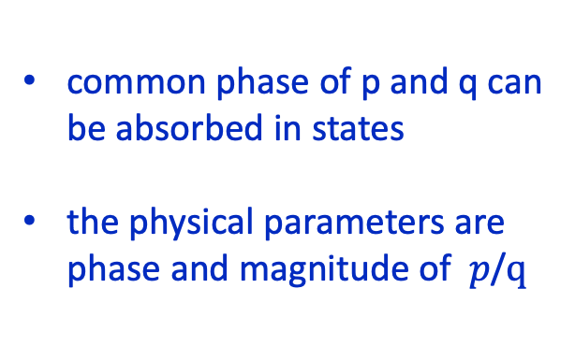
mass eigenstates
define ‘light’ and ‘heavy’ mass states
normalization:
these are eigenstates of H if
common phase of p and q can be absorbed in states
the physical parameters are phase and magnitude of $p$/$q$

Slide 30
CP violation in mixing
suppose $arg\left(Γ_{12}\right)=arg\left(M_{12}\right)≡ φ_{M}$
we shall later see that $|q$ / $p | ≠1$ leads to “CP violation in mixing”
in case of no CPV in mixing, we have

Slide 31
orthogonal states:
not-necessarily orthogonal states:

Slide 32
CP eigenstates
flavour eigenstates
CP eigenstates
if we can produce an ‘even’ (or ‘odd) state, then without CP violation, it will remain even (or odd)

Slide 33

epsilon
alternative parametrization, traditional for Kaon system
CPV in mixing: $Re(ε)≠0$
mass eigenstates expressed in terms of the CP-even and CP-odd states
in practice,
epsilon turns out to be small

Slide 34
summary of definition of states
flavour eigenstates: can be produced in hadronization process
CP eigenstates: states with definite CP
mass eigenstates: eigenstates of ‘open’ Hamiltonian

Slide 35
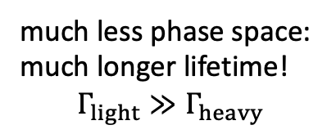
K-short and K-long
without CPV in mixing, mass eigenstates correspond to “CP eigenstates”
CP-even
CP-odd
as a result, the $K^{0}$ decays are predominantly
“K-short”
much less phase space:
much longer lifetime!
$$Γ_{light}≫Γ_{heavy}$$
“K-long”

Slide 36
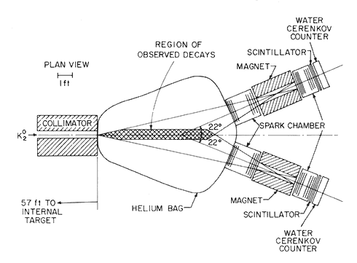
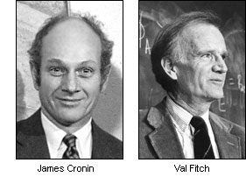
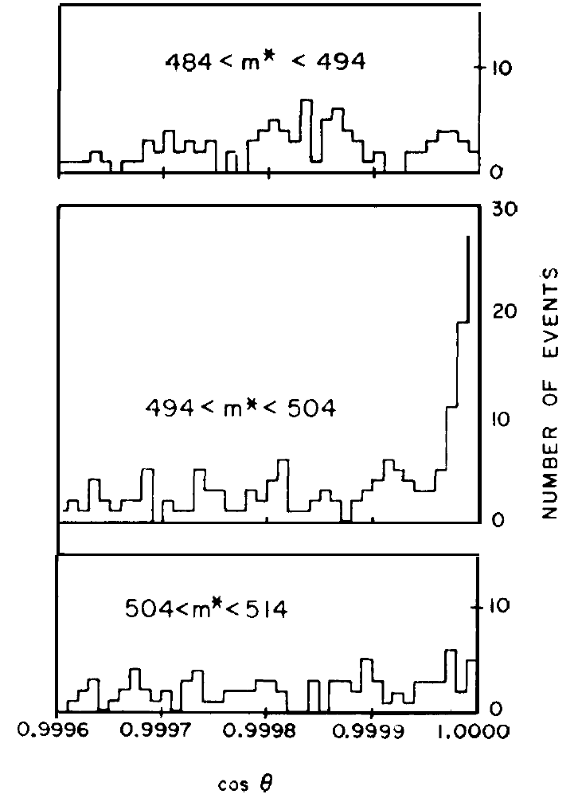



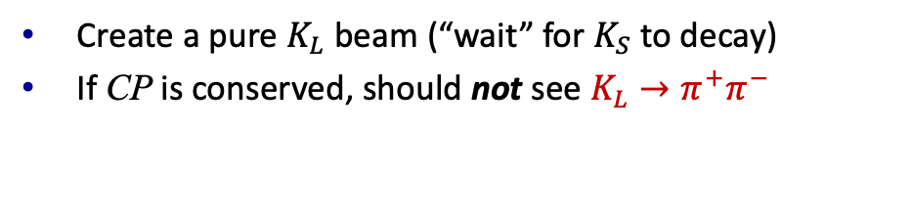
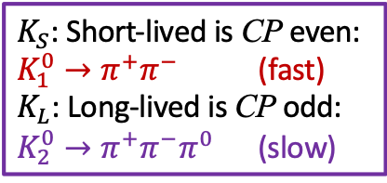

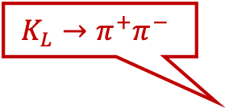
Discovery of CP-Violation
15
$K_{S}$: Short-lived is CP even:
$K_{1}^{0}→π^{+}π^{−}$ (fast)
$K_{L}$: Long-lived is CP odd:
$K_{2}^{0}→π^{+}π^{−}π^{0}$ (slow)
Create a pure $K_{L}$ beam (“wait” for $K_{S}$ to decay)
If CP is conserved, should not see $K_{L}→π^{+}π^{−}$
$$K^{0}$$
$$K_{L}→π^{+}π^{−}$$
James Cronin
Val Fitch
Effect is tiny:
about 2/1000
mass, $θ$
Signal: $K_{L}→π^{+}π^{−}$
Background: $K_{L}→π^{+}π^{−}π^{0}$
θ
cos θ
Notes:
Pion parity=-1. Signal will appear in Kaon mass window and zero theta angle.

Slide 37
Time evolution
production happens through flavour eigenstates (strong interaction)
detection (usually) also happens through flavour eigenstates (EM interaction)
in between: propagation of mass eigenstates
lepton
B0-meson
anti-b-quark
d-quark
b-quark

Slide 38
Time-evolution
time-evolution of mass eigenstates follows from SE:
eigenvalue of ‘open’ Hamiltonian
remember: mu is complex, so this includes the decay:
oscillation
exponential decay

Slide 39
Time-evolution
time-evolution of mass eigenstates follows from SE:
eigenvalue of ‘open’ Hamiltonian
now consider time-evolution of flavour eigenstates

Slide 40
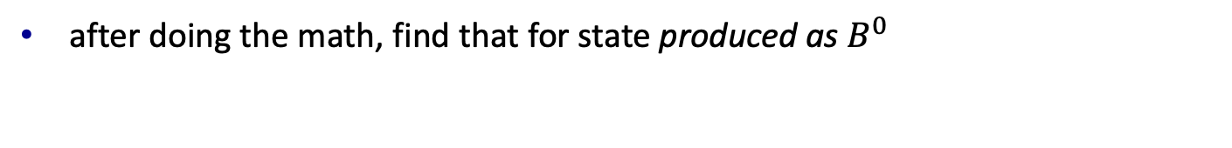
Time-evolution
after doing the math, find that for state produced as $B^{0}$
with

Slide 41
Mixing ‘probability’
mixing probability:
CP violation in mixing:
what is ?

Slide 42

Mixing probability
after some algebra find
exponential decay
oscillation with period $2π/Δm$
in the $B_{d}^{0}$ system, $ΔΓ≪ Γ$, giving for the ‘mixing asymmetry’

Slide 43
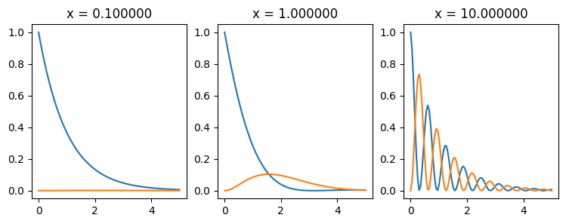
Time-evolution
to characterize time-behaviour define x = Δm/Γ

Slide 44
 | <τ> [ps] | Δm [hbar/ps] | x=Δm/Γ | y=ΔΓ/2Γ
K⁰ | 180 | 0.005 | ~1 | ~1
D⁰ | 0.41 | ~0.01 | ~0 | 0.01
B⁰ | 1.5 | 0.507 | 0.8 | ~0
B_{s}⁰ | 1.5 | 17.8 | 27 | ~0.05

Slide 46
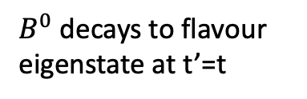
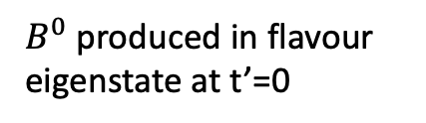

Measuring the oscillation frequency
$B^{0}$ produced in flavour eigenstate at t’=0
$B^{0}$ decays to flavour eigenstate at t’=t
$B^{0}$ oscillates
we can identify flavour at decay by looking at final state
but how do we know the flavour at production?

Slide 47
Flavour tagging

Slide 48
Flavour tagging
two different inputs:
“opposite-side flavour tagging”
  measure the flavour of the other b-quark in the event
  at production, it has the opposite charge
“same-side flavour tagging”
  measure correlation with other particles during hadronization phase
  only available at LHC (not at B-factories)
no perfect method: all information combined in MV classifier

Slide 49







For the exercise
in the exercise we will measure $Δm_{d}$ on a sample of $B^{0}→ψK^{∗0}$ events
$$μ^{+}$$
J/$ψ$
$$μ^{−}$$
$$K^{+}$$
$$K^{∗0}$$
$$π^{−}$$
$$B^{0}$$

Slide 50
The ‘Feynman diagram’

Slide 51
The ‘Feynman diagram’

Slide 52
The ‘Feynman diagram’
charge of the Kaon is related to the flavour of the B at decay
in the ntuple, B flavour at decay is represented by the variable pid

Slide 53
mistag rate
flavour tag determines B flavour at production, but it makes errors:
  oscillations of tag side B
  picked wrong OS kaon/lepton
  picked wrong SS pion
output of flavour tagger in ntuple is
  q: flavour of B
  eta: estimate of mistag rate
Prob(right tag) = (1 – η)
Prob(tag wrong) = η

Slide 54
Dilution from mistag rate
tagging errors lead to a ‘dilution’ of observed asymmetry
perfect tagging:
tagging with mistag rate $η$:
“dilution factor:”

Slide 55
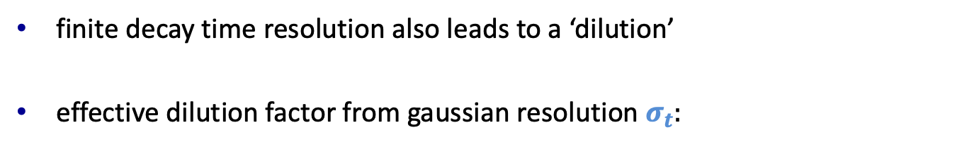
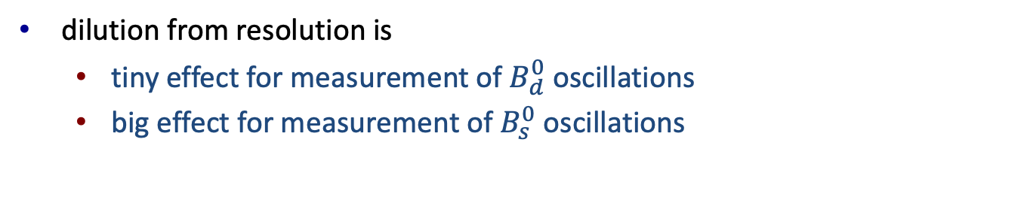
Asymmetry dilution due to resolution
finite decay time resolution also leads to a ‘dilution’
effective dilution factor from gaussian resolution $σ_{t}:$
dilution from resolution is
  tiny effect for measurement of $B_{d}^{0}$ oscillations
  big effect for measurement of $B_{s}^{0}$ oscillations

Slide 57

x $D$^{tag}

Slide 58

x $D$^{tag}
x $D$^{reso}

Slide 59

x $D$^{tag}
x $D$^{reso}
+ non-oscillation backgrounds

Slide 60
x $D$^{tag}
x $D$^{reso}
+ non-oscillation backgrounds
+ acceptance effects due to cuts removing prompt backgrounds

Slide 61
Exercises
see README.md file at
now: exercises 5-7
  https://github.com/wouterhuls/FlavourPhysicsBND2023/

