Slide 2
Hmmmm… am I a creative scientist?
A media technologist?

Slide 3
The Media Technology MSc program is a place where students, artists and scientists are encouraged to develop a creative approach to science. The students are educated to translate their personal interest and inspiration into research projects. The program is open to unusual questions, unconventional research methods and forms of output that exceed the traditional thesis format. To answer these questions, students create actual products, because we are convinced that by doing and creating, new scientific insights into the underlying question are encountered.

Slide 4
In media technology one trend, technology or fad quickly follows the next. For anyone with an interest in media technology and creative science it is important to be up to date with the latest and greatest, from augmented reality to bioengineering, and from fabrication to responsive environments. However it is equally important to be able to critically reflect on these trends, to connect these to classical discussions, and to identify what is really novel and what is merely a hype. Only then we will truly be able to research and imagineer for the future in non incremental ways.
The New Media New Technology (NMNT) class explores the latest media and creative research technologies and concepts, organized by more timeless themes such as new media history, social relationships, space and intelligent perception and action, so that these technologies can be placed into perspective and context. The course follows a tinkering approach and is a mix of lectures and practical assignments, and students are asked to create works that incorporate a new technology or concept and motivate why it is not just a gimmick or hype. Prototypes and end results will be presented at an exposition open to the general public.

Slide 5
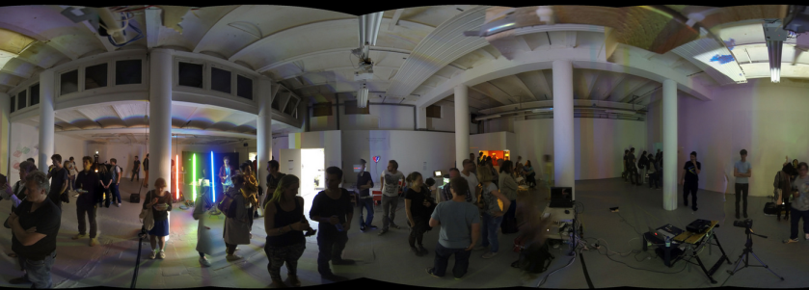
Friday, June 6, 2014

Slide 6
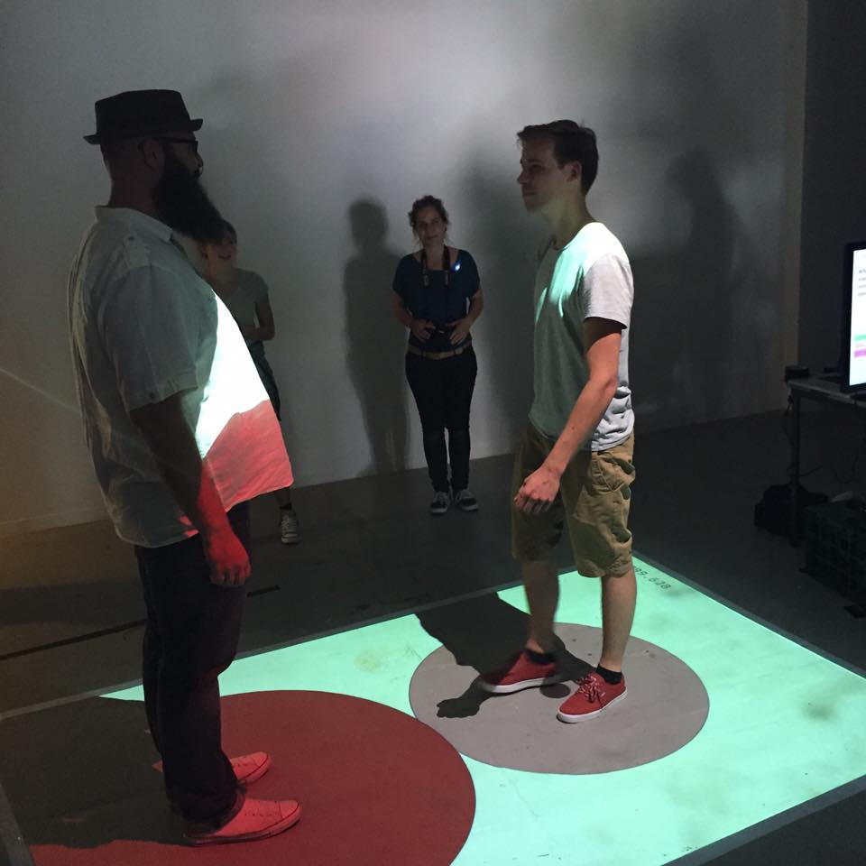
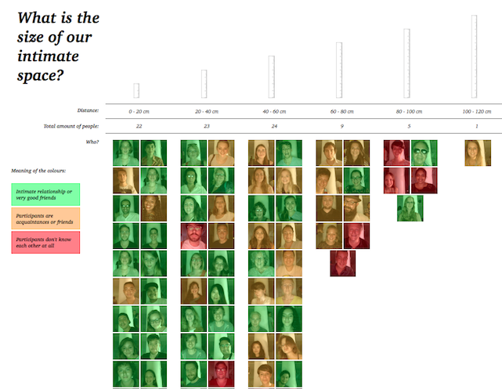
The Size of Self
Lise Stork & Donna Schipper (2015)
Did you ever consciously experience your personal space? Do you know how it affects you and how far it reaches?
With our installation we want to show you an important part of your physical body that you probably weren’t aware of before. You can explore its boundary by sensing it and seeing it projected around you simultaneously. Hopefully, by augmenting your personal space, we can give you the impression as if it truly belongs to you and show to you what your intimate space might look like.
Data of all participants is gathered and visualised in a graph that may, eventually, show interesting patterns in how the size of intimate space is dependent on relationships and potentially other variables.
Click the image for a video.

Slide 7
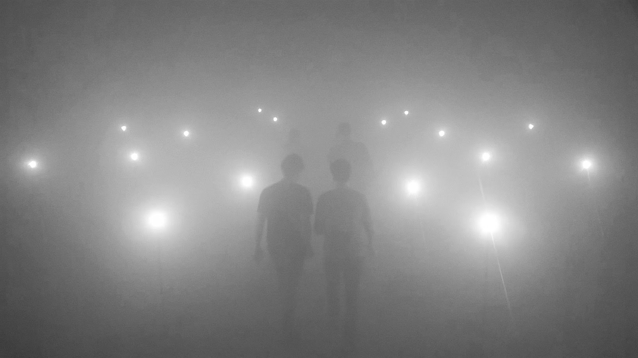
95% Invisible
Zois Loumakis (2015)
Light with its ubiquitous presence acts as a medium for our empirical observations, therefore delimits our sensory experiences. “95% invisible” is an audio-visual installation inspired from what is hidden from the absence of light. By creating a shadow play it aims to explore how light sound and space shapes our sensory understanding and thus the perception of our environment.
Click the image for a video.

Slide 8
Ediacaran Dreamings
Alexandra Barancova & Kees Sommer (2018)
Inspired by cephalopod neural networks, Chthulucene tentacular thinking and cooperation in evolution. Squids, cuttlefish, octopuses, nautiloids; this work is an investigation into these home-world aliens. Ediacaran Dreamings is a sensory representation of an autonomous coordinating system, inviting the audience to think with it. The piece is custom designed around the base structure, a serendipitous find on location.
Click the image for a video.

Slide 9
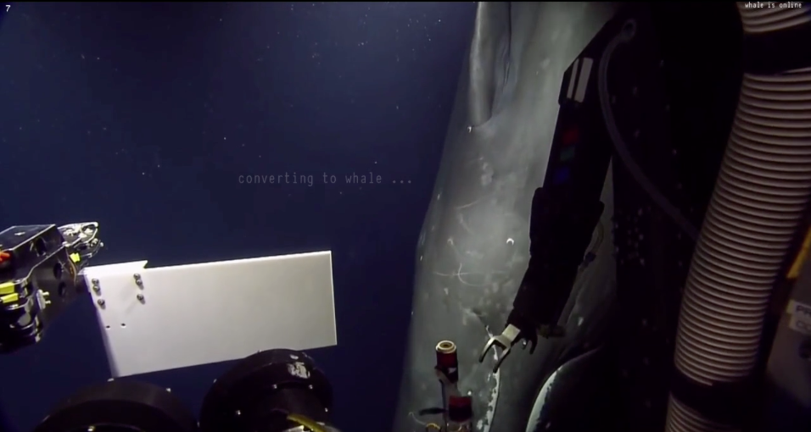
@Whale
Ayla Kolster, Tinka Zorge & Joëlle Zweekhorst (2018)
The deep blue seas have just become a little less dark and mysterious with the help of this new communication device.
Click the image for a video.

Slide 10
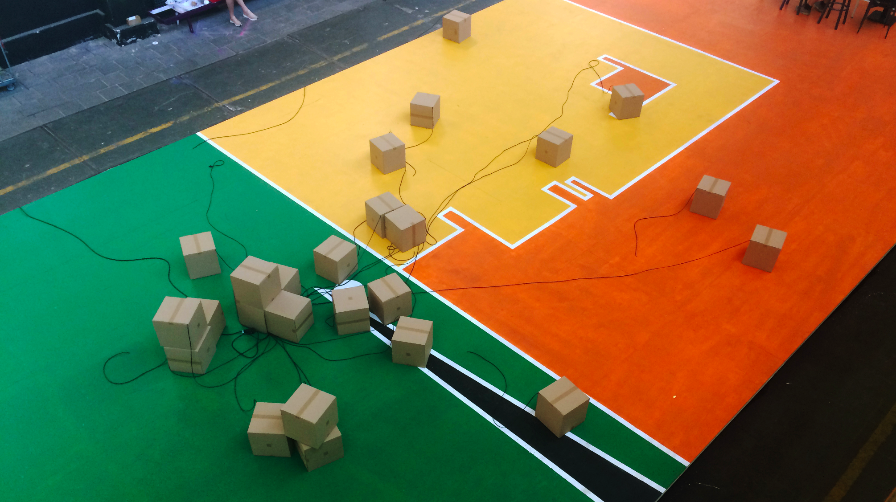
Hello World
Nicole de Groot, Joost Mollen & Max Peeperkorn (2019)
The freedom of robots is inherently limited by their existence. Always designed for a specific purpose. Only able to perceive the world through their given senses. These bots are looking for the way out
Click the image for a video.

Slide 12
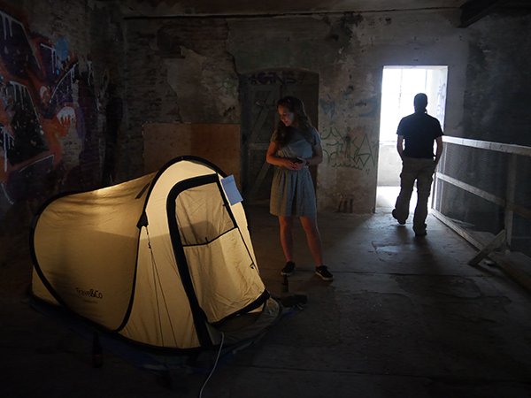
I See You
by Mark von Königsfeld, Esra İşgüzar, Wouter Moraal (2017) In these times where extremes in thought are getting more common it can be dangerous to voice your opinion to another person, online and offline. This installation is a new way of communication that is designed to be intimate but still keeping participants safe so they have a space to settle differences.

Slide 13
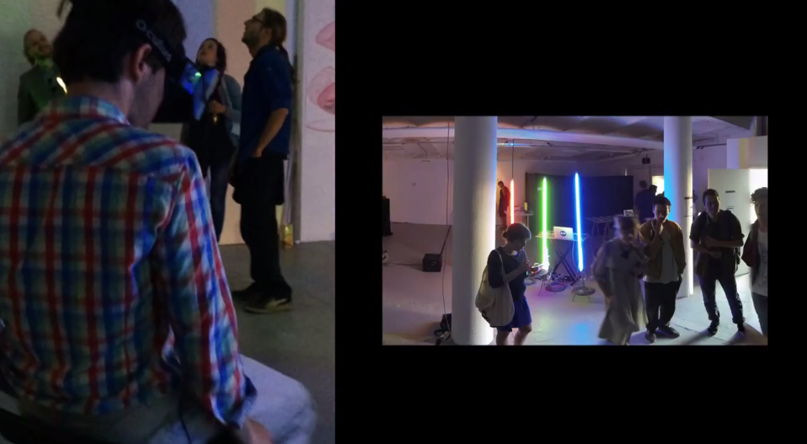
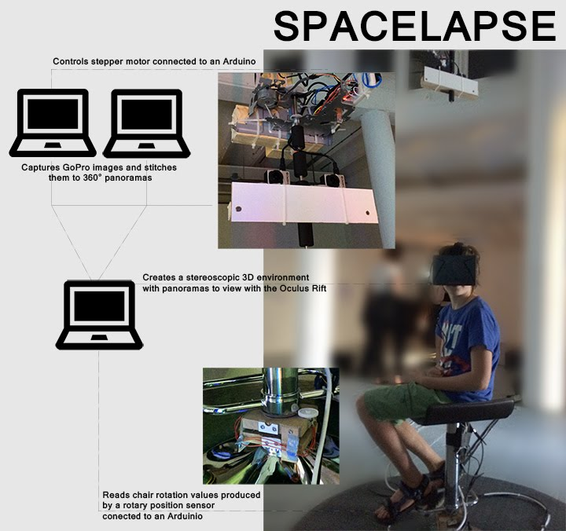
Spacelapse
by Daan Krijnen, Sabrina Verhage & Carolien Teunisse (2014)
Experience space-time like never before! With our Spacelapse installation you will be pulled out of reality to experience the fourth dimension in a different way. With the use of a stereoscopic head mounted display you can experience the space around you as if it is real, with one significant difference, the ability to control the passing of time!
Click the left picture for a video

Slide 14
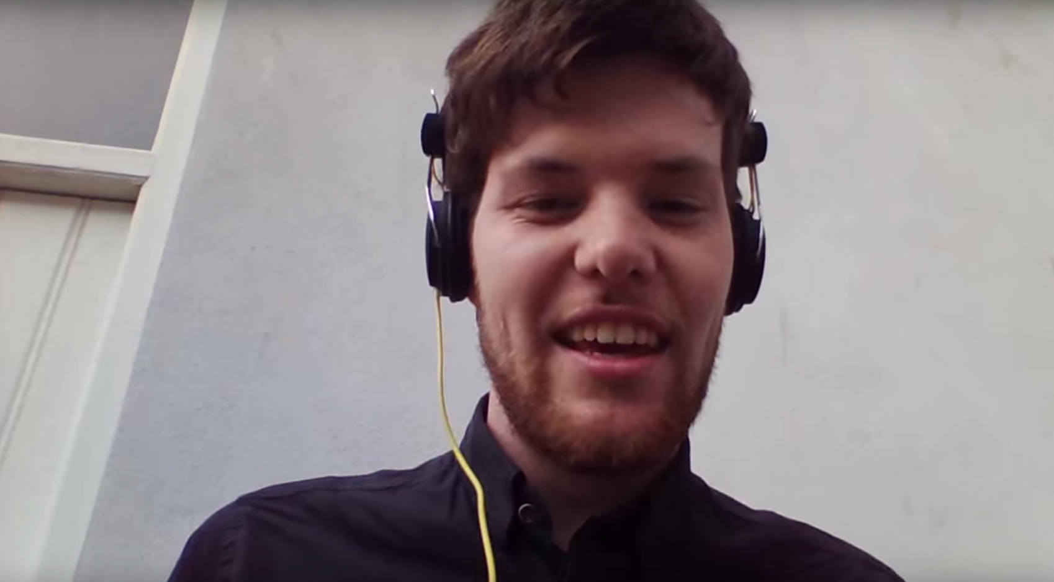
Bed Time Stories
Jeroen van Oorschot (2015)
Visitors are asked to read a bed time story for kids who for various reasons never get read a story by their parents.
Little did they know their contribution was used for something else.
If you want to know for what, click the image for a video

Slide 15
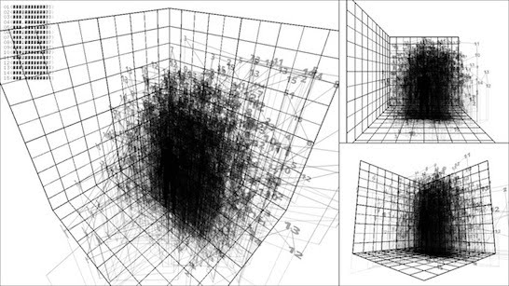
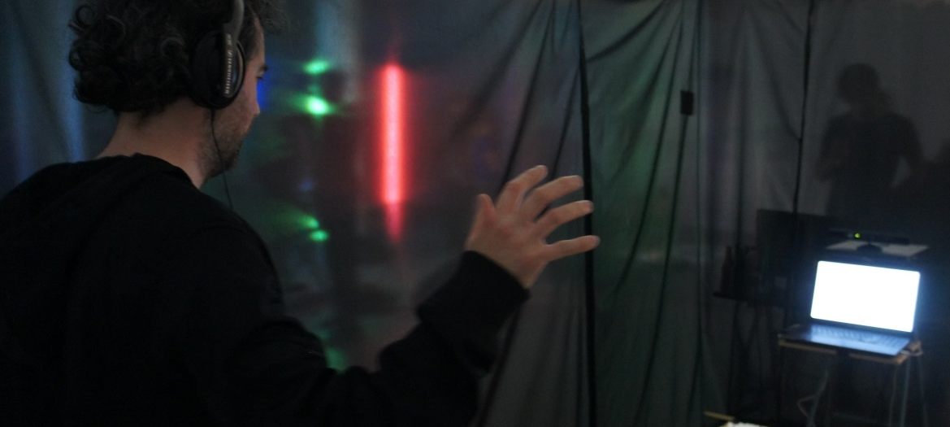
From Left to 10 by Donna Piët, Sam Verkoelen & Jules Verdijk (2014)
Revisiting a study by Galton from 1881 about number form. We allow visitors to discover their own number form and those of others.

Slide 16
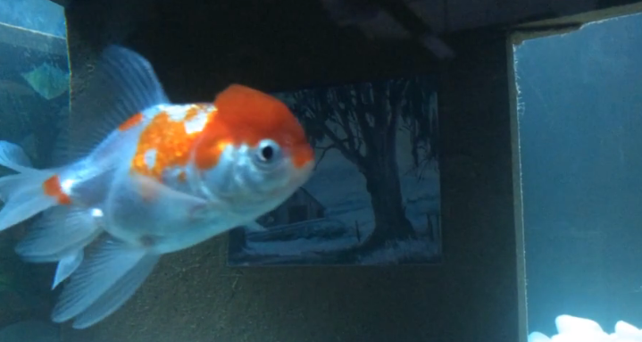
Homo Sapiens 3.0
by Dirrik Emmen, Coen Dekker & Tom Rijntjes (2014)
Neuroscientific efforts propel increasingly accurate methods of mapping brain activity to stimuli. What if these mappings were recorded and represented outside grey matter? Or could one's mind be copied, compressed and stored as if it were virtual?
Click the picture for a video

Slide 17
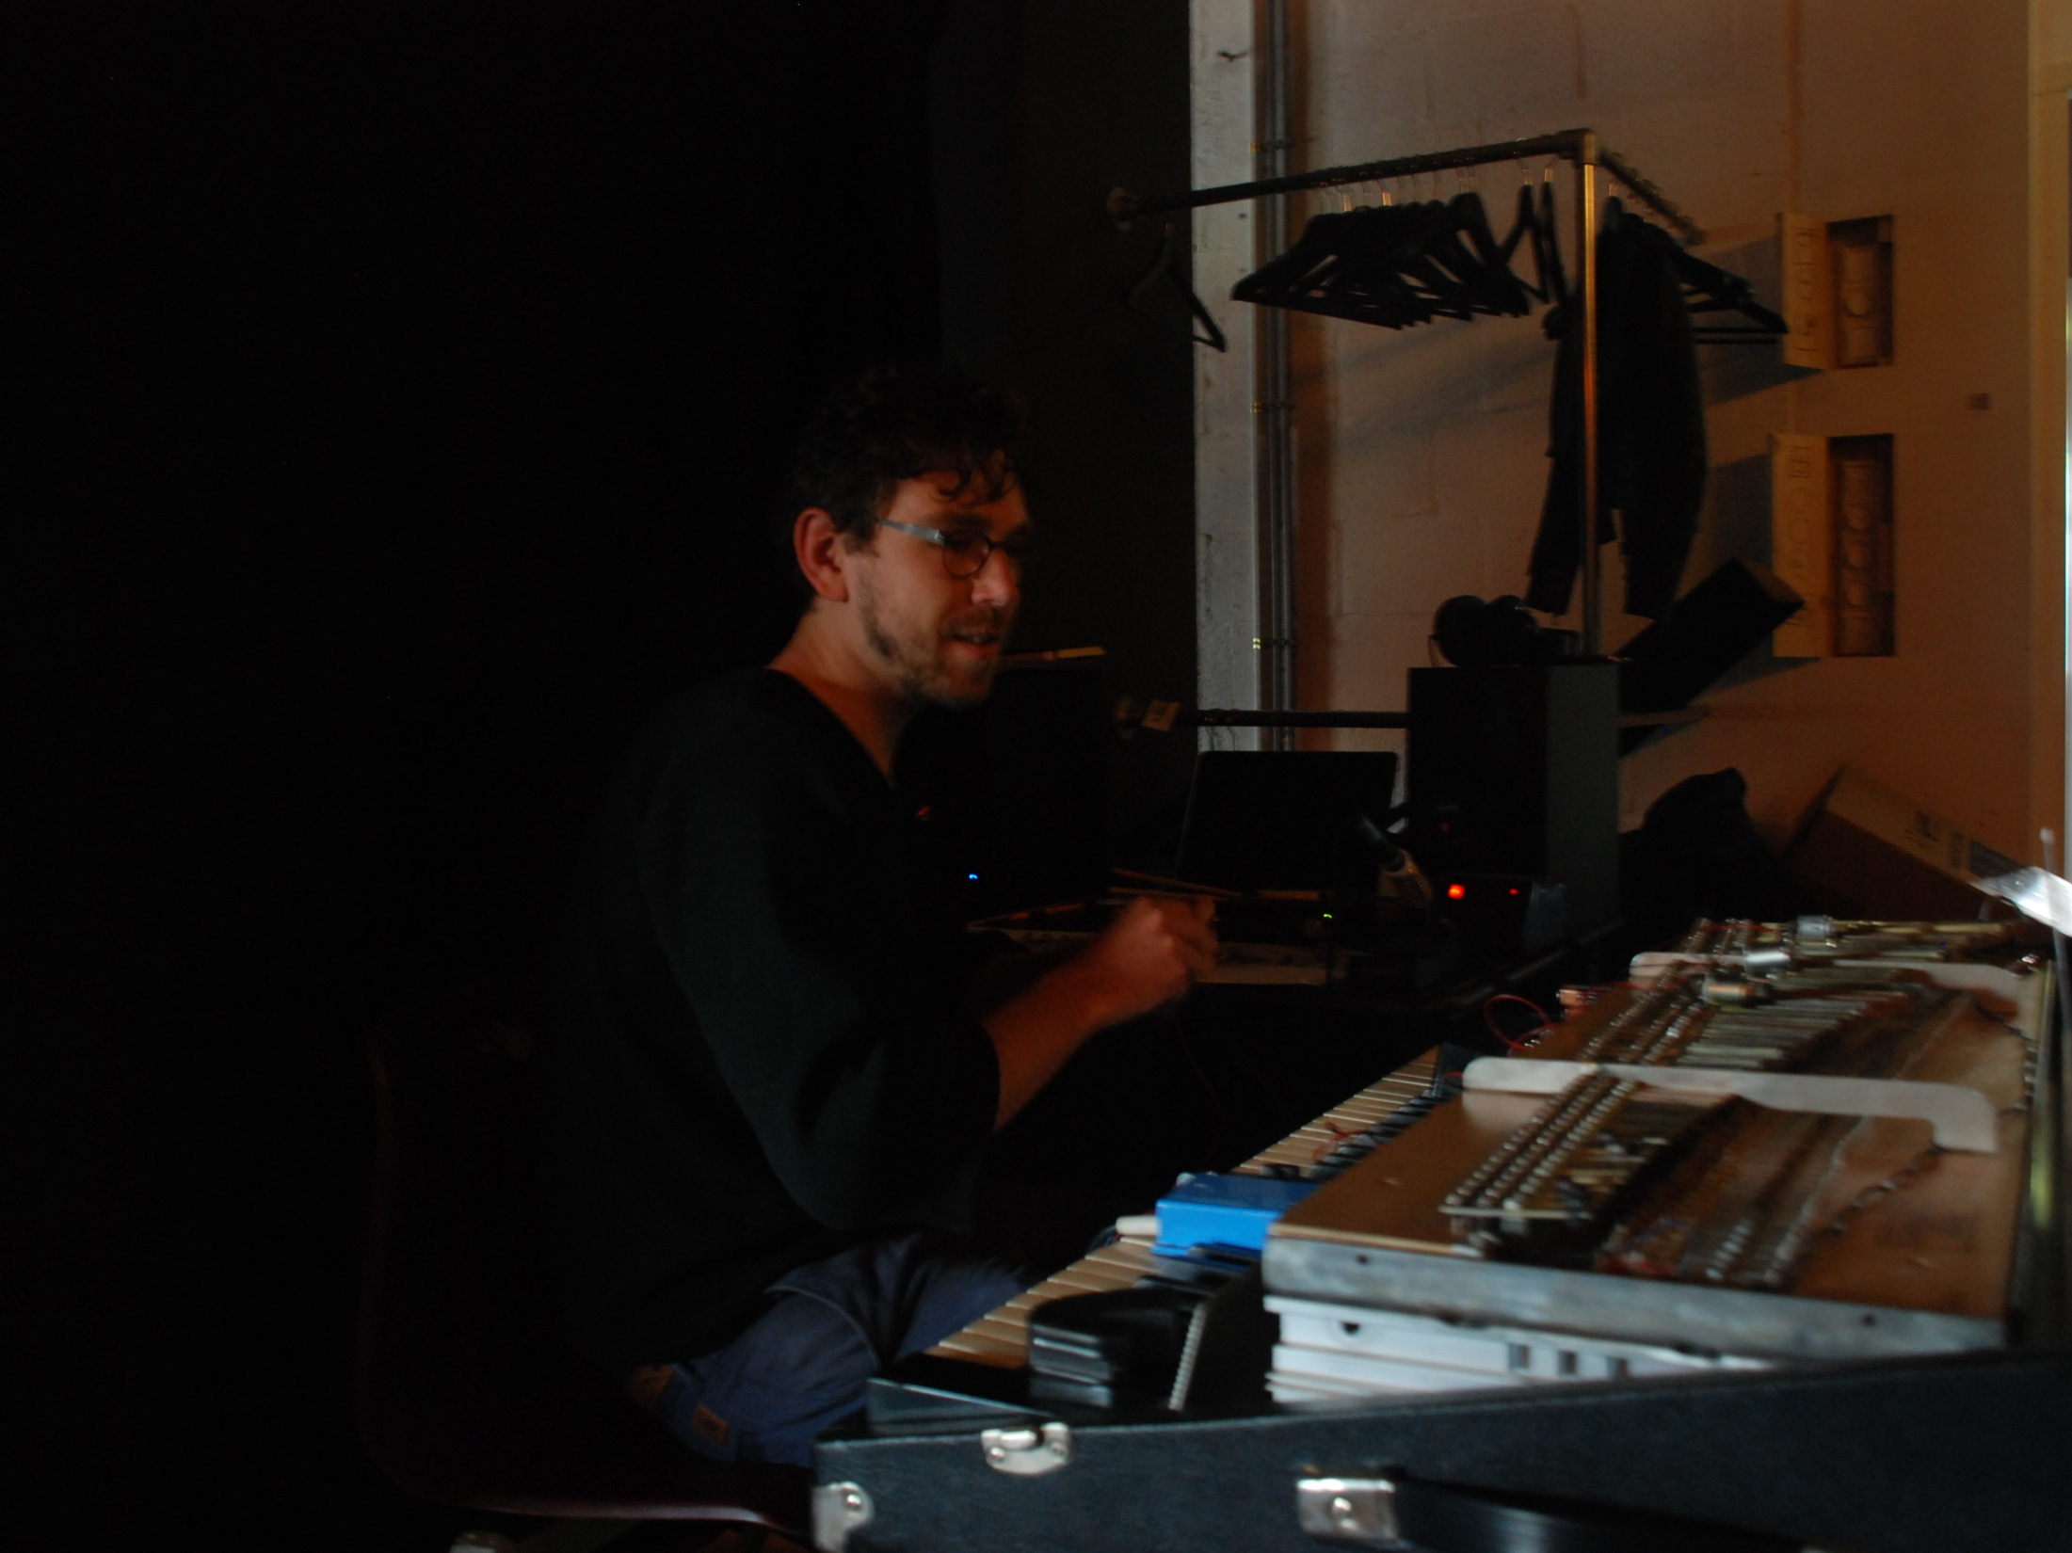
Fender Rhodes,
A Real Time Composition
Harpo ‘t Hart (2013)
Harpo ‘t Hart knows his Fender Rhodes inside out but by programming himself algorithmically & mechanistically and hacking his instrument with uncommon hardware he discovers new sounds and compositions

Slide 18
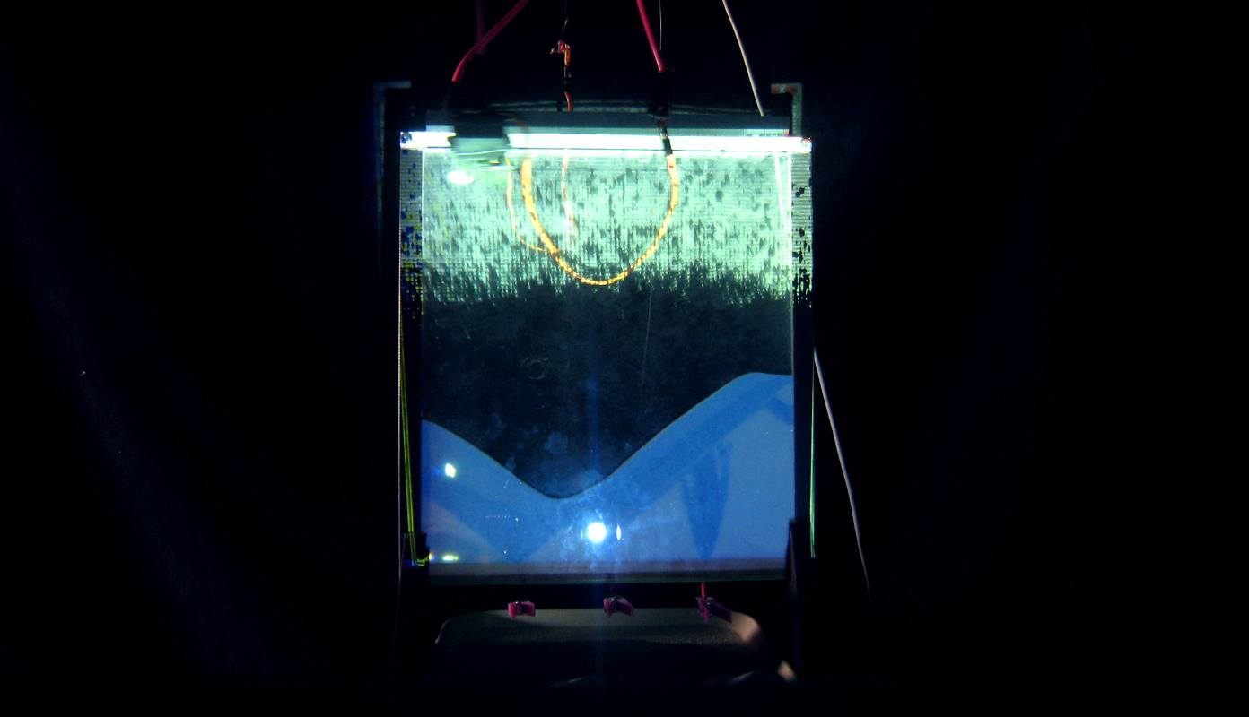
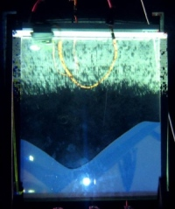
The Sandbox
Arjen Suijker, Annika Geurtsen and Jorrit Siebelink (2013)
Since the beginning of the 'digital' era, playful activities such as building things out of simple materials have moved away from the physical world into the digital world of computers.
The Sandbox is an installation which tries to bring back some of the excitement of building something in real life by combining an analog sandbox world with the limitless possibilities of the digital world. It consists out of an analog display in which the user can literally build a world with 'sand'.
This world will be combined with projections of a 'digital space' which reacts according to what the user has built in the analog display

Slide 19
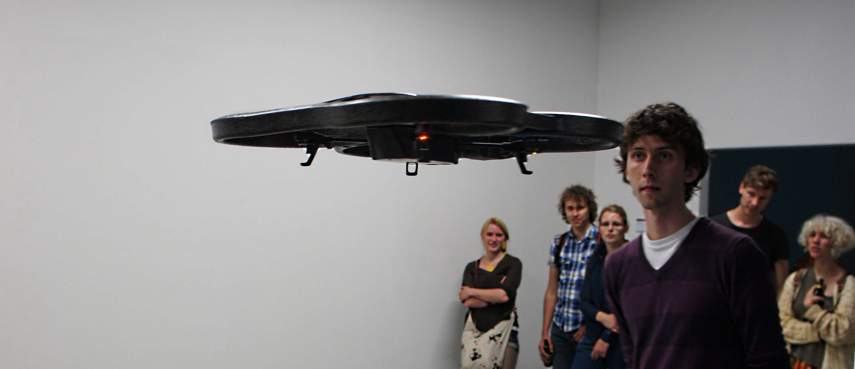
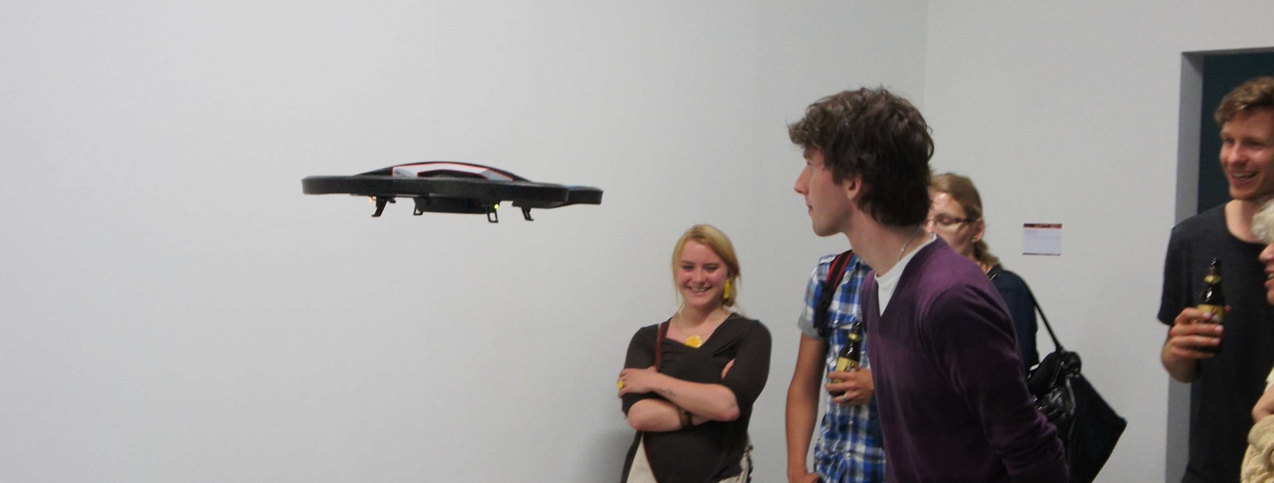
FaceDrone
by Daan Krijnen (2014)
Drones ,tracking and mirroring visitor behavior by tracking their faces and emotion

Slide 20
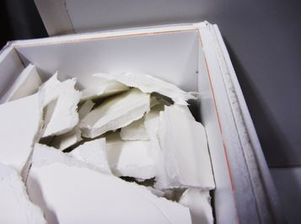
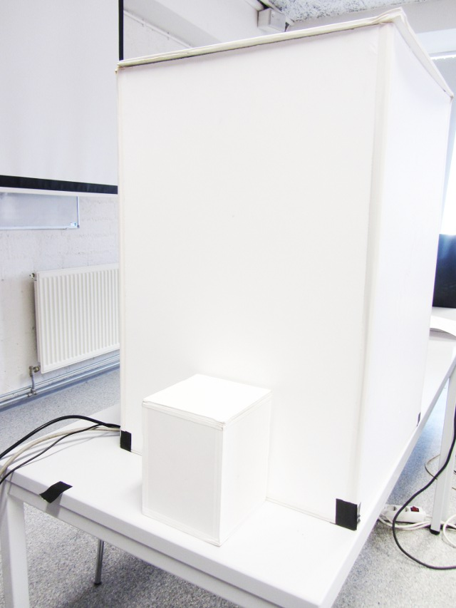
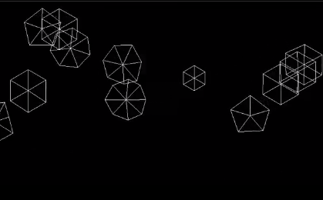
Quantisatron
Bernd Dudzik and Haixiang Zhang (2013)
In quantization, information gets lost when transfering from the analog to the digital world. At the same time, once on the other side is reached, endless possibilities of manipulation are possible, leading to the creation of entirely new properties.
The quantisatron gets fed with analog matter, which is tranferred into digital creatures that live forever.

Slide 21
Random Piece of History
Bobby Smulders (2013)
Dynamic Regeneration of GeoCities Websites

Slide 22
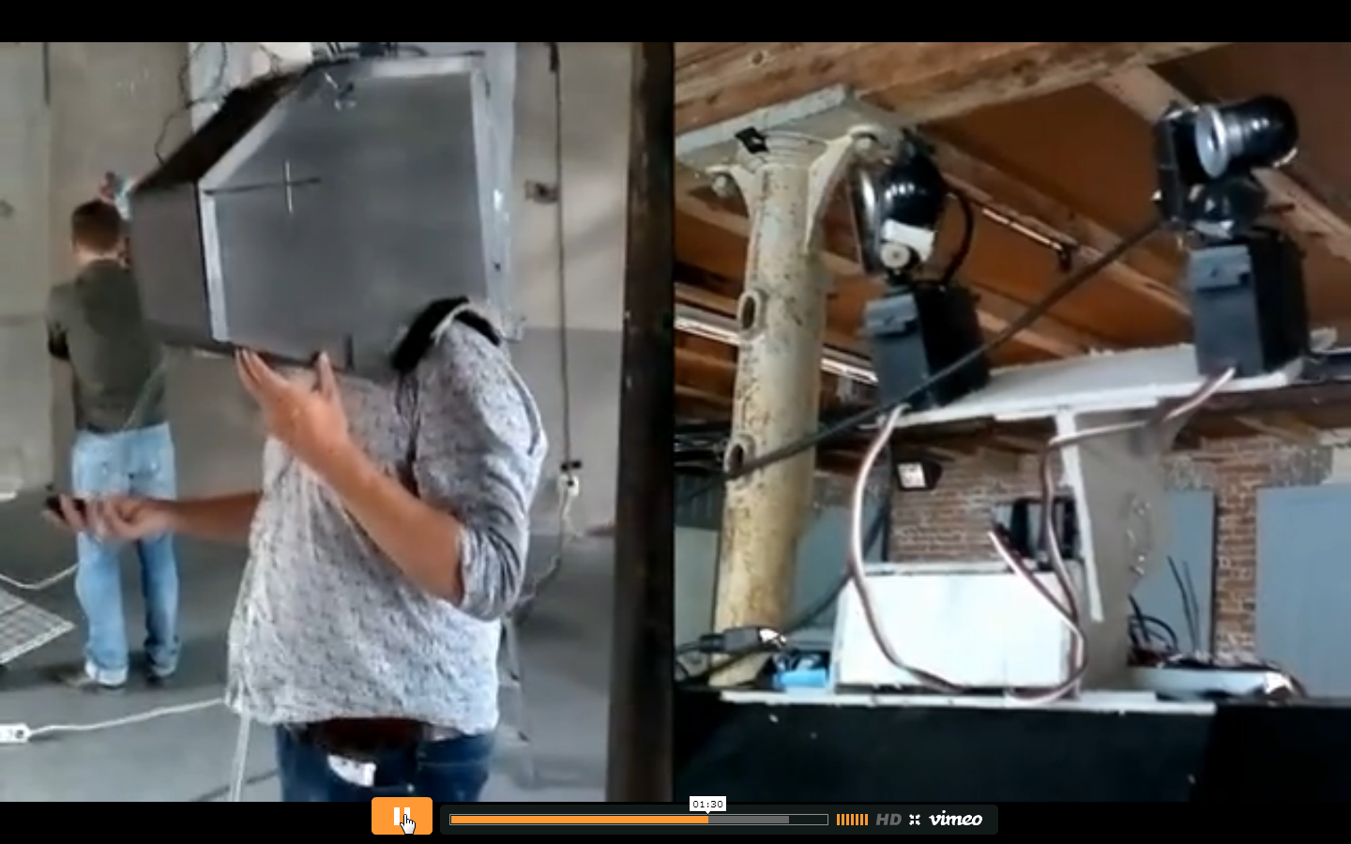
Desyncapitator
Jan Jaap van Assen & Erik Jansen (2011)
Our brain has the capability to process loads of visual data. This data is partly generated by our eyes which let us perceive the world around us. Maybe we can observe more visual aspects of the world if we weren’t limited to only our eyes. Behold The Desyncapitator, a visual extension machine which will try to blow your mind by feeding a digital remixed version of the surroundings on your retina.
See http://www.janjaapvanassen.com/?p=65

Slide 23
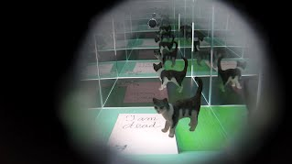
Schroedingers Cat
Arnold Jan Quanjer and Aurismas Bavarskis (2012)
A physical implementation of Schroedingers quantum thought experiment: how can the cat in the box be dead and alive at the same time?

Slide 24
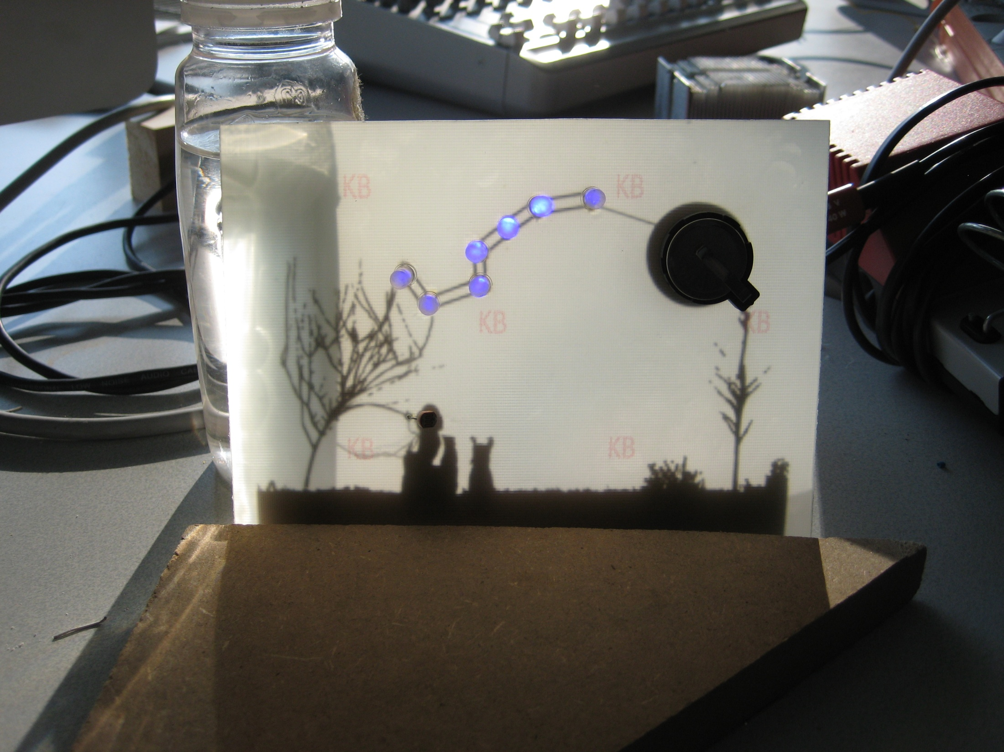
PCB Art
Arne Boon & Grace Gao (2012)
An aesthetic sketch and functioning electronic circuit in one.

Slide 25
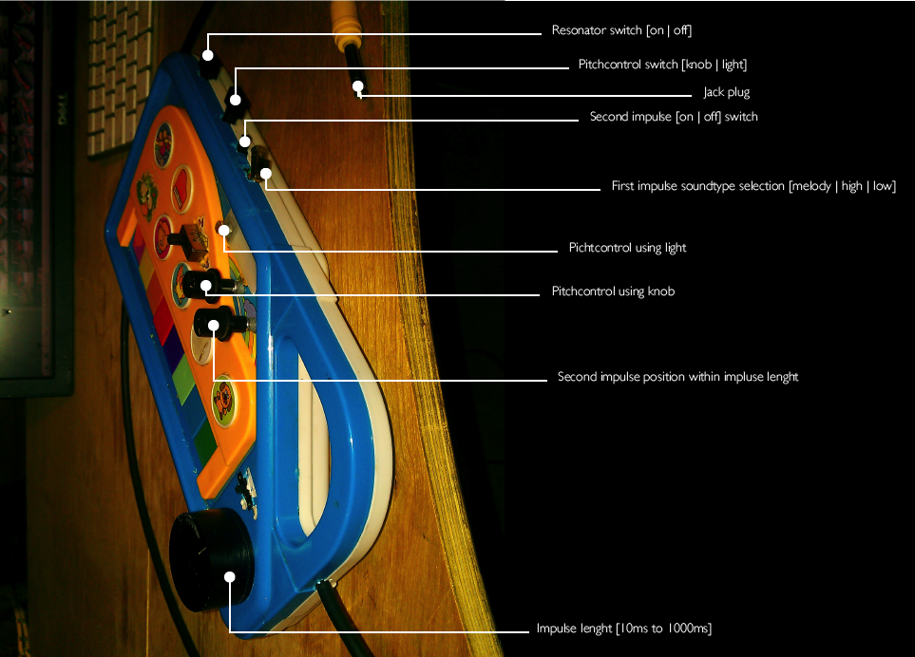
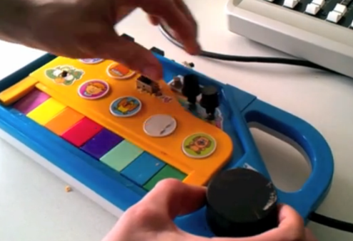
Circuit Bending
Atze de Vries & Tom Groen (2011)
Turning a baby synthesizer into an evil sound machine
https://vimeo.com/21201975

Slide 26
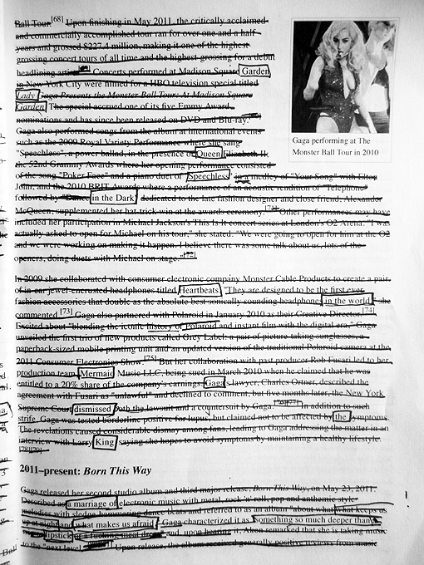
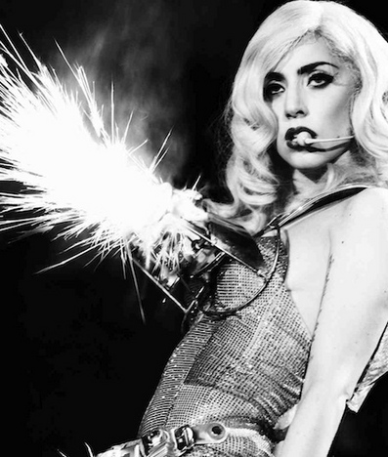
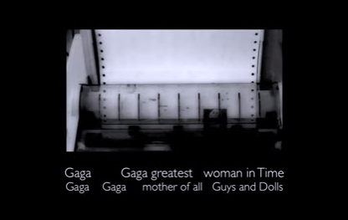
Lady Gaga 32.8 Feet
Lisa Gliederpuppe (2012)
A Wikipedia Poem

Slide 27
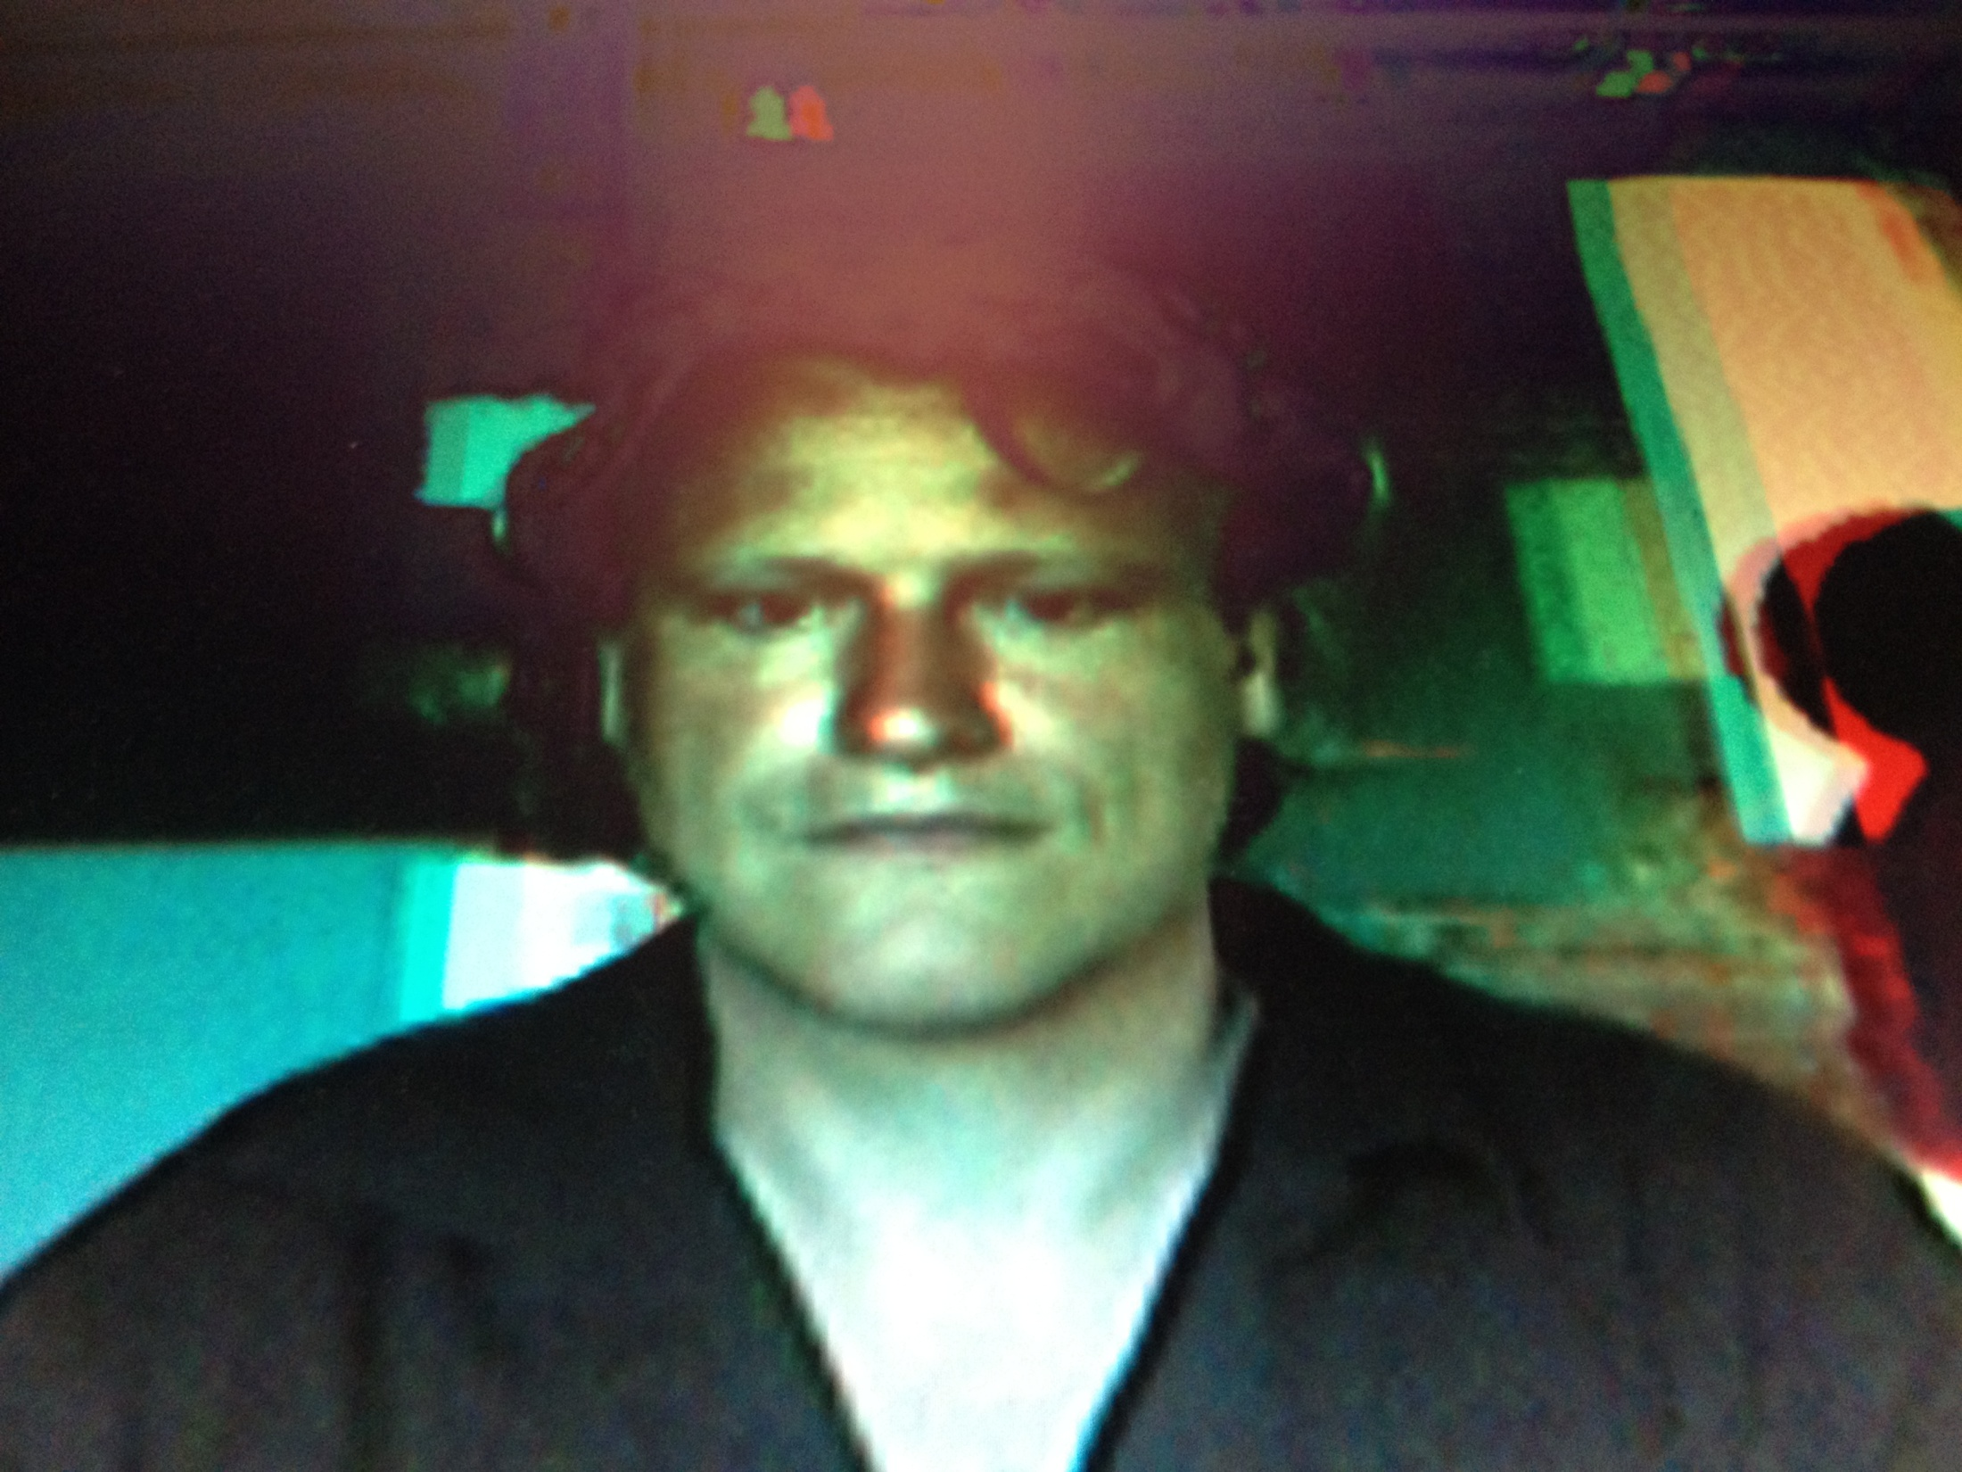
Cyclops
Chris Heydra (2012)
Is it possible to create a 3D image with a single camera as opposed to the usual set of stereoscopic cameras?

Slide 28
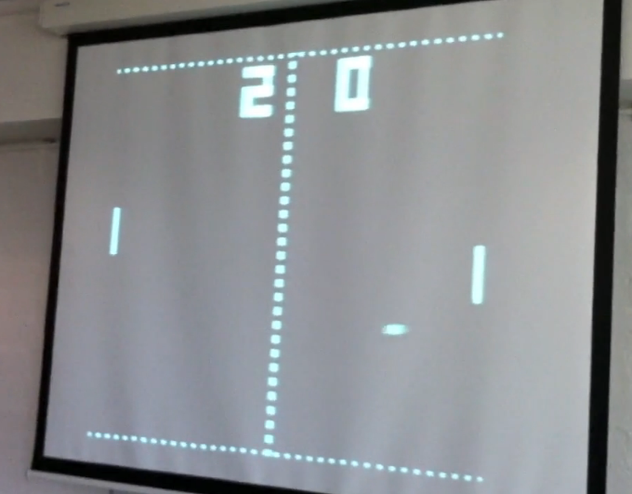
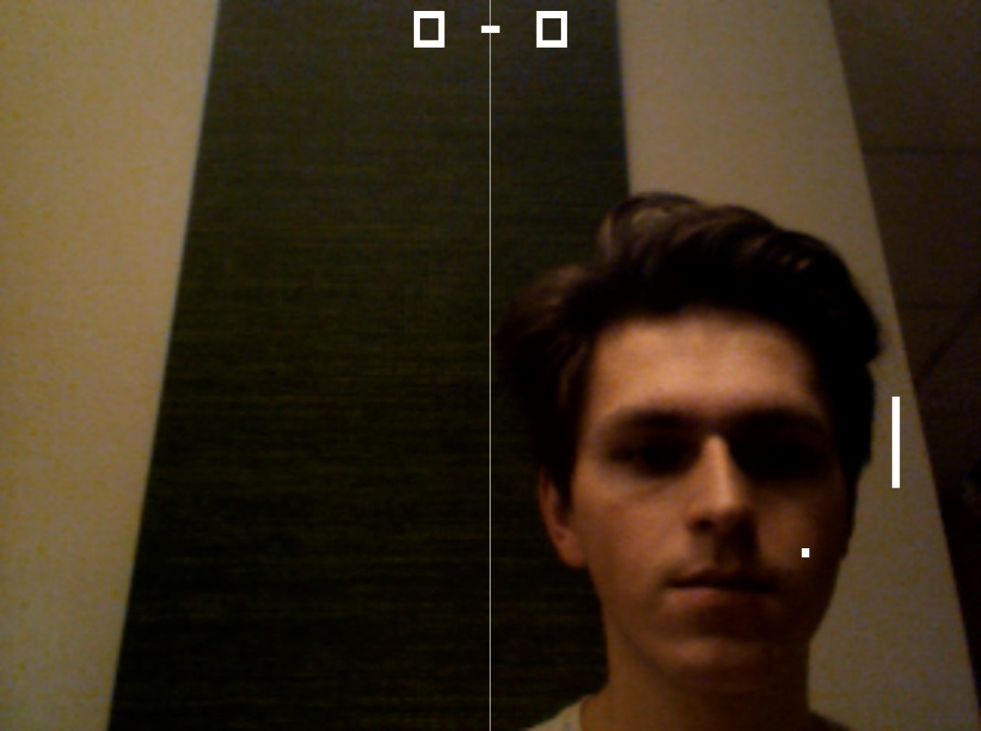
TwitPong
Patrick Heneise & Martin Weber (2011)
Why not play Pong with Twitter?
FacePong
Alwin Zwets (2011)
Playing Pong with your face

Slide 29
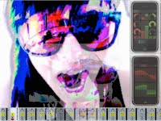
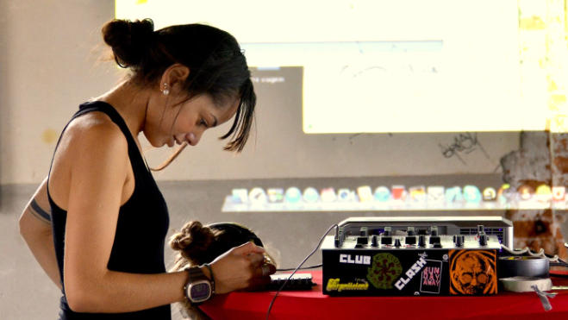
iPhone VJ
Joanna Camargo Coelho (2012)
The audience can become the VJ through an intuitive multi touch iPhone application

Slide 30
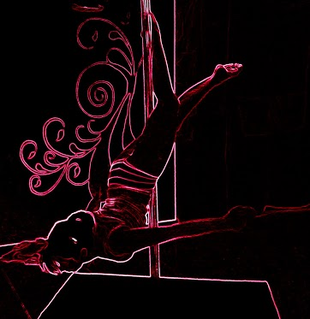
Sensi Pole
Grace Gao, Tamara Pinos, Bardo Frings (2012)
What is so attractive about Pole Dancing? Is it the music, the lights, the movements? Sensi Pole is an interactive pole that will influence space and sound in order to create a different experience for the performer and the audience.

Slide 31
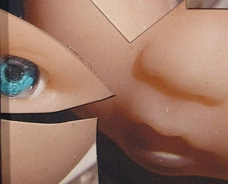
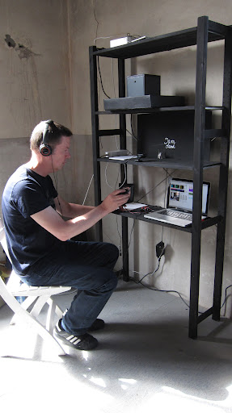
My heart is a machine
but I can hear the sound of singing fish and polytheen babies
Arnold Jan Quanjer (2012)
In this installation your heartbeat is scanned and sonified. After sonification your heart sounds like a pulsating machine in a steel plant.
But despite your heart sounds like a machine you still will be able to hear the sound of singing fish and polytheen babies.

Slide 32
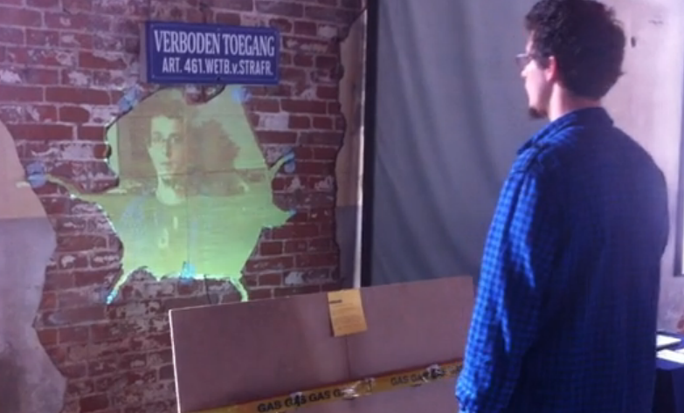
Dream Deferred
Roy van Roijen & Rosen Bogdanov (2012)
How many times you imagine being on a beach realizing you are still in the same old place, with the same old people? This installation creates a similar effect, by projecting dreams that in the end deteriorate to your own reality.
https://vimeo.com/43303402

Slide 33
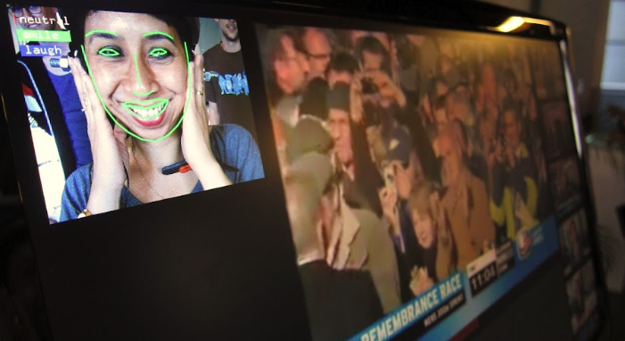
SmileTracker
Arne Boon & Guido Huijser (2012)
SmileTracker application developed in this study aims to accurately gauge the users' emotive response to humorous videos. It detects the user’s emotive response and dynamically composes a ranking of the most fun videos. This project is the first step towards a non-linear storytelling steered by facial expressions of the viewer.

Slide 34
Steampunk Tweets
Polly Oskam & Ali Elgin (2012)
A tribute to the telegraph. A steampunk Twitter to Morse player.
http://youtu.be/VVngqsnE-KY

Slide 35
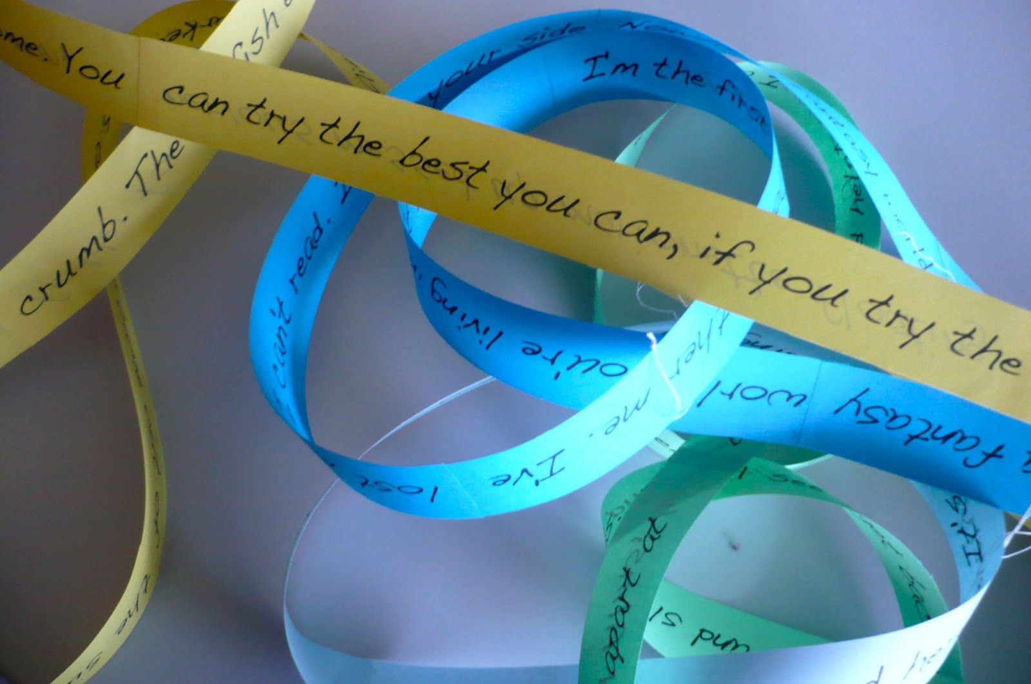
Radiohead Hypertext Cut Up
Tamara Pinos Cisneros (2012)
A Hypertext Cut Up with infinite loops of Radiohead’s Kid A.

Slide 36
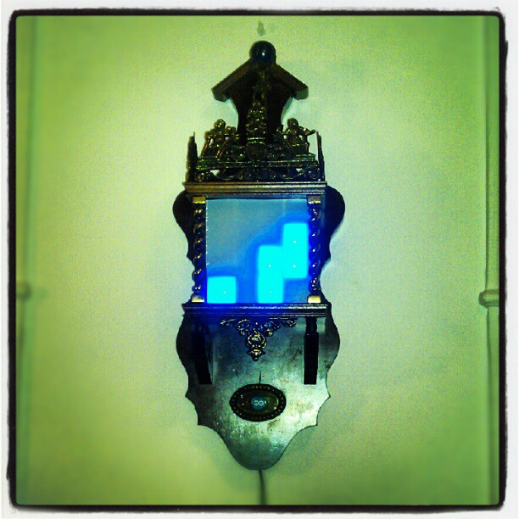
A Clockwork Binary
Robin de Lange (2012)

Slide 37
As we may think…

Slide 38
What is it like to go back to the future?

Slide 39
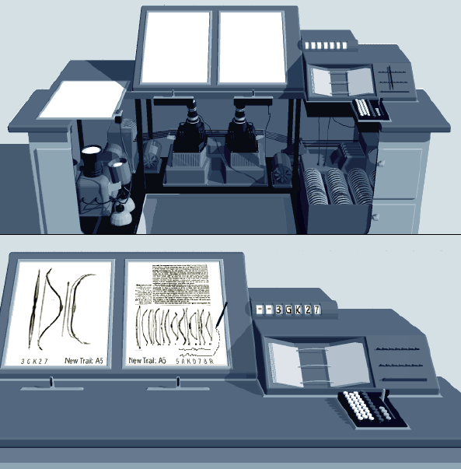
As We May Think

Slide 40
Contents
All Media Was Once New
Hardware, Interfaces, Humans
Cybernetic Art
Next editions: Space, Futures etc.

Slide 41
Wasn’t all media once new?

Slide 42
All Media was Once New
The Concept of Media
Storing, delivering, exchanging data?
Materials used by an artist to create work?
Interface between humans and the physical world? Human ‘extensions’?
Other mediators?
The medium and the message?
Old New Media – and the impact
Fire
Cave Drawings
Writing
Book Press
Phonograph
Telegraph
Telephone
Movies
…

Slide 43
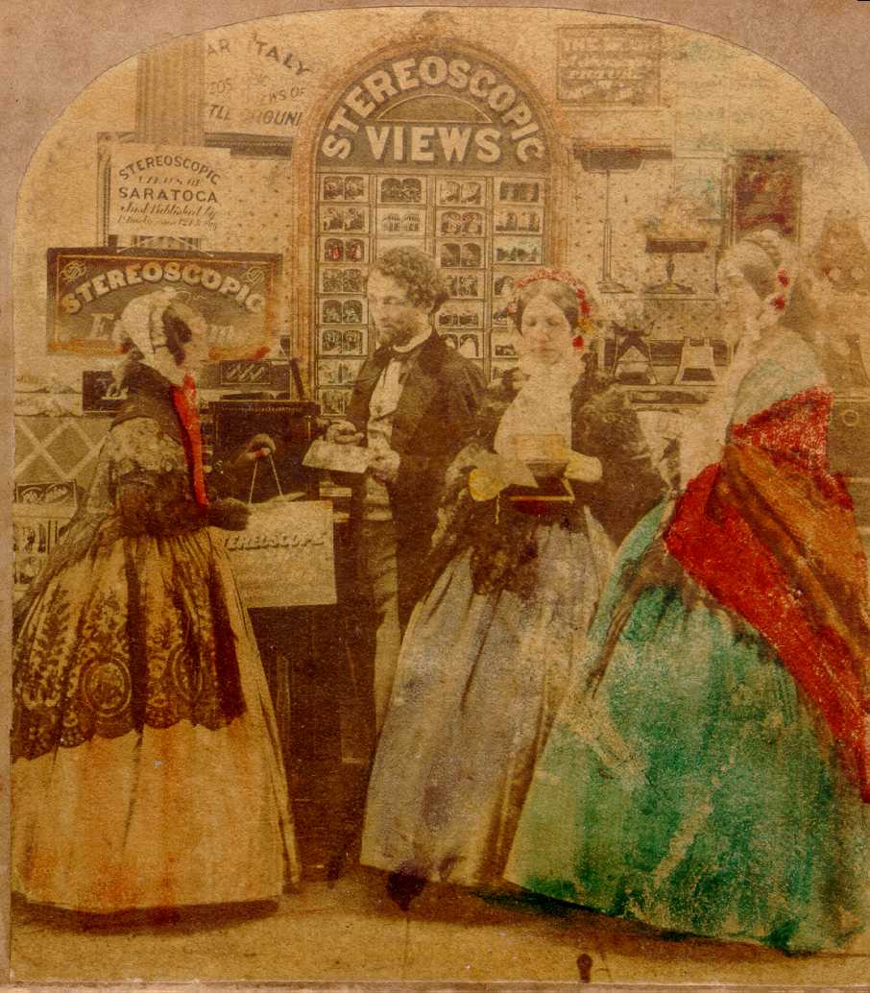
3D TV anyone?
Stereoscopic Emporium, 1860
Wiggle Steroscopy

Slide 44
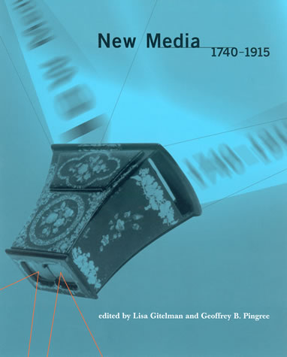
All Media Was Once New
Zograscopes & Societal Impact of VR
Physiognotrace and Politics
Optical Telegraphs and Education
The Telephone and the Amish
The Telegraph and Online Cruising
Scrapbook making as non linear story telling
Notes:
Telegraph and online cruising
Anonymity
Chat
Mistaken identity
Erotic communication
edating
cyberthreats
power reversal

Slide 45
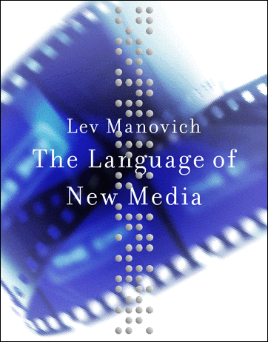
New Media Theory(Manovich, 2001)
What New Media is not
Digital and discrete
Single player for all digital media
Random access
Information loss
Endless copying
Notes:
Having proposed a list of the key diffirences between new and old media, I now
would like to address other potential candidates, which I have ommitted.The
following are some of the popularly held notions about the difference between
new and old media which this section will subject to scrutiny:
1. New media is analog media converted to a digital representation. In
contrast to analog media which is continuos, digitally encoded media
is discrete.
2. All digital media (text, still images, visual or audio time data, shapes,
3D spaces) share the same the same digital code. This allows diffirent
media types to be displayed using one machine, i.e., a computer, which
acts as a multimedia display device.
3. New media allows for random access. In contrast to film or videotape
which store data sequentially, computer storage devices make possible
to access any data element equally fast.
4. Digitization involves inevitable loss of information. In contrast to an
analog representation, a digitally encoded representation contains a
fixed amount of information.
5. In contrast to analog media where each successive copy loses quality,
digitally encoded media can be copied endlessly without degradation.
6. New media is interactive. In contrast to traditional media where the
order of presentation was fixed, the user can now interact with a media
object. In the process of interaction the user can choose which
elements to display or which paths to follow, thus generating a unique
work. Thus the user becomes the co-author of the work.

Slide 46
New Media Theory(Manovich, 2001)
A new language
Numerical
Modular
Automation
Variability
Transcoding

Slide 47
New Media
Integration
Interactivity
Immersion
Hypermedia
Narrative

Slide 48
Trailblazers: selected old new media icons

Slide 49
Timelines - Arts
Richard Wagner (1849) – Gesamtkunstwerk
László Moholy-Nagy (1924) - Theatre of Totality
Dada
John Cage, Merce Cunningham, Jasper Johns
Allan Kaprow – Happenings
Fluxus
From Software – Information Technology: It’s New Meaning for Art, Seek, 1970
Nam June Paik – Cybernated Art

Slide 50
Timeline - Narrative
Jorge Luis Borges (1941) – The Garden of Forking Paths
Vannevar Bush (1945) – Memex
Douglas Engelbart (1965) – oNLine System
Ted Nelson – Xanadu, Hyperlink, Hypertext, Computer Lib / Dream Machines
William Burroughs (1964) – The Future of the Novel / Cut Up and Fold In
Lynn Hershman (80s, 90s) - Deep Contact, Fantasy Beyond Control
Tim Berners Lee (1989) – The Web
Roy Ascott - Dataspace

Slide 51
Timeline - Space and Other Realities
Morton Heilig (1962) – Sensorama
Ivan Sutherland (1965) – The Ultimate Display
Myron Krueger (1970s) – Videoplace, Responsive Environments
Richard Bolt (1980) – Put That There
Ben Shneiderman (1983) – Direct Manipulation
Scott Fisher (1980s) – VIEW
William Gibson (1984) – Neuromancer
Daniel Sandin (1990s) - CAVE

Slide 52
Timelines - Hardware, Interfaces, Humans
Vannevar Bush (1945) – Memex
Norbert Wiener – Cybernetics
J. Licklider – Man-Computer Symbiosys
Douglas Engelbart (1962) – Augmenting Human Intellect
Sutherland (1963)
Alan Kay – Dynabook / Xerox Parc (1968-77)
Arduino, Processing, OpenFrameworks

Slide 53
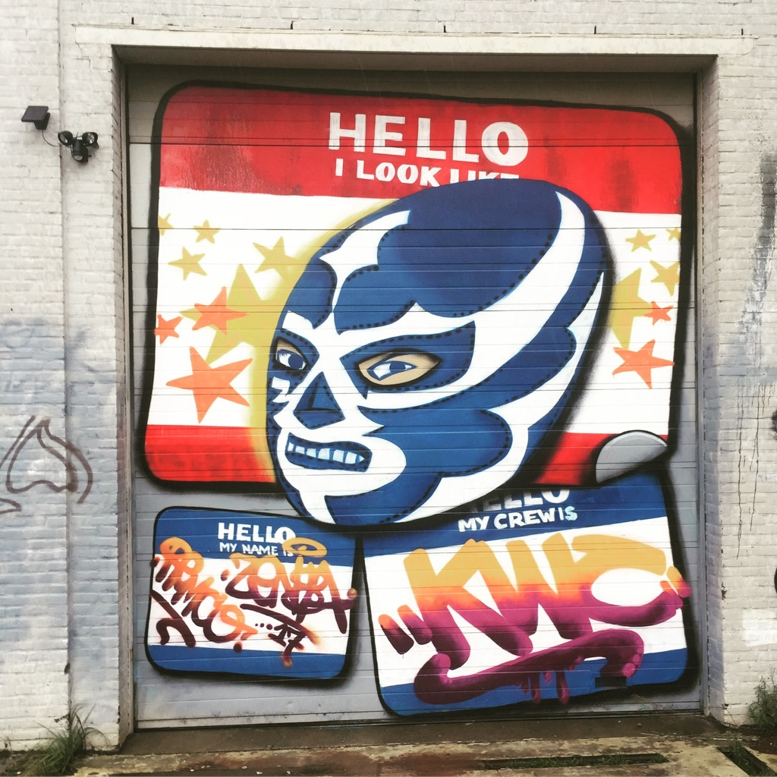
Hardware, Interfaces,
Humans

Slide 54
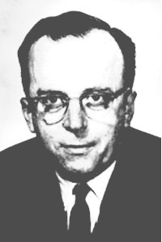
Mechanically Extended Man
Man-Computer Symbiosys
Human Extended Machine
J.C.R. Licklider
Notes:
There was a great deal of optimisim, also in the fifties, when AI would be ‘solved’. For examples Simon, Newell & Shaw General Problem Solver.

Slide 55
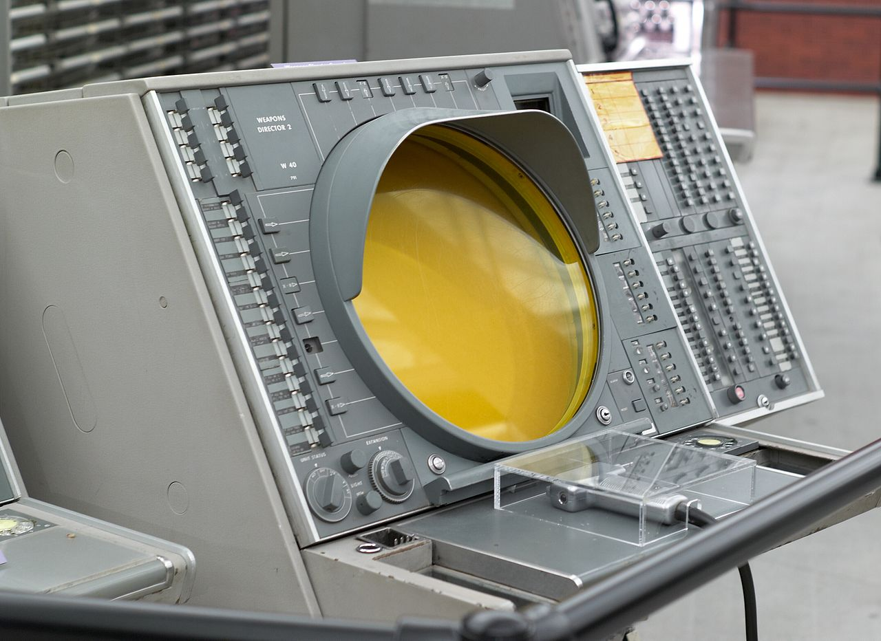
Men will set the goals, formulate the hypotheses, determine the criteria, and perform the evaluations. Computing machines will do the routinizable work that must be done to prepare the way for insights and decisions in technical and scientific thinking
Notes:
Requirements:
Machines should support the formulative process
Machines should operate in a real time interactive fashion wit the human
Self observation: 80% of the time was spent in getting ready to think. Hours getting data gathered and into a visual format. Seconds to take a conclusion.
Issue – many of the circumstances are unforeseen, many different variables, changing sequences. Men are flexible – ‘reprogramming all the time’

Slide 56
Man Computer Symbiosis (Licklider 1962)
About Licklider
Trained in engineering and behavioral psychology
Led ARPA from 1962
Promoted computer science, networked systems (‘Intergalactic Computer Network’, ARPANET) interactive systems
Man Computer Symbiosis (1962)– in between Mechanically Extended Man and Artificial Intelligence. Outlines a roadmap of needs that we still work from today
Division of roles
Man sets goals, formulates hypotheses, determine criteria, perform evaluations, deals with exceptions
Machine will perform the routinizable work to prepare the way for technical and scientific thinking. But help with formulating, real time thinking, translate high level hypotheses or tasks into testable and executable models. Help to get ready to think, support incremental problem solving.
Notes:
The main aims are 1) to let computers facilitate formulative thinking as they now facilitate the solution of formulated problems, and 2) to enable men and computers to cooperate in making decisions and controlling complex situations without inflexible dependence on predetermined programs. In the anticipated symbiotic partnership, men will set the goals, formulate the hypotheses, determine the criteria, and perform the evaluations. Computing machines will do the routinizable work that must be done to prepare the way for insights and decisions in technical and scientific thinking. Preliminary analyses indicate that the symbiotic partnership will perform intellectual operations much more effectively than man alone can perform them. Prerequisites for the achievement of the effective, cooperative association include developments in computer time sharing, in memory components, in memory organization, in programming languages, and in input and output equipment.

Slide 57
Man Computer Symbiosis (Licklider 1962)
Computers should be
Formulative: Help formulate thinking, not just aid formulated problem solving
Interactive & Real Time: Cooperate interactively in real time with man without reliance on inflexible programs
Requirements
Intelligence - Statistical inference, decision theory, game theory machine; suggest courses of action; pattern matching and diagnosis;
Memory- improved memory organization and associative search,
Solve the language problem - Goal driven languages and conversation rather than procedural languages, automated problem solving
Interaction / IO - Real time, interactive processing, connected users,; new input output devices, an IO display that directly combines text and drawing, speech production and recognition

Slide 58
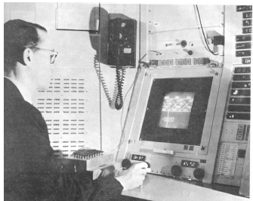
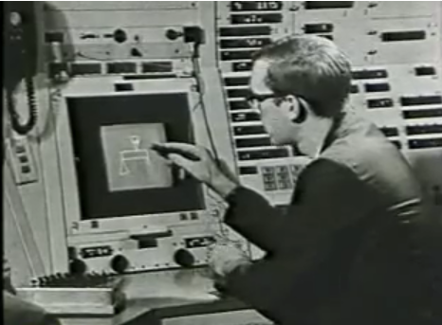
Sketchpad (Sutherland, 1963)
Helps user solve a complex visual problem
Conversation as direct manipulation
Computer understands the structure, drawings and images consist of objects
Optimization is used to solve problems and assist the user in what he is trying to achieve
Foundation for GUIs, CAD, OO etc.
Reuse of drawing by copying or linking

Slide 59
Sketchpad (Sutherland, 1963)

Slide 60
Augmenting Human Intellect (Engelbart 1962, 1968)
Augmentation Research Center at Stanford
Starting point is a conceptual framework for augmenting human intellect: H-LAM/T (Engelbart 1962)
How can people as well as technology work together to solve complex problems
For diplomats, designers, architects, scientists, ..
Human, Language, Artefacts, Methodology, Training
Intelligence amplification (as opposed to AI)
Evollution of intelligence: concept manipulation, symbol manipulation, external symbol manipulation, automated external symbol manipulation
Thought experiment and paper based simulation
Introduced many concepts and tools that are common today (Engelbart 1968)
Invented a knowledge worker workstation that could be used to create structured and hyperlinked documents mixing images and text
Networked collaboration was a key aspect
Precursor to Xerox PARC
Notes:
Artifacts—physical objects designed to provide for human comfort, for the manipulation of things or materials, and for the manipulation of symbols.2a4a
Language—the way in which the individual parcels out the picture of his world into the concepts that his mind uses to model that world, and the symbols that he attaches to those concepts and uses in consciously manipulating the concepts ("thinking").2a4b
Methodology—the methods, procedures, strategies, etc., with which an individual organizes his goal-centered (problem-solving) activity.2a4c
Training—the conditioning needed by the human being to bring his skills in using Means 1, 2, and 3 to the point where they are operationally effective.
The system we want to improve can thus be visualized as a trained human being together with his artifacts, language, and methodology. The explicit new system we contemplate will involve as artifacts computers, and computer-controlled information-storage, information-handling, and information-display devices. The aspects of the conceptual framework that are discussed here are primarily those relating to the human being's ability to make significant use of such equipment in an integrated system.
[…]
You can integrate your new ideas more easily, and thus harness your creativity more continuously, if you can quickly and flexibly change your working record. If it is easier to update any part of your working record to accommodate new developments in thought or circumstance, you will find it easier to incorporate more complex procedures in your way of doing things. This will probably allow you to accommodate the extra burden associated with, for instance, keeping and using special files whose contents are both contributed to and utilized by any current work in a flexible manner—which in turn enables you to devise and use even-more complex procedures to better harness your talents in your particular working situation.
[..]
Individuals who operate effectively in our culture have already been considerably "augmented." Basic human capabilities for sensing stimuli, performing numerous mental operations, and for communicating with the outside world, are put to work in our society within a system—an H-LAM/T system—the individual augmented by the language, artifacts, and methodology in which he is trained. Furthermore, we suspect that improving the effectiveness of the individual as he operates in our society should be approached as a system-engineering problem—that is, the H-LAM/T system should be studied as an interacting whole from a synthesis-oriented approach.2b1
This view of the system as an interacting whole is strongly bolstered by considering the repertoire hierarchy of process capabilities that is structured from the basic ingredients within the H-LAM/T system. The realization that any potential change in language, artifact, or methodology has importance only relative to its use within a process' and that a new process capability appearing anywhere within that hierarchy can make practical a new consideration of latent change possibilities in many other parts of the hierarchy—possibilities in either language, artifacts, or methodology—brings out the strong interrelationship of these three augmentation means.
[..]
It has been jokingly suggested several times during the course of this study that what we are seeking is an "intelligence amplifier." (The term is attributed originally to W. Ross Ashby^{[2,3]}. At first this term was rejected on the grounds that in our view one's only hope was to make a better match between existing human intelligence and the problems to be tackled, rather than in making man more intelligent. But deriving the concepts brought out in the preceding section has shown us that indeed this term does seem applicable to our objective.2c2a
Accepting the term "intelligence amplification" does not imply any attempt to increase native human intelligence. The term "intelligence amplification" seems applicable to our goal of augmenting the human intellect in that the entity to be produced will exhibit more of what can be called intelligence than an unaided human could; we will have amplified the intelligence of the human by organizing his intellectual capabilities into higher levels of synergistic structuring. What possesses the amplified intelligence is the resulting H-LAM/T system, in which the LAM/T augmentation means represent the amplifier of the human's intelligence.2c2b
In amplifying our intelligence, we are applying the principle of synergistic structuring that was followed by natural evolution in developing the basic human capabilities. What we have done in the development of our augmentation means is to construct a superstructure that is a synthetic extension of the natural structure upon which it is built. In a very real sense, as represented by the steady evolution of our augmentation means, the development of "artificial intelligence" has been going on for centuries.
[…]
Before we pursue further direct discussion of the H-LAM/T system, let us examine some background material. Consider the following historical progression in the development of our intellectual capabilities:2c4a
2c4b
(1) Concept Manipulation—Humans rose above the lower forms of life by evolving the biological capability for developing abstractions and concepts. They could manipulate these concepts within their minds to a certain extent, and think about situations in the abstract. Their mental capabilities allowed them to develop general concepts from specific instances, predict specific instances from general concepts, associate concepts, remember them, etc. We speak here of concepts in their raw, unverbalized form. For example, a person letting a door swing shut behind him suddenly visualizes the person who follows him carrying a cup of hot coffee and some sticky pastries. Of all the aspects of the pending event, the spilling of the coffee and the squashing of the pastry somehow are abstracted immediately, and associated with a concept of personal responsibility and a dislike for these consequences. But a solution comes to mind immediately as an image of a quick stop and an arm stab back toward the door, with motion and timing that could prevent the collision, and the solution is accepted and enacted. With only non-symbolic concept manipulation, we could probably build primitive shelter, evolve strategies of war and hunt, play games, and make practical jokes. But further powers of intellectual effectiveness are implicit in this stage of biological evolution (the same stage we are in today).2c4b1
(2) Symbol Manipulation—Humans made another great step forward when they learned to represent particular concepts in their minds with specific symbols. Here we temporarily disregard communicative speech and writing, and consider only the direct value to the individual of being able to do his heavy thinking by mentally manipulating symbols instead of the more unwieldly concepts which they represent. Consider, for instance, the mental difficulty involved in herding twenty-seven sheep if, instead of remembering one cardinal number and occasionally counting, we had to remember what each sheep looked like, so that if the flock seemed too small we could visualize each one and check whether or not it was there.2c4b2
(3) Manual, External, Symbol Manipulation—Another significant step toward harnessing the biologically evolved mental capabilities in pursuit of comprehension and problem solutions came with the development of the means for externalizing some of the symbol-manipulation activity, particularly in graphical representation. This supplemented the individual's memory and ability to visualize. (We are not concerned here with the value derived from human cooperation made possible by speech and writing, both forms of external symbol manipulation. We speak of the manual means of making graphical representations of symbols—a stick and sand, pencil and paper and eraser, straight edge or compass, and so on.) It is principally this kind of means for external symbol manipulation that has been associated with the evolution of the individual's present way of doing his concept manipulation (thinking).2c4b3

Slide 61
Augmenting Human Intellect (Engelbart 1962, 1968)

Slide 62
Augmenting Human Intellect (Engelbart 1962, 1968)

Slide 63
Experimenting with various pointing devices light pen, joystick, track ball, graphicon, noise pointers, knee brace, …

Slide 64
The mouse won (1963)

Slide 65
The mouse won (1963)

Slide 66
The mouse won
Production version for surfing the Arpanet

Slide 67
The mouse won
Production version for surfing the Arpanet

Slide 68
But Engelbart invented a lot more than just the mouse
Demo by ‘WebCam’ (1968 Fall Joint Computer Conference)
Workstation, files, documents, delete / insert / move / copy, mouse, scrolling, hierarchical lists, hyperlinks, imagemaps, freeze panes, document collaboration and conferencing, paint style drawing, ARPANET plans (20 nodes, 20KB)….

Slide 69
Computer supported meetings (1967)

Slide 70
The Personal Workstation

Slide 71
The Personal Workstation

Slide 72
The Personal Workstation

Slide 73
Dynabook & Personal Dynamic Media (Kay and Goldberg, 1968 - 1977)
The Dynabook, the first Notebook, developed at the Learning Research Group @Xerox PARC
Desktop Metaphor
Overlapping Windows GUI, WYSIWYG
Rich Multimedia
Smalltalk OO language
Tested on kids & musicians

Slide 74
Put That There (Bolt, 1980)
Immersive environment controlled by speech and gesture

Slide 76
The Story Continues….
Tinkering Hardware (Arduino, Makerbots, Squishy Circuits …) and Software (Processing, OpenFrameworks, etc etc …)
Wearable Computing
Robotics
Affective Computing
Augmented and Artifical Intelligence
Internet of Things
…

Slide 77
Early Cybernetic Art

Slide 78
Nicolas Schöffer: CYSP 1, 1956
Cybernetics and Spatiodynamics
‘Robot Dancer – Homeostat on wheels’ (Cybernetic Zoo)

Slide 82
CYSP1 Anatomy
Senses
Sound
Color (‘heat’)
Dark / light
Brain
Philips computer, homeostatic principles
Excited by slience, blue colors, darkness
Calmed by noise, red colors, intense light
(Detector underneath to not cross lines)
Muscles
Drive in all directions, two speeds
Axial and eccentric rotation
Move individual polychrome plates (11 rectangular, 5 discs)
Excited: move forward, retreat, make turn, turn plates
Notes:
From http://cyberneticzoo.com/cyberneticanimals/1956-cysp-1-nicolas-schoffer-hungarianfrench/
“In point 2, CYSP-1 is affected by sound intensity, by light intensity and heat (an interpretation of th”e colour of the light eg red=warm, blue=cold). Sound is detected by microphone input, and CYSP-1 reacts by being excited by silence and is calmed by noise. Photoelectric cells detecting colour are excited by the color blue, which means that it moves forward, retreats or makes a quick turn, and makes its plates turn fast; it becomes calm with red. It is also excited in the dark and becomes calm in intense light. CYSP-1 has total autonomy of movement (being travel in all directions at two speeds) as well as axial and eccentric rotation, and the setting setting in motion of its 16 pivoting polychromed plates (11 rectangular, 5 disc). This is the internal feedback talked about in point 3 above, and is the BRAIN, in this case a homeostatic one. "Liberating the machine" can be seen as a general reference to the MUSCLES in the "electronic brain" model above.”

Slide 83
Edward Ihnatowicz
Polish cybernetics and robotics researcher and artist
Sound Activated Mobile, Senster, the Bandit
Nice collections of musings on rechnology and art by him at Senster.com

Slide 84
One of the first cybernetic art shows, curated by Jasia Reichardt, at the Institute of Contemporary Arts, London in 1968

Slide 89
Notes:
http://www.dse.nl/~evoluon/index-e.html

Slide 94
SEEK @The Jewish Museum NYC Architecture Machine Group, 1970
Installation by MIT Architecture Machine group at on exhibition held at Jewish Museum (1970)
Computer stacks blocks, builds mental model of the world... But gerbils can topple stacks

Slide 97
Sense and act in an environment, deal with unexpected events
Planning versus randomness
Smart environments – totalitarian mechanistic worlds

Slide 99
Lab 1

Slide 100
Narrative and Hypermedia

Slide 101
New Media Narrative
Non linear
Collaborative
Hyperlinked
Associative
Multimedial
Interactive
….

Slide 102
Examples of Traditional Media with Similar Characteristics
Luis Borges – the Garden of the Forking Paths (1941)
William Burroughs – The Cut Up Method by Brian Gyson (1961)
Cinema started with non-linearity
Many examples today in different ‘traditional’ media

Slide 103
The Memex (Vannevar Bush, 1945)
Thought experiment
Defining a new peacetime challenge for researchers
Analogue hypertext system

Slide 104
Ted Nelson
Introduces the term hypertext and hypermedia in Nelson (1965)
Specifically also targets personal and creative uses in addition to business and scientific use
Beyond mere linking – encode relationships between chunks of text
Support iterative nature of creative and critical writing processes – help to get from draft to final
Evolutionary File System – entries, lists, links, sequences
Different from the hierarchical nature of Engelbart’s system

Slide 105
Ted Nelson
Computer Lib / Dream Machines (1974)
Xanadu: a radically open network for creating media

Slide 106
Ted Nelson

Slide 107
Lynn Hershman
Preceded by Roberta – an alternative identity
Lorna Interactive Video (1979-1983)
Agorophobic girl in small apartment, controlled by media
Evoke manipulation by viewer
Make decisions
Select artefacts to see history and future
36 chapters, 3 endings

Slide 108
Tim Berners Lee (1989)
Scientist at CERN
‘Information Management – a Proposal’ often quoted as the launching paper for the web

Slide 109
Narrative in Games
Example: Pavel Curtis, Mudding: Social Phenomena in Text Based Virtual Realities
Author reports on social mechanisms on LambdaMoo MUD

Slide 110
Narrative in Games - MUDs
Linear story
Scripted flow game
Non linear story
Hyperlinked story
Scripted purpose game
Non goal oriented game
Players make their own ‘story’; interesting to see what behavior evolves as it is purely text based
Typical MUD Characteristics
Not goal oriented
Multi player
Extensible
Interesting Observations
Selected gender
Protective anonymity and abuse (toading punishment)
MUD conversation
Social gravity
Non verbal communication
Parallel conversations. Multitopic
Ambiguity

