Slide 1
Computer labs
Goal:
Consolidate the concepts learned during the lecture
Hands-on experience with collecting and evaluating DTD
The Monday after each lab (before 17:00):
Submit the completed lab to: https://surfdrive.surf.nl/files/index.php/s/rUTjwWP2uPiRrBy (see course manual)
Password: (written during the lab)
Name your file: lab1_lastname.pdf
You need to complete 80% of the labs to have the right to the resit. They are graded (pass/fail) and you must show effort on each question.
Work in groups is encouraged!
But this should be acknowledged: Mention at the top of your lab report, ”I worked with Javier Garcia on exercises 2 and 4”
No plagiarism: Copying an answer from another student (or the Internet) is a serious academic offense.

Slide 2
Group project
Goal: Practice the entire workflow of answering a research question using DTD, including assessing errors in the data and the potential harms for society.
Two deliverables: a written report (week 5) and a presentation (week 8)
Example research questions:
How politically polarized is Dutch society?
Is hate speech more likely to be shared on social media feeds of specific subpopulations?
Have comments in newspapers become more emotional after the Hamas attack/Israeli invasion?
What personality traits are associated with comments in different newspaper sections?
Take into consideration:
In the second assignment, you will use a text classification model to label the data. These models can detect the presence of hate speech, political leanings, personality traits, or different emotions. Make sure that your RQ is about one of these topics and that your data contains text.
Potential datasets (where you are likely to be able to extract data):
User-centric approaches: TikTok, Instagram, LinkedIn, 9GAG, Imgur, Twitter, Gab, Truth Social, Douyin,
Platform-centric approaches: The Guardian (comments), Facebook Social Connectedness Index, Reddit comments
Don’t try anything too complicated! The focus is not on answering a complex RQ, but on assessing the errors in the data and the potential consequences for the analysis.
Notes:
Based heavily on the labs
W3: We will discuss if the RQ matches the data and the data collection
(i.e. meet already next week!)

Slide 3
Group project
Timeframe (see group guidelines):
Before the feedback moment in week 3:
Decide on a research question that you would like to investigate using DTD. Feel free to come up with a couple options.
Fill the ethical review form.
Start collecting data (you will learn how to next week)
Week 3 (Wednesday): Feedback moment (15 min/group). Come prepared!
Bring and hand in a list of 10+ concrete tasks and who completed those tasks. Make sure that the list is signed by all group members.
Ideally bring a couple slides with your RQ, dataset, and proposed next steps.
Before feedback moment in week 4:
Finish collecting data
Discuss the errors you anticipate in the data (you will need to read BbB chapter 3.1-3.4 for that)
Week 4 (Wednesday): Feedback moment (15 min/group). Come prepared! (bring list of tasks)
Week 5: Submission of first report (< 1000 words)
Notes:
Based heavily on the labs
W3: We will discuss if the RQ matches the data and the data collection
(i.e. meet already next week!)

Slide 4
Group project
Timeframe: (cont)
Before feedback moment on week 7:
Run a text classification model of your choice (you’ll learn in week 5)
Discuss the biases you expect to arise from this.
Reflect on the ethical and power imbalances of the data used.
Week 7 (Wednesday), feedback moment (15 min/group). Come prepared! (bring list of tasks)
Before feedback moment on week 8:
Elaborate how you would expand the study to tackle the issues you encounter
Draft a presentation
Week 8 (Wednesday): Feedback moment (15 min/group). Come prepared! (bring list of tasks)
Week 8 (Friday): Group presentation
Week 9 (Friday): Exam

Slide 5
Group project grading
30% process: Individual grade
Attending the feedback moments (no attendance = zero in the process grade)
Constructively participating during the feedback moments
Contributing to the group (assessed by the list of small tasks)
70% group work
Assignment 1: Report (<1,000 words, excluding references and potential figures).
Assignment 2: Presentation (7-10 minutes)
Rubric and template for the report will follow in the next week

Slide 6
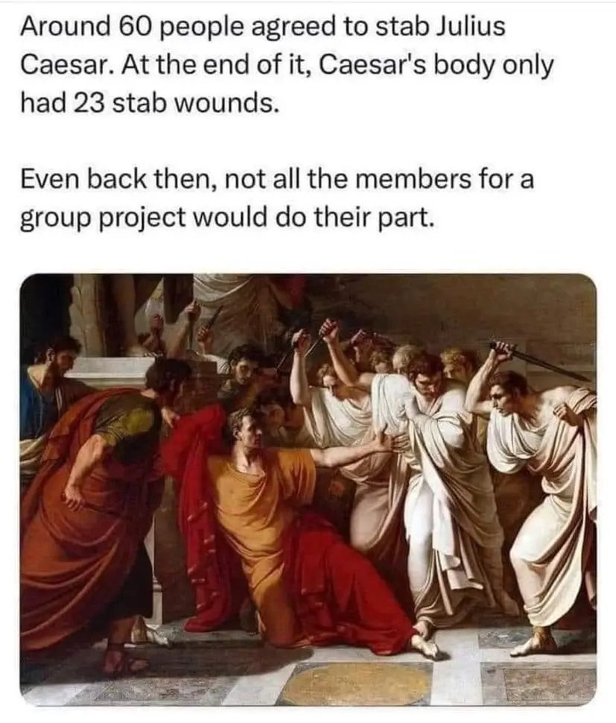
Group contract
Group work is often great (deeper learning, teamwork skills, community)
But it can be challenging when working styles or expectations clash.
A group contract sets ground rules and expectations and mitigate these problems.
Please spend 2 minutes to think about and write down:
* Four ground rules that will benefit you and your group (e.g., having regular meetings every week)
* 1 – 4 things you have experienced in the past and you DO NOT want to happen, alongside with how you think it can be prevented
(activity based on Gloria Totten’s group contract template)

Slide 7
Final 15 minutes: draft group contract
Use the template posted on the website (project guidelines), or here: https://docs.google.com/document/d/1VdUVTzQaxsFTXqVFKyJlNi9FZ_WlRKkHP-da_1MlPxI
(click on File -> Make a copy)
Before Monday at 17:00, sign it and upload it here (one person per group is enough): https://surfdrive.surf.nl/files/index.php/s/HgeNKHK8K9JS4jW
Password: written down during the lab
First step for the group project (next week):
Read project guidelines
Start thinking about possible research questions and datasets that could help answering it. Keep it simple!

