Slide 1
Changes in the Philadelphia accent from the perspective of natural selection
Cesko C. Voeten
Notes:
add context pen/ben
"noise" -> can also come from community
external/social internal/linguistic
accent is maybe too sociolectal
When we talk about sound change, we mean changes in pronuncation: accent.
Replace IPA with lexical sets
dots slide: replace with philly: there have been claims about sound change - see birthyear curves from LRF - but there's something missing from it
significant difference between start and end point vs interpretation of selection
noise that exists in all data, vs noise that is drift
duration: is there a correlation between ay0-raising and duration
IA group, but has Joe done this?
genetic drift, natural selection, parallels

Slide 2
outline
Variation and change
An evolutionary approach
A case study
Future experiment

Slide 3
Variation and change

Slide 4
sound change
Human language is a cultural product that is continuously evolving, much in the same way as biological systems are (Baxter et al 2006, de Boer 1999, Wedel 2006)
This is particularly noticeable in sound change, which is much more responsive to variation and change than e.g. sentence structure
Research question for today: what is the process underlying sound change, and how can we operationalize this process in terms of socio-cultural evolution?
Notes:
When we talk about sound change, we mean changes in pronunciation: accent

Slide 5
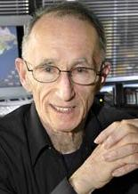
philadelphia
UPenn has a long history of looking at accent change in the Philadelphia accent
This is all thanks to Bill Labov (picture), a Penn professor who has devoted his career to the study of language variation and change (e.g. Labov 1994, 2001, 2010)
In particular, he established the Philadelphia Neighborhood Corpus – a corpus of recordings by students in his LING560 course taught from 1972 to 2010

Slide 6
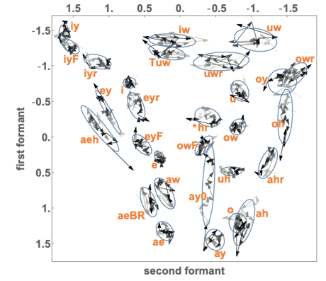
The Philadelphia Neighborhood Corpus
This talk uses the Philadelphia Neighborhood Corpus to investigate vowel changes over a hundred years of change.
The PNC has:
408 speakers born between 1880 and 1994 (393 available in our annotated data)
All of its vowels extracted automatically from the students’ recordings
Many vowel changes over these 100 years of language use

Slide 7
Why vowels?
Vowels are relevant to accent change in a way that consonants aren’t
Consonants are critical for word identification, vowels are much more malleable
  Compare: SL__PL_SS, _O_A_E_
  Compare: tie/die, cot/caught
For an extreme example of this, see Maye, Aslin, & Tanenhaus (2008), titled The Weckud Wetch of the Wast – lexical adaptation to a novel accent.
Vowels (therefore?) are very suitable carriers of social information
Notes:
sleepless, located

Slide 8
What are vowels, really?
Lungs, airflow, obstructions, etc
Formants
Normalization

Slide 9
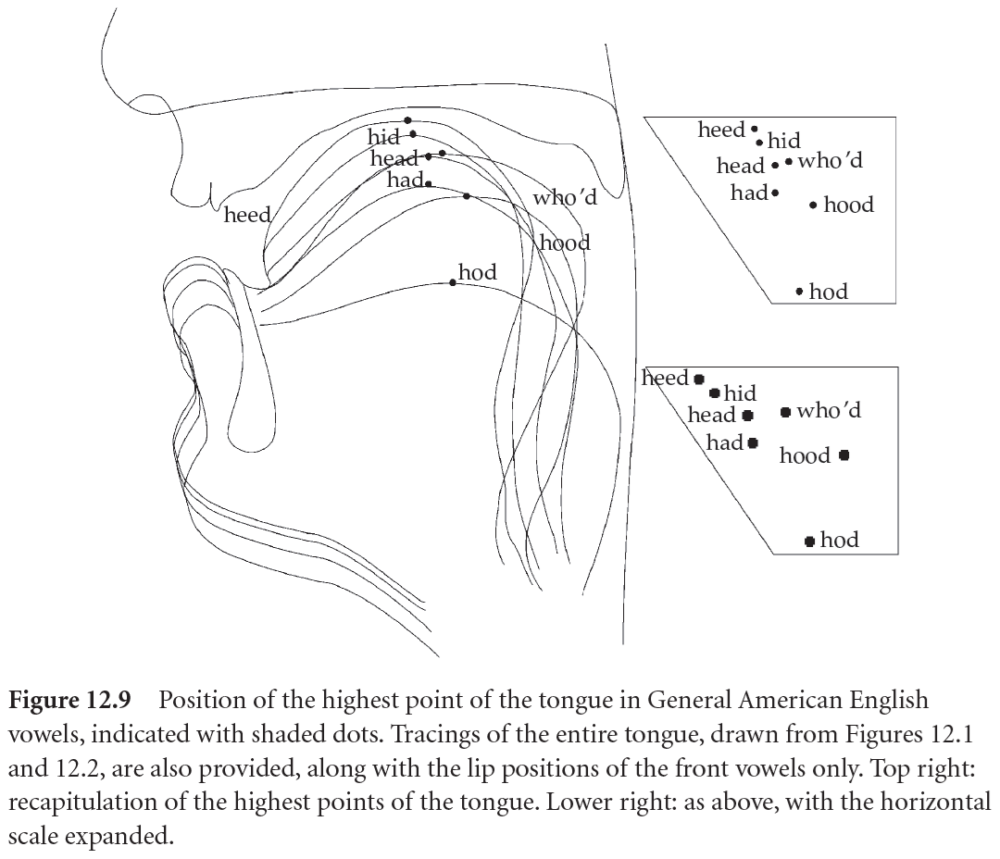
Measuring vowels
When you articulate a vowel, you push air from your lungs past your vocal folds through your oral cavity
Your vocal folds vibrate, giving you your voice
Your tongue position blocks parts of airflow, allowing you to produce different vowels (see picture, from Ladefoged & Disner 2012:132)
We can measure your tongue position from a microphone recording as F1 (high/low) and F2 (front/back)

Slide 10
From variation to change
There is intrinsic variation in vowel production: a couple ms longer or shorter, a couple Hz higher or lower, …
And there is extrinsic variation: differences that are meaningful (e.g., “man” vs “men”, or – in Philadelphia – “banana” vs “banana”, Sneller 2018)
If intrinsic variation is reanalyzed as extrinsic variation, this creates an opportunity for sound change
  E.g.: “street” > “shtreet” (Baker, Archangeli, & Mielke 2011)
But such an individual “mini sound change” will only succeed if the person also has the social clout to cause others to adopt it (“the chance alignment of social and phonetic variability”; Baker, Archangeli, & Mielke 2011)
This is why sound change is rare (Stevens & Harrington 2014)

Slide 11
Constraining sound change
Not all logically possible changes occur (the constraints problem – Weinreich, Labov, & Herzog 1968)
We have seen phonetic constraints: [s]>[sh] is especially likely in “street”
  These have been claimed to guide possible sound changes (Garrett & Johnson 2013)
And social constraints – the aforementioned “chance alignment of social and phonetic variability”
  A common theme in sociolinguistics: young women, particularly those who break with established community norms (Labov 2001)

Slide 12
An evolutionary approach

Slide 13
Finding phonetic pressure
The transmission of language throughout generations is a stochastic process
The input that children receive is:
  Only a subset of all possible utterances
  Variable: production and perception have inherent variability
  Amenable to reanalysis: the child’s parse may not match the adult’s mental representation (e.g. Latin caelum > Italian cielo > French ciel).
Absent such variation, finding sound change would be easy: just look for trends over time
Present this variation, finding sound change requires the separation of stochastic drift and selection pressure
Notes:
Same in biology: genetic drift (it happens) and natural selection (the new variant has a competitive advantage)

Slide 14
Example: “fight” in philadelphia
/ay0/: the vowel in FIGHT
Graph (Labov, Rosenfelder, & Fruehwald 2013:40) shows how this vowel’s F1 has moved up over the years => there has been a sound change
Did this come about due to stochastic drift or due to selection pressure?
No way to know by just observing a significant trend over time, because this question is one about the underlying process

Slide 15
Hypothesizing Stochastic drift & selection pressure
There is random variation in the transmission of variants across generations: stochastic drift
  The population target drifts over time due to random sampling effects
There is preferential transmission of some variants across generations: selection pressure
  Force to stay near the current vowel target: purifying selection (‘constraint’)
  Force to move towards a new target: directional selection (‘driving rate’)
Possible to formulate hypotheses about the process of a given trend:
  H0: the stochastic variation is sufficient to explain a change: Δ ≠ 0, α = 0
  H1: a change is due to stochasticity PLUS directional selection: Δ ≠ 0, α ≠ 0

Slide 16
Example application
Language changes in English do-support (Newberry et al 2017). All four variants show a significant trend over time, but only the blue and yellow variants were (directionally) selected; the trend in the gray forms is actually due to chance (stochastic drift).

Slide 17
our model
Ornstein-Uhlenbeck process (cf. Nourmohammad et al 2017)
Describes a Gaussian random variable moving in a specific direction over time
Add effects for stochastic drift + selection pressure
  Stochastic drift: random movement (pictured)
  Directional selection: targeted movement (pictured)
  Purifying selection: force constraining both of these types of change (not pictured)
F1
F2
Notes:
So the question is if the directional movement exceeds the stochastic movement (which in this picture it clearly does)

Slide 18
implementation
Population-genetic model for continuous traits (Nourmohammad et al 2017)
Grid search for maximum-likelihood coefficients for the three parameters Δ, α, and c
We compare the values that yield the maximal likelihood to values on adjacent grid points that have lower likelihoods; this results in a CI for those values
We do this for F1 and F2 separately (after PCA) and then combine the results

Slide 19
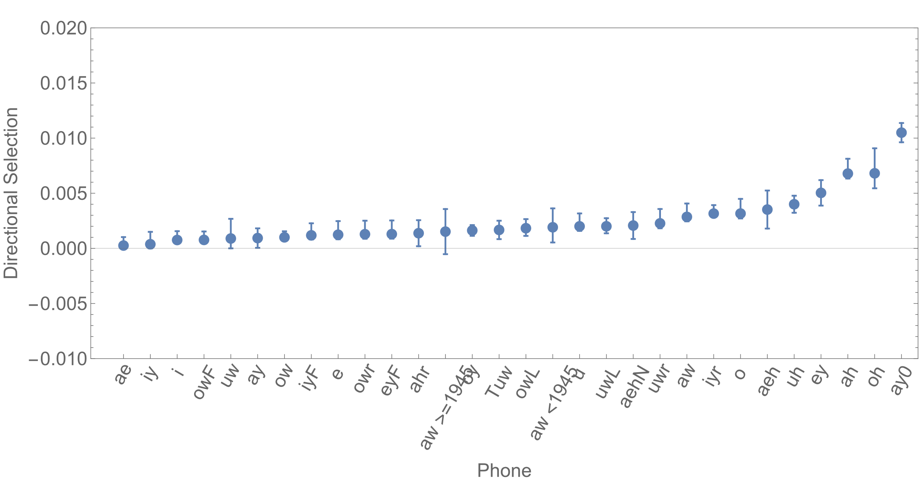
results for all vowels (directional selection)

Slide 20
A case study

Slide 21
results for all vowels (directional selection)
Notes:
Ay is barely significant: {0.000930601,{0.0000466876,0.00181451}}
Ay0: {0.0104945,{0.00962181,0.0113674}}

Slide 22

Canadian raising
F1
“ay0”: FIGHT – vowel followed by T (or any other voiceless consonant)
“ay”: EYE – vowel not followed by T
Both vowels start at a vowel similar to HAD and end at the KIT vowel
In Canada, FIGHT participates in Canadian Raising
  Starting point moves from TRAP to STRUT
  FIGHT becomes FOIGHT and MOUTH becomes MEUTH
  A super well-known stereotype
KIT
FOOT
STRUT
F2
TRAP
Notes:
Well-known stereotype => socio-indexical meaning

Slide 23
What’s it doing here?
Why do we find Canadian Raising in Philadelphia?! And why only half of it?
Imported from Canada? Not quite.
Rather, there is an endogenous innovation, that is currently sweeping through the entire US, called American Raising
This is FIGHT>FOIGHT, without the corresponding MOUTH>MEUTH
How come?

Slide 24
natural causes?
F1
In a word like FIGHT, the T has two consequences for the preceding vowel:
  Pre-fortis clipping: the vowel gets shortened
  Offglide peripheralization: the end of the vowel moves from KIT to SLEEP
Both of these have been proposed as natural causes for American Raising (Davis & Berkson 2021):
  Shorter vowel: the tongue can’t go down as much before it has to go back up
  Peripheralization: the second half of the vowel becomes higher and fronter, and drags the first half along with it
SLEEP
KIT
FOOT
STRUT
F2
TRAP

Slide 25
Or is it just a social preference?
An altogether different explanation: the change is based on gender differences
Conn (2005): men are ahead of American Raising
  More correctly: both men and women participate in the change, but it is socially stigmatized, which causes women to retreat from it every couple of years
  The end result is that men are always ahead, even though it is the women who are actually the cause of that
Wagner (2014): raised [aɪ]s are social markers of toughness
What if the change originated at some point due to the following-consonant issue, but has since come to be driven simply due to having acquired this social relevance – with the following consonant playing no driving role at all?

Slide 26
Operationalizing the question
Three factors, three operationalizations
  Pre-fortis clipping: if this is responsible for driving the change, the directional selection we observed in the FIGHT vowel should be accompanied by directional selection for shorter vowel duration (Fruehwald 2016)
  Offglide peripheralization: if the offglide is driving the change, the vowel at 80% should see stronger directional selection than the vowel at 35% (Rosenfelder 2007)
  Gender: if gender is driving the change, we should see stronger directional selection in men than in women (Conn 2005)

Slide 27
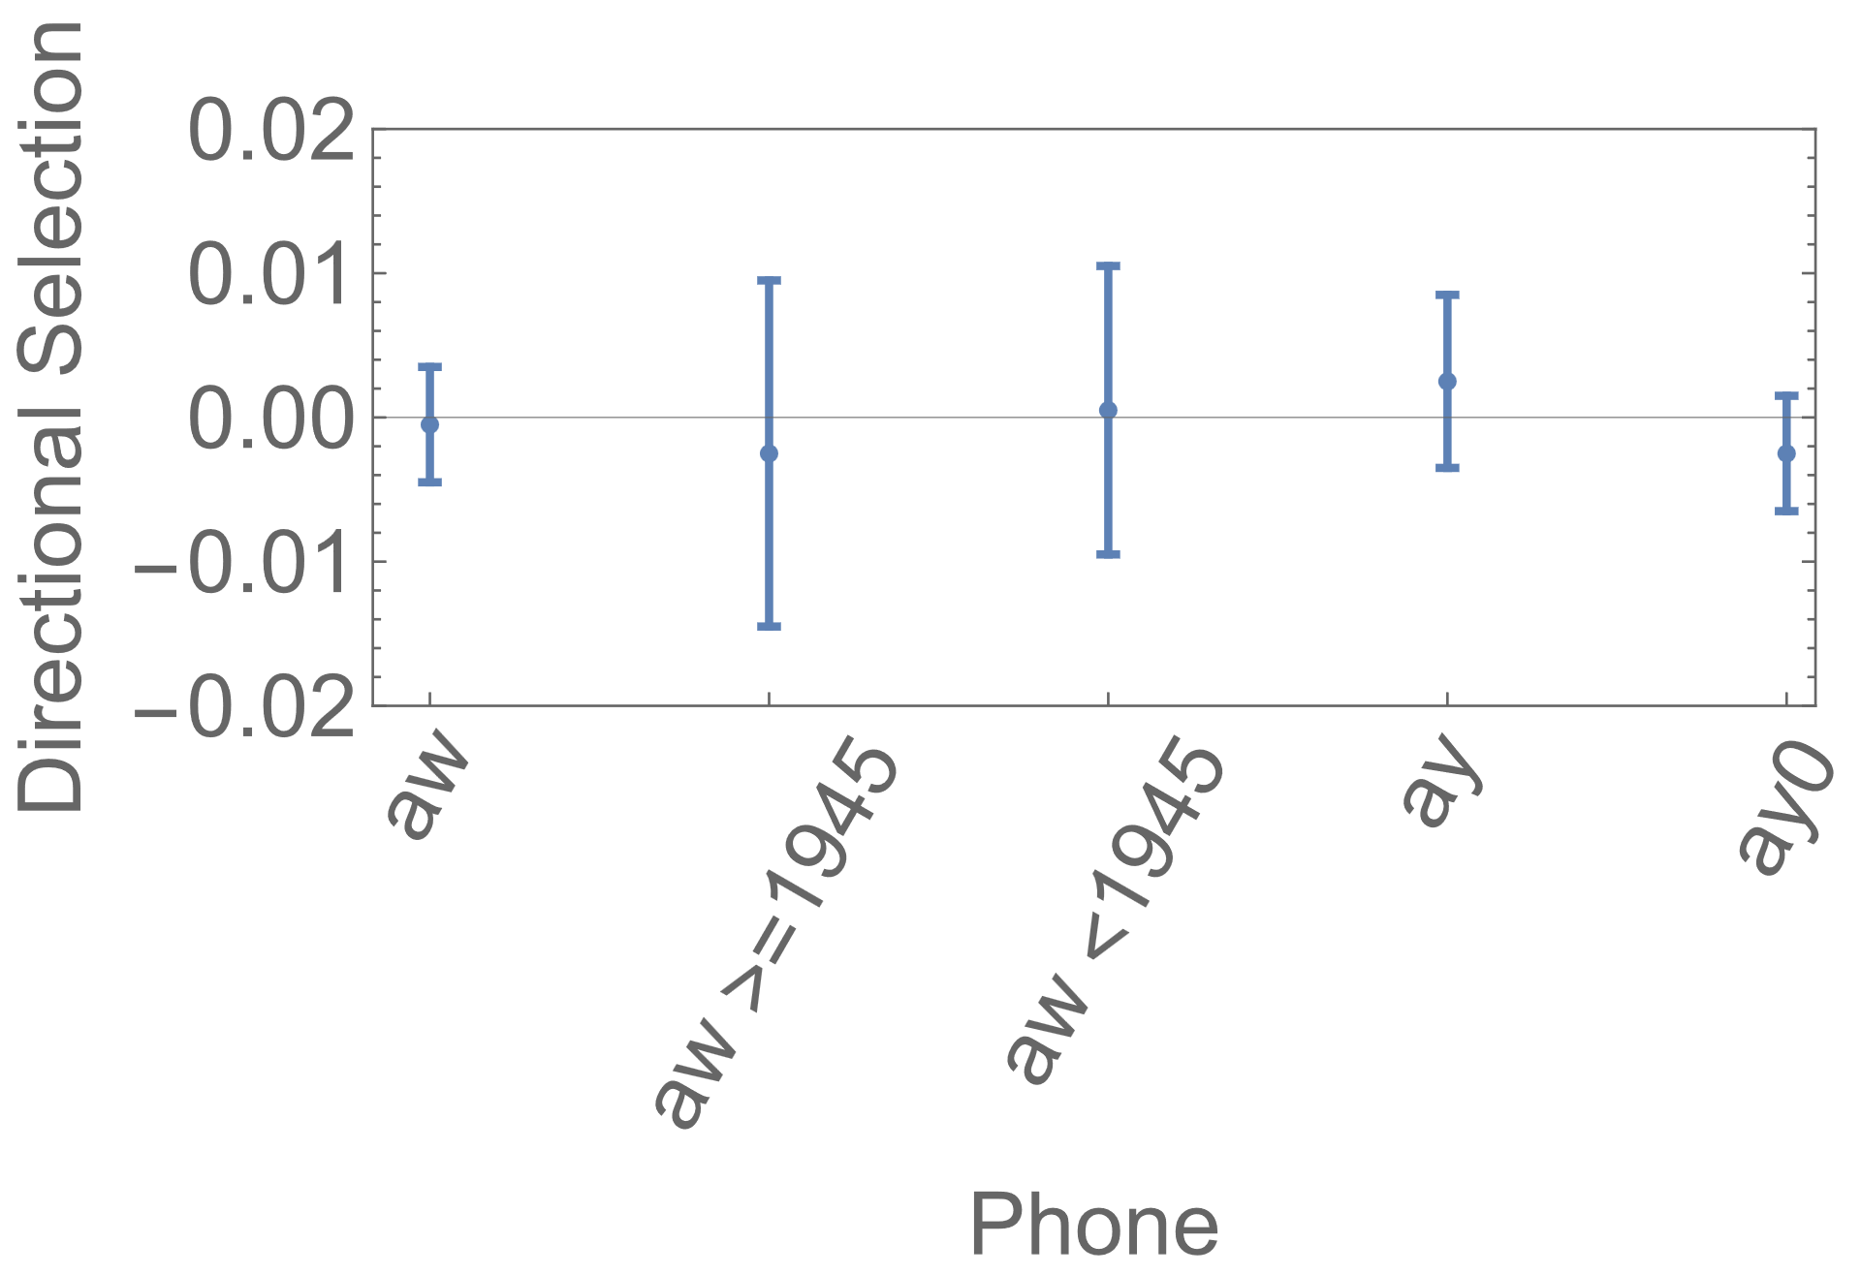
duration
Measured the durations and ran the same model on them
No evidence for selection pressure on vowel durations
I.e.: no evidence that pre-fortis clipping is the mechanism driving the change

Slide 28
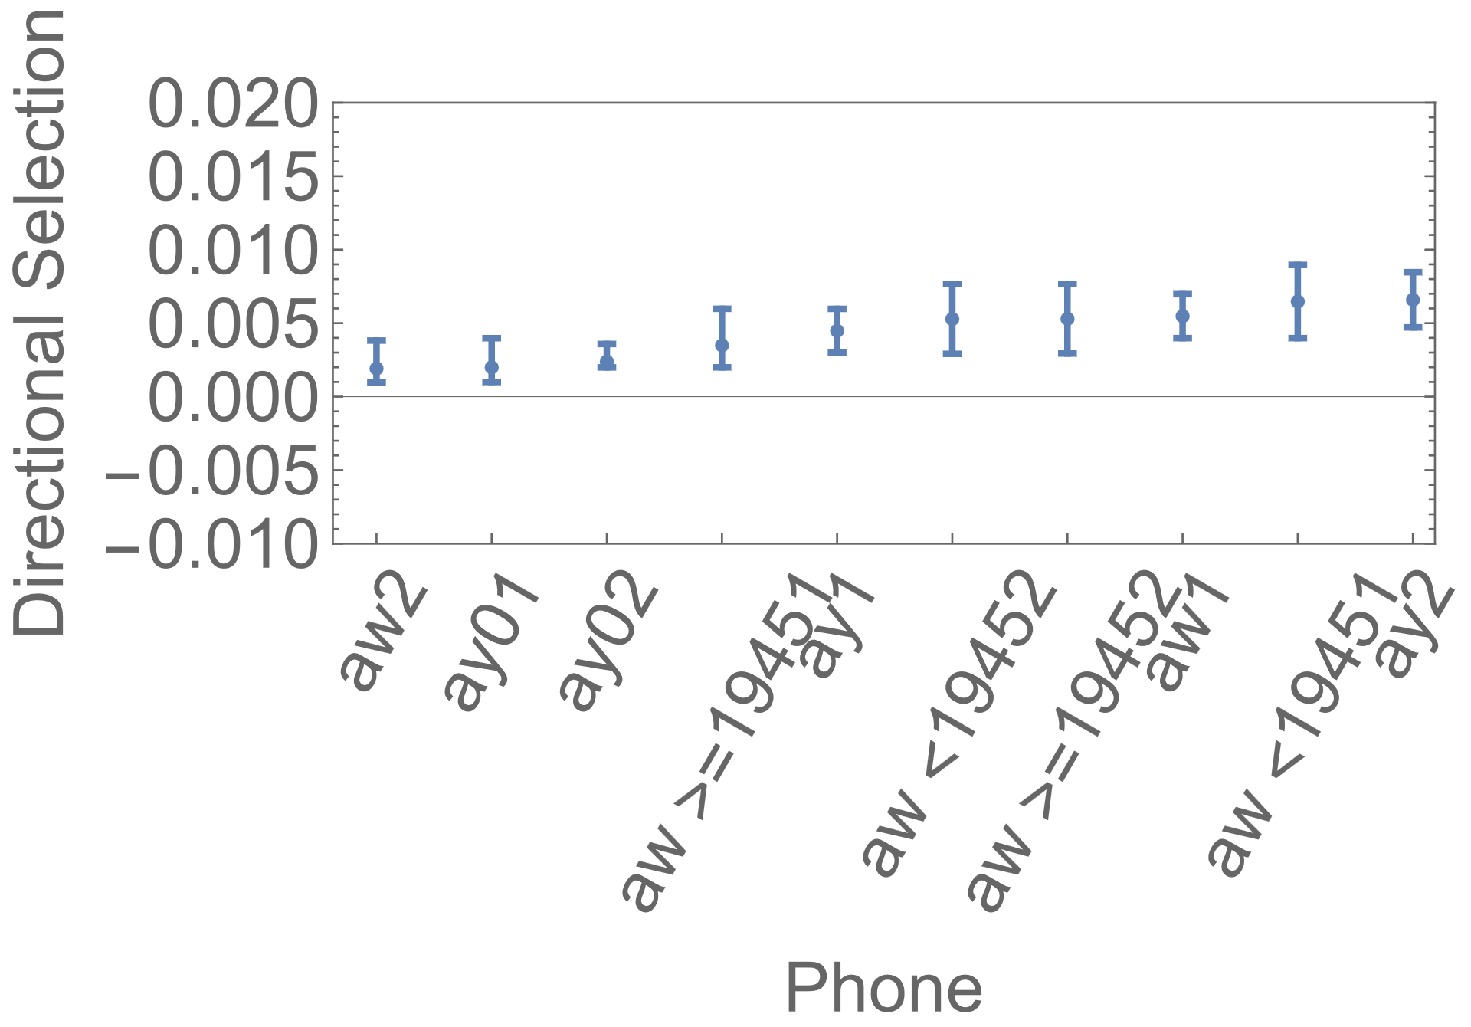
Offglide peripheralization
Divided each vowel into two pieces:
  35% realization
  80% realization
No significant difference in selection pressure between them
I.e.: no evidence that peripheralization of the offglide is the mechanism driving the change

Slide 29
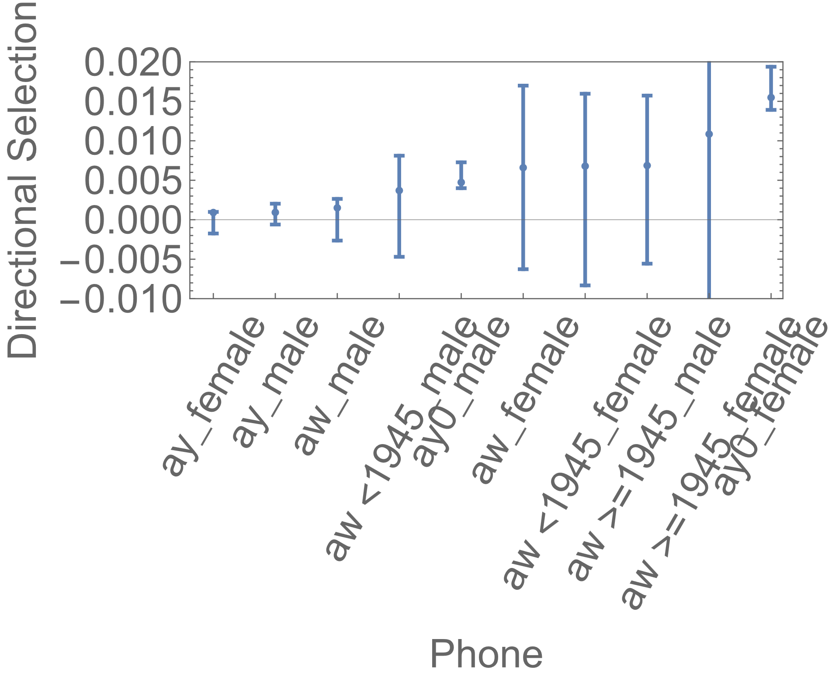
Gender differences
Significant difference in gender
Both genders show significant directional selection, but it’s significantly larger in women than in men
Opposite conclusion from Conn (2005)!
Notes:
Possible explanation: trend (based on GAM) is not completely linear: change appears male-led until 1940, and after that the genders appear pretty even. Did women stop retreating then?
Possible more speculative explanation: women have purifying selection away from the innovation, men have larger drift than women?

Slide 30
conclusions
Significant evidence for directional selection of (ay): the EYE vowel outside of the FIGHT context
Significantly stronger directional selection of (ay0): the FIGHT vowel in the FIGHT context
No significant selection on durations or offglides: these are not actively driving the change forward
Significant gender difference in directional selection: this is driving the change
Phonetic forces may have been the original catalyst, but the incrementation of change is driven by gender differences

Slide 31
Future experiment

Slide 32
A possible experiment
For American Raising, we observed that the phonetic factor ‘following consonant’ triggered the change, but did not play an active role in driving it – the increased driving rate for this change was due to the social factor ‘gender’
Does this mean that social factors are enough?
  Do the proposals by Baker, Archangeli, & Mielke (2011) and Stevens & Harrington (2014) reduce to something simpler: just social circulation alone?
Questions like these are hard to answer in vivo

Slide 33

A possible experiment
Roberts & Clark (2020) had dyads invent a communication system based on color
Colors varied across a trackpad in X and Y dimensions – just as formants do in F2 and F1 dimensions
Participants had to communicate up to 12 animals by constructing “words” out of 1 or more colors
RQ in R&C: do participants optimize the dispersion of these colors?

Slide 34


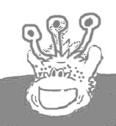

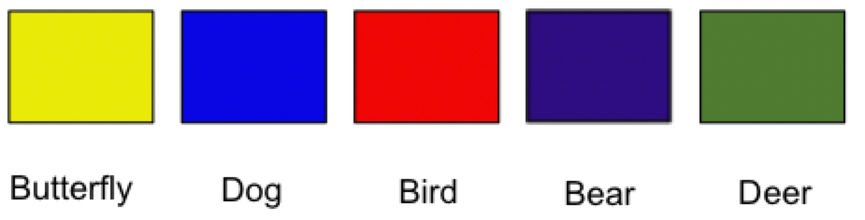
proposal
Have new participants learn a color communication system
They then communicate with two types of aliens, who both display random variation in their color use
Do participants “hallucinate” associations between these alien types (social factor) and this random variation?
If so, the social factor is enough
Requires control condition of nonrandom variation
Notes:
The answer should be yes, because we learn dialectal variants all the time

Slide 35
Thank you and thanks to my collaborators: Meredith tamminga, josh plotkin, gareth roberts

Slide 36

acknowledgments
This publication is part of the project Evolutionary forces in vowel change with file number 019.212SG.009 of the research programme Rubicon which is (partly) financed by the Dutch Research Council (NWO).

