Slide 1
An operationalization of causal factors in vowel shifts
Cesko C. Voeten (University of Pennsylvania & Fryske Akademy)
Meredith Tamminga (University of Pennsylvania)
Joshua B. Plotkin (University of Pennsylvania)

Slide 2
Why this talk? Well, just ‘cause
The search for causal forces in language change is as old as the study of language change itself – e.g., chain shifts in vowel systems
We want to assign causality, but often do so on the basis of only correlations:
  Grimm’s law: lenition ‘because’ consonant is intervocalic
  Young educated women drive language change ‘because’ of different social roles between men and women
Goal for today: problematize these approaches to causality in language change, and introduce a better solution (coming from syntax, adapted to sound change)

Slide 3
Cause or correlation?
Historical linguistic work runs the danger of conflating two scenarios:
  young women are more advanced on change X than old men (correlation)
  young women lead change X (cause)
Does not actually follow:
  Change X could be an innovation caused by women
  Change X could be ongoing anyway but coincidentally used more by women
  Change X could be ongoing anyway but inhibited by men

Slide 4
example
Language changes in English do-support (Newberry et al 2017, Nature). All four variants show a significant trend over time, but only the blue and yellow variants were (directionally) selected; the trend in the gray forms is actually due to chance (stochastic drift).

Slide 5
A solution: biology
The problem: a significant trend over time can be due to selection pressure or it can be due to stochastic drift
N.B.: same is true of factors found to be correlated to such a trend!
Solution used by Newberry et al (2017): model the population process by which change spreads & estimate both of these quantities
Changes correlation between time and factor to correlation between causal force and factor
This evolutionary perspective on language change has ample recognition in linguistic literature (e.g. Baxter et al 2006, de Boer 1999, Wedel 2006) and in fact has inspired parts of biology itself (e.g. Schleicher 1853a,b)

Slide 6
Our goals
Newberry et al tested one (internal) factor: ‘type of do-support’
They found that different do-support types had different profiles of change: two had selection significantly >0, other two could be explained using only stochasticity
Our current project:
  Extend the method to vowel data
  Test language-internal and language-external factors

Slide 7
The model
Model: Ornstein-Uhlenbeck process (cf. Nourmohammad et al 2017)
Describes a Gaussian random variable moving in a specific direction over time
Add effects for stochastic drift + selection pressure
  Stochastic drift: randomness about the movement towards the target
  Selection pressure: change in the position of the target
  This differentiates caused changes from historical accidents
F1
F2

Slide 8
From do-support to vowels
Categorical ([+/-do-support]) to gradient (F1 & F2) measure
  This is why we use the Ornstein-Uhlenbeck process
  Replaces Newberry et al’s Wright-Fisher process (which is for binary data)
  Requires a second type of selection pressure to be accounted for: purifying selection
  Has a convenient formulation as a Fokker-Planck equation (cf. Baxter et al 2006)
One dependent variable to two
  We can estimate F1 & F2 independently if we first make them independent using PCA
Notes:
Purifying selection is not needed in a binary (Wright-Fisher) model, because there purifying selection is automatically given by the complement of directional selection (p(not change) = 1 – p(change)). Not so in the case of continuous data, where these two situations are entirely separable.
PCA is necessary because F1 & F2 are correlated, but the OU model (which only takes one dependent variable, so we must run two separate models for each vowel) assumes that they’re i.i.d. Gaussian. Working with principal components rather than F1 and F2 transforms the data to (by definition) meet the independent/identically distributed part of the assumption. The Gaussian part speaks for itself – we suppose, uncontroversially, that F1 and F2 are normal random variables.

Slide 9
operationalization
There is random noise in the transmission of variants across generations: stochastic drift
There is preferential transmission of some variants across generations (selection pressure):
  Force to stay near the current vowel target: purifying selection (‘constraint’)
  Force to move towards a new target: directional selection (‘driving rate’)
We can quantify each of these three forces and see if they interact with language-internal and external factors

Slide 10
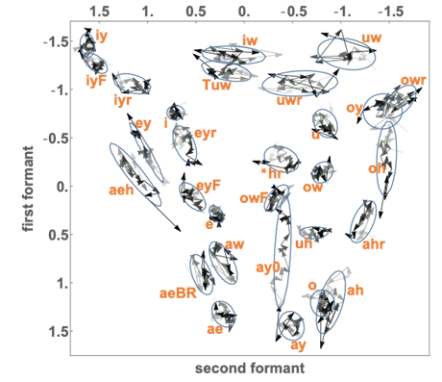
The Philadelphia Neighborhood Corpus
We use the Philadelphia Neighborhood Corpus to investigate vowel changes over a hundred years of change
The PNC has/is:
408 speakers born between 1880 and 1994 (393 available in our annotated data)
Simultaneously real-time and apparent-time
Lots of vowel changes visible
Appropriate for this statistical approach

Slide 11
Factors to test
Language-internal:
Vowel & phonological context
Dispersion (de Boer 1999, also see Boersma & Hamann 2008)
Confusability (Shephard 1972)
Frequency (Bybee 2002)
Rule complexity (Labov 1994, Sneller 2018)
Language-external, i.e. social:
Gender, age, education, ethnicity (Labov et al 2016)
Occupation (Tebbe, Horwitz, & Tamminga in progress)
Neighborhood (Wagner 2008)
Ethnicity (Wagner 2014)
More TBF

Slide 12
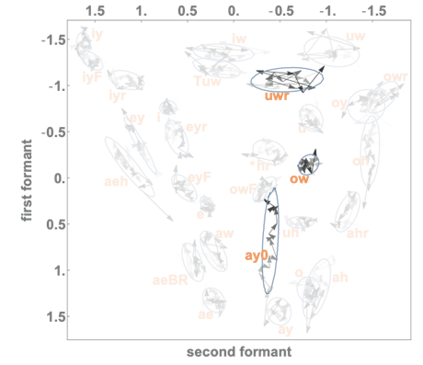
Current status
We currently have a correlation with the system-internal factor of vowel type:
(ow) (GOAT): tightly clustered, little variation > purifying selection?
(uwr) (CURE): extensive variation, but no apparent trend over time > stochastic drift?
(ay0) (FIGHT): specific, targeted change over time > directional selection?
Notes:
These three highlighted vowels look like (raw data) they are representative for these three types of change, but can we test this statistically? (Yes – purpose of the entire talk.) See next slides

Slide 13
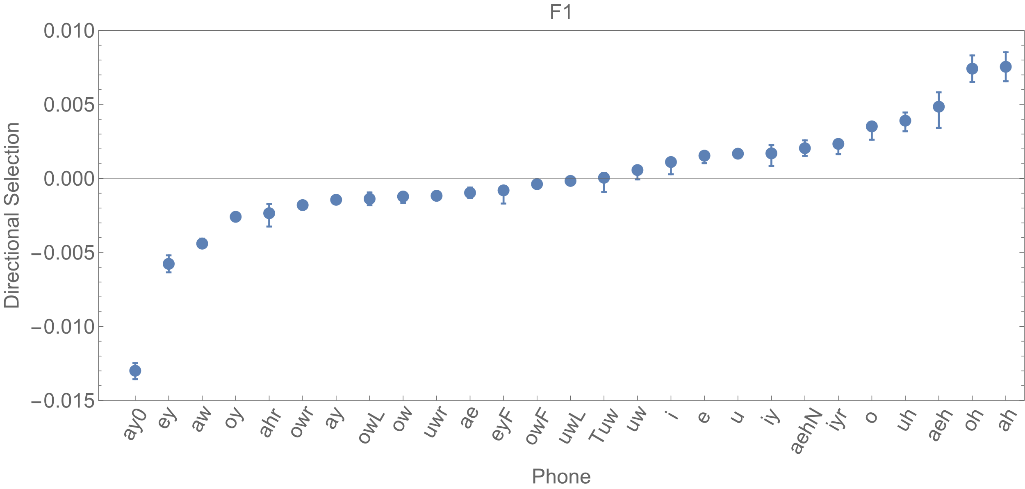
Directional selection – f1
Notes:
Results obtained on PC1/PC2 scale but transformed back to the usual F1/F2 scale. Interpretation of directional selection value (according to my understanding of what Josh said): amount of change (in a “deliberate” direction, on top of whatever random year-to-year variation there is too) in Lobanov F1 per year.
Ay0 is the FIGHT vowel followed by a voiceless obstruent. You may recognize this as being (half of) Canadian Raising, which Philadelphia has apparently invented independently (one of the goals of this project is to figure out why/how, but not currently on the horizon). This is a “new and vigorous change” (Labov), which these results support!
Uwr was (thought to be two slides ago) stochastic drift. It’s a nice example: you can see here that this vowel, too, exhibits some directional selection, but to a quantitatively relatively negligible extent. This is good: it illustrates that each of the three forces are always there to some extent or another, but vary in magnitude based on real linguistic factors (large selection for ay0, nearly – but not exactly – nil selection for uwr).

Slide 14
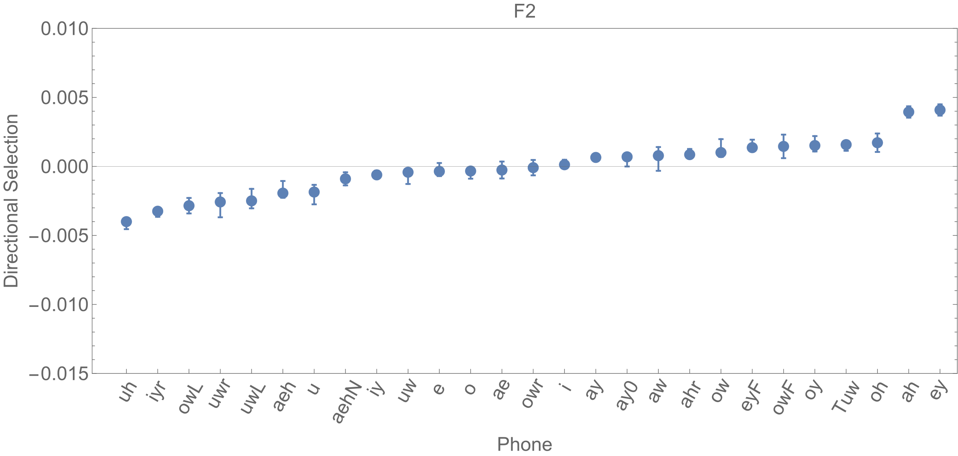
Directional selection – f2
Notes:
Nothing really interesting – good news

Slide 15
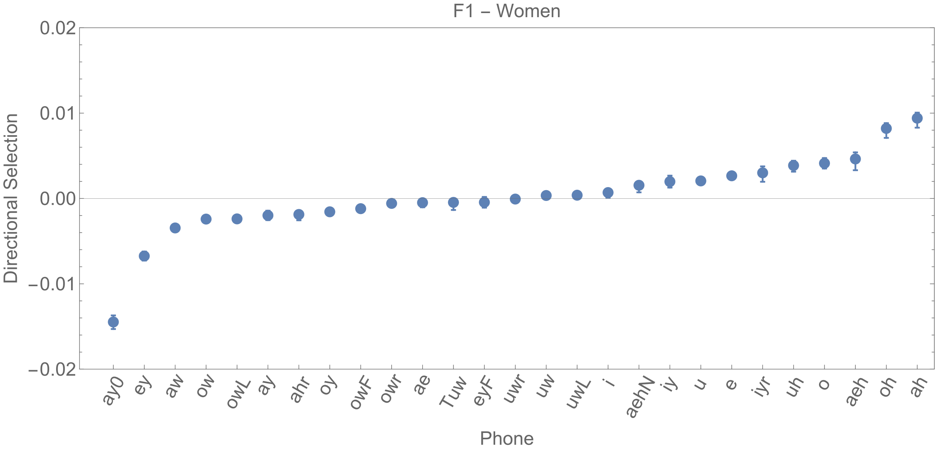
F1, women only

Slide 16
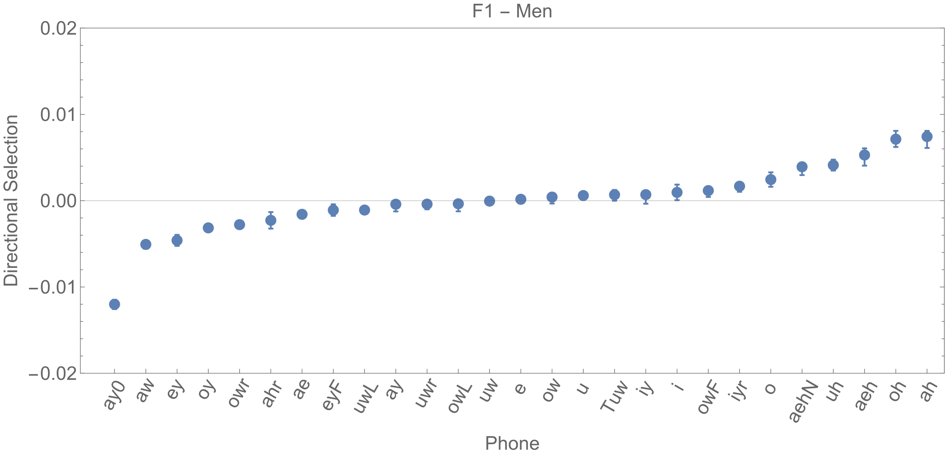
F1, men only
Notes:
Circles in same place as on prev slide. No overlap between error bars → significant difference between men and women. I.e., as strongly supported by sociolinguistic literature, women are leading ay0-raising compared to men!
Significant differences for aeh aehN aw ay ay0 e ey i ow owF owL owr oy Tuw u uh uwL

Slide 17
Main points & conclusions
Selection pressure disentangles caused change from historical accidents
Operationalizable as, respectively, directional selection and stochastic drift
Over syntax, sound change adds an extra dimension and an extra selection type
Our adaptation to sound change works!
Results match ongoing changes in Philadelphia, importantly raising of (ay0)
Gender differences successfully demonstrated as being a driving factor

Slide 18
Thanks!

Slide 19
references
Baxter, G. J., Blythe, R. A., Croft, W., & McKane, A. J. (2006). Utterance selection model of language change. Physical Review E 73(4), 046118.
de Boer, B. (1999). Self-organisation in vowel systems. Ph.D. dissertation, Free University Brussels.
Boersma, P., & Hamann, S. (2008). The evolution of auditory dispersion in bidirectional constraint grammars. Phonology 25(2), pp. 217–270.
Bybee, J. (2002). Word frequency and context of use in the lexical diffusion of phonetically conditioned sound change. Language Variation and Change 14(3), pp. 261–290.
Labov, W. (1994). Principles of linguistic change. Volume I: Internal factors. Blackwell.
Labov, W., Fisher, S., Gylfadottir, D., Henderson, A., & Sneller, B. (2016). Competing systems in Philadelphia phonology. Language Variation and Change 28(3), pp. 273–305.
Newberry, M. G., Ahern, C. A., Clark, R., & Plotkin, J. B. (2017). Detecting evolutionary forces in language change. Nature 551(7679), pp. 223–226.
Nourmohammad, A., Rambeau, J., Held, T., Kovacova, V., Berg, J., & Lässig, M. (2017). Adaptive evolution of gene expression in Drosophila. Cell Reports 20(6), pp. 1385–1395.
Shepard, N. R. (1972). Psychological representation of speech sounds. In: E.E. David Jr. & P.R. Denes (Eds.). Human communication: A unified view (pp. 67–113). McGraw-Hill.
Sneller, B. (2018). Mechanisms of phonological change. Ph.D. dissertation, University of Pennsylvania.
Tebbe, M., Horwitz, S., & Tamminga, M. (in progress). Effects of speaker occupational classification on Philadelphia vowel changes.
Wagner, S. E. (2008). Linguistic change and stabilization in the transition from adolescence to adulthood. Ph.D. dissertation, University of Pennsylvania.
Wagner, S. E. (2014). Linguistic correlates of Irish-American and Italian-American ethnicity in high school and beyond. Language & Communication 35, pp. 75–87.
Schleicher, A. (1853a). ‘Die ersten Spaltungen des indogermanischen Urvolkes’. Allgemeine Monatsschrift für Wissenschaft und Literatur, pp. 786–787.
Schleicher, A. (1853b). ‘O jazyku litevském, zvlástě na slovanský. Čteno v posezení sekcí filologickékrál. České Společnosti Nauk dne 6. června 1853’. Časopis Čsekého Museum 27, pp. 320–334.
Wedel, A. B. (2006). Exemplar models, evolution and language change. The Linguistic Review 23(3), pp. 247–274.

Slide 20

acknowledgments
This publication is part of the project Evolutionary forces in vowel change with file number 019.212SG.009 of the research programme Rubicon which is (partly) financed by the Dutch Research Council (NWO).

