Slide 1


Quantum Cryptography Beyond QKD
Christian Schaffner
Research Center for Quantum Software
Institute for Logic, Language and Computation (ILLC)
University of Amsterdam
Centrum Wiskunde & Informatica
All material available on https://homepages.cwi.nl/~schaffne
QCALL Summer School, Baiona, Spain
Thursday, 10 May 2018

Slide 2
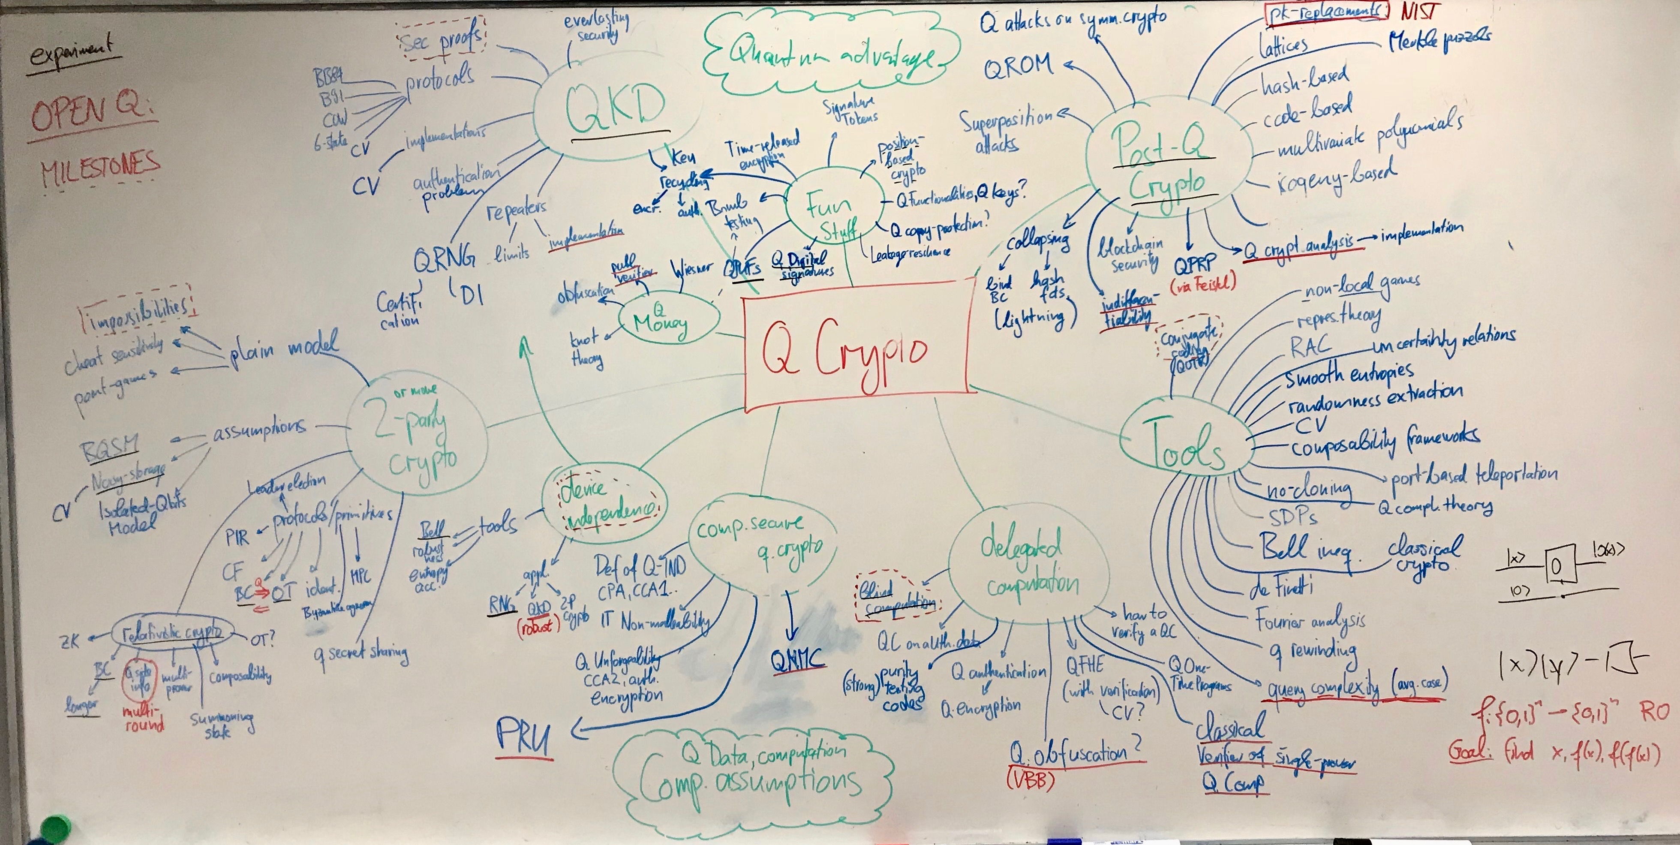
Notes:
Here’s everything I know about Q crypto

Slide 3
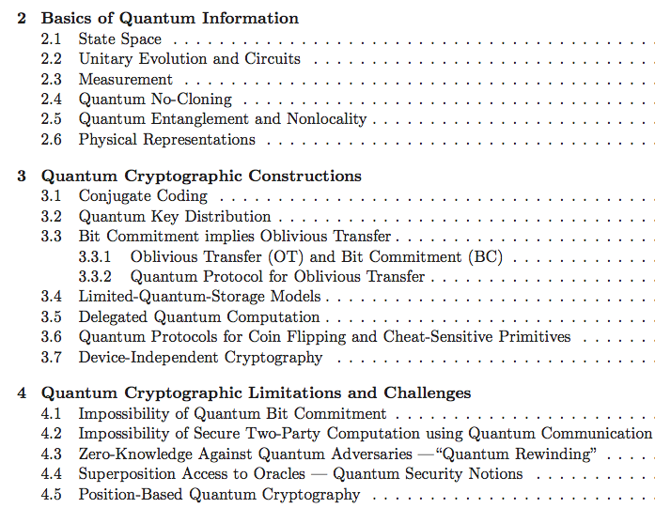
Quantum Cryptography Beyond QKD
survey article with
Anne Broadbent
aimed at classical cryptographers
http://arxiv.org/abs/1510.06120
In Designs, Codes and Cryptography 2016
[Broadbent Schaffner 16 in Designs, Codes and Cryptography]
Notes:
Why did they invite me?

Slide 4
QCrypt Conference Series
Started in 2011 by Christandl and Wehner
Steadily growing since then:
approx. 100 submissions, 30 accepted as contributions,
330 participants in Cambridge 2017. This year: Shanghai, China
goal of the conference: represent the previous year’s best results on quantum cryptography, and to support the building of a research community
Trying to keep a healthy balance between theory and experiment
Half the program consists of 4 tutorials of 90 minutes, 6-8 invited talks
[QCrypt charter, QCrypt 2017 business meetings slides]

Slide 5
Overview
[thanks to Serge Fehr, Stacey Jeffery, Chris Majenz, Florian Speelman, Ronald de Wolf]
Notes:
Started from an 10-year old mindmap from 2008, right after my PhD. Added new things, more tools

Slide 6
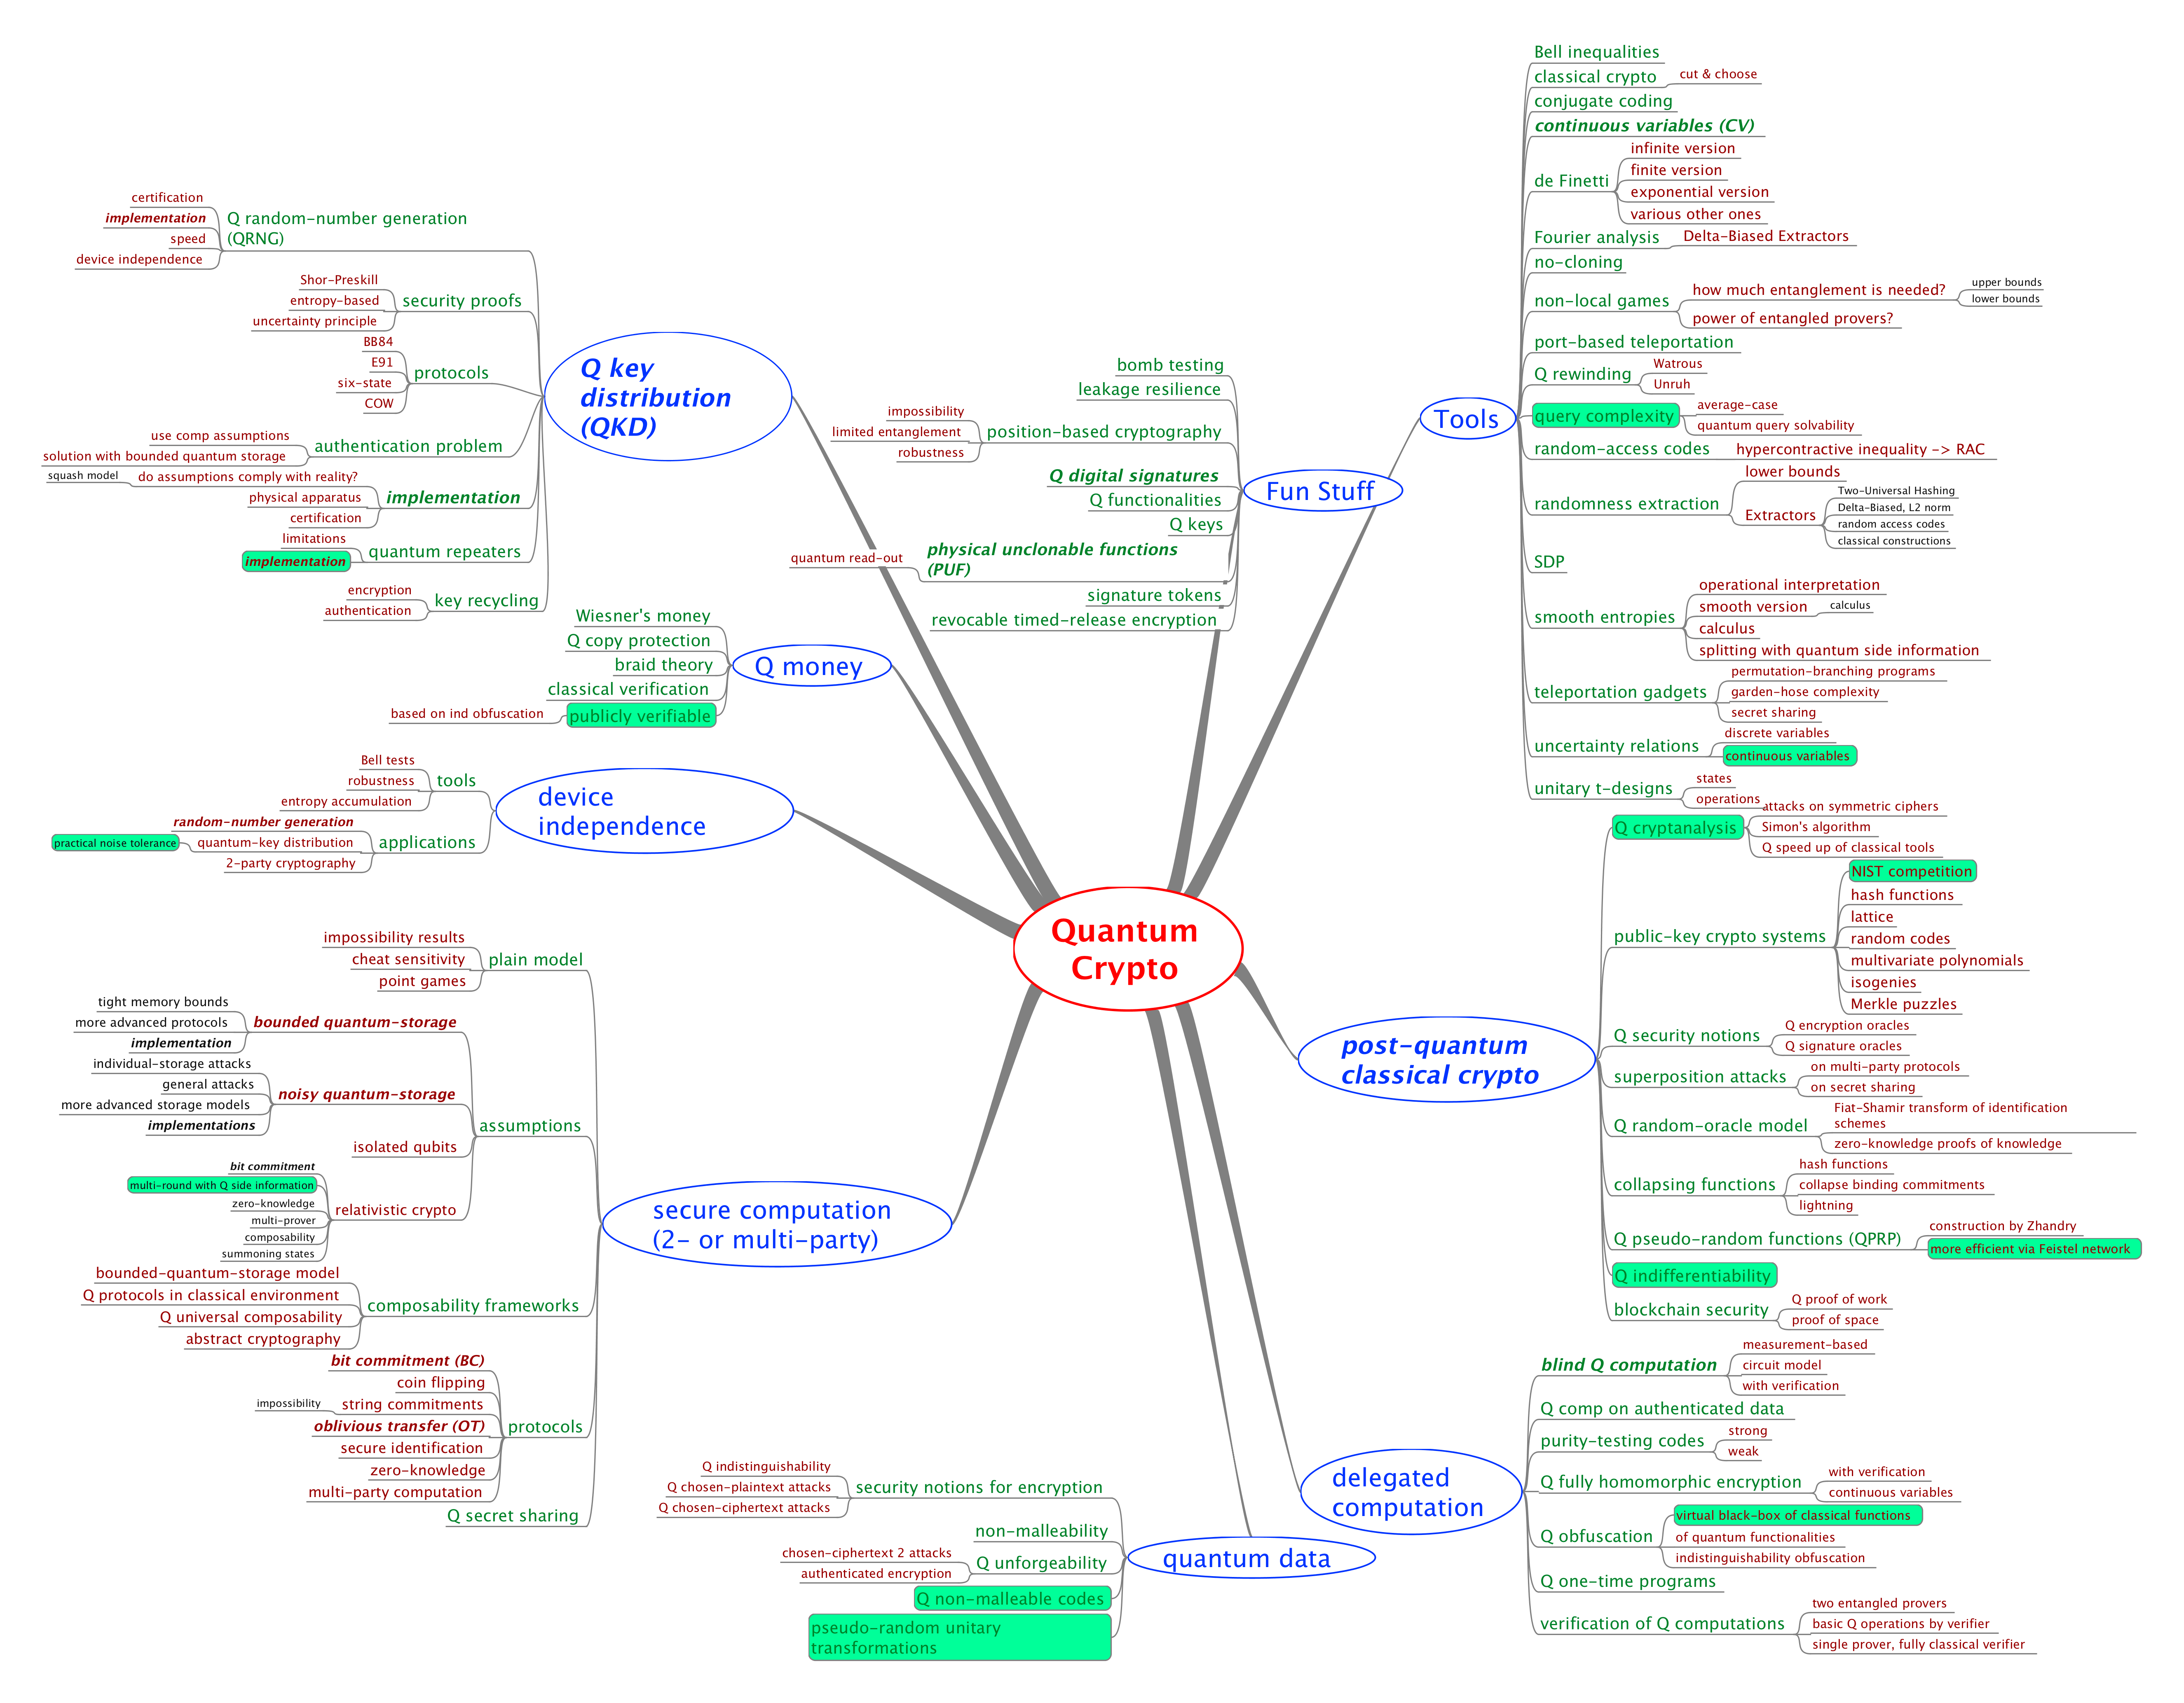
MindMap
Tools
Q advantage
experiments
Selection of
open questions
Fork me on github!
Post Q crypto
Q data
[https://github.com/cschaffner/QCryptoMindmap]

Slide 7
MindMap
Tools
Q advantage
experiments
Selection of
open questions
Fork me on github!
Post Q crypto
Q data
[https://github.com/cschaffner/QCryptoMindmap]

Slide 8
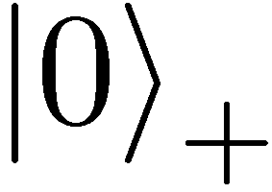
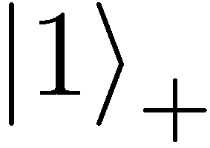
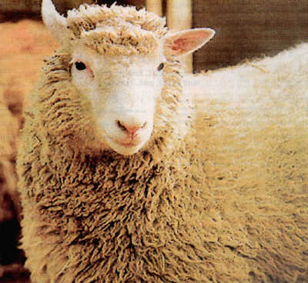
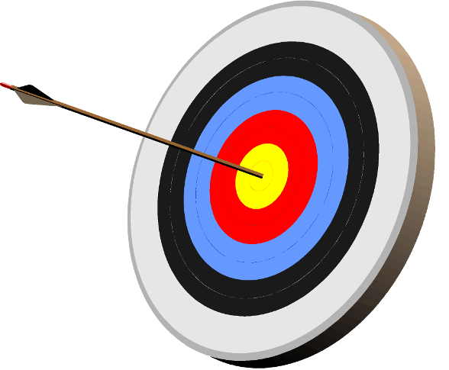
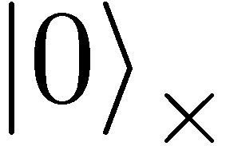
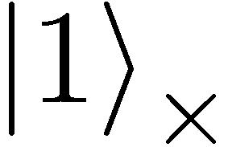
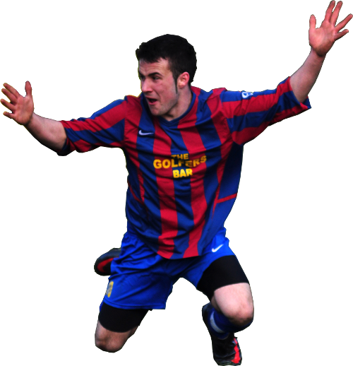
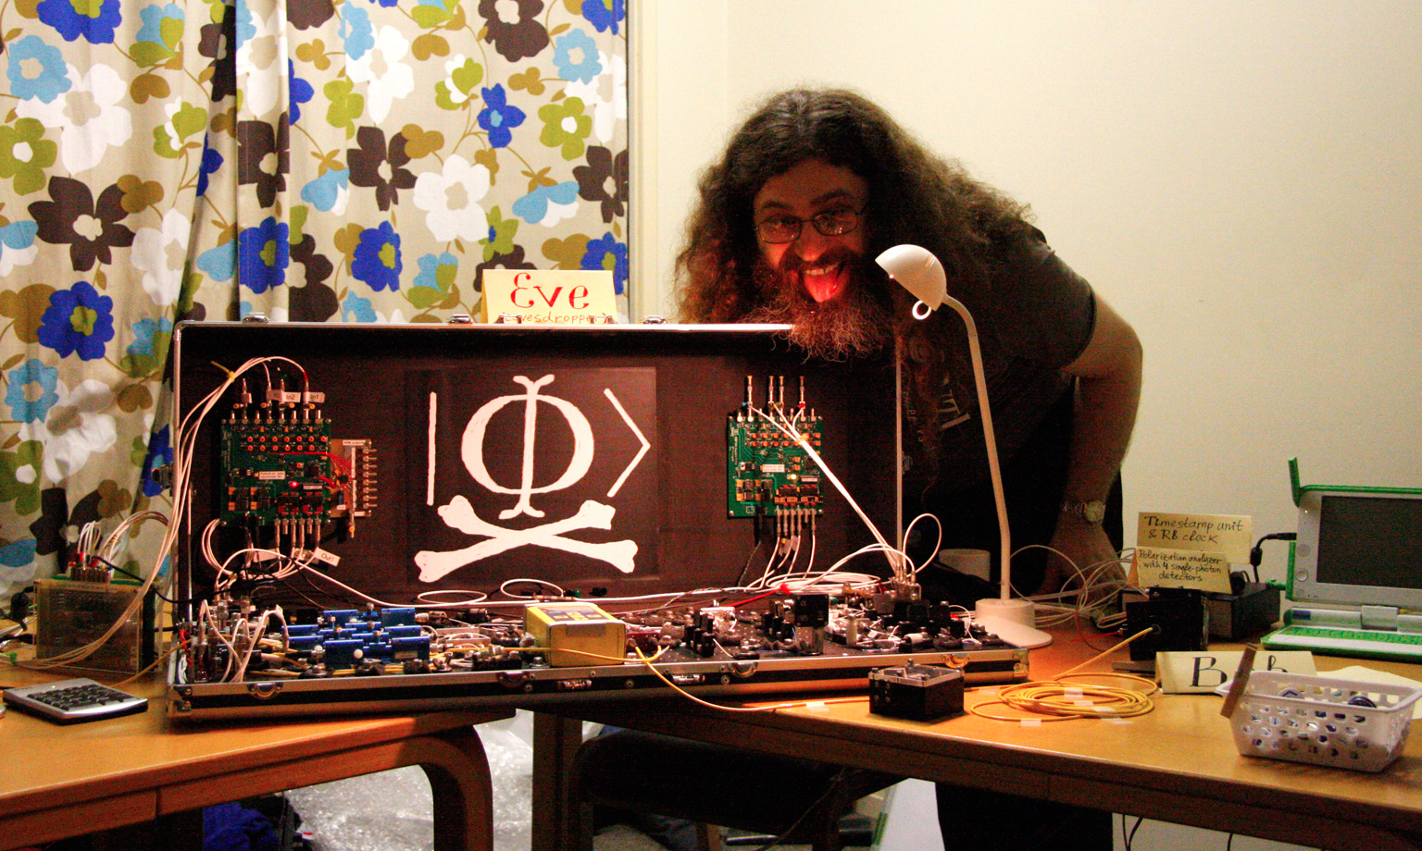
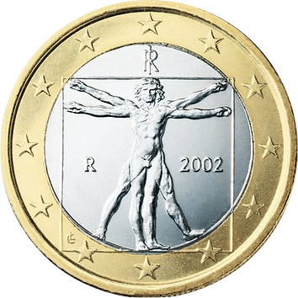









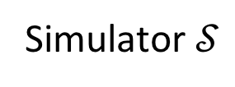
Preview
$$s_{0}$$
OT
$$c$$
$$s_{1}$$
$$s_{c}$$
Simulator $𝒮$
$$x$$
$$ℱ$$
$$y$$
$$f(x,y)$$
$$g(x,y)$$

Slide 9
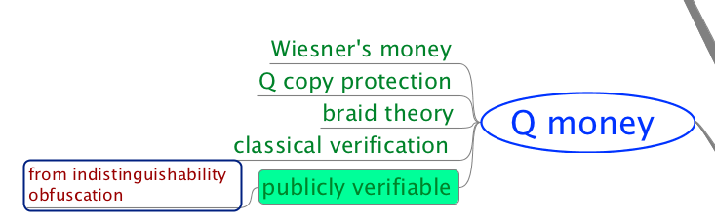
Quantum Money

Slide 10
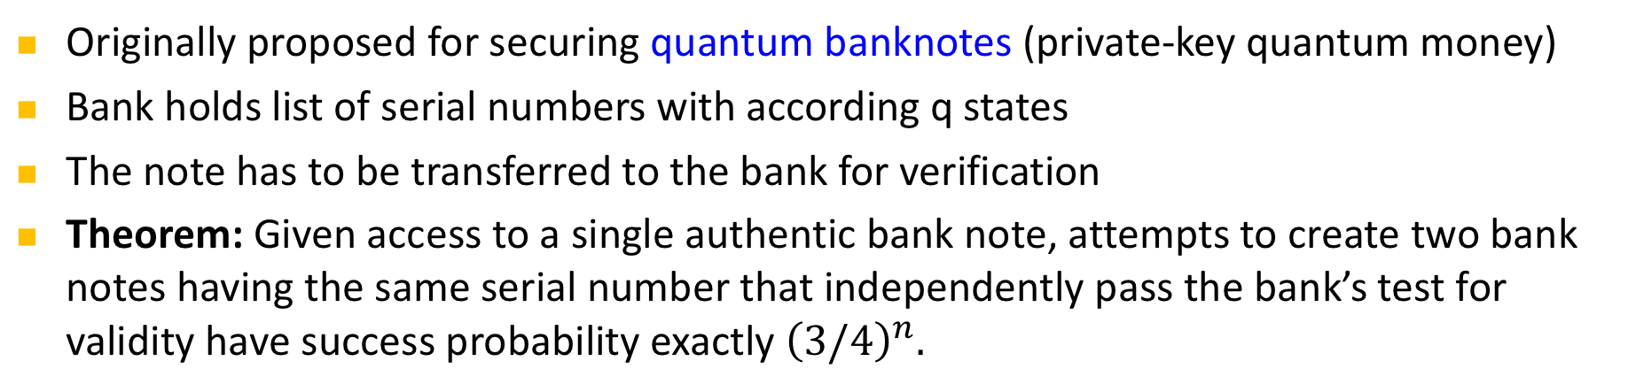
Conjugate Coding & Quantum Money
also known as quantum coding or quantum multiplexing
0 1 1 1 0
Originally proposed for securing quantum banknotes (private-key quantum money)
Bank holds list of serial numbers with according q states
The note has to be transferred to the bank for verification
Theorem: Given access to a single authentic bank note, attempts to create two bank notes having the same serial number that independently pass the bank’s test for validity have success probability exactly ${\left(3/4\right)}^{n}.$
[Wiesner 68, Molina Vidick Watrous 13]
Notes:
add link to BB84

Slide 11
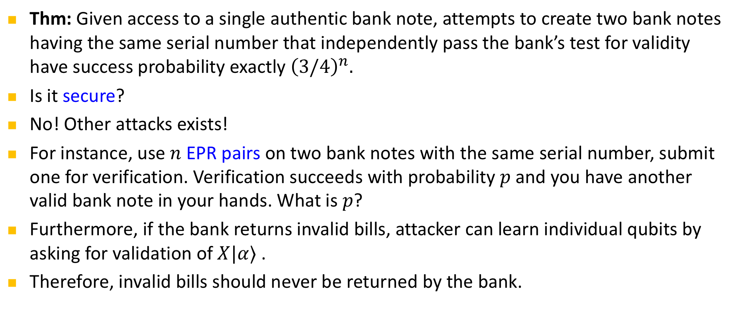
Quantum Money
Thm: Given access to a single authentic bank note, attempts to create two bank notes having the same serial number that independently pass the bank’s test for validity have success probability exactly ${\left(3/4\right)}^{n}.$
Is it secure?
No! Other attacks exists!
For instance, use $n$ EPR pairs on two bank notes with the same serial number, submit one for verification. Verification succeeds with probability $p$ and you have another valid bank note in your hands. What is $p$?
Furthermore, if the bank returns invalid bills, attacker can learn individual qubits by asking for validation of $X|α⟩$ .
Therefore, invalid bills should never be returned by the bank.
[Molina Vidick Watrous 13, Lutomorski 10]
Notes:
add link to BB84

Slide 12
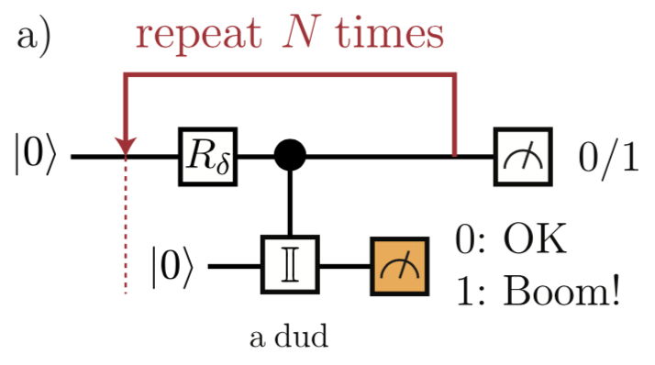
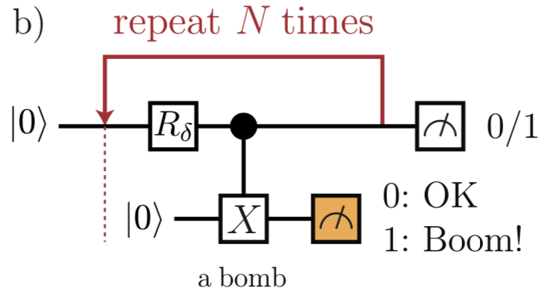
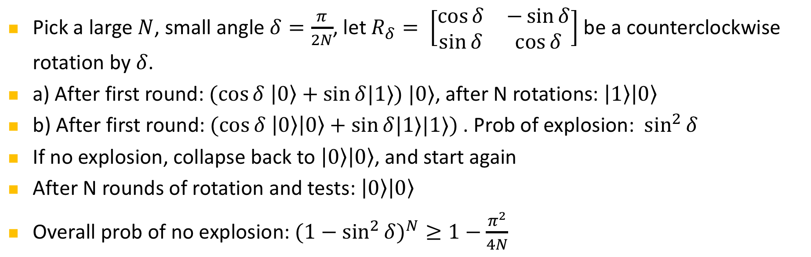
Elitzur-Vaidman’s bomb quality tester
Pick a large $N$, small angle $δ=\frac{π}{2N}$, let $R_{δ}= \left[\begin{matrix}\cos{δ} & −\sin{δ} \\ \sin{δ} & \cos{δ}\end{matrix}\right]$ be a counterclockwise rotation by $δ$.
a) After first round: $(cos{δ \left|0\right\rangle +\sin{δ|1⟩) |0⟩}}$, after N rotations: $\left|1\right\rangle \left|0\right\rangle$
b) After first round: $(cos{δ \left|0\right\rangle \left|0\right\rangle +\sin{δ|1⟩|1⟩) }}$. Prob of explosion: $\sin^{2}{δ}$
If no explosion, collapse back to $\left|0\right\rangle \left|0\right\rangle$, and start again
After N rounds of rotation and tests: $\left|0\right\rangle \left|0\right\rangle$
Overall prob of no explosion: ${{(1−sin}^{2}{δ)}}^{N}≥1−\frac{π^{2}}{4N}$
[Elitzur Vaidman 93, figures from Brodutch Nagaj Sattath Unruh 14]
Notes:
add link to BB84

Slide 13
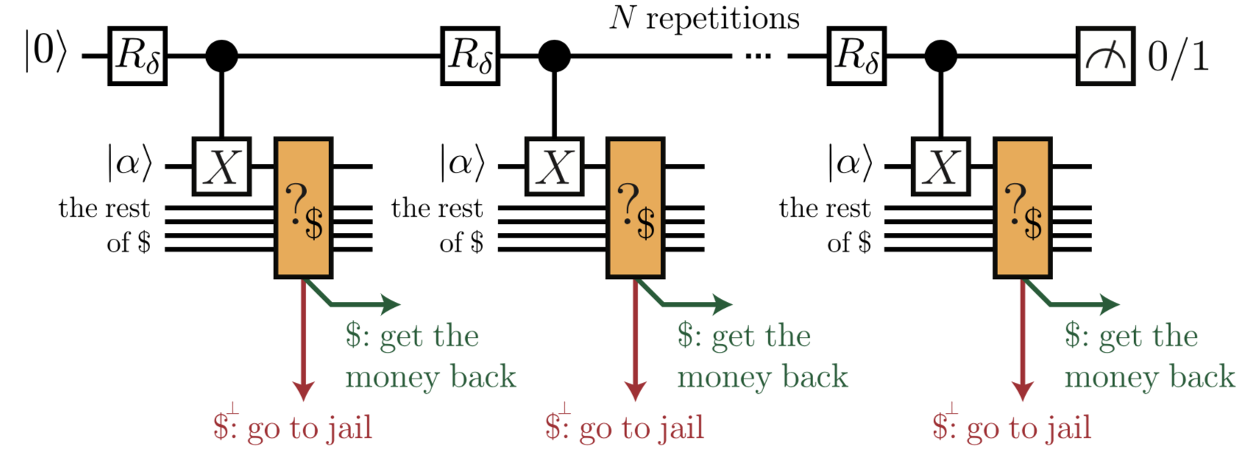
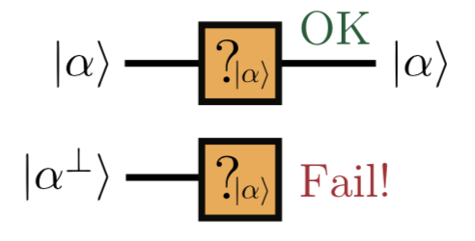
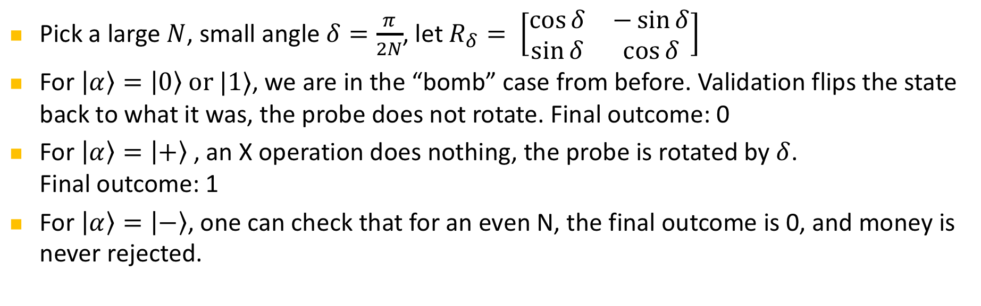
Bomb Testing to Counterfeit Q Money
Pick a large $N$, small angle $δ=\frac{π}{2N}$, let $R_{δ}= \left[\begin{matrix}\cos{δ} & −\sin{δ} \\ \sin{δ} & \cos{δ}\end{matrix}\right]$
For $\left|α\right\rangle =\left|0\right\rangle or |1⟩$, we are in the “bomb” case from before. Validation flips the state back to what it was, the probe does not rotate. Final outcome: 0
For $\left|α\right\rangle =\left|+\right\rangle$, an X operation does nothing, the probe is rotated by $δ$.
Final outcome: 1
For $\left|α\right\rangle =\left|−\right\rangle$, one can check that for an even N, the final outcome is 0, and money is never rejected.
[Brodutch Nagaj Sattath Unruh 14]
Notes:
add link to BB84

Slide 14
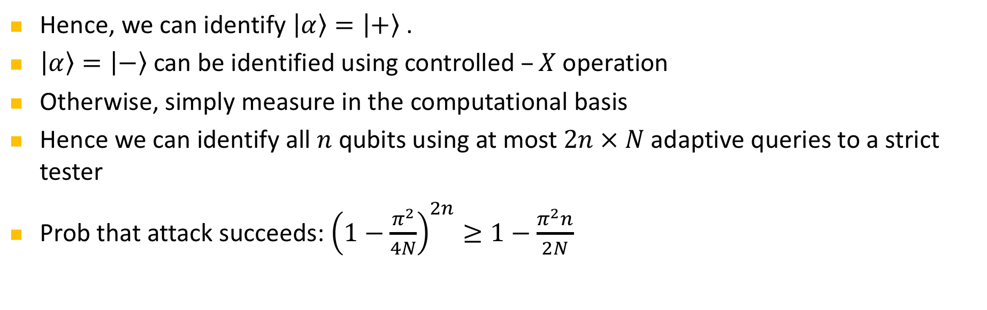
Bomb Testing to Counterfeit Q Money
Hence, we can identify $\left|α\right\rangle =\left|+\right\rangle$.
$\left|α\right\rangle =\left|−\right\rangle$ can be identified using controlled $–X$ operation
Otherwise, simply measure in the computational basis
Hence we can identify all $n$ qubits using at most $2n × N$adaptive queries to a strict tester
Prob that attack succeeds: ${\left(1−\frac{π^{2}}{4N}\right)}^{2n}≥1−\frac{π^{2}n}{2N}$
[Brodutch Nagaj Sattath Unruh 14]
Notes:
add link to BB84

Slide 15
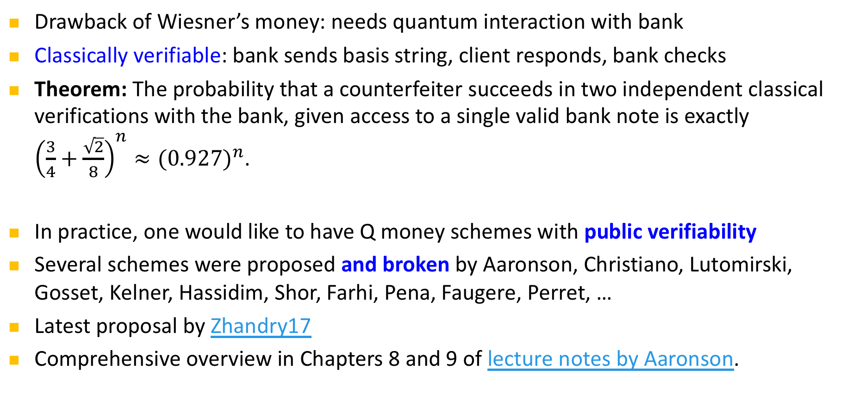
More practical Q Money
Drawback of Wiesner’s money: needs quantum interaction with bank
Classically verifiable: bank sends basis string, client responds, bank checks
Theorem: The probability that a counterfeiter succeeds in two independent classical verifications with the bank, given access to a single valid bank note is exactly ${\left(\frac{3}{4}+\frac{\sqrt{2}}{8}\right)}^{n}≈{(0.927)}^{n}$.
In practice, one would like to have Q money schemes with public verifiability
Several schemes were proposed and broken by Aaronson, Christiano, Lutomirski, Gosset, Kelner, Hassidim, Shor, Farhi, Pena, Faugere, Perret, …
Latest proposal by Zhandry17
Comprehensive overview in Chapters 8 and 9 of lecture notes by Aaronson.
[Molina Vidick Watrous 13, Aaronson 09, …]
Notes:
add link to BB84

Slide 16
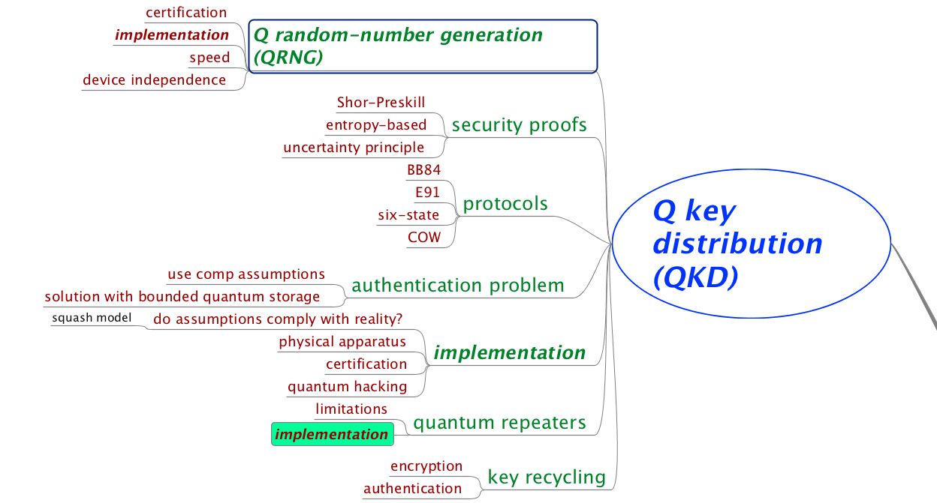
Quantum Key Distribution (QKD)

Slide 17
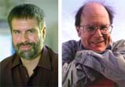


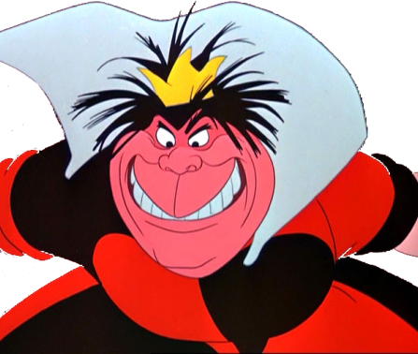
Quantum Key Distribution (QKD)
Alice
[Bennett Brassard 84]
Bob
k = ?
k = 0101 1011
Eve
k = 0101 1011
Three-party scenario: two honest players versus one dishonest eavesdropper
Quantum Advantage: Information-theoretic security is provably impossible with only classical communication (Shannon’s theorem about perfect security)
Notes:
add link to BB84

Slide 18
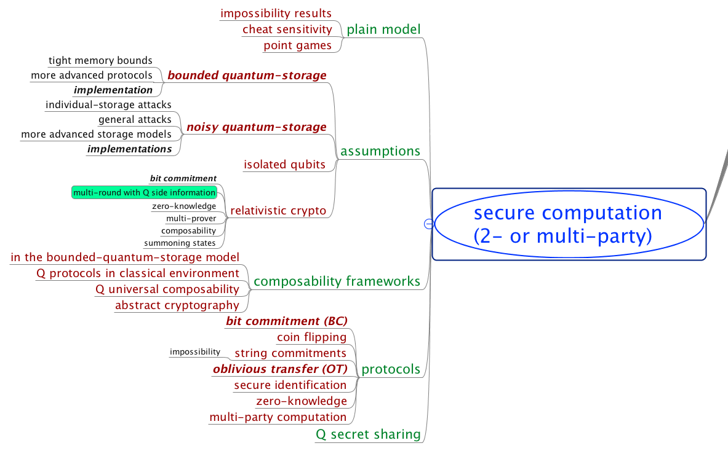

Slide 19

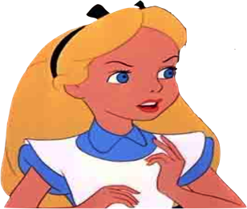

















Secure Two-Party Cryptography
Information-theoretic security
No computational restrictions
Correctness (both honest)
usefulness
Coin-Flipping
Bit Commitment
Oblivious Transfer
2-Party Function Evaluation
Multi-Party Computation
(with dishonest majority)
$$⇒$$
$$⇏$$
Security for honest Alice
quantum usefulness
$$⇒$$
$$⇏$$
$$⇒$$
usefulness
$$s_{0}$$
OT
$$c$$
$$⇒$$
$$⇒$$
$$s_{1}$$
$$s_{c}$$
Security for honest Bob
$$⇔$$
$$x$$
$$ℱ$$
$$y$$
$$f(x,y)$$
$$g(x,y)$$
[Blum 83, Kilian 88]

Slide 20
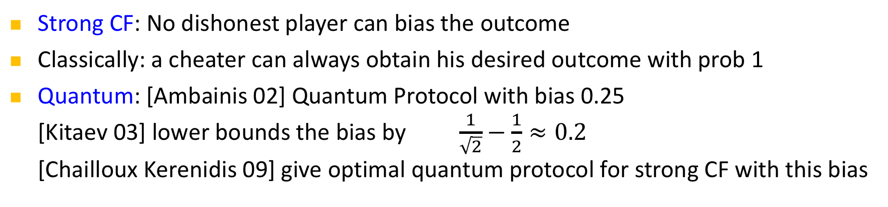
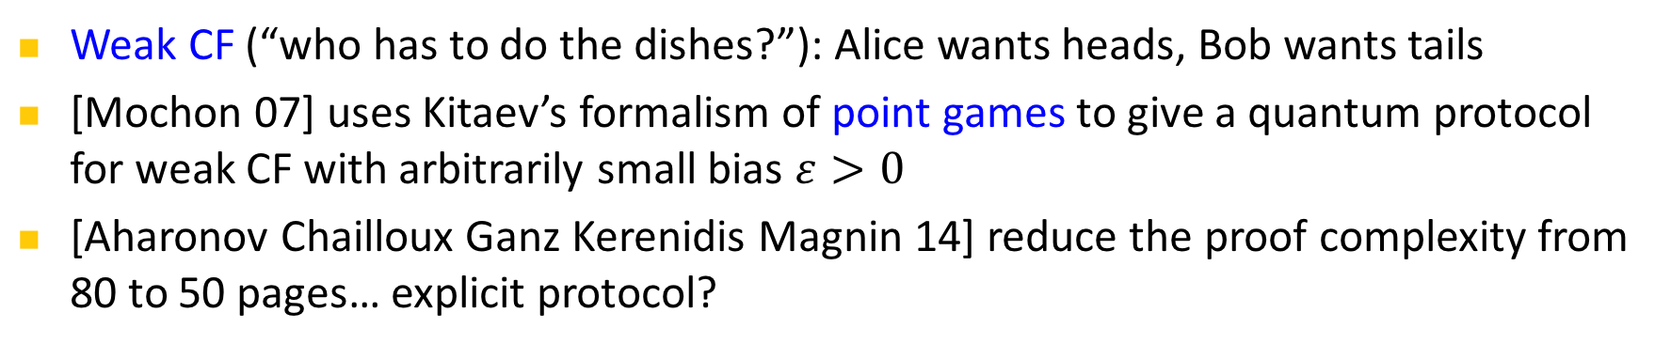
Coin Flipping (CF)
Strong CF: No dishonest player can bias the outcome
Classically: a cheater can always obtain his desired outcome with prob 1
Quantum: [Ambainis 02] Quantum Protocol with bias 0.25
[Kitaev 03] lower bounds the bias by $\frac{1}{\sqrt{2}}−\frac{1}{2}≈0.2$
[Chailloux Kerenidis 09] give optimal quantum protocol for strong CF with this bias
Weak CF (“who has to do the dishes?”): Alice wants heads, Bob wants tails
[Mochon 07] uses Kitaev’s formalism of point games to give a quantum protocol for weak CF with arbitrarily small bias $ε>0$
[Aharonov Chailloux Ganz Kerenidis Magnin 14] reduce the proof complexity from 80 to 50 pages… explicit protocol?

Slide 21
Bit Commitment (BC)
Two-phase (reactive) protocol:
a=0 or
a=1
commit
a = ?
Bob‘s
view
Hiding: even dishonest Bob does not learn a
Binding: dishonest Alice cannot change her mind
open
a
Classically: impossible
Quantum: believed to be possible in the early 90s
shown impossible by [Mayers 97, LoChau 97] by a beautiful argument (purification and Uhlmann’s theorem)
[Chailloux Kerenidis 11] show that in any quantum BC protocol, one player can cheat with prob 0.739. They also give an optimal protocol achieving this bound. Crypto application?
[Brassard Crepeau Jozsa Langlois: A quantum BC scheme provably unbreakable by both parties, FOCS 93]
Notes:
Going back to the original paper on quantum bit commitment [BCJL93], we note that a subtlety in the definition of the binding property is the origin of the false claim of security: while it is true that the protocol is such that Alice is unable to simultaneously hold messages that would unveil a commitment to b=0 and as b=1 (and thus, to be able to choose to open b=0 and b=1), this is insufficient to prove security, since in fact Alice is able to delay her choice of commitment until the very end of the protocol—at which point she can choose to open as either b = 0 or b = 1 (but not necessarily both at the same time!).

Slide 22


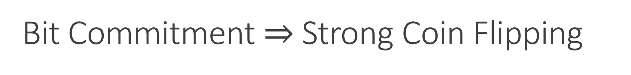











Bit Commitment $⇒$ Strong Coin Flipping
$$⇒$$
$$⇏$$
$$⇒$$
$$⇏$$
$$⇒$$
$$s_{0}$$
OT
$$c$$
$$s_{1}$$
$$s_{c}$$
$$⇒$$
$$⇒$$
$$x$$
$$ℱ$$
$$y$$
$$f(x,y)$$
$$g(x,y)$$

Slide 23
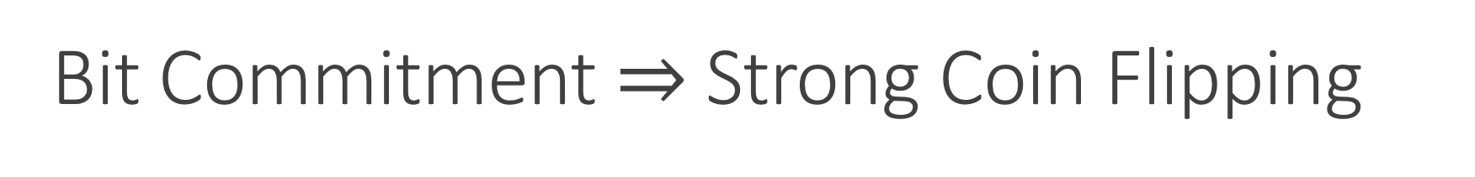
Bit Commitment $⇒$ Strong Coin Flipping
a=0 or
a=1
a
a
b=0 or
b=1
b
a = b
a ≠ b
[Blum 83]

Slide 24


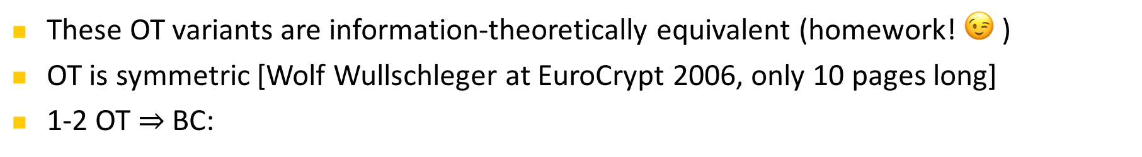

















Oblivious Transfer (OT)
1-out-of-2 Oblivious Transfer:
Rabin OT:
(secure erasure)
$$s_{0}$$
OT
$$c$$
$$s_{1}$$
$$s_{c}$$
Dishonest Alice does not learn choice bit
Dishonest Bob can only learn one of the two messages
$$s$$
ROT
$s$ / $⊥$
These OT variants are information-theoretically equivalent (homework! 😉 )
OT is symmetric [Wolf Wullschleger at EuroCrypt 2006, only 10 pages long]
1-2 OT $⇒$ BC:
$$r_{1}$$
$$c_{1}∈_{R}\{0,1\}$$
open
OT
$${a⊕r}_{1}$$
$$s_{c_{1}}$$
commit
$$r_{2}$$
OT
$$c_{2}∈_{R}\{0,1\}$$
$a=0$ or
$$a=1$$
$${a⊕r}_{2}$$
$$s_{c_{2}}$$
$${a, r}_{1},r_{2},…$$
$$r_{3}$$
OT
$$c_{3}∈_{R}\{0,1\}$$
$${a⊕r}_{3}$$
$$s_{c_{3}}$$
[Wiesner 68, Even Goldreich Lempel 85, Rabin 81]

Slide 25






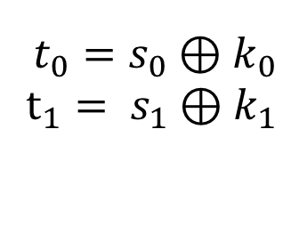
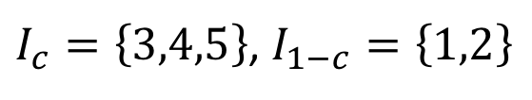



Quantum Protocol for Oblivious Transfer
$$s_{0}$$
$$c$$
OT
$$s_{1}$$
$$s_{c}$$
0 1 1 1 0
0 0 1 1 0
$$I_{0},I_{1}$$
$I_{c}=\left\{3,4,5\right\}$, $I_{1−c}=\left\{1,2\right\}$
$$f_{0},f_{1}$$
$${t_{0}=s}_{0}⊕k_{0}$$
$$t_{1}= s_{1}⊕k_{1}$$
$$k_{1}=f_{1}\left(110\right)$$
$$k_{0}=f_{0}(01)$$
$$k_{1}=f_{1}\left(110\right)$$
Correctness ✓
$$s_{1}=t_{1}⊕f_{1}\left(110\right)$$
[Wiesner 68, Bennett Brassard Crepeau Skubiszewska 91]

Slide 26
Quantum Protocol for Oblivious Transfer
$$s_{0}$$
$$c$$
OT
$$s_{1}$$
$$s_{c}$$
0 1 1 1 0
0 0 1 1 0
$$I_{0},I_{1}$$
$I_{c}=\left\{3,4,5\right\}$, $I_{1−c}=\left\{1,2\right\}$
$$f_{0},f_{1}$$
$${t_{0}=s}_{0}⊕k_{0}$$
$$t_{1}= s_{1}⊕k_{1}$$
$$k_{1}=f_{1}\left(110\right)$$
$$k_{0}=f_{0}(01)$$
$$k_{1}=f_{1}\left(110\right)$$
✓
$$s_{1}=t_{1}⊕f_{1}\left(110\right)$$
Security for honest Bob
[Wiesner 68, Bennett Brassard Crepeau Skubiszewska 91]

Slide 27




Quantum Protocol for Oblivious Transfer
$$s_{0}$$
$$c$$
OT
$$s_{1}$$
$$s_{c}$$
store all qbits
0 1 1 1 0
0 0 1 1 0
$$I_{0},I_{1}$$
$I_{c}=\left\{3,4,5\right\}$, $I_{1−c}=\left\{1,2\right\}$
$$f_{0},f_{1}$$
$$k_{1}=f_{1}\left(110\right)$$
$${t_{0}=s}_{0}⊕k_{0}$$
$$t_{1}= s_{1}⊕k_{1}$$
$$k_{1}=f_{1}\left(110\right)$$
$$k_{0}=f_{0}(01)$$
$$k_{0}=f_{0}(01)$$
Security for honest Bob ✓
Security for honest Alice
$$s_{1}=t_{1}⊕f_{1}\left(110\right)$$
$$s_{0}=t_{0}⊕f_{0}\left(01\right)$$
❌
[Wiesner 68, Bennett Brassard Crepeau Skubiszewska 91]

Slide 28


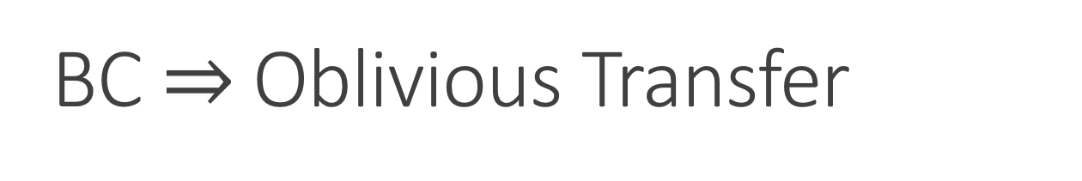


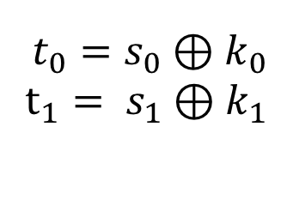

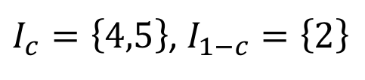


BC $⇒$ Oblivious Transfer
$$s_{0}$$
$$c$$
OT
$$s_{1}$$
$$s_{c}$$
0 1 1 1 0
0 0 1 1 0
0 0 1 1 0
0 1
$$I_{0},I_{1}$$
$I_{c}=\left\{4,5\right\}$, $I_{1−c}=\left\{2\right\}$
$$f_{0},f_{1}$$
$${t_{0}=s}_{0}⊕k_{0}$$
$$t_{1}= s_{1}⊕k_{1}$$
$$k_{1}=f_{1}\left(10\right)$$
$$k_{0}=f_{0}(1)$$
$$k_{1}=f_{1}\left(10\right)$$
$$s_{1}=t_{1}⊕f_{1}\left(10\right)$$
[Bennett Brassard Crepeau Skubiszewska 91, Damgaard Fehr Lunemann Salvail Schaffner 09, Unruh 10]

Slide 29
Limited Quantum Storage
$$s_{0}$$
$$c$$
OT
$$s_{1}$$
$$s_{c}$$
store all qbits
0 1 1 1 0
wait 1 sec
$$I_{0},I_{1}$$
$I_{c}=\left\{3,4,5\right\}$, $I_{1−c}=\left\{1,2\right\}$
$$f_{0},f_{1}$$
$${t_{0}=s}_{0}⊕k_{0}$$
$$t_{1}= s_{1}⊕k_{1}$$
$$k_{1}=f_{1}\left(110\right)$$
$$k_{0}=f_{0}(01)$$
$$k_{1}=f_{1}\left(110\right)$$
$$s_{1}=t_{1}⊕f_{1}\left(110\right)$$
[Damgaard Fehr Salvail Schaffner 05, Wehner Schaffner Terhal 09]

Slide 30












Summary of Quantum Two-Party Crypto
Information-theoretic security
No computational restrictions
Coin-Flipping
Bit Commitment
Oblivious Transfer
2-Party Function Evaluation
$$⇒$$
$$⇏$$
quantum usefulness
$$⇒$$
$$⇏$$
$$⇒$$
$$s_{0}$$
OT
$$c$$
$$⇒$$
$$⇒$$
$$s_{1}$$
$$s_{c}$$
$$x$$
$$ℱ$$
$$y$$
$$f(x,y)$$
$$g(x,y)$$
[Blum 83, Kilian 88]

Slide 31
Thank you!
https://github.com/cschaffner/QCryptoMindmap
http://arxiv.org/abs/1510.06120
In Designs, Codes and Cryptography 2016
Thanks to all friends and colleagues that contributed to quantum cryptography and to this presentation.
Questions

