Slide 1
Hybrid Decoding – Classical-Quantum Trade-Offs for Information Set Decoding
Andre Esser Sergi Ramos-Calderer Emanuele Bellini José I. Latorre Marc Manzano
@ PQCrypto 2022, online

Slide 2
Motivation
Qubits very limited resource
Even if polynomial: millions of qubits
We need time-memory trade-offs for ISD
Goal: construct hybrid algorithms using less qubits

Slide 3
Syndrome Decoding and Information Set Decoding

Slide 4
Syndrome Decoding Problem
Definition: Syndrome Decoding Problem (SDP)
Given : parity-check matrix , syndrome and integer
Find : vector of weight with
$s$
$H$
$e$

Slide 5
Information Set Decoding [Prange ‘62]
$n$
$s$
$r$
$H$
$e$

Slide 6
Information Set Decoding [Prange ‘62]
$n$
$s$
$r$
$H$
0 0 0 0 0 0 0 0 0 0 0 0
$r$
5

Slide 7
Information Set Decoding [Prange ‘62]
$A$
$s$
Solve linear system
$r$
Guess other set of zeros
0 0 0 0 0 0 0 0 0 0 0 0 0
0 0 0 0 0 0 0 0 0 0 0 0
e
$r$
weight
5

Slide 8
Quantum Circuit Input
6

Slide 9
Quantum Version of Prange
Create superposition over all subsets
Perform Gaussian elimination
Grover search for subset leading to weight
0 0 0 0 0 0 0 0 0 0 0 0 0
e’
e’
weight
7

Slide 10
Quantum Circuit Input
$n$
$s$
$s’$
$A$
$I_{r}$
$r$
e
Classical: time
Quantum: time
8

Slide 11
Quantum Circuit Input
$n$
s’
$A$
$I_{r}$
$r$
0 0 0 0 0 0 0 0 0 0 0 0
$r$
8

Slide 12
Quantum Circuit Input
$A′$
s
$0$
$I$
8

Slide 13
Quantum Circuit Input
$I$
$0$
8

Slide 14
Quantum Circuit Input
$r$
$n−r$
$s’$
$I_{r}$
$r$
$A$
e
suffices as input:
bits
8

Slide 15
Classical-Quantum Trade-Offs – Shortened-Hybrid
9

Slide 16
Shortening the Code
$n$
$s’$
$I_{r}$
$r$
$A$
$α$
e 0 0 0 0
e
0 0 0 0
is sufficient
bits
Guess zeros (classically)
Apply quantum circuit
If no solution returned: goto 1.)
10

Slide 17
How to Measure Performance
Classical Prange:
qubits and time
Quantum Prange:
qubits and time
Hybrid Prange:
qubits and time
11

Slide 18
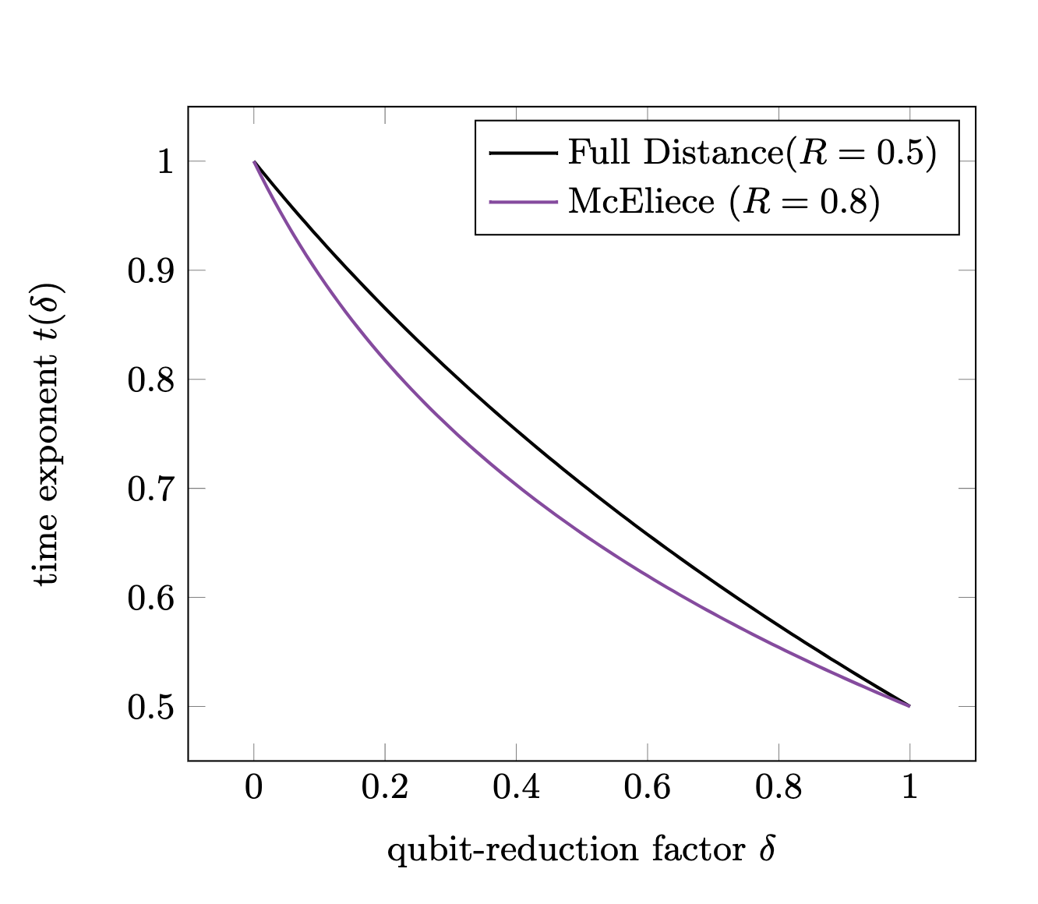
Performance of Shortened-Hybrid
McEliece
Full Distance , constant
rate sensitive,
weight insensitive
$R=1−r/n$
12

Slide 19
Punctured-Hybrid and Beyond
13

Slide 20
Puncturing the Code
$n$
Unique solution:
$s’$
Multiple Solutions?
$0$
$I_{r}$
$r$
$A$
$β$
now #solutions:
$p$
suffice
bits
Permute & puncture
Apply quantum circuit
If no solution returned: goto 1.)
14

Slide 21
Puncturing the Code
$n$
Unique solution:
$s’$
Multiple Solutions?
$0$
$I_{r}$
$r$
$A$
$β$
now #solutions:
$p$
suffice
bits
Permute & puncture
Apply quantum circuit #solutions many times
If no valid solution returned: goto 1.)
14

Slide 22
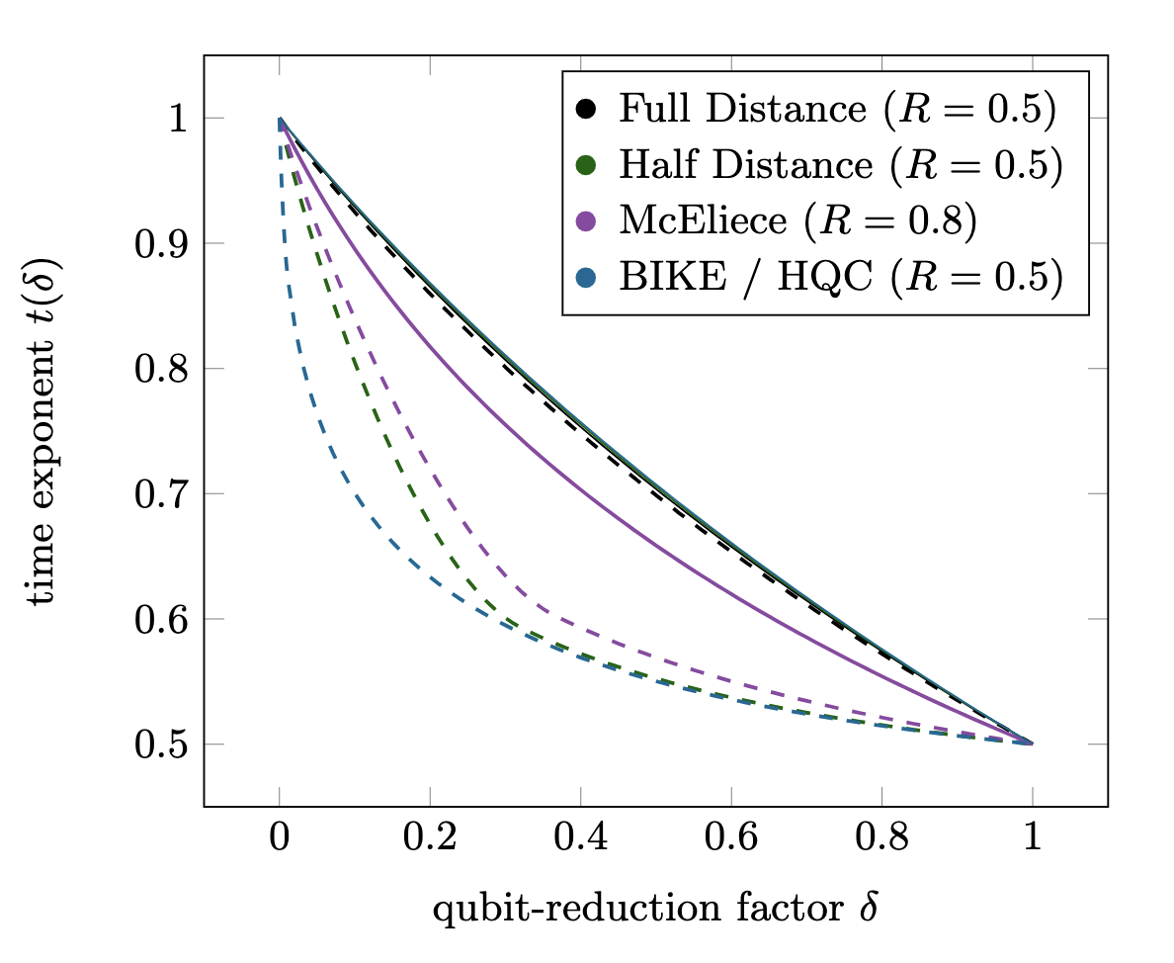
Performance of Punctured-Hybrid
weight sensitive,
less rate sensitive
$R=1−r/n$
:
BIKE / HQC < McEliece < HD < FD
15

Slide 23
Combining both Trade-Offs
$n$
$s’$
$I_{r}$
$r$
$A$
e
16

Slide 24
Combining both Trade-Offs
$n$
$s’$
$0$
$I_{r}$
$r$
$A$
#solutions:
$β$
$α$
$p$
0 0 0 0
suffice
bits
Permute, shorten & puncture
Apply quantum circuit #solutions many times
If no valid solution returned: goto 1.)
16

Slide 25
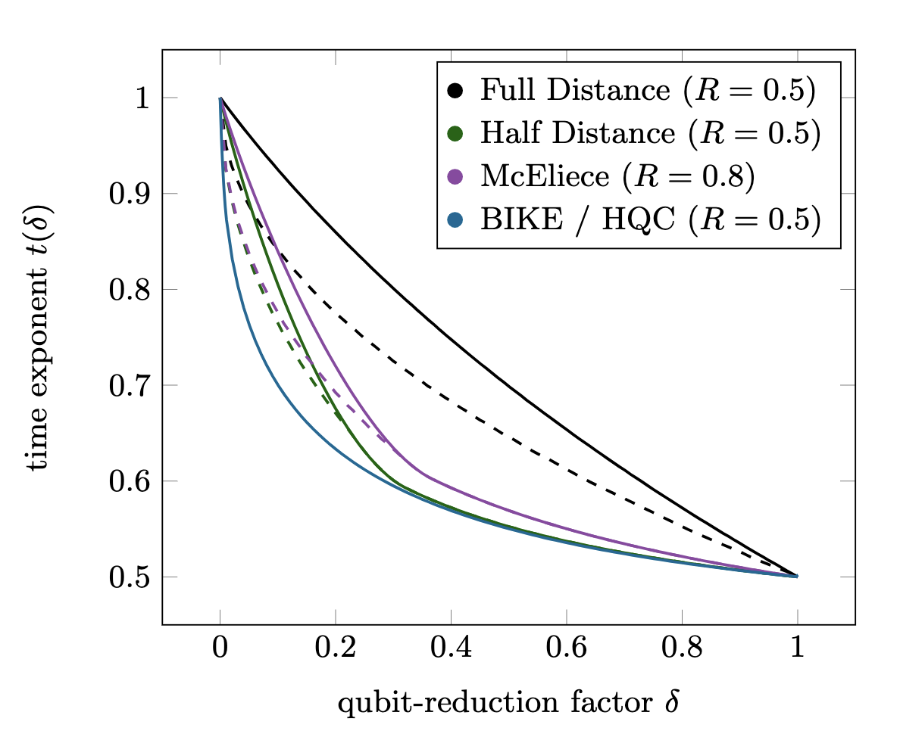
Performance of Punctured-Hybrid
weight and rate sensitive
$R=1−r/n$
:
BIKE / HQC < McEliece < HD < FD
17

Slide 26
Conclusion
Width trade-offs with significant runtime gain
Most effective for low weight
Interpolating classic and quantum Prange
Support near- to mid-term realizations
Thank you!
2022 / 964
18

