Slide 1
Quantum Cryptography
Christian Schaffner
Research Center for Quantum Software
Informatics Institute
University of Amsterdam
Amsterdam University College
Monday, 20 March 2023

Slide 2
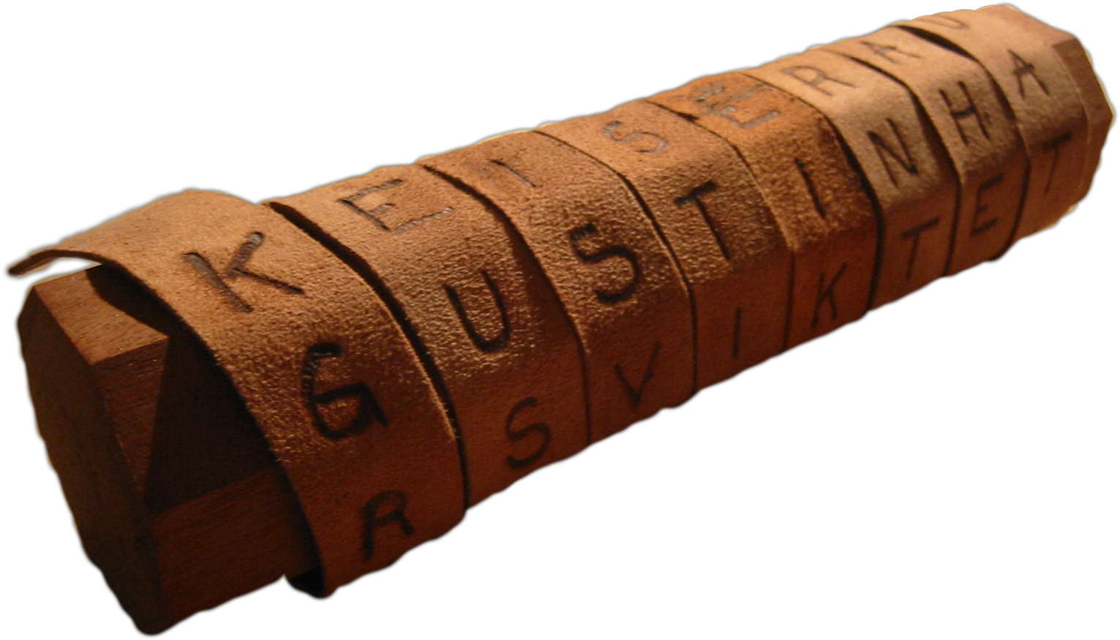
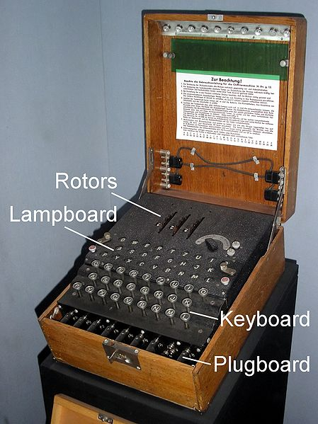
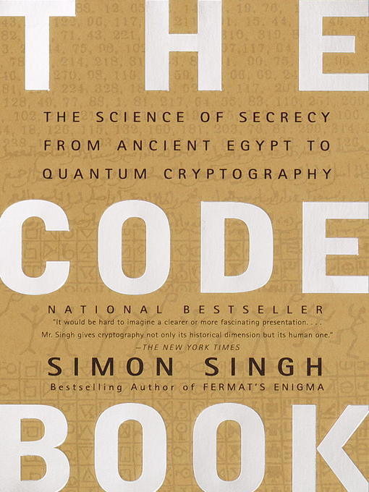
Classical Cryptography
3000 years of fascinating history
Until 1970: private communication was the only goal
Scytale
Enigma

Slide 3
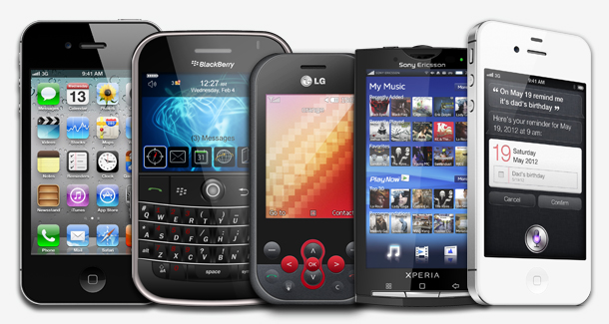
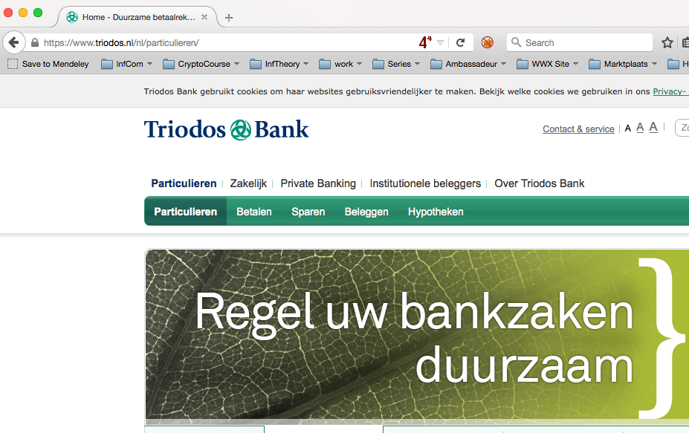
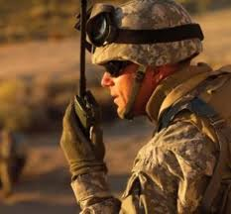
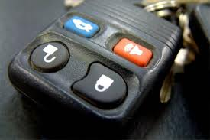
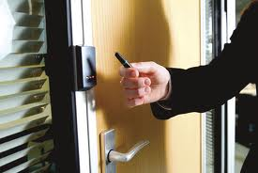
Modern Cryptography
is everywhere!
is concerned with all settings where people do not trust each other

Slide 4
What will you Learn from this Talk?
Classical Cryptography
Quantum Mechanics
Crypto Threat of Quantum Computing
Quantum Cryptography
Quantum Future

Slide 5
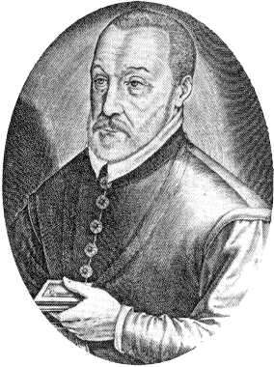
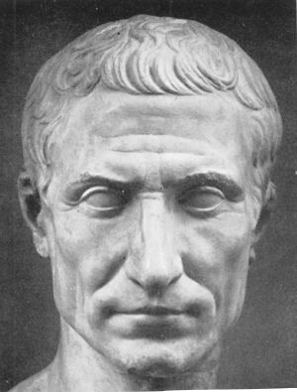

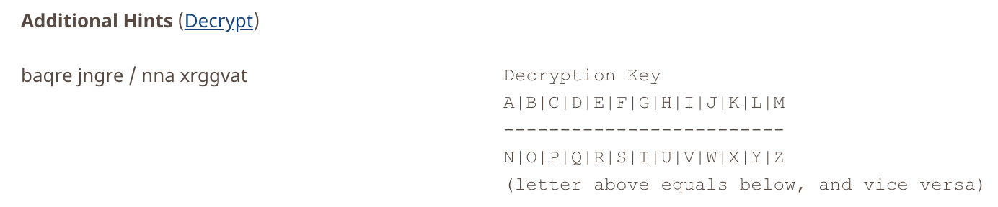
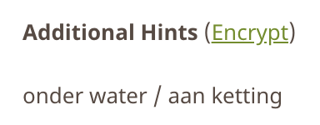
Ancient Cryptography
Blaise de Vigenère
Scytale
50 BC
1000 AD
2015 AD
500 BC
500 AD
1500 AD
Caesar Cipher (ROT4)
(variant still in use)

Slide 6
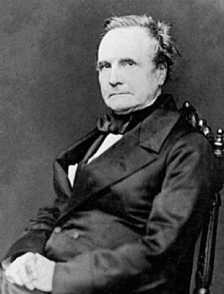
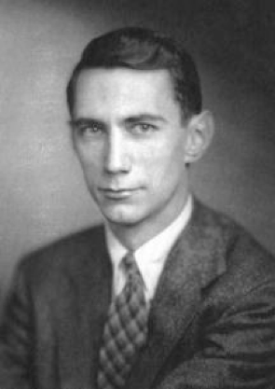
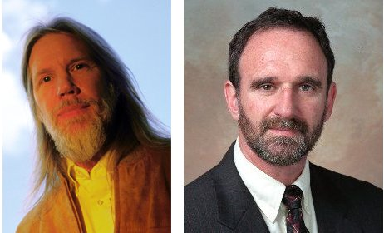
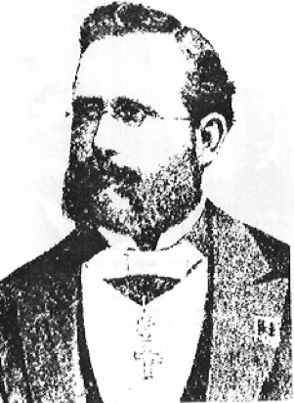
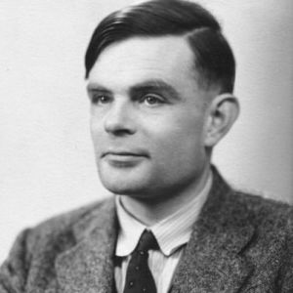

Ancient Cryptography
Charles Babbage
Claude Shannon
Diffie / Hellman
1850
1950
2015
1800
1900
1976
“a cryptographic system should be secure even if everything but the key is known to the adversary”
Enigma
Alan Turing
(The Imitation Game)
Auguste Kerckhoffs
Notes:
een systeem van versleuteling moet even veilig zijn, zelfs als alles behalve de sleutel over het systeem publiek bekend is

Slide 7
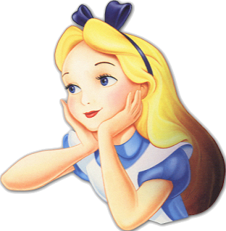

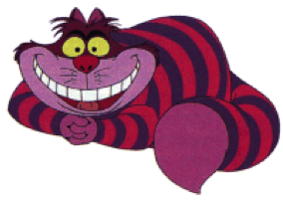
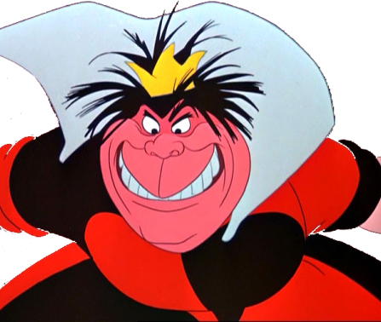
Secure Encryption
m = “I love you”
m = 0000 1111
Alice
Bob
k = ?
Eve
k = 0101 1011
k = 0101 1011
Goal: Eve does not learn the message
Setting: Alice and Bob share a secret key k

Slide 8
eXclusive OR (XOR) Function (exclusive disjunction)
x | y | x ⊕ y
0 | 0 | 0
1 | 0 | 1
0 | 1 | 1
1 | 1 | 0
Some properties:
  ∀ x : x ⊕ 0 = x
  ∀ x : x ⊕ x = 0
  ∀x,y : x ⊕ y ⊕ y = x
Notes:
quick check: please raise your hand if you have NOT seen this function before.
Please raise your hand if you HAVE seen this function before.
Now raise your hand if you have not raised your hand yet. For the people raising their hand now: you should seriously double-check the logic “axiom of the excluded middle”, asserting that either you HAVE seen this function before, or that you have NOT.

Slide 9
One-Time Pad Encryption
m = 0000 1111
c = m ⊕ k = 0101 0100
m = c ⊕ k = 0000 1111
Alice
Bob
k = ?
Eve
k = 0101 1011
k = 0101 1011
Goal: Eve does not learn the message
Setting: Alice and Bob share a key k
Recipe:
Is it secure?
x | y | x ⊕ y
0 | 0 | 0
0 | 1 | 1
1 | 0 | 1
1 | 1 | 0
m = 0000 1111
c = 0101 0100
k = 0101 1011
k = 0101 1011
c = m ⊕ k = 0101 0100
c ⊕ k = 0000 1111
c ⊕ k = m ⊕ k ⊕ k = m ⊕ 0 = m

Slide 10
Perfect Security
m = ?
c = m ⊕ k = 0101 0100
m = c ⊕ k = ?
Alice
Bob
k = ?
Eve
k = ?
k = ?
Given that c = 0101 0100,
  is it possible that m = 0000 0000 ?
    Yes, if k = 0101 0100.
  is it possible that m = 1111 1111 ?
    Yes, if k = 1010 1011.
  it is possible that m = 0101 0101 ?
    Yes, if k = 0000 0001
In fact, every m is possible.
Hence, the one-time pad is perfectly secure!
x | y | x ⊕ y
0 | 0 | 0
0 | 1 | 1
1 | 0 | 1
1 | 1 | 0

Slide 11
Problems With One-Time Pad
m = 0000 1111
c = m ⊕ k = 0101 0100
m = c ⊕ k = 0000 1111
Alice
Bob
k = ?
Eve
k = 0101 1011
k = 0101 1011
The key has to be as long as the message.
The key can only be used once.
In practice, other encryption schemes (such as AES) are used which allow to encrypt long messages with short keys.
One-time pad does not provide authentication:
Eve can easily flip bits in the message
Notes:
for encrypting internet traffic

Slide 12
Symmetric-Key Cryptography
Alice
Bob
Eve
Encryption insures secrecy:
Eve does not learn the message, e.g. one-time pad
Authentication insures integrity:
Eve cannot alter the message
General problem: players have to exchange a key to start with

Slide 13
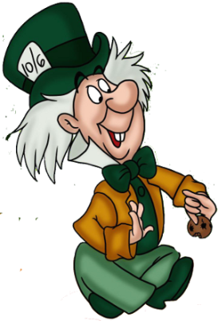
Public-Key Cryptography
Alice
Charlie
Bob
secret key
Eve
public key
Solves the key-exchange problem.
Everyone can encrypt using the public key.
Only the holder of the secret key can decrypt.
Digital signatures: Only secret-key holder can sign, but everyone can verify signatures using the public-key.

Slide 14
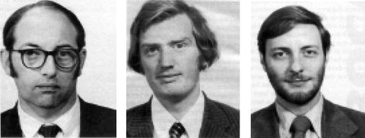


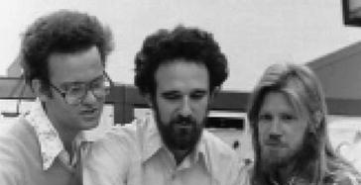
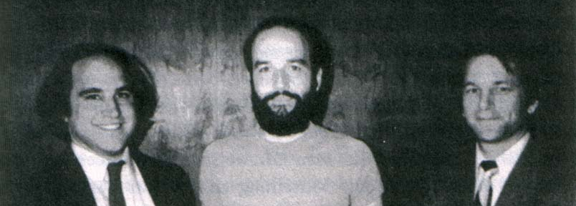
History of Public-Key Crypto
Early 1970s: invented in the „classified world“ at the
British Government Communications Head Quarters (GCHQ)
by Ellis, Cocks, Williamson
Mid/late 1970s: invented in the „academic world“
by Merkle, Hellman, Diffie, and Rivest, Shamir, Adleman (RSA)
Notes:
picture: http://link.springer.com/referenceworkentry/10.1007%2F978-1-4419-5906-5_210/fulltext.html#Fig2_210
James H. Ellis, Clifford C. Cocks, Malcolm J. Williamson (from left to right)
Ralph Merkle, Martin Hellman, Whitfield Diffie, (at Stanford)
and Ron Rivest, Adi Shamir, Leonard Adleman (at MIT)

Slide 15
Cryptography and Logic
Crypto-Toolbox
electronic voting system
Encryption
Hash function
Signature
Key establishment
Cryptographic protocols for advanced tasks are built from basic building blocks
Problem: security proofs become very hard to verify
Solution:
  Logic provides formal methods to specify tools and task
  Use automatic proof checkers to verify security
Notes:
pictures from an overview presentation by Michael Backes: http://www.infsec.cs.uni-saarland.de/~backes/
http://www.zurich.ibm.com/security/publications/2004/BaPfWa2004aCryptoLibSlides.ppt

Slide 16
What will you Learn from this Talk?
Classical Cryptography
Introduction to Quantum Mechanics
Crypto Threat of Quantum Computing
Quantum Cryptography
Quantum Future

Slide 17
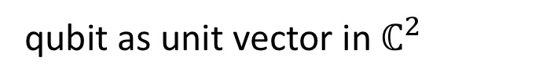
Quantum Bit: Polarization of a Photon
qubit as unit vector in $ℂ^{2}$

Slide 18
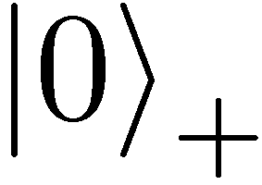
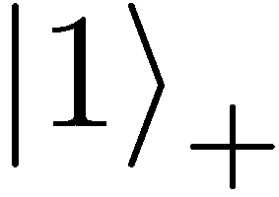
Qubit: Rectilinear/Computational Basis

Slide 19
Detecting a Qubit
No photons: 0
Alice
Bob

Slide 20
Measuring a Qubit
No photons: 0
Photons: 1
Alice
Bob
Measurement:
with prob. 1 yields 1
0/1

Slide 21
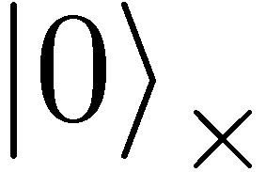
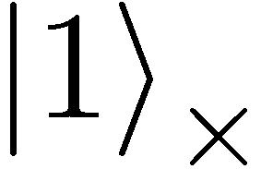

Diagonal/Hadamard Basis
Measurement:
with prob. ½ yields 0
=
with prob. ½ yields 1
0/1

Slide 22
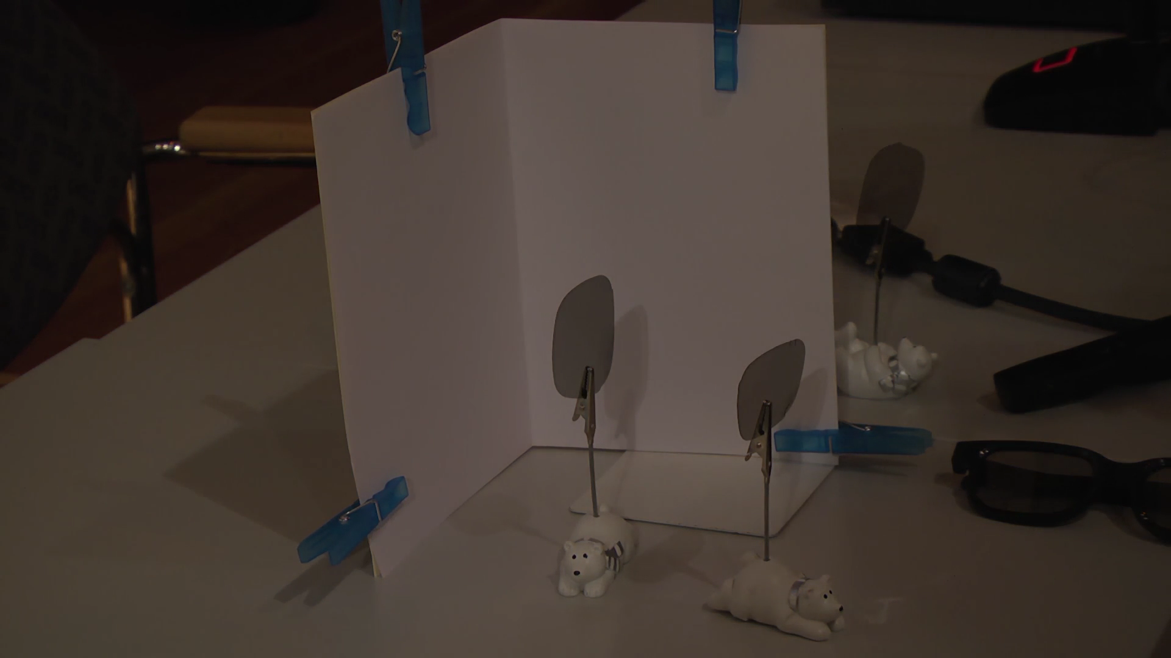
Video

Slide 23
Measuring Collapses the State
Measurement:
with prob. ½ yields 0
=
with prob. ½ yields 1
0/1

Slide 24
Measuring Collapses the State
=
=

Slide 25
Quantum Mechanics
+ basis
x basis
Measurements:
with prob. 1 yields 1
0/1
with prob. ½ yields 0
0/1
with prob. ½ yields 1

Slide 26
Demonstration of Quantum Technology
generation of random numbers
50%
50%
(diagram from idQuantique white paper)
no quantum computation, only quantum communication required

Slide 27
Quantum (Optics) Games
Single-player puzzle game: Laser Maze, beam bending logic game
Virtual game: http://quantumgame.io/

Slide 28
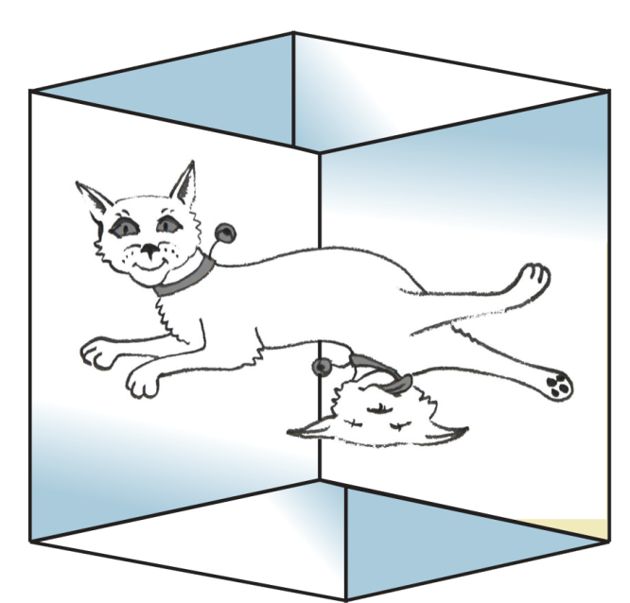

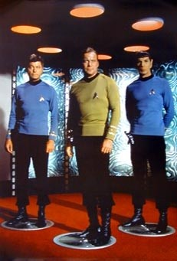
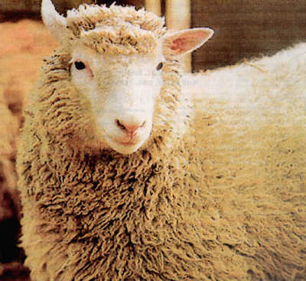
Wonderland of Quantum Mechanics

Slide 29
Quantum Computing
Classical bit: 0 or 1
Quantum bit: can be in
superposition of 0 and 1
Yields a (probably) more powerful computational model
=

Slide 30

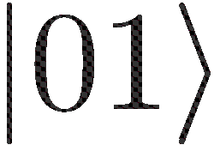
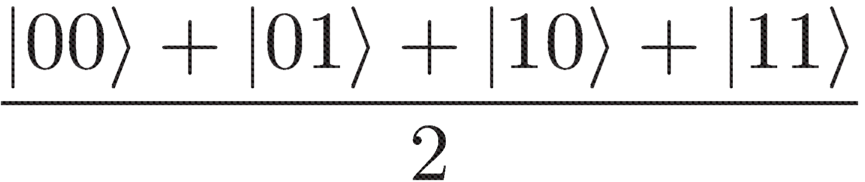
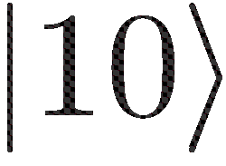
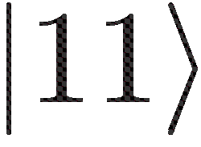
Many Qubits
=
1 qubit lives in a 2-dimensional space,
can be in a superposition of 2 states
2 qubits live in a 4-dimensional space,
can be in a superposition of 4 states
3 qubits can be in superposition of 8 states
n qubits can be in superposition of 2^{n} states
So, with 63 qubits, one can do
2⁶³ = 9223372036854775808 calculations simultaneously!
Problem: Measuring this huge superposition collapses everything and yields only one random outcome

Slide 31
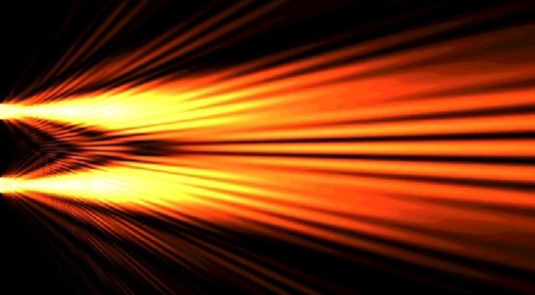
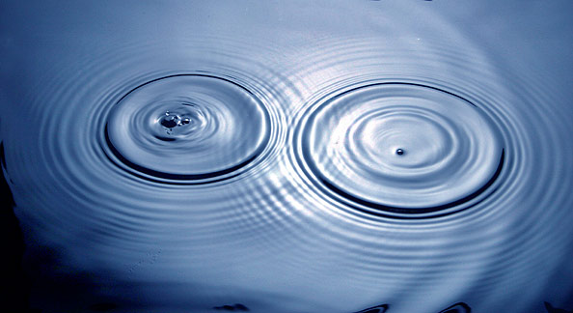
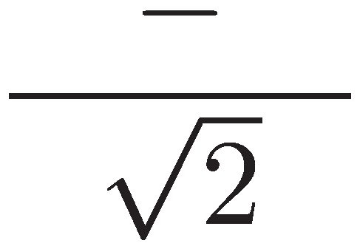
Quantum Computing
With n qubits, one can do 2^{n} calculations simultaneously
Problem: Measuring this huge superposition will collapse the state and only give one random outcome
Solution: Use quantum interference to measure the computation you are interested in!
=
Seems to work for specific problems only
Requires clever design of quantum algorithms and quantum software!

Slide 32
What will you Learn from this Talk?
Classical Cryptography (& Politics)
Introduction to Quantum Mechanics
Crypto Threat of Quantum Computing
Quantum Cryptography
Quantum Future

Slide 33
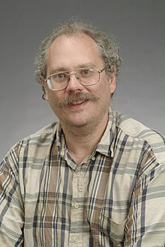
Quantum Algorithms: Factoring
[Shor ’94] Polynomial-time quantum algorithm for factoring integer numbers
15 = 3 * 5
27 = 3 * 3 * 3
31 = 1 * 31
57 = 3 * 19
91 = 7 * 13
173 = 1 * 173
RSA-100 = 1522605027922533360535618378132637429718068114961380688657908494580122963258952897654000350692006139 = 37975227936943673922808872755445627854565536638199 × 40094690950920881030683735292761468389214899724061
Notes:
RSA-100 tooke a few days to factor in 1991. It now takes about 1 hour on a standard laptop.

Slide 34
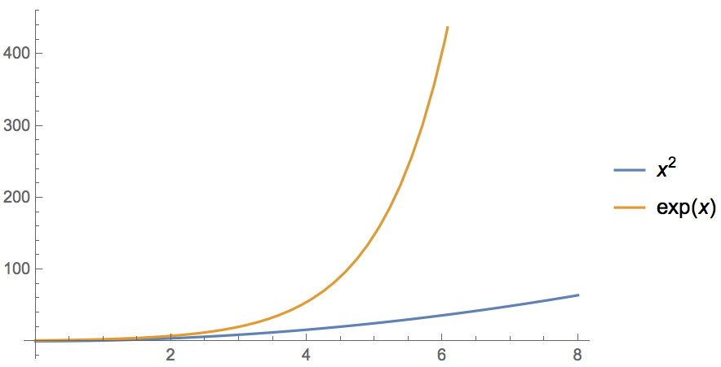
Quantum Computer breaks Public-Key Crypto
[Shor ’94] Polynomial-time quantum algorithm for factoring integer numbers
Classical Computer : Exponential time
Quantum Computer : Poly-time: n²
For a 600-digit number (RSA-2048)
    Classical: age of universe
    Quantum: few minutes
  Consequence: Large enough quantum computers break all currently used public-key cryptosystems!!!
Notes:
15 = 3 * 5
51 = 3 * 17
123 * 456 = 56088

Slide 35
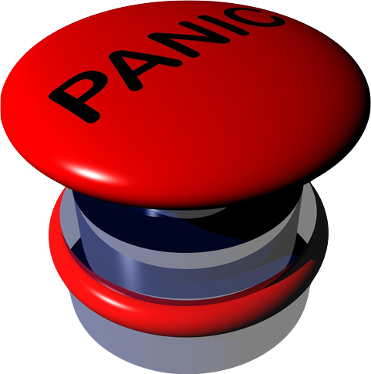
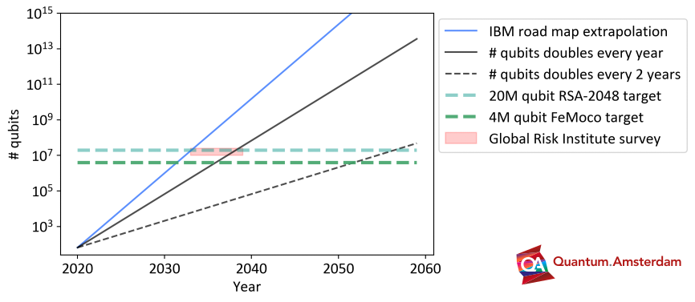


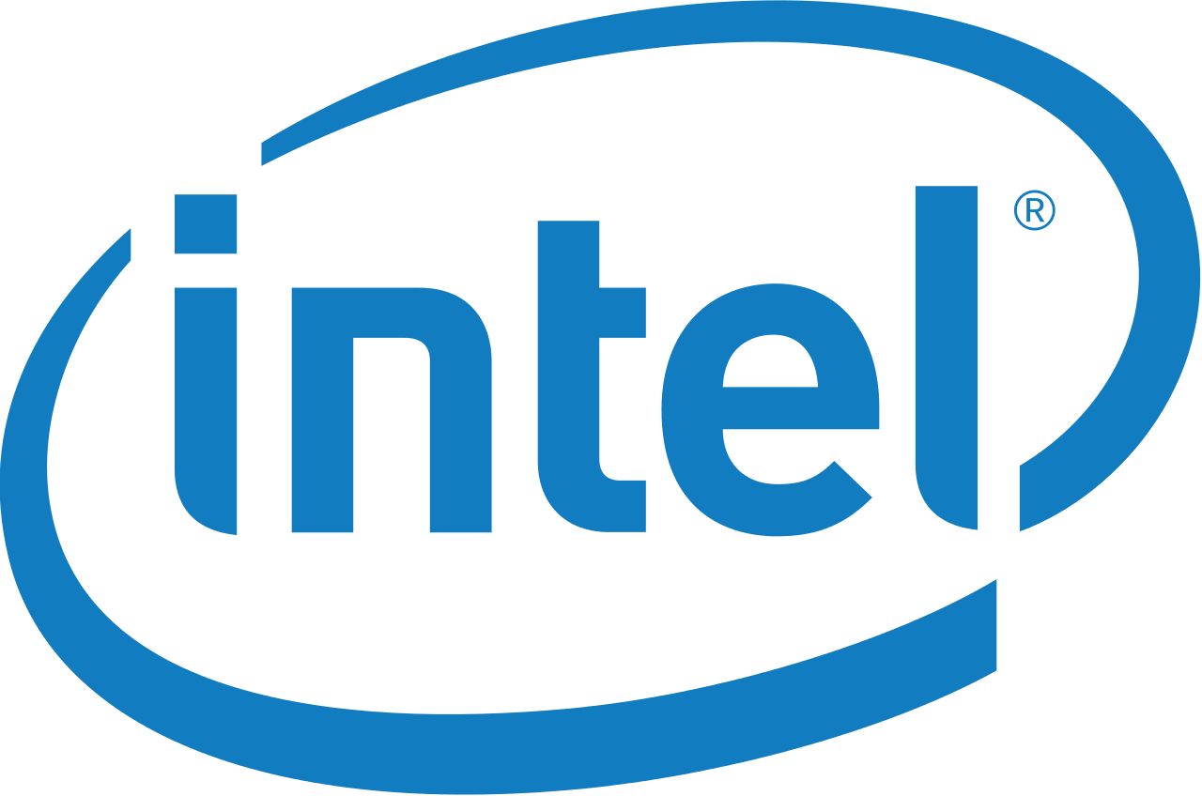
Store Now, Decrypt Later
store all (encrypted) internet traffic
change encryption
required security
scale up q computing
secrets revealed!
time
2023
2035?
Possible to scale up q computers in theory, no fundamental theoretical obstacles known, but enormous technical challenge (control vs decoherence)
Check our professional guide for an estimated timeline

Slide 36
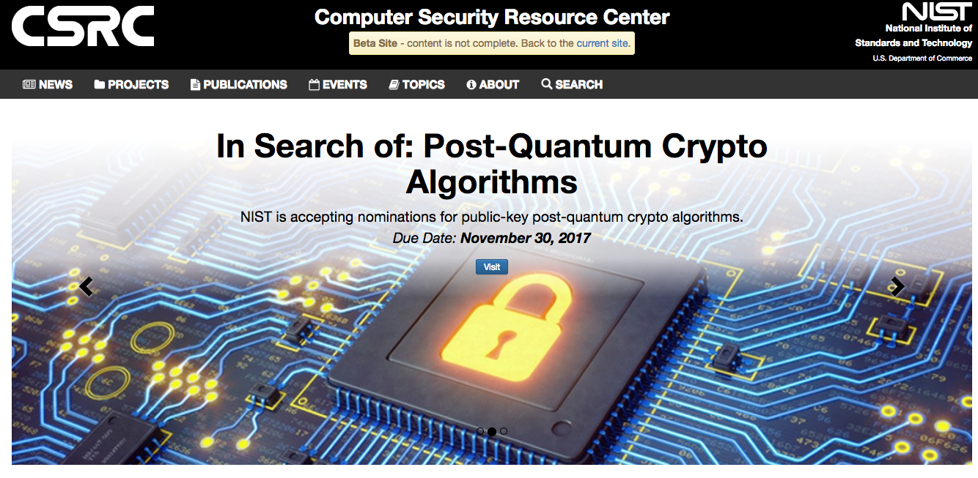

Conventional Quantum-Safe Cryptography
Wanted: new assumptions to replace factoring and discrete logarithms in order to build conventional public-key cryptography
[https://csrc.nist.gov/Projects/Post-Quantum-Cryptography ]
2018: NIST “competition”: 82 submissions (23 signature, 59 encryption schemes)
3-5 years of crypto-analysis
2022+: new standards, world-wide adoption
Ongoing projects to create quantum-safe PKIs, assess impact on society etc.

Slide 37

Example: Lattice-Based Cryptography
For any vectors $v1,…,vn$in $ℝn$,
the lattice spanned by $v1,…,vn$
is the set of points
$L=\{a1v1+…+anvn| ai \text{integers}\}$
Shortest Vector Problem (SVP): given a lattice $L$, find a shortest (nonzero) vector
2v₁
v₁+v₂
2v₂
v₁
v₂
2v₂-v₁
2v₂-2v₁
0

Slide 38
Example: Lattice-Based Cryptography
v₂
v₁
3v₂-4v₁
0
Shortest Vector Problem (SVP): given a lattice, find a shortest (nonzero) vector
no efficient (classical or quantum) algorithms known
public-key encryption schemes can be built on the computational hardness of SVP

Slide 39
What will you Learn from this Talk?
Classical Cryptography (& Politics)
Introduction to Quantum Mechanics
Crypto Threat of Quantum Computing
Quantum Cryptography
Quantum Future

Slide 40
No-Cloning Theorem
U
Quantum operations:
?
?
?
Proof: copying is a non-linear operation

Slide 41
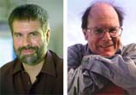
Quantum Key Distribution (QKD)
Alice
[Bennett Brassard 84]
Bob
k = ?
k = 0101 1011
Eve
k = 0101 1011
Offers a quantum solution to the key-exchange problem
Puts the players into the starting position to use symmetric-key cryptography (encryption, authentication etc.).

Slide 42
Quantum Key Distribution (QKD)
[Bennett Brassard 84]
0 1 1 1 0
0 0 1 1 0
k = 110
k = 110

Slide 43
Quantum Key Distribution (QKD)
?
?
?
?
?
[Bennett Brassard 84]
0 1 1 1 0
0 0 1 1 0
k = ?
k = 10
k = 10
Quantum states are unknown to Eve, she cannot copy them.
Honest players can test whether Eve interfered.

Slide 44
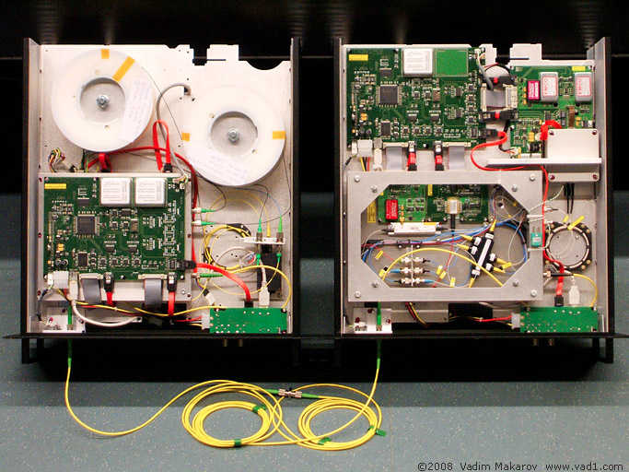

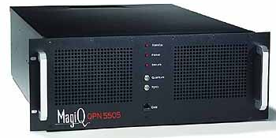
Quantum Key Distribution (QKD)
Alice
[Bennett Brassard 84]
Bob
Eve
technically feasible: no quantum computer required,
only quantum communication

Slide 45
What will you Learn from this Talk?
Classical Cryptography (& Politics)
Introduction to Quantum Mechanics
Crypto Threat of Quantum Computing
Quantum Cryptography
Quantum Future

Slide 46

Notes:
https://qureca.com/quantum-initiatives-worldwide-update-2023/

Slide 47








Dutch Quantum Ecosystem
2016: QuSoft founded
2016: QuTech: 135 Mio € , 50 Mio $ Intel
2017: Quantum Software Consortium, NWO 18.8 Mio € for 10 years
2020: Quantum.Amsterdam founded
2021: growth fund for Quantum Delta NL 615 Mio € for 7 years

Slide 48




The Future is Quantum (or not)
New UvA building “LabQ”, hopefully ready in 2026
New UvA MSc in “Quantum Computer Science”, starting 2024/25

Slide 49
What Have You Learned from this Talk?
Classical Cryptography
  Long history
  One-time pad
  Public-key cryptography
  Links to Logic (and Politics)
m = 0000 1111
c = m ⊕ k = 0101 0100
Alice
Bob
k = ?
Eve
k = 0101 1011
k = 0101 1011

Slide 50
What Have You Learned from this Talk?
Quantum Mechanics
  Qubits
  Quantum Computer
  Shor’s Algorithm
  No-cloning

Slide 51

Answers to the Quantum Threat
Conventional Post-Quantum Cryptography
Can be deployed without quantum technologies
Believed to be secure against quantum attacks of the future
Quantum Cryptography
Requires some quantum technology (but no large-scale quantum computer)
Typically no computational assumptions

Slide 52
Thank you for your attention!
Questions

