Slide 1
Documentation methods & tools
TU Delft – RDM 101 course
Notes:
In this presentation we will have a look at different ways to document your projects, data, and code. (click)

Slide 2
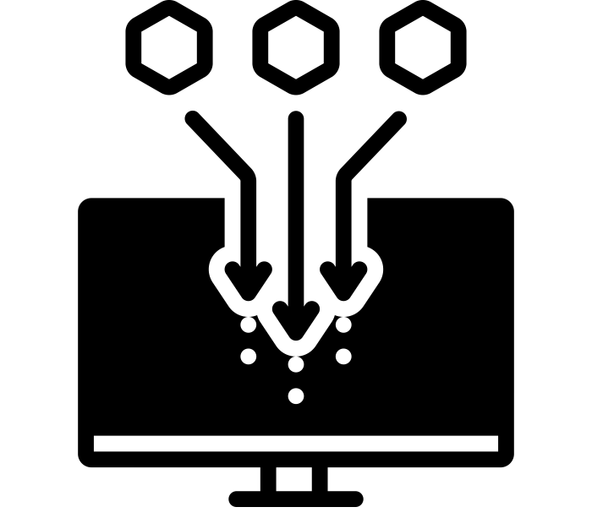
Documentation
Data organisation & naming
Process (data collection)
file size
file format
software
Data provenance
Data description (metadata)
collecting by Priyanka, ownership by Lars Meiertoberens, Both from the Noun Project
Notes:
Documentation can mean many things: (click)
One aspect of documentation is data organisation and naming conventions – these were covered in the previous video.
Documentation can also be: (click)
A description of the process, that is how the data was collected, (click)
A description of the data, also called metadata or data about data. What is relevant metadata will vary a lot by field, but common metadata are (click) file size, (click) format, and (click) the software needed to open a file (click)
Finally, documentation can be about the data provenance – a technical term that refers to data ownership and a historical report of data use and edits (click)

Slide 3
Documentation of projects & datasets
Notes:
We’re going to start with some generic methods of documenting your projects and the data they produce (click).

Slide 4
README file – what is it?
Helps ensure that what you’re documenting is interpreted correctly – both by yourself and others!
Helps document a project, dataset or file
Notes:
One of the most common types of documentation is the README file. (click)
README files are documents containing the necessary information to ensure that what you’re documenting will be interpreted correctly, both by yourself and by others. (click)
README files are extremely versatile and can be used to document whole projects, but also individual datasets or files. (click)

Slide 5
README file – how to make one?
Write it in an open format e.g. .txt or .md (Markdown)
Make it clear what the README file is documenting
Structure it with defined sections
General information
Methodological information
Sharing and access information
Pro tip: take some time to create a template that you can re-use with multiple projects, datasets or files!
Information adapted from the Cornell Research Data Management Service Group guidance
Notes:
To create a README file, there’s some things you should keep in mind (click):
It’s a good idea to use an open format for your README files, so not Word documents! A txt file is a safe option that everyone can create and read, or look into Markdown files to be able to give files more structure. (click)
It should be clear what a README file is documenting. For example, if you’re using it to document a project, place the README file in the root folder, or if it’s documenting a file, add the name of that file to the title of the README file. It’s also a good idea to add this information in the text of the README file. (click)
Try to structure your REAME files with sections to make them easier to understand. Some sections that will likely be useful are general information, methodological information, and sharing and access information. (click).
A pro-tip for making README files is to take some time to create a README template that you can reuse with multiple projects, datasets, or files. (click).

Slide 6
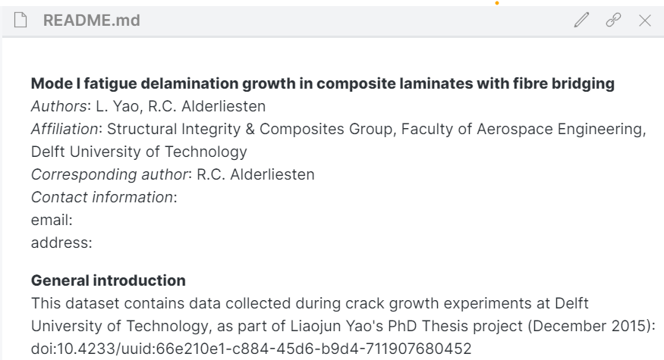
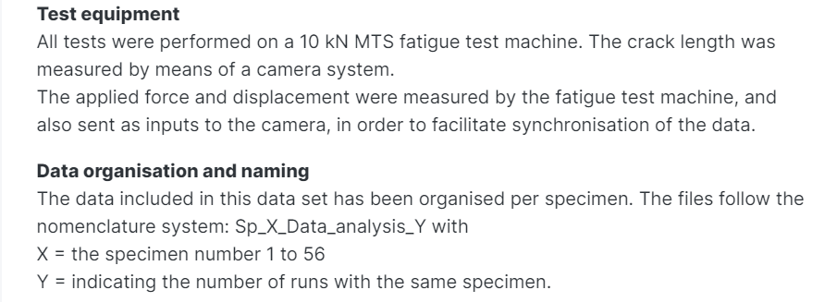
README example
General information, e.g. title, authors, and link to publication
Methodology information, e.g. test equipment
Other information, e.g. organisation and naming convention
0
Yao & Alderliesten (2015). https://doi.org/10.4121/uuid:6da548f6-f801-41b4-8d88-db9ae81f6913
Notes:
Here we have an example of a README file. (click)
At the top, we see some general information about the project, such as the project title, the authors, and a link to the publication. (click)
We then see methodological information, such as the equipment that was used to run the experiments of the project. (click)
Finally, we have other information that help people navigate the project, such as information on how the project is organised and what the fila names mean. (click).

Slide 7
Data dictionaries (Codebooks)
Used to explain variables in tabular data
Should include
Variable name
Variable explanation
Level explanation, esp. for categorical and ordinal
Measurement unit
Allowed values
How missing information is coded
If possible, use standard names for variables!
Notes:
Another commonly used piece of documentation is the data dictionary, also known as a codebook in the social sciences. (click).
Codebooks are used to explain variables in tabular data (usually spreadsheets) (click)
Some of the things that should be explained are (click) what the variable names refer to (click), what the variable itself is (click), what the different levels of the variable mean if the variable is categorical or ordinal (click), what the measurement unit is (click), what the range of allowed values is (click), and finally how missing information is coded (click)
To make this a little simpler, do try to use standard names for your variables! (click)

Slide 8
Data dictionary example
Notes:
So here we have some tabular data that would be quite difficult to interpret without a data dictionary. For example, we can see there are at least two different timepoints but we don’t know what these refer to. Or, there’s a variable called cont but we don’t know what that means. Its values seem to either be 0 or 1 so it’s probably categorical, but we don’t know more than that. (click)
Thankfully the researcher did provide a data dictionary! (click)
So we can see that there are three timepoints: the first one at six weeks, the second one at three months and so on. (click).

Slide 9
Documentation of code
Notes:
Let’s now look at some ways to document code. (click)

Slide 10
Git
It’s software to keep track of different versions of your files.
It’s like a mini file-system taking ‘snapshots’ of your files.
You add comments to keep track of the changes.
If you ever break your file, you can go back to one of the old snapshots of the file – one that worked!
Although git is mostly used to version control scripts (code), it can be used effectively with all plain text files.
Git isn’t great for (big) binary files, e.g. images and videos.
Git logo by Jason Long from Wikimedia Commons
Notes:
Starting off with git! Git can be intimidating and has a steep learning curve, but is really useful once you get used to it! But what is git? (click)
Git is software that keeps track of different versions of your files (click)
It’s like a mini file-system that takes snapshots of your files (click)
So when you make changes and you want to save a version of that file, you take a snapshot and write a comment to describe the changes (click)
If you ever break your file, you can just go back to one of the old versions of the file – one that worked! (click)
Although git is mostly used to version control scripts (so, code), it can be used effectively with all plain text files. (click)
Though note that it isn’t great for big binary files, for example images and videos. (click).

Slide 11
GitHub/GitLab
Git is great for keeping track of locally stored files, but these can be hard for others to access!
GitHub and GitLab are web-based tools for working collaboratively on your version-controlled files.
Both GitHub and GitLab provide free options:
GitHub offers free private repositories to academics.
GitLab offers private repositories where you can control who has access by default.
GitLab instance from TU Delft: https://gitlab.tudelft.nl/users/sign_in
Notes:
Git is really useful for keeping track of your locally stored files, that is the files stored on your computer, but these files can be hard for other to access, which isn’t great for collaboration. (click)
That’s where GitHub and GitLab come in! They are web-based tools that allow you to work collaboratively on version-controlled files. (click)
Both GitHub and GitLab provide free options: (click)
GitHub offers free private repositories when you use it with an email from an academic institution (click)
GitLab offers private repositories by default (click)
There is also a GitLab instance from TU Delft. (click)

Slide 12
Jupyter notebooks
Files containing executable code, code outputs, (formatted) narrative text, formulas etc. – great as documentation for papers!
Most popular with Python users, but developed for three main languages: Julia, Python and R (hence the name!)
You can use them like you do scripts: for data cleaning, numerical simulation, statistical modeling, machine learning, etc.
You’ll need to install jupyter to create and edit notebooks locally.
You can then share links to static versions (nbviewer) or to executable versions (Binder) of the notebooks.
Notes:
A type of file that can be really helpful for documenting code is Jupyter notebooks. (click)
Jupyter notebooks are files that contain executable code, the output of that code, narrative text that you can format nicely, and even mathematical formulas. So if you want to share your scripts along with your papers, it’s a good idea to share your scripts as Jupyter notebooks! (click)
Jupyter notebooks are most popular with Python users, but they were originally developed for use with three main languages: Julia, Python, and R (hence the name!). It is also possible to use Jupyter notebooks with dozens of other languages though! (click)
You can use Jupyter notebooks like you would any script: you can use them for data cleaning, numerical simulations, statistical modelling, machine learning etc. (click)
To create and edit Jupyter notebooks on your computer, you’ll have to install jupyter (click)
And then you can share links either static versions of your notebooks with nbviewer or executable versions with Binder. Of course sharing the actual Jupyter notebook files is also possible. (click)

Slide 13
Interactive version: https://mybinder.org/v2/gh/jupyterlab/jupyterlab-demo/master?urlpath=lab/tree/demo
Notes:
Here is an example of a Jupyter notebook that has been shared as a Binder, meaning the code is executable. (click) You can see the executable code in the grey boxes (click) and there’s also formatted text and formulas, and even code output – that’s the plot at the bottom!
In case you’re wondering about how the formulas are typeset, the raw file looks like this (click) – if you’re familiar with LaTeX math mode this should be familiar (click)
But the most fun thing about Jupyter notebooks, in my opinion, is that the code is executable! So you could change this code to get a different plot! In this case, the plot itself is interactive, so you can just change the values for sigma, beta and rho to change the plot, like so (click). So you can see that I’ve changed all the values and the plot looks very different.

Slide 14
Interactive version: https://mybinder.org/v2/gh/jupyterlab/jupyterlab-demo/master?urlpath=lab/tree/demo
Notes:
there’s also formatted text and formulas (click)

Slide 15
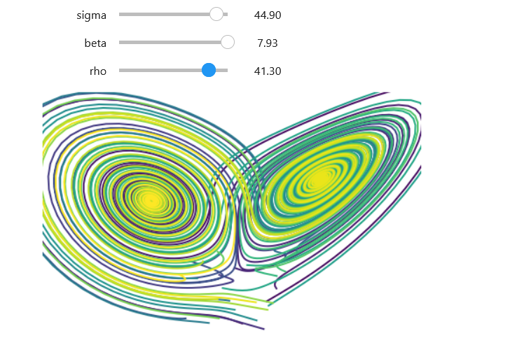
Interactive version: https://mybinder.org/v2/gh/jupyterlab/jupyterlab-demo/master?urlpath=lab/tree/demo
Notes:
and even code output – that’s the plot at the bottom! (click)
In case you’re wondering about how the formulas are typeset, the raw file looks like this (click) – if you’re familiar with LaTeX math mode this should be familiar (click)
But the most fun thing about Jupyter notebooks, in my opinion, is that the code is executable! So you could change this code to get a different plot! In this case, the plot itself is interactive, so you can just change the values for sigma, beta and rho to change the plot, like so (click). So you can see that I’ve changed all the values and the plot looks very different. (click)

Slide 16
Documentation in the lab
Notes:
Let’s now move on how to document your experiments in the lab. (click).

Slide 17
Lab notebooks – the basics
State the researcher’s name and the period of use on the notebook cover
Number all pages consecutively
Write all entries with permanent ink – no pencils!
Write in a commonly agreed language, e.g. English
Write down the date for each record
Notes:
If you run experiments in a lab, you should be using a lab notebook. (click)
State your name and the period during which you used the notebook on the cover (click)
Number all pages on the notebook consecutively (click)
Write all entries with permanent ink – don’t use a pencil! (click)
Write in a commonly agreed language, in international settings that’s likely to be English (click)
Write down the date for each record (click)

Slide 18
Lab notebooks – more basics!
Make sure that it is possible to separate the different experiments – e.g., by using meaningful names
Note where the raw experimental data will be stored and the name of the corresponding data file
Do not keep loose pages in your notebook – fix any relevant papers and/or pictures properly
Notes:
Make sure that it is possible to separate the different experiments, for example by giving them meaningful names (click)
Make a note of where the raw experimental data will be stored and write down the name of the corresponding data file (click)
Do not keep loose pages in your notebook – fix any relevant papers and/or pictures properly to make sure they don’t get lost or out of order (click)

Slide 19
Electronic Lab Notebooks (ELNs)
Digital documentation, categorization and linking of
Raw, intermediate and final data
Experimental and measurement parameters
Samples
Searchable
Easier to read
Traceable (version control)
Illustration by Connie Clare
Notes:
Instead of using a physical notebook, you can also use an electronic lab notebook! (click)
Electronic lab notebooks allow for digital documentation, categorisation and linking of data. More specifically, they allow you to link (click)
Raw, intermediate, and final data (click)
Experimental and measurement parameters and (click)
Samples (click)
Electronic lab notebooks are searchable, so it’s easier to find what you’re looking for (click)
They’re also easier for both you and other to read, since they’re not handwritten (click)
And finally they are traceable and it’s possible to use version control with them (click)

Slide 20
ELNs @ TU Delft
Rspace is maintained on a university server
daily back ups are retained for two weeks, weekly snapshots are kept for one year
eLABJournal is offered as a cloud service
Access is authenticated via your TU Delft NetID
Not suitable for sensitive personal (e.g. patient) data or highly confidential (e.g. nuclear reactor) information
More information: https://www.tudelft.nl/en/library/research-data-management/r/manage/electronic-lab-notebook
Notes:
At TU Delft, you have access to two ELN platforms: Rspace and eLABJournal. (click)
RSpace is maintained on a university server which is backed up daily with a two week retention period. Weekly snapshots are kept for a period of 1 year. (click)
eLABJournal is offered as a cloud service, so I would encourage you to read about their security measures. You can find more information by following the link at the bottom of the slide. (click)
Access to both eLABJournal and RSpace is authenticated via your TU Delft netID. (click)
Neither eLABJournal nor RSpace is suitable for sensitive personal data relating to human individuals such as patient data or other special categories of data or highly confidential information such as nuclear reactor information, state secrets, etc. (click)

Slide 21
Metadata
Notes:
The last type of documentation we will talk about is metadata, or data about data.

Slide 22
Metadata for local data
In the file name:
e.g., 20201015_Type_ID_DataType.xxx
In the README file
Using tags
Notes:
You can add metadata to local data, that is data that are saved on your own computer or server drive. (click)
You can do that by adding the metadata in the file name, as shown in the example. (click)
Or you can add metadata in the README file for the project or dataset. (click)
Finally you can use tags to add metadata – you learned about using tags in the Data Organisation video. (click).

Slide 23
Metadata for published data
You can fill in a metadata form when publishing data to a repository
You can use a metadata editor
Notes:
Most researchers encounter metadata when publishing data on a data repository. (click)
When uploading the data to a repository, you will be asked to fill in a metadata form – how detailed this metadata form will vary from repository to repository. Disciplinary repositories are more likely to ask for detailed, discipline-specific metadata than general repositories. (click)
You can also use a metadata editor to create metadata. We will now look at two tools that create JSON files with metadata that you can use with datasets or with code. (click)

Slide 24
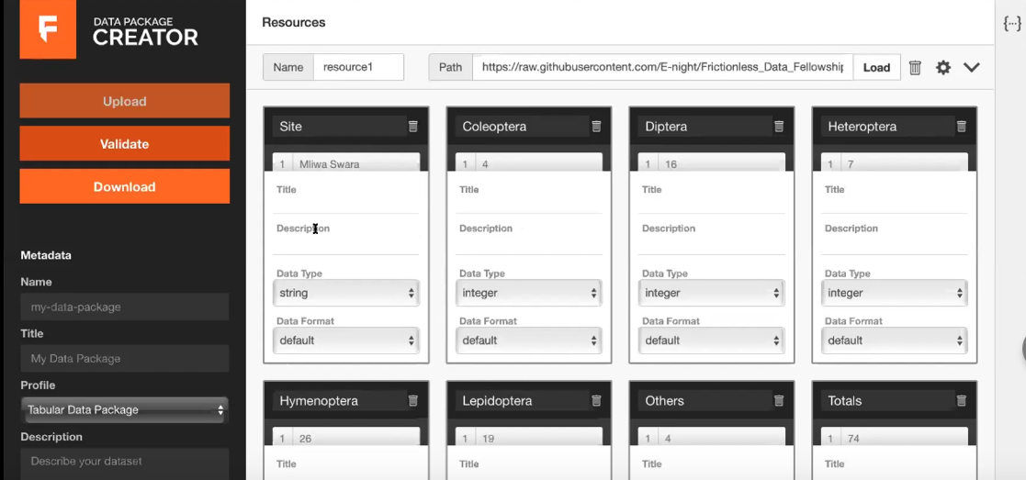
Tools to add metadata – datasets
https://create.frictionlessdata.io/
Notes:
The first tool we’ll mention is the Data Package Creator from frictionless data.
A data package is a container with all relevant data, metadata, and data attributes. Data packages are useful for sharing data because they contain all the information needed to reuse the data. They also protect data from being lost or misread – e.g. a number in a data package will not be read as a date. (click)
On the left-hand side you can see the metadata editor where you can add metadata such a title and further down keywords and a licence (click)
The black boxes you see in the middle represent the columns in a dataset. You can use these boxes to specify the data of the variable, for example if it is a string or integer. (click)

Slide 25
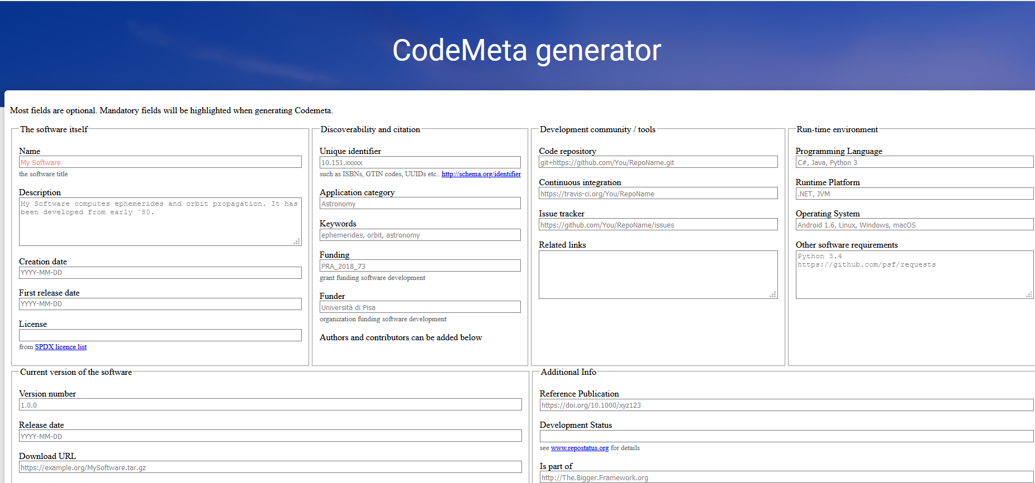
Tools to add metadata – code
https://codemeta.github.io/codemeta-generator/
Notes:
The second tool we’ll see is the CodeMeta generator from Software Heritage.
You can use this to create metadata for your code. There’s a lot of information here but most fields are optional.
Some important information to add though are (click) the name, description and license for the code, as well as versioning information. (click)

Slide 26
Metadata standards
You can get started with this overview of metadata standards on the Digital Curation Centre website: https://www.dcc.ac.uk/guidance/standards/metadata
You can find a more detailed and up-to-date list of metadata standards on FAIRsharing: https://fairsharing.org/standards/
Notes:
If you’re interested in metadata standards, there are more resources you can look at. There’s a nice introduction on the Digital Curation Centre website, and if you want to dig deeper, you can find a more detailed and up-to-date list on FAIRsharing.org

