Slide 1


The Quantum-Random-Oracle Model
Christian Schaffner
Research Center for Quantum Software
Institute for Logic, Language and Computation (ILLC)
University of Amsterdam
Centrum Wiskunde & Informatica
Distinguished Lectures on Quantum Software,
Thursday, 14 March 2019
Goto http://qusoft.pwall.nl for the quiz now!

Slide 2
What will you Learn from this Talk?
Classical Random-Oracle Model
Quantum Access
Recent Tools
Recent Results

Slide 3


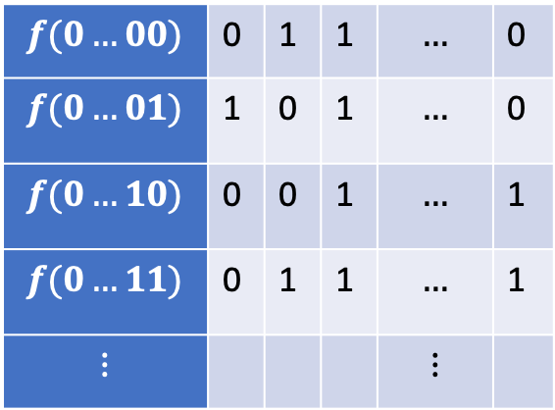
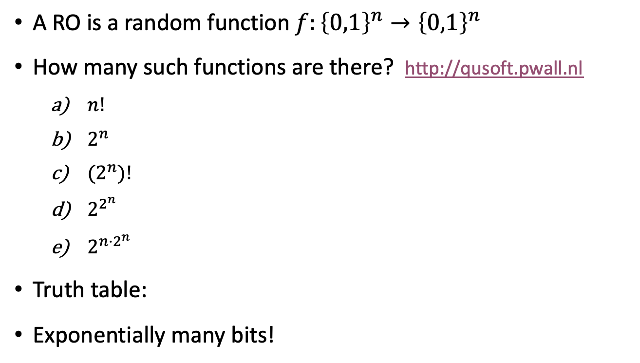
Random Oracle (RO)
A RO is a random function $f:{\left\{0,1\right\}}^{n}→{\left\{0,1\right\}}^{n}$
How many such functions are there? http://qusoft.pwall.nl
  $n!$
  $2^{n}$
  ${(2}^{n})!$
  $2^{2^{n}}$
  $2^{n⋅2^{n}}$
Truth table:
Exponentially many bits!
$n$ columns
$$f(0…00)$$ | 0 | 1 | 1 | $$…$$ | 0
$$f(0…01)$$ | 1 | 0 | 1 | $$…$$ | 0
$$f(0…10)$$ | 0 | 0 | 1 | $$…$$ | 1
$$f(0…11)$$ | 0 | 1 | 1 | $$…$$ | 1
$$⋮$$ |  |  |  | $$⋮$$
$2^{n}$ rows
Notes:
For n=6, 6*2^6 = 384, already more functions than atoms in the universe

Slide 4

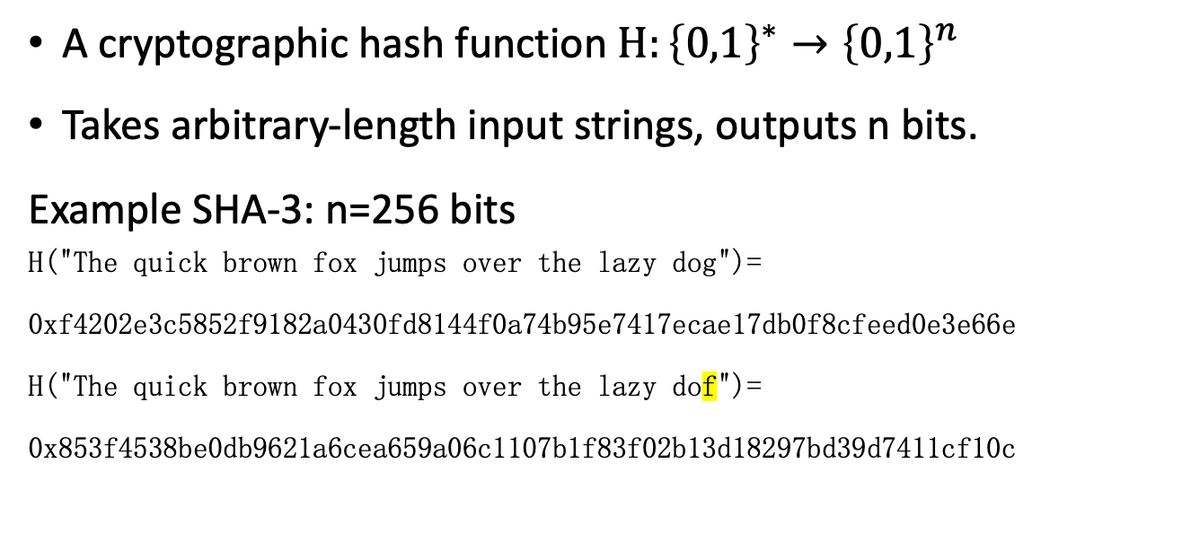

Hash Functions
A cryptographic hash function $H:{\left\{0,1\right\}}^{∗}→{\left\{0,1\right\}}^{n}$
Takes arbitrary-length input strings, outputs n bits.
Example SHA-3: n=256 bits
H("The quick brown fox jumps over the lazy dog")=
0xf4202e3c5852f9182a0430fd8144f0a74b95e7417ecae17db0f8cfeed0e3e66e
H("The quick brown fox jumps over the lazy dof")=
0x853f4538be0db9621a6cea659a06c1107b1f83f02b13d18297bd39d7411cf10c
$$H$$
An ideal hash function should behave as random oracle

Slide 5
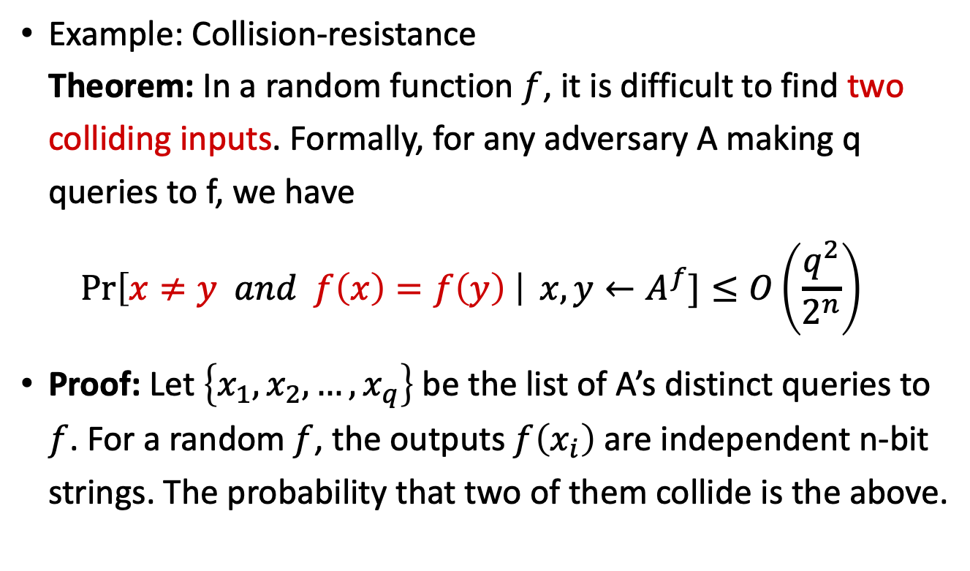
Hash Functions As Random Oracles
An ideal hash function should behave as random oracle
Example: Collision-resistance
Theorem: In a random function $f$, it is difficult to find two colliding inputs. Formally, for any adversary A making q queries to f, we have
$\operatorname{Pr}\left[x≠y and f\left(x\right)=f\left(y\right) \right| x,y←A^{f}]≤O\left(\frac{q^{2}}{2^{n}}\right)$
Proof: Let $\left\{x_{1},x_{2}, …, x_{q}\right\}$ be the list of A’s distinct queries to $f$. For a random $f$, the outputs $f\left(x_{i}\right)$ are independent n-bit strings. The probability that two of them collide is the above.
$$H$$

Slide 6


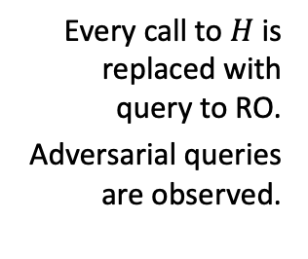


Random-Oracle Model (ROM)
Heuristic to model hash functions in cryptographic proofs
“knows $H$”
protocol
$$H$$
informal
description:
Every call to $H$ is replaced with query to RO.
Adversarial queries are observed.
$$H:{\left\{0,1\right\}}^{∗}→{\left\{0,1\right\}}^{n}$$
protocol
Formal random-oracle model:
[Bellare Rogaway 93, slide by Dziembowski]
Notes:
Having an oracle is convenient, so that players do not need to be given access to an exponentially large random object
As long as adversary has not queried a particular input x, H(x) is independent and uniform

Slide 7



Criticism of the ROM
There exists a signature scheme that is
secure in the ROM, but
not secure if RO is instantiated with any real hash function.
Very “artificial” example, no ”realistic” examples known
Common view: ROM proof is better than no proof
[Canetti Goldreich Halevi 98, slide by Dziembowski]

Slide 8



Digital Signatures
Alice
Bob
public key
Eve
secret key
Only secret-key holder can sign, but everyone can verify signatures using the public-key.

Slide 9
Digital Signatures
Alice
Bob
public key
Eve
secret key
Only secret-key holder can sign, but everyone can verify signatures using the public-key.
Very widely used:
Problems: expensive,
insecure against quantum attacks
[Bart Preneel @QCrypt 2014]
Notes:
Post-quantum crypto tries to solve the second problem by making it even more expensive!

Slide 10
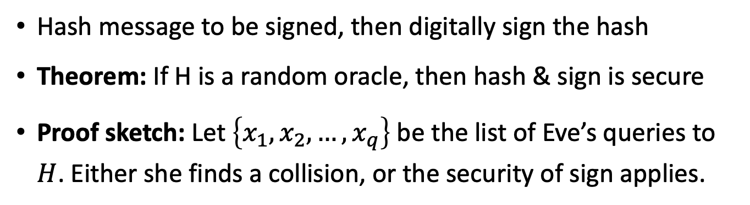

Hash & Sign
$$H$$
Alice
Bob
public key
Eve
secret key
Hash message to be signed, then digitally sign the hash
Theorem: If H is a random oracle, then hash & sign is secure
Proof sketch: Let $\left\{x_{1},x_{2}, …, x_{q}\right\}$ be the list of Eve’s queries to $H$. Either she finds a collision, or the security of sign applies.
Notes:
Post-quantum crypto tries to solve the second problem by making it even more expensive!

Slide 11

Building Hash Functions
Secure building block $f:{\left\{0,1\right\}}^{2n}→{\left\{0,1\right\}}^{n}$
Construct a hash function $H:{\left\{0,1\right\}}^{∗}→{\left\{0,1\right\}}^{n}$ from it
[Merkle Damgård 79, image: wikipedia]

Slide 12

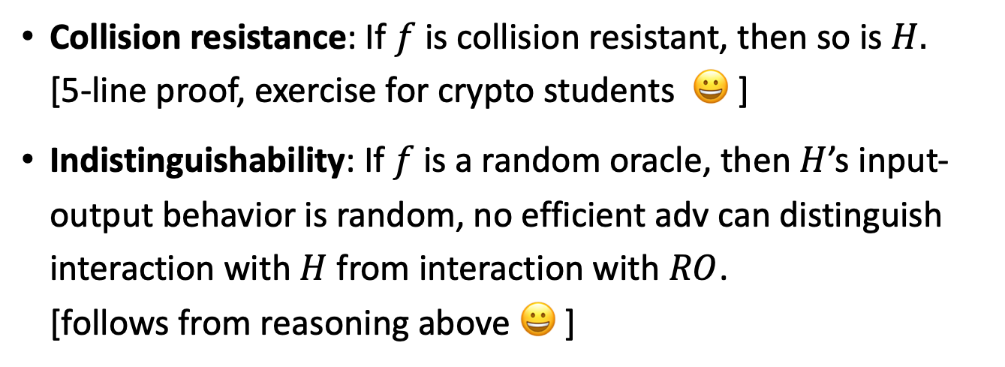
Security Notions
Collision resistance: If $f$ is collision resistant, then so is $H.$
[5-line proof, exercise for crypto students 😀 ]
Indistinguishability: If $f$ is a random oracle, then $H$’s input-output behavior is random, no efficient adv can distinguish interaction with $H$ from interaction with $RO$.
[follows from reasoning above 😀 ]
Real:
Ideal:
Dist
Dist
[Merkle Damgaard 79, Bellare Canetti Krawczyk 05]

Slide 13
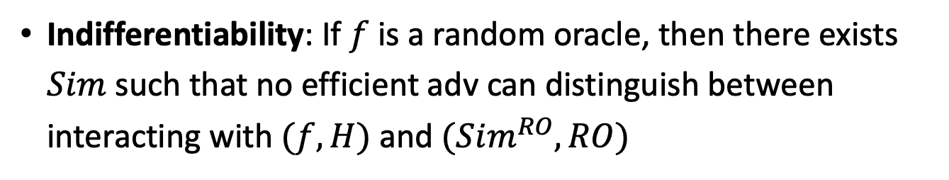
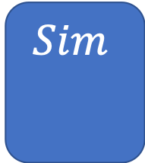
Indifferentiability
Indifferentiability: If $f$ is a random oracle, then there exists $Sim$ such that no efficient adv can distinguish between interacting with $(f,H)$ and $(Sim^{RO}, RO)$
$$Sim$$
Real:
Ideal:
Dist
Dist
[Maurer Renner Holenstein 04, Coron Dodis Malinaud Puniya 05]

Slide 14
What will you Learn from this Talk?
Classical Random-Oracle Model
Quantum Access
Recent Tools
Recent Results

Slide 15



Quantum-Random-Oracle Model (QROM)
Post-quantum cryptography or quantum-safe cryptography studies quantum attackers on classical crypto.
Attacker can look up description of hash function on Wikipedia, then run it in superposition on her quantum computer
We need to allow attacker quantum (superposition) access to the random oracle
“knows $H$”
$$H:{\left\{0,1\right\}}^{∗}→{\left\{0,1\right\}}^{n}$$
[Boneh Dagdelen Fischlin Lehmann Schaffner Zhandry 11]

Slide 16
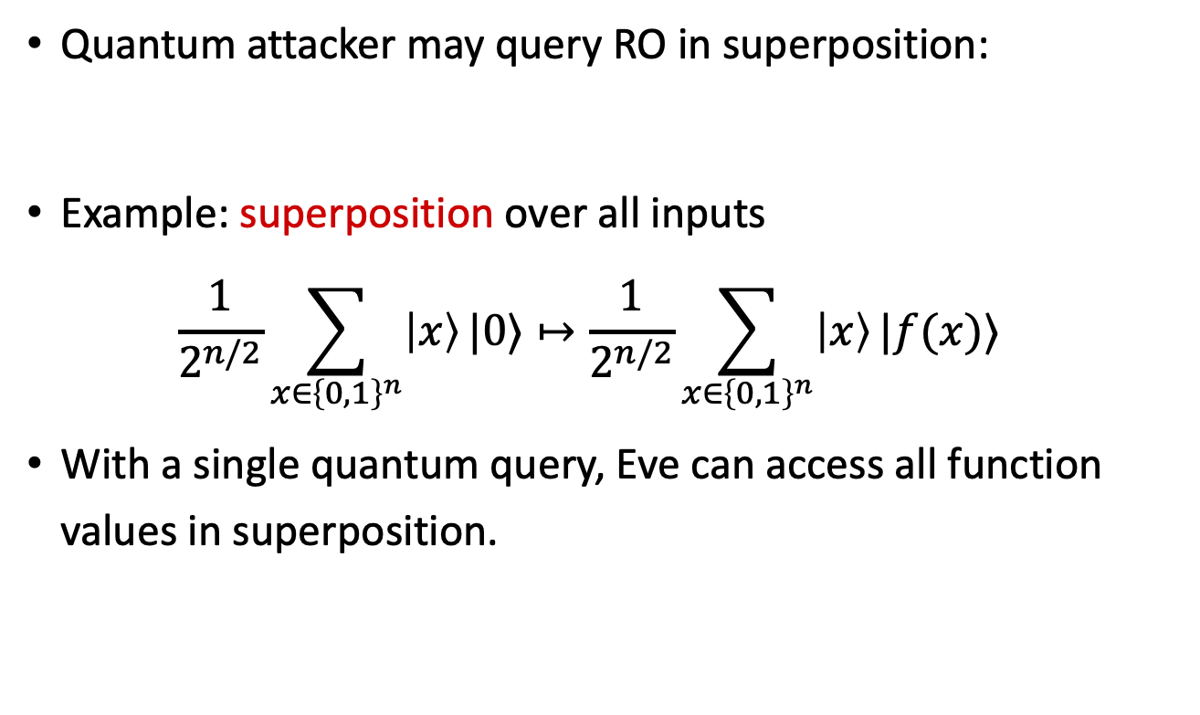

Quantum Superposition Access
Quantum attacker may query RO in superposition:
Example: superposition over all inputs
$\frac{1}{2^{n/2}}\sum_{x∈{\left\{0,1\right\}}^{n}}{\left|x\right\rangle }|0⟩↦\frac{1}{2^{n/2}}\sum_{x∈{\left\{0,1\right\}}^{n}}{\left|x\right\rangle }|f(x)⟩$
With a single quantum query, Eve can access all function values in superposition.
$$H:{\left\{0,1\right\}}^{∗}→{\left\{0,1\right\}}^{n}$$
Standard oracle (StO): ${\left|x\right\rangle }_{X}{\left|y\right\rangle }_{Y}↦{\left|x\right\rangle }_{X}{\left|y⊕f\left(x\right)\right\rangle }_{Y}$

Slide 17
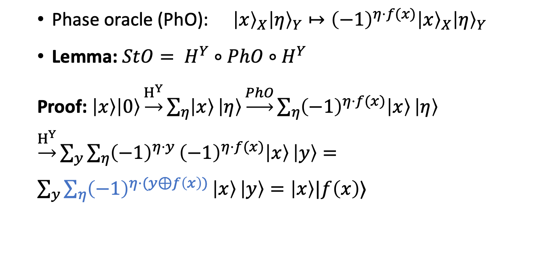
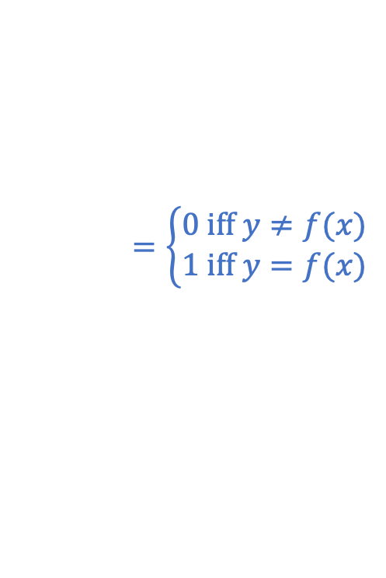
Change of Viewpoint: Phase Oracle
Standard oracle (StO): ${\left|x\right\rangle }_{X}{\left|y\right\rangle }_{Y}↦{\left|x\right\rangle }_{X}{\left|y⊕f\left(x\right)\right\rangle }_{Y}$
Phase oracle (PhO): ${\left|x\right\rangle }_{X}{\left|η\right\rangle }_{Y}↦{\left(−1\right)}^{η⋅f(x)}{\left|x\right\rangle }_{X}{\left|η\right\rangle }_{Y}$
Lemma: $StO= H^{Y}∘PhO∘H^{Y}$
Proof: $\left|x\right\rangle \left|0\right\rangle \underset{→}{H^{Y}}\sum_{η}{\left|x\right\rangle }\left|η\right\rangle \underset{→}{PhO}\sum_{η}{{\left(−1\right)}^{η⋅f(x)}\left|x\right\rangle }\left|η\right\rangle$ $\underset{→}{H^{Y}}\sum_{y}{{\sum_{η}{{\left(−1\right)}^{η⋅y}}\left(−1\right)}^{η⋅f(x)}\left|x\right\rangle }\left|y\right\rangle =\sum_{y}{\sum_{η}{{\left(−1\right)}^{η⋅(y⊕f\left(x\right))}}\left|x\right\rangle }\left|y\right\rangle =\left|x\right\rangle |f\left(x\right)⟩$
$$=\left\{\begin{aligned}0 \text{iff} y≠f(x) \\ 1 \text{iff} y=f(x)\end{aligned}\right.$$

Slide 18
Trouble in the QROM
Many classical ROM proves break down in the QROM
Efficient simulation: how to emulate a ROM towards an adversary
Adaptive programmability: depending on the adversary’s queries, plant a challenge in the answer
Extractability: Simulator learns pre-images of adversary’s queries
Rewinding: replaying some hash values but changing some outputs
[Boneh Dagdelen Fischlin Lehmann Schaffner Zhandry 11]

Slide 19
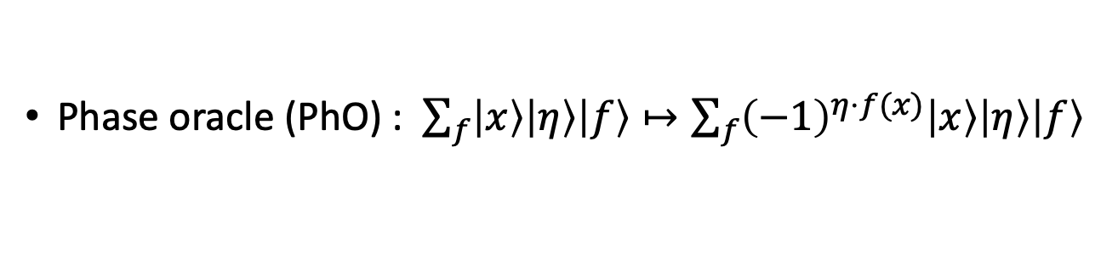

A Brilliant Idea: Purification
[Mark Zhandry 2018: How to Record Quantum Queries]
Introduce purifying register for function truth table
StO: $\sum_{f}{\left|x\right\rangle \left|y\right\rangle \left|f\right\rangle }↦\sum_{f}{\left|x\right\rangle \left|y⊕f(x)\right\rangle \left|f\right\rangle }$
For random oracle, database is superposition over all truth tables
From Eve’s point of view, there is no difference!
Phase oracle (PhO) : $\sum_{f}{\left|x\right\rangle \left|η\right\rangle \left|f\right\rangle }↦\sum_{f}{{\left(−1\right)}^{η⋅f(x)}\left|x\right\rangle \left|η\right\rangle \left|f\right\rangle }$

Slide 20
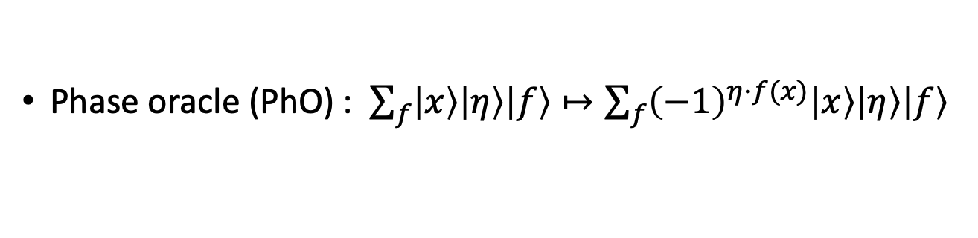

Change of Viewpoint: Fourier Oracle
Fourier Oracle (FO): ${FO :=H}^{F}∘PhO∘H^{F}$:
$\left|x\right\rangle \left|η\right\rangle \left|0^{n}⋯0^{n}\right\rangle \underset{→}{H^{F}}\sum_{f}{\left|x\right\rangle \left|η\right\rangle \left|f\right\rangle }\underset{→}{PhO}\sum_{f}{{\left(−1\right)}^{η⋅f(x)}\left|x\right\rangle \left|η\right\rangle \left|f\right\rangle }$
$\underset{→}{H^{F}}$ $\sum_{f,φ}{{{\left(−1\right)}^{φ⋅f}\left(−1\right)}^{η⋅f(x)}\left|x\right\rangle \left|η\right\rangle \left|φ\right\rangle }= …$
$=|x⟩|η⟩|0^{n}⋯0^{n} η 0^{n}⋯0^{n}⟩$
By making a query, Eve entangles herself with the truth table in a very clean way!
Phase oracle (PhO) : $\sum_{f}{\left|x\right\rangle \left|η\right\rangle \left|f\right\rangle }↦\sum_{f}{{\left(−1\right)}^{η⋅f(x)}\left|x\right\rangle \left|η\right\rangle \left|f\right\rangle }$
[Mark Zhandry 2018: How to Record Quantum Queries]

Slide 21

Compressing the Database
Fourier Oracle (FO): ${FO :=H}^{F}∘PhO∘H^{F}$:
$\left|x\right\rangle \left|η\right\rangle \left|0^{n}⋯0^{n}\right\rangle \underset{→}{FO}|x⟩|η⟩|0^{n}⋯0^{n} η 0^{n}⋯0^{n}⟩$
Multiple FO queries “populate” the database
Compression: only keep track of the non-zero entries
$\left|x\right\rangle \left|η\right\rangle \left|D\right\rangle$ $\underset{→}{FO}\left|x\right\rangle \left|η\right\rangle \left|D∪(x,η)\right\rangle$
Allows efficient simulation of the random oracle to the adversary
[Mark Zhandry 2018: How to Record Quantum Queries]

Slide 22
What will you Learn from this Talk?
Classical Random-Oracle Model
Quantum Access
Recent Tool
Recent Results

Slide 23
Many Recent Applications
Indifferentiability [Zhandry 18; Czajkowski Majenz Schaffner Zur, Feb 19]
Fujisaki-Okamoto transformation [Zhandry 18]
Query lower bounds for searching and (multi-)collisions in random functions [Liu Zhandry, Nov 18]
Quantum Lazy Sampling [Czajkowski Majenz Schaffner Zur, Feb 19]
Fiat-Shamir transform [Don Fehr Majenz Schaffner, Feb 18; Liu Zhandry, March 19]
4-round Luby-Rackoff/Feistel construction [Hosoyamada Iwata, March 19]

Slide 24
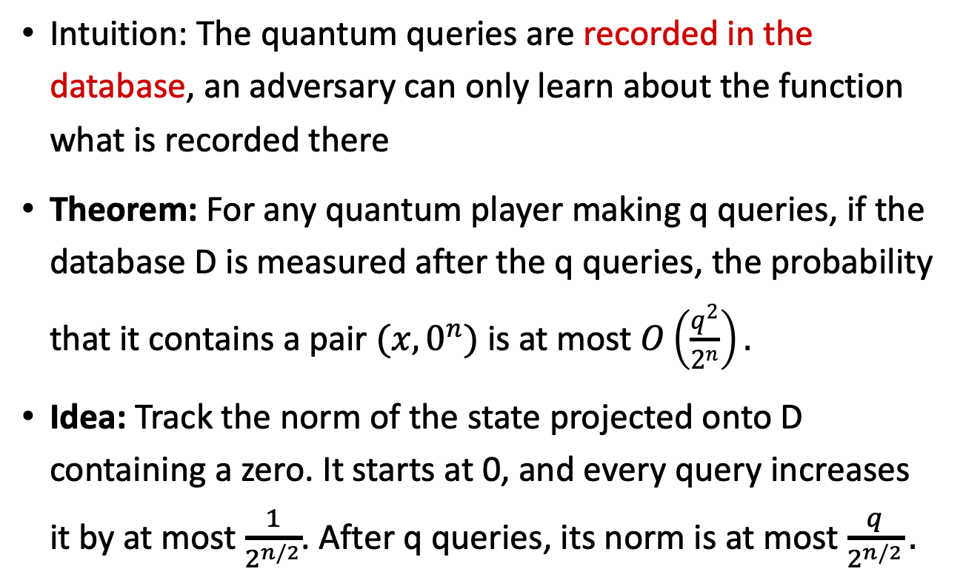
Query Lower Bounds
Intuition: The quantum queries are recorded in the database, an adversary can only learn about the function what is recorded there
Theorem: For any quantum player making q queries, if the database D is measured after the q queries, the probability that it contains a pair $(x,0^{n})$ is at most $O\left(\frac{q^{2}}{2^{n}}\right).$
Idea: Track the norm of the state projected onto D containing a zero. It starts at 0, and every query increases it by at most $\frac{1}{2^{n/2}}$. After q queries, its norm is at most $\frac{q}{2^{n/2}}.$
[Mark Zhandry 2018: How to Record Quantum Queries]

Slide 25
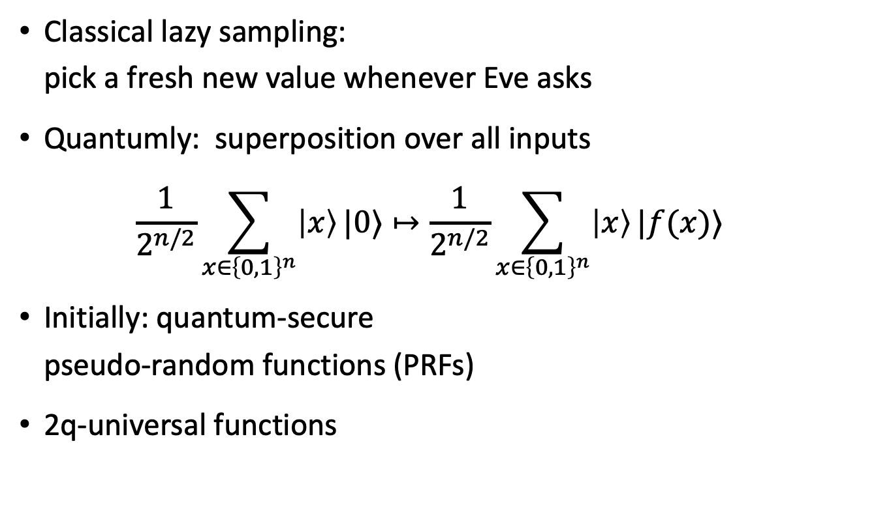

Quantum Lazy Sampling
Classical lazy sampling:
pick a fresh new value whenever Eve asks
Quantumly: superposition over all inputs
$\frac{1}{2^{n/2}}\sum_{x∈{\left\{0,1\right\}}^{n}}{\left|x\right\rangle }|0⟩↦\frac{1}{2^{n/2}}\sum_{x∈{\left\{0,1\right\}}^{n}}{\left|x\right\rangle }|f(x)⟩$
Initially: quantum-secure
pseudo-random functions (PRFs)
2q-universal functions
$$H:{\left\{0,1\right\}}^{∗}→{\left\{0,1\right\}}^{n}$$
[Boneh Dagdelen Fischlin Lehmann Schaffner Zhandry 11, Zhandry 12]

Slide 26

Quantum Lazy Sampling
[Czajkowski Majenz Schaffner Zur 19]
Generalized recording of quantum queries to non-uniform function distributions (e.g. permutations)
Combined with Unruh’s one-way-to-hiding lemma
Indifferentiability of sponge construction used in SHA-3
$$Sim$$
Real:
Ideal:
Dist
Dist
[Ambainis Hamburg Unruh 18]

Slide 27
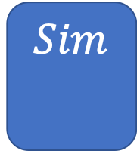
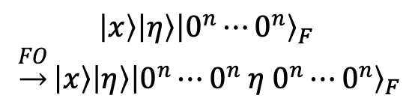
Summary
Classical Random-Oracle Model
Quantum Access
Recent Tool
Recent Results
$$H:{\left\{0,1\right\}}^{∗}→{\left\{0,1\right\}}^{n}$$
$$\left|x\right\rangle \left|η\right\rangle {\left|0^{n}⋯0^{n}\right\rangle }_{F}$$
$\underset{→}{FO}\left|x\right\rangle \left|η\right\rangle {\left|0^{n}⋯0^{n} η 0^{n}⋯0^{n}\right\rangle }_{F}$
$$Sim$$

Slide 28
Thank you for your attention!
Questions
Matt Green on classical ROM: https://blog.cryptographyengineering.com/2011/11/02/what-is-random-oracle-model-and-why/
Check https://qusoft.pwall.nl for more questions and an evaluation

