Slide 1
Is democracy the right system? Building an engaged RDM community
Dr Marta Teperek
Office of Scholarly Communication, University of Cambridge
mt446@cam.ac.uk
@martateperek
23 September, Masterclass Research Support 2016, Rotterdam

Slide 2
Slides are available
https://doi.org/10.5281/zenodo.154352
All images are under CC0, unless indicated otherwise

Slide 3
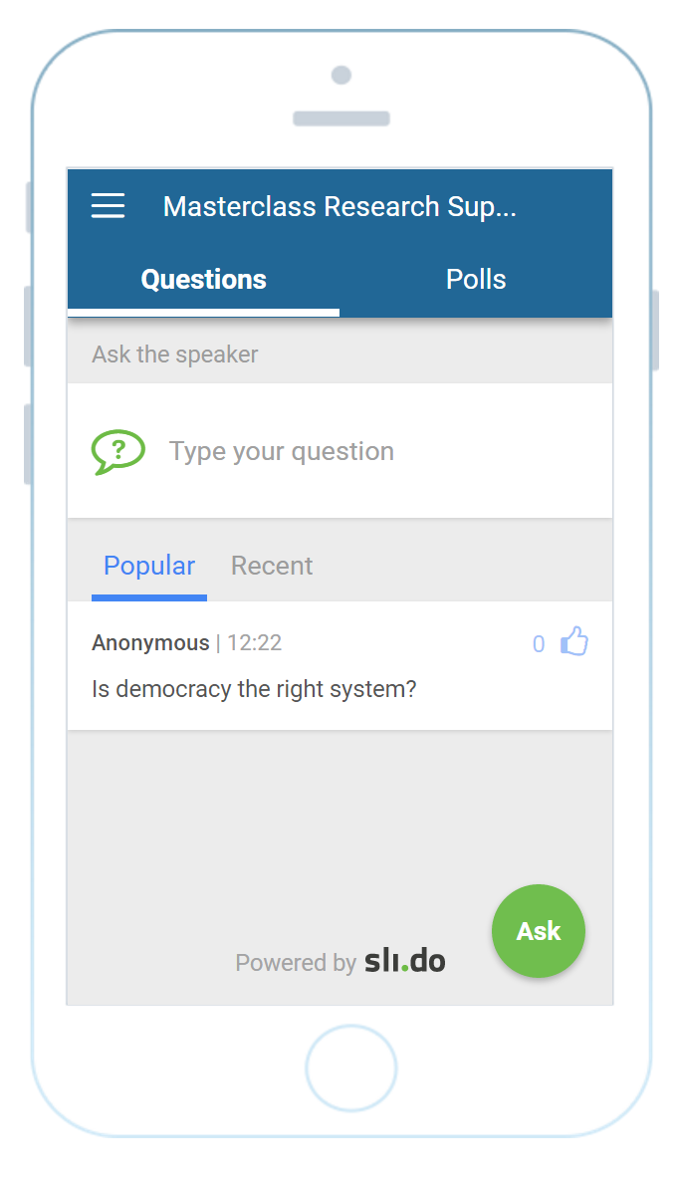
If you have questions…
www.slido.com
Code: #5393

Slide 4
My question to you…
Who speaks with researchers?

Slide 5
Content
This session will cover:
Background to Cambridge
How not to start with RDM
Alternative approach
Reflections – is democracy the right system?
https://doi.org/10.5281/zenodo.154352

Slide 6
Background to Cambridge
18,000 students; 9,000 staff
6 Schools:
Arts and Humanities
Biological Sciences
Clinical Medicine
Humanities and Social Sciences
Physical Sciences
Technology
150 Departments and Institutes, 31 colleges
Fragmented support services
2 people doing RDM

Slide 7
How not so start with RDM

Slide 8
Fast and simple

Slide 9
You must share to comply with funders’ policies
You must do it
EPSRC do random checks to make sure data are shared in publications that acknowledge their funding
https://www.epsrc.ac.uk/files/aboutus/standards/clarificationsofexpectationsresearchdatamanagement/

Slide 10
Bad start
Immediate reaction:
This is not my priority
Why would I do that?
People will steal my results!
Data management is a waste of time
Nobody will understand my data
It would take me 5 years to find all my data!

Slide 11
Let’s re-think the approach

Slide 12
Alternative approach
Let’s try to be more collaborative
Alternative approach

Slide 13
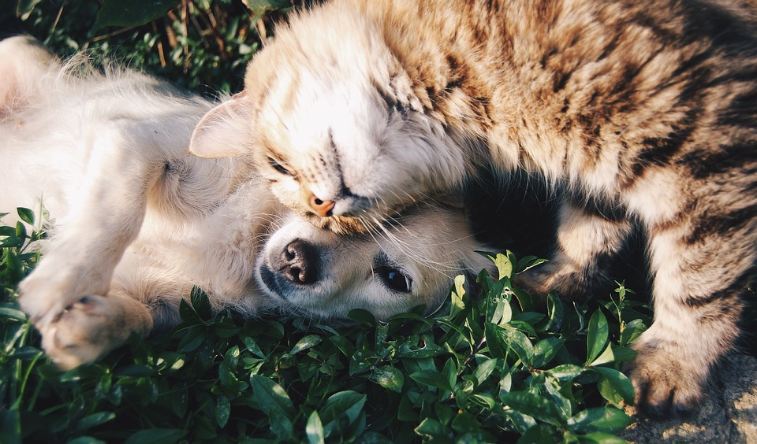
Trying to understand your researchers’ pain
Building trust

Slide 14
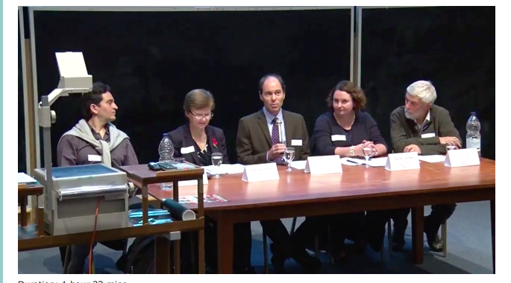
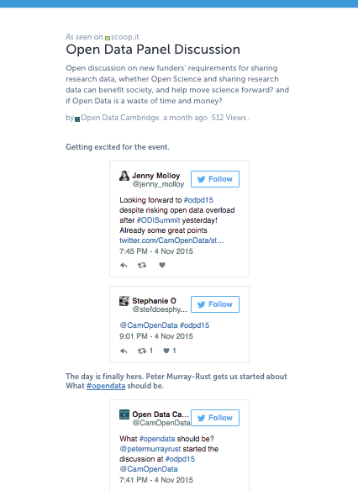
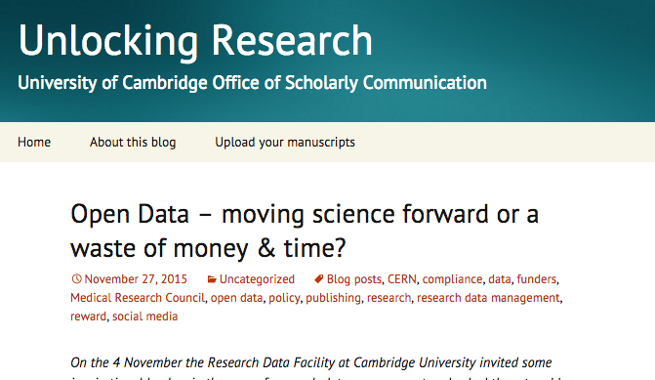
Never dismiss questions – be open for discussion
“Open Data – moving science forward or a waste of money & time?”
https://storify.com/CamOpenData/odpd15
Video: https://upload.sms.cam.ac.uk/media/2113537
https://unlockingresearch.blog.lib.cam.ac.uk/?p=392
Notes:
DON’T DISMISS people’s concerns and questions. Treat them seriously and discuss.
Big event in Cambridge on 4 Nov 2015:
With Tim Smith from Zenodo/CERN
Sarah Jones from DCC
Frances Rawle from the MRC
Two Pis from Cambridge:
Rafael Carazo-Salas
Peter Murray-Rust

Slide 15
Ask questions, but explain why you’re asking
Researchers are busy – they need to know you’re not wasting their time

Slide 16
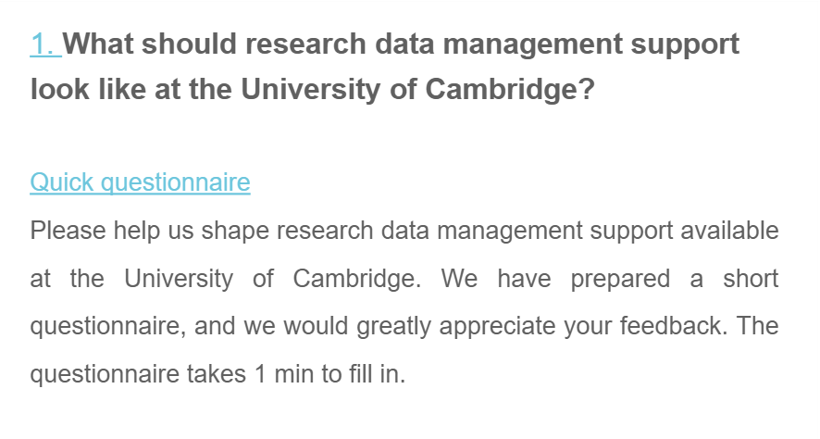
Let researchers shape RDM services
129 responses

Slide 17
Researchers wanted:
Online information
Support with data management
Support with data management plans
Training
Repository
Easy way to find these resources

Slide 18
Online information
www.data.cam.ac.uk

Slide 19
On-demand consultancy
www.data.cam.ac.uk/consultancy

Slide 20
Data management plan support service
+ guidance
+ example plans
On top of DMPonline
www.data.cam.ac.uk/DMPsupport

Slide 21
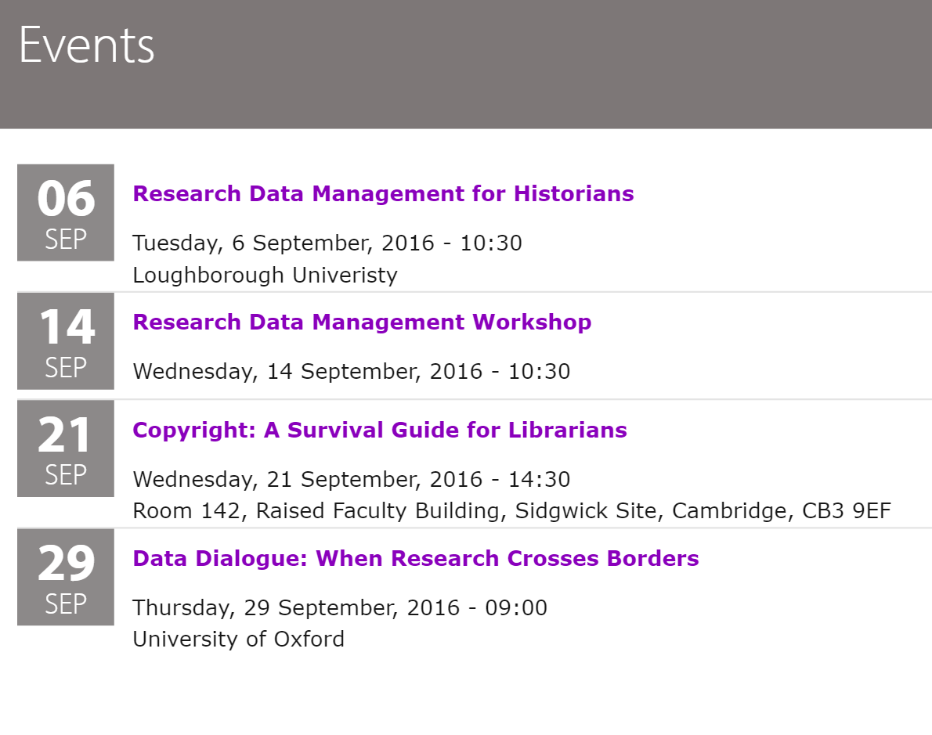
Training
www.data.cam.ac.uk/events

Slide 22
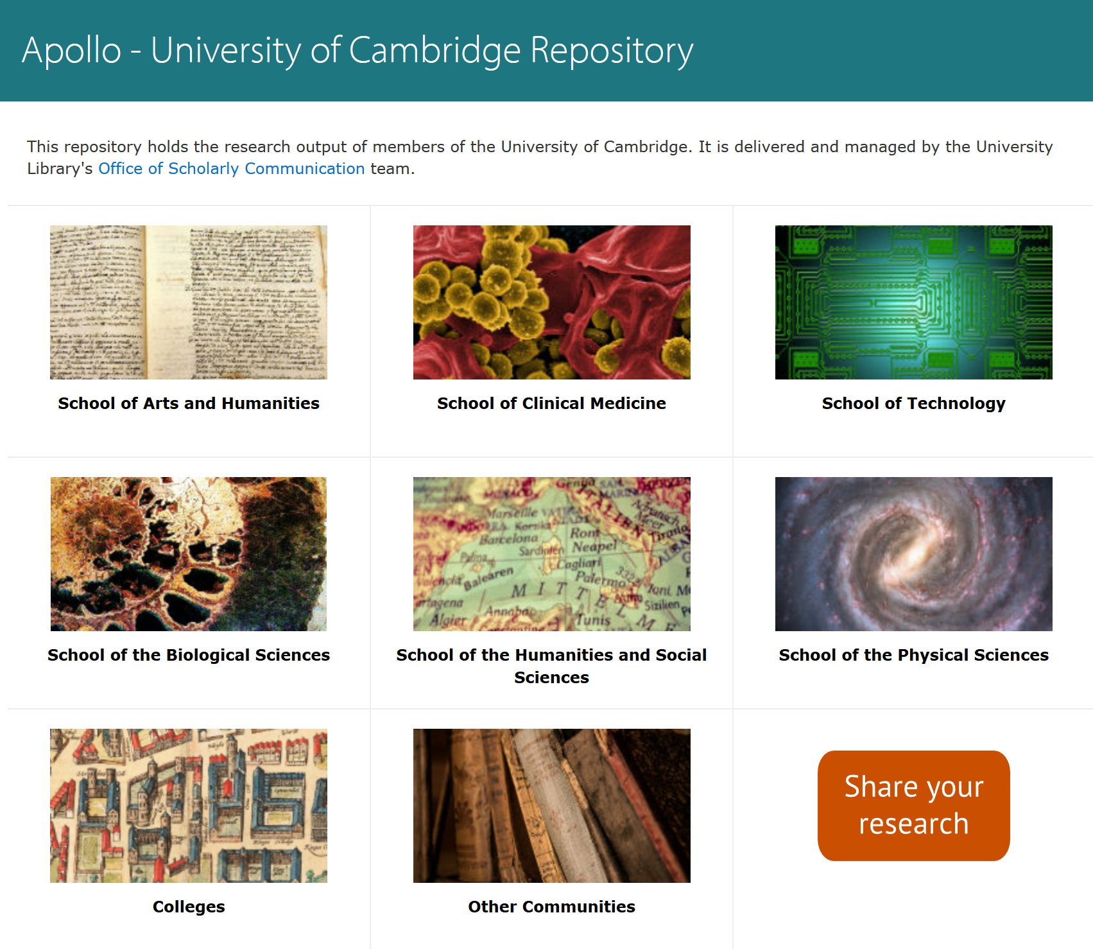
Repository
www.repository.cam.ac.uk

Slide 23
Advocacy and outreach
Huge engagement programme:
We have spoken with over 1,800 academics
75 individual information sessions about data sharing
37 different training events and workshops
Since January 2015
2015)

Slide 24
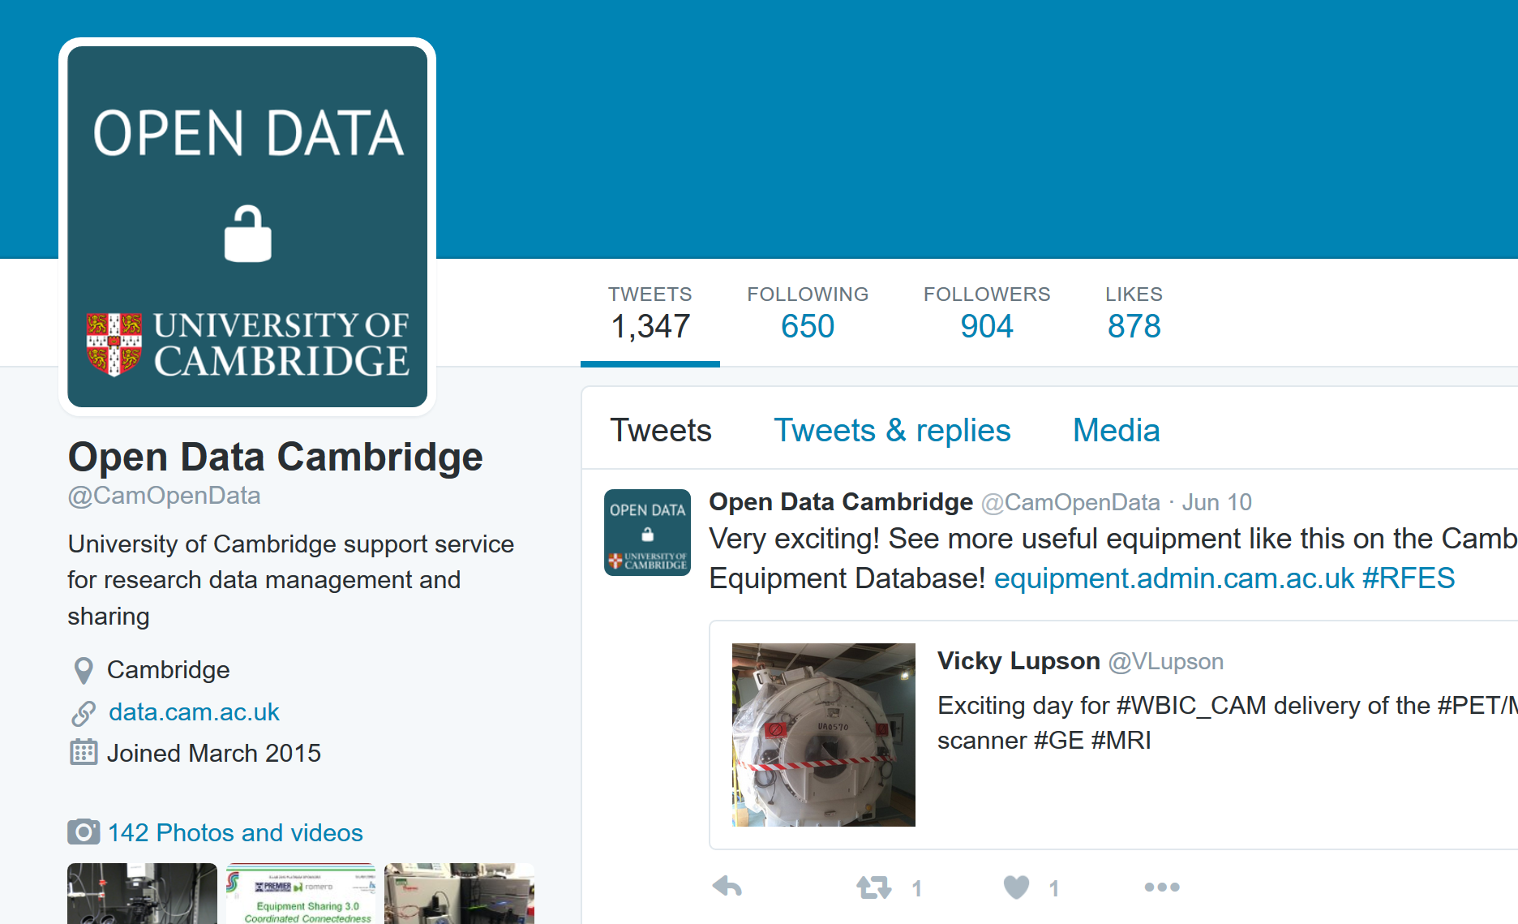
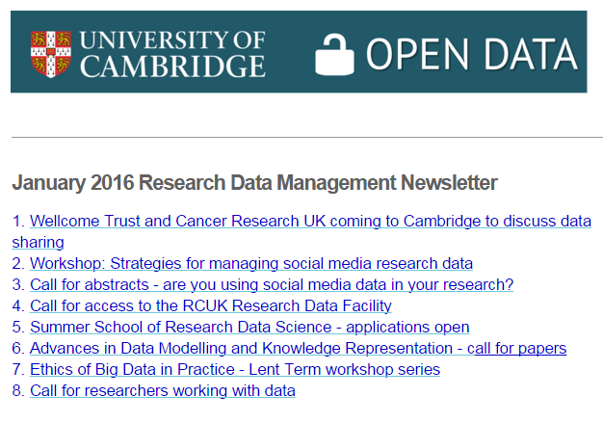
Advocacy and outreach
Various communication channels
Twitter: @CamOpenData
Over 900 followers
Newsletter: over 1,700 subscribers
http://www.data.cam.ac.uk/datanews

Slide 25
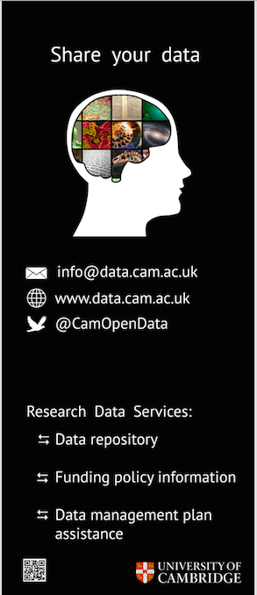
Advocacy and outreach
Various communication channels
www.lib.cam.ac.uk/librarians/oa/oa_promo.html
Notes:
Mention how nice are our postcards with all the links on the reverse ☺

Slide 26
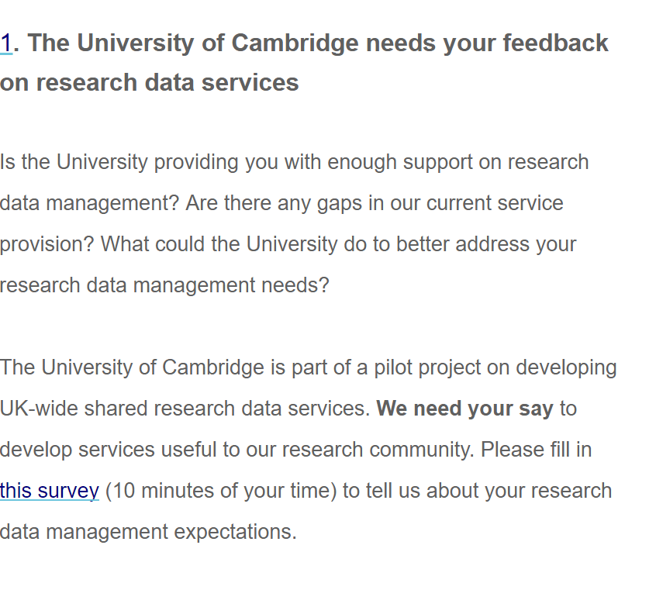
Follow-up survey in July 2016 (with Jisc)
440 responses

Slide 27
Answers inform service development
Why wouldn't you be willing to share your data publicly?
Top reason: contains personal/sensitive data
We’re now scoping for providing managed access to data
Full data available: http://bit.ly/2cUmlff

Slide 28
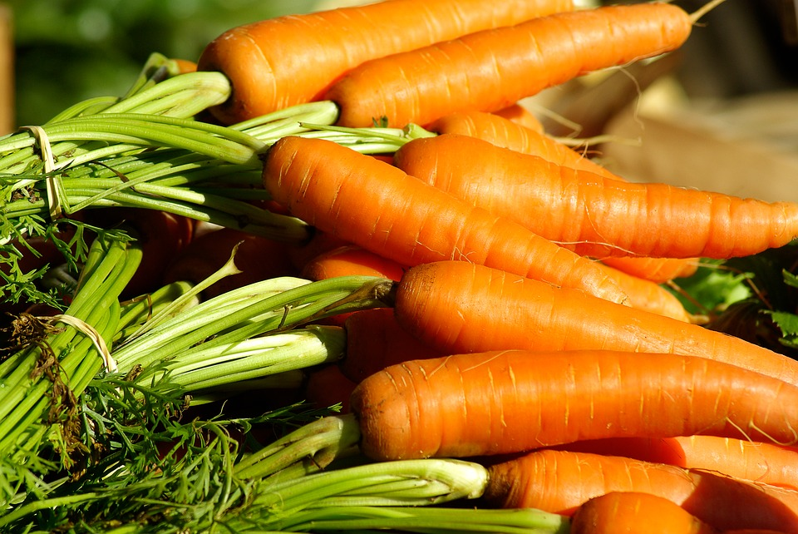
Understanding reveals the motivations
The benefits of good data management and sharing

Slide 29
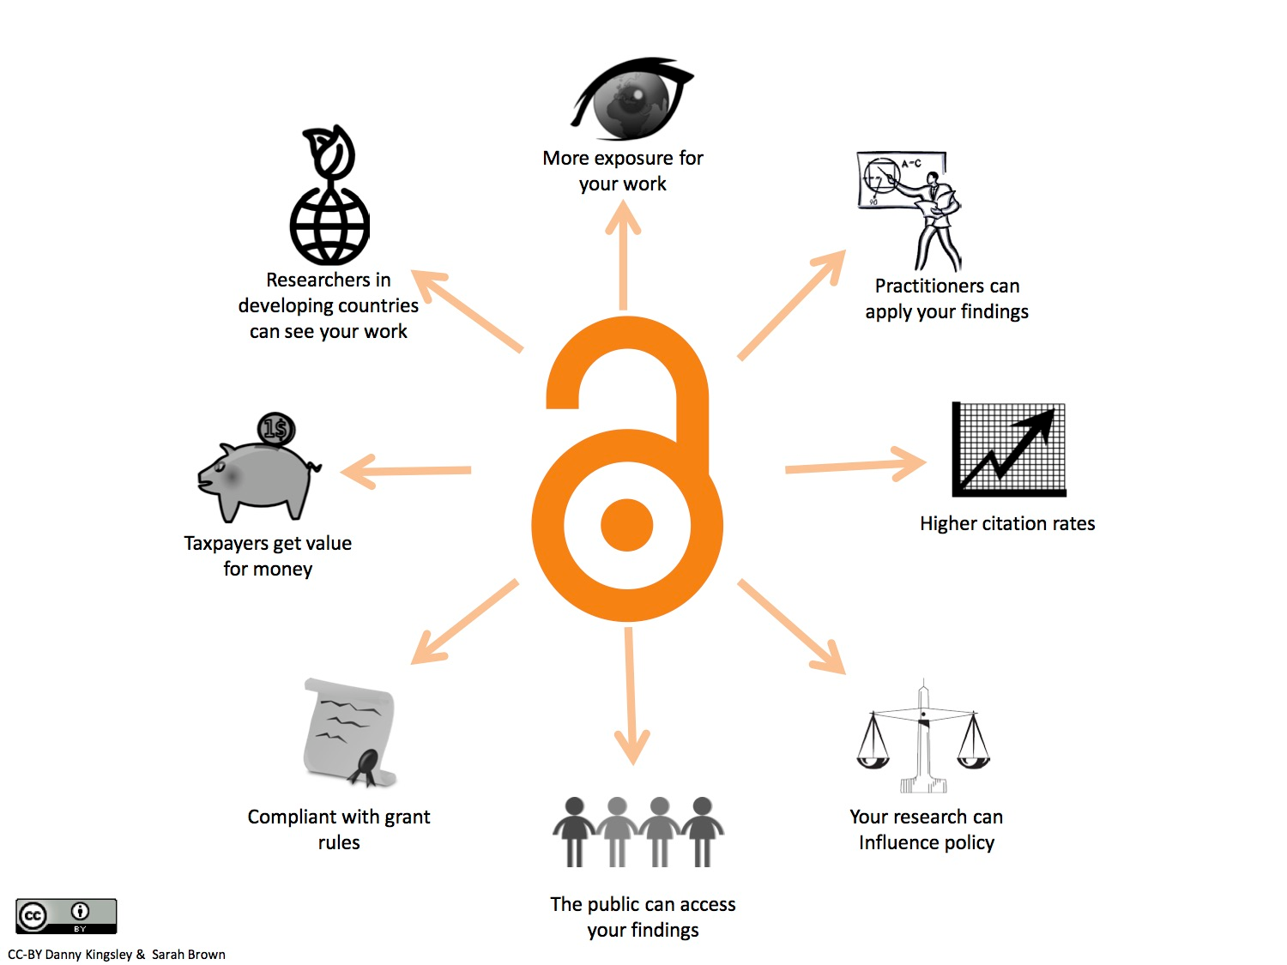
Sharing your data is ‘A Good Thing’

Slide 30
The forgotten benefits?
Some other very important reasons to share
Intrinsic motivations are more effective

Slide 31
Open Research is fundamental to being an academic
Research relies on the principle that we share our findings
Ideas and results need to be shared to move human knowledge forward

Slide 32
Science relies on the principle that findings are shared
FDA record of clinical trials with 12 antidepressants:
Only positive results published
From Dr Eric Turner: https://figshare.com/articles/Peer_review_After_Results_are_Known_Are_we_PARKing_the_Cart_Before_the_Horse_/3381379

Slide 33
Non-positive results need be shared not to waste time and resources
p-value 0.05: who is going to publish their results?

Slide 34
Selfish reason: share once and don’t be bothered
Corresponding authors:
Or
http://dx.doi.org/10.1021/acsami.6b00661

Slide 35
Selfish reason: share once and don’t be bothered
https://www.repository.cam.ac.uk/handle/1810/248506

Slide 36
Get access to shared data
Two questions asked when discussing data sharing with researchers:
It would be useful if research data underpinning publications was available
I (/my group) regularly share research data underpinning publications

Slide 37
Let your community work with you
Empowering researchers

Slide 38
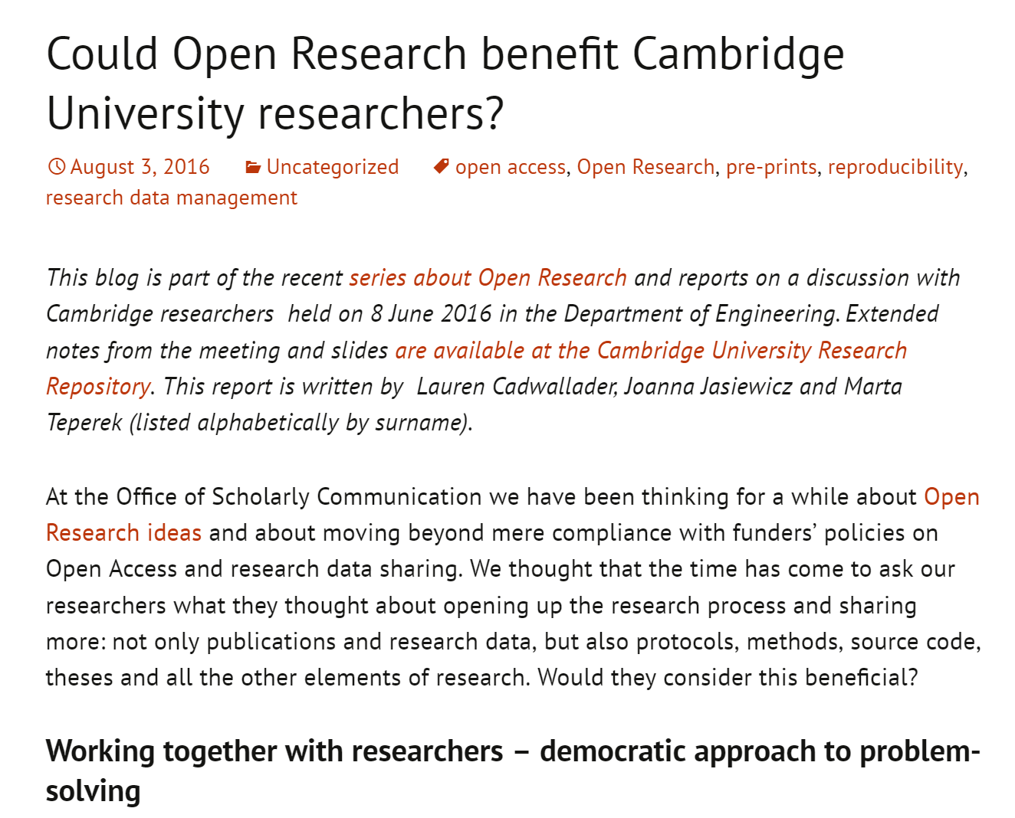
Let researchers shape the policy
https://unlockingresearch.blog.lib.cam.ac.uk/?p=817

Slide 39
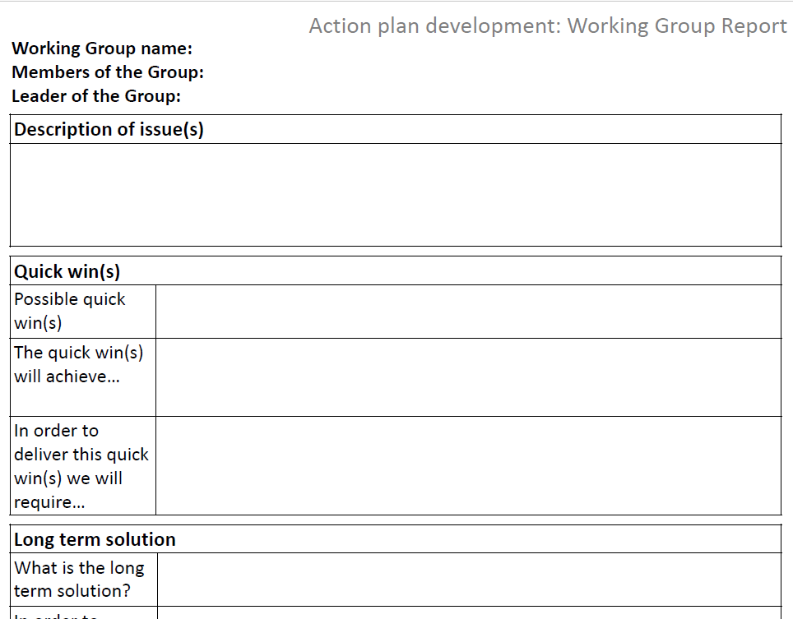
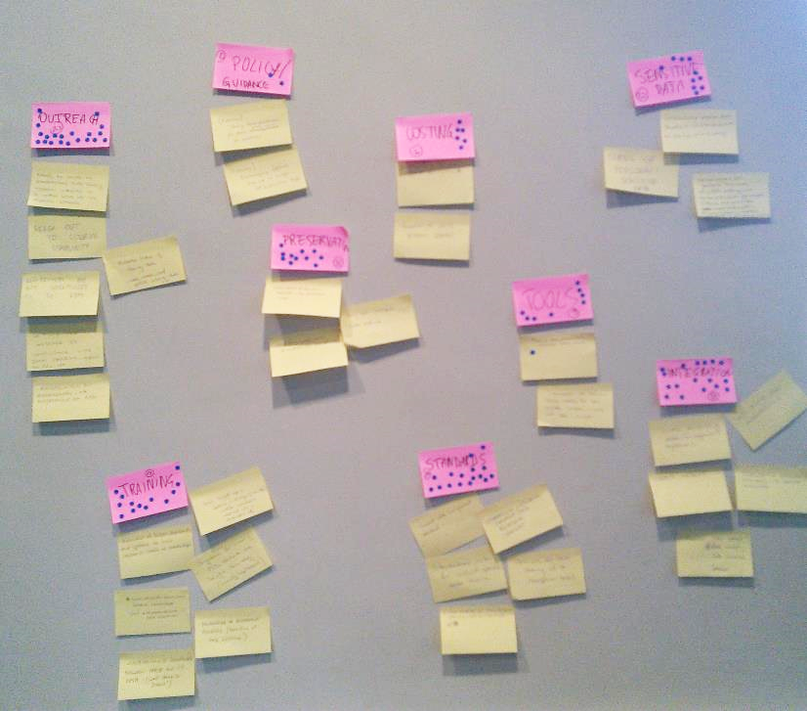
Creation of the RDM Project Group at Cambridge

Slide 40
Let your community work with you
Working collaboratively across the University

Slide 41
Why it’s important to collaborate across the University?
From Bill Hubbard Getting the rights right: when policies collide
http://www.slideshare.net/UKSG/hubbard-uksg-may2015-public

Slide 42
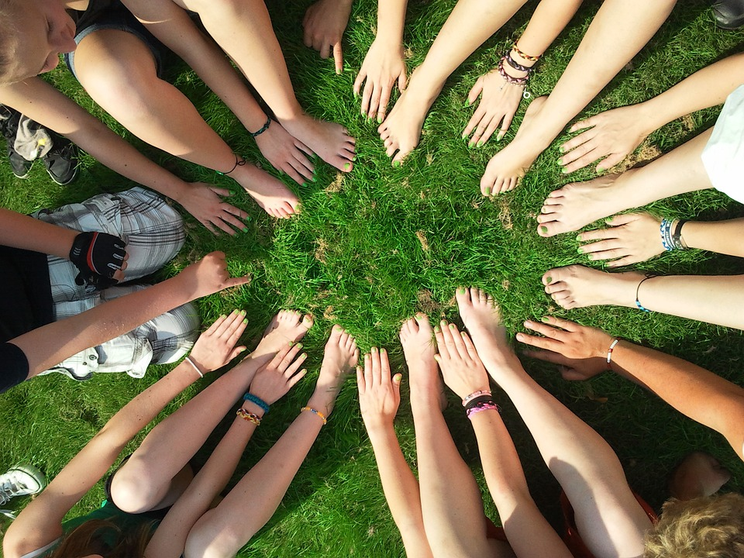
‘Get together’ working group
Aims:
Coordinate efforts
Improve communication
Focus on researchers

Slide 43
‘Get together’ working group
Library
IT people
Research information system
Contracts and grants office
University assessment
Research strategy office
Ethics officer
Legal team

Slide 44
Hot desking – get to know each other
Grants office
Research information office
Cambridge University Press
Coffee drop-in at departments
IT people - TBC

Slide 45
Collaboration outside of the University
Preservation
Big Data
Sustainability
New needs in 21st century
These problems are not limited to Cambridge

Slide 46
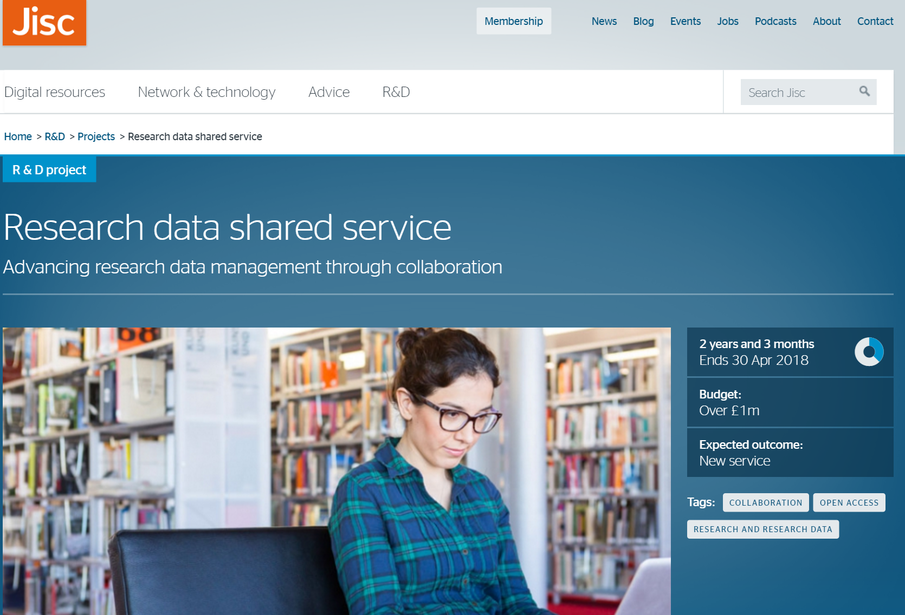
Jisc research data shared service
https://www.jisc.ac.uk/rd/projects/research-data-shared-service

Slide 47
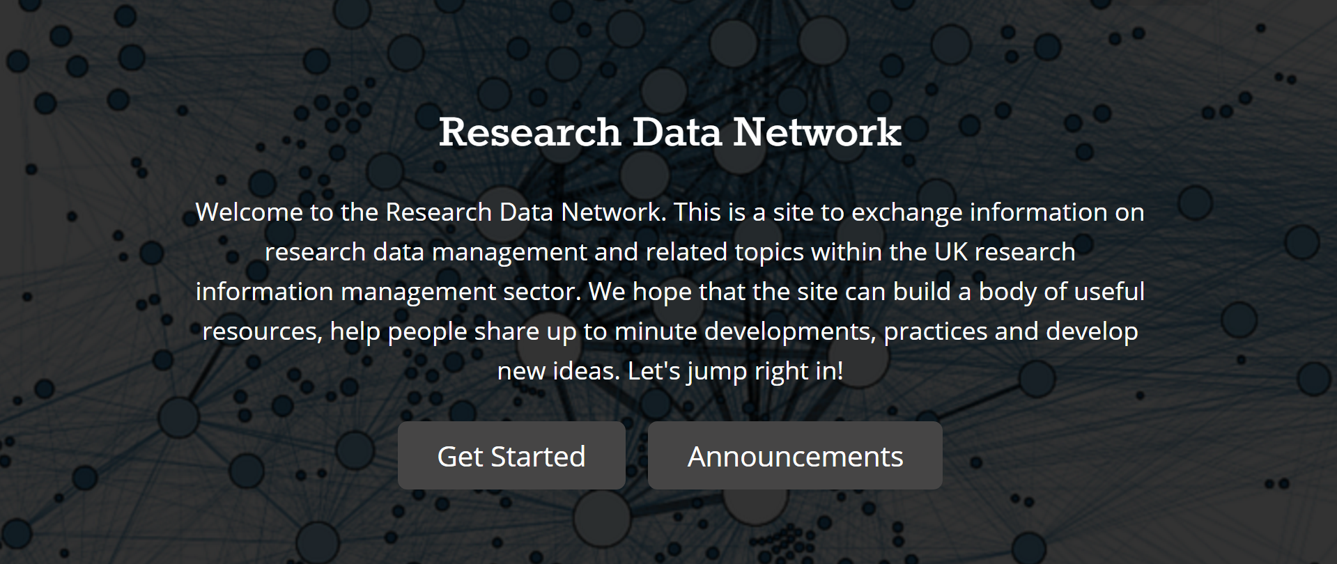
UK Research Data Network (Jisc initiative)
https://research-data-network.readme.io/
And our blog post: https://unlockingresearch.blog.lib.cam.ac.uk/?p=891

Slide 48
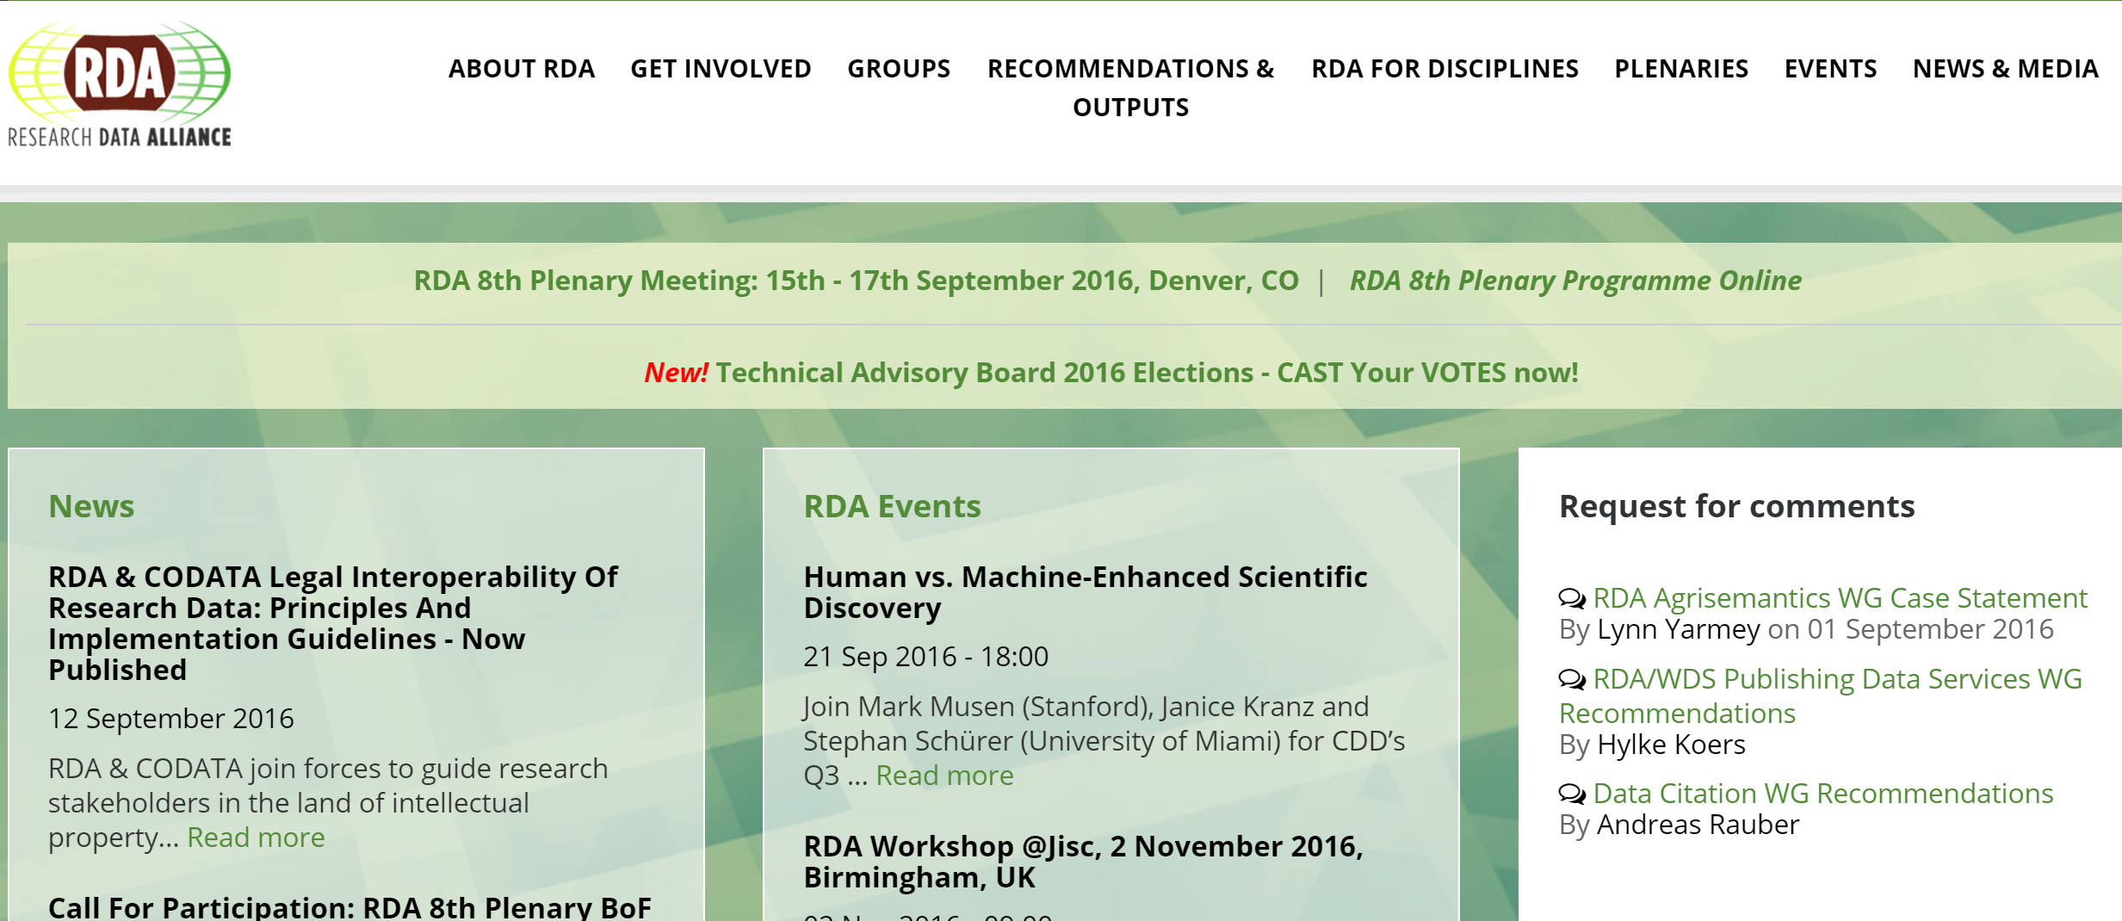
Global networks – Research Data Alliance
https://rd-alliance.org/

Slide 49
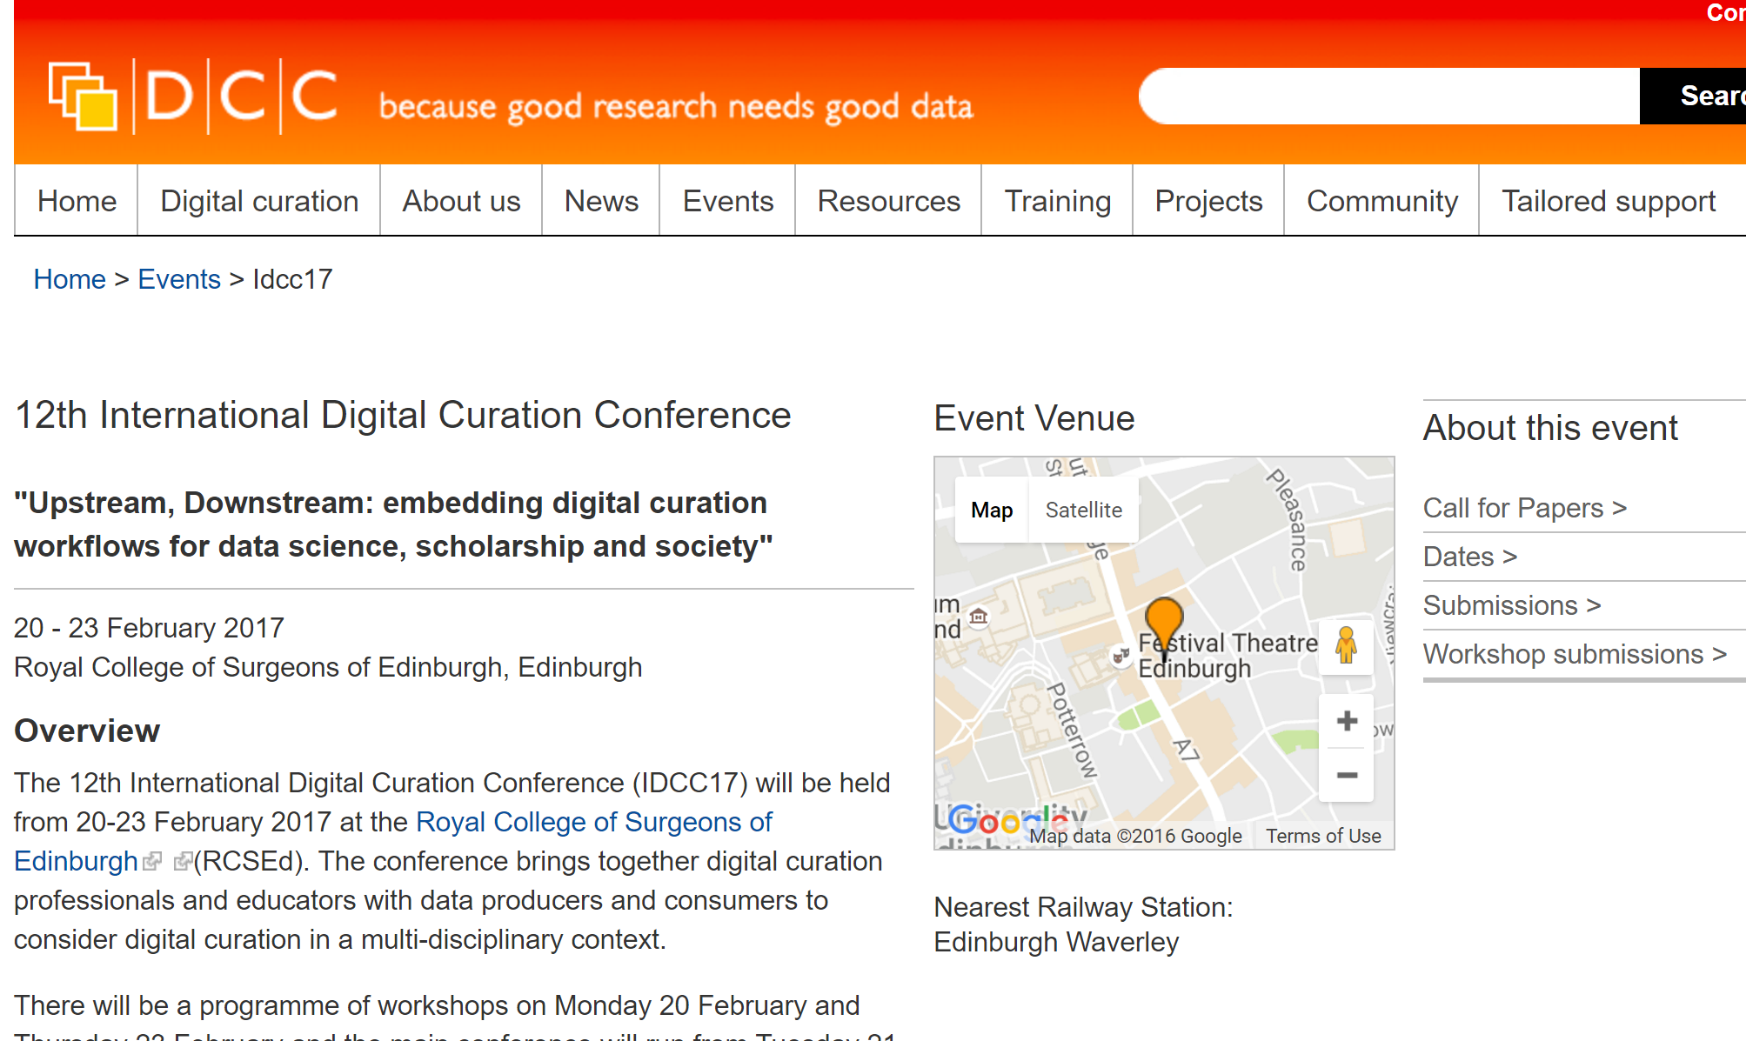
Global networks - IDCC
http://www.dcc.ac.uk/events/idcc17
And my blog post from 2016: https://unlockingresearch.blog.lib.cam.ac.uk/?p=579

Slide 50
Did it work?
Researchers’ feedback on our services

Slide 51
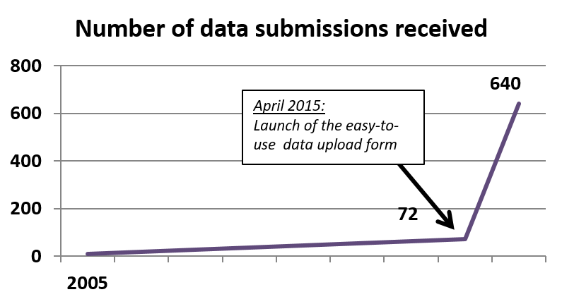
Behavioural change in sharing
Researchers used to panic and share their data at the last minute (compliance requirements)
More and more frequently:
Data shared before publication – access for peer-reviewers
Placeholder requests for data in preparation
Richer metadata (new fields needed!)
Data sharing seems to be more and more embedded in the publication process
2015
2016
In a bit more than a year 10X more data submissions than during a decade 2005 - 2015

Slide 52
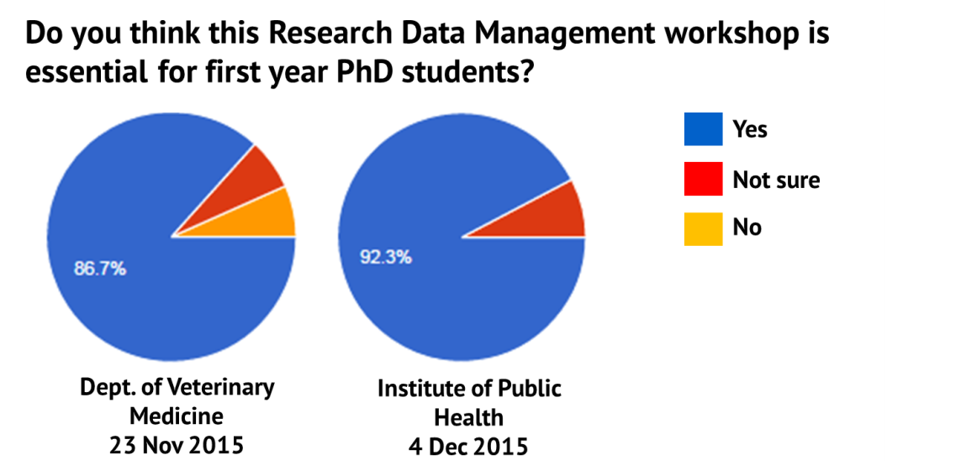
Feedback on training
Requests for the workshop to be compulsory
Anonymous feedback:
“I thought this was the best workshop I've attended so far. Very professional delivery, good balance of participant interaction.”
“Course should be mandatory and done at the beginning of the year. It was excellent - thank you. I wish I did it at the beginning.”

Slide 53
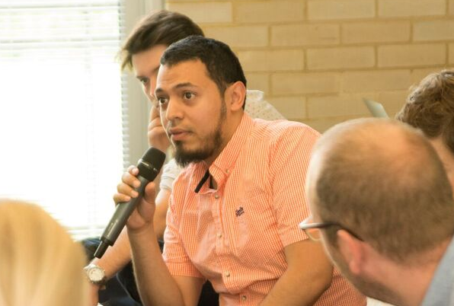
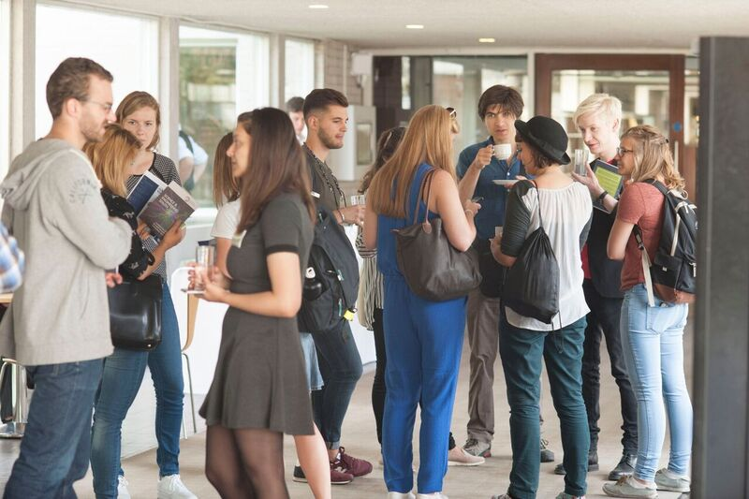
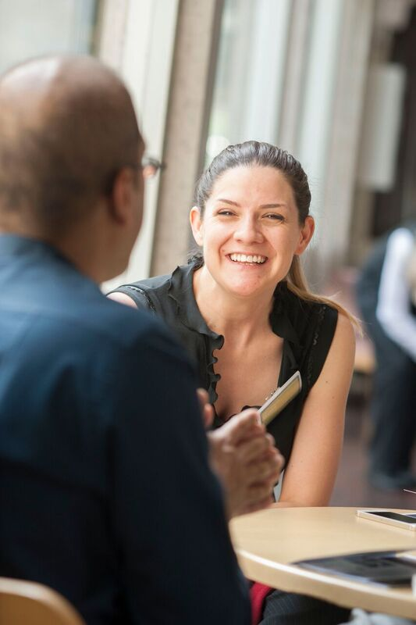
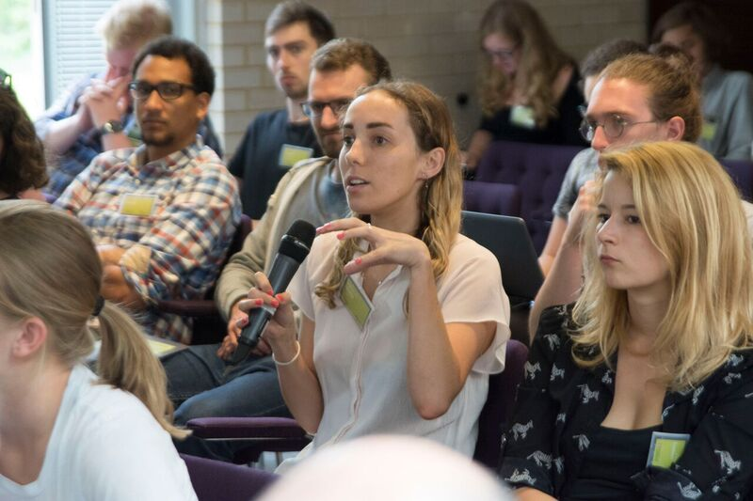
Informed discussions about barriers to sharing
20 case study abstracts from researchers
80 attendees: researchers and data managers
https://unlockingresearch.blog.lib.cam.ac.uk/?p=868

Slide 54
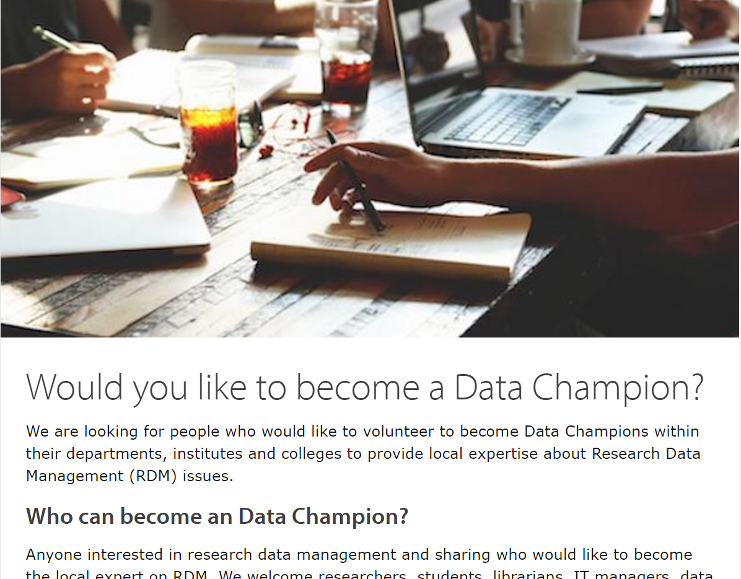
Call for data champions
http://www.data.cam.ac.uk/datanews/call-data-champions

Slide 55
Was it worth it?
Time to reflect…

Slide 56
Is democracy the right system?
Advantages | Disadvantages
Trust in the community Best solutions Community support and engagement (no more stones!) Community takes the ownership Very rewarding | Time-consuming Difficult Needs careful planning

Slide 57
Thank you
Questions: mt446@cam.ac.uk
www.data.cam.ac.uk
@martateperek
@CamOpenData
https://unlockingresearch.blog.lib.cam.ac.uk/
Slides: https://doi.org/10.5281/zenodo.154352

Slide 58
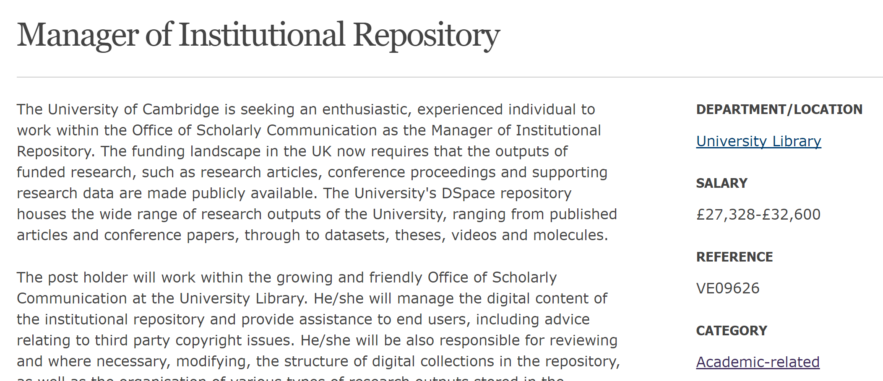
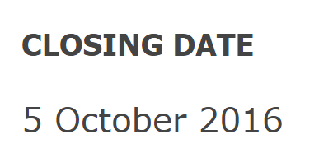
Opportunity to join our Cambridge team
Applicants from outside the UK very welcome to apply – tell your colleagues!
http://www.jobs.cam.ac.uk/job/10908/

Slide 59
Questions?
www.slido.com
Code: #5393

