Slide 1
dCache & DMF:
tape at SURFsara
DMF
(slides stolen from Jurriaan Saathof)
How dCache talks to DMF (Onno)
Atlas tape caroussel (slides stolen from Ron Trompert)
Presentation: Onno Zweers onno.Zweers@surfsara.nl
Hepix Barcelona 2018

Slide 2
Data Preservation Services @ SURFsara
Data services
Jurriaan Saathof
Systems Expert

Slide 3
Hierarchal Storage Management
Based on DMF by SGI
Complete filesystem view
Low cost storage media
Disk to tape
Only data blocks
Inodes remain on disk
Policies
Filesize
File age / last access time
Automated process
Queueing
Jurriaan Saathof– Data Preservation Services @ SURFsara

Slide 4
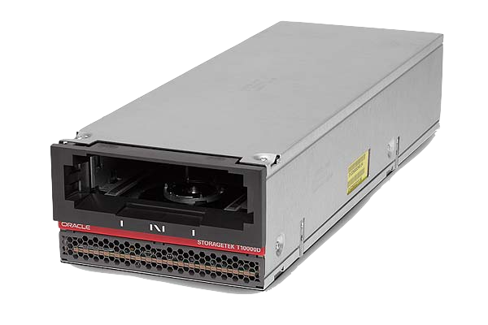
Overview DMF
To dCache
Data movers
SAN
CXFS filesystem
DMF server (DB)
Tape movers
Tapedrives
Jurriaan Saathof – Data Preservation Services @ SURFsara

Slide 5
Hardware
Hardware (focus on LOFAR project, shared system)
4 data movers (shared with Grid projects)
10GE, 4x FC8 (2x disk, 2x tape)
Will be upgraded to 40GE, 8x FC16 @ Q4 2017
11 tapemovers (shared by all)
8x FC16 (4x disk, 4x tape)
79TB filesystem (dedicated for LOFAR)
12x 8+2 RAID6 LUN (120 disks, dedicated hardware controllers, 8x FC16)
3x 4-disk stripe
Inodes on SSD
10x T10000-D tapedrives configured (out of 34, shared by all)
@252MB/s (native)
8x reserved for writing, 2x always available for reading
Jurriaan Saathof – Data Preservation Services @ SURFsara

Slide 6
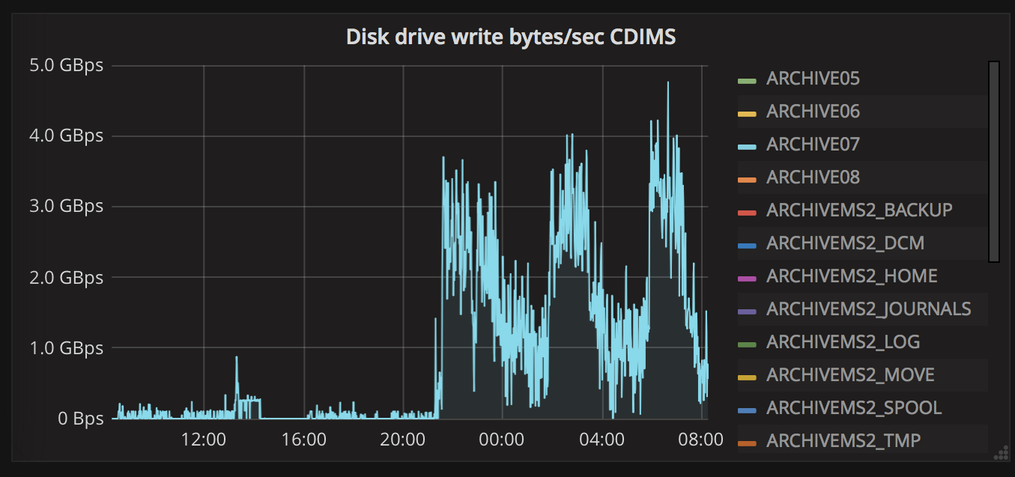
I/O Performance (LOFAR filesystem)
Jurriaan Saathof – Data Preservation Services @ SURFsara

Slide 7
Automated Cartridge System
Jurriaan Saathof – Data Preservation Services @ SURFsara

Slide 8
Automated Cartridge System (2)
Each library up to:
10000 slots
64 drives
8 robots
@SURFsara:
2 libraries
25 drives each
4 robots each
Jurriaan Saathof – Data Preservation Services @ SURFsara

Slide 9
Some more facts
Two StorageTek tape libraries, 10k slots each
Separate buildings
Data blocks can be on tape or cached on CXFS
iNodes of CXFS filesystem remain on SSDs
Small files remain on CXFS
Replicas
HEP & Lofar: 1 copy
Other: 2 copies, spread among 2 libraries
Migrating to LTO-8, 12 TB per cartridge

Slide 10
How dCache talks to DMF (1/3)
An HSM script `dmfcp.sh` enables dCache to copy data to and from tape.
put
hpn-scp file from pool dir to a data mover node node
check adler32 checksum
If success, exit 0 to let dCache know it succeeded, and return the tape file name
get
dmstat on CXFS node to check the file status
dmget to request copy from tape to CXFS
repeat until status is online (on CXFS)
hpn-scp copy file to the dCche pool dir
exit code success: dCache will calculate the checksum and update location info
delete
hpn-ssh data-mover-node “rm -rf”

Slide 11
How dCache talks to DMF (2/3)
Pitfall: exit codes are essential not to lose data.
scp
result=$?
scp | logger
result=${PIPESTATUS[0]}

Slide 12
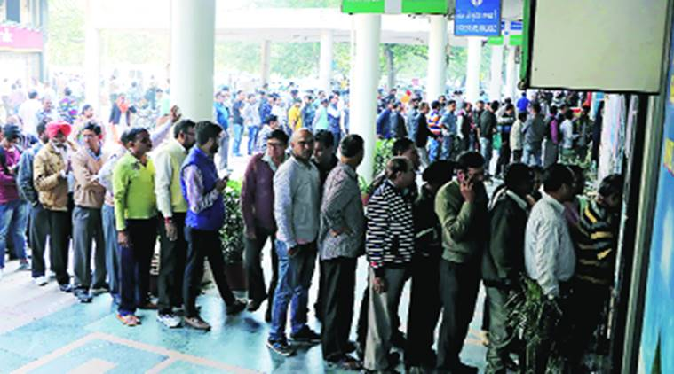
How dCache talks to DMF (3/3)
dCache SRM
dCache pool
DMF

Slide 13
ATLAS tape caroussel @ NL-T1
Slides: Ron Trompert
Presentation: Onno Zweers
Hepix Barcelona 2018 – BoF tape session

Slide 14
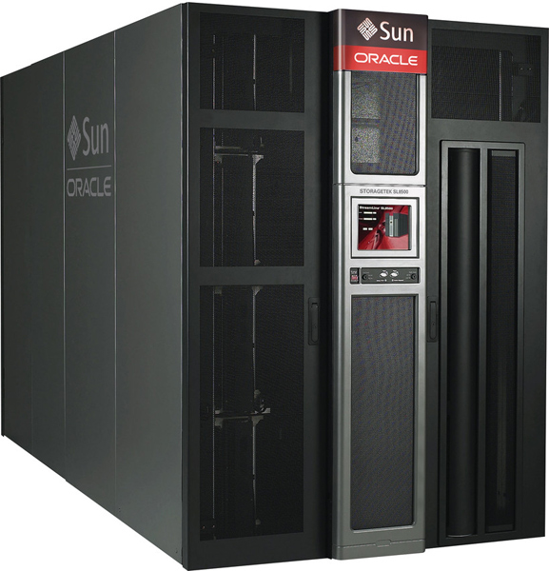
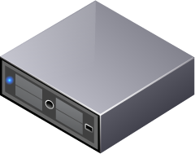
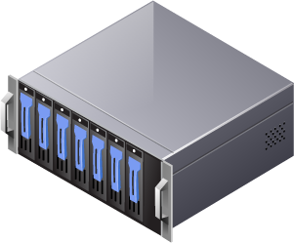
ATLAS tape caroussel @ NL-T1
Setup
DMF

Slide 15
ATLAS tape caroussel @ NL-T1
10 tape drives T10KD
16 stage pool nodes (8.3TB-14.7TB per node) which do 100 stage requests concurrently each (the rest is queued by dCache)
We have added an extra 90TB to hold the complete dataset on the stage pools
The more concurrent stage requests DMF gets, the better because the more efficient DMF can schedule staging

Slide 16
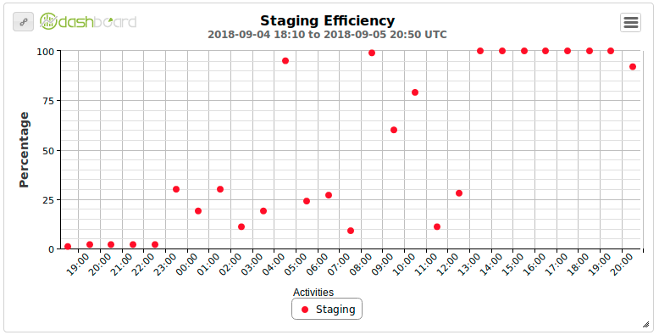
ATLAS tape caroussel @NL-T1
Basically left the config alone, but…..
We had a bumpy start

Slide 17
ATLAS tape caroussel @NL-T1
Setting srmmanager.request.get.max-requests = 30000 srmmanager.request.bring-online.max-inprogress = 30000 fixed it.
They were both 10000

Slide 18
ATLAS tape caroussel @NL-T1
When copying data from stage pools to DATADISK we have discovered a config error causing a high load. (WebDAV transfers were not limited.) Fixed it.
Played around a bit with the 100 concurrent stage requests per pool but that did not make a noticeable difference.

Slide 19
ATLAS tape caroussel @NL-T1
Staged at about 630MB/s on average
Remounts
Sep 5: "avgtaperemounts": 4.79
Sep 6: "avgtaperemounts": 4.73
Sep 7: "avgtaperemounts": 3.91
Sep 8: "avgtaperemounts": 2.57

Slide 20
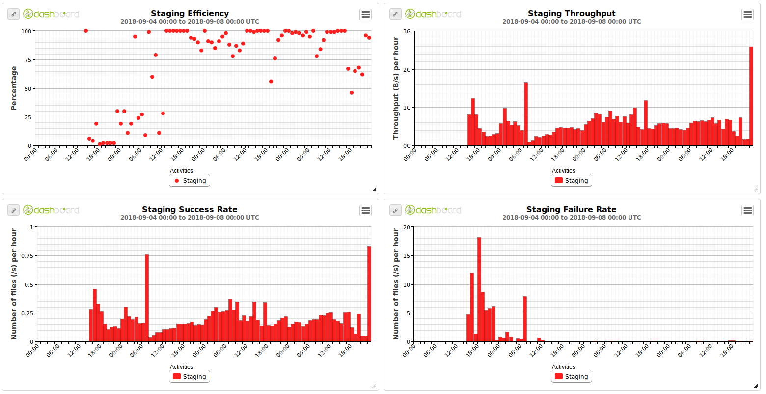
ATLAS tape caroussel @NL-T1

Slide 21
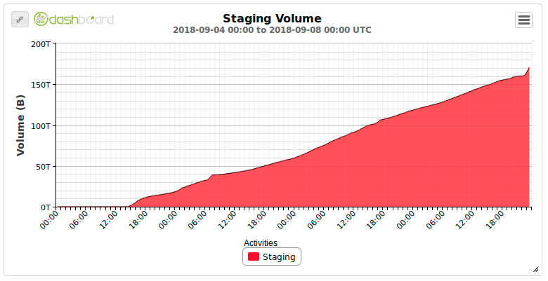

Slide 22
ATLAS tape caroussel @NL-T1
To increase performance:
More tape drives
CXFS filesystem used by our tape backend from which dCache copies files needs to become faster. The more tape drives we get (and the more dCache pool nodes) the more I/O capacity of the file system is needed
Thinking of NVMe-base storage (but nothing concrete yet)
It is maybe better to replace the polling mechanism by a mechanism where the pool is notified that a file is online

Slide 23
ATLAS tape caroussel @NL-T1
It would be good to run the tests again
See if a file is read from tape more than once→ should not happen
Tuning number of concurrent stage requests and read operations from CXFS/DMF nodes to optimize throughput

Slide 24
Thank you

