Slide 1
Building dCache
From Source
Onno Zweers
dCache Workshop, Madrid, May 2019
Thanks to dCache team for making it easy

Slide 2
Why build dCache from source?
Latest bug fixes, before official release
Discover newest features, and plan ahead implementing them
Be prepared for (major) upgrades
Add your own debugging statements
Provide feedback on the most recent developments – influence! Why not?
If you need a stable system, better grab an official release.
Live demo?

Slide 3
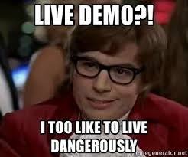
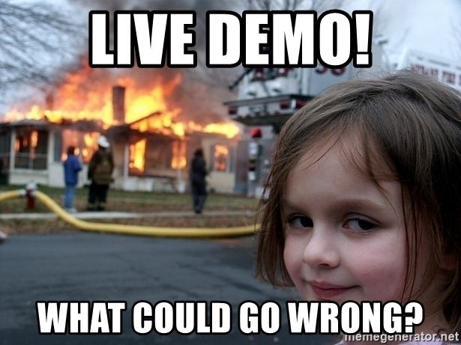
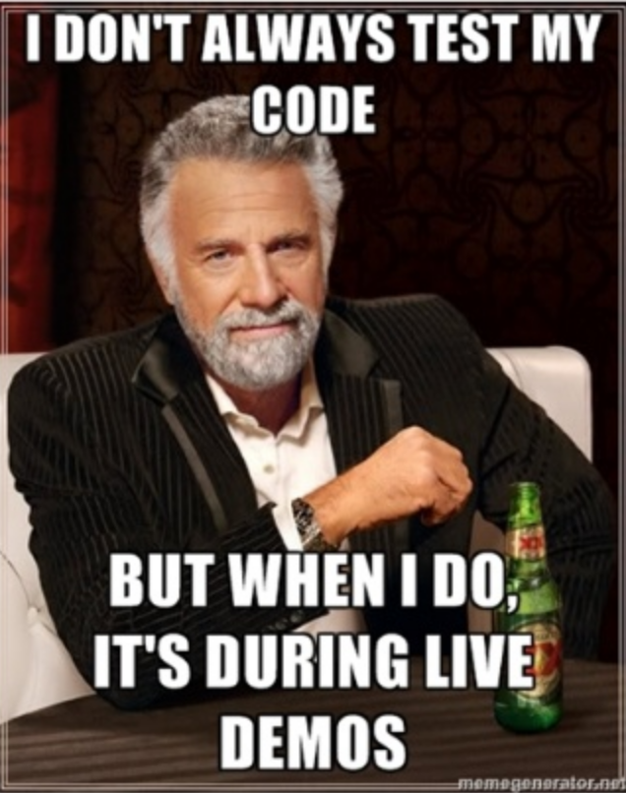
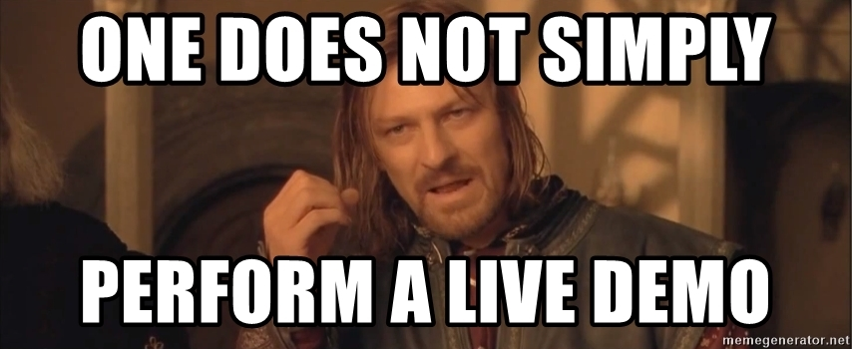

Slide 4
OK no live demo.

Slide 5
What you need
Docs: https://github.com/dCache/dcache/blob/master/BUILDING.md
RHEL or Centos 7 or 8
yum groupinstall "Development tools"
yum install java-11-openjdk java-11-openjdk-devel
~ 1GB disk space
A recent Maven from https://maven.apache.org
The EL version is too old
See next slide

Slide 6
Install Maven
cd /opt
wget https://www-eu.apache.org/dist/maven/maven-3/3.8.2/binaries/apache-maven-3.8.2-bin.tar.gz
tar xzvf apache-maven-3.8.2-bin.tar.gz
export PATH=/opt/apache-maven-3.8.2/bin:$PATH
Put that in ~/.bash_profile too
mvn --version

Slide 7
Build dCache master snapshot (first time)
cd
git clone https://github.com/dCache/dcache.git
cd dcache
mvn clean package -am -pl packages/fhs -P rpm
ls -l packages/fhs/target/rpmbuild/RPMS/noarch/dcache*.rpm
yum localinstall \ packages/fhs/target/rpmbuild/RPMS/noarch/dcache*.rpm
Configure dCache
Copy config from production
Check references to hostnames (don’t mix up prod with test)

Slide 8
Build dCache master snapshot (following times)
cd dcache
git pull
cp packages/fhs/target/rpmbuild/RPMS/noarch/dcache*.rpm /tmp/ # backup old pkg
mvn clean package -am -pl packages/fhs -P rpm
ls -l packages/fhs/target/rpmbuild/RPMS/noarch/dcache*.rpm
dcache check-config
dcache stop
yum upgrade packages/fhs/target/rpmbuild/RPMS/noarch/dcache*.rpm
(if yum thinks it’s not an upgrade: yum downgrade ... )
dcache check-config
dcache database update
dcache start

Slide 10
Additional notes
Build a specific branch
git checkout remotes/origin/5.1 # work with branch 5.1
You may need Java 8 for older branches
Back to master: git checkout master
mvn …
dcache stop
yum downgrade …
Downgrade
dcache stop
dcache database rollbackToDate $(date --date yesterday +%FT%T)
yum downgrade/update …
Check your dcache.conf, it may have been replaced!

Slide 11
Additional notes
Use master but skip a few specific commits: https://github.com/dCache/dcache/issues/4842#issuecomment-491207285

Slide 12
Thanks for listening!
Onno Zweers
E-mail: onno.zweers@surfsara.nl
www.surf.nl

