Slide 1
Introduction to UNIX and Linux
Module 2.0: Getting access to a supercomputer
Caspar van Leeuwen – caspar.vanleeuwen@surfsara.nl
Marco Verdiccio

Slide 2
Objectives
Logging in on Cartesius using password
Logging in on Cartesius using private/public keypair

Slide 3
Outline
Intro to SURFsara workshops
Change password in SURFsara user portal
Installing terminal client software
Logging in with a username and password
Logging in with a key pair
Introduction to UNIX – getting access

Slide 4
SURFsara workshops
09-01: Intro to Linux – Caspar van Leeuwen
- No intro needed
- Only login & keypair authentication

Slide 5
SURFsara workshops
15-01: Using Surfsara Computing Facilities – Lykle Voort (& me)
- What is a cluster / supercomputer?
- Interact with the system
- Write job scripts
- Use pre-installed software (modules)

Slide 6
SURFsara workshops
30-01: HPC cloud – Marcus van Dijk (?)
- How to use / connect to the HPC cloud?
- Set up your own VM
- …

Slide 7
SURFsara workshops
30-01: High performance machine learning – Valeriu Codreanu
- Practical knowledge on scaling deep learning
(distribution, algorithmic adapatations, etc)

Slide 8
Changing your password (1)
Go to
https://portal.surfsara.nl

Slide 9
Changing your password (2)
Introduction to UNIX – getting access

Slide 10
Changing your password (3)

Slide 11
Install UNIX access tools on your laptop
Windows
MobaXterm (http://mobaxterm.mobatek.net) (Portable edition)
Mac OSX
Terminal (pre-installed in /Applications/Utilities)
XQuartz (http://www.xquartz.org)
Linux
Terminal
Gnome-terminal (Gnome desktop)
Konsole (KDE desktop)
Introduction to UNIX – getting access

Slide 12
Remote Login (SSH) to SURFsara
Authentication on typical SURFsara systems
Lisa & Cartesius
username/password
public / private key pair
HPC Cloud
public / private key pair (only!)
Grid
username/password (local clusters)
Grid certificate (for other national and international clusters)
Introduction to UNIX – getting access

Slide 13
Terminal – OSX
Introduction to UNIX – getting access

Slide 14
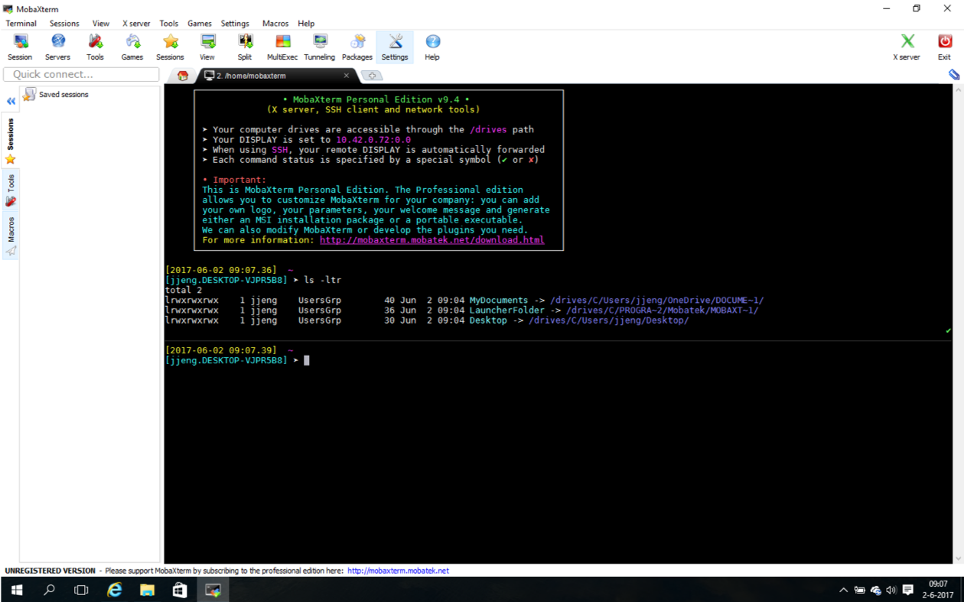
Terminal – Windows (with MobaXterm)
Introduction to UNIX

Slide 15
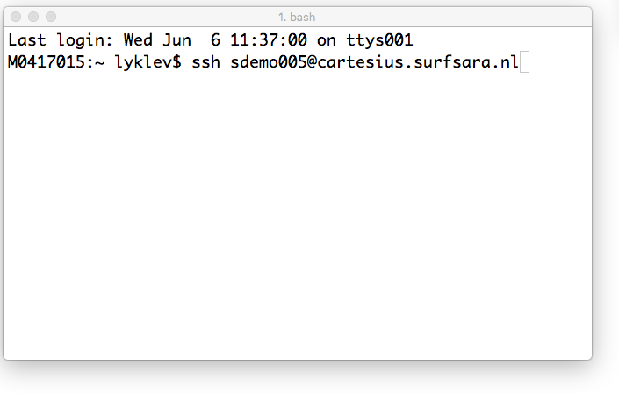
Login to Cartesius – with username
Introduction to UNIX – getting access

Slide 16
Login to Cartesius – with username (2)
Introduction to UNIX – getting access

Slide 17
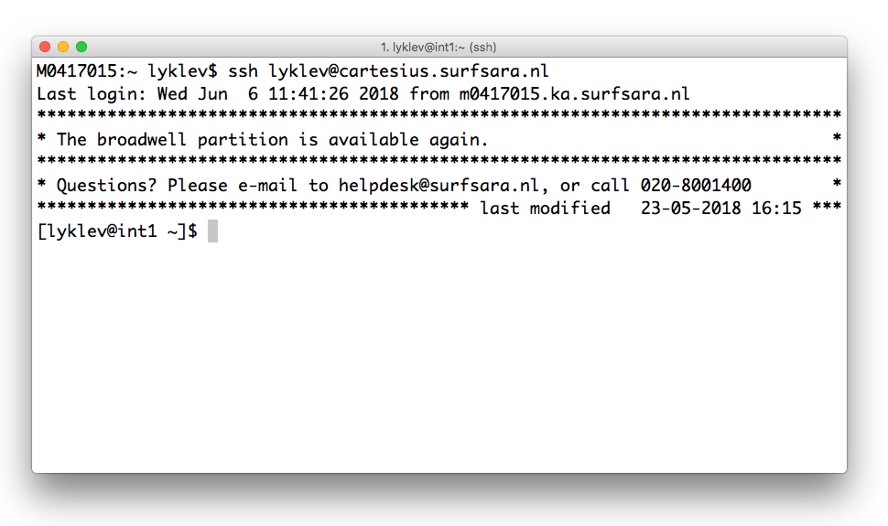
Login to Cartesius – with username (3)
Introduction to UNIX – getting access

Slide 18
Asymmetric Encryption – key pair
Introduction to UNIX – getting access

Slide 19
Asymmetric encryption
Asymmetric encryption:
Encrypts data with the public key
Decrypting only possible with the private key

Slide 20
Authentication using a keypair
Alice’s public key
Alice
Alice’s private key

Slide 21
Public/Private keypair: conclusion
You can use a public/private keypair to log in on remote systems
Your private key identifies you
You must keep your private key ... private
Keep your private key on your own machine
Store your public key on remote machines
Notes:
own: your own computer, that is a computer that you have access to and from where you will login on other machines
remote machine: machine that you want to login on

Slide 22
Create key pair – OSX (1)
Introduction to UNIX – getting access

Slide 23
Create key pair – OSX (2)
Introduction to UNIX – getting access

Slide 24
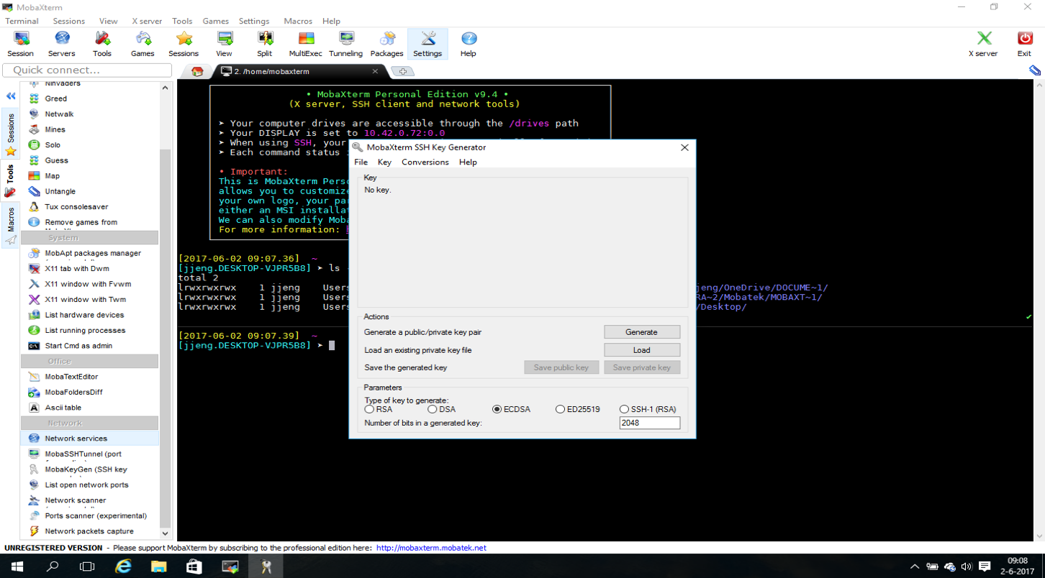
Create key pair – Windows (1)
Introduction to UNIX – getting access

Slide 25
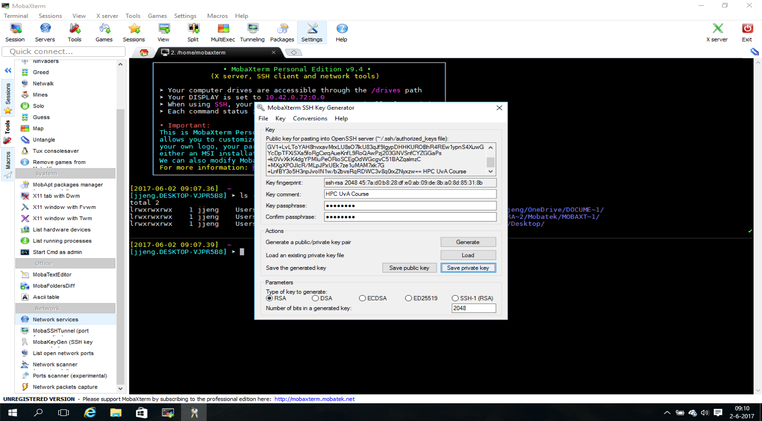
Create key pair – Windows (2)
Introduction to UNIX – getting access

Slide 26
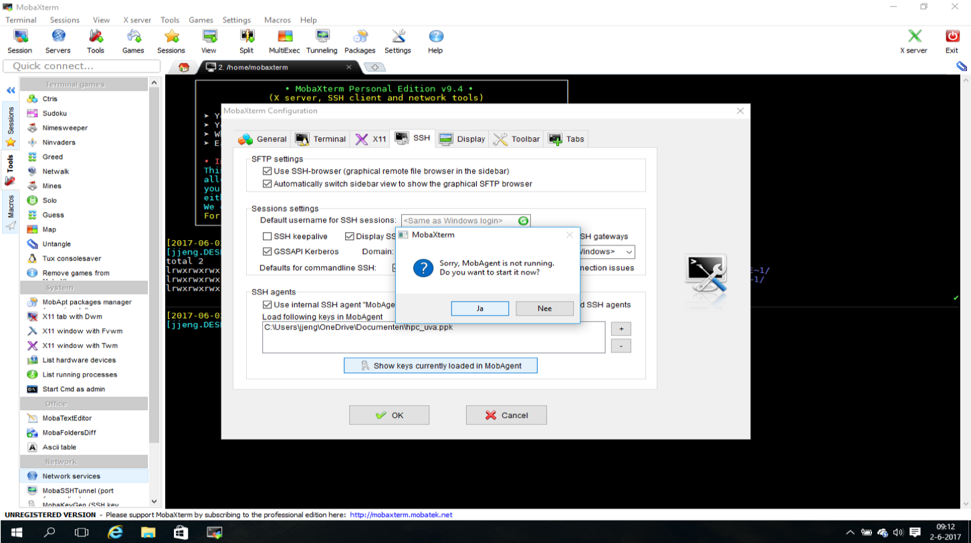
Start MobAgent – Windows
Introduction to UNIX – getting access

Slide 27
Storing your public key
Introduction to UNIX – getting access

Slide 28
Storing your public key (2)
Introduction to UNIX – getting access

Slide 29
Login to Lisa – with key pair (6)
Introduction to UNIX – getting access

Slide 30
Questions
Introduction to UNIX – getting access

