Slide 1
Lecture 4: RARE Decays

Slide 2
Learning goals
what are rare decays?
sketch of theory of rare decays
some ‘recent’ highlights in rare B decays
  Bs->mumu
  Bd->K*gamma
  lepton-flavour violation tests

Slide 3
Standard Model: “No FCNC at tree level”
80
CKM: Flavour changing charged currents
No Flavour changing neutral currents

Slide 4

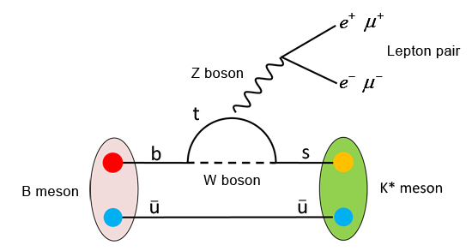
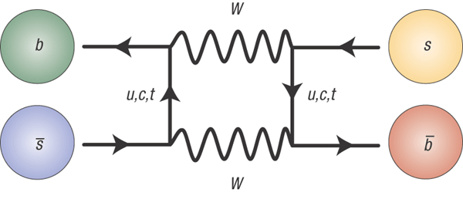
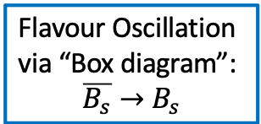
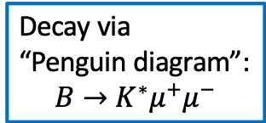
FCNC at loop level
neutral currents are possible at higher order
Decay via
“Penguin diagram”:
$$B→K^{∗}μ^{+}μ^{−}$$
Flavour Oscillation
via “Box diagram”:
$$\overline{B_{s}}→B_{s}$$
we call them ‘rare’
  higher order
  often ‘GIM suppressed’ (cancellation due to unitarity)

Slide 5
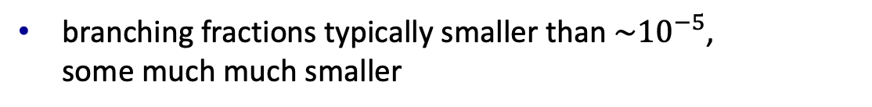
Examples of rare decays
very incomplete table
branching fractions typically smaller than $\sim {10}^{−5}$,
some much much smaller

Slide 6

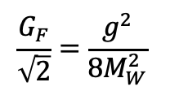
Effective couplings
82
Beta decay: “charged current”:
$$n→p e^{−}\overline{ν_{e}}$$
$$\frac{G_{F}}{\sqrt{2}}=\frac{g^{2}}{8M_{W}^{2}}$$
Effective theory: exploit separation of scales

Slide 7

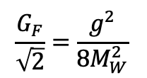
Effective couplings
82
Beta decay: “charged current”:
$$\frac{G_{F}}{\sqrt{2}}=\frac{g^{2}}{8M_{W}^{2}}$$
$$n→p e^{−}\overline{ν_{e}}$$
Rare B decay: “Flavour changing neutral current”:
$$B^{0}→K^{∗}μ^{+}μ^{−}$$

Slide 8
Dealing with bound states
consider “$B →D l ν”$
quark level process

Slide 9
Dealing with bound states
consider “$B →D l ν”$
quark level process
hadron level process

Slide 10
Dealing with bound states
sketch of solution (no formal theory!)
coefficient:
can be computed in SM
local operator:
computation involves QCD

Slide 11
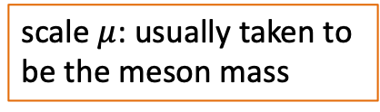
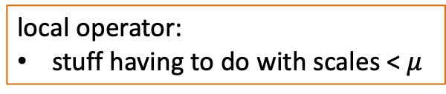
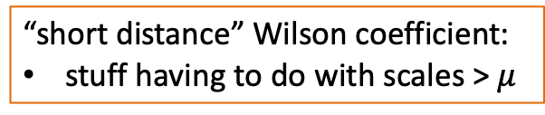
General solution: operator product expansion
approximate H with effective Hamiltonian that integrates out ‘all heavy stuff’, not just the W, but also the top, etc
scale $μ$: usually taken to
be the meson mass
“short distance” Wilson coefficient:
stuff having to do with scales > $μ$
local operator:
stuff having to do with scales < $μ$

Slide 12
General solution: operator product expansion
“short distance” Wilson coefficient:
perturbative: SM computation ‘easy’
sensitive to New Physics
“long distance” matrix element
non-perturbative: difficult
not sensitive to New Physics
Wilson coefficients and matrix elements depend on scale ‘mu’
  computations need to ‘match’, such that mu-dependence cancels
matrix elements are hard to compute but effective approximations available: “heavy quark effective theory”, “lattice calculations”, etc

Slide 13
Rare $B$-decays and effective couplings: $b→sq\overline{q}$
85
𝒪₁
𝒪₂
𝒪₃ – 𝒪₆
𝒪₇ – 𝒪₁₀

Slide 14
Rare $B$-decays and effective couplings: $b→sl^{+}l^{−}$
86
𝒪_{7γ}
𝒪_{8G}
𝒪_{9V} – 𝒪_{10A}

Slide 15
Effects of ‘new physics’
new ‘heavy’ particles only affect scales > mu
  → change Wilson coefficients
new physics may also lead to local operators that are absent in SM
  e.g. with scalar bosons or right-handed currents
  lead to different `kinematics’ of final state particles

Slide 16
(from Riley Henderson at FPCP’23)

Slide 17
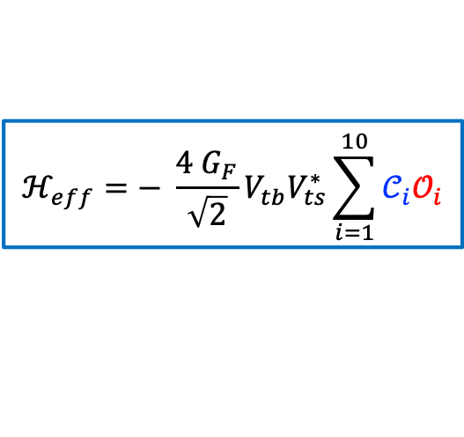

Rare $B$-decays and effective couplings: $b→sμ^{+}μ^{−}$
87
Effective 4-fermion coupling:
$$b→sμ^{+}μ^{−}$$
$$ℋ_{eff}=− \frac{4 G_{F}}{\sqrt{2}}V_{tb}V_{ts}^{∗}\sum_{i=1}^{10}{𝒞_{i}𝒪_{i}}$$
Standard Model diagrams:
Beyond Standard Model:
Photon penguin:
Vector, Axial vector:
O₇
O₉ , O₁₀
Experimental test: Compare calculable C_{i} coefficients to experimental data
    Sensitivity for NP in Wilson coefficients C₇, C₉, C₁₀

Slide 18
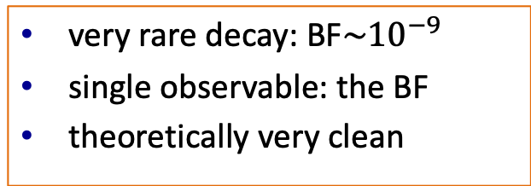

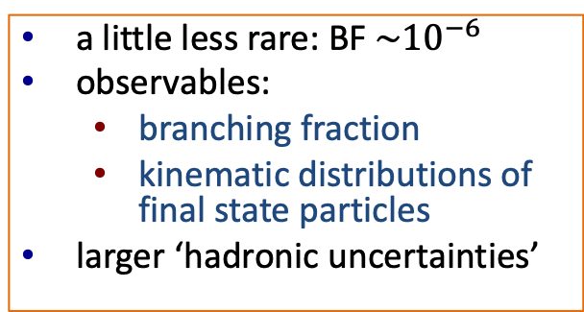
Examples of $b→s{{ l}^{+ }l}^{−}$ transitions
very rare decay: BF$\sim {10}^{−9}$
single observable: the BF
theoretically very clean
a little less rare: BF ${\sim 10}^{−6}$
observables:
  branching fraction
  kinematic distributions of final state particles
larger ‘hadronic uncertainties’

Slide 19
$${B_{s,d}→μ}^{+}μ^{−}$$
very rare decay in SM: FCNC, helicity suppressed
precise SM calculation (update!)
considered very sensitive to new physics (SUSY etc)
“clean/easy” experimental signature: just count!
Q: why is the Bd decay more rare than the Bs decay?

Slide 20
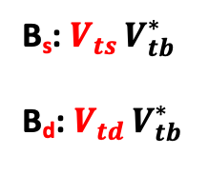
B_{s}: $V_{ts }V_{tb}^{∗}$
B_{d}: $V_{td }V_{tb}^{∗}$

Slide 21


$${B_{s,d}→μ}^{+}μ^{−}$$
observed signals at the LHC:
$${B_{d}→μ}^{+}μ^{−}$$
$${B_{s}→μ}^{+}μ^{−}$$
note the importance of good mass resolution!

Slide 22
$${B_{s,d}→μ}^{+}μ^{−}$$
good agreement between experiment and theory
non-SM contributions not much more than 15%
  → strong contraints on BSM physics
no clear evidence yet for Bd->μμ

Slide 23

${B_{d}→K^{∗0}μ}^{+}μ^{−}$ (and alike)
invariant mass-squared of μμ pair is called “q-squared”:

Slide 24
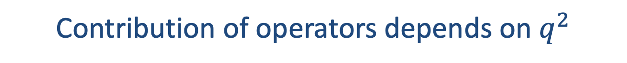
Contribution of operators depends on $q^{2}$
≈
≈
≈

Slide 25
Branching fractions of Rare Decays: $b→s μ^{+}μ^{−}$
92
JHEP 06 (2014) 133
JHEP 06 (2014) 133
JHEP 06 (2014) 133
JHEP 08 (2013) 131
JHEP 09 (2015) 179
JHEP 06 (2015) 115
Branching fractions related to $b→s μ^{+}μ^{−}$transition consistently lower than predicted.

Slide 26
Angular distributions
in >2-body decays, also ”angular distributions” sensitive to NP
experimental challenge: backgrounds and angular efficiency
theoretical challenge: choose observables with small hadronic uncertainties

Slide 27

Example: angular distributions in $B^{0}→ K^{∗0}μμ$
LHCb, arXiv:2003.04831
not great agreement with SM prediction

Slide 28
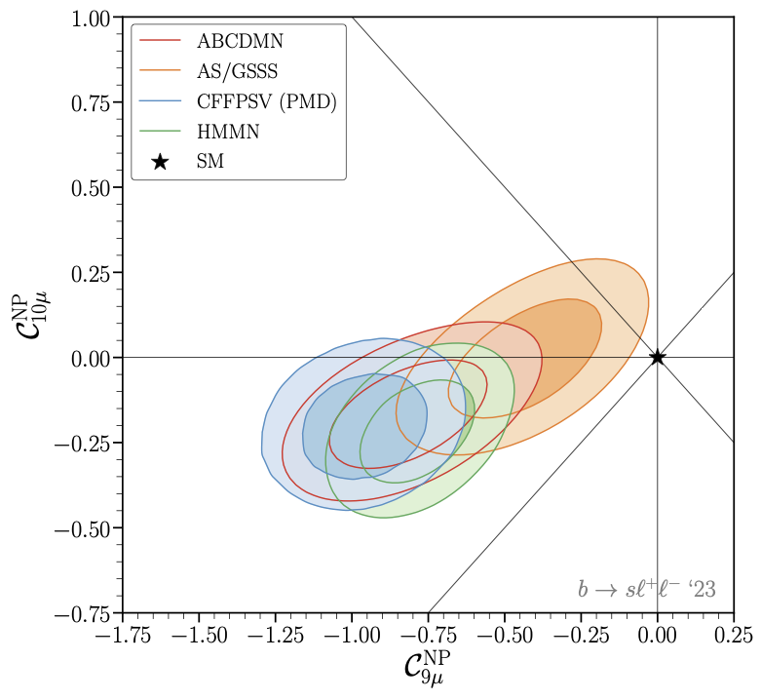
Global Fit of $b→s μ^{+}μ^{−}$
94
different theoretical
collaborations
global fits: perform fits so all b->sll data, allowing for NP contributions to Wilson coefficients
the fit seems to indicate new contributions to ‘C9’
the ‘pull’ of the SM is about 4 sigma

Slide 29
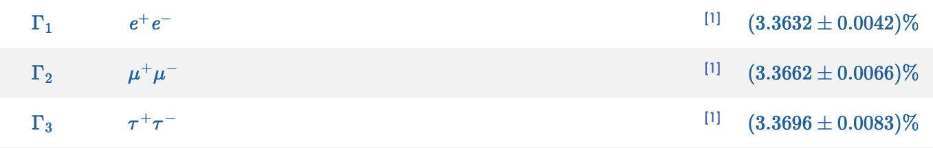
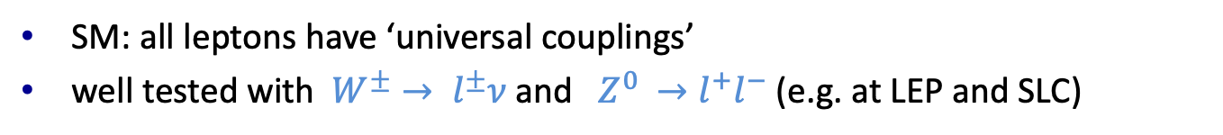
Lepton universality
SM: all leptons have ‘universal couplings’
well tested with $W^{±}→ l^{±}ν$ and $Z^{0 }→l^{+}l^{−}$ (e.g. at LEP and SLC)
for example, branching fractions of Z to leptons from PDG:
meson decays provide additional tests, e.g. sensitivity to new forces between quarks and leptons (“lepto-quarks”)

Slide 30



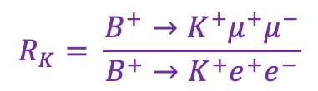
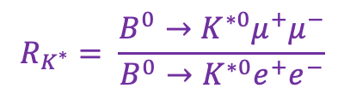


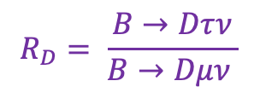





B-decays and lepton universality
89
$b→c l ν$ charged current: ”Allowed” → large decay rates
$$c$$
$$R_{D}= \frac{B→Dτν}{B→Dμν }$$
$$b$$
$$τ/μ$$
$$R_{D^{∗}}= \frac{B→D^{∗}τν }{B→D^{∗}μν }$$
$${ν_{τ}}/{ν_{μ}}$$
$b→sl^{+}l^{−}$ neutral current: “Forbidden” → rare decays
$$R_{K}= \frac{B^{+}→K^{+}μ^{+}μ^{−}}{B^{+}→K^{+}e^{+}e^{−}}$$
$$s$$
$$b$$
$${μ^{+}}/{e^{+}}$$
$$R_{K^{∗}}= \frac{B^{0}→K^{∗0}μ^{+}μ^{−}}{B^{0}→K^{∗0}e^{+}e^{−}}$$
$${μ^{−}}/{e^{−}}$$

Slide 31

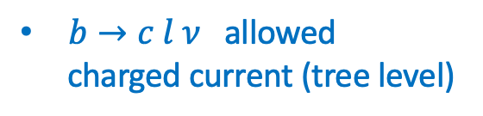
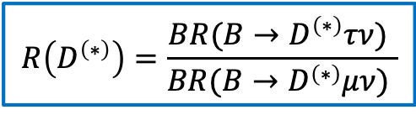
$R_{D}$ and $R_{D^{∗}}$
90
$b→c l ν$ allowed
charged current (tree level)
$$R\left(D^{\left(∗\right)}\right)=\frac{BR(B→D^{\left(∗\right)}τν) }{BR(B→D^{\left(∗\right)}μν) }$$
Involves leptons of 2nd and 3rd generation
SM
$\sim 4σ$ deviation

Slide 32

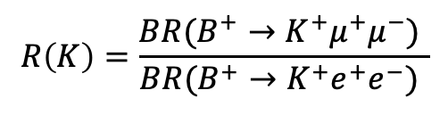

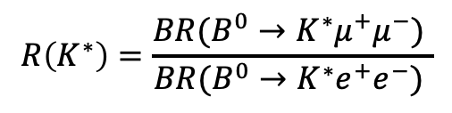
$R_{K}$ and $R_{K^{∗}}$
91
$b→s l^{+}l^{−}$ suppressed neutral current
$$R\left(K\right)=\frac{BR(B^{+}→K^{+}μ^{+}μ^{−}) }{BR(B^{+}→K^{+}e^{+}e^{−}) }$$
OLD
~3.5 $σ$
$$R\left(K^{∗}\right)=\frac{BR(B^{0}→K^{∗}μ^{+}μ^{−}) }{BR(B^{0}→K^{∗}e^{+}e^{−}) }$$
caused some excitement in past, because LHCb seemingly found deviations from 1
latest LHCb results are perfectly compatible with expectations
Involves leptons of 1st and 2nd generation

Slide 33
$R_{K}$ and $R_{K^{∗}}$
91
$b→s l^{+}l^{−}$ suppressed neutral current
2020
$$R\left(K\right)=\frac{BR(B^{+}→K^{+}μ^{+}μ^{−}) }{BR(B^{+}→K^{+}e^{+}e^{−}) }$$
~3.5 $σ$
$$R\left(K^{∗}\right)=\frac{BR(B^{0}→K^{∗}μ^{+}μ^{−}) }{BR(B^{0}→K^{∗}e^{+}e^{−}) }$$
2020
Involves leptons of 1st and 2nd generation
situation until 2022: >3 sigma deviation from expectation

Slide 34
ee
Underestimated background:

Slide 35
$R_{K}$ and $R_{K^{∗}}$
91
$b→s l^{+}l^{−}$ suppressed neutral current
$$R\left(K\right)=\frac{BR(B^{+}→K^{+}μ^{+}μ^{−}) }{BR(B^{+}→K^{+}e^{+}e^{−}) }$$
$$R\left(K^{∗}\right)=\frac{BR(B^{0}→K^{∗}μ^{+}μ^{−}) }{BR(B^{0}→K^{∗}e^{+}e^{−}) }$$
Involves leptons of 1st and 2nd generation
situation today : good agreement with expectation in this observable

Slide 36
why we should keep testing “Lepton universality”
Isidori, 2019

Slide 37
Isidori, 2019

Slide 38
S. Fajfer, ICHEP2018

Slide 39
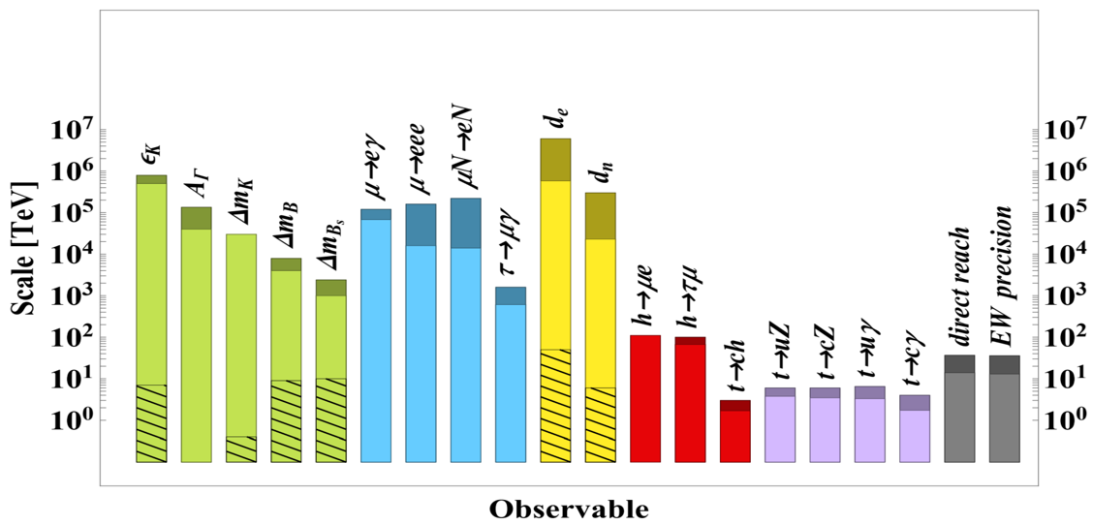
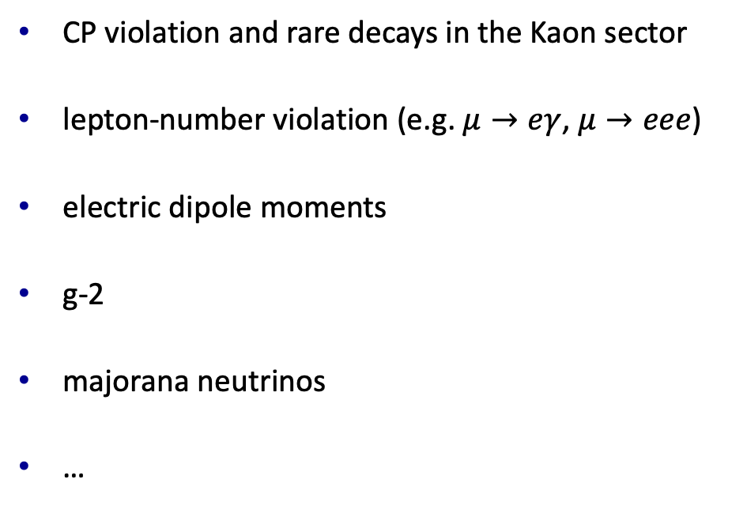
Some of the things that I did not cover
CP violation and rare decays in the Kaon sector
lepton-number violation (e.g. $μ→eγ$, $μ→eee$)
electric dipole moments
g-2
majorana neutrinos
…
arXiv:1910.11775

Slide 40
Closing remarks
low energy measurements can be sensitive to very high mass scales
several ‘quark flavour physics’ measurements show tension with SM predictions
  experimental effects?
  theoretical understanding?
  new physics?
→ Belle-II/LHC measurements will improve a lot over coming decade
lot’s of other exciting experiments ongoing: watch tight!

