Slide 1
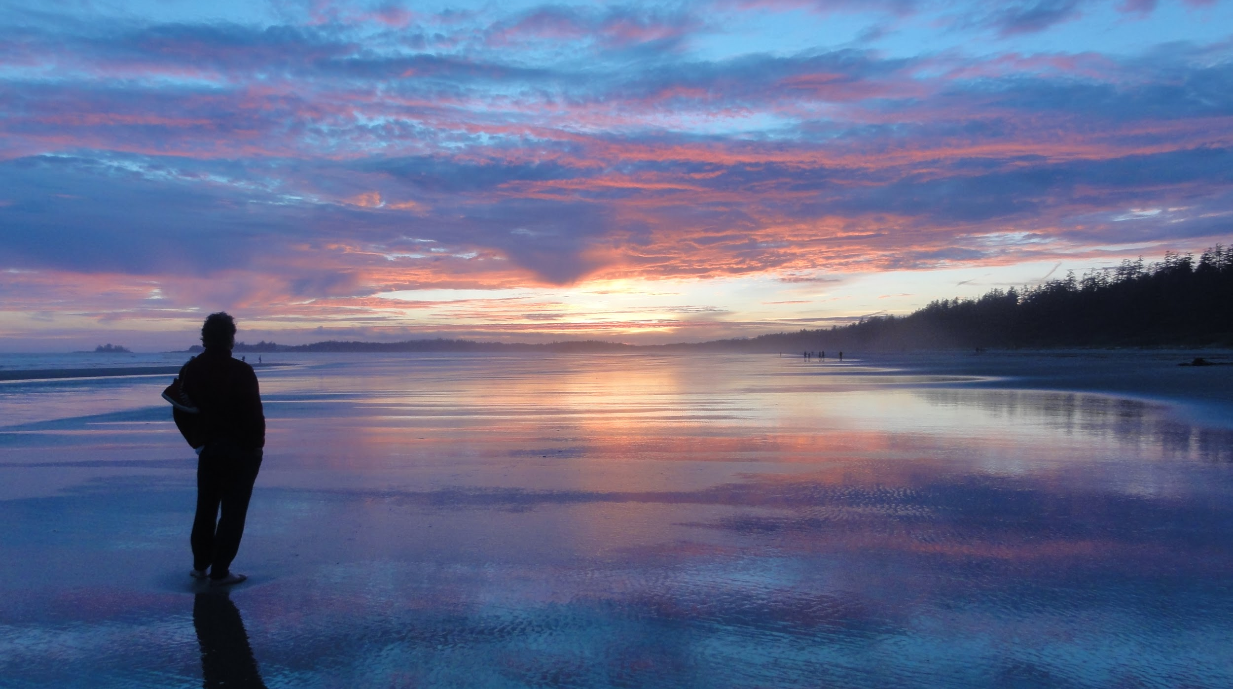
Developments in Sharing and Reusing Open Education Around the World
Open Education Seminar
Putting the TU Delft Strategic Framework Into Practice
Paul Stacey
8-Mar-2018

Slide 2
http://www.oeconsortium.org/
https://www.openeducationweek.org/
https://conference.oeconsortium.org/2018/

Slide 3
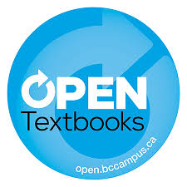
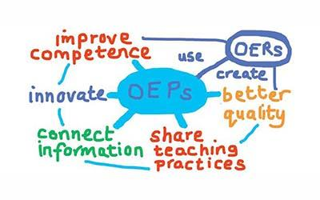
Open Science Logo by gemmerich CC BY-SA

Slide 4
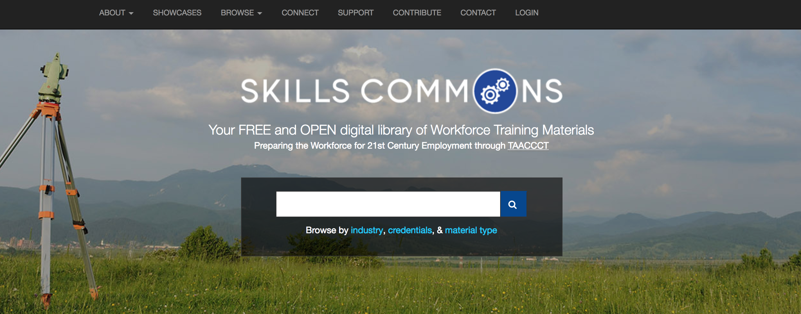
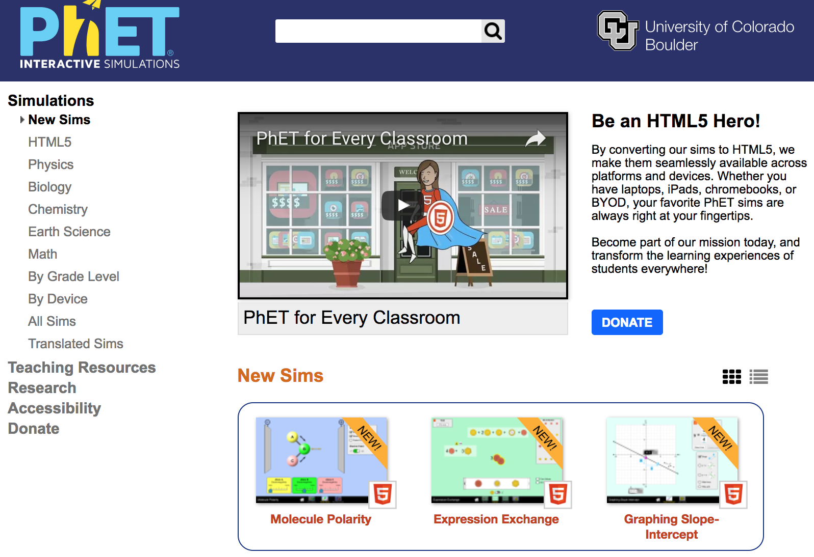
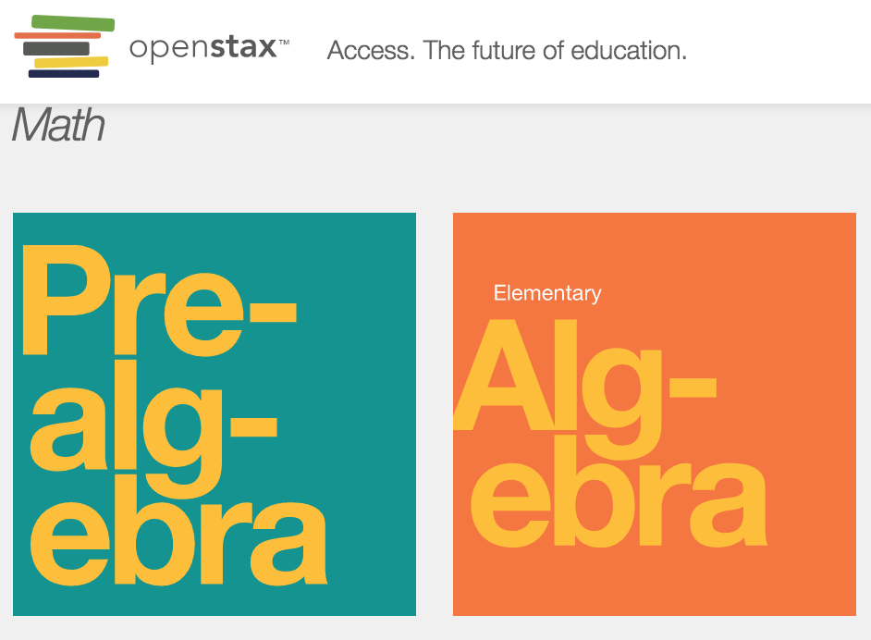
Different Types of OER
https://www.skillscommons.org/
https://openstax.org/
https://www.tcc.edu/academics/degrees/textbook-free
https://phet.colorado.edu/en/simulations/category/new

Slide 5
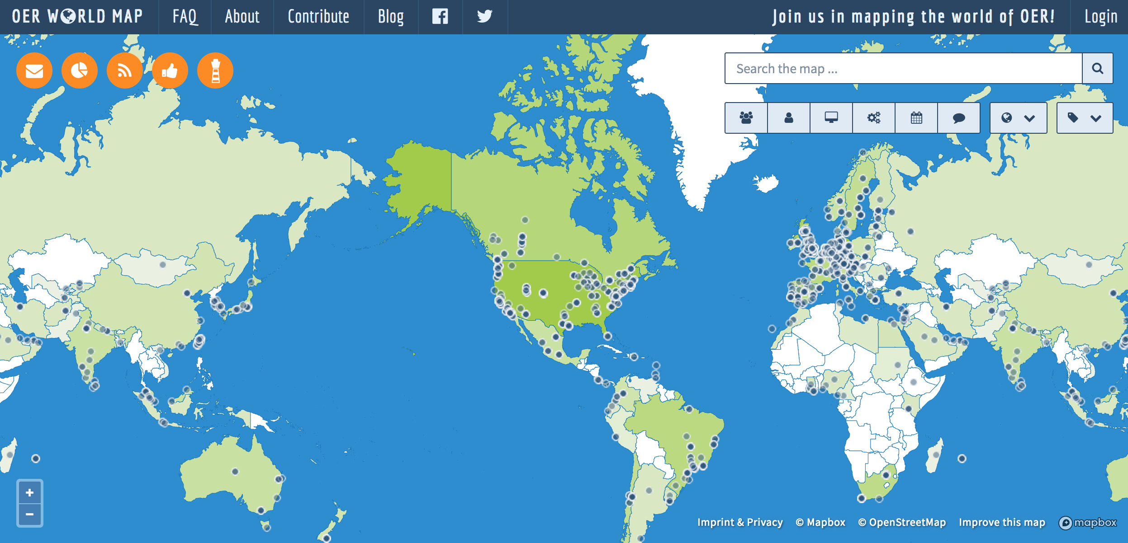
https://oerworldmap.org/

Slide 6
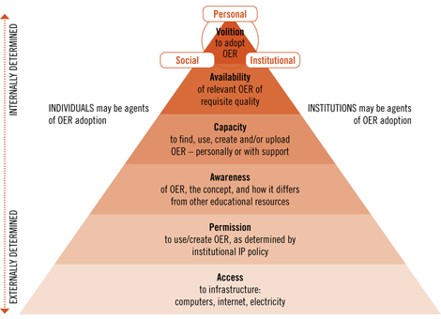
https://zenodo.org/record/1094852#.Wo1pohNuaCQ2

Slide 7
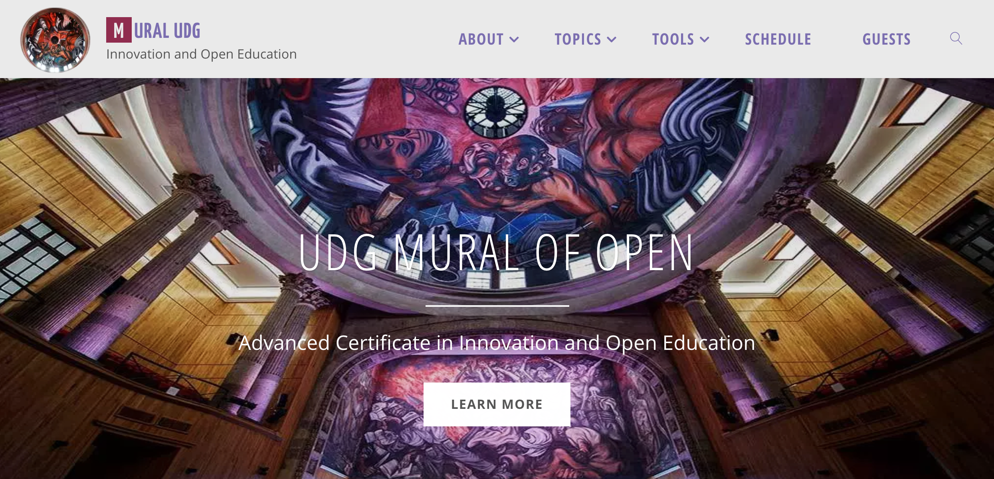
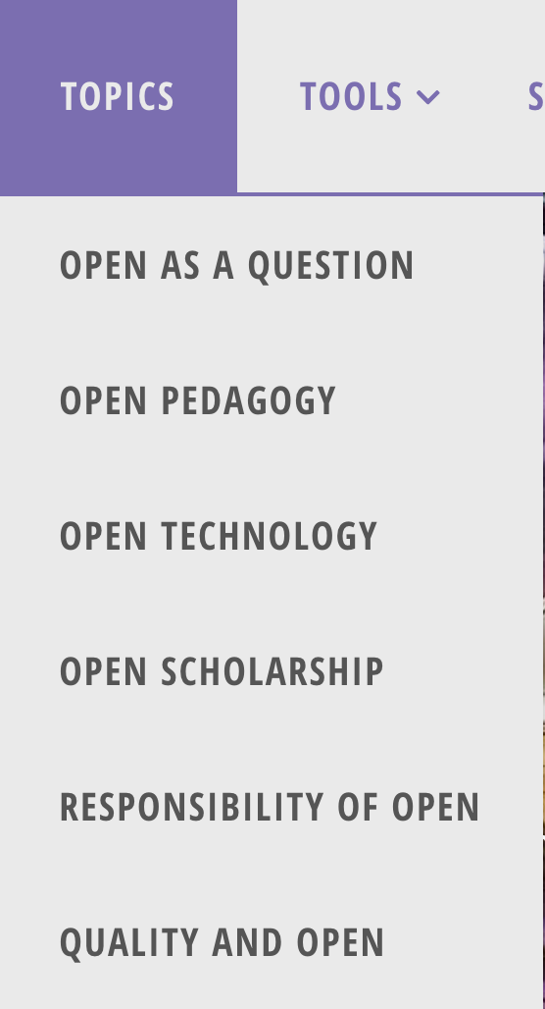
University of Guadalajara
https://muraludg.org/

Slide 8
https://openstax.org/

Slide 9
https://open.umn.edu/opentextbooks/

Slide 10
https://openstax.org/blog/announcing-openstax-creator-fest

Slide 11
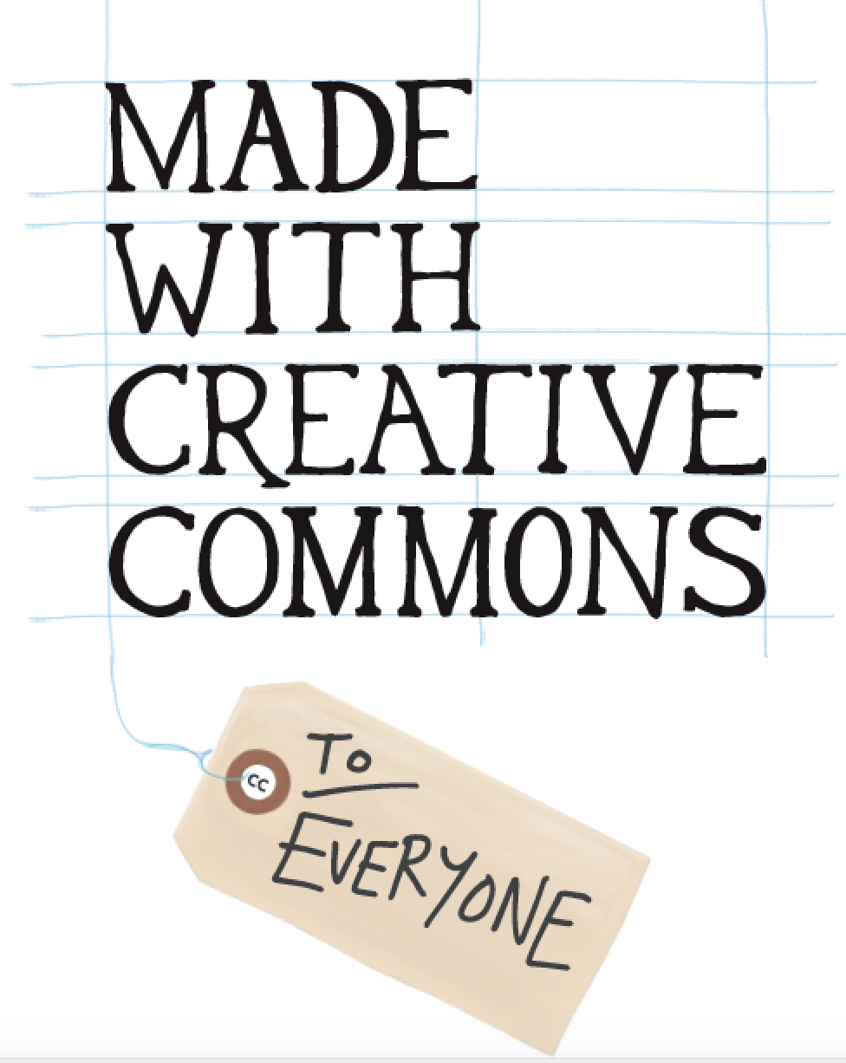
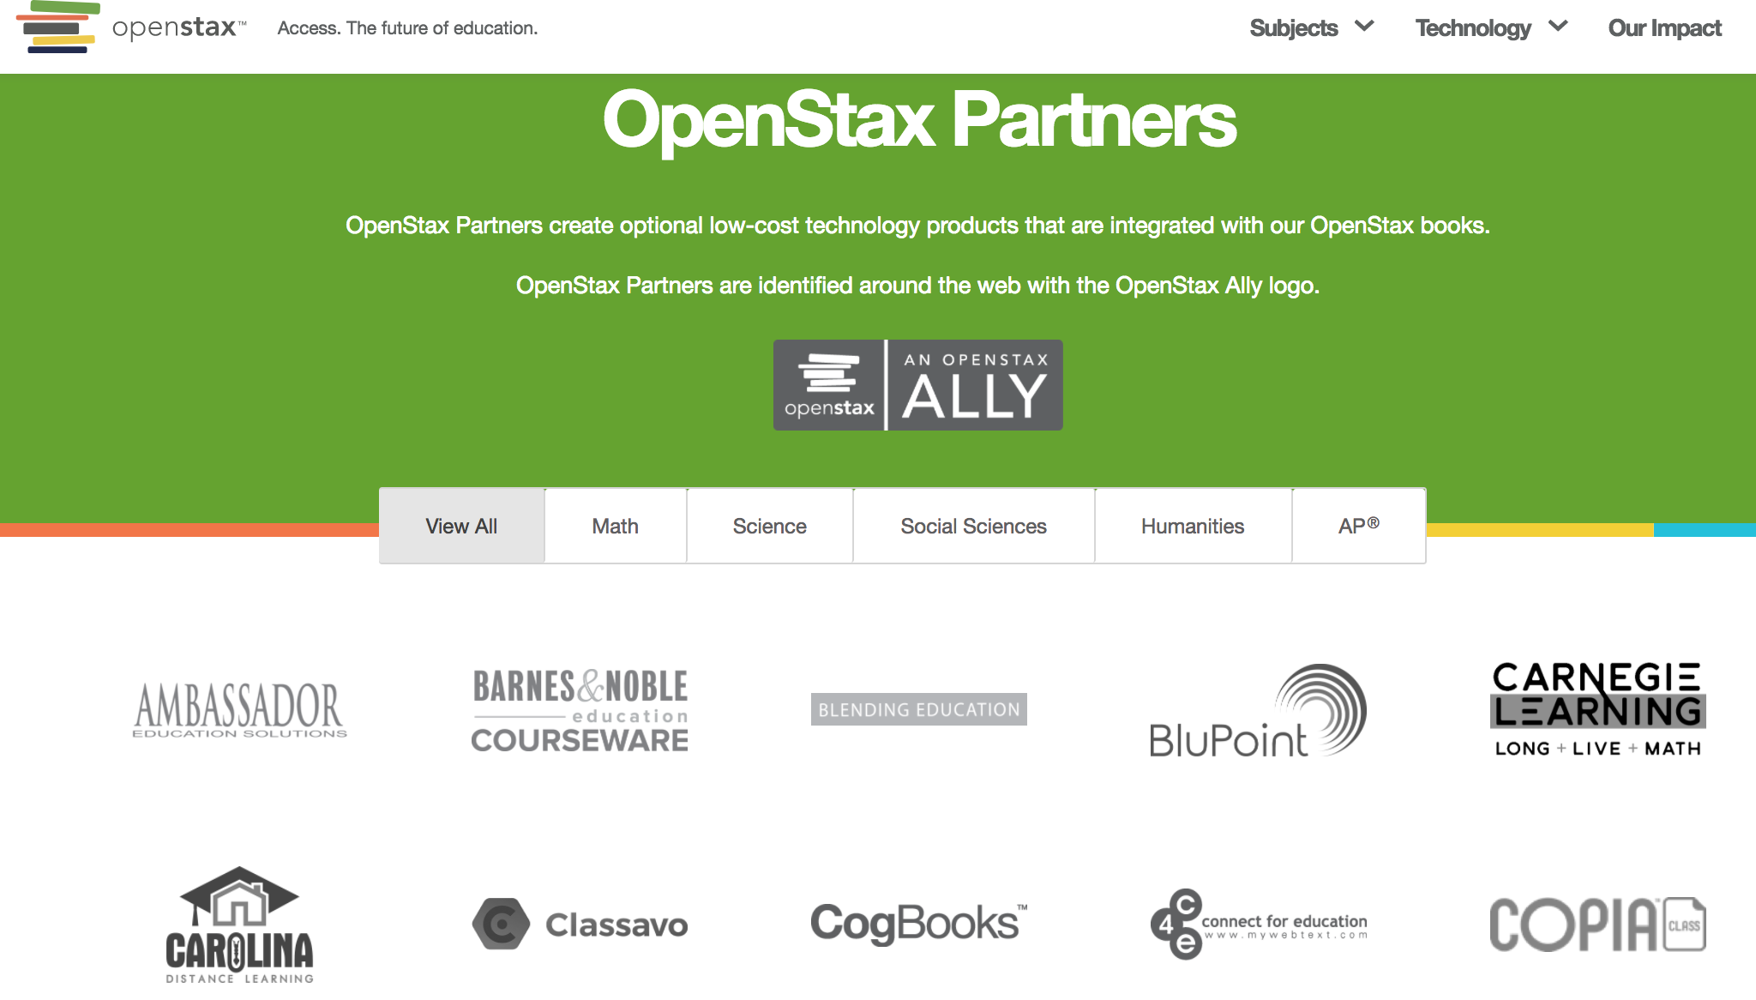
Open Business Models
https://madewith.cc

Slide 12
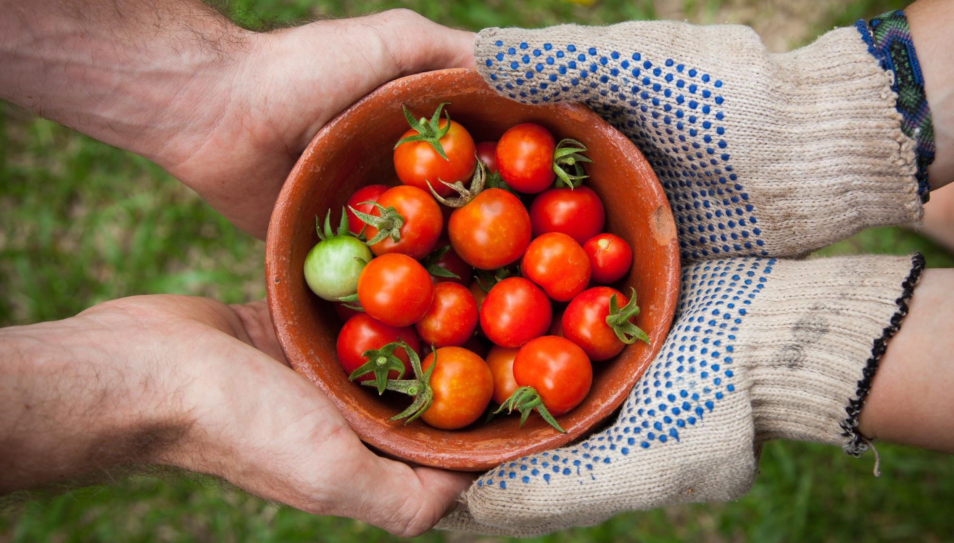
COMMONS
Photo by Elaine Casap on Unsplash

Slide 13
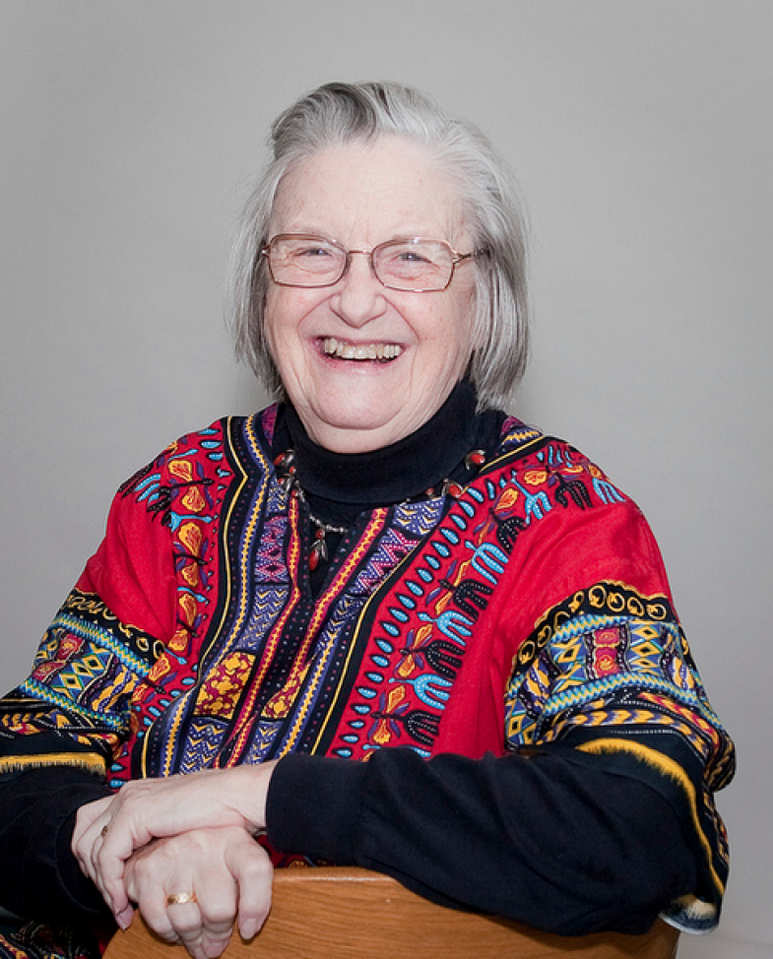
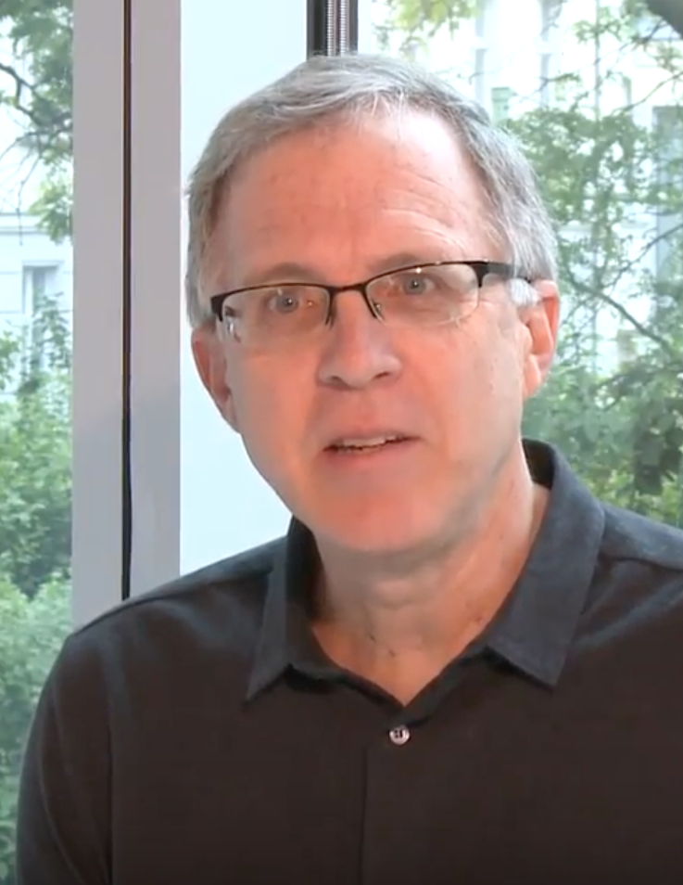
WHAT IS A COMMONS?
“A community based social system, independent of the state and market, for the long-term stewardship of resources.“
Open = practice of commoning
Commons = social practice + pool of managed resources
Elinor Ostrom
David Bollier

Slide 14
From the what to the how …
WHAT
HOW
Open pedagogy,
Open educational practices (OEP)
from Christina Hendrick’s Students & Open Education: From the What to the How & Why (& When Not) https://osf.io/vch46/
Notes:
Open pedagogy icon created from icons purchased through a subscription to The Noun Project: thenounproject.com

Slide 15
… and why
From cost savings …
To other benefits as well …
Physics course headline from this article; student savings from BCcampus

Slide 16
Open pedagogy, student contributions to OER & OEP
The “How” of teaching and learning

Slide 17
Much talk of Open Pedagogy in 2017
https://www.yearofopen.org/
Year of Open logo licensed CC BY 4.0
Notes:
Posts by Robert Schuwer, Maha Bali, Arthur Gill Green, David Wiley, Rajiv Jhangiani, Heather Ross, Devon Ritter

Slide 18
A few quotes about open pedagogy
“we shift the student emphasis to contribution to knowledge as opposed to simple consumption of knowledge” (Heather Ross)
“the ability for learners to shape and take ownership of their own education” (Devon Ritter)
“Open as a means to connect with a broader, global community” (Tannis Morgan)
“Teacher as ‘the’ authority vs. students being able to bring other sources of authority” (Jim Luke)

Slide 19
Reducing “Disposable” Assignments
“…trying to create assignments that are sustainable or not disposable, assignments that would have benefit to others beyond the limited course time and space” (Maha Bali)
David Wiley on “disposable assignments”
E.g., eCampus Ontario student experience design lab, “exponential learning” project
Images licensed CC0 on pixabay.com: trash can and symbol for no
Notes:
Renewable assignments: using OER, then releasing as OER
Students contributing to OER falls under “open pedagogy” more than students doing things that add value to the world but are not OER, I think…but this could be disputed by others.
eCampus ontario student experience design lab, exponential learning project: https://sxdlab.ecampusontario.ca/wp-content/uploads/2017/08/Exponential-Learning.pdf
Exponential Learning: How many courses use the same assignments year after year, requiring students to do the
exact same work over and over? How many assignments have you done that were looked at once, then never
again? How often have you felt like you were working just to get a grade, instead of doing something of value?
This project tackles the issue of meaningless work, by inviting students to explore new ways to make sure
everything they do has value. Instead of “throwing away” the work of students, Exponential Learning captures it
and makes it available to other students. Then, when students do an assignment, they build on all this previous
work and do something new that future students will be able to use. This will make assignments more
meaningful and useful, which will increase engagement and expand our collective knowledge on every topic.
This initiative is led by three student Project Designers:
Anne Filion, Danielle Cruz, and Eric Chung
.
For more information about the project and/or to add comments or suggestions, please visit
sxdlab.ecampusontario.ca or tweet us @SXDLa

Slide 20
OER-enabled pedagogy
“What teaching and learning practices are possible (or practical) in the context of OER that aren’t possible when you don’t have permission to engage in the 5R activities?”
-- D. Wiley, “OER-enabled pedagogy”
Reuse
Revise
Remix
Retain
Redistribute

Slide 21
Some themes in open pedagogy
Students producing OER, public knowledge; non-disposable assignments
Student choice, agency, autonomy; e.g., as co-creators of curricula
Connecting to wider networks
Open-ended problems; valuing creativity & change
Transparency in teaching & learning, fostering trust
Increasing access: financial & other
From two blog posts: May 2017, Oct 2017
Notes:
Blog posts with discussions of these aspects, which are gathered from many others’ views (the first post in particular lists all those views and gives hyperlinks; the second post adds a few readings to the list)
http://blogs.ubc.ca/chendricks/2017/05/23/navigating-open-pedagogy-pt2/
http://blogs.ubc.ca/chendricks/2017/10/25/open-pedagogy-shared-aspects/

Slide 22
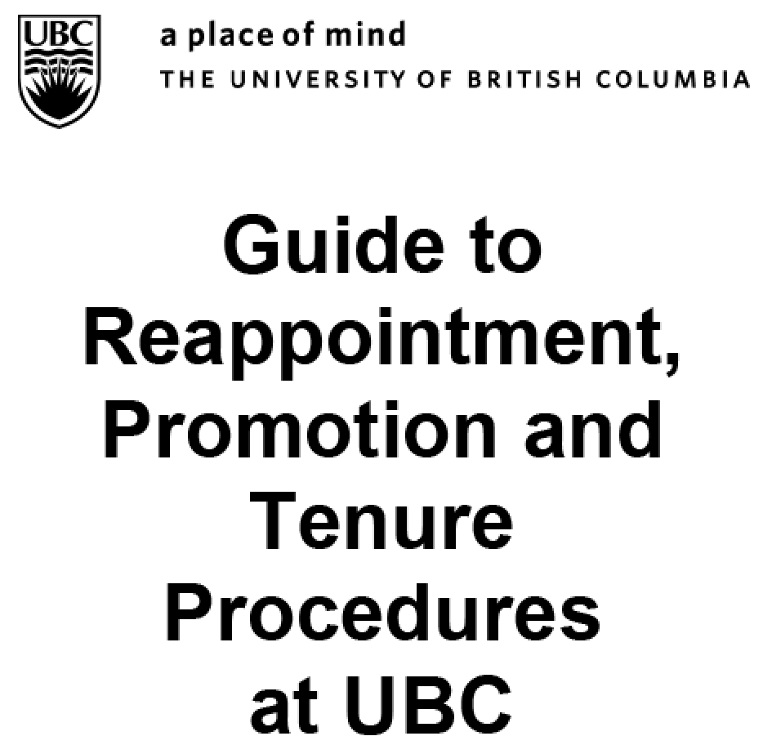
Open Educational Resources Policies
3.4.1 Evidence of educational leadership is required for tenure/promotion. Evidence can include:
Contributions to the practice and theory of teaching and learning literature, including publications in peer-reviewed and professional journals, conference publications, book chapters, textbooks and open education repositories / resources.
http://www.hr.ubc.ca/faculty-relations/files/SAC-Guide.pdf

Slide 23
https://www.slideshare.net/jennifersnoekbrown/oer-challenges-benefits-71571096
https://www.slideshare.net/MrNick/a-librarians-road-map-to-open-acces
https://www.slideshare.net/LornaMCampbell/crossing-the-field-boundaries-open-science-open-data-and-open-education
https://www.slideshare.net/jonvoss/si-lodlam-3novid
Notes:
New role as part of teams collaborating with faculty and students co-creating teaching and learning materials
Bring library perspective to emerging OER field
Knowledge about copyright, Information and Digital literacy - pedagogical shift in librarianship

Slide 24
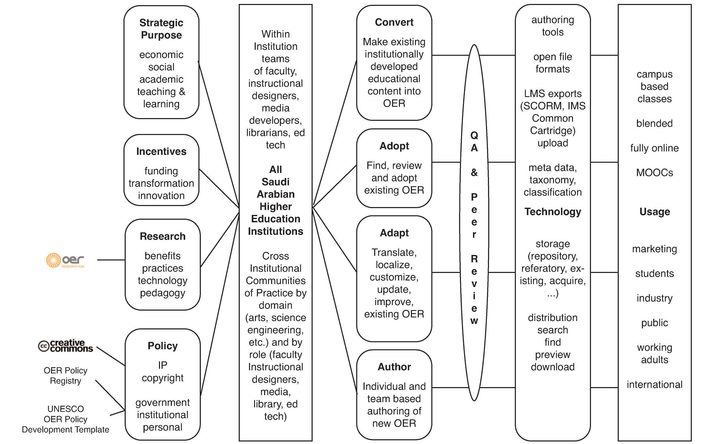

Slide 25
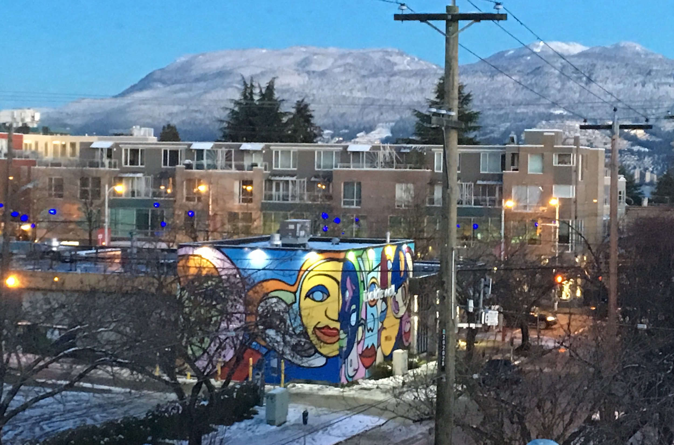
Paul Stacey
Executive Director
Open Education Consortium
Vancouver, British Columbia, Canada
E-mail: paulgordonstacey@gmail.com

