Slide 1
MR-DSS -- Smaller MinRank-based (Ring-)Signatures
Emanuele Bellini, Andre Esser,
Carlo Sanna, and Javier Verbel
https://eprint.iacr.org/2022/973.pdf
Cryptography Research Center
tii.ae

Slide 2
Motivation
Digital signature schemes
$A$uthenticity of digital messages.
Quantum secure $→$Against classical + quantum adversaries.
3 schemes selected by NIST $→$ - Dilithium, Falcon (Structured lattices)
- SPHINCS+ (Hash-based)
Demand to diversify $→$ New NIST call for proposals
MinRank problem:
Extensively study for cryptanalysis.
Simple, and easy to describe.
So far limited proposals based on the MinRank problem.
TII – Technology Innovation Institute
Cryptography Research Center
2

Slide 3
Our contribution
MR- DSS: A post-quantum MinRank-Based Digital Signature Scheme.
Previous MinRank-based signatures:
2001: First MinRank-based signature scheme by N. Courtois. [Cou21]
ZK protocol with soundness 2/3 + Fiat-Shamir.
Allows for ring signatures.
MR- DSS:
Built over Courtois’ scheme.
Sigma protocols with helper [Beu20] + Fiat-Shamir
Soundness error to ½.
Signature and PK sizes smaller than Courtois’.
Concurrent work: Signature scheme by Santoso, Ikematsu, Namura, and Yasuda.
Different approach + achieves soundness error of 1/2.
TII – Technology Innovation Institute
Cryptography Research Center
3

Slide 4
Outline
Preliminaries.
Our zero-knowledge protocol with Helper.
MR-DSS signature scheme.
Parameters.
TII – Technology Innovation Institute
Cryptography Research Center
4

Slide 5
Preliminaries
Cryptography Research Center
tii.ae

Slide 6
The MinRank problem
Input: An integer $r$, and $k+1$ matrices $M_{0}, …,M_{k}∈ 𝔽_{q}^{m x n}$
Output: $α_{1 }{,…, α}_{k }∈ 𝔽_{q } such than rank(M0+ \sum_{i=1}^{k}{αi Mi )≤r}$
Features:
NP- complete, and hard for random instances.
Simple: Based on linear algebra computations.
Extensively studied: Cryptanalysis of Rainbow, GeMSS, ROLLO, etc.
Quantum secure.
TII – Technology Innovation Institute
Cryptography Research Center
6

Slide 7
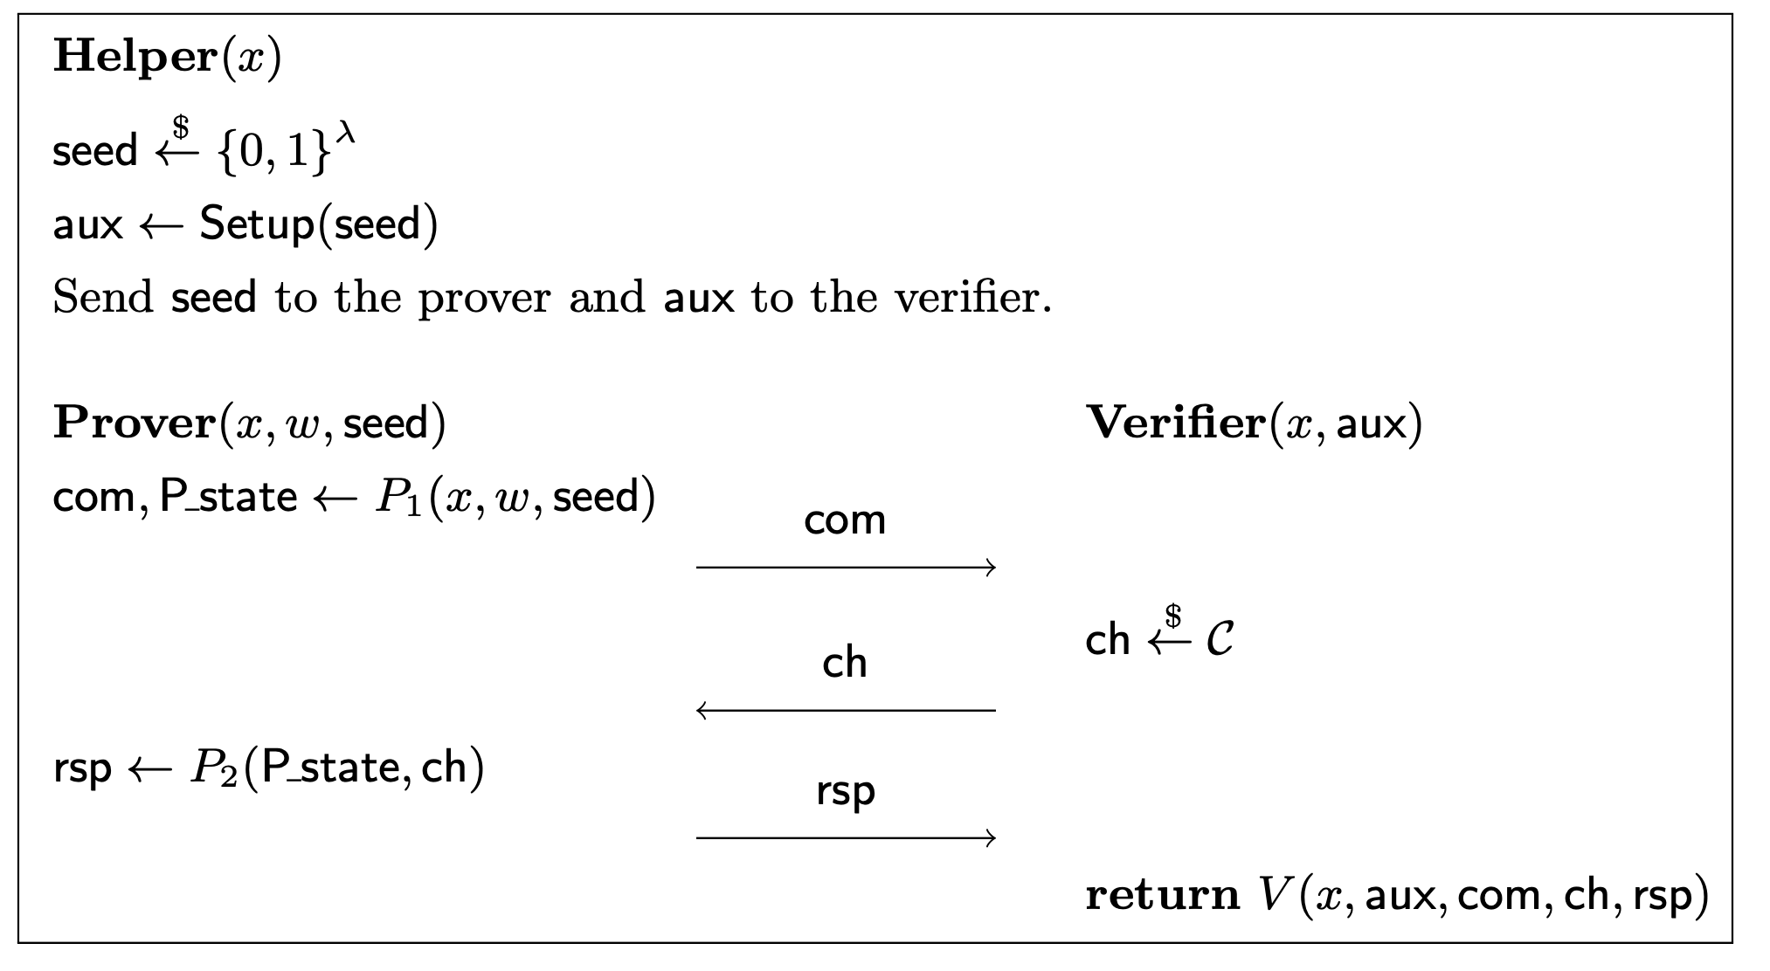
A 3-pass sigma protocol with helper [Beu20]
A protocol between the Prover$(x, w)$ and the Verifier$\left(x\right)$
Goal: Proof the knowledge $w$ such that $\left(x, w\right)∈ ℛ.$
The Helper: trusted by the Prover and the Verifier.
Accept or Reject ?
TII – Technology Innovation Institute
Cryptography Research Center
7

Slide 8
Security properties sigma protocol with Helper
Correct: A prover holding $w$ is always accepted.
2-special sound: A witness $w$can be efficiently extracted $\left(x,aux,{com}_{}, ch, rsp\right) and \left(x,aux ,{com}_{}, ch^{′}, rsp^{′}\right).$
3. HV-zero-knowledge: There exists an efficient simulator $𝒮(x)$ that produces transcripts indistinguishable from the ones by Prover$(x, w)$.
Has soundness error $p$: Any efficient adversary $𝒜(1^{λ}, x)$ passes with prob. $≤ p+negl\left(λ\right).$
TII – Technology Innovation Institute
Cryptography Research Center
8

Slide 9
Removing the Helper + Fiat-Shamir signatures
Cut-and-choose[KKW18]: A way to simulate the Helper
Prover$(x, w)$:
for $i∈\left\{1,…, s\right\}:$
${seed}_{i}\underset{←}{\$} {\{0,1\}}^{λ}$
$${ aux}_{i}←Setup\left({seed}_{i}\right)$$
${ com}_{i}$ and ${rsp}_{i}$as before
Verifier$\left(x\right)$:
Sample $I⊂\{1,…, s\}$, $\left|I\right|= τ$
Checks ${aux}_{i}=Setup\left({seed}_{i}\right)$ $∀ i∉I$
$$\underset{→}{ {com}_{i}, { aux}_{i} ∀i }$$
$$\underset{←}{ I, {\{{ch}_{i}\}}_{i∈I} }$$
$$\underset{→}{ {{\{seed}_{i}\}}_{i∉I} , {\left\{{rsp}_{i}\right\}}_{i∈I}}$$
Validates ${(x,{aux}_{i },{com}_{i},{ch}_{i},{rsp}_{i})}_{i∈I}$
Fiat-Shamir Transform:
$$\underset{→}{ com }$$
$$\underset{←}{ ch =H(com ||msg)}$$
$$\underset{→}{ rsp }$$
A signature for $msg$:
The Transcripts of the simulated protocol
$$⟹$$
Prover$(x, w, msg)$:
TII – Technology Innovation Institute
Cryptography Research Center
9

Slide 10
Our Zero-Knowledge Protocol with Helper
Cryptography Research Center
tii.ae

Slide 11
Our zero-knowledge protocol with Helper
($x, w)=$(($M_{0} ,…,M_{k}), (E, α))$ s.t : $E≔M0+Σ_{i=1}^{k}αi Mi , and rank\left(E\right)≤r$
Based on: $∀$ $T, S, β TES=TM_{0}S− T\underset{\begin{aligned} \\ ≔ N_{1}\end{aligned}}{\underbrace{\left(\sum_{i=1}^{k}{β_{i} M_{i}}\right)} S}+ T\underset{\begin{aligned} \\ ≔ N_{2}\end{aligned}}{\underbrace{\left(\sum_{i=1}^{k}{(α_{i}+ β_{i}) M_{i}}\right)}}S$
TII – Technology Innovation Institute
Cryptography Research Center
11

Slide 12
Our zero-knowledge protocol with Helper
($x, w)=$(($M_{0} ,…,M_{k}), (E, α))$ s.t : $E≔M0+Σ_{i=1}^{k}αi Mi , and rank\left(E\right)≤r$
Based on: $∀$ $T, S, β TES=TM_{0}S− T\underset{\begin{aligned} \\ ≔ N_{1}\end{aligned}}{\underbrace{\left(\sum_{i=1}^{k}{β_{i} M_{i}}\right)} S}+ T\underset{\begin{aligned} \\ ≔ N_{2}\end{aligned}}{\underbrace{\left(\sum_{i=1}^{k}{(α_{i}+ β_{i}) M_{i}}\right)}}S$
Helper: $\left(β, S, T\right)← PRG\left(seed\right), and$ ${com}_{0}=Com(S, T)$, ${com}_{1}= Com(T N_{1}S)$
Prover$\left(M,(E, α), seed\right):$ Verifier$(M, \left({com}_{0},{com}_{1}\right))$
$$ch \underset{←}{\$} \{0, 1\}$$
$${com}_{}=Com\left(T N_{2}S\right)$$
$$\underset{→}{ {com}_{} }$$
If $ch=0:$
${ com}_{1}=Com\left(R_{1}\right) and rank\left(R_{2}−R_{1}\right)≤r ?$
else:
Recompute $N_{2}$from $R_{2}, and T, S for R_{1}$
${com}_{0}=Com\left(R_{1}\right)$ and ${com}_{}=Com\left(TN_{2}S\right)$
If $ch=0:$
$(R_{1},R_{2})=$ $\left(TN_{1}S, TN_{2}S\right)$
else:
$$(R_{1},R_{2})= \left(\left(S, T\right), α+β\right)$$
$$\underset{←}{ ch }$$
$$\underset{→}{ R }$$
TII – Technology Innovation Institute
Cryptography Research Center
12

Slide 13
MR-DSS signature scheme
Cryptography Research Center
tii.ae

Slide 14
The Signature Scheme
KeyGen: ${ M}_{1},…,M_{k}, E, α$ are random, with $rank\left(E\right)≤r$
PK: $M=\left(M_{0}, …, M_{k}\right),$ where $M0≔E+Σ_{i=1}^{k}αi Mi$
SK $=(E, α)$
Optimizations:
Smaller PK: We force $k$ zeros coordinates of $M0$.
$$mn\log\left(q\right)⟹(mn −k)\log\left(q\right)$$
Send rank-r matrix: $\left(TN_{1}S, TN_{2}S −TN_{1}S\right)$ instead of $\left(TN_{1}S, TN_{2}S\right)$
$mn\log\left(q\right)⟹r(m+ n) \log\left(q\right)$
14

Slide 15
The Ring-Signature Scheme
Ring Signatures:
A ring with $u$user is a set $ℛ ≔({PK}_{1},…, {PK}_{u})$ .
A member of $ℛ$ is a holder${SK}_{i}$ for some $i$.
Any member of $ℛ$ can sing a given message.
Anyone with $ℛ$ can verify a signature.
Anonymity: The identity of the signer remains secret within $ℛ$.
MRr-DSS:
A fixed random public set $M=\left(M_{0}, …, M_{k}\right)∈𝔽^{m ×n}$.
(PK, SK) = $(R, (E, α))$, where $R≔− E+M0 +Σ_{i=1}^{k}αi Mi$, $rank\left(E\right)≤r$
The vector $( 1$, $α1$,… ,$αk$, $0 ,…, 0, 1 , 0, … ,0)$ is a solution to
MinRank with : $(M0$, $M1$,…, $Mk$,$R_{1},…,R_{j−1}, R,R_{j+1},…, R_{u})$
From $α$ we produce a signature for the ring$(R_{1},…,R_{j−1}, R,R_{j+1},…, R_{u}$).
15

Slide 16
Parameters
Cryptography Research Center
tii.ae

Slide 17
Attacks on the MinRank problem
We want $α∈𝔽^{k}$such that: $E≔M0+Σ_{i=1}^{k}αi Mi ∈ 𝔽^{m ×n}, and rank\left(E\right)≤r$
Kernel Search: Guess $⌈\frac{k}{m}⌉$ L.I vectors in $kernel(E)$.
Support Minors [BBCGPSTV20]: Rows of $M0+Σ_{i=1}^{k}αi Mi$ $∈Row−Space of C∈𝔽^{r ×n}$.
3. Hybrid approach [BBBGT22] : Guess $l_{v }<r$of the ${α_{i}}^{′}s$, and $a< ⌈\frac{k}{m}⌉$ vectors in $kernel(E)$.
MinRan$k \left(m×n, k, r\right)= q^{l_{v }+ar}$MinRan$k\left(m×\left(n −a \right), k−am −l_{v }, r\right)$
4. $k+1<\left(m −r\right) (n−r)$ to get uniqueness of $α.$
5. $m \left(n −r \right)−k+1$ big enough to avoid the ”big-m” attack [Cou01].
TII – Technology Innovation Institute
Cryptography Research Center
17

Slide 18
Removing the Helper and the Signature Scheme
Cat | $λ$ | q | m/n | k | r | Alg. | Bit complexity
I | 128 | 16 | 16 | 142 | 4 | KS | 158
III | 192 | 16 | 19 | 167 | 6 | KS | 231
V | 256 | 16 | 22 | 254 | 6 | SM | 295
Bit complexity of proposed parameters
Cat | Signature size (KB) |  | PK size (B)
 | Courtois’s | MR-DSS | Courtois’s | MR-DSS
I | 65 | 27 | 144 | 73
III | 135 | 60 | 205 | 121
V | 248 | 106 | 274 | 147
Signature and pk size comparisons, $s=2λ and τ=λ.$
TII – Technology Innovation Institute
Cryptography Research Center
18

Slide 19
Performance ring-signatures small rings.
#users $(u)$ | $$2^{3}$$ | $$2^{4}$$ | $$2^{5}$$ | $$2^{6}$$ | $$2^{7}$$ | Assumption | Security
MRr-DSS | 27 | 27 | 32 | 36 | 45 | MinRank | Cat I
[KKW18] | - | - | - | 250 | - | LOWMC | Cat V
Raptor[LZ19] | 10 | - | - | 81 | - | MSIS/MLWE | 100 bit
[EZSLL19] | 19 | - | - | 31 | - | MSIS/MLWE | Cat II
Falafl [BKP20] | 30 | - | - | 32 | - | MSIS/MLWE | Cat I
Calamari[BKP20] | 5 | - | - | 8 | - | CSIDH | 128 bit
LESS[BBNPS22] | 11 | - | - | 14 | - | Code Equiv. | 128 bit
Comparison ring signature size (in KB).
TII – Technology Innovation Institute
Cryptography Research Center
19

Slide 20
Conclusions and future work
Conclusions:
1. We proposed MR-DSS: A signature scheme based on MinRank problem.
3-pass ZK proof + Fiat-Shamir transform.
Its ZK protocol has soundness error of $\frac{1}{2}$.
It improves by a factor >2 sig. size of Courtois’s scheme.
It is quantum-secure.
An interesting alternative for ring-signatures.
Future work:
ZK protocol for MinRank with smaller soundness.
2. Trapdoor MinRank-based signatures.
TII – Technology Innovation Institute
Cryptography Research Center
20

Slide 21
Thank you!
Questions?
tii.ae

