Slide 1
Integrating doughnut principles into university economics courses
Juliette Alenda
Department of Economics, IMR, Radboud University
Juliette.alenda-demoutiez@ru.nl

Slide 2
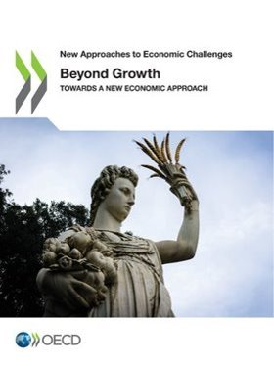
Transformation in economics needed: (extract OECD)
Addressing these challenges requires rethinking many of the dominant approaches to economic policymaking which OECD countries have adopted over the last 40 years. This will involve:
A new conception of economic and social progress – a deeper understanding of the relationship between growth, human wellbeing, a reduction in inequalities and environmental sustainability, which can inform economic policymaking and politics.
New frameworks of economic theory and analysis – a richer basis of understanding and evidence on how economies work, and new tools and techniques to help policymakers devise policy.
New approaches to economic policy – a wider set of policy and institutional reforms, based on the new frameworks and analysis, to achieve the new social and economic goals.

Slide 5
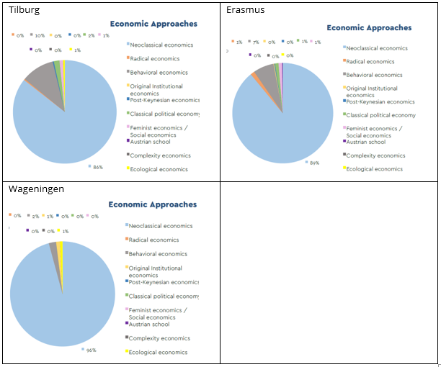
https://static1.squarespace.com/static/5f4a3e096331322d95b2221e/t/603b98b63bcb991173d5b386/1614518480282/Thinking%2Blike%2Ban%2Beconomist.pdf

Slide 6
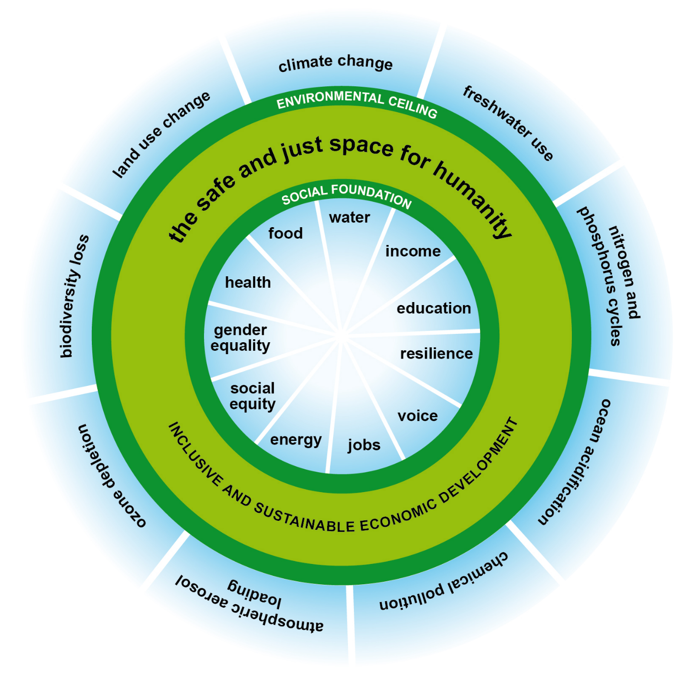
Doughnut economics

Slide 7
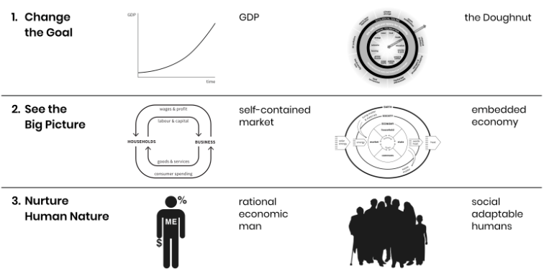
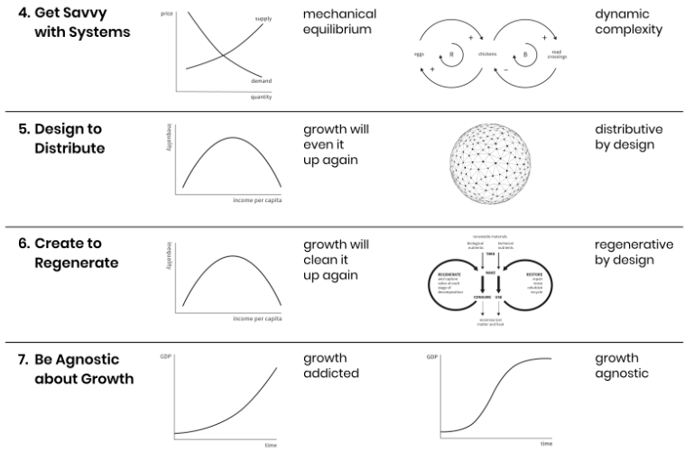
The seven principles

Slide 8
1. Change the goal => change the framing of many courses

Slide 9
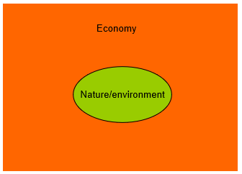
2. See the big picture => Go beyond market and monetary mechanisms and show dependency between parts of the system

Slide 10
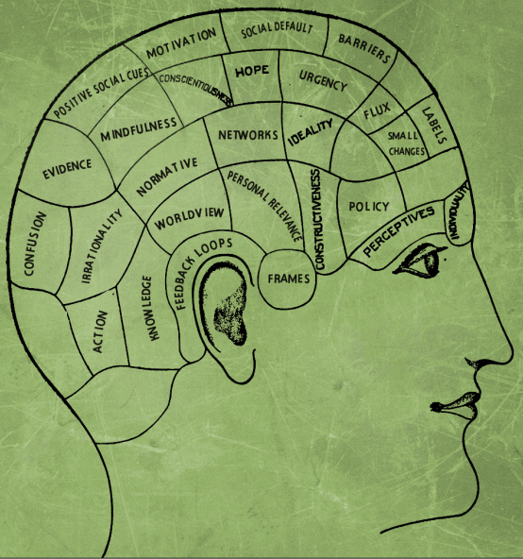
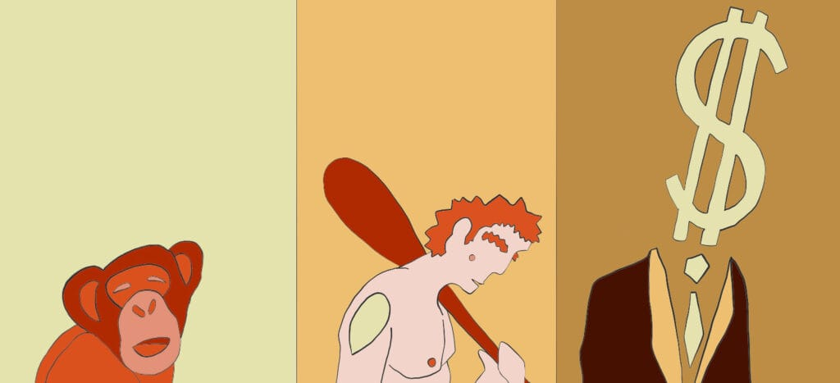
3. Nurture human nature => insights from other disciplines

Slide 11
4. Get savvy with the system => embrace evolutionary and complexity thinking

Slide 12
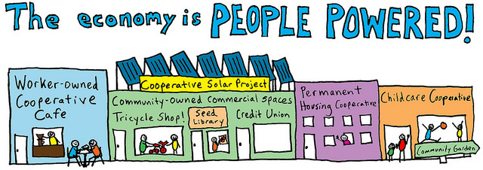
5. Design to redistribute => integrate power relationships and justice issues

Slide 13
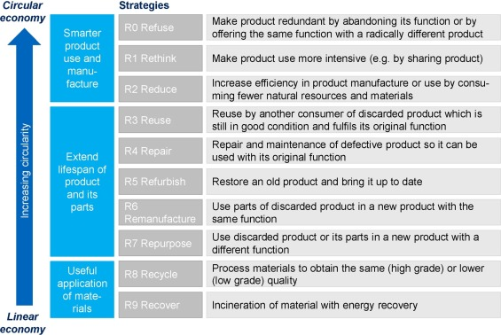
6. Create to regenerate => from competition to cooperation
https://doi.org/10.1016/j.resconrec.2017.09.005

Slide 14
7. Be Agnostic about growth => growth is not the solution for everything: go beyond traditional policies, and rethink consumerism

Slide 15
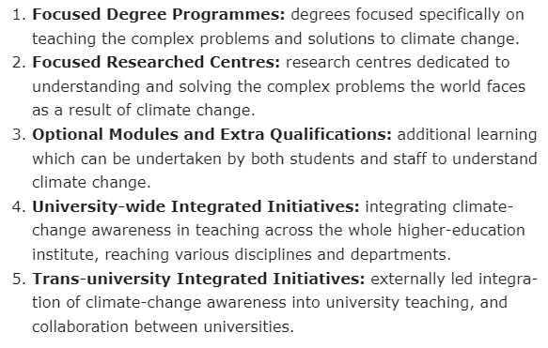
Example of my course: Economics and Sustainable Development
https://www.kateraworth.com/2018/12/07/how-can-universities-teach-more-students-more-about-climate-change/

Slide 16
Design: reviewing the balance between all parts of the economic system
Topic 1: Different views of sustainability in economics
Lecture 2: Weak versus Strong sustainability
Lecture 3: How to value nature?
Topic 2: Beyond GDP and traditional models of growth
Lecture 4: The limits of economic growth as we know it
Lecture 5: Alternatives for the future
Topic 3: Behaviors, cooperation and sustainable development
Lecture 6: Impacting individual behaviors
Lecture 7: Engaging citizens
Topic 4: Firms and sustainability
Lecture 8: Corporate social responsibility
Lecture 9: Circular economy (Guest lecture)
Topic 5: National and transnational policies
Lecture 10: Innovation policy and the energy sector (Guest lecture)
Lecture 11: Fiscal policies and need for international cooperation
Topic 6: Sustainable development and the financial system
Lecture 12: Money and green finance
Lecture 13: Climate, finance and the role of central banks (guest lecture)
Lecture 14: Conclusions and Q&A. The paths forward.

Slide 17
Content
Topic 1: Different views of sustainability in economics
Lecture 2: Weak versus Strong sustainability
Lecture 3: How to value nature?
Topic 2: Beyond GDP and traditional models of growth
Lecture 4: The limits of economic growth as we know it
Lecture 5: Alternatives for the future
Topic 3: Behaviors, cooperation and sustainable development
Lecture 6: Impacting individual behaviors
Lecture 7: Engaging citizens
Topic 4: Firms and sustainability
Lecture 8: Corporate social responsibility
Lecture 9: Circular economy (Guest lecture)
Topic 5: National and transnational policies
Lecture 10: Innovation policy and the energy sector (Guest lecture)
Lecture 11: Fiscal policies and need for international cooperation
Topic 6: Sustainable development and the financial system
Lecture 12: Money and green finance
Lecture 13: Climate, finance and the role of central banks (guest lecture)
Lecture 14: Conclusions and Q&A. The paths forward.
2
4
1
7
3
4
4
6
4
5
4
5
5
7

Slide 18
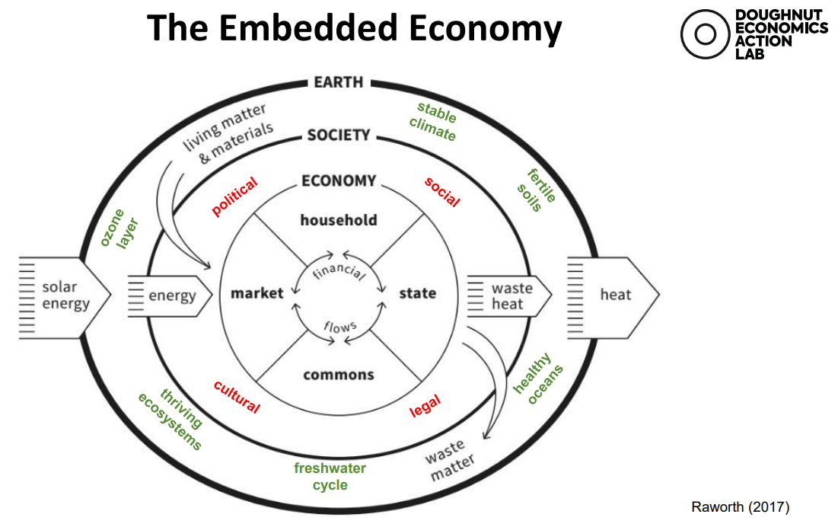
Some conclusions
Compass, not a map
A content designed to rethink economics but also to support students in forging their own opinion
It is important to raise awareness of many issues (sustainability, justice, diversity of contexts and voices in the world)
Make the connection with the real-world
In each course, it is possible to explore some principles, to go beyond mainstream theories

Slide 19
https://www.researchgate.net/publication/319310305_General_Guide_Of_Schools_Of_Economic_Thought_-_3rd_Edition

Slide 20
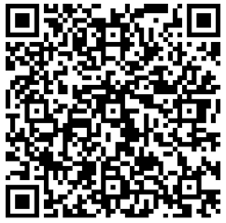
Discussion
How would you envision this in your own courses?
Anything (for sure) I forgot, any aspects to add?
Should we start by redesigning programmes or first by redesigning courses?
Contribute: Doughnut Economics Action Lab (DEAL)

