Slide 1
Different stages, different questions – Research cycle
The Research Cycle
Good data management practices are essential along the whole research project to make sure that you, and your collaborators, are able to generate meaningful scientific results. If you think about your project as in a simplified cycle, it can look like the cycle on the left.
In each of these steps of your research there are Research Data Management questions that you need to ask yourself.
You can browse through the research cycle on the left via the arrows or by clicking all icons. Click the icons and read all questions.

Slide 2
Different stages, different questions – Research cycle
Think & Plan
At the beginning of your project, you need to consider how you will work with the data and code in a responsible way.
Will you deal with personal data?
Are there any ethical/legal/contractual issues regarding data collection?
What is the expected size of the data to be collected? Do you need to ask for extra storage capacity?
How will you securely store the data ?
Are there any funder/company/university requirements regarding Research Data Management?

Slide 3
Different stages, different questions – Research cycle
Discover
You might want to re-use data or code from others within your project. Such data/code could come from public institutions, companies, public registries, or commercial data providers
In this case you need to consider:
What are the rights concerning the data/code you are planning to use?
What are the obligations concerning the data/code you are planning to use?
Are costs involved to get access to the data or to use a software?

Slide 4
Different stages, different questions – Research cycle
Gather & Analyse
As soon as you start collecting/creating data/code (or even before), think about:
Where are you going to store the data?
Is the data frequently and safely backed-up?
Who is responsible for storage, back-up and security of the data?
What versioning tool will you use for your code?
Who will be allowed to access the data/code during the study?
Which folder structure will you use to organize the data/code in a findable way?
What are the file naming conventions you will use?
What is the relevant documentation that needs to be stored together with your data/code to help you (and others) to understand the data?

Slide 5
Different stages, different questions – Research cycle
Write & Publish
Once you are done processing and analysing the data, you will start sharing your findings with the scientific community, or with the public.
Funders, journals and universities want data and code to be made available for others to re-use, reproduce or verify your findings. Think about:
Are there policies about data/code publication from your university, funder of your project or the journal where you want to publish your results that you need to comply with?
How will you share the underlying data/code of your publications?
Which data repository will you use to publish your data/code?

Slide 6
Different stages, different questions – Research cycle
Share & Impact
Many projects might start by re-using findings and data/code from others in order to produce new research. To ensure that the data/code of your project are optimised for reuse and have an impact, ask yourself:
Are the data, code and procedures well described?
Which licence should I use the data/code I publish/share to ensure that they are used as I would like to?
Would a re-user know how to cite the data/code that I publish?

Slide 7
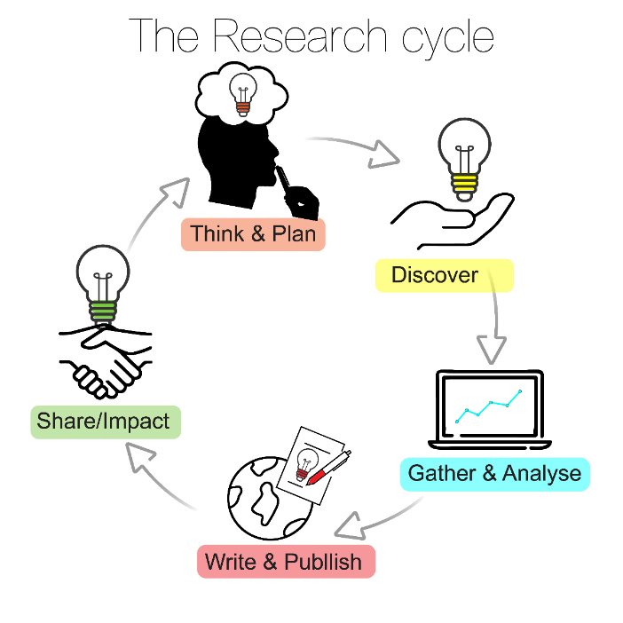
During this course we will revise and discuss some best practices that will help you answer these questions. We will also work together towards preparing a Data Management Plan, which can help you to consider all these questions and create a good strategy on how to manage your data.

