Slide 1

Space/Environments
Peter van der Putten,
New Media New Technology

Slide 2
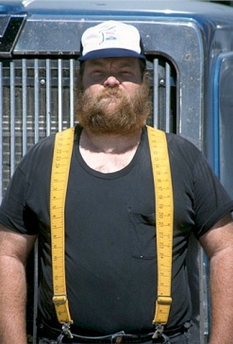

Meatspace
Augmented Virtuality
Augmented Reality
Virtual Reality
Diminished Reality
Artificial Reality

Slide 3

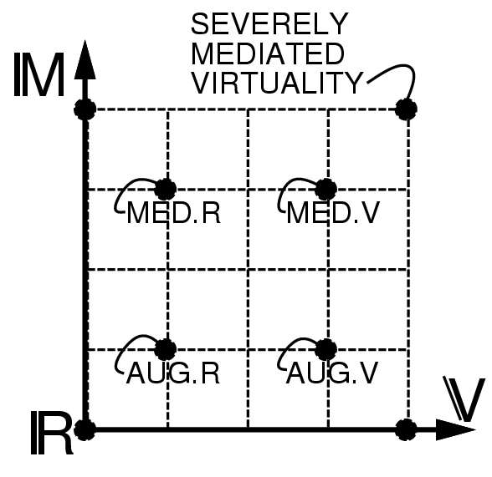
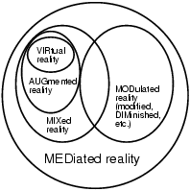
Milgram's Reality-Virtuality Continuum
Steve Mann. Mediated Reality with implementations for everyday life. presenceconnect.com, the on line companion to the MIT Press journal PRESENCE: Teleoperators and Virtual Environments, Date Posted: 2002 August 6

Slide 4
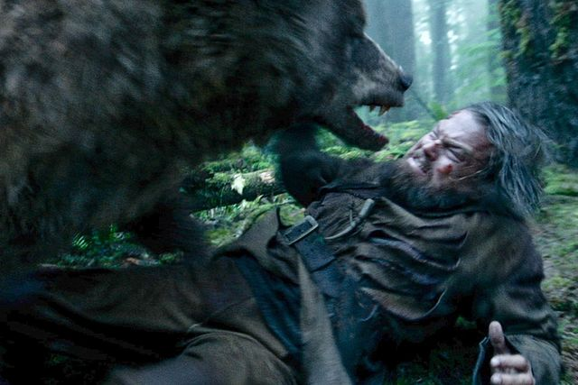
The Cinema of the Future
(Morton Heilig, 1955)
Notes:
Morton Heilig:
Hollywood filmmaker 60 documentaties, inventor, philosopher. Father of vr. Reality machines that integrate senses. Moved to mexico and patented telesphere mask and sensorama.
(Observation, integration (needs, emotions, trigger action), action [processing-OF!]. Science bestow knowledge. Art digest into deeper feelings. Industry to act. Mind, heart, muscle.)
Example: primitive man explaining he was attacked by a bear: growl like a bear, pretend to climb a tree. Reproduce elements/stimuli that led to emotions.
With language things actually became more complex – can convey thoughts, facts, concepts but emotions and perceptions are hard.
Art is bad at production, no methodology. And that is because the laws of art lie hidden in the subconscious, emotions.
http://uschefnerarchive.com/mortonheilig/

Slide 5
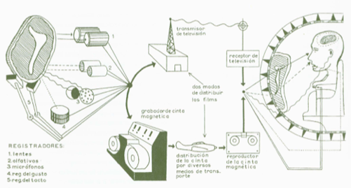
The Cinema of the Future (Morton Heilig, 1956)
Notes:
More direct forms of communications: painting, sculpture, dance, singing.
Goal is convey the richness of the experience. Integrated secondary arts like opera, ballet, theatre – but hard to control the performance– Gesamtkunstwerk.
Machine came to the rescue – it can control and orchestrate all of this.
Methodology and sciene of art - Laws of psyche and
Cinema is step 1. First sound, then color, then 3d film for depth, widescreen and then full peripheral vision for immersion. [make point about mediation – film music for example]
First law: naure of mans art is rooted in psychic apparatus and limited by seses adn action repertoire
Second law: consciousness is a composite of experiences, sense impressions conveyed through the brain by all senses
Odor will be decomposed and recorded on magnetic tape – see, listen, smell, feel
Science of art: methodology of using these senses as building blocks, when united create experience anc consciousness, find ways to combine, recording and projecting these experiences
Wll surpass ‘feelies’ – Aldous Huxley.
Third law. Sight 70%, hearing 20, smell 5, touch 4, taste 1
Shift attention across modalities (standing on a hill top example)
Integrate all but need to lead attention. How to do this? Can participants choose? An encompassing experience can also be an intimate one.
Fourth law: reception → imitation → creation from portraying outer to inner world
Note interaction is missing!

Slide 6
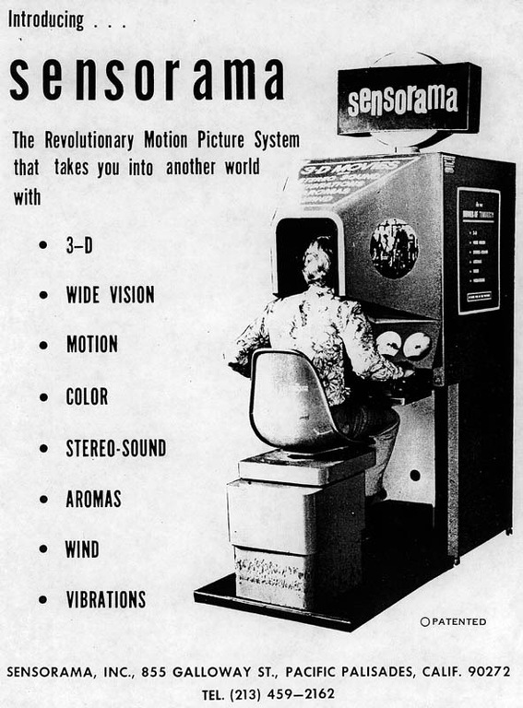
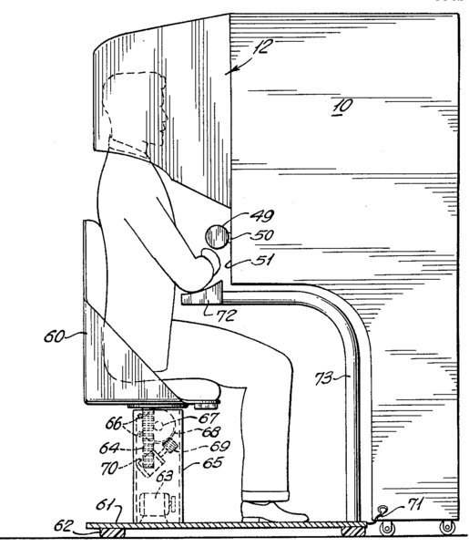
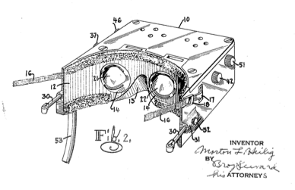
The Cinema of the Future (Morton Heilig, 1956)
Telesphere Mask and Sensorama
Dissolving the fourth wall of film
Notes:
http://uschefnerarchive.com/morton-heilig-biography/
SENSORAMA MOTION PICTURE PROJECTOR – A closed loop 35 mm projector capable of projecting a 10 minute 35mm film 16,000 times (the formerrecord was 2000 times)
SENSORAMA 3-D MOTION PICTURE CAMERA – Side-by-side dual film 35mm 3-D motion picture camera, with two 400 ft magazines. This camera is small enough to be hand-held.
THRILLERAMA THEATER – Rear Projected 3-D motion picture system with live actors in front of the screen, interacting with teh 3-D images on the screen.
HASSELBLAD 3-D CAMERA MOUNT- Designed for shooting large 3-D stills with side-by-side Hasselblad cameras.
HASSELBLAD 3-D CAMERA MOUNT- Designed for shooting large 3-D stills with side-by-side Hasselblad cameras.
PIG PIX 3-D VIEWER – A still viewer, that presents large peripheral 3-D images, which can be folded flat and sent through the mail.
MOTOCRUISER – A gas powered 3-wheel stand up scooter, with folding handle, that fits into the trunk of a car
POWERSKOOT – An electric battery powered 3-wheel sit down scooter that folds and fits into the trunk of a car.
TWINBLADE ROLLER SKATES – Rollerskates that combine some of the best features of in-line and quad (four-wheel) skates.
ROLLERHANDS – Rhand weights that provide skaters with upper body exercise, rear view mirrors, and shock absorption in the event of a fall.
PATENTS
TELESPHERE MASK – First patented head-mounted display, with stereoscopic (3-D) TV, wide vision and true binaural sound.. 1960 READ ONLINE
EXPERIENCE THEATER – A motion picture theater that gives a large audience an illusion of reality, via 3-D motion pictures, with peripheral imagery, directional sound, aromas, wind, temperature variations and body tilting. 1969 READ ONLINE
SENSORAMA SIMULATOR – A simulator for one to four people that provides an illusion of reality. 1962 READ ONLINE
SUPERCRUISER SCOOTER – A four wheel, foot-powered scooter, with dual drum brakes, and quick-folding handle. 1985
ALL TERRAIN SKATEBOARD – A skateboard with four 8-inch pneumatic tires and an up-and-down foot deck. 1989
BACK TO INDEX

Slide 7
The Ultimate Display
Notes:
Even onszelf voorstellen.

Slide 8
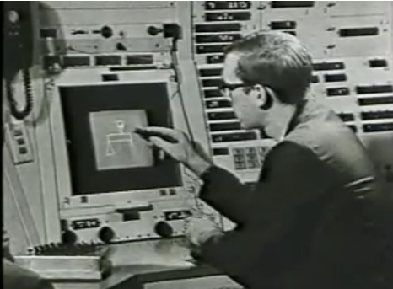
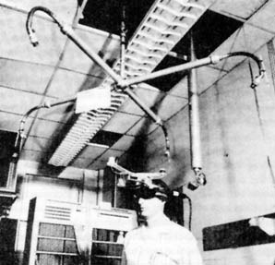
The Ultimate Display.
Ivan Sutherland, 1965
‘The ultimate display would, of course, be a room within which the computer can control the existence of matter. A chair displayed in such a room would be good enough to sit in.
Handcuffs displayed in such a room would be confining, and a bullet displayed in such a room would be fatal.
With appropriate programming such a display could literally be the Wonderland into which Alice walked.’
Notes:
Creator of Sketchpad – the guys had to use oscilloscope based screen for his writing program because there were no freaking pixel based CRTs yet!
Marrying computer to design navigation and habitation of virtual worlds. Essay of his vision.

Slide 9
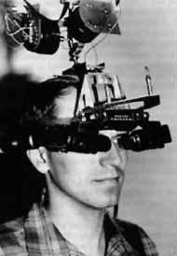
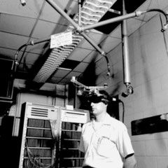
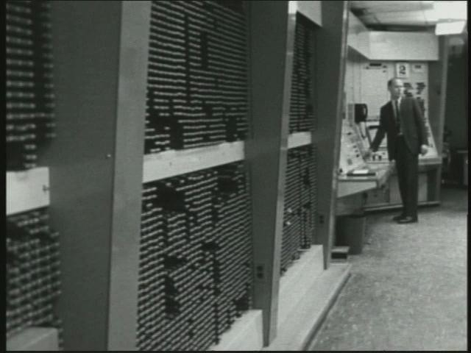
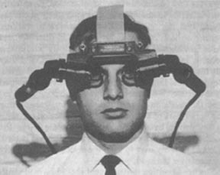
Head Mounted Display, Ivan Sutherland, 1965
Notes:
1965-1970

Slide 10
Building blocks for the reality engine
To rebuild reality?
No.
To gain familiarity with concepts not realizable in the physical world.
Ivan Sutherland (1965)

Slide 11
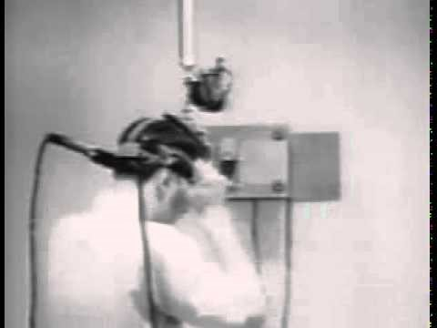

Slide 12
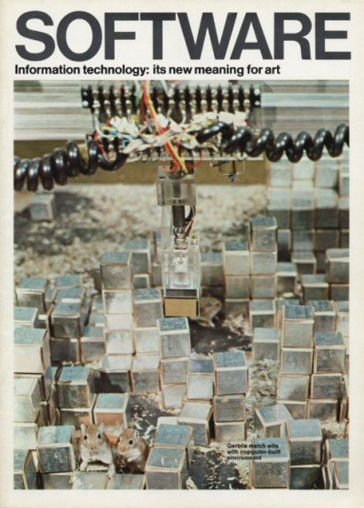

Slide 13
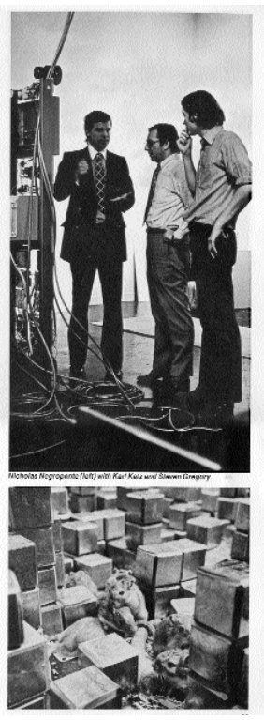
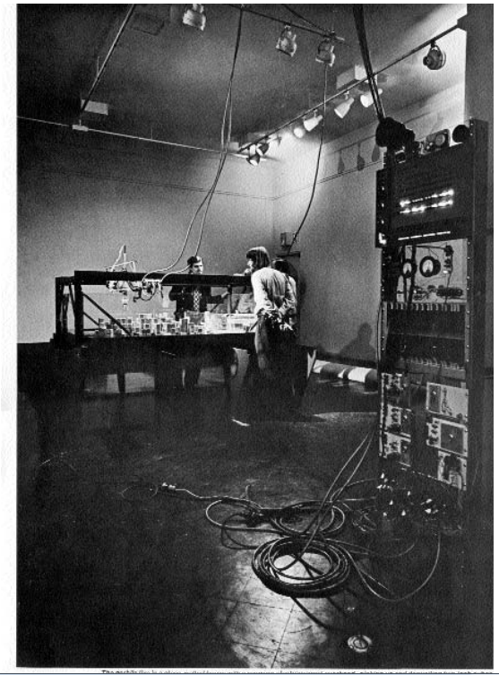
SEEK @The Jewish Museum NYC
Architecture Machine Group, 1970
Installation by MIT Architecture Machine group at on exhibition held at Jewish Museum (1970)
Computer stacks blocks, builds mental model of the world... But gerbils can topple stacks

Slide 14
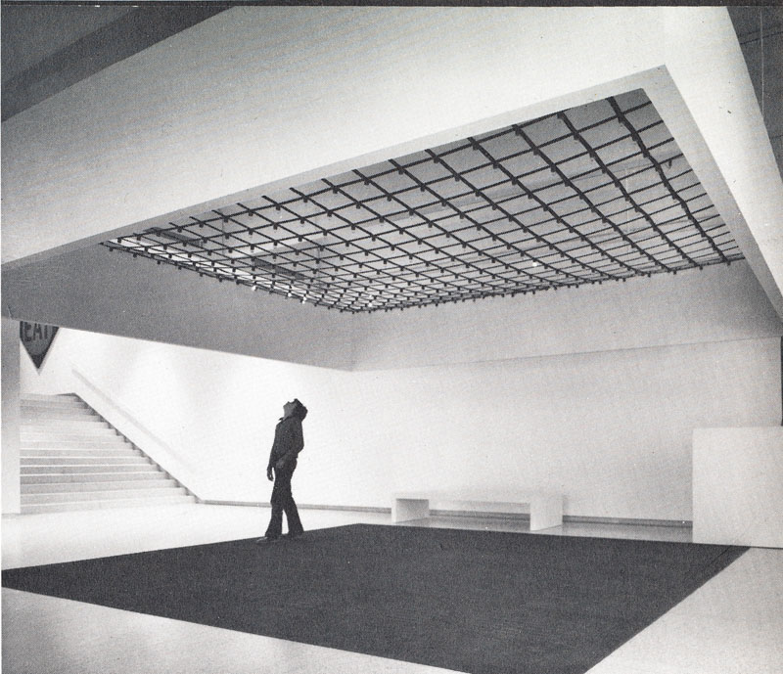
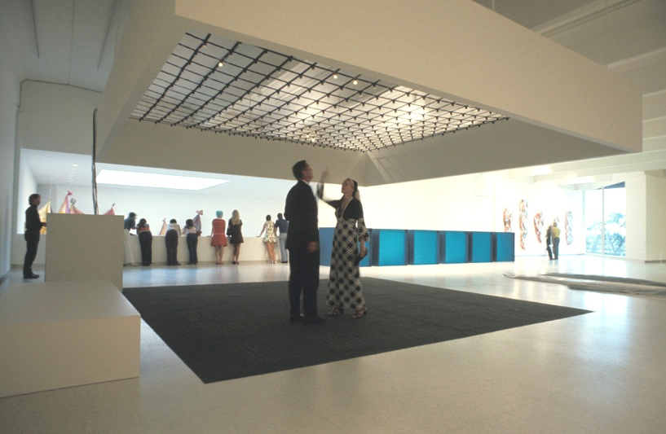
James Seawright: Network III (1971)
Seawright, James: Network III, 1971, Walker Art Center, Minneapolis 1971.
Notes:
Kinetic interactive sculpture
Left: Davis: Experiment 1975, p.195. Photo: Eric Sutherland.
Right: Image source: URL: http://blogs.walkerart.org/visualarts/files/2011/12/ex1971wns_ins_027.jpg
https://www.dataisnature.com/?p=2021
http://iasl.uni-muenchen.de/links/GCA-II.3e.html#Seawright
In 1971 Seawright´s "Network III" was installed at the Walker Art Center in Minneapolis. If visitors walked on pressure-sensitive elements then they produced patterns on a grid of overhead lights placed directly above the sensors. "6 x 6 arrays of pressure-sensitive mats, normally used to control the opening of automatic doors" were hidden under " a 20´ x 20´ [6,09 x 6,09 m] square of industrial carpeting". On the ceiling 400 lamps were mounted "at the intersections" of "a grid of web-belting" "at an 11´´ [28 cm] interval".
The input of the floor sensors was prepared by a minicomputer PDP 8-L. It executed programmed algorithms structuring the lights to build patterns. The computer, hidden under a white box, could control each light.
To the moves of one or two visitors the program reacted with light patterns. Seawright programmed in the "PDP 8 assembly language" "a circle about two feet [60,96 cm] diameter" with a "blinking circle" as its variant. "A cross or plus sign" could appear as "rotating", too. Furthermore a certain sensor´s input caused "a solid square box" as an output.
If three or more visitors entered the carpet, then the program shut down with "a spectacular blowup". The "processing speed and memory capacity" of the minicomputer were insufficient for algorithms enabling the system to react with light patterns to more than two persons. The program identified the persons on the sensors as "target 1" or "target 2" and assigned to them different "overhead patterns". If both visitors moved to "adjacent" sensors then the "overhead patterns" for "target 1" and "target 2" "would superimpose, but when either one moved to a new location their identities (the coordination visitor – target) would sometimes be exchanged." 43

Slide 15
Rain Room, Random International (2012)
Notes:
https://www.random-international.com/rain-room-2012

Slide 16
Notes:
https://time.graphics/line/22340
rAndom International, Rain Room
A field of falling water that pauses wherever a human body is detected. Cameras installed around the room detect human movements and send instructions to the rain drops to continually move away from visitors. The water drips through a grid in the floor where it is treated before being sent back up to the ceiling to fall again.

Slide 18
Responsive Environments - Myron Krueger (1970-1975)
Artist as Composer of Responsive Environments – intelligent real time computer mediated spaces
Response is the medium: focus on experience through interaction
Immersiveness, audience participation, real time interaction, randomness, computer mediated spaces, ...
Input
State Update
Output

Slide 19
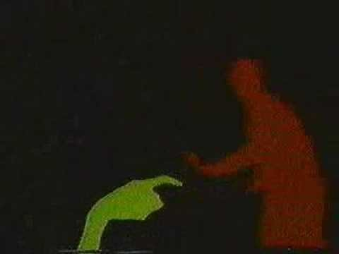
Myron Krueger, Videoplace (1975)

Slide 20
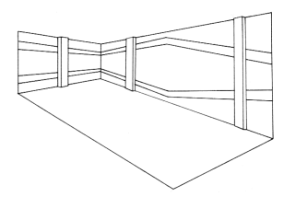
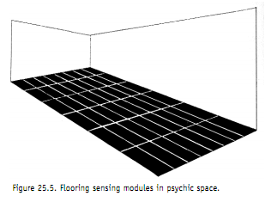
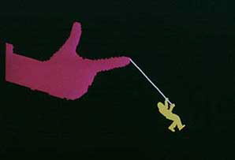
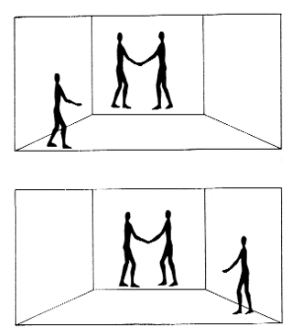
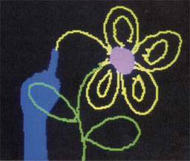
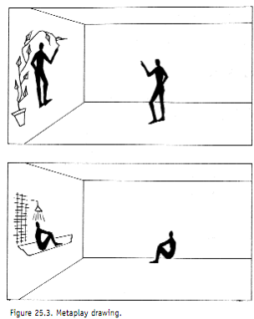
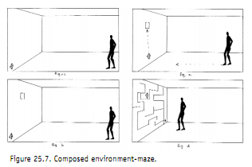
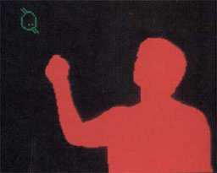
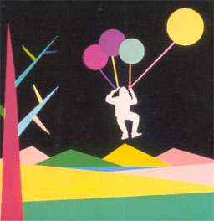
Responsive Environments - Myron Krueger
Glowflow, (‘69), METAPLAY (‘70),PSYCHIC SPACE (‘71), MAZE, VIDEOPLACE (‘75)
Notes:
Glowflow – fluorescerent tubes etc.
darkened room in which glowing lines of light defined an illusory space (Figure 25.1). The display was accomplished by pumping phosphorescent particles through transparent tubes attached to the gallery walls. These tubes passed through opaque columns concealing lights which excited the phosphors. A pressure sensitive pad in front of each of the six columns enabled the computer to respond to footsteps by lighting different tubes or changing the sounds generated by a Moog synthesizer or the origin of these sounds.
However, the artists’ attitude toward the capacity for response was ambivalent. They felt that it was important that the environment respond, but not that the audience be aware of it. Delays were introduced between the detection of a participant and the computer’s response so that the contemplative mood of the environment would not be destroyed by frantic attempts to elicit more responses.
→ Computer needs to perceive; few participants for focus; sound and visual aesthetics secondary
→ Interactve a potentially rich composable medium. The only aesthetic concern is the quality of the interaction!
Metaplay
METAPLAY’S focus reflected my reactions to GLOWFLOW. Interaction between the participants and the environment was emphasized; the computer was used to facilitate a unique real-time relationship between the artist and the participant.
An 8′ by 10′rear-projection video screen dominated the gallery. The live video image of the viewer and a computer graphic image drawn by an artist, who was in another building 1 mile away, were superimposed on this screen. Both the viewer and the artist could respond to the resulting image.
Image positioning, resizing, rotation, copying etc.
Wizard of Oz the experience
Resulted in unusual dialogue. Draw one picture transform it into the other. Play games like tic tac toe. Live Graffiti evolved. Draw around hand, move hand. Pleasure of discovery.
Psychic space
PSYCHIC SPACE was both an instrument for musical expression and a richly composed, interactive, visual experience. Participants could become involved in a softshoe duet with the environment, or they could attempt to match with the computer by walking an unpredictable maze. 16-24 grid of sensing tiles.
Keyboard sometimes abruptly rotated.
After a longer period of time an additional feature came into play. If the computer discovered that a person’s behavior was characterized by a short series of steps punctuated by relatively long pauses, it would use the pause to establish a new kind of relationship. The sequence of steps was responded to with a series of notes as before; however, during the pause the computer would repeat these notes again. If the person remained still during the pause, the computer assumed that the relationship was understood. The next sequence of steps was echoed at a noticeably higher pitch. Subsequent sequences were repeated several times with variations each time. This interaction was experimental and extremely difficult to introduce clearly with feedback alone, i.e., without explicit instructions.
Guitar duel from movie deliverance
→ Immersive training
Maze
The maze program focused on the interaction between one individual and the environment. The participant was lured into attempting to navigate a projected maze. The intrigue derived from the maze’s responses, a carefully composed sequence of relations designed to constitute a unique and coherent experience.
If participant cheated, stretch the line, move the line, move the whole maze
When you get closer to the goal, change the maze. Target could never be reached.
[→ Interaction is not just about working together nicely, it can also be about frustration. Full range of emotions].
Videoplace
VIDEOPLACE is a conceptual environment with no physical existence. It unites people in separate locations in a common visual experience, allowing them to interact in unexpected ways through the video medium. The term VIDEOPLACE is based on the premise that the act of communication creates a place that consists of all the information that the participants share at that moment.
No sound on purpose. We around limitations – you cannot talk, touch etc. New behaviors and interactions develop.
Mediate reality. Graphics such as organisms, objects. Resize, recolor, reposition, rotate. New laws of cause and effect. Bodies that touch result into sounds.
→ [no more drawing artist]
http://jtnimoy.net/itp/newmediahistory/videoplace/

Slide 21
Responsive Environments - Myron Krueger
Glowflow, (’69)
Notes:
Glowflow – fluorescerent tubes etc.
darkened room in which glowing lines of light defined an illusory space (Figure 25.1). The display was accomplished by pumping phosphorescent particles through transparent tubes attached to the gallery walls. These tubes passed through opaque columns concealing lights which excited the phosphors. A pressure sensitive pad in front of each of the six columns enabled the computer to respond to footsteps by lighting different tubes or changing the sounds generated by a Moog synthesizer or the origin of these sounds.
However, the artists’ attitude toward the capacity for response was ambivalent. They felt that it was important that the environment respond, but not that the audience be aware of it. Delays were introduced between the detection of a participant and the computer’s response so that the contemplative mood of the environment would not be destroyed by frantic attempts to elicit more responses.
→ Computer needs to perceive; few participants for focus; sound and visual aesthetics secondary
→ Interactve a potentially rich composable medium. The only aesthetic concern is the quality of the interaction!

Slide 22
Responsive Environments - Myron Krueger
METAPLAY (‘70)
Notes:
Metaplay
METAPLAY’S focus reflected my reactions to GLOWFLOW. Interaction between the participants and the environment was emphasized; the computer was used to facilitate a unique real-time relationship between the artist and the participant.
An 8′ by 10′rear-projection video screen dominated the gallery. The live video image of the viewer and a computer graphic image drawn by an artist, who was in another building 1 mile away, were superimposed on this screen. Both the viewer and the artist could respond to the resulting image.
Image positioning, resizing, rotation, copying etc.
Wizard of Oz the experience
Resulted in unusual dialogue. Draw one picture transform it into the other. Play games like tic tac toe. Live Graffiti evolved. Draw around hand, move hand. Pleasure of discovery.

Slide 23
Responsive Environments - Myron Krueger
PSYCHIC SPACE (‘71)
Notes:
Psychic space
PSYCHIC SPACE was both an instrument for musical expression and a richly composed, interactive, visual experience. Participants could become involved in a softshoe duet with the environment, or they could attempt to match with the computer by walking an unpredictable maze. 16-24 grid of sensing tiles.
Keyboard sometimes abruptly rotated.
After a longer period of time an additional feature came into play. If the computer discovered that a person’s behavior was characterized by a short series of steps punctuated by relatively long pauses, it would use the pause to establish a new kind of relationship. The sequence of steps was responded to with a series of notes as before; however, during the pause the computer would repeat these notes again. If the person remained still during the pause, the computer assumed that the relationship was understood. The next sequence of steps was echoed at a noticeably higher pitch. Subsequent sequences were repeated several times with variations each time. This interaction was experimental and extremely difficult to introduce clearly with feedback alone, i.e., without explicit instructions.
Guitar duel from movie deliverance
→ Immersive training

Slide 24
Responsive Environments - Myron Krueger
MAZE,
Notes:
Maze
The maze program focused on the interaction between one individual and the environment. The participant was lured into attempting to navigate a projected maze. The intrigue derived from the maze’s responses, a carefully composed sequence of relations designed to constitute a unique and coherent experience.
If participant cheated, stretch the line, move the line, move the whole maze
When you get closer to the goal, change the maze. Target could never be reached.
[→ Interaction is not just about working together nicely, it can also be about frustration. Full range of emotions].

Slide 25
Responsive Environments - Myron Krueger
VIDEOPLACE (’75-)
Notes:
Videoplace
VIDEOPLACE is a conceptual environment with no physical existence. It unites people in separate locations in a common visual experience, allowing them to interact in unexpected ways through the video medium. The term VIDEOPLACE is based on the premise that the act of communication creates a place that consists of all the information that the participants share at that moment.
No sound on purpose. We around limitations – you cannot talk, touch etc. New behaviors and interactions develop.
Mediate reality. Graphics such as organisms, objects. Resize, recolor, reposition, rotate. New laws of cause and effect. Bodies that touch result into sounds.
→ [no more drawing artist]
http://jtnimoy.net/itp/newmediahistory/videoplace/

Slide 26
Response is the medium
Sense – Control – Display
Beauty of aural and visual response is secondary
Composing responsive environments at a meta level
Artificial Realities
Learning and adaptation
Personal Amplifiers
Cooperation and frustration – meaningful interaction
Play
Build relations between participant and environment

Slide 27
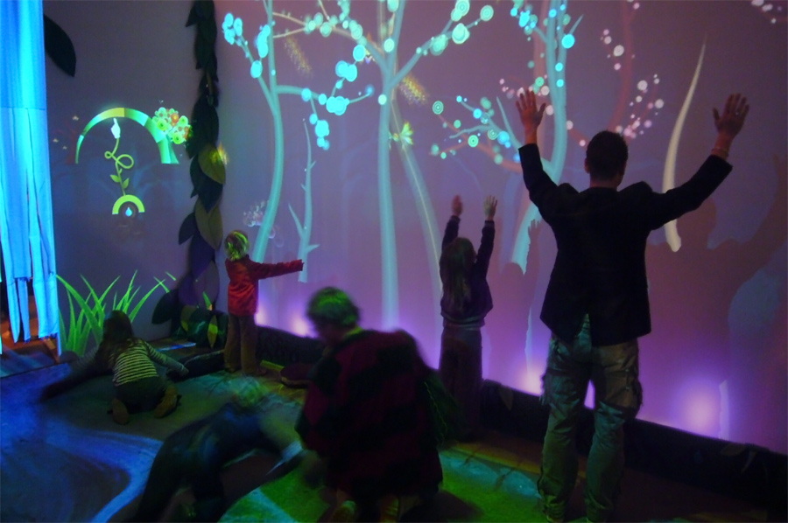
Modern Responsive Environment Example: Funky Forest
Funky Forest, Theo Watson:
A Modern Responsive Environment

Slide 28
Ted Nelson
Hypertext/Hypermedia (1965)
Notes:
Ted Nelson
One of the founding fathers of New Media.
Came up with the ideas for hypertext, hyperfilm in the 60’s (started 1960, pub in 1965).
Stretchtext
"A File Structure for the Complex, the Changing, and the Indeterminate",

Slide 29
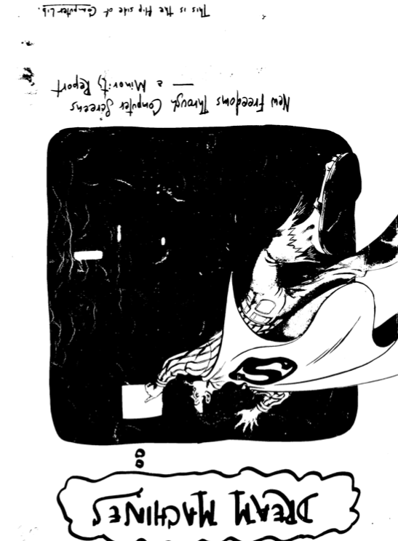
Ted Nelson
Computer Lib / Dream Machines (1974)
Notes:
Ted Nelson
Computer Lib
Liberate computing from corporate world.
Guardianship of computing can no longer be left to the Computer Priesthood.
Everybody should understand computers. Wrote is a letter to a nephew, chatty and personal.
Dream Machine. Present dreams and dream machines.
Democratize and make it a personal device for creative expression. Help write, think and show. Design emotional computing experiences – quotes Russell saying reason ought to be slave by emotions
Literally a Dream Machine.
IR, Ai, Computer Assisted Interaction.
“Technology is an expression of mans dream. If man did not indulge its fantasies, his thoughts alone would inhibit the development of technology itself. The technological realities of today are already obsolete and the future of technology is bound only by the limit of our owns dreams.” How Wachspress, Hyper Reality, 1973.

Slide 30
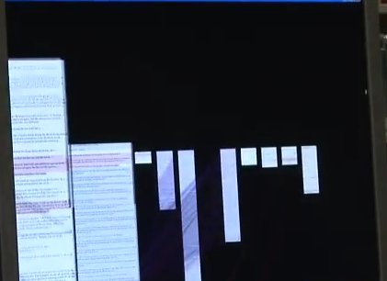
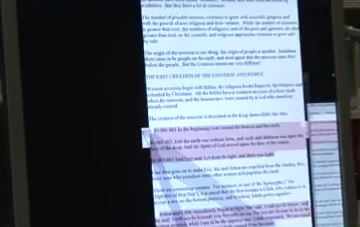
Ted Nelson - Xanadu
Notes:
Content and experiences created by the users themselves.
Need to live somewhere. Shared space, shared envt. Made available worldwide.
Dissolve teacher-student / creator user boundaries.

Slide 31
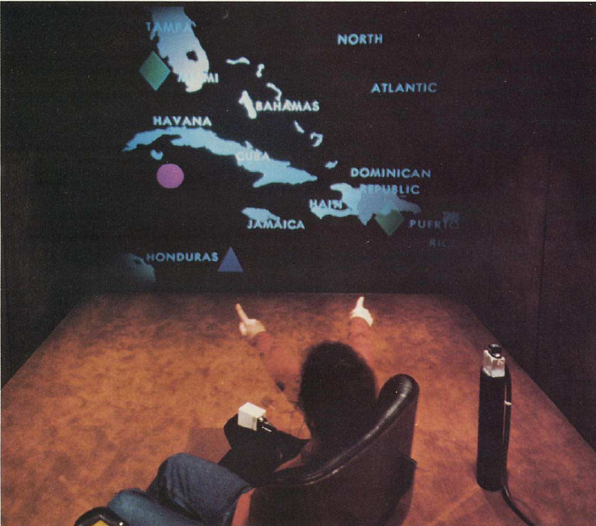
Notes:
Spatial Data Management Systems
Method of Loci analalogy - memory palace
Media Room
Eames Chair
Right hand navigation, pointing, pronouns
Left hand inspect multimedia – maps, electronic books, videodisc episodes.
Blend real Media Room physical space and virtual graphical space
Commands: create/move/make that/delete
Technology:
From disconnected utterances to connected speech, interactive (300ms). 120 words. (discrete utterance 1000). Training only once per word (twice for digits)
Positioning: disturbance of magnetic fields. Coils in x, y , z plance. One transmitter cube, one sensor cube. Sensor is lightweight,finger ring/wrist.

Slide 32

Notes:
Spatial Data Management Systems
Method of Loci analalogy - memory palace
Media Room
Eames Chair
Right hand navigation, pointing, pronouns
Left hand inspect multimedia – maps, electronic books, videodisc episodes.
Blend real Media Room physical space and virtual graphical space
Commands: create/move/make that/delete
Technology:
From disconnected utterances to connected speech, interactive (300ms). 120 words. (discrete utterance 1000). Training only once per word (twice for digits)
Positioning: disturbance of magnetic fields. Coils in x, y , z plance. One transmitter cube, one sensor cube. Sensor is lightweight,finger ring/wrist.

Slide 33
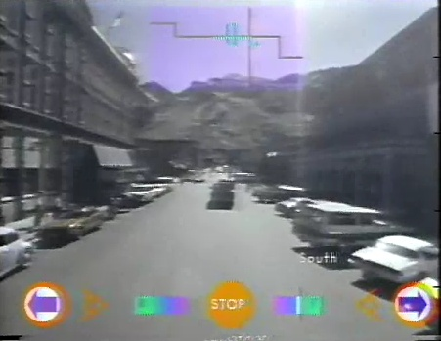
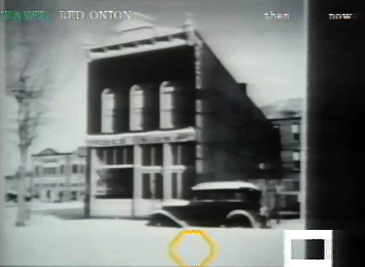
ASPEN Movie Map
Architecture Machine Group, 1979
Notes:
http://www.youtube.com/watch?v=Hf6LkqgXPMU

Slide 34
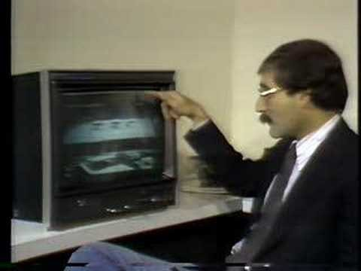
ASPEN Movie Map
Architecture Machine Group, 1979
Notes:
http://www.youtube.com/watch?v=Hf6LkqgXPMU
Spatial Data Management System
Analogy to Method of Loci
Dataland
Navia

Slide 35
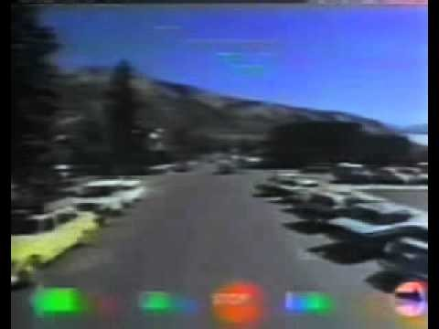
ASPEN Movie Map
Architecture Machine Group, 1979
Notes:
http://www.youtube.com/watch?v=Hf6LkqgXPMU

Slide 36
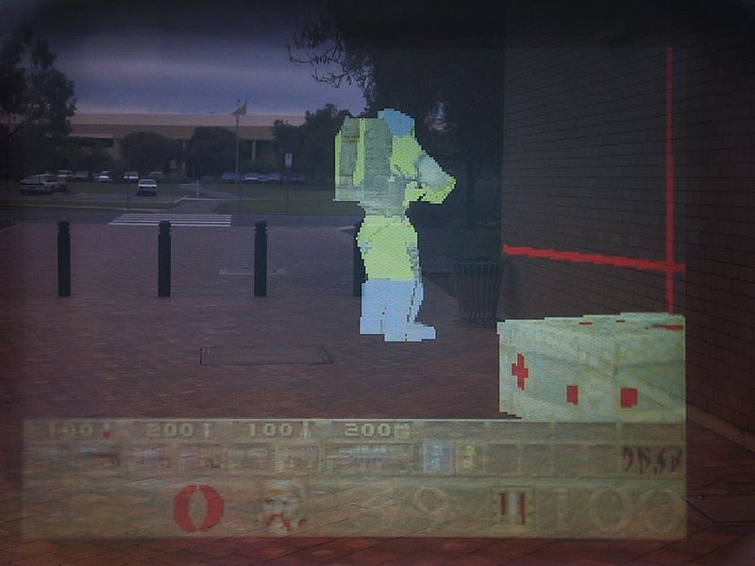
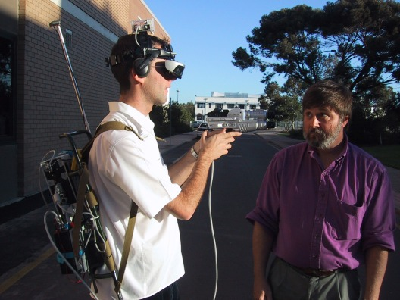
Augmented Reality: ARQuake (2000)

Slide 37
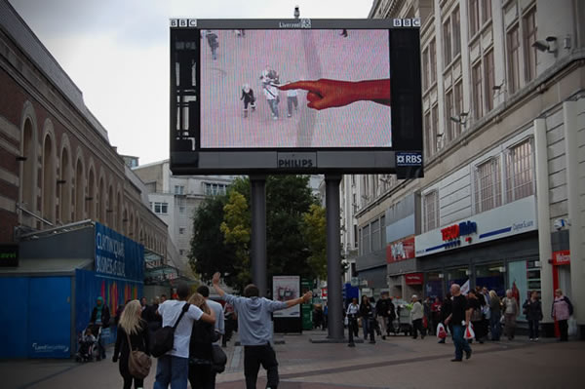
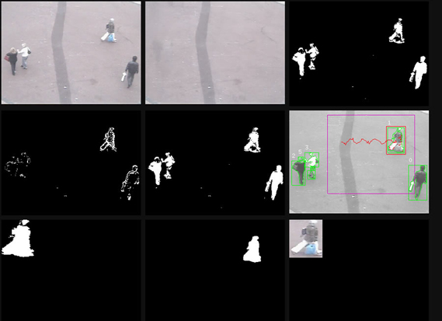
Augmented Reality: The Hand from Above

Slide 38
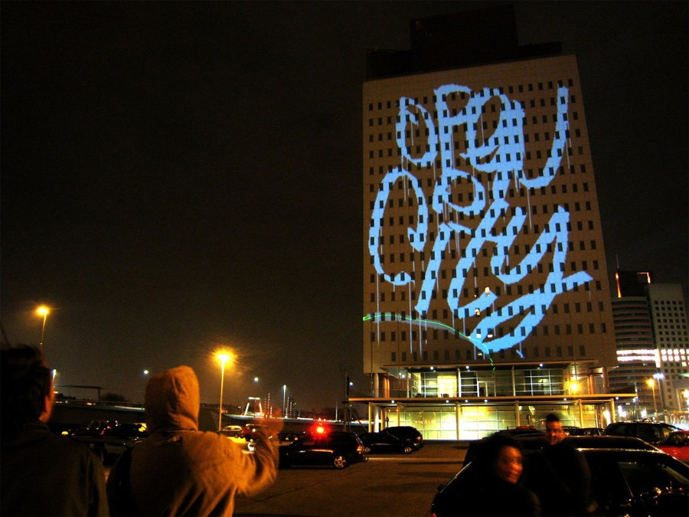
Theo Watson. Laser Tag, 2007.
Notes:
http://www.theowatson.com/site_docs/work.php?id=40

Slide 39
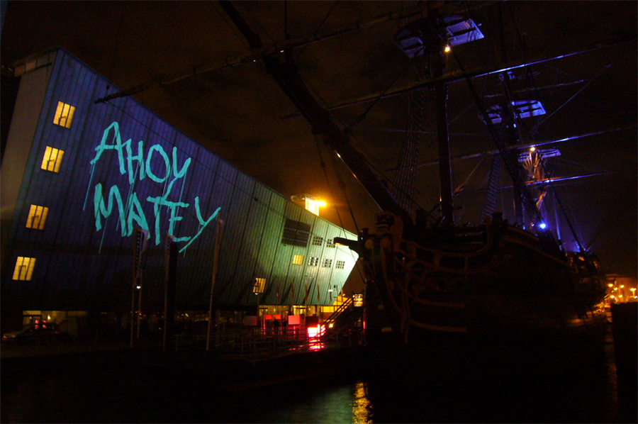
Theo Watson. Laser Tag, 2007.

Slide 40



Meatspace
Reality
Cyberspace
Virtuality

