Slide 1
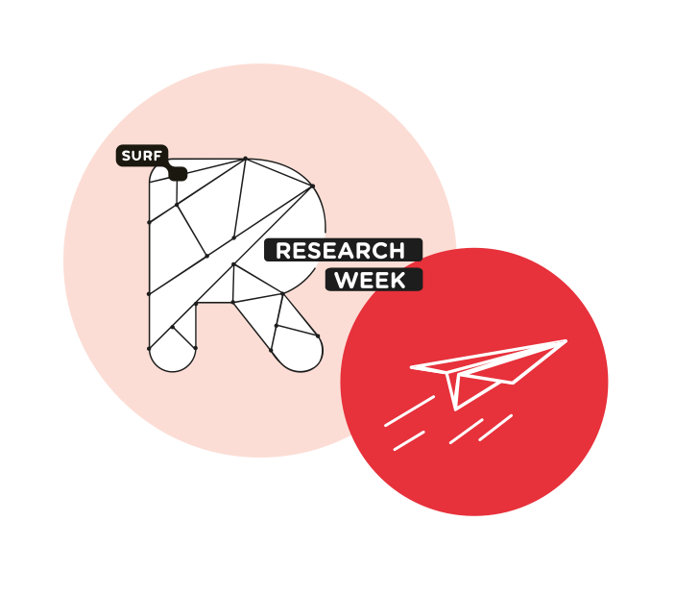
How to Tackle the GDPR "Monster"
Marlon Domingus, Erasmus University Rotterdam
Margriet Miedema, LCRDM
11/05/2022
TRUST IN RESEARCH

Slide 2
Itinerary
Marlon: 1. GDPR: (1) Data Protection and (2) Free flow of personal data 2. Special position of scientific research in the GDPR 3. The ‘Monster’ of the GDPR 4. How to slay the heads of the ‘Monster’ of the GDPR. 5. Questions

Slide 3
Itinerary
Margriet: 1. Case Imprisoned Fathers:
Purposes of the study, Target Group, Method, Participating Parties, Data used in the research, Storage location data, Initial Design.
2. Questions

Slide 4
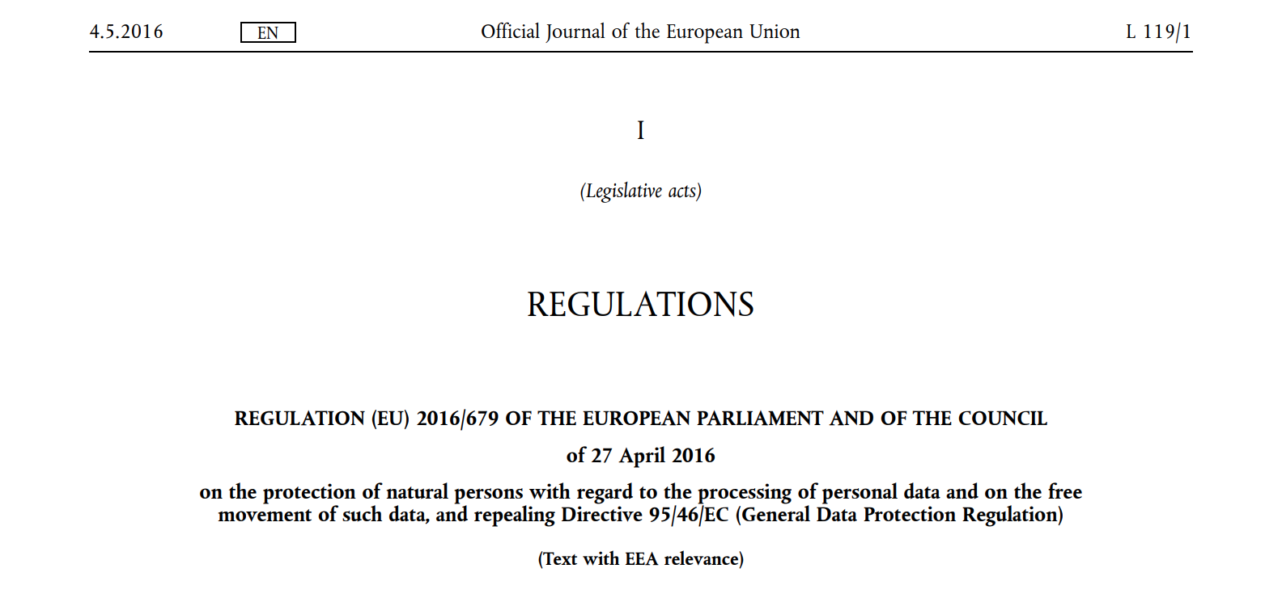
1. GDPR: (1) Data Protection and (2) Free flow of personal data

Slide 5
1. GDPR: (1) Data Protection and (2) Free flow of personal data
The General Data Protection Regulation (EU GDPR) 'facilitates on the protection of natural persons with regard to the processing of personal data and on the free movement of such data',
and specifies in GDPR recital 3: 'to ensure the free flow of personal data between Member States’.

Slide 6
2. Special position of scientific research in the GDPR
See GDPR recital 157:
By coupling information from registries, researchers can obtain new knowledge of great value with regard to widespread medical conditions such as cardiovascular disease, cancer and depression. On the basis of registries, research results can be enhanced, as they draw on a larger population. Within social science, research on the basis of registries enables researchers to obtain essential knowledge about the long-term correlation of a number of social conditions such as unemployment and education with other life conditions. Research results obtained through registries provide solid, high-quality knowledge which can provide the basis for the formulation and implementation of knowledge-based policy, improve the quality of life for a number of people and improve the efficiency of social services. In order to facilitate scientific research, personal data can be processed for scientific research purposes, subject to appropriate conditions and safeguards set out in Union or Member State law.

Slide 7
2. Special position of scientific research in the GDPR
See GDPR Art 5.1.b.:
further processing for archiving purposes in the public interest, scientific or historical research purposes or statistical purposes shall, (…), not be considered to be incompatible with the initial purposes.
[Personal data collected for a legitimate purpose, can be GDPR compliant re-used for research purposes]

Slide 8
2. Special position of scientific research in the GDPR
GDPR Article 89: “Safeguards and derogations relating to processing for archiving purposes in the public interest, scientific or historical research purposes or statistical purposes"
Art 89.2. Where personal data are processed for scientific or historical research purposes or statistical purposes, Union or Member State law may provide for derogations from the rights referred to these rights of the research participants:
Article 15 - Right of access of the data subject
Article 16 - Right to rectification
Article 18 - Right to restriction of processing
[Example, for reasons of reproducibility and scientific integrity, further processing of personal data must be discontinued after consent has been withdrawn. Yet, the personal data that have been processed up to the moment of withdrawal of consent (and have therefore been legitimately obtained and processed) may continue to be processed. This must be clearly communicated in advance to the potential research participants.]

Slide 9
So:

Slide 10
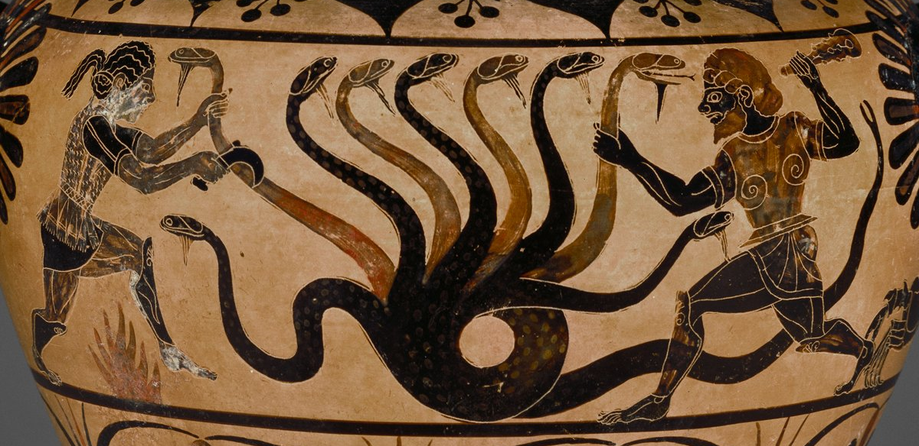
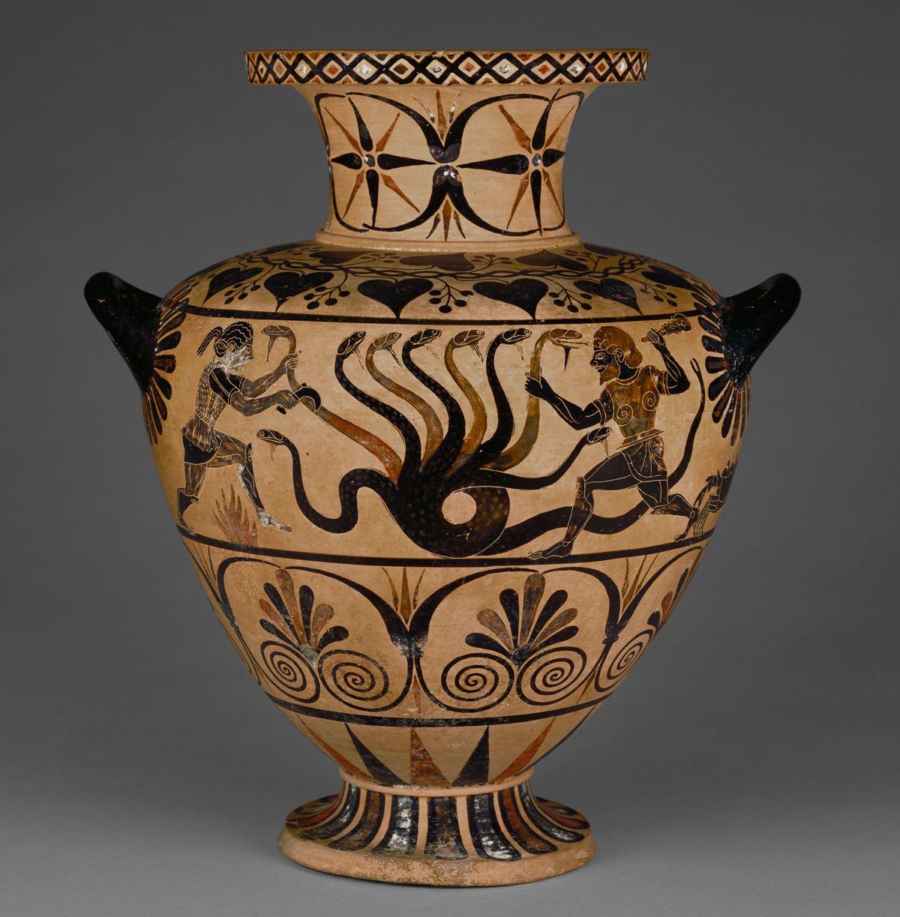
3. The ‘Monster’ of the GDPR. Meet the Lernean Hydra.
Source: Herakles, Iolaos, and the Lernean Hydra; two sphinxes on the reverse; and a crab under the horizontal handle. Etruscan pottery — at the Getty Villa, Los Angeles, California.
By: Eagle Painter, CC BY-SA 3.0, https://commons.wikimedia.org/w/index.php?curid=3967001

Slide 11
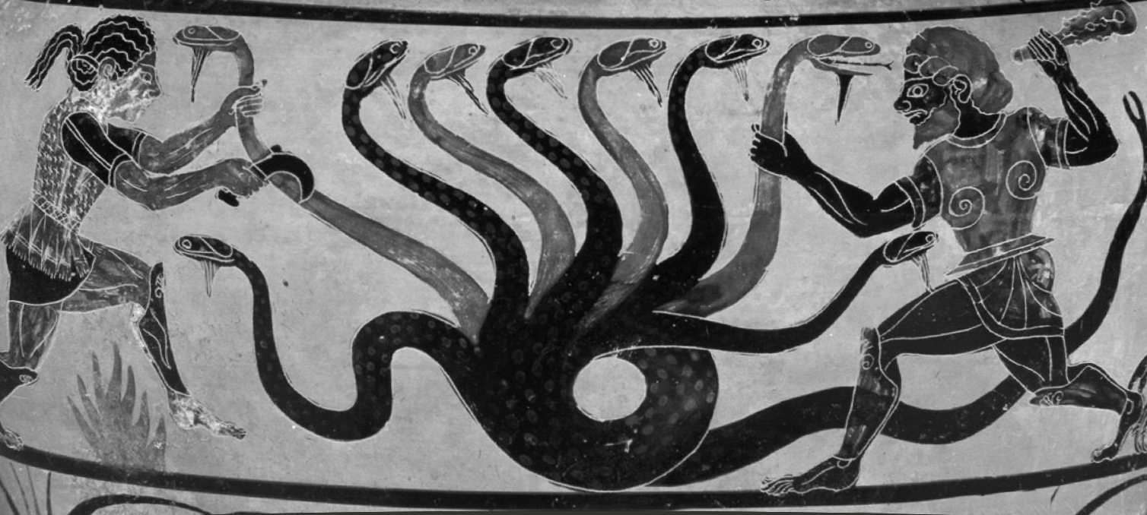
3. The ‘Monster’ of the GDPR. Meet the 9 heads.
Integrity
Accuracy
Data Minimisation
Transparency
Purpose Limitation
Storage Limitation
Fairness
Lawfulness
Confidentiality

Slide 12
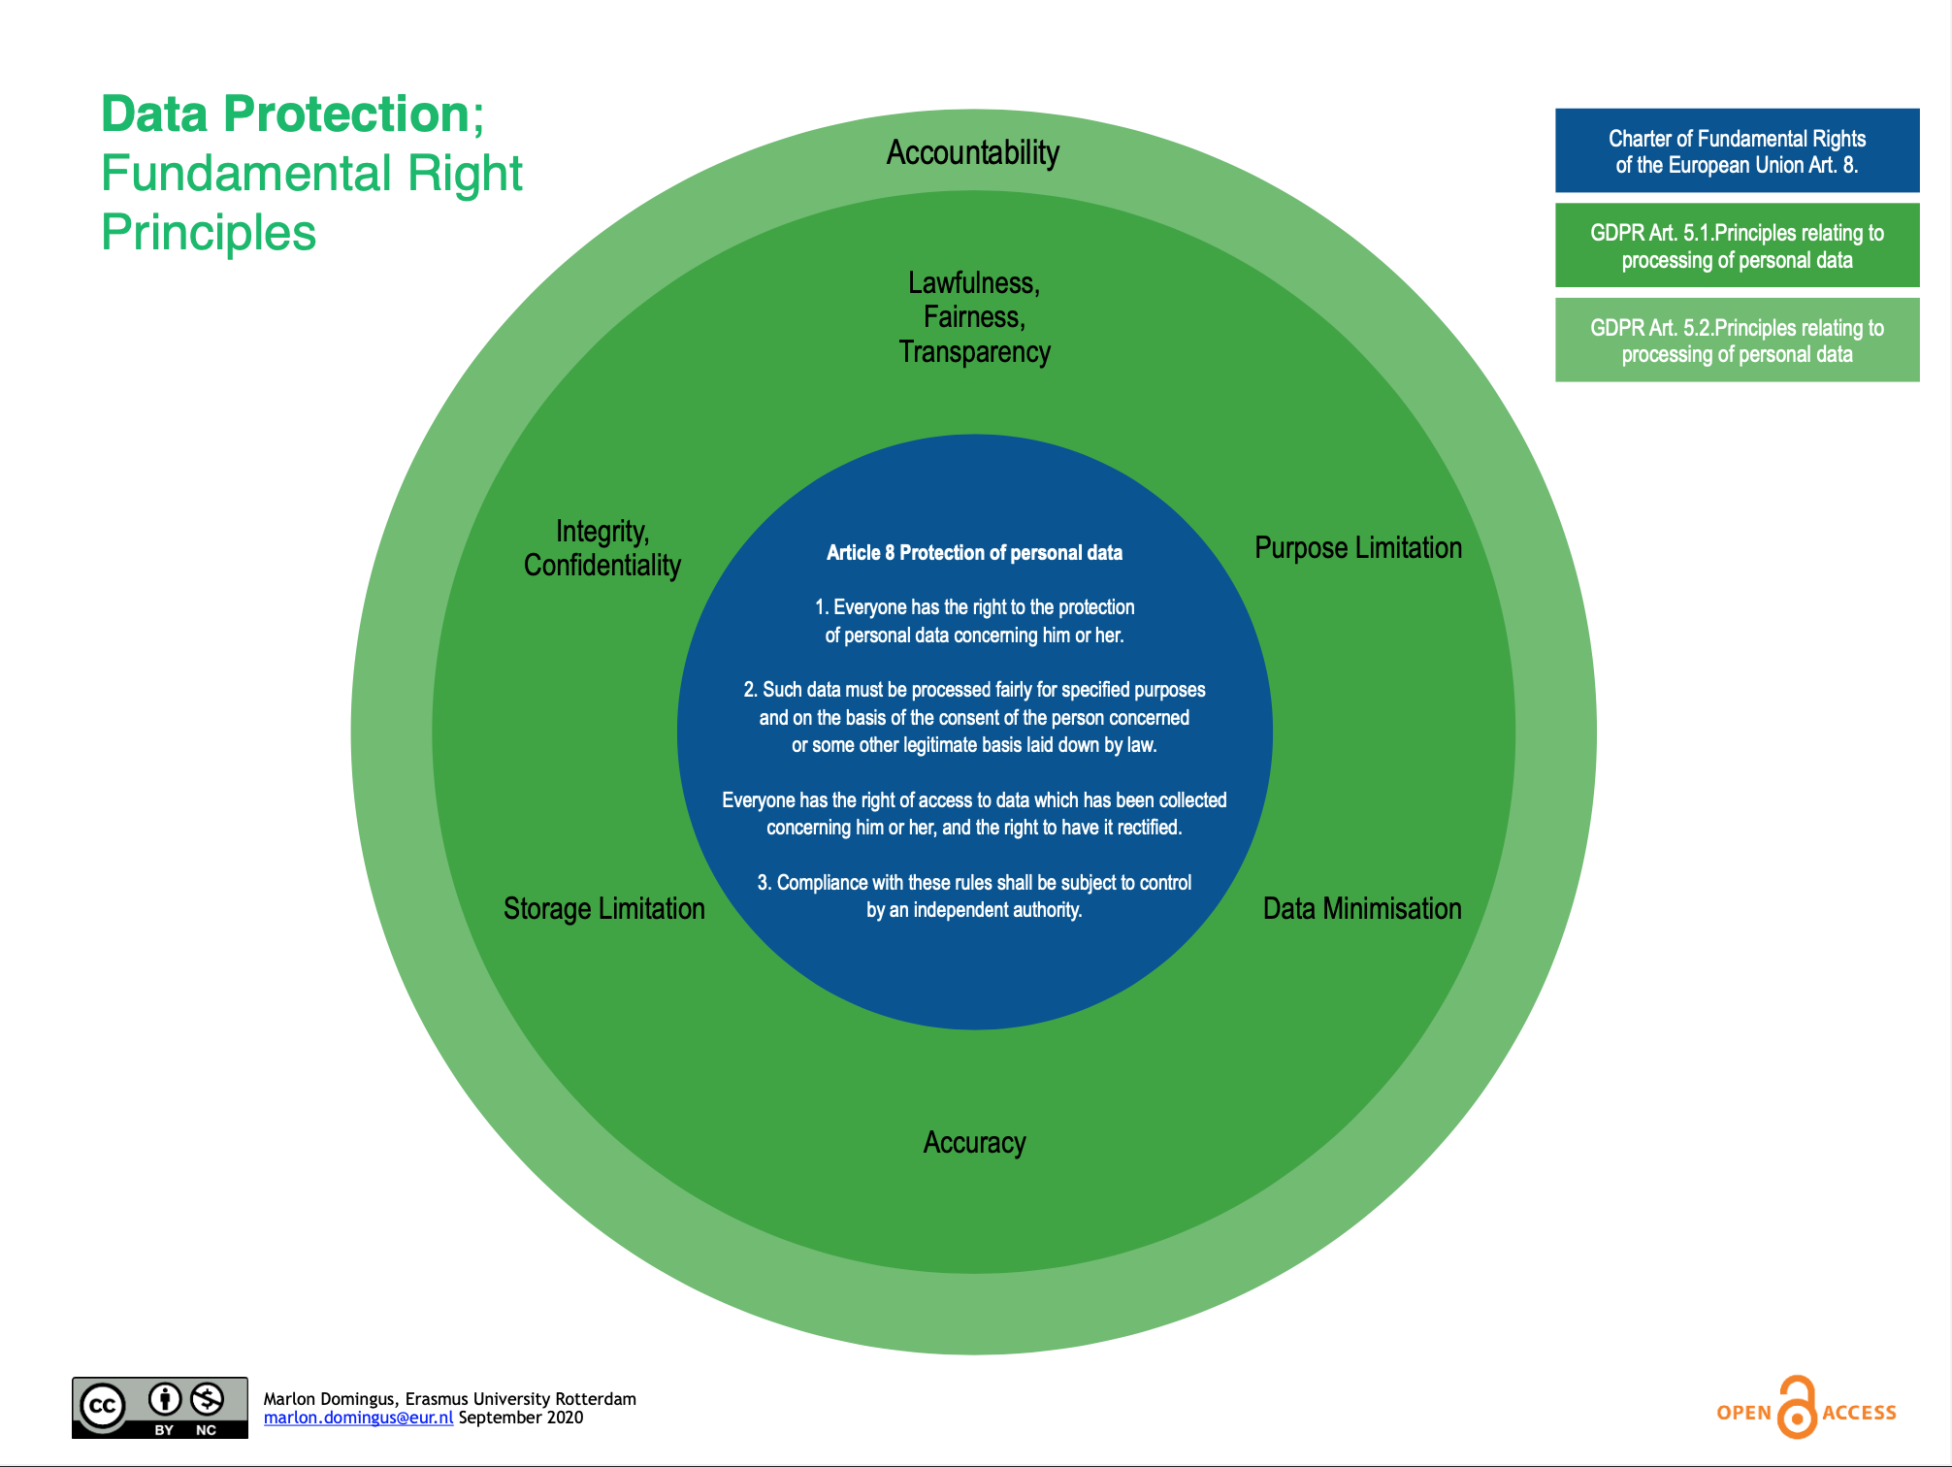
4. How to slay the heads of the ‘Monster’ of the GDPR.
Source: Zenodo.
https://doi.org/10.5281/zenodo.6074950

Slide 13
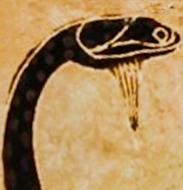
4. How to slay the heads of the ‘Monster’ of the GDPR.
Source: Zenodo.
https://doi.org/10.5281/zenodo.6074950

Slide 14
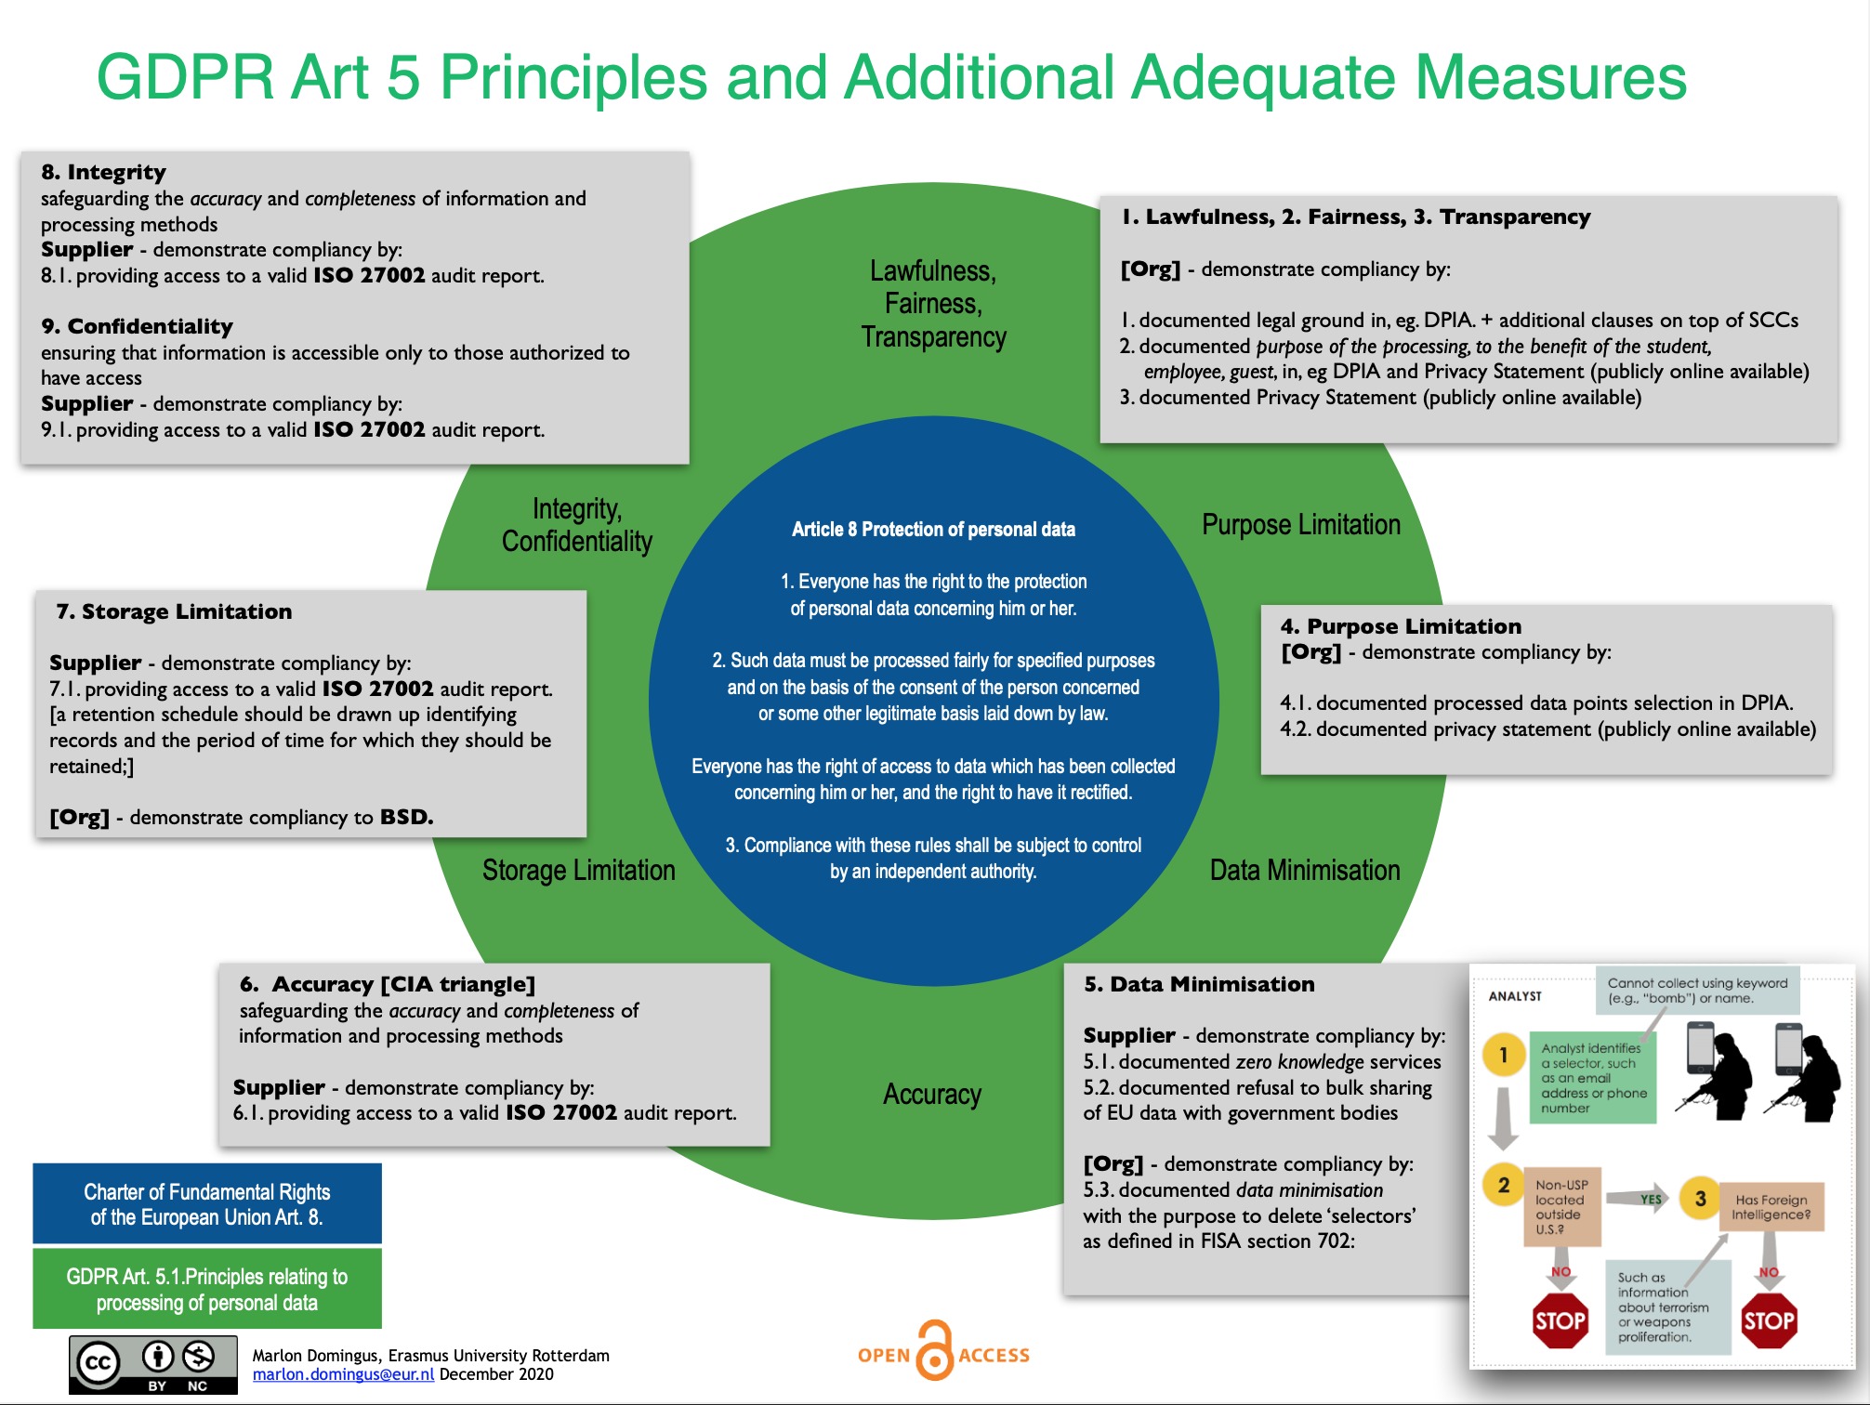
4. How to slay the heads of the ‘Monster’ of the GDPR.
Source: Zenodo.
https://doi.org/10.5281/zenodo.6074950

Slide 15
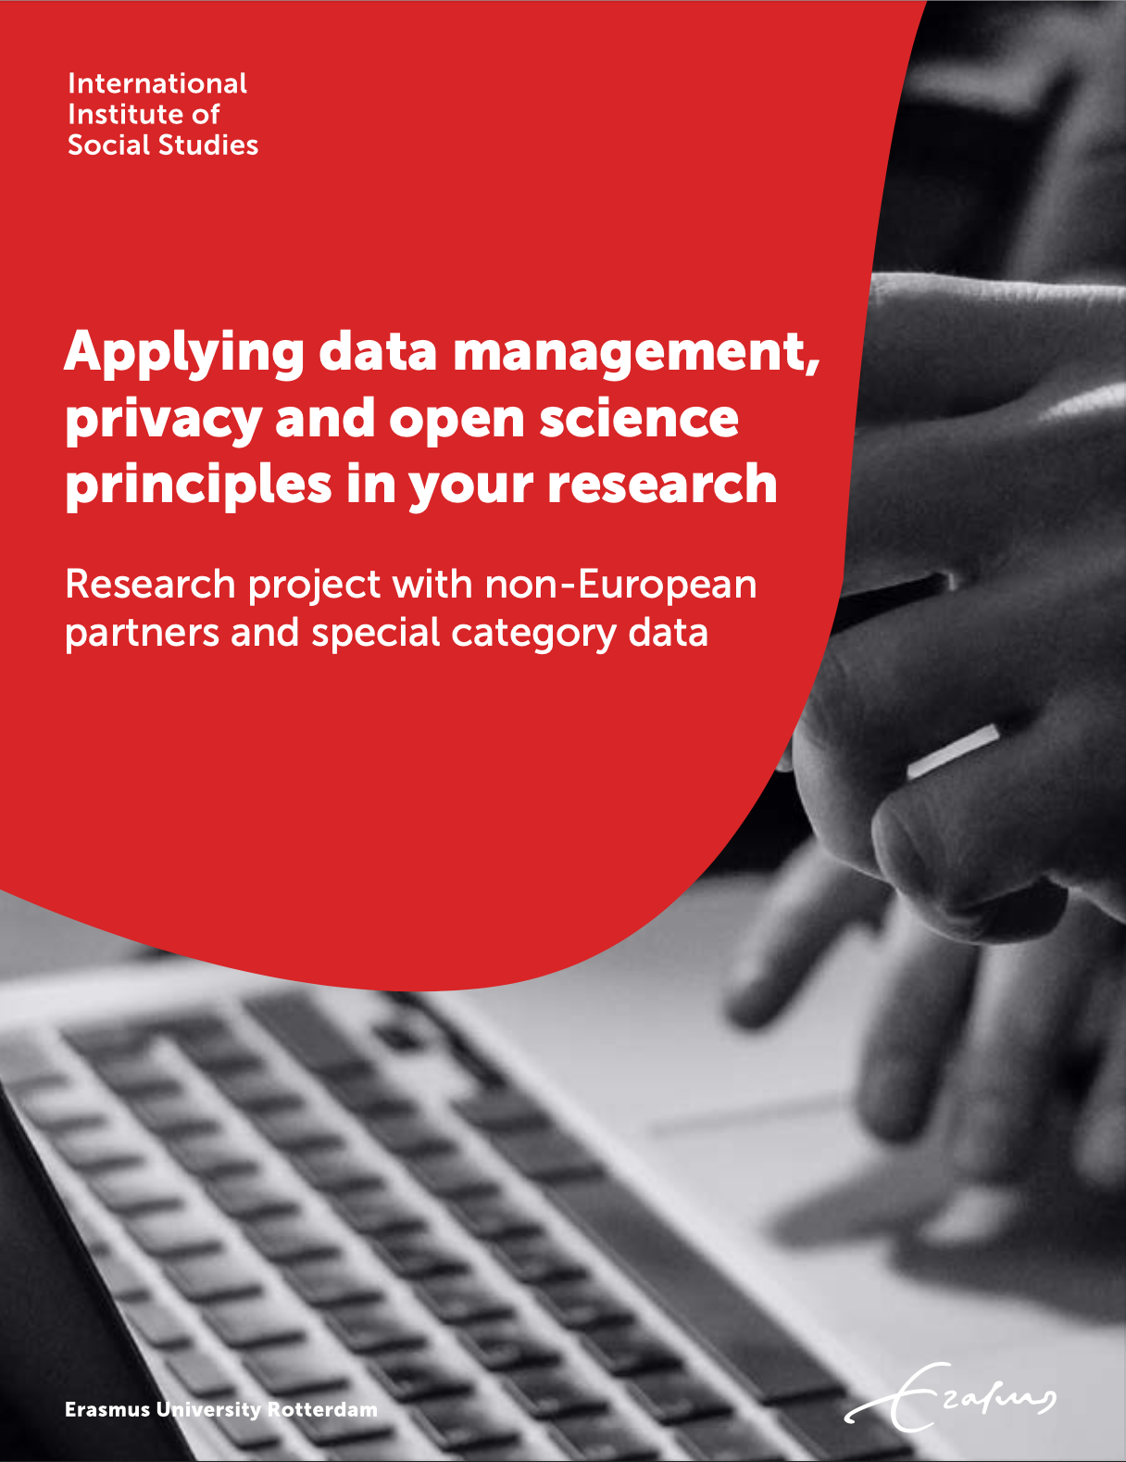
4. How to slay the heads of the ‘Monster’ of the GDPR.

Slide 16
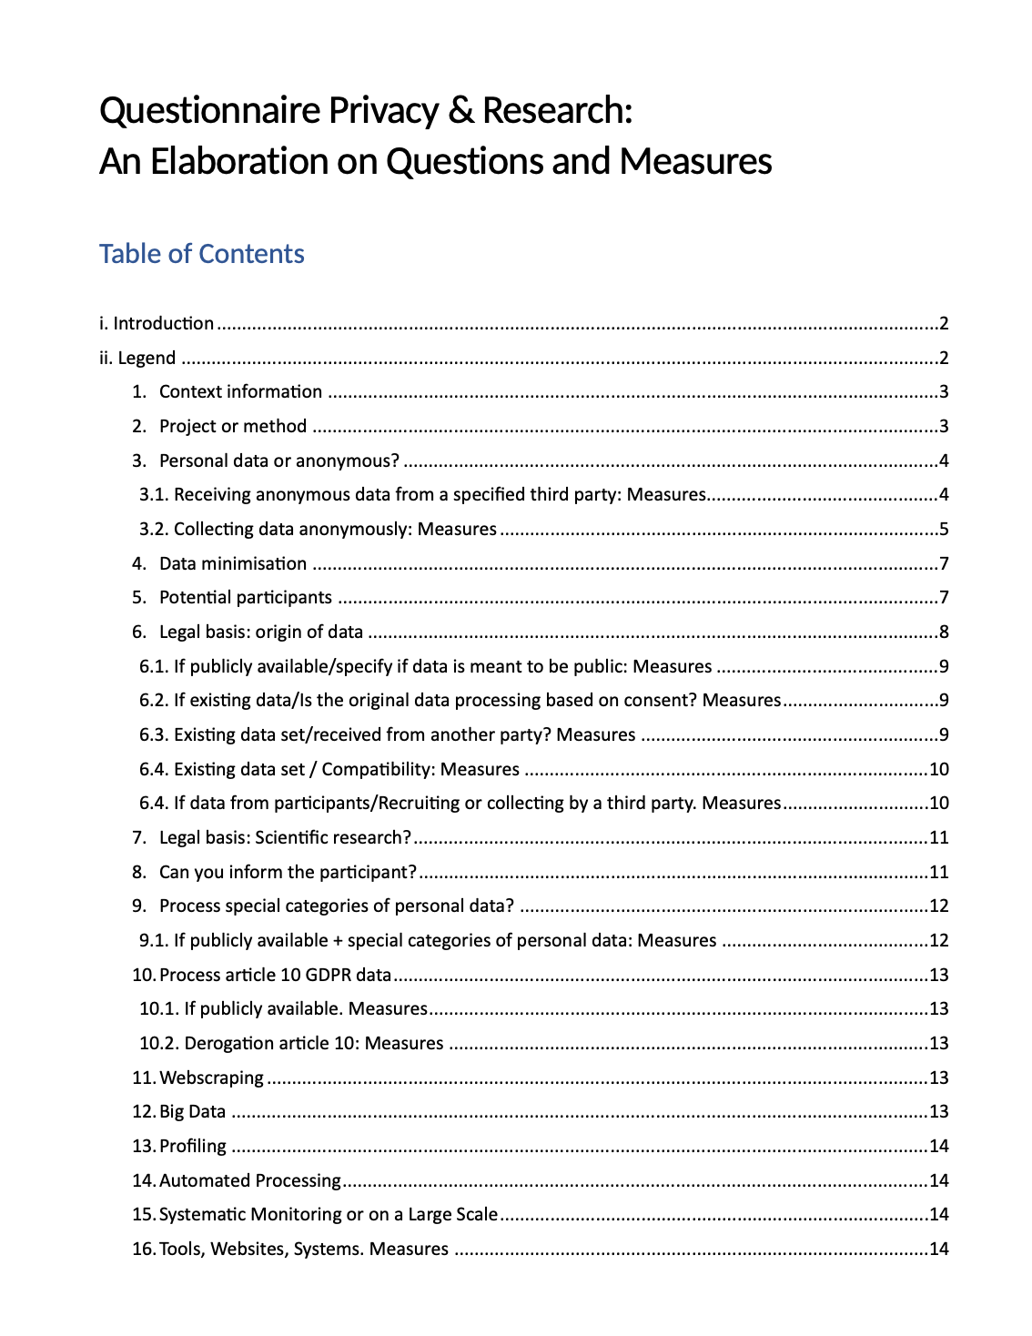
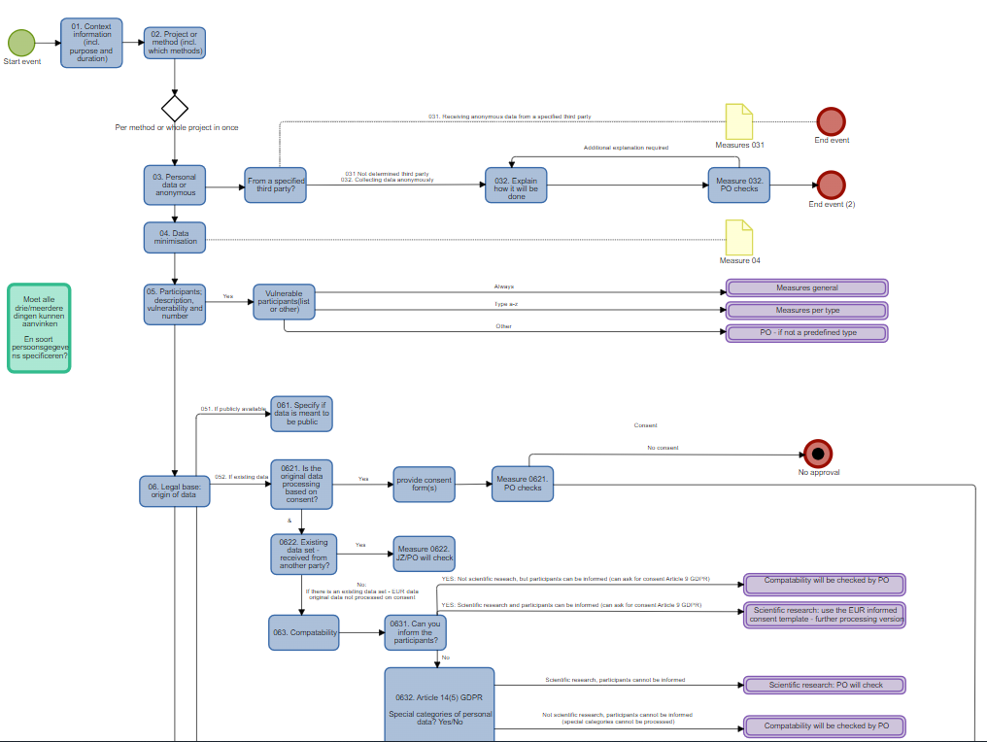
4. How to slay the heads of the ‘Monster’ of the GDPR.
Work in progress @ EUR by:
Bo Schijven, Lucine Pogosian , Sue Chang-de Wit
and Annemee Metselaar.

Slide 17
5. Questions
drs. Marlon Domingus, CIPP/e, CIPM
Data Protection Officer
Erasmus University Rotterdam
dpo@eur.nl

Slide 18
Imprisoned fathers
SURF RESEARCH WEEK, May 11, 2022

Slide 19
QUESTIONS
Is a DPIA necessary? Yes/No and why?
Raw data: should they be stored after completing the study? And if so, for how long?
The keys to link child to case code: who should guard it where?
What should be published/archived?
For accountability: e.g. to prove that 20 fathers/their children are involved
For reuse?
For replicability?

Slide 20
Purposes of the study
develop a strategy to identify and reach out to vulnerable children/ families of which the father is imprisoned as to identify their needs
develop a framework for professionals to strengthen protective factors in an early stage as to promote the psychosocial development of these children.

Slide 21
Who are involved?
20 imprisoned fathers in 2 different prisons
children and mothers in their family setting
Professionals:
Besides Researchers UAS;
2 prison staff members/case managers of 2 different prisons
2 youth policy officers of 2 different municipalities
2 staff members of bureau X of different municipalities
2 ambulatory care workers Y(ambulante hulpverlening)
policy officer of VNG, Expert Center Child

Slide 22
METHOD: ACTION RESEARCH
the best interests of the children are central in the study
develop a new strategy by researching and evaluating the process together with families and professionals involved
individual and network sessions to evaluate the strategies for support.

Slide 23
Data
Personal data: e.g. on social economic background, educational level
The researchers work with a casus code, so data collected is pseudonymized from the start
The data which the professionals collect for the help offer is part of their regular information gathering procedures

Slide 24
Storage location data
The research data will be stored on SharePoint in a protected environment based on the need-to-know principles (matrix provided).
SharePoint libraries will be created with restricted access.
Recorded interviews will be transferred to SharePoint library asap after the interview and deleted form the storage device right after.
Professional partners involved will have their usual data storage involved with daily practice

Slide 25
INITIAL DESIGN
Action research: materials/methods will be developed together with families and professionals. Version control of materials is essential.
Informed consent of father, mother and a special version for the child (12-18). Children <12 can accept the help offer but will not be interviewed.
Semi structured interviews will be recorded and transcribed, written observations, analysis of these data by coding
Three consultations with professionals will take place on casus level: the network strategy, support offer and products developed will be evaluated and developed.

Slide 26
QUESTIONS
Is a DPIA necessary? Yes/No and why?
Raw data: should they be stored after completing the study? And if so, for how long?
The keys to link child to case code: who should guard it where?
What should be published/archived?
For accountability: i.e. to prove that 20 fathers and their children are involved
For reuse?
For replicability?

Slide 27
MESSAGES
Privacy by design.. Helpful to replace your self in the participants: what would you want to be sure of if you were a teenager participating, or their mother or their father?
DPIA when children are involved and/or bijzondere persoonsgegevens
What are the expectations in sharing the data with whom for what purpose (consent form input)
Think off agreements with all the parties involved
Procedure in place to withdraw data from participants who during the study retract their consent
How is the transparency towards the participants assured

Slide 28
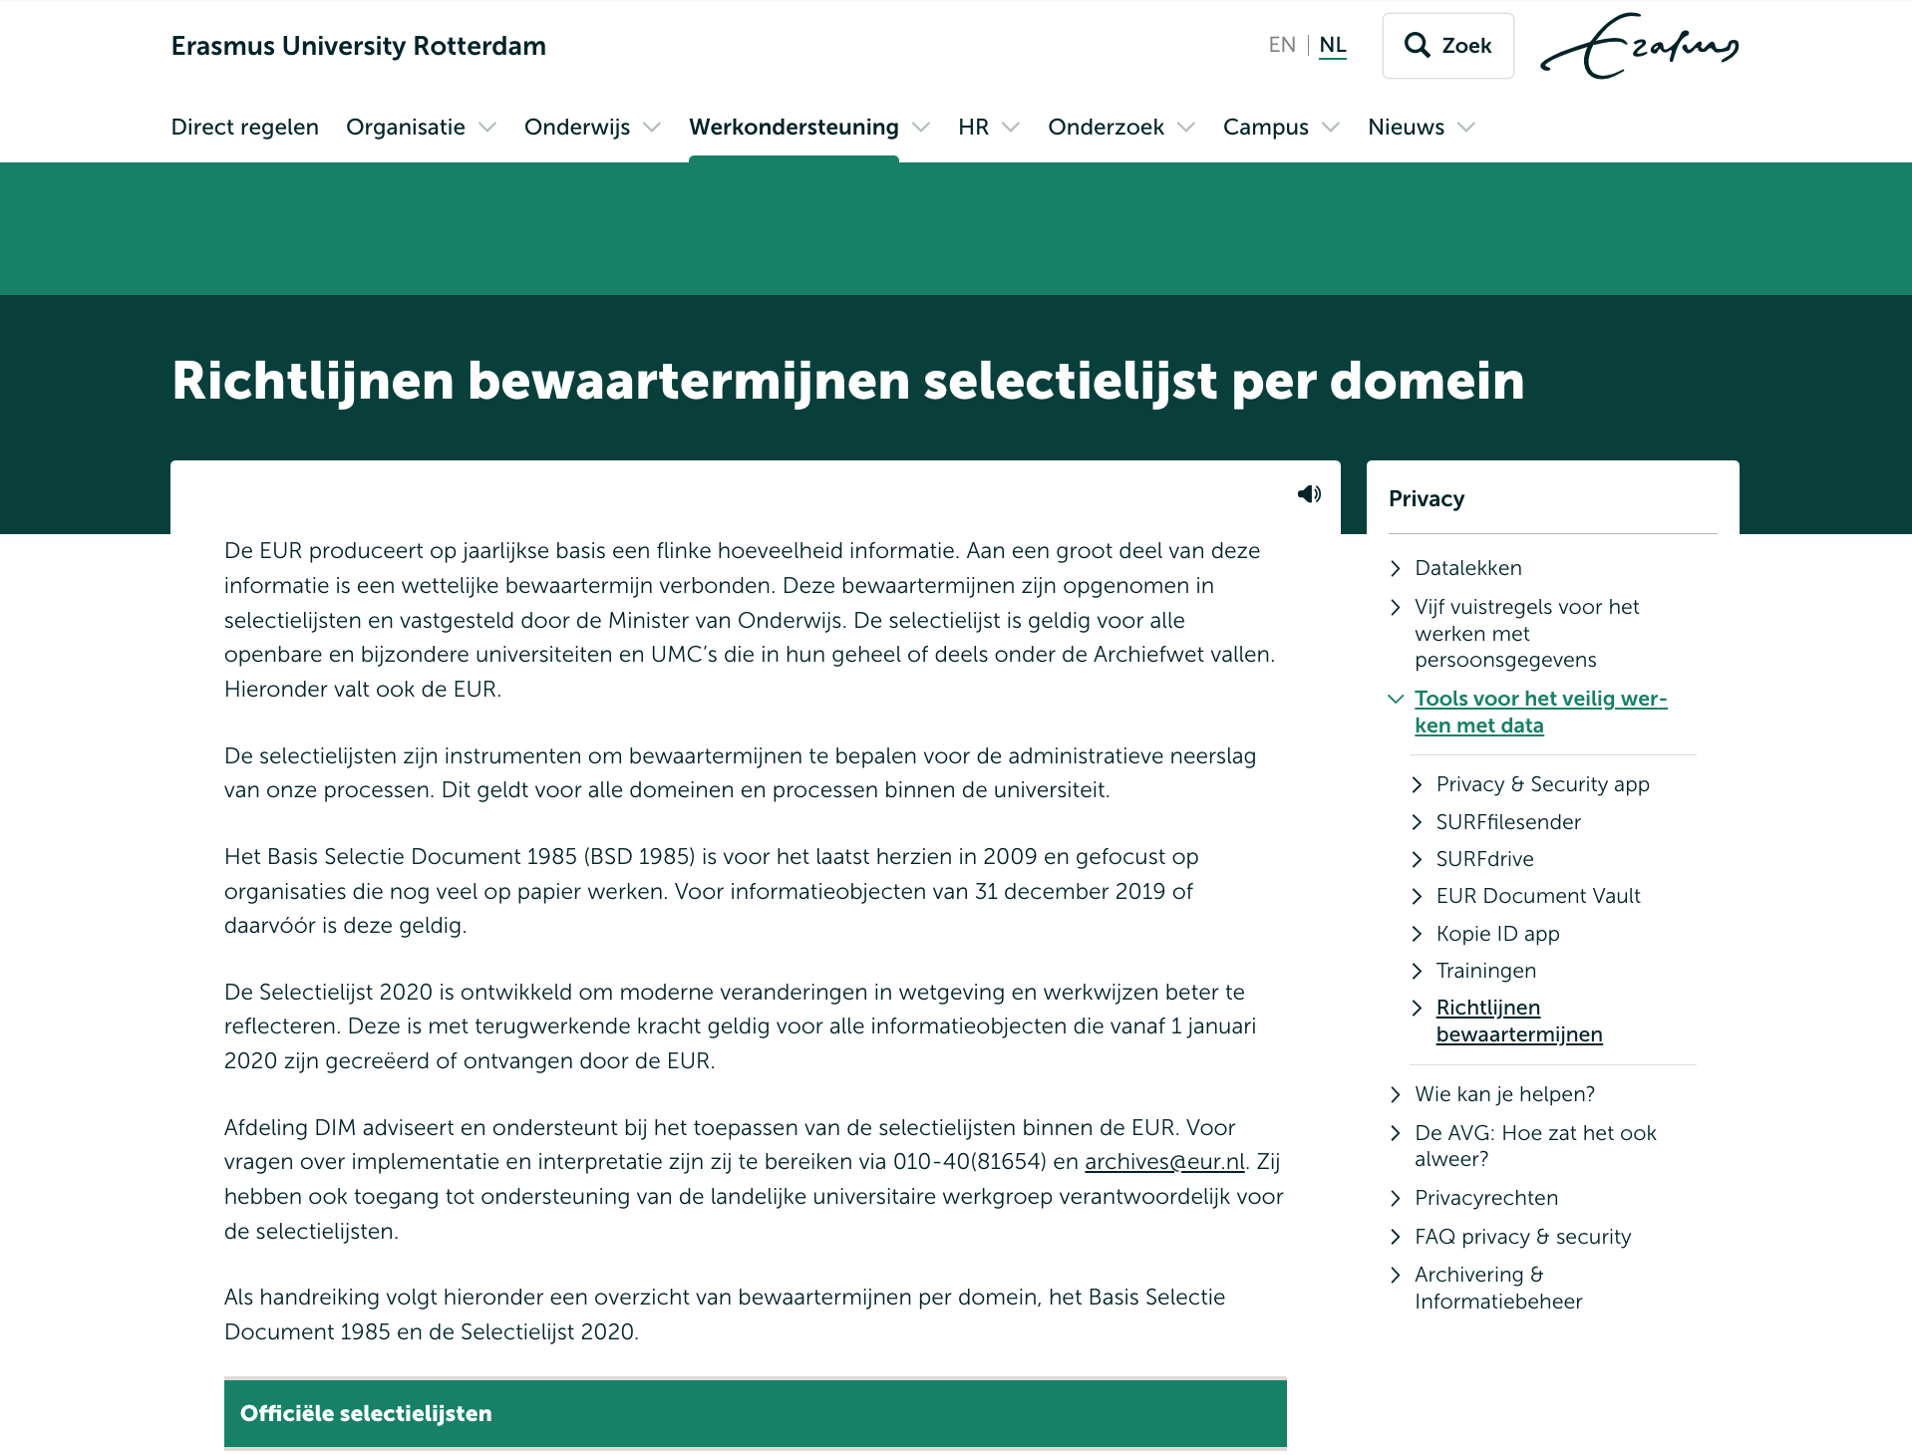
Re Storage Limitation

Slide 29
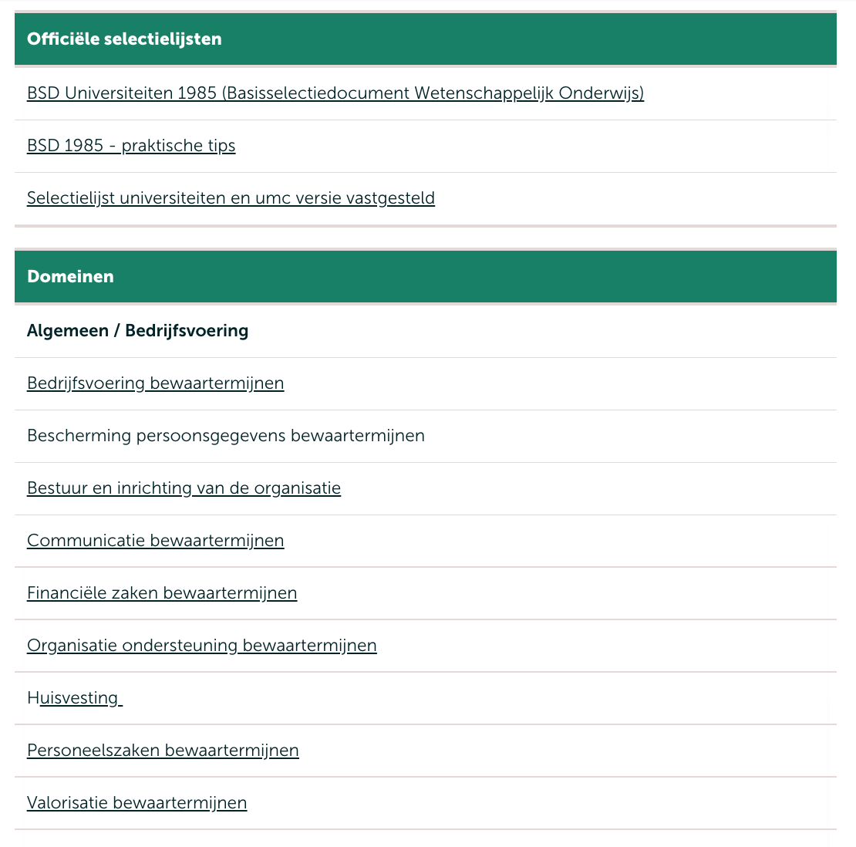
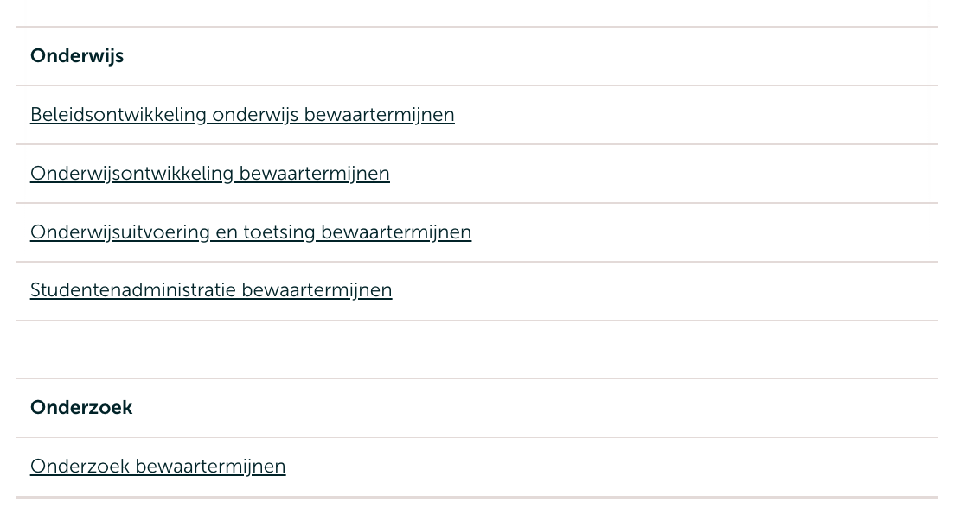
Re Storage Limitation

Slide 30
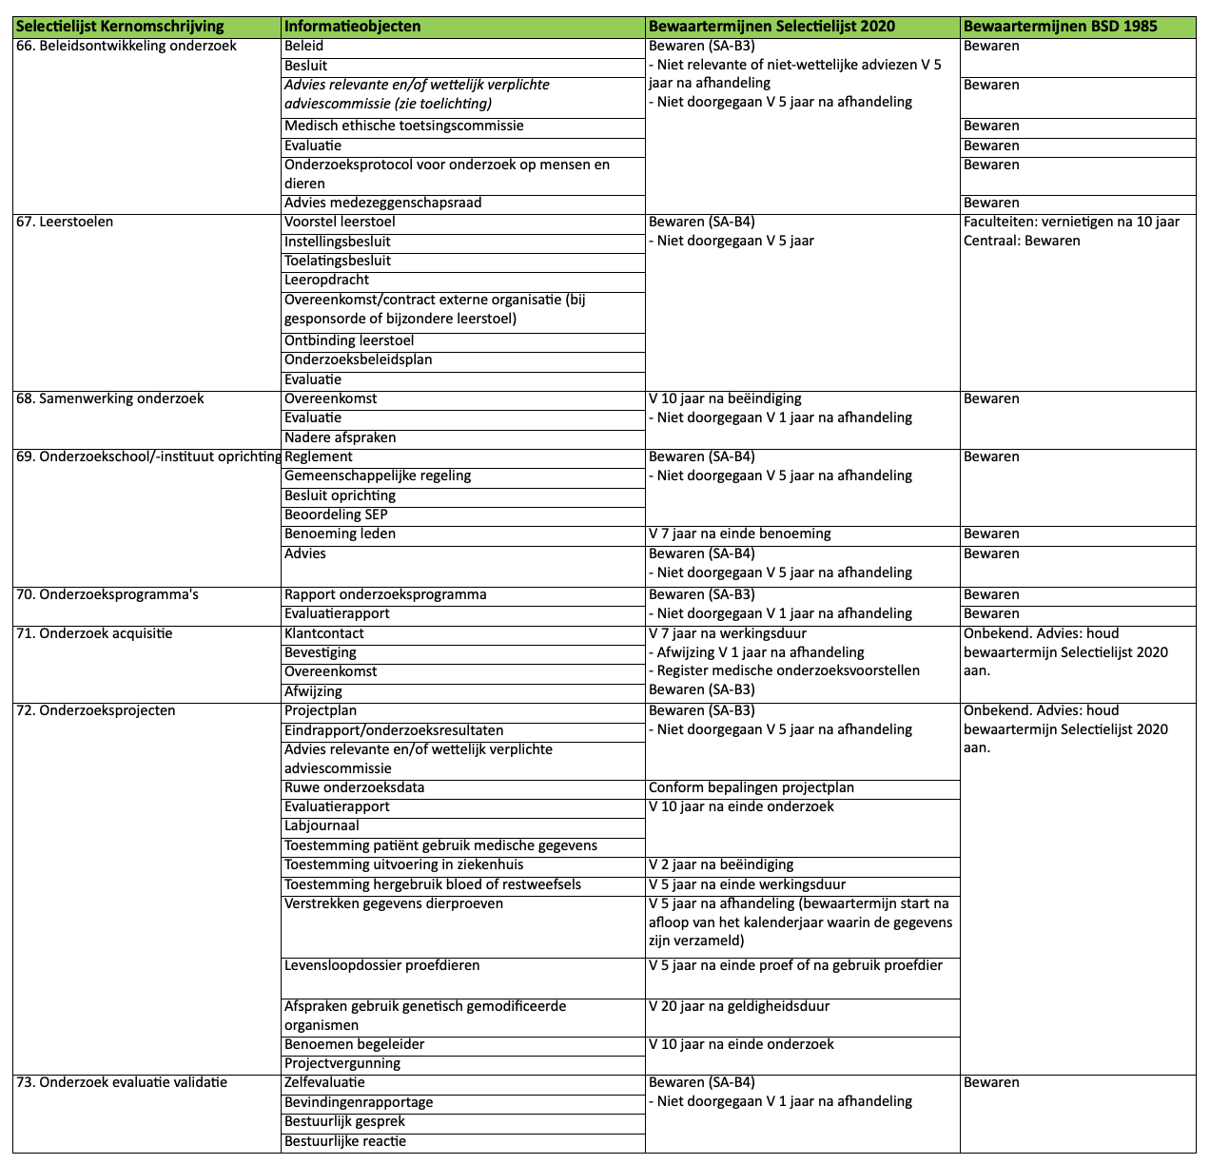
Re Storage Limitation

Slide 31
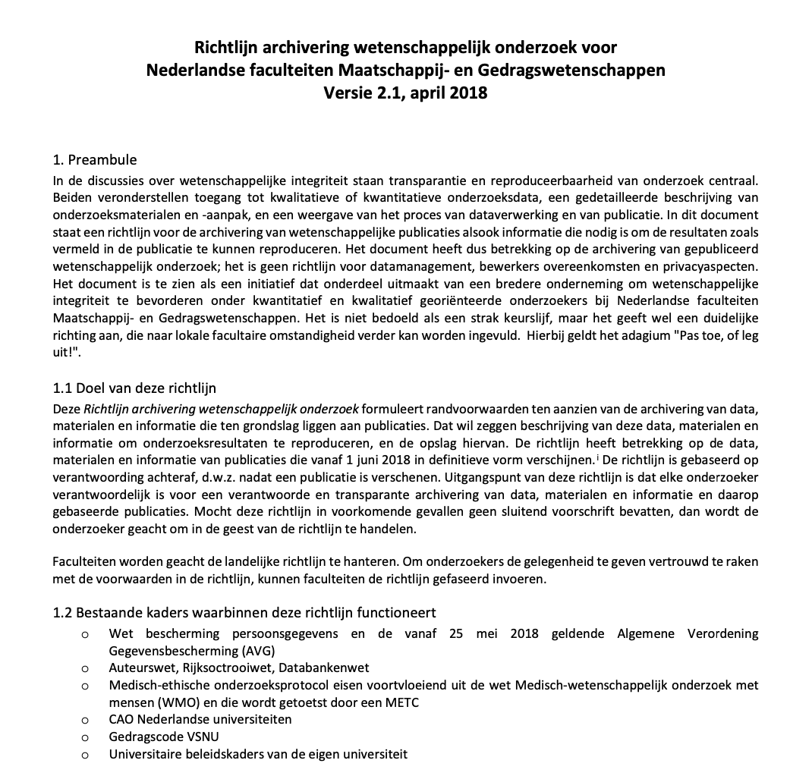
Discipline Specific Guidance: Social and Behavioural Sciences

Slide 32
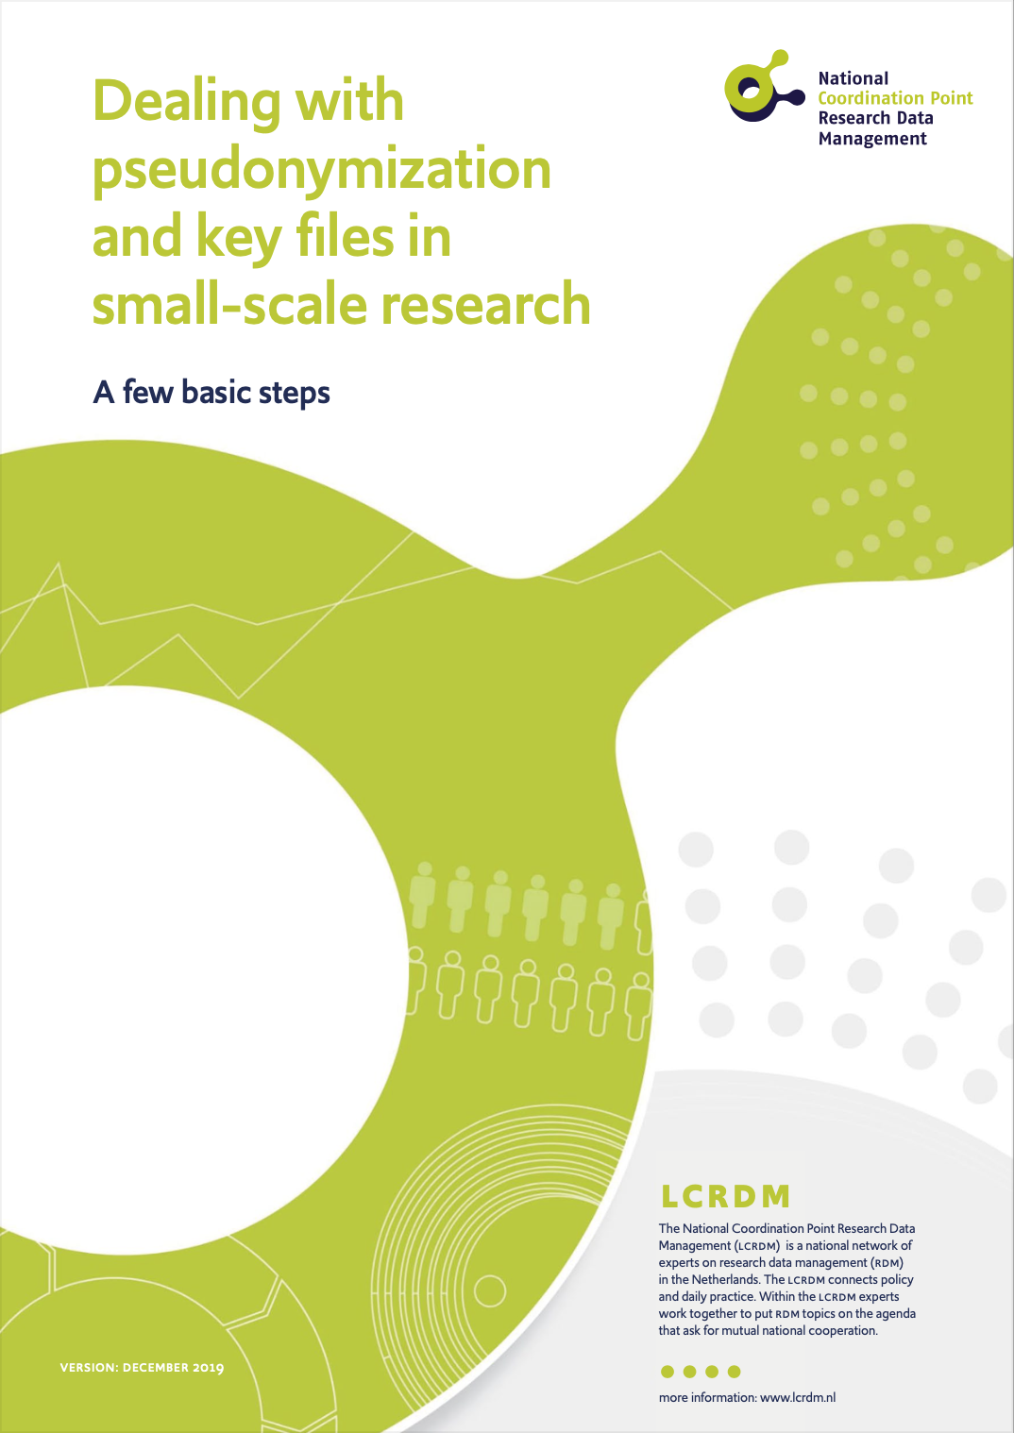
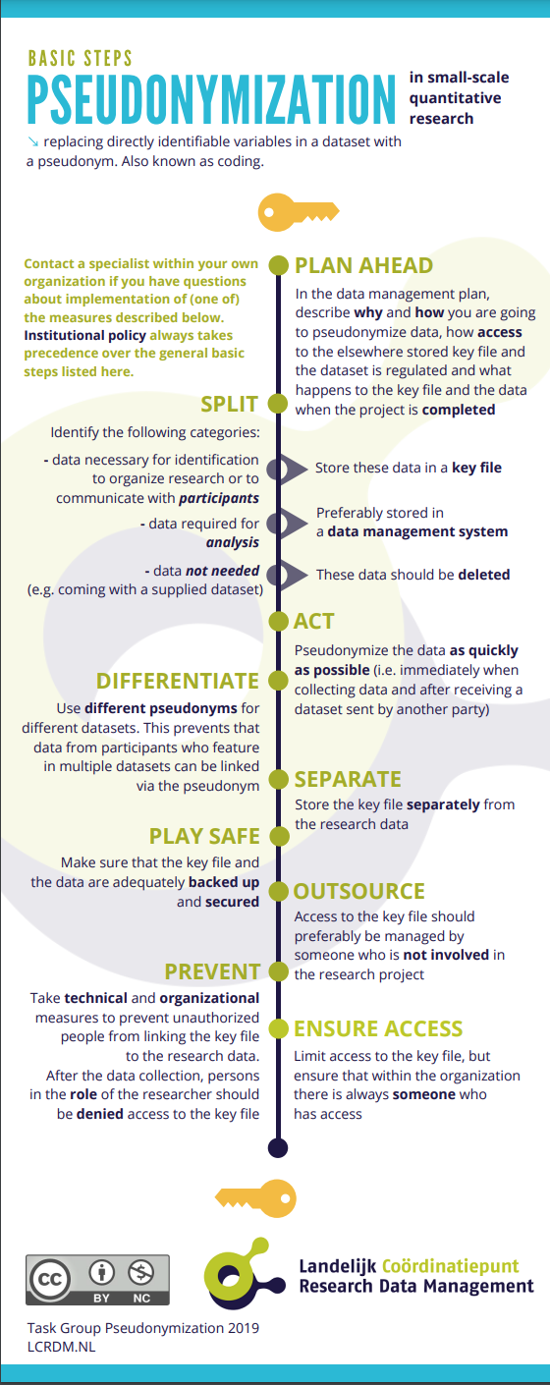
Pseudonymization / Anonymization
Source
Source
Source

