Slide 1
Week 5. Modal analysis
Oriol Colomés

Slide 2
Learning objectives
At the end of this week you will be able to:
Define numerical methods to perform a modal analysis of systems governed by Partial Differential Equations. This entails:
Characterize the modal properties of a system of PDEs
Define numerical methods that return characteristic eigenfrequencies and eigenmodes of a system of PDEs
Analize and justify the results

Slide 3
5.1
Introduction to modal analysis

Slide 4
What is modal analysis?
An operation from which we can calculate intrinsic properties of the system.
In the context of dynamic structural analysis, these are:
Natural frequencies
Natural shapes of vibration
The natural frequencies correspond to the frequencies at which the structure responds, when moved from its resting position and then released (ultimately finding the equilibrium again).
The natural shapes of vibration correspond to deformed mode of the freely vibrating structure at each of the natural frequencies.
The modal properties (frequencies and shapes) can be used to assess about the suitability of the constructed model.

Slide 5
What is modal superposition?
An operation that consists in calculating the structural response by superposing the response of each natural vibration mode. How does it work?
The response of each mode (modal response) can be calculated independently of the others, as if it was a SDOF system
The response of the structure is obtained by adding the modal responses
It relies on superposition of responses, and thus it is valid only for linear (or linearized) systems.

Slide 6
Why would we use modal superposition?
The modal response of each mode is obtained in the same way as a SDOF system (“easy” and fast: solving coupled differential equations is “more difficult”/slower than solving a normal ODE)
Most of the times, not all modes need to be included in the response for it to be accurate (modal reduction), saving time in this way
The highest modes require smaller time steps for convergence, if explicit methods are used - Euler stepping method or Runge-Kutta (ODE45). Not including them, we can get away with larger time steps, thus saving time
The highest frequency modes are the least accurate in any case, so it is okay to exclude them.

Slide 7
5.2
Modal Orthogonality

Slide 8
Modal properties
Some properties of the modal basis (number and dimensions/ values of $ω_{j}$, orthogonality):
There are as many eigen pairs ($ω_{j}$,$φ_{j}$) as there are equations (dimensions of matrices $K$ and $M$). The modal shapes have as many components as the dimensions of $K$and $M$.
All eigenvalues $ω_{j}$are real (because $K$ and $M$ are (semi-)positive definite)
If the structure is at least isostatic, then $K$ is positive definite and all eigenvalues $ω_{j}$ are positive. Otherwise, some eigen frequencies $ω_{j}$ are null, which correspond to rigid body motions.
The eigen shapes (modal shapes) are linearly independent, and stiffness and mass orthogonal, i.e.,

Slide 9
Modal orthogonality
Exercise: Proof that the eigenvectors are $M$ and $K$-orthogonal
Hints:
Write the modal equation for two distinct eigenvalues, i and j
Multiply first line by $φ_{j}^{T}$ and second by$φ_{i}^{T}$
Use the symmetry of matrix $M$ and $K$

Slide 10
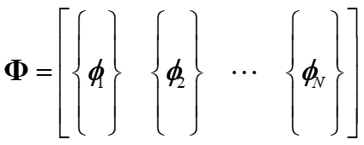
Modal orthogonality
Use the orthogonal properties of the modal shapes to uncouple the equations
Write the equations of motion (FEM, DEM, any other method)
Calculate the eigenshapes (free dofs only)

Slide 11
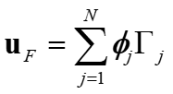
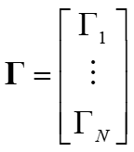
Modal orthogonality
Use the orthogonal properties of the modal shapes to uncouple the equations
Write the solution as a combination (superposition) of the modal shapes
Replace $u_{F}$ and ${\ddot{u}}_{F}$ in the equation of motion
Left multiply by $φ^{T}$

Slide 12
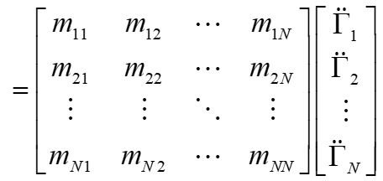
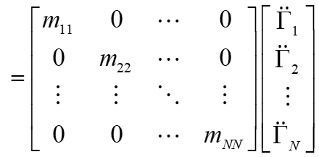
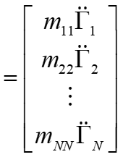
Modal orthogonality
Use the orthogonal properties of the modal shapes to uncouple the equations

Slide 13
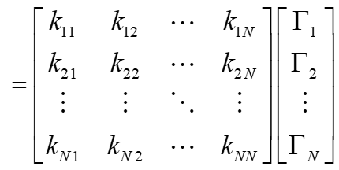
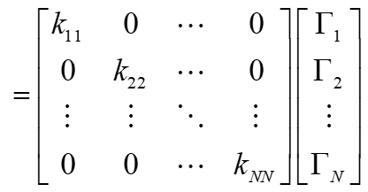
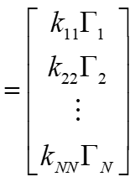
Modal orthogonality
Use the orthogonal properties of the modal shapes to uncouple the equations

Slide 14
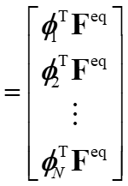
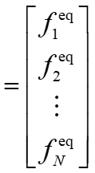
Modal orthogonality
Use the orthogonal properties of the modal shapes to uncouple the equations

Slide 15
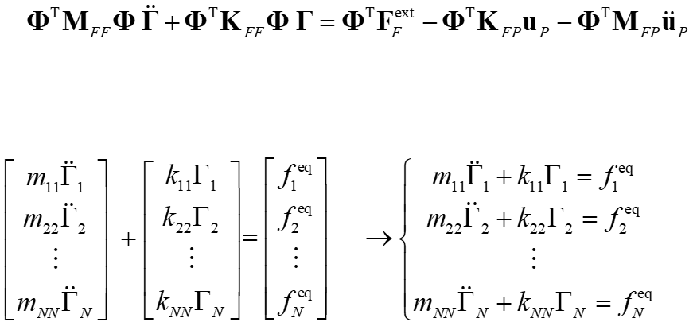
Modal orthogonality
Use the orthogonal properties of the modal shapes to uncouple the equations

Slide 16
5.3
Modal superposition in damped systems

Slide 17
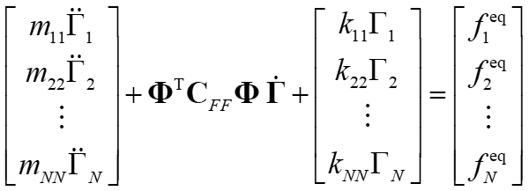
Modal superposition for damped systems
What happens when we add damping?
Replace $u_{F}$, ${\dot{u}}_{F}$and ${\ddot{u}}_{F}$ by the corresponding modal summations, and multiply by

Slide 18
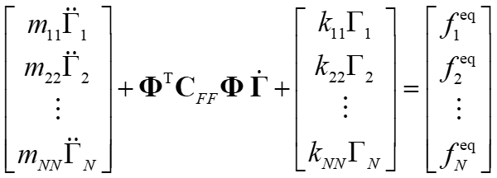
Modal superposition for damped systems
What happens when we add damping?
Is the matrix diagonal?
????????
NO. For generic matrix C, the transformed matrix is not diagonal, meaning that the equations cannot be uncoupled in this way.

Slide 19
Modal superposition for damped systems
What happens when we add damping?
However, it is common practice to define damping in such a way that the resultant transformed matrix is diagonal:
Rayleigh damping
Modal damping

Slide 20
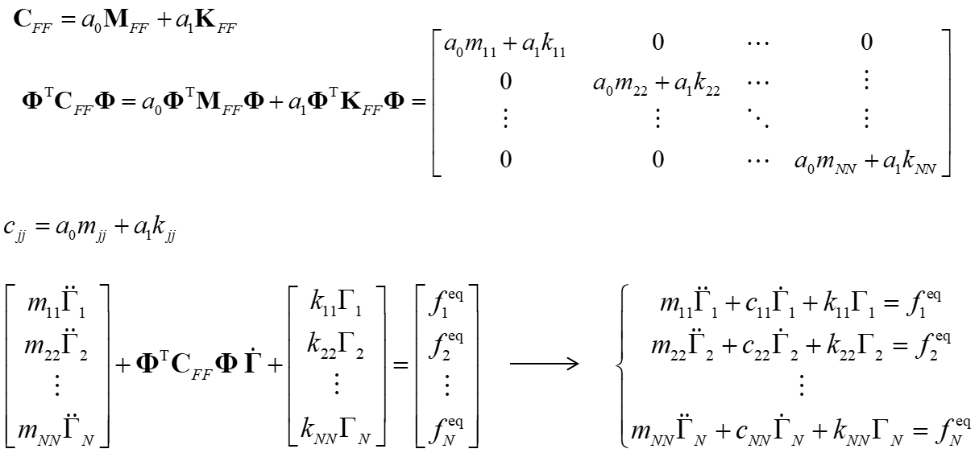
Rayleigh damping

Slide 21
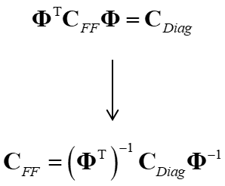
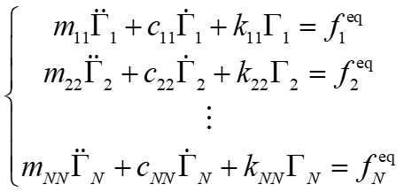
Modal damping ratio
In this approach, we define damping associated with each mode shape, usually as a percentage of the critical damping:
If we want to retrieve the damping matrix:
This is very rarely necessary!

Slide 22
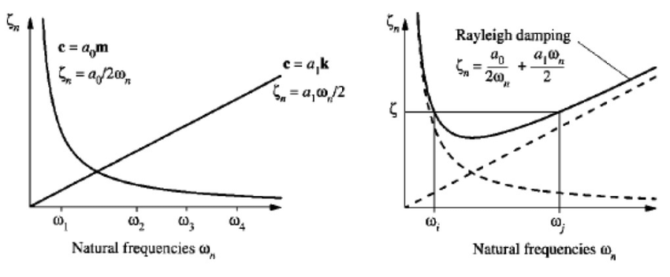
Raleigh damping vs Modal damping ratio
Modal damping ratio:
Rayleigh damping:

Slide 23
5.4
Initial conditions

Slide 24
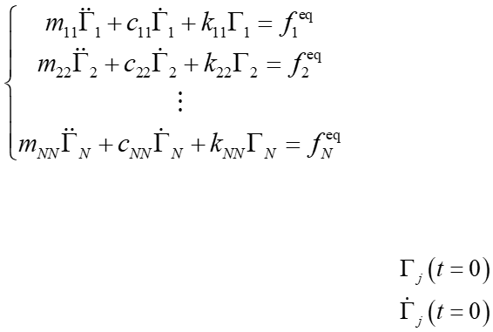
Initial conditions in modal superposition
The unknowns of the resulting system are modal shapes. We cannot use the physical displacement, velocity and acceleration fields directly! ☹
Uncoupled system of equations:
For us to be able to solve it, we still need to define initial conditions for each of the modal responses:

Slide 25
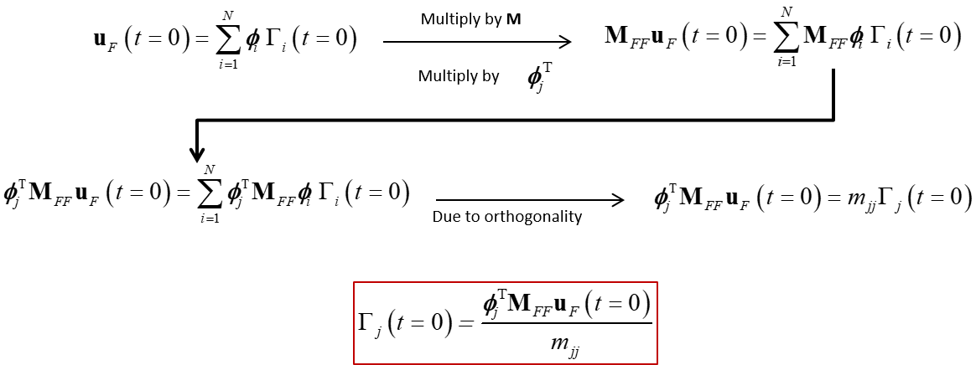
Initial conditions in modal superposition
How?

Slide 26
Initial conditions in modal superposition
Exactly the same process….
What about velocities?
Initial modal displacement
Initial modal velocity

Slide 27
The final modal superposition recipe
Calculate the mass and stiffness matrices (K, M) of your system (FEM, FD, …)

Slide 28
Thank you for your attention
Oriol Colomés

