Slide 1
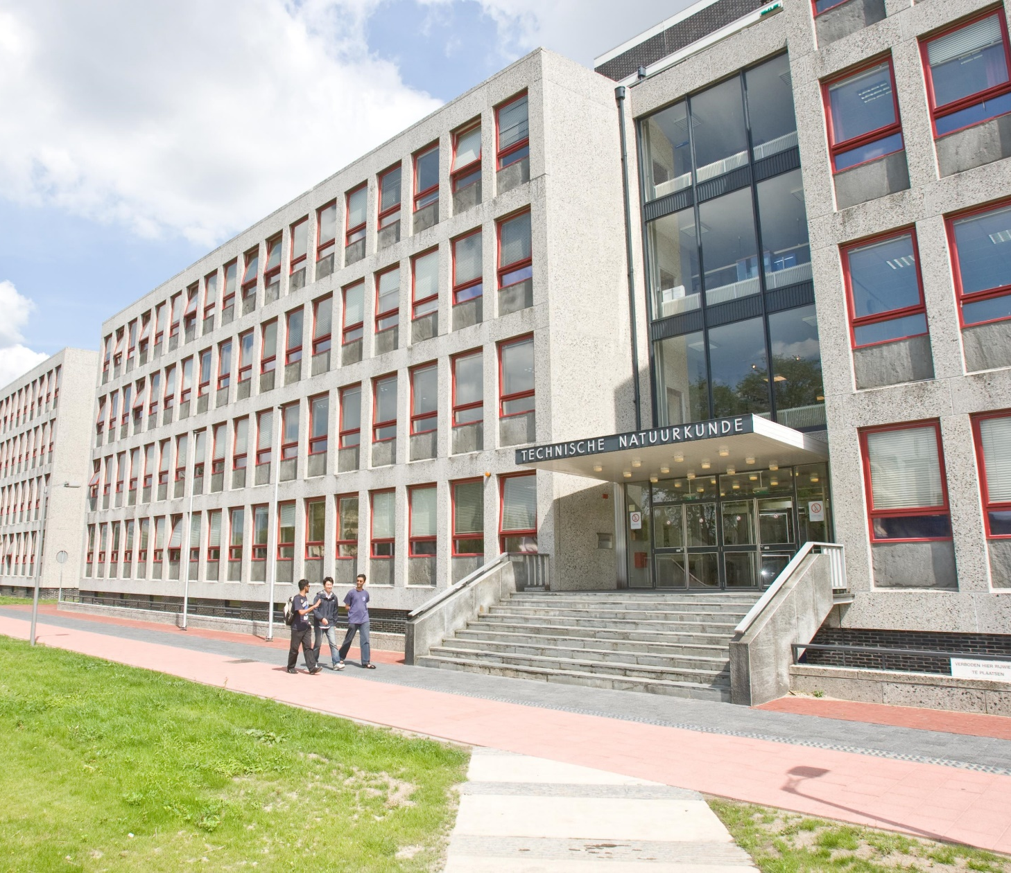
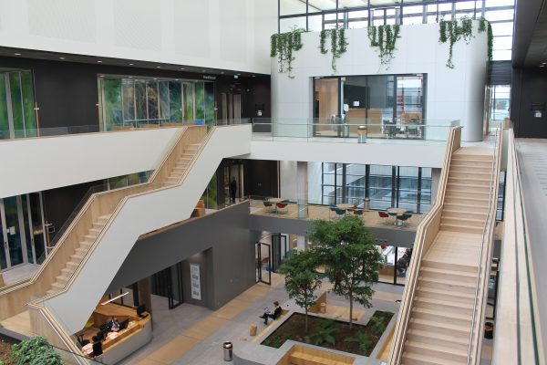
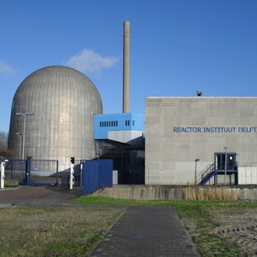
Research Data Management & Open Science
Esther Plomp
PhD Onboarding Day
2 February 2023
https://tinyurl.com/onboardingEsther3

Slide 2
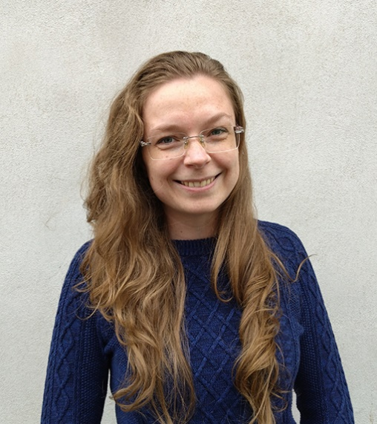
Data Steward
Esther Plomp
e.plomp@tudelft.nl
22.F131
Interview PhD-in-4
Advice on data/code/open science
See intranet for all the topics
Information:
Research Data Management Website
Open Science at TU Delft
Open Science at TNW
Tools and platforms
Training
Software/coding trainings
Research Data Management 101 (Faculty versions in Feb/March & May/June. Sign up for waitinglist.
Open Science program (next round starting in ~September)
Software/code
Digital Competence Center
Open Science Community Delft
Website
Joining

Slide 3
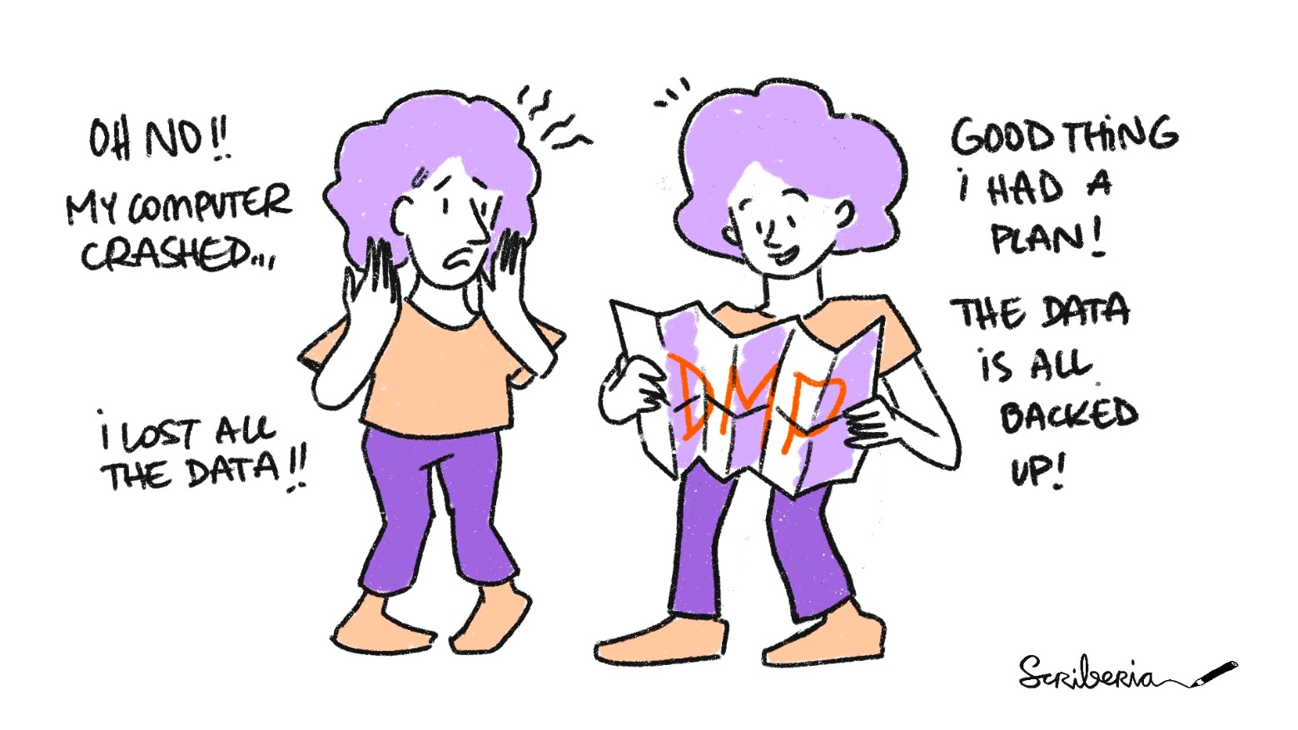
Data Management plan
TU Delft Research Data Framework, Faculty Policy
Any PhD starting after 1st of Jan 2020:
Write a Data Management Plan: as part of the Go/No-Go meeting in your first year.
In the PhD agreement you’ll have to describe how you’ll do this
You can fill out a plan using DMPonline (see here for a short explanation)
Where do you store your data? How will you share your data from your publications?
Your supervisor will have to approve your plan.
More detailed information on the Open Science support website
The Turing Way project illustration by Scriberia. Used under a CC-BY 4.0 licence. DOI: 10.5281/zenodo.3332807

Slide 4
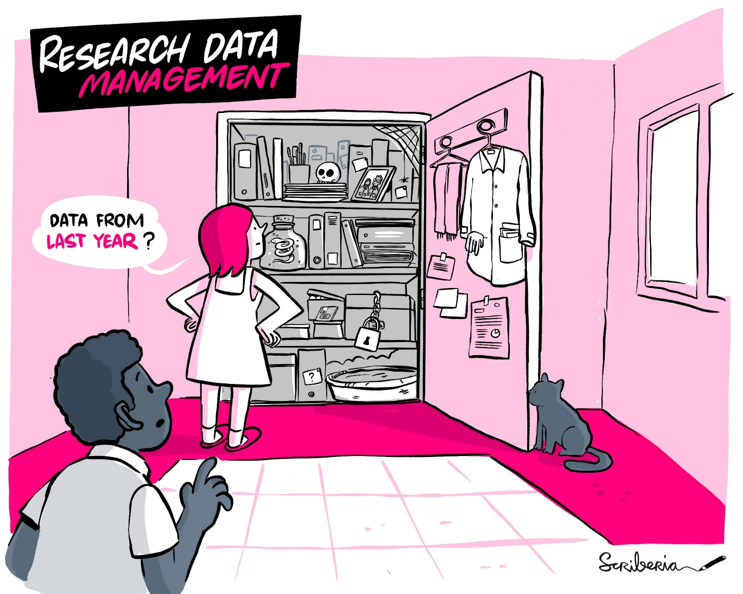
Sharing the data/code underlying your articles/thesis
Before your defense you should share your research outputs (data/code underlying the articles/thesis).
The data management plan allows you to already think about how you will do this!
More information on the Open Science support website.
The Turing Way project illustration by Scriberia. Used under a CC-BY 4.0 licence. DOI: 10.5281/zenodo.3332807.

Slide 5
Opslag locaties + infographic

Slide 6
Do’s Don’ts
Set up a Data Management plan
Ask questions
Follow workshops/courses (for credits!)
Discuss data/code/open science with your supervisor
Join the Open Science Community
Keep everything closed (unless you have restrictions)
Share without discussing this with your supervisor/collaborators
Figure everything out yourself

Slide 7
Notes:
Join the community!
Data Champions became an initiative of the Open Science Community Delft

