Slide 1
Quantum Cryptography
Christian Schaffner
Research Center for Quantum Software
Informatics Institute (IvI)
University of Amsterdam
Pitch for Quantum Cryptography Logic June project
Wednesday, 11 May 2022

Slide 2
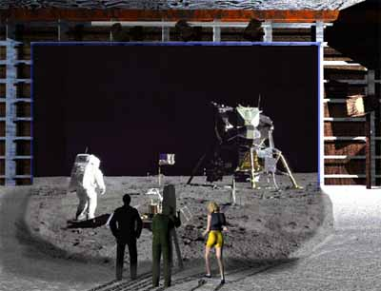
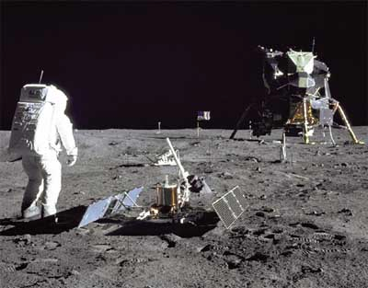
1969: Man on the Moon
The Great Moon-Landing Hoax?
NASA
How can you prove that you are at a specific location?
http://www.unmuseum.org/moonhoax.htm
Notes:
In 1969, man has first set foot on the moon, as you can see here on this picture sent around the world by NASA...
Or not? Maybe it was all just a “great moon-landing hoax”, as speculated on various conspiracy-theory websites on the internet?
One fascinating cryptographic question I want to study in my project is: “How can you prove that you are at a specific location?”
More about it later…

Slide 3
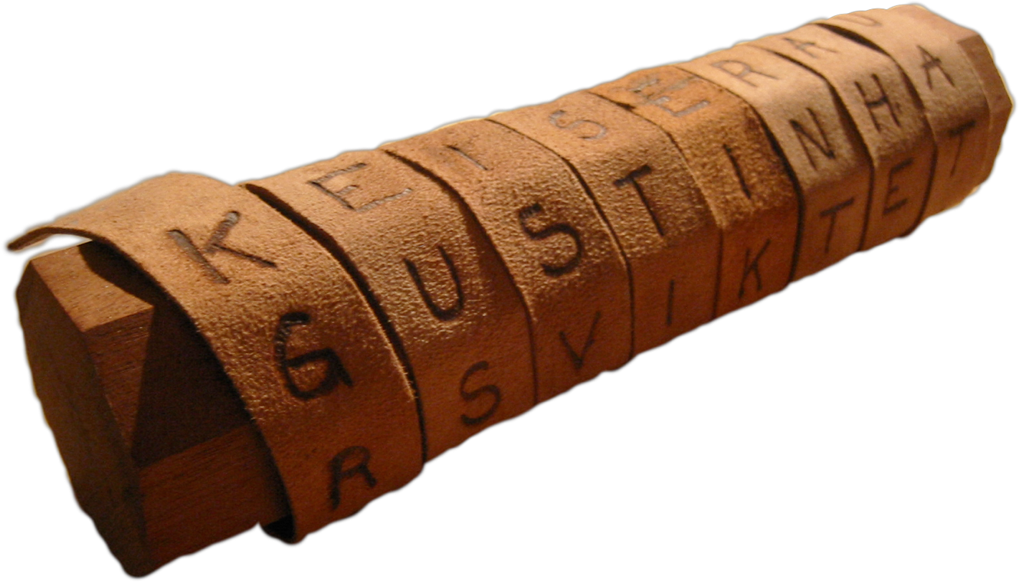
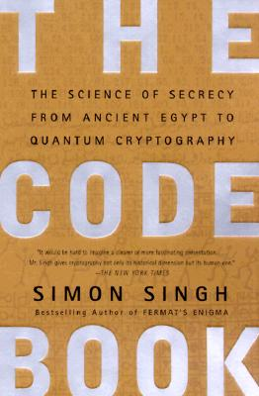
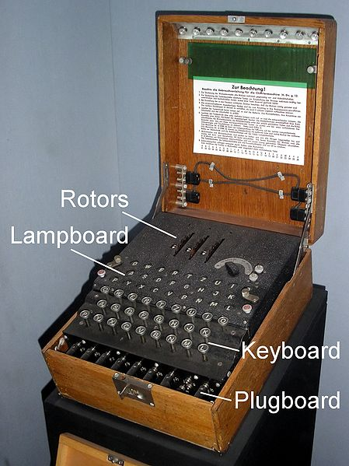
Classical Cryptography
3000 years of fascinating history
Until 1970: private communication was the only goal
Scytale
Enigma

Slide 4
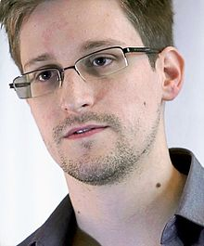
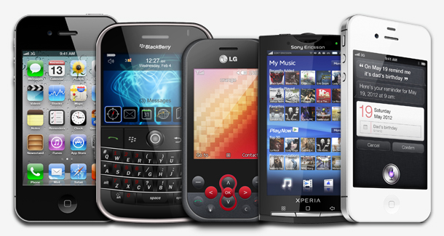
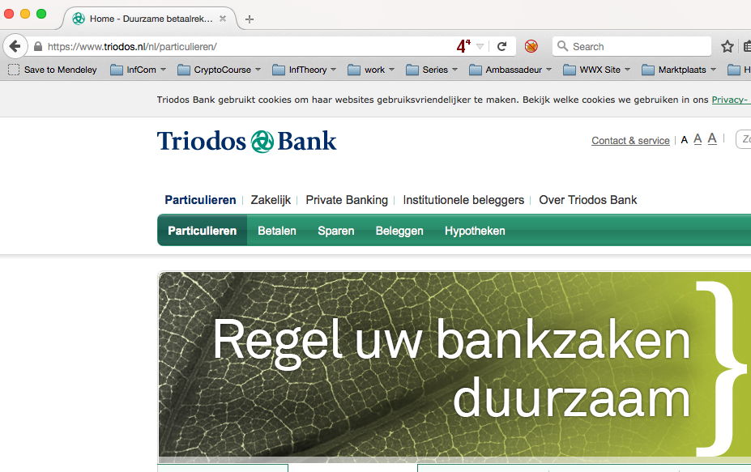
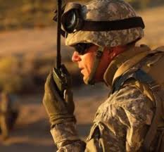
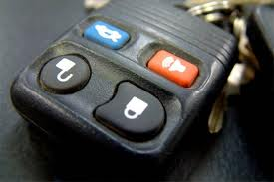
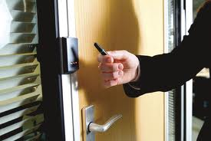
Modern Cryptography
Edward Snowden
is everywhere!
is concerned with all settings where people do not trust each other

Slide 5
What will you learn from this project?
Classical Cryptography
Quantum Mechanics
Crypto Threat of Quantum Computing
Quantum Cryptography
Position-Based Cryptography

Slide 6
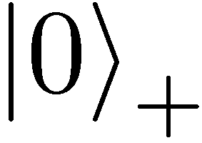
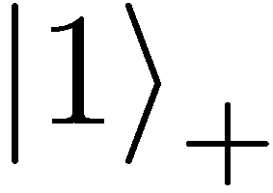
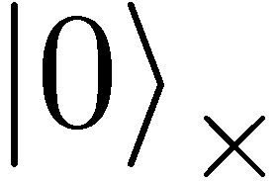
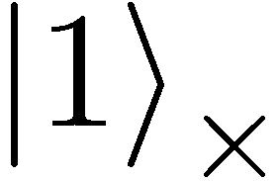

Quantum Mechanics
+ basis
$×$ basis
Measurements:
Quantum operations:
U
with prob. 1 yields 1
H
0/1
with prob. ½ yields 0
0/1
with prob. ½ yields 1

Slide 7
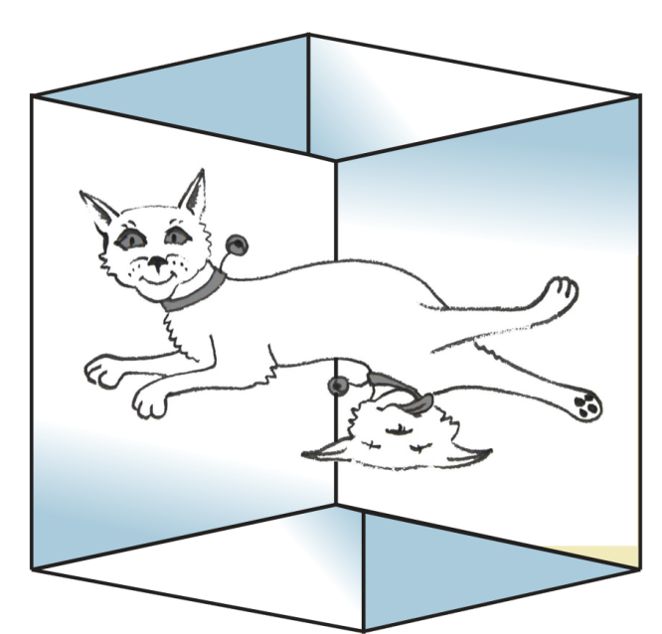

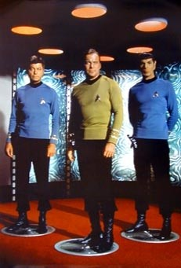
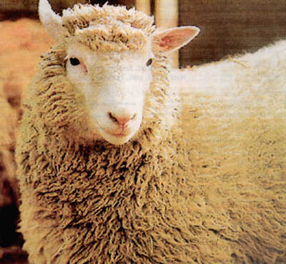
Wonderland of Quantum Mechanics

Slide 8
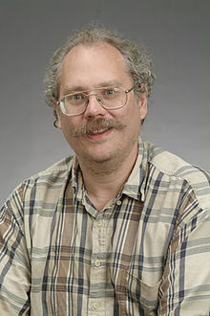
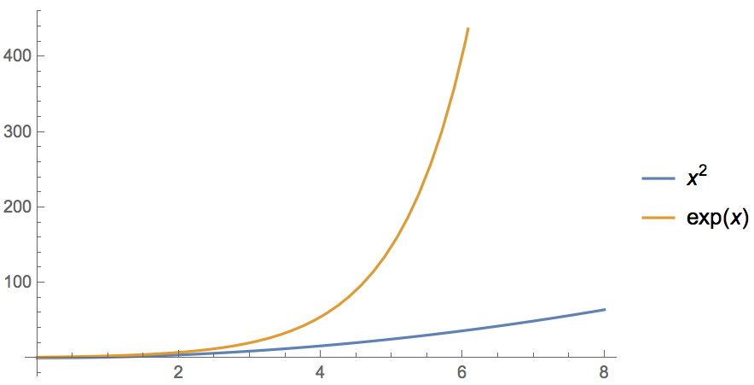
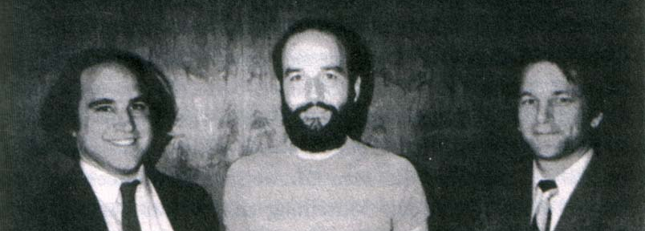
Quantum Computer breaks Public-Key Crypto
[Shor ’94] Polynomial-time quantum algorithm for factoring integer numbers
Classical Computer : Exponential time
Quantum Computer : Poly-time: n²
For a 600-digit number (RSA-2048)
    Classical: age of universe
    Quantum: few minutes
  Consequence: Large enough quantum computers break all currently used public-key cryptosystems!!!
Notes:
15 = 3 * 5
51 = 3 * 17
123 * 456 = 56088

Slide 9
Current Cryptography under Quantum Attacks
Security level systems | Conventional attacks | Quantum attacks
Symmetric-key encryption (AES-256) | 256 bits of security | 128 bits
Hash functions (SHA3-256) | 128 bits | 85 bits
Public-key crypto (key exchange, digital signatures, encryption) (RSA-2048, ECC-256) | 112 bits | ~ 0 bits
Products, services, businesses relying on security either stop functioning or do not provide expected levels of security
Notes:
Ask who knows the difference between private and public key! Explain the advantage of public-key crypto

Slide 10



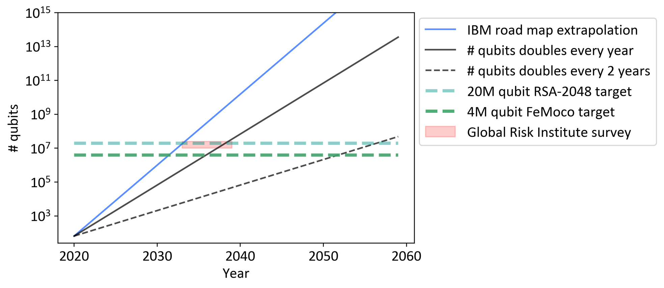
Can We Build Quantum Computers?
Possible to build in theory, no fundamental theoretical obstacles have been found yet.
Enormous technical challenge (control vs decoherence)
http://www.quantumcryptopocalypse.com

Slide 11




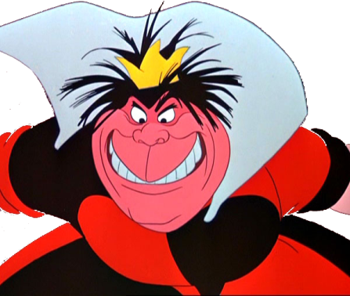
Quantum Key Distribution (QKD)
Alice
[Bennett Brassard 84]
Bob
k = ?
k = 0101 1011
Eve
k = 0101 1011
Offers a quantum solution to the key-exchange problem
Puts the players into the starting position to use symmetric-key cryptography (encryption, authentication etc.).

Slide 12
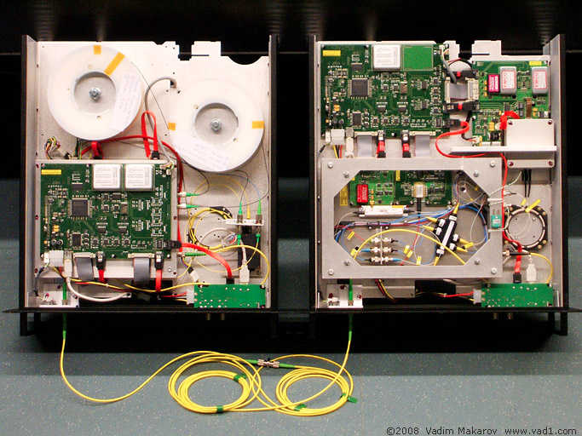

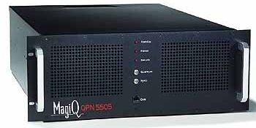
Quantum Key Distribution (QKD)
Alice
[Bennett Brassard 84]
Bob
Eve
technically feasible: no quantum computer required,
only quantum communication

Slide 13
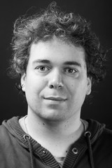

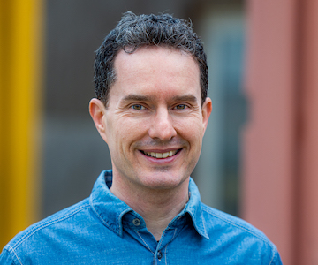
Teachers
Florian Speelman
Sebastian Zur
Christian Schaffner

Slide 14
Pre-Requisites
Basic knowledge of quantum information, as aquired in ”Quantum Computing” (by de Wolf), or “Quantum Information Theory” (Ozols/Helsen)
Chapter 0 of edx course
Material
Quantum Cryptography course by Wehner/Vidick on edx.org
https://www.edx.org/course/quantum-cryptography

Slide 15
Format
6 EC = full-time entertainment (40h/week) in June
At least 10 2-hour in-person sessions in June 2022
Student presentation of research paper
Assessment
3 homework assignments
Student presentation
Possibly: small report
Pass/fail grade

Slide 16

Thank you for your attention!
Questions
https://staff.science.uva.nl/c.schaffner/courses/qcrypto/2022/

