Slide 1
Why should we care about security in sustainability? Investigating the role of Information Security in the Success of Circular Economy
Abhishta, Yasir Haq and Devrim Murat Yazan
University of Twente
The Netherlands

Slide 2
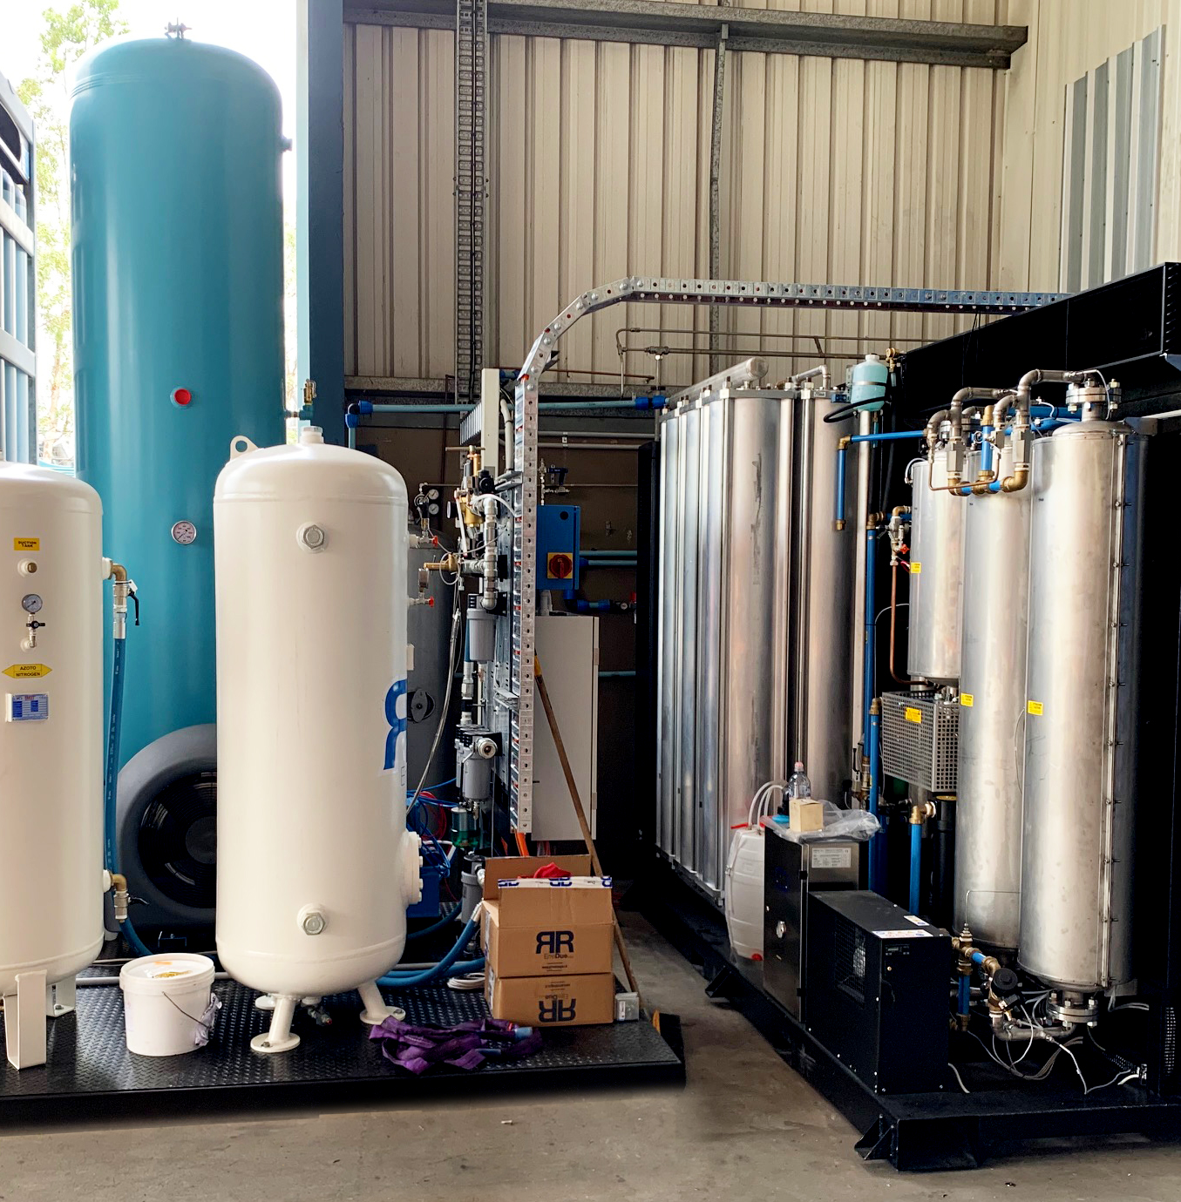
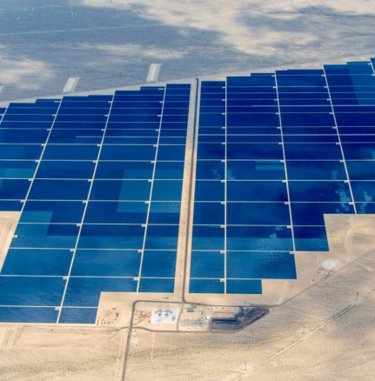
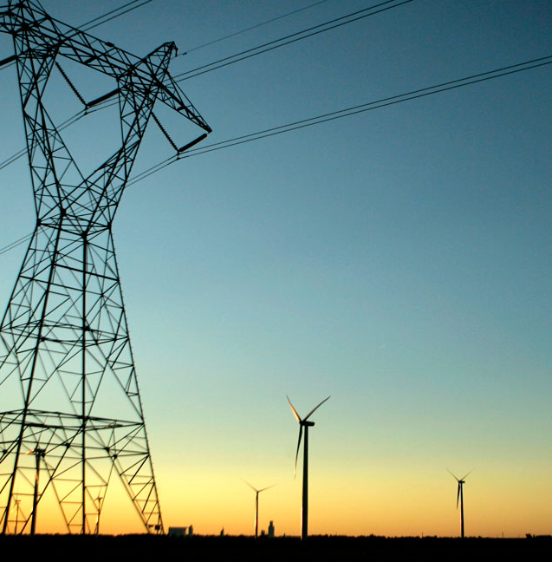
Dependence of sustainability on IT/IoT and OT
Internet of Things (IoT) is believed to be one of the enabling paradigms of sustainable digital transformation and environmental protection (Salam, 2019)
Digital technologies can help fight climate change, resource scarcity and species endangerment (Beier, et al., 2018; Garrity, 2015; Schneider, 2019).
Use of data driven decisions forces the embedding of digital technologies in business processes.

Slide 3
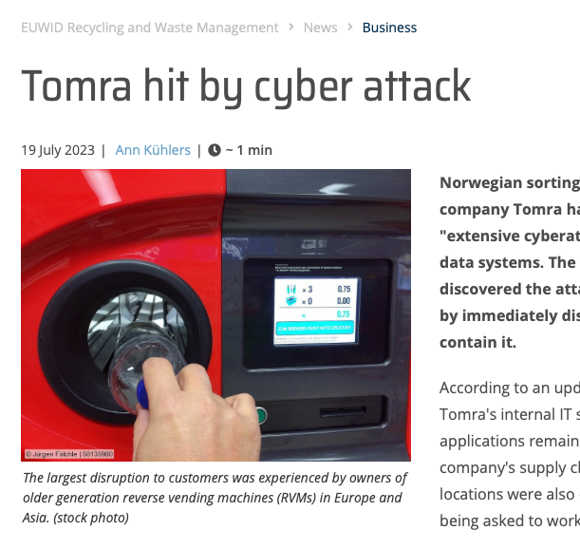
Cyber attacks have the potential to disrupt these benefits.
Concerns over data security affect the acceptance and marketability of recycled products in B2B and B2C settings (Polyportis et al., 2022).
Cyber threats erode trust among stakeholders, complicating the establishment of reliable data-sharing agreements (Antikainen et al., 2018).
The potential for cyber attacks to compromise proprietary information heightens the need for robust data protection (Antikainen et al., 2018).

Slide 4
Our Goal
“ to understand the proposed role of information security in safeguarding information systems that facilitate a circular economy. ”

Slide 5
Methodology: A data driven literature review.
Query Scopus for relevant literature
Initial visualisation using VoS viewer
Title-Abstract screening using ASreview
Using BERTopic for topic detection in selected literature
Full Article Screening for representative liturature
Step 1
Step 2
Step 3
Step 4

Slide 6
Step 1: Query Development
( "circular economy" OR "industrial symbiosis" OR "circular value chain" OR "shared economy" OR "zero waste" )
Circular Economy or Industrial Symbiosis
+
AND
((information OR cyber OR data OR network) AND security )
Cyber Security
Timeline: 2015 to May 31st, 2024

Slide 7
Step 2: Vos Viewer and AS Review
Developed by University of Leiden.
Creates and visualizes bibliometric networks (e.g., co-authorship, co-citation).
Options to adjust node sizes, colors, and labels for clarity.
We develop a network of keywords to develop an initial visualisation.
Developed by Utrecht University.
AS Review automates the process of conducting systematic reviews, saving researchers significant time and effort.
Utilizes machine learning algorithms to prioritize and select relevant studies, enhancing the efficiency of the review process.

Slide 8
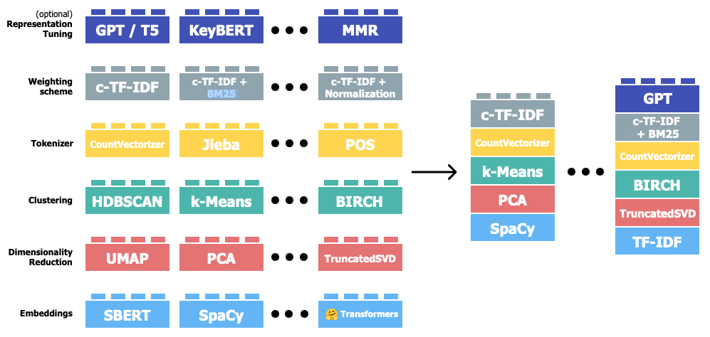
Step 3: BERTopic based Topic Detection
Borrowed from documentation: https://maartengr.github.io/BERTopic/algorithm/algorithm.html#visual-overview

Slide 9
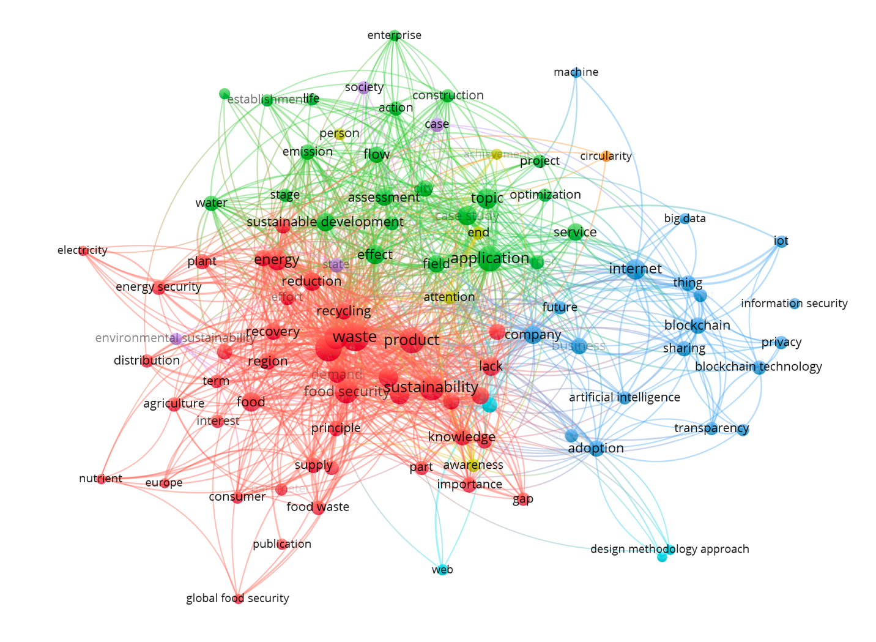
Result: Query Development and Initial Visualisation
Scopus query results in a 293 articles between 2015 and 2024.

Slide 10
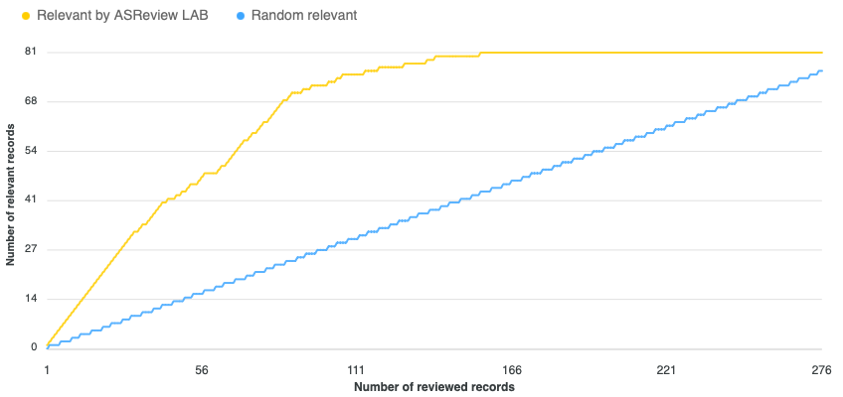
Result: Title-Abstract Screening
Inclusion Criteria
“digital security” applied to “CE business process”.
challenges for adoption of IT/OT.
Exclusion Criteria
Food security related articles.
Preface of conference proceedings.
Opinion pieces
We identify 90 (~30%) relevant documents.

Slide 11
Relevant Documents (1/2)

Slide 12
Relevant Documents (2/2)
Notes:
Barriers to CE
Blockchain for Trust
AI in supply chains
Implementation of blockchain
E-Waste Collectors/IoT adoption

Slide 13
Result: Topic detection
Topic | Count | Description | Summary
0 | 13 | 0_barriers_technologies_circular_industry | Discusses revolutionizing supply chain and circular economy barriers and strategies.
1 | 11 | 1_sharing_zero_defect_quality | Explores user participation dilemmas in the circular economy and zero-defect quality strategies.
2 | 9 | 2_recycling_life_waste_end | Investigates recycling, life cycle management, and end-of-life waste management practices.
3 | 8 | 3_blockchain_technology_success_management | Highlights leveraging blockchain for enhanced traceability and success management.
4 | 8 | 4_based_research_application_systems | Examines threat modelling of IoT systems using distributed approaches and research applications.
5 | 6 | 5_performance_ai_triggers_2030 | Looks into future food engineering systems and AI triggers for performance by 2030.
6 | 5 | 6_key_logistics_bcdts_bct | Discusses blockchain and IoT embedded sustainable virtual logistics systems.

Slide 14
Topic 0: revolutionizing supply chain and circular economy barriers and strategies.
Security can be a barrier to success of CE technologies.

Slide 15
Topic 1: user participation dilemmas in the circular economy and zero-defect quality strategies.
Security can add value by creating trust.

Slide 16
Topic 2: recycling, life cycle management, and end-of-life waste management practices.
Recycling devices can have security as a barrier.

Slide 17
Topic 3: leveraging blockchain for enhanced traceability and success management.
Blockchain as a technology for trust.

Slide 18
Topic 4: threat modeling of IoT systems using distributed approaches and research applications.
Security in applications for waste management.

Slide 19
Topic 5: future food engineering systems and AI triggers for performance by 2030.
Supply chain security has a role to play.

Slide 20
Topic 6: Discusses blockchain and IoT embedded sustainable virtual logistics systems.
Case studies on BC implementations in transportation.
Notes:
Credentials management.

Slide 21
Take-aways
Only a few articles (most in the last 5 years) have looked at the interplay of security and circlar economy.
Recycling of IoT devices could be an issue due to security concerns.
In secure platforms for information sharing would not have a widespread adoption.
Security is both an enabler and barrier to circular economy.
There is a lack of literature that could help standardise security in circular economy systems.
There is little discussion about the adoption of AI w.r.t. security in present literature.
Digital soveregnity concerns and adoption of PQC has never been dicussed.
If work is not done in these directions we run a risk of creating CE ecosystems that are highly dependent on few digital players.

Slide 22
References
Beier, G., Niehoff, S. and Xue, B., 2018. More sustainability in industry through industrial internet of things? Applied Sciences, 8(2), pp.1-12.
Garrity, J., 2015. Harnessing the internet of things for global development. [pdf] Available at: <https://www.itu.int/en/action/broadband/Documents/Harnessing-IoT-Global-Development.pdf>
Salam, A., 2019. Internet of Things for Sustainable Community Development – Wireless Communications, Sensing, and Systems. Heidelberg, Berlin: Springer.
Schneider, S., 2019. The impacts of digital technologies on innovating for sustainability. In Innovation for sustainability. New York: Springer, pp.415–433.
Antikainen, M., Uusitalo, T., & Kivikytö-Reponen, P. (2018). Digitalisation as an enabler of circular economy. Procedia Cirp, 73, 45-49.
Polyportis, A., Mugge, R., & Magnier, L. (2022). Consumer acceptance of products made from recycled materials: A scoping review. Resources, Conservation and Recycling, 186, 106533.

Slide 23
Thank you!
Any questions?
Feel free to reach out to me at s.abhishta@utwente.nl

