Slide 1
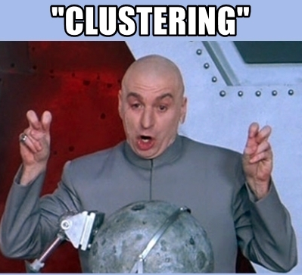
12th Summer School on Data Science
Gerasimos (Jerry) Spanakis
Most slides are based on:
Introduction to Data Mining (by Tan, Steinbach, Karpatne, Kumar)
Most memes are taken from giphy.com

Slide 2
Agenda
What is clustering and why is challenging?
Algorithms for Clustering
  K-means
  Hierarchical Clustering
  DBSCAN
Clustering Validation
  How to make sure your clustering makes sense?
Lab on simple clustering tasks using WEKA

Slide 3
What is clustering?
Finding groups of objects such that the objects in a group will be similar (or related) to one another and different from (or unrelated to) the objects in other groups
Inter-cluster distances are maximized
Intra-cluster distances are minimized

Slide 4
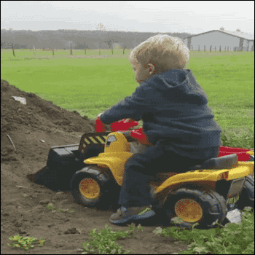
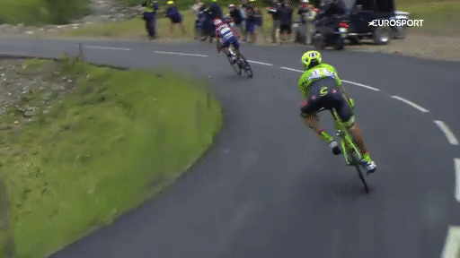
Easy, peasy, right?
YOU on your first clustering attempt
YOU chasing a
“good clustering”

Slide 5


Slide 6
Examples of clustering applications
Information retrieval: Document clustering
Marketing: Discover distinct groups in customer bases (e.g. facebook grouping: “People established adult life”)
Land use: Areas of similar land use in earth observation database
Insurance: Groups of policy holders with a high average claim cost
…

Slide 7

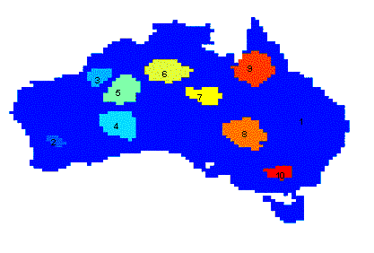
Why do it?
Understanding
  Group related documents for browsing
  Group genes and proteins that have similar functionality
  Group stocks with similar price fluctuations
Summarization
  Reduce the size of large data sets
Clustering precipitation in Australia

Slide 8
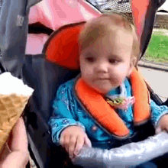
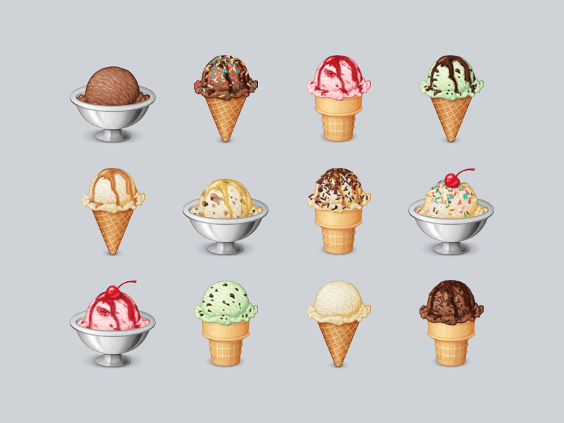

Why do it (again)
“The revolution (in AI) will not be supervised”
We need to have models that understand the world, like humans do
  We don’t give many “labels” to humans
  They just learn by observing the world

Slide 9

Clustering IS
Ambiguous
How many clusters?
Six Clusters
Two Clusters
Four Clusters

Slide 10

What is a good clustering?
A good clustering method will produce
high quality clusters
  high intra-class similarity: cohesive within clusters
  low inter-class similarity: distinctive between clusters
The quality of a clustering method depends on
  Data, distance, … (see next slide)
  its implementation,
  Its ability to discover some or all of the hidden patterns

Slide 11

Input data matters
Type of data in the input
  Measurements?
  Image? Text? Timeseries?
Type of distance used
  Central to clustering
  Depends on data and application
Data characteristics that affect proximity and/or density are
  Dimensionality (issues with sparseness)
  Attribute type
  Special relationships in the data
Noise and Outliers
  Often interfere with the operation of the clustering algorithm

Slide 12
Major Clustering Approaches
Partitioning approach:
  Construct various partitions and then evaluate them by some criterion, e.g., minimizing the sum of square errors
  We will see: K-means
Hierarchical approach:
  Create a hierarchical decomposition of the set of data (or objects) using some criterion
  We will see: Agglomerative Clustering
Density-based approach:
  Based on connectivity and density functions
  We will see: DBSCAN

Slide 13

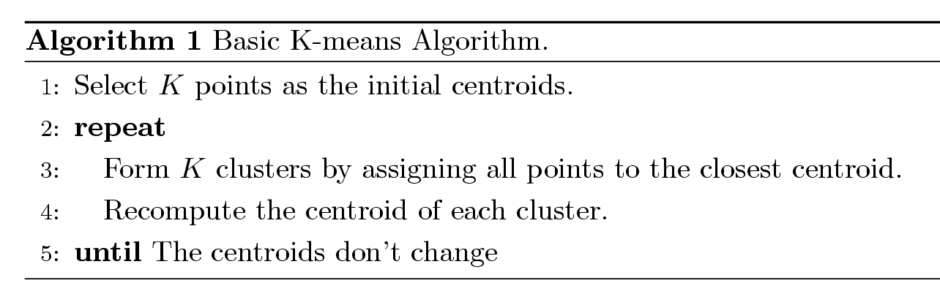
K-means Clustering
The basic algorithm is very simple
Number of clusters, K, must be specified
Each cluster is associated with a centroid (center point)
Each point is assigned to the cluster with the closest centroid

Slide 14
Example of K-means Clustering

Slide 15
Example of K-means Clustering

Slide 16
K-means Clustering – Facts
Initial centroids are often chosen randomly.
  Clusters produced vary from one run to another.
The centroid is (typically) the mean of the points in the cluster.
We need a distance measure:
Euclidean, cosine, correlation, etc.
K-means will converge after a few iterations
  Often the stopping condition is changed to ‘Until relatively few points change clusters’

Slide 17
Evaluating K-means Clusters
Most common measure is Sum of Squared Error (SSE)
  For each point, the error is the distance to the nearest cluster
  To get SSE, we square these errors and sum them.
  x is a data point in cluster C_{i} and m_{i} is the representative point for cluster C_{i}
    can show that m_{i} corresponds to the center (mean) of the cluster
  Given two sets of clusters, we prefer the one with the smallest error
  One easy way to reduce SSE is to increase K, the number of clusters
    A good clustering with smaller K can have a lower SSE than a poor clustering with higher K

Slide 18

Limitations of K-means
K-means has problems when clusters are of differing
  Sizes
  Densities
  (Non-globular shapes)
K-means has problems when the data contains outliers
How do we select the initial centroids?

Slide 19
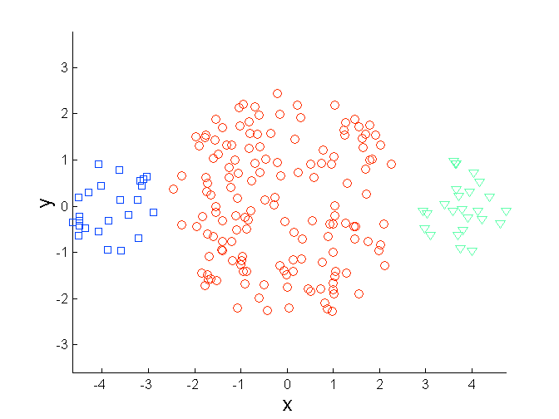
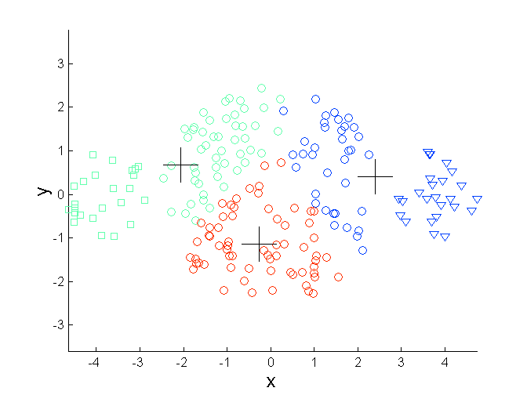
Limitations of K-means: Differing Sizes
Original Points
K-means (3 Clusters)

Slide 20
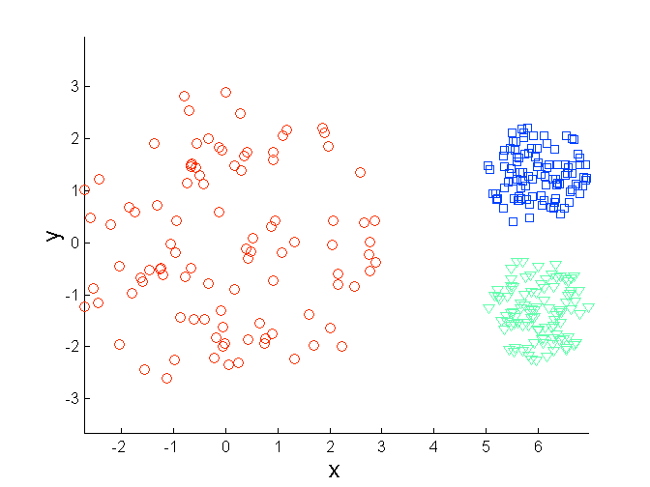
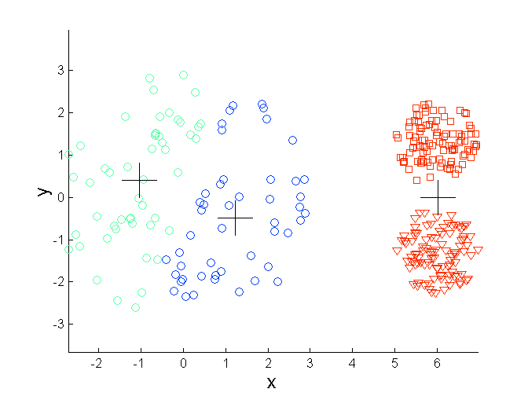
Limitations of K-means: Differing Density
Original Points
K-means (3 Clusters)

Slide 21
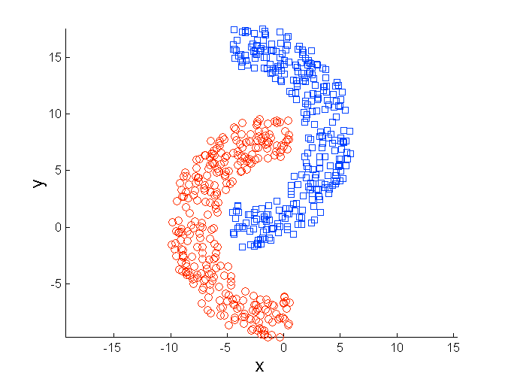
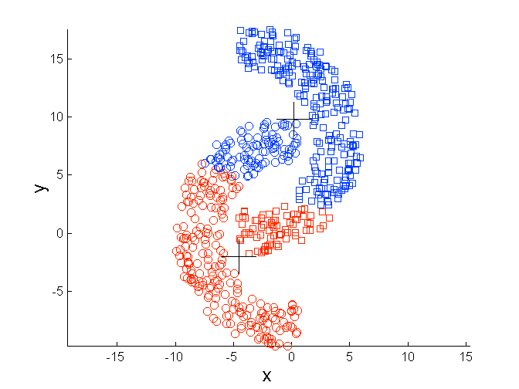
Limitations of K-means: (Non-globular) Shapes
Original Points
K-means (2 Clusters)

Slide 22

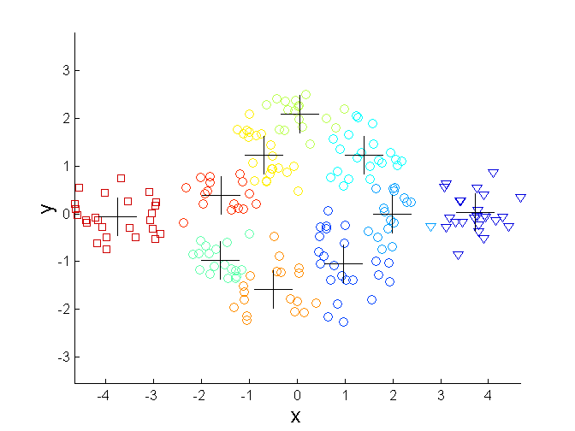
Overcoming K-means Limitations
Original Points K-means Clusters
One solution is to use many clusters.
  Find parts of clusters, but need to put together.

Slide 23
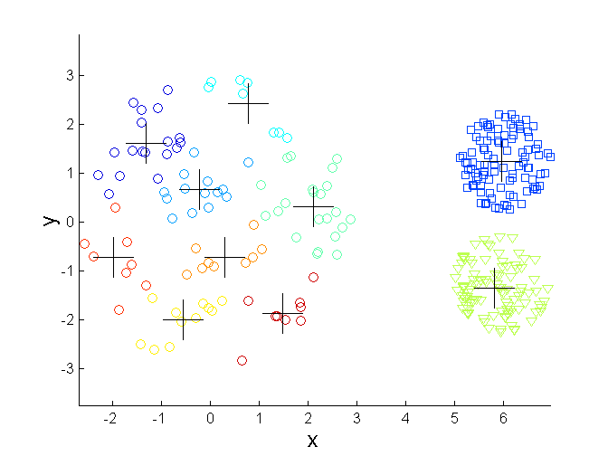
Overcoming K-means Limitations
Original Points K-means Clusters

Slide 24
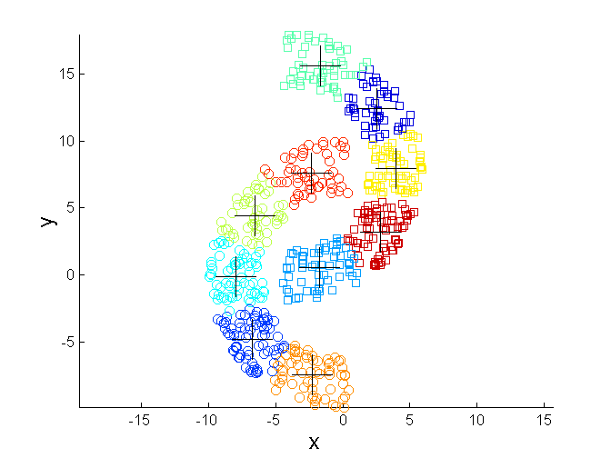

Overcoming K-means Limitations
Original Points K-means Clusters

Slide 25

Hold on… Another issue

Slide 26
Importance of Choosing Initial Centroids

Slide 27
Importance of Choosing Initial Centroids …

Slide 28
Importance of Choosing Initial Centroids …

Slide 29
Solutions to Initial
Centroids Problem
Multiple runs
  Helps, but probability is not on your side
Sample and use hierarchical clustering to determine initial centroids
Select more than K initial centroids and then select among these initial centroids
Post-processing
Generate a larger number of clusters and then perform a hierarchical clustering
K-means variants e.g. bisecting K-means

Slide 30
Hierarchical Clustering
Produces a set of nested clusters organized as a hierarchical tree
Can be visualized as a dendrogram
  A tree like diagram that records the sequences of merges or splits

Slide 31


Strengths of Hierarchical Clustering
Do not have to assume any particular number of clusters
  Any desired number of clusters can be obtained by ‘cutting’ the dendrogram at the proper level
They may correspond to meaningful
taxonomies
  Example in biological sciences (e.g.:
  animal kingdom, phylogeny reconstruction)

Slide 32

Agglomerative Clustering Algorithm
Most popular hierarchical clustering technique
Basic algorithm is straightforward
  Compute the proximity matrix
  Let each data point be a cluster
  Repeat
  Merge the two closest clusters
  Update the proximity matrix
  Until only a single cluster remains
Key operation is the computation of the proximity of two clusters
  Different approaches to defining the distance between clusters distinguish the different algorithms

Slide 33
Starting Situation
Start with clusters of individual points and a proximity matrix
p1
p2
p3
p4
p5
. . .
p1
p2
p3
p4
p5
.
.
.
Proximity Matrix

Slide 34
Intermediate Situation
After some merging steps, we have some clusters
C1
C2
C3
C4
C5
C1
C2
C3
C3
C4
C4
C5
Proximity Matrix
C1
C2
C5

Slide 35
Intermediate Situation
We want to merge the two closest clusters (C2 and C5) and update the proximity matrix.
C1
C2
C3
C4
C5
C1
C2
C3
C3
C4
C4
C5
Proximity Matrix
C1
C2
C5

Slide 36
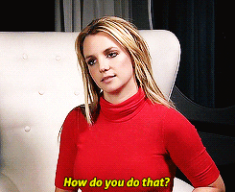
After Merging
The question is:
“How do we update the proximity matrix?”
C2 U C5
C1
C3
C4
C1
?
C2 U C5
? ? ? ?
C3
C3
?
C4
C4
?
Proximity Matrix
C1
C2 U C5

Slide 37
How to Define Inter-Cluster Distance
p1
p2
p3
p4
p5
. . .
p1
Similarity?
p2
p3
p4
p5
MIN
MAX
Group Average
Distance Between Centroids
Other methods driven by an objective function
  Ward’s Method uses squared error
.
.
.
Proximity Matrix

Slide 38
How to Define Inter-Cluster Similarity
p1
p2
p3
p4
p5
. . .
p1
p2
p3
p4
p5
MIN
MAX
Group Average
Distance Between Centroids
Other methods driven by an objective function
  Ward’s Method uses squared error
.
.
.
Proximity Matrix

Slide 39
How to Define Inter-Cluster Similarity
p1
p2
p3
p4
p5
. . .
p1
p2
p3
p4
p5
MIN
MAX
Group Average
Distance Between Centroids
Other methods driven by an objective function
  Ward’s Method uses squared error
.
.
.
Proximity Matrix

Slide 40
How to Define Inter-Cluster Similarity
p1
p2
p3
p4
p5
. . .
p1
p2
p3
p4
p5
MIN
MAX
Group Average
Distance Between Centroids
Other methods driven by an objective function
  Ward’s Method uses squared error
.
.
.
Proximity Matrix

Slide 41
How to Define Inter-Cluster Similarity
p1
p2
p3
p4
p5
. . .
p1
×
×
p2
p3
p4
p5
MIN
MAX
Group Average
Distance Between Centroids
Other methods driven by an objective function
  Ward’s Method uses squared error
.
.
.
Proximity Matrix

Slide 42
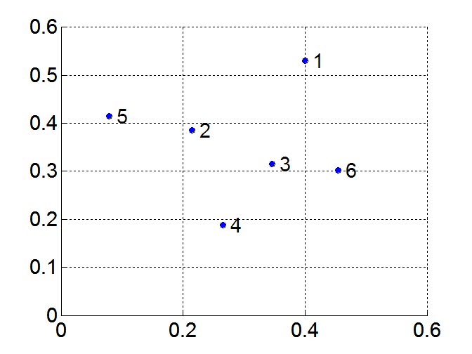
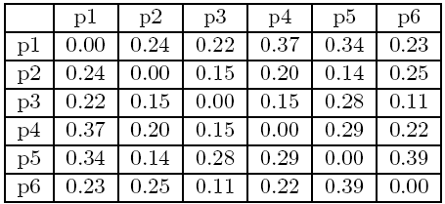
MIN or Single Link
Proximity of two clusters is based on the two closest points in the different clusters
  Determined by one pair of points, i.e., by one link in the proximity graph
Example:
Distance Matrix:

Slide 43
Hierarchical Clustering: MIN
5
1
3
5
2
1
2
3
6
4
4
Nested Clusters
Dendrogram

Slide 44
Strength of MIN
Original Points
Six Clusters
Can handle non-elliptical shapes

Slide 45
Limitations of MIN
Two Clusters
Original Points
Sensitive to noise and outliers
Three Clusters

Slide 46
MAX or Complete Linkage
Proximity of two clusters is based on the two most distant points in the different clusters
  Determined by all pairs of points in the two clusters
Distance Matrix:

Slide 47
Hierarchical Clustering: MAX
4
1
2
5
5
2
3
6
3
1
4
Nested Clusters
Dendrogram

Slide 48
Strength of MAX
Original Points
Two Clusters
Less susceptible to noise and outliers

Slide 49
Limitations of MAX
Original Points
Two Clusters
Tends to break large clusters
Biased towards globular clusters

Slide 50
Group Average
Proximity of two clusters is the average of pairwise proximity between points in the two clusters.
Need to use average connectivity for scalability since total proximity favors large clusters
Distance Matrix:

Slide 51
Hierarchical Clustering: Group Average
5
4
1
2
5
2
3
6
1
4
3
Nested Clusters
Dendrogram

Slide 52
Hierarchical Clustering: Group Average
Compromise between Single and Complete Link
Strengths
  Less susceptible to noise and outliers
Limitations
  Biased towards globular clusters

Slide 53
Cluster Similarity: Ward’s Method
Similarity of two clusters is based on the increase in squared error when two clusters are merged
  Similar to group average if distance between points is distance squared
Less susceptible to noise and outliers
Biased towards globular clusters
Hierarchical analogue of K-means
  Can be used to initialize K-means

Slide 54
Hierarchical Clustering: Comparison
5
1
4
1
3
2
5
5
5
2
1
MIN
2
MAX
2
3
6
3
3
6
1
4
4
4
5
5
1
4
1
2
2
5
2
Ward’s Method
5
2
3
6
Group Average
3
3
6
4
1
1
4
4
3

Slide 55
Hierarchical Clustering:
Problems and Limitations
Once a decision is made to combine two clusters, it cannot be undone
It needs much more space AND time
No global objective function is directly minimized
Different schemes have problems with one or more of the following:
  Sensitivity to noise and outliers
  Difficulty handling clusters of different sizes and non-globular shapes
  Breaking large clusters

Slide 56

DBSCAN
DBSCAN is a density-based algorithm.
  Density = number of points within a specified radius (Eps)
  A point is a core point if it has at least a specified number of points (MinPts) within Eps
    These are points that are at the interior of a cluster
    Counts the point itself
  A border point is not a core point, but is in the neighborhood of a core point
  A noise point is any point that is not a core point or a border point

Slide 57
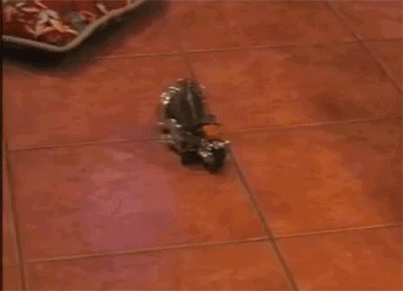
DBSCAN: Core, Border, Noise Points
MinPts = 7

Slide 58
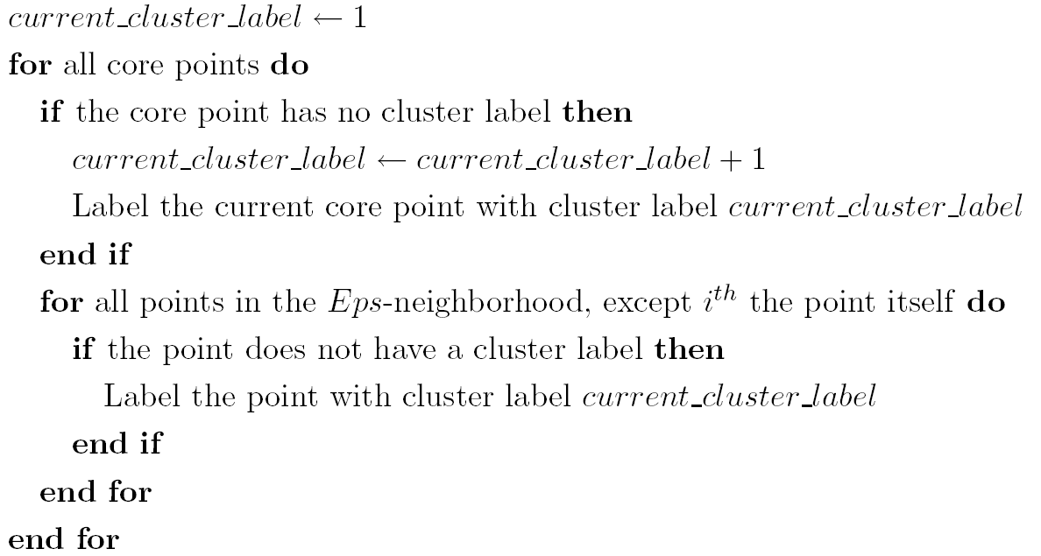
DBSCAN Algorithm
Eliminate noise points
Perform clustering on the remaining points

Slide 59
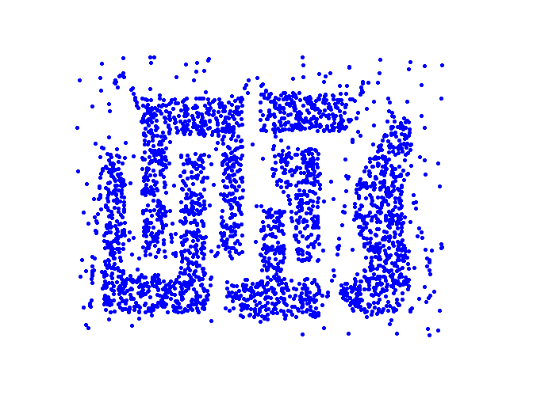
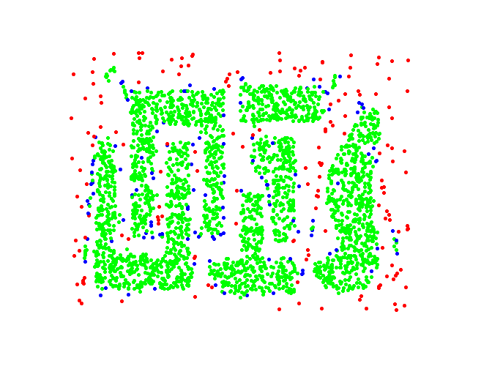
DBSCAN: Core, Border and Noise Points
Original Points
Point types: core, border and noise
Eps = 10, MinPts = 4

Slide 60
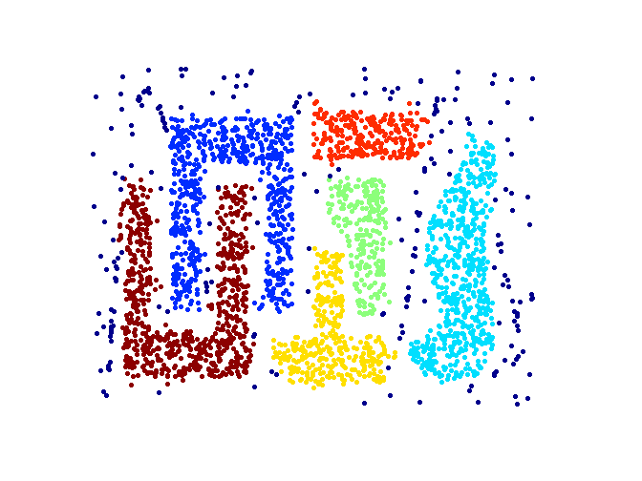
When DBSCAN Works Well
Original Points
Clusters
Resistant to Noise
Can handle clusters of different shapes and sizes

Slide 61
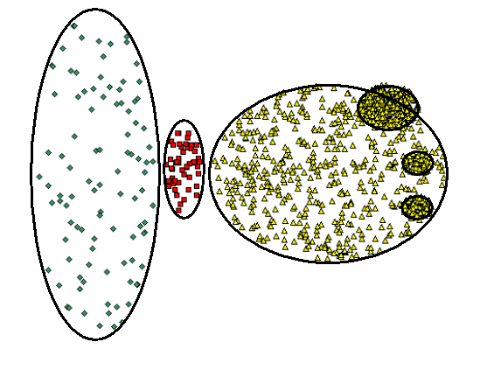
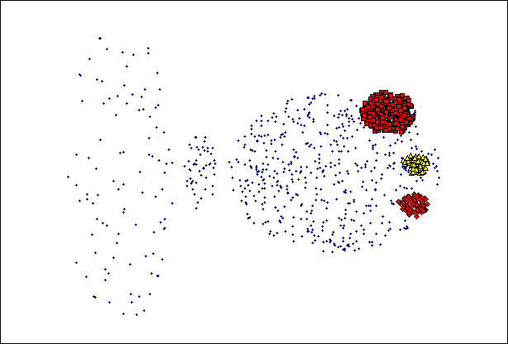
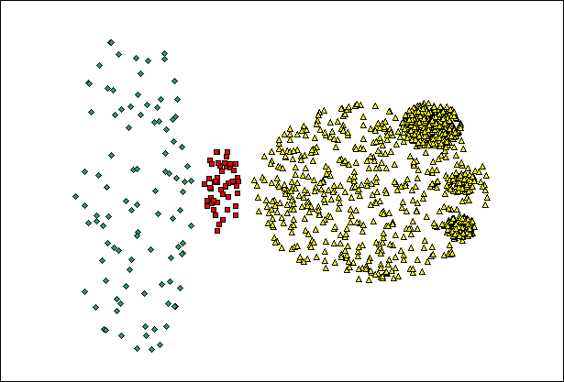
When DBSCAN Does NOT Work Well
(MinPts=4, Eps=9.75).
Original Points
Varying densities
High-dimensional data
(MinPts=4, Eps=9.92)

Slide 62
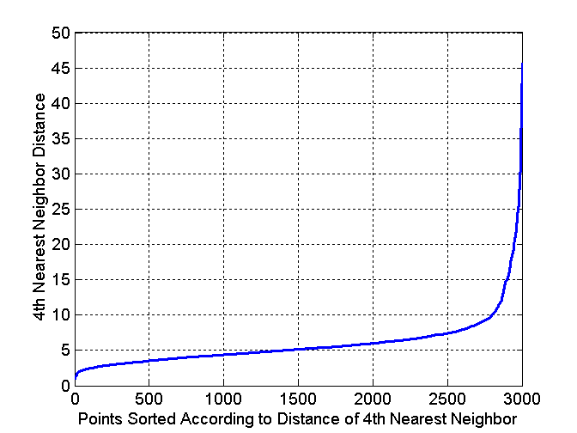
DBSCAN: Determining EPS and MinPts
Idea is that for points in a cluster, their k^{th} nearest neighbors are at roughly the same distance
Noise points have the k^{th} nearest neighbor at further distance
So, plot sorted distance of every point to its k^{th} nearest neighbor

Slide 63



Cluster Validity

Slide 64

Cluster Validity
For supervised classification we have a variety of measures to evaluate how good our model is
  Accuracy, precision, recall
For cluster analysis, the analogous question is how to evaluate the “goodness” of the resulting clusters?
But “clusters are in the eye of the beholder”!
Evaluation is really important here:
  To avoid finding patterns in noise
  To compare clustering algorithms
  To compare two sets of clusters
  To compare two clusters

Slide 65
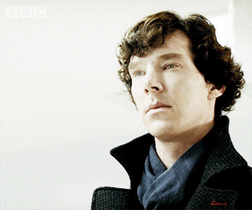
Clusters found in Random Data
Random Points
DBSCAN
K-means
Complete Link

Slide 66
Measures of Cluster Validity
Numerical measures that are applied to judge various aspects of cluster validity, are classified into the following three types.
  External Index: Used to measure the extent to which cluster labels match externally supplied class labels.
    Entropy or Purity
  Internal Index: Used to measure the goodness of a clustering structure without respect to external information.
    Sum of Squared Error (SSE)
  Relative Index: Used to compare two different clusterings or clusters.
    Often an external or internal index is used for this function, e.g., SSE or entropy

Slide 67
Cluster Validity: Similarity Matrix
Order the similarity matrix with respect to cluster labels and inspect visually.

Slide 68
Cluster Validity: Similarity Matrix
Clusters in random data are not so crisp
DBSCAN

Slide 69
Cluster Validity: Similarity Matrix
Clusters in random data are not so crisp
K-means

Slide 70
Cluster Validity: Similarity Matrix
Clusters in random data are not so crisp
Complete Link

Slide 71
Cluster Validity: Similarity Matrix
DBSCAN

Slide 72
Internal Measures: SSE
Clusters in more complicated figures aren’t well separated
Internal Index: Used to measure the goodness of a clustering structure without respect to external information
  SSE
SSE is good for comparing two clusterings or two clusters (average SSE).
Can also be used to estimate the number of clusters

Slide 73
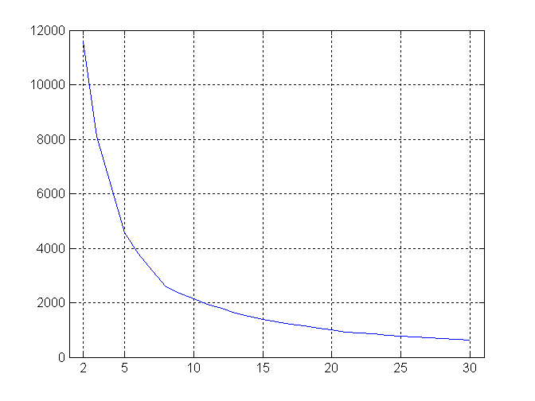
Internal Measures: SSE
SSE curve for a more complicated data set
SSE of clusters found using K-means

Slide 74
Internal Measures: Cohesion and Separation
A proximity graph based approach can also be used for cohesion and separation.
  Cluster cohesion is the sum of the weight of all links within a cluster.
  Cluster separation is the sum of the weights between nodes in the cluster and nodes outside the cluster.
cohesion
separation

Slide 75
Internal Measures: Silhouette Coefficient
Silhouette coefficient combines ideas of both cohesion and separation, but for individual points, as well as clusters and clusterings
For an individual point, i
  Calculate a = average distance of i to the points in its cluster
  Calculate b = min (average distance of i to points in another cluster)
  The silhouette coefficient for a point is then given by
  s = (b – a) / max(a,b)
  Typically between 0 and 1.
  The closer to 1 the better.
Can calculate the average silhouette coefficient for a cluster or a clustering

Slide 76
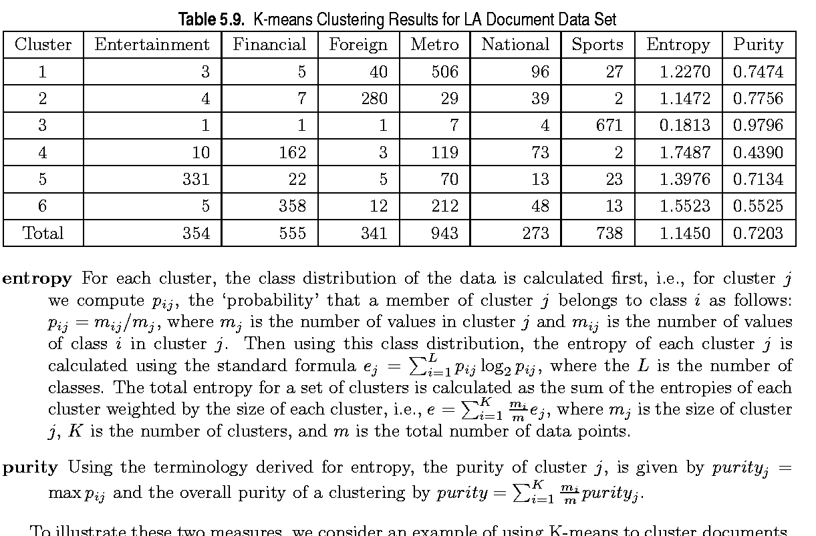
External Measures of Cluster Validity: Entropy and Purity

Slide 77

Final Comment on Cluster Validity
“The validation of clustering structures is the most difficult and frustrating part of cluster analysis.
Without a strong effort in this direction, cluster analysis will remain a black art accessible only to those true believers who have experience and great courage.”
Algorithms for Clustering Data, Jain and Dubes

Slide 78


To summarize
Clustering is the most basic unsupervised technique
Different algorithms might raise different results for what is the “optimal” clustering
It is important to properly evaluate the results and justify any conclusion/decision using numbers

