Slide 1
Black Holes born from stars
Dr. Giovanna Pugliese
Anton Pannekoek Institute for Astronomy
University of Amsterdam
Notes:
Credit: https://www.nasa.gov/feature/goddard/2019/hubble-studies-gamma-ray-burst-with-highest-energy-ever-seen - GRB 190114C
NASA’s Hubble Space Telescope has given astronomers a peek at the location of the most energetic outburst ever seen in the universe — a blast of gamma-rays a trillion times more powerful than visible light. That’s because in a few seconds the gamma-ray burst (GRB) emitted more energy than the Sun will provide over its entire 10-billion year life.
In January 2019, an extremely bright and long-duration GRB was detected by a suite of telescopes, including NASA’s Swift and Fermi telescopes, as well as by the Major Atmospheric Gamma Imaging Cherenkov (MAGIC) telescopes on the Canary islands. Follow-up observations were made with Hubble to study the environment around the GRB and find out how this extreme emission is produced.
“Hubble’s observations suggest that this particular burst was sitting in a very dense environment, right in the middle of a bright galaxy 5 billion light years away. This is really unusual, and suggests that this concentrated location might be why it produced this exceptionally powerful light,” explained one of the lead authors, Andrew Levan of the Institute for Mathematics, Astrophysics and Particle Physics Department of Astrophysics at Radboud University in the Netherlands.
The complementary Hubble observations reveal that the GRB occurred within the central region of a massive galaxy. Researchers say that this is a denser environment than typically observed (for GRBs) and could have been crucial for the generation of the very-high-energy radiation that was observed. The host galaxy of the GRB is actually one of a pair of colliding galaxies. The galaxy interactions may have contributed to spawning the outburst.

Slide 2
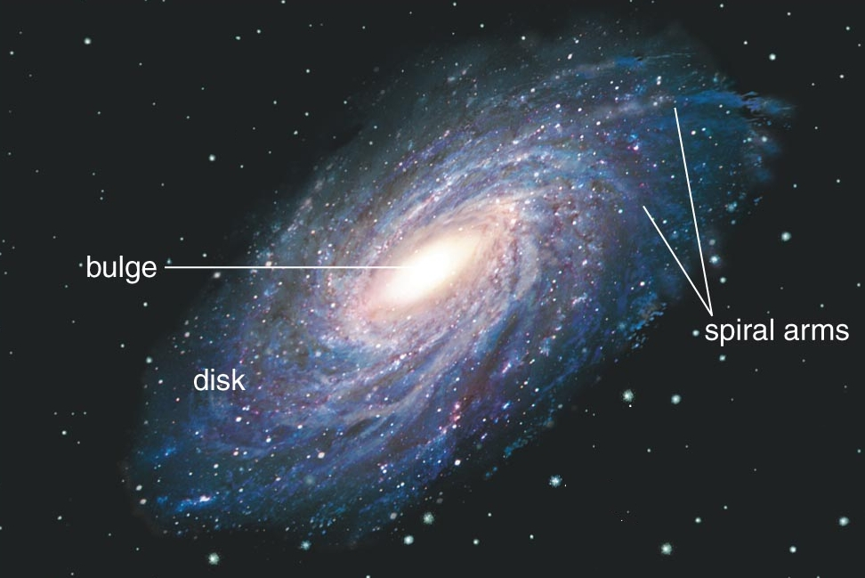
1 ly =10,000,000,000,000 km!
1 ly ≈ 62,000 distance Earth- Sun
30 kpc
1 pc = 3.26 lyrs
1 kpc = 1000 pc
M⨀ = 10³⁰ kg
Sagittarius A★
Solar system at about 8 kpc from the Galactic Center
In the Galactic Center there is a SMBH of about
3,600,000 M⨀
Orbital period of the Sun is 225,000,000 years
Milky Way
>100 Billion stars
D ≈ 100,000 ly
δ ≈ 10,000 ly
We are here
Cygnus X-1
Cassiopeia A
Crab Nebula
Notes:
https://astronomy.com/news/2019/12/the-milky-way-may-have-two-supermassive-black-holes?utm_source=asyfb&utm_medium=social&utm_campaign=asyfb&fbclid=IwAR1lqfr1FYPlUeDxOz2TJwfmCuAbfjJEHuGAT9eoORW4vWRF5uPPmi-txnw
Back to when the universe was about 100 million years old, to the era of the very first galaxies. They were much smaller than today’s galaxies, about 10,000 or more times less massive than the Milky Way. Within these early galaxies the very first stars that died created black holes, of about tens to thousand the mass of the Sun. These black holes sank to the center of gravity, the heart of their host galaxy. Since galaxies evolve by merging and colliding with one another, collisions between galaxies will result in supermassive black hole pairs – the key part of this story. The black holes then collide and grow in size as well. A black hole that is more than a million times the mass of our son is considered supermassive.

Slide 3
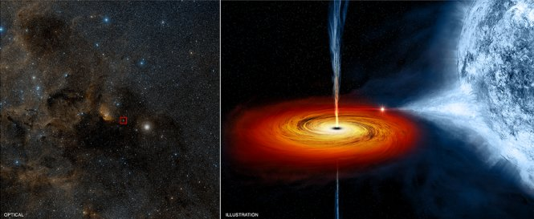
Detection of X-ray emission in accretion disks around BHs
Cygnus X-1:
M = 10.8 M
Spinning = 800 / s
Notes:
https://www.newscientist.com/article/dn18348-introduction-black-holes/
Cygnus X-1: 071.335, +03.067 6,070 liys = 1,90 kpc
Occurred millions of years ago
Its event horizon is spinning around more than 800 times a second
The mass of the BH should be 14.8 times the mass of the Sun

Slide 4
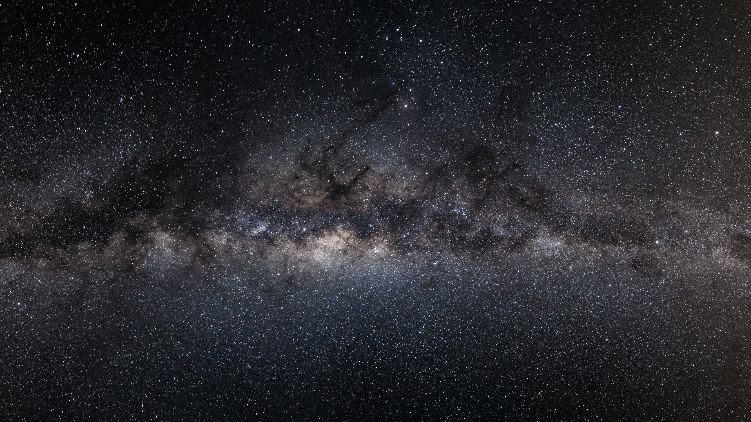
Stellar Black Holes
Final stage of stars with initial mass larger than 50 M, going through explosion and generate a BH in 2x10⁶ yrs
Collapsing stars cannot produce BHs between 65 M and 120 M, a range known as "pair-instability mass gap."
Also generated in merges of stars in a binary system, for example where either a neutron star, or a very massive star, or another BH is present
Notes:
https://www.eurekalert.org/pub_releases/2020-09/nu-sdf083120.php
The physics of stellar evolution can explain how stars as massive as 130 solar masses can produce black holes that are up to 65 solar masses. But for heavier stars, a phenomenon known as "pair instability" is thought to kick in. When the core's photons become extremely energetic, they can morph into an electron and antielectron pair. These pairs generate less pressure than photons, causing the star to become unstable against gravitational collapse, and the resulting explosion is strong enough to leave nothing behind. Even more massive stars, above 200 solar masses, would eventually collapse directly into a black hole of at least 120 solar masses. A collapsing star, then, should not be able to produce a black hole between approximately 65 and 120 solar masses -- a range that is known as the "pair-instability mass gap."

Slide 5
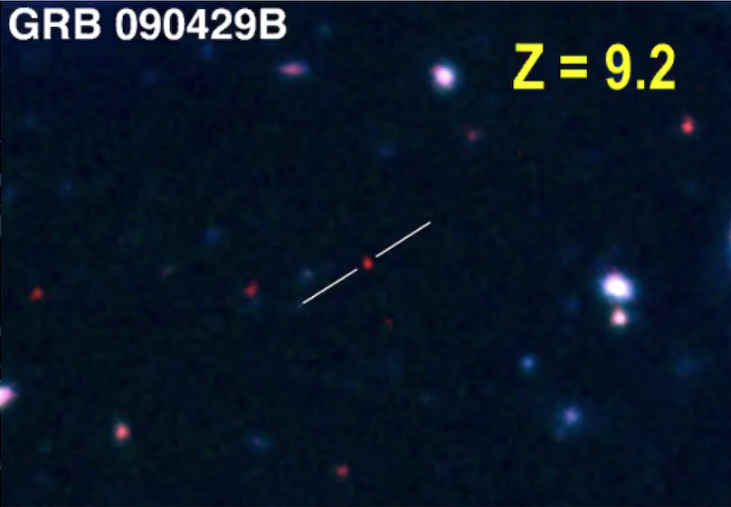
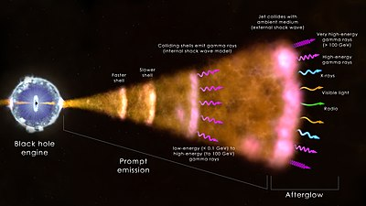
Long Gamma Ray Bursts

Slide 6
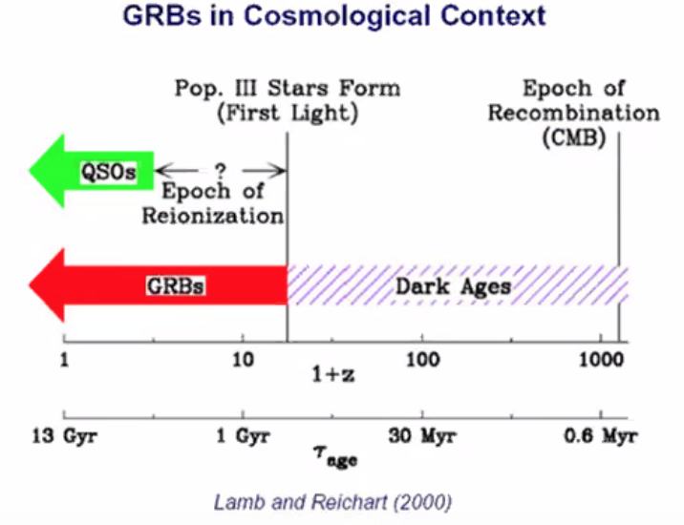
Us now
Big Bang

Slide 7
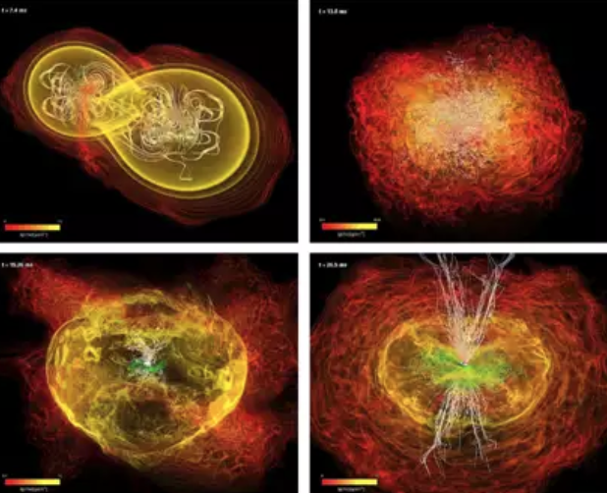
Short Gamma Ray bursts

Slide 8
Notes:
https://www.ligo.caltech.edu/video/ligo20160211v4
This simulation depicts the birth, 1.3 billion years ago, of the gravitational waves discovered by LIGO on September 14, 2015. The waves are generated by two black holes that spiral around each other, then collide and merge. In the bright green regions, the waves stretch space; in the dark green regions, they squeeze space. As the black holes approach each other, the waves get stronger and the separation between them gets shorter, giving rise to what scientists refer to as a "chirp." The two black holes collide and merge into a new black hole, bringing the waves to a crescendo. The new-born black hole vibrates briefly, then becomes quiet and stops generating waves. The waves all depart from the black hole’s vicinity, traveling out into the universe, carrying news of the black holes’ collision.

Slide 9
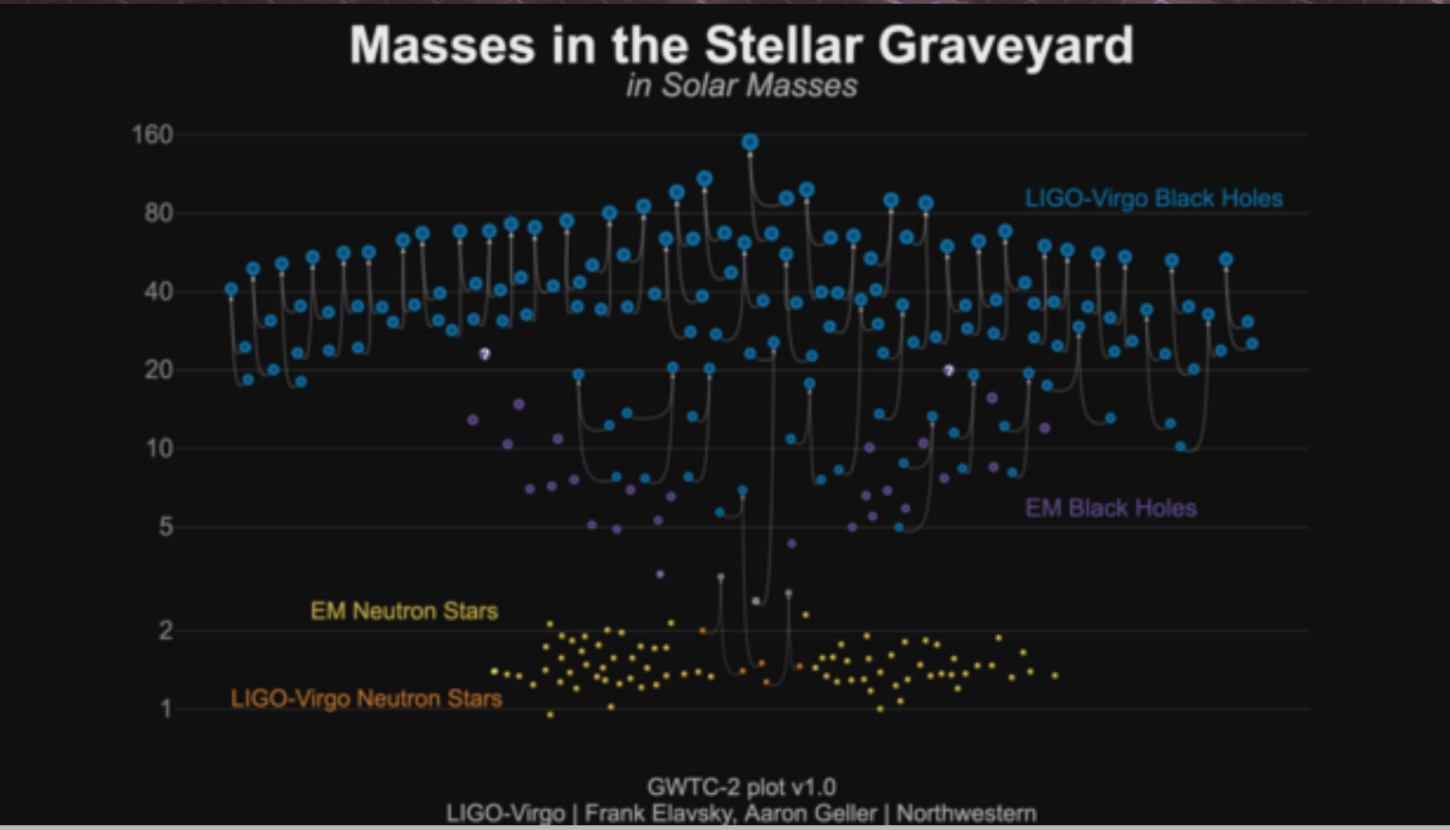
BH: 142 M at 5 Gpcs
Notes:
https://www.ligo.caltech.edu/news/ligo20201028?fbclid=IwAR358hybF26U5HnbY8z5vPzaDq6mN9-I3d8YNdUTt0gl47SpuWkoAoWWzPo
https://www.eurekalert.org/pub_releases/2020-09/nu-sdf083120.php
This is the first conclusive discovery of an intermediate-mass black hole, an object which has long eluded astronomers.
Two black holes likely collided and merged to create a more massive black hole with a final mass 142 times that of the sun, or 142 solar masses. This final black hole is the first to be found in an intermediate-mass range that lies between stellar-mass and supermassive black holes.
Another first is that the heavier of the two merging black holes, at 85 solar masses, is the first black hole so far detected within what is known as the "pair-instability mass gap.” This newest merger appears to be the most massive yet, involving two in spiraling black holes with masses about 85 and 66 solar masses. It released an enormous amount of energy, equivalent to around 8 solar masses, spread across the Universe in the form of gravitational waves.
The signal of GW190521, resembling about four short wiggles, was extremely brief in duration, lasting less than one-tenth of a second. From what the researchers can tell, it was generated by a source that is roughly 5 gigaparsecs away, when the universe was about half its current age, meaning that the signal travelled across space for 7 billion years before reaching Earth. GW190521's source is the most distant gravitational-wave source detected so far.

Slide 10
Summary
During the last 25 years GRBs contributed to the study of BH formation and their environment in other galaxies
The simultaneous detection of a short GRB and GWs in 2017 confirmed binary BHs merge and produce more massive BHs.
Gravitational waves proved to be real: Nobel Prize 2017 and General Relative was once again proved true!
The LIGO observatory suggested the formation of an IMBH from the merge of 2 very massive BHs (2020).
Interdisciplinary science (astroparticle physics) has proved to be a powerful tool to study the universe

Slide 11
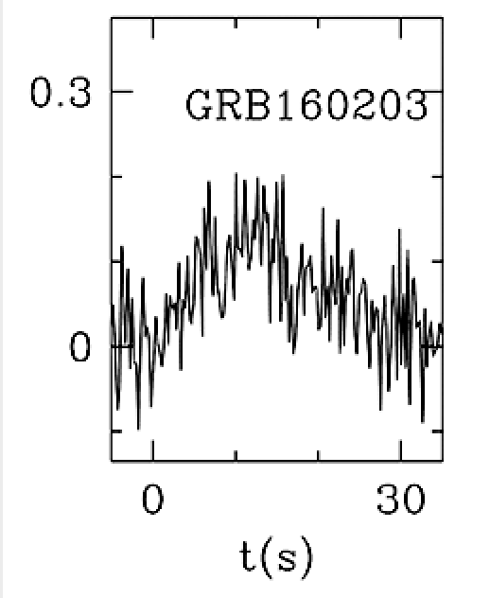
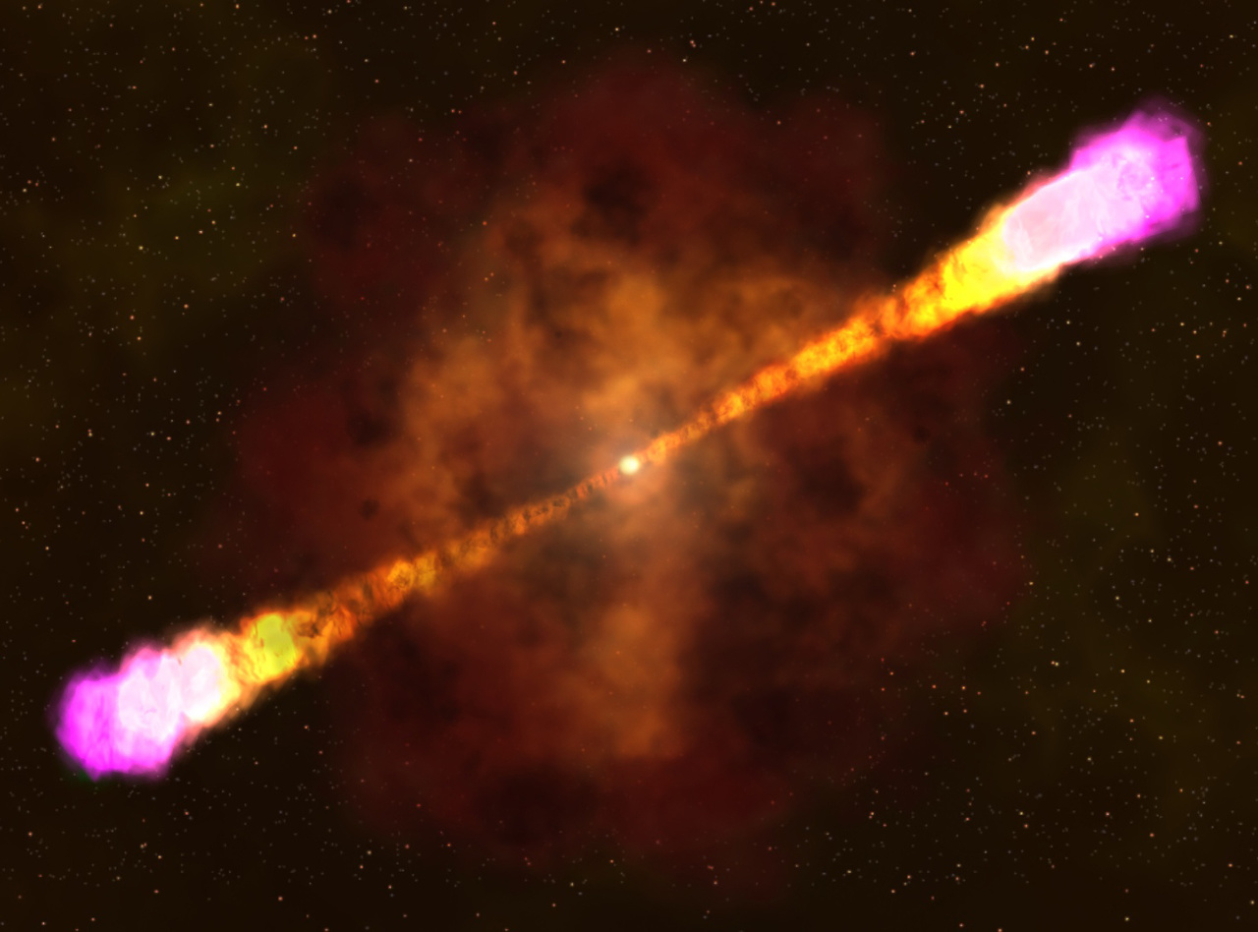
Occurred about 11.9 Gyrs ago
Notes:
https://astronomynow.com/2017/07/27/gamma-ray-burst-captured-in-unprecedented-detail/

Slide 12
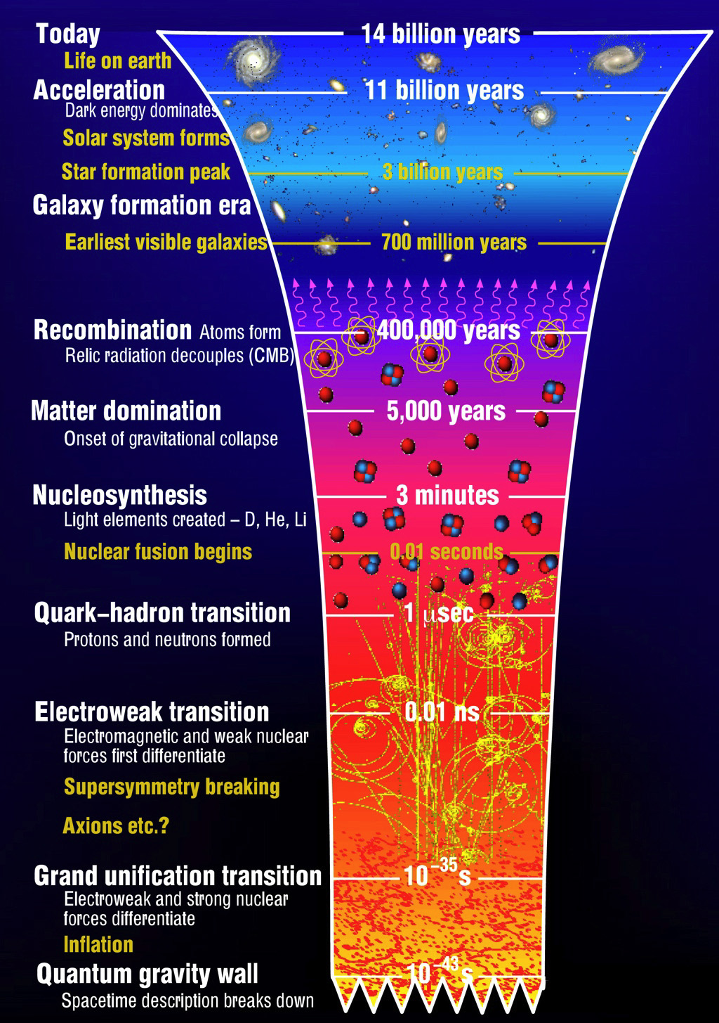
Notes:
http://www.ctc.cam.ac.uk/outreach/origins/big_bang_three.php

Slide 13
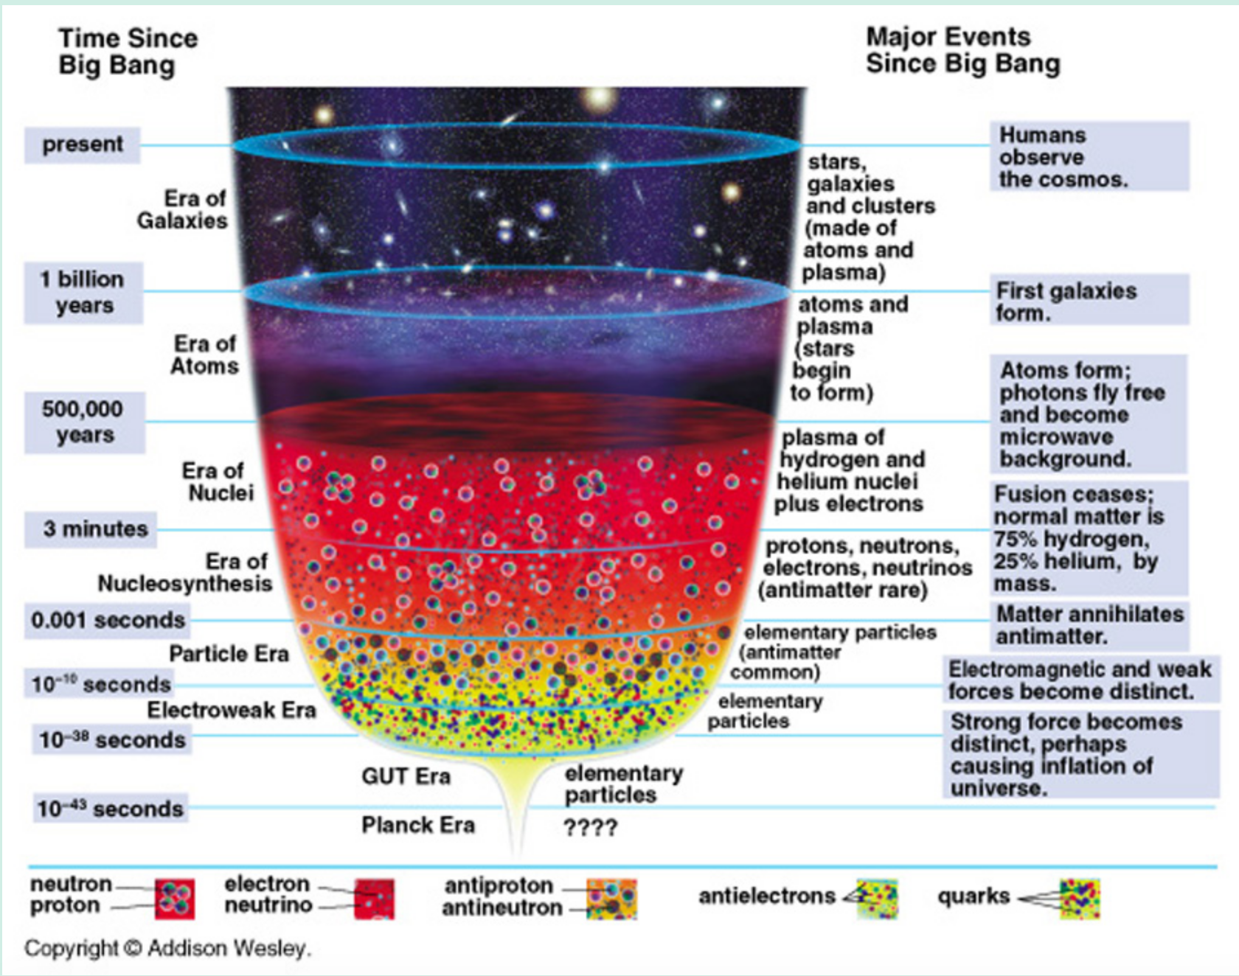

Slide 14
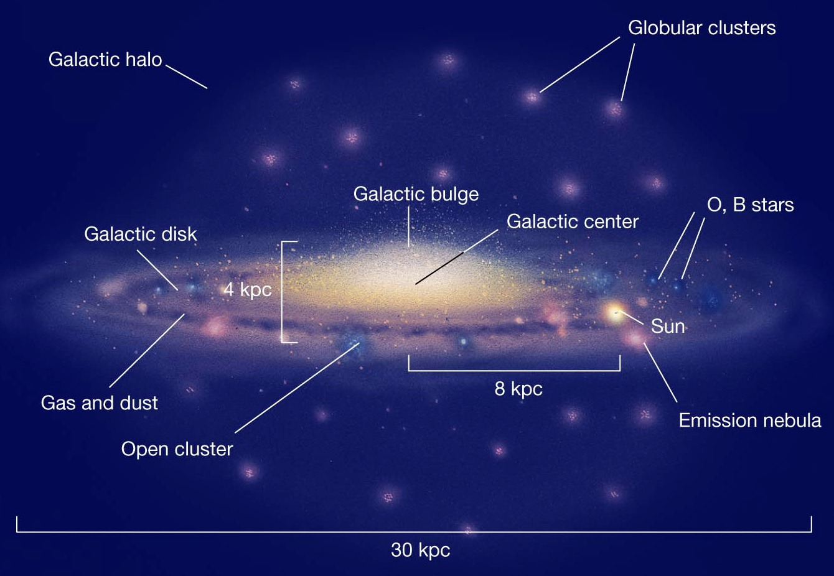

Slide 15
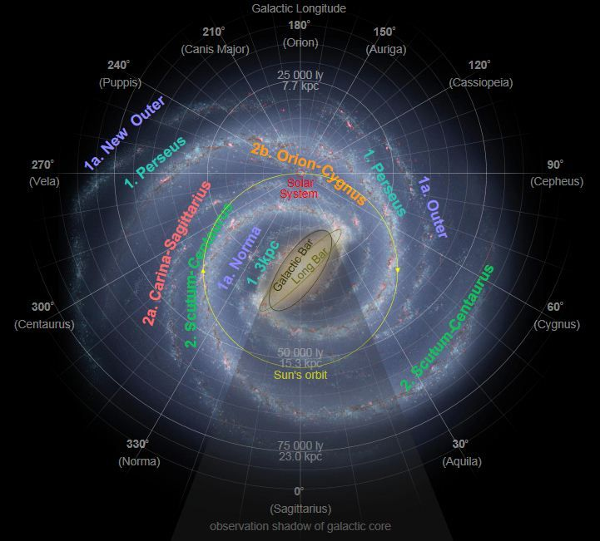

Slide 17
Average Earth-Moon distance: About 300000 km
Average Earth-Sun distance:
1 AU= 150,000,000 km
Earth’s rotation 1670 km/h
Our orbit around the Sun 108000 km/h
Sun around the Galaxy 720000 Km/h

