Slide 1



The Quantum-Random-Oracle Model
Christian Schaffner
Research Center for Quantum Software & Technology
Theory of Computer Science (TCS) group
Informatics Institute of University of Amsterdam
Goto https://app.wooclap.com/QROM for the quiz now!
PQC Spring School 2024 by QSI
Porto, Portugal. Tuesday, 12 March 2024

Slide 2
What will you Learn from this Talk?
Classical Random-Oracle Model
Quantum Access
Three Tools
Extensions and Applications

Slide 3


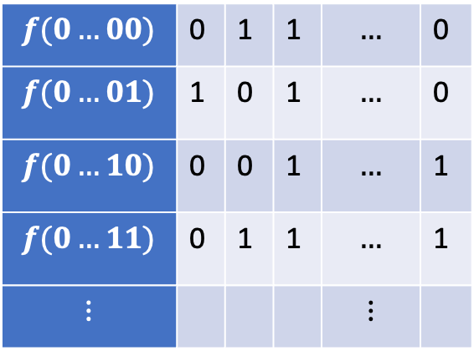
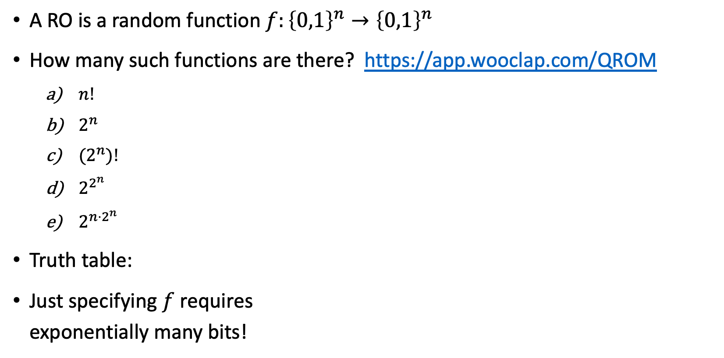
Random Oracle (RO)
A RO is a random function $f:{\left\{0,1\right\}}^{n}→{\left\{0,1\right\}}^{n}$
How many such functions are there? https://app.wooclap.com/QROM
  $n!$
  $2^{n}$
  ${(2}^{n})!$
  $2^{2^{n}}$
  $2^{n⋅2^{n}}$
Truth table:
Just specifying $f$ requires
exponentially many bits!
$n$ columns
$$f(0…00)$$ | 0 | 1 | 1 | $$…$$ | 0
$$f(0…01)$$ | 1 | 0 | 1 | $$…$$ | 0
$$f(0…10)$$ | 0 | 0 | 1 | $$…$$ | 1
$$f(0…11)$$ | 0 | 1 | 1 | $$…$$ | 1
$$⋮$$ |  |  |  | $$⋮$$
$2^{n}$ rows
Notes:
For n=6, 6*2^6 = 384, already more functions than atoms in the universe

Slide 4


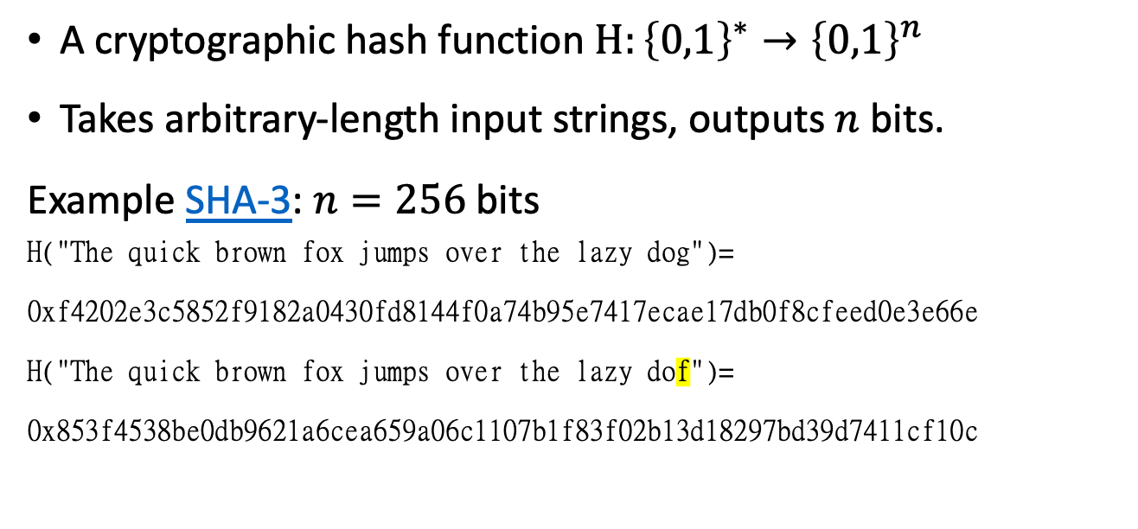
Hash Functions
A cryptographic hash function $H:{\left\{0,1\right\}}^{∗}→{\left\{0,1\right\}}^{n}$
Takes arbitrary-length input strings, outputs $n$ bits.
Example SHA-3: $n=256$bits
H("The quick brown fox jumps over the lazy dog")=
0xf4202e3c5852f9182a0430fd8144f0a74b95e7417ecae17db0f8cfeed0e3e66e
H("The quick brown fox jumps over the lazy dof")=
0x853f4538be0db9621a6cea659a06c1107b1f83f02b13d18297bd39d7411cf10c
$$H$$
An ideal hash function should behave as random oracle

Slide 5
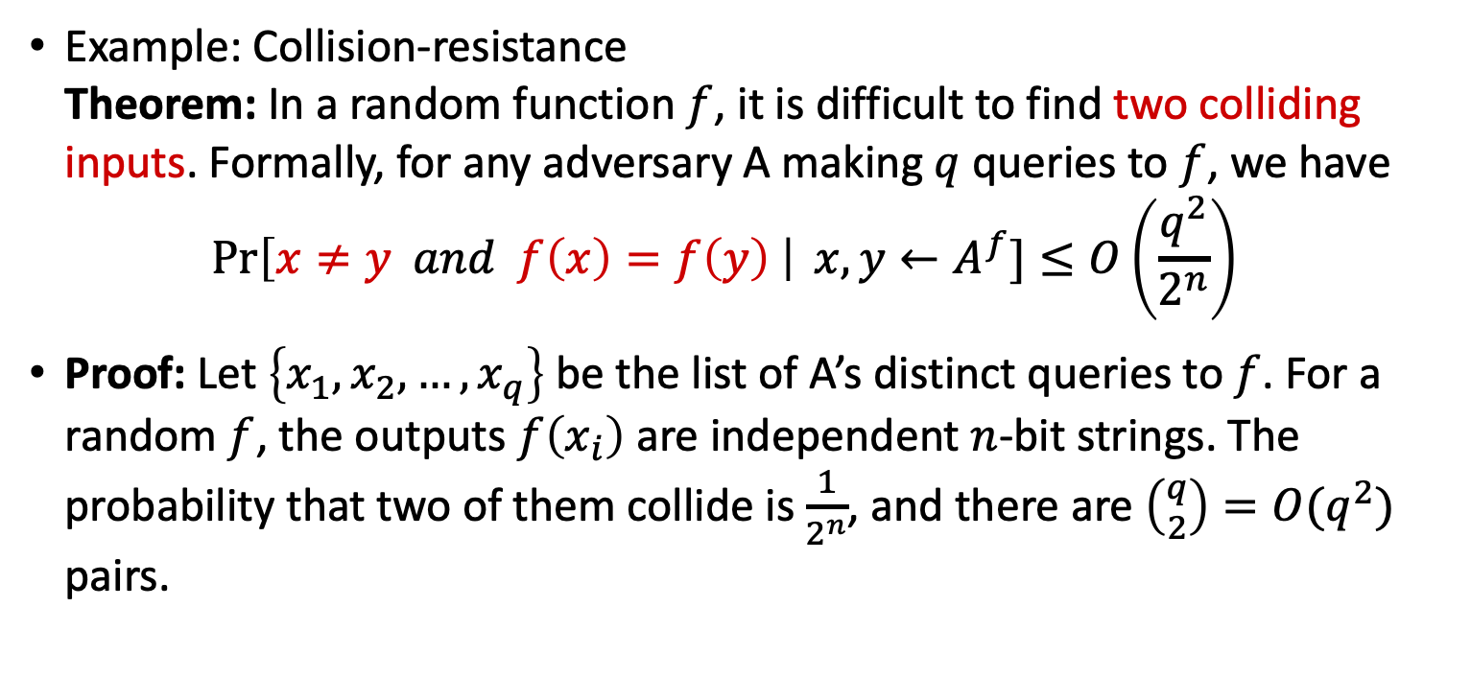
Hash Functions As Random Oracles
An ideal hash function should behave as random oracle
Example: Collision-resistance
Theorem: In a random function $f$, it is difficult to find two colliding inputs. Formally, for any adversary A making $q$ queries to $f$, we have
$\operatorname{Pr}\left[x≠y and f\left(x\right)=f\left(y\right) \right| x,y←A^{f}]≤O\left(\frac{q^{2}}{2^{n}}\right)$
Proof: Let $\left\{x_{1},x_{2}, …, x_{q}\right\}$ be the list of A’s distinct queries to $f$. For a random $f$, the outputs $f\left(x_{i}\right)$ are independent $n$-bit strings. The probability that two of them collide is $\frac{1}{2^{n}}$, and there are $\left({q \atop 2}\right)=O(q^{2})$ pairs.
$$H$$
Notes:
(infinitely) many collisions exist in hash functions, but they are hard to find

Slide 6




Digital Signatures
Alice
Bob
public key
Eve
secret key
Only secret-key holder can sign, but everyone can verify signatures using the public-key.

Slide 7
Digital Signatures
Alice
Bob
public key
Eve
secret key
Only secret-key holder can sign, but everyone can verify signatures using the public-key.
Very widely used:
Problems: expensive,
insecure against quantum attacks
[Bart Preneel @QCrypt 2014]
Notes:
Post-quantum crypto tries to solve the second problem by making it even more expensive!

Slide 8
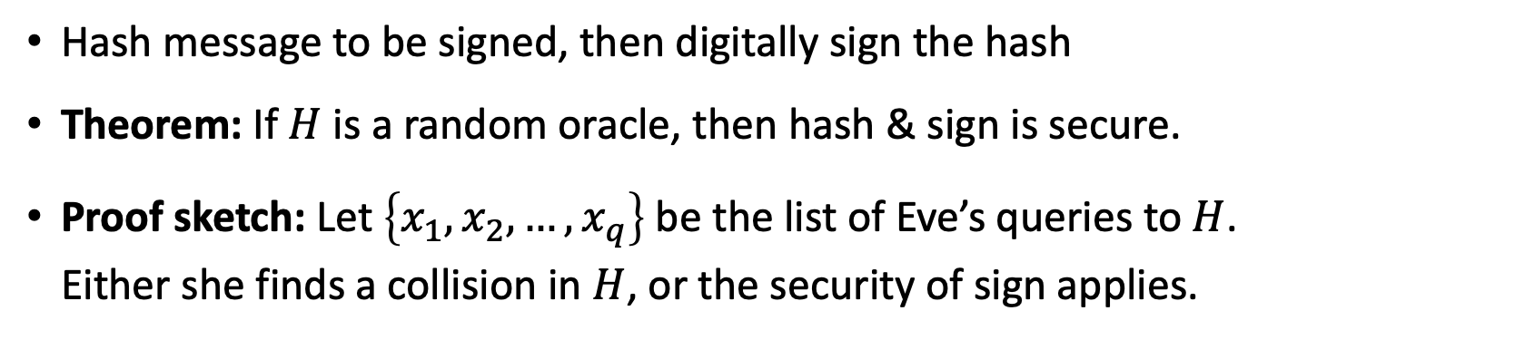

Hash & Sign
$$H$$
Alice
Bob
public key
Eve
secret key
Hash message to be signed, then digitally sign the hash
Theorem: If $H$ is a random oracle, then hash & sign is secure.
Proof sketch: Let $\left\{x_{1},x_{2}, …, x_{q}\right\}$ be the list of Eve’s queries to $H$.
Either she finds a collision in $H$, or the security of sign applies.

Slide 9
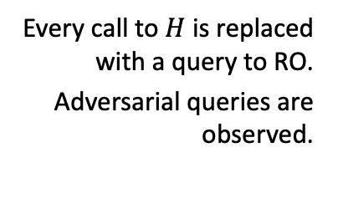



Random-Oracle Model (ROM)
Heuristic to model hash functions in cryptographic proofs
“knows $H$”
protocol
$$H$$
Informal description:
$$H:{\left\{0,1\right\}}^{∗}→{\left\{0,1\right\}}^{n}$$
protocol
Every call to $H$ is replaced with a query to RO.
Adversarial queries are observed.
Formal random-oracle model:
[Bellare Rogaway 93, slide by Dziembowski]
Notes:
Having an oracle is convenient, so that players do not need to be given access to an exponentially large random object
As long as adversary has not queried a particular input x, H(x) is independent and uniform

Slide 10

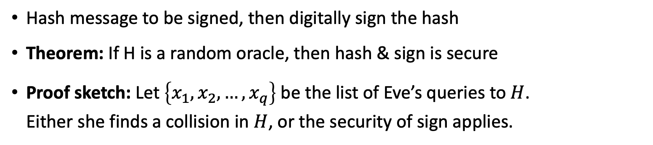
Hash & Sign in the Random Oracle Model
$$H$$
Alice
Bob
public key
Eve
secret key
Hash message to be signed, then digitally sign the hash
Theorem: If H is a random oracle, then hash & sign is secure
Proof sketch: Let $\left\{x_{1},x_{2}, …, x_{q}\right\}$ be the list of Eve’s queries to $H$.
Either she finds a collision in $H$, or the security of sign applies.
$$H:{\left\{0,1\right\}}^{∗}→{\left\{0,1\right\}}^{n}$$

Slide 11
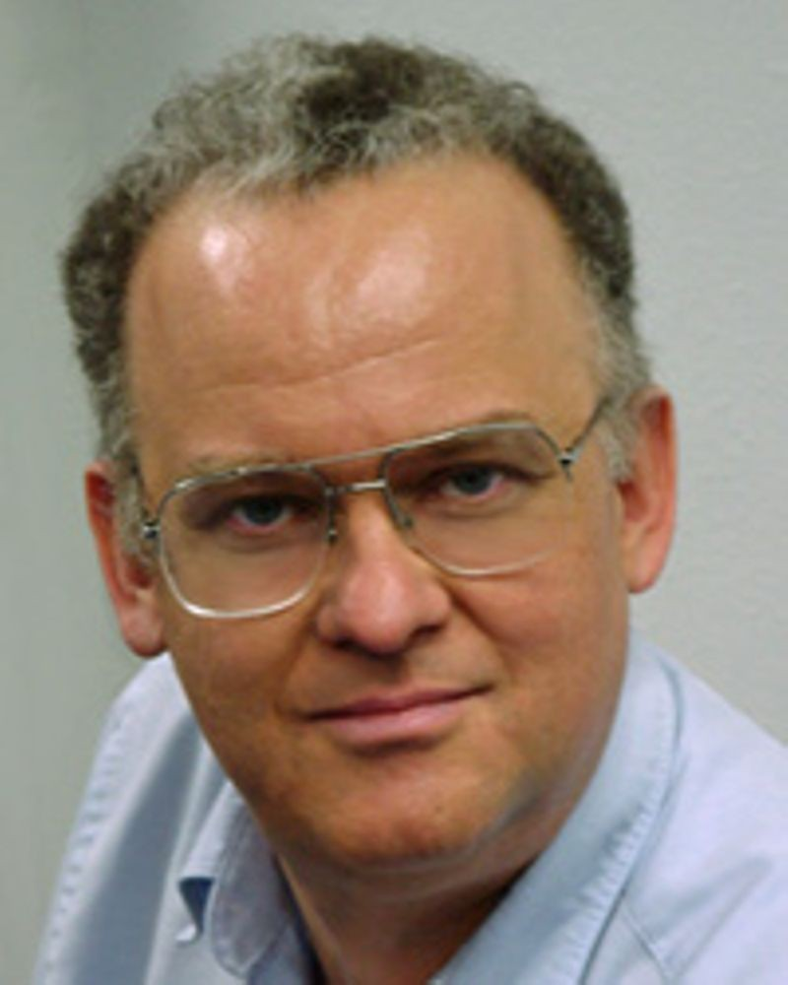
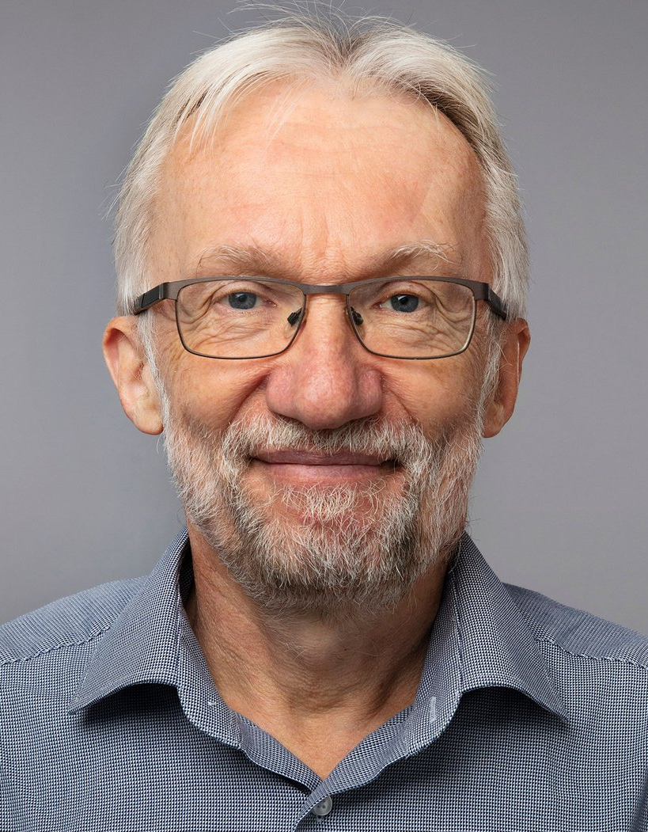

Building Hash Functions
Secure building block $f:{\left\{0,1\right\}}^{2n}→{\left\{0,1\right\}}^{n}$
Construct a hash function $H:{\left\{0,1\right\}}^{∗}→{\left\{0,1\right\}}^{n}$ from it
[Merkle Damgård 79]
[Merkle Damgård 79, image: wikipedia]

Slide 12

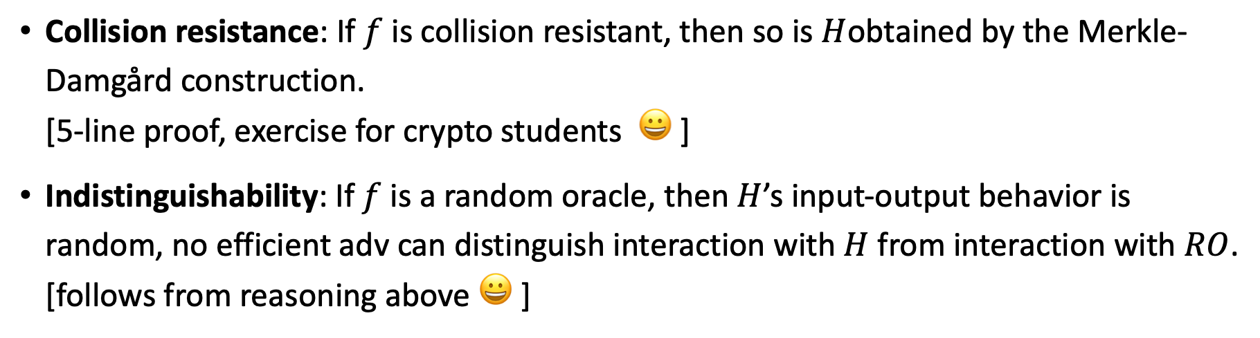
Security Notions
Collision resistance: If $f$ is collision resistant, then so is $H$obtained by the Merkle-Damgård construction.
[5-line proof, exercise for crypto students 😀 ]
Indistinguishability: If $f$ is a random oracle, then $H$’s input-output behavior is random, no efficient adv can distinguish interaction with $H$ from interaction with $RO$.
[follows from reasoning above 😀 ]
Real:
Ideal:
Dist
Dist
[Merkle Damgård 79, Bellare Canetti Krawczyk 05]

Slide 13
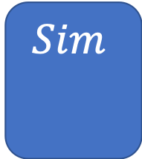
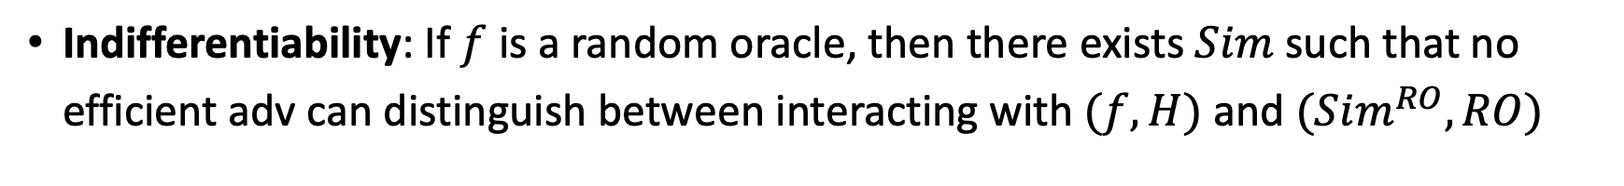
Indifferentiability
Indifferentiability: If $f$ is a random oracle, then there exists $Sim$ such that no efficient adv can distinguish between interacting with $(f,H)$ and $(Sim^{RO}, RO)$
$$Sim$$
Real:
Ideal:
Dist
Dist
[Maurer Renner Holenstein 04, Coron Dodis Malinaud Puniya 05]

Slide 14



Criticism of the Random-Oracle Model (ROM)
There exists a digital signature scheme that is
secure in the ROM, but
not secure if RO is instantiated with any real hash function.
Very “artificial” example, no ”realistic” examples known
Common view: ROM proof is better than no proof
[Canetti Goldreich Halevi 98, slide by Dziembowski]
[Matthew Green: https://blog.cryptographyengineering.com/2011/11/02/what-is-random-oracle-model-and-why/ ]

Slide 15



Classical Random-Oracle Model in Practice
Digital Signatures: Fiat-Shamir Heuristic used by
CRYSTALS-Dilithium, Hash-and-sign in FALCON
Public-Key Encryption: KEMs are often built using the Fujisaki-Okamoto transform
like in CRYSTALS-Kyber
Indifferentiability proofs
Etc.
https://app.wooclap.com/QROM
Notes:
Post-quantum crypto tries to solve the second problem by making it even more expensive!

Slide 16
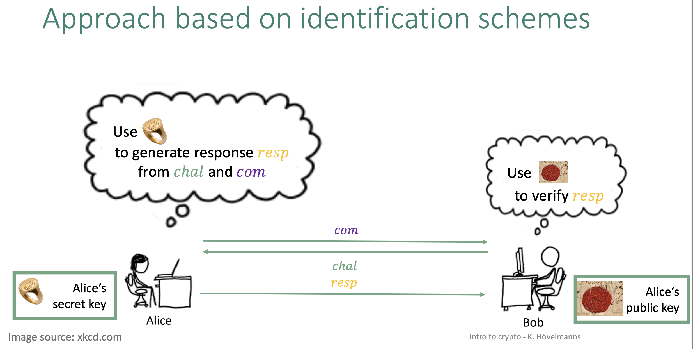
Example: Fiat-Shamir Transform
[slide by Kathrin Hövelmanns]
Notes:
Post-quantum crypto tries to solve the second problem by making it even more expensive!

Slide 17
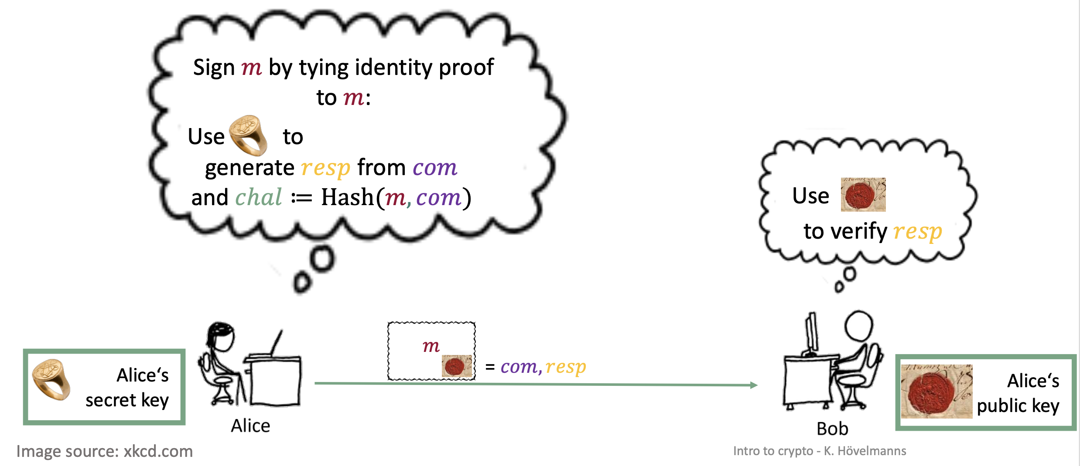
Example: Fiat-Shamir Transform
[slide by Kathrin Hövelmanns]
Notes:
Post-quantum crypto tries to solve the second problem by making it even more expensive!

Slide 18
What will you Learn from this Talk?
Classical Random-Oracle Model
Quantum Access
Three Tools
Extensions and Applications

Slide 19


Quantum-Random-Oracle Model (QROM)
Post-quantum cryptography or quantum-safe cryptography studies quantum attackers on classical crypto.
Attacker can look up description of hash function on Wikipedia, then run it in superposition on her quantum computer
We need to allow attacker quantum (superposition) access to the random oracle
“knows $H$”
$$H:{\left\{0,1\right\}}^{∗}→{\left\{0,1\right\}}^{n}$$
[Boneh Dagdelen Fischlin Lehmann Schaffner Zhandry 11]

Slide 20

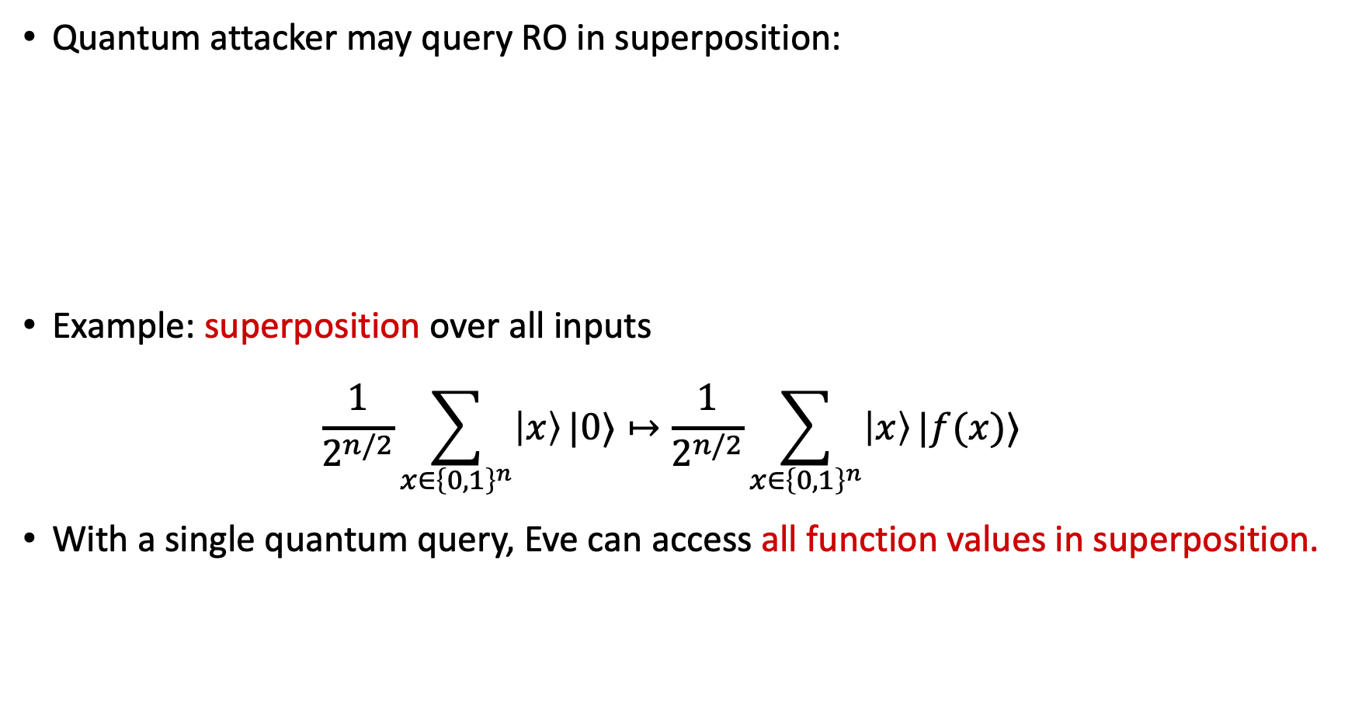





Quantum Superposition Access
Quantum attacker may query RO in superposition:
Example: superposition over all inputs
$\frac{1}{2^{n/2}}\sum_{x∈{\left\{0,1\right\}}^{n}}{\left|x\right\rangle }|0⟩↦\frac{1}{2^{n/2}}\sum_{x∈{\left\{0,1\right\}}^{n}}{\left|x\right\rangle }|f(x)⟩$
With a single quantum query, Eve can access all function values in superposition.
Standard oracle (StO): ${\left|x\right\rangle }_{X}{\left|y\right\rangle }_{Y}↦{\left|x\right\rangle }_{X}{\left|y⊕f\left(x\right)\right\rangle }_{Y}$
$$H:{\left\{0,1\right\}}^{∗}→{\left\{0,1\right\}}^{n}$$
$$|x⟩$$
$$|x⟩$$
$$O_{f}$$
$$|y⟩$$
$$|y⊕f(x)⟩$$

Slide 21
Trouble in the QROM
Many classical ROM proofs break down in the QROM
Efficient simulation: how to emulate a RO towards an adversary
Adaptive programmability: depending on the adversary’s queries,
plant a challenge in the answer
Extractability: Simulator learns pre-images of adversary’s queries
Rewinding: replaying some hash values but changing some outputs
$$H:{\left\{0,1\right\}}^{∗}→{\left\{0,1\right\}}^{n}$$
protocol
[Boneh Dagdelen Fischlin Lehmann Schaffner Zhandry 11]

Slide 22
What will you Learn from this Talk?
Classical Random-Oracle Model
Quantum Access
Three Tools
Extensions and Applications

Slide 23
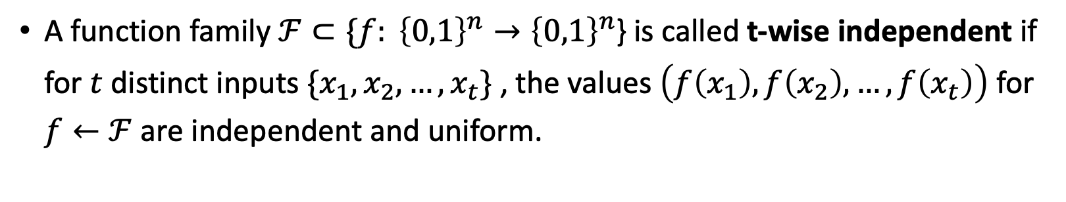
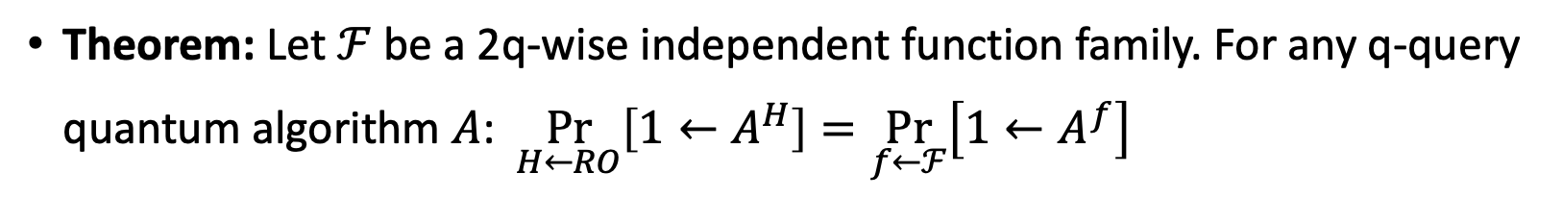
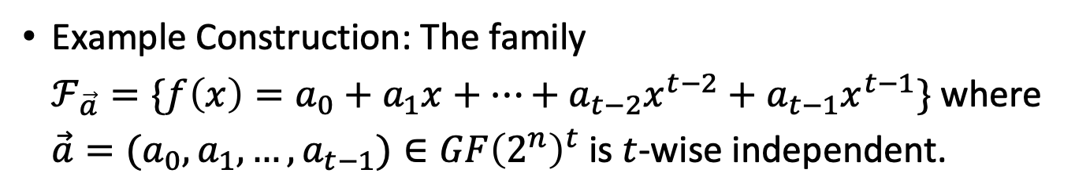
Tool 1: q-wise independent functions
A function family $ℱ⊂\{f: {\left\{0,1\right\}}^{n}→{\left\{0,1\right\}}^{n}$} is called t-wise independent if for $t$ distinct inputs $\{x_{1},x_{2},…, x_{t}\}$ , the values $\left(f\left(x_{1}\right), f\left(x_{2}\right),…, f\left(x_{t}\right)\right)$ for $f←ℱ$ are independent and uniform.
Example Construction: The family
$ℱ_{\vec{a}}=\{f\left(x\right)={{a_{0}+a_{1}x+…+a_{t−2}x^{t−2}+a}_{t−1}x}^{t−1}\}$ where $\vec{a}=(a_{0},a_{1},…,a_{t−1})∈GF{\left(2^{n}\right)}^{t}$ is $t$-wise independent.
Theorem: Let $ℱ$ be a 2q-wise independent function family. For any q-query quantum algorithm $A$: $\underset{H←RO}{Pr}\left[{1←A}^{H}\right]=\underset{f←ℱ}{Pr}\left[1←A^{f}\right]$

Slide 24
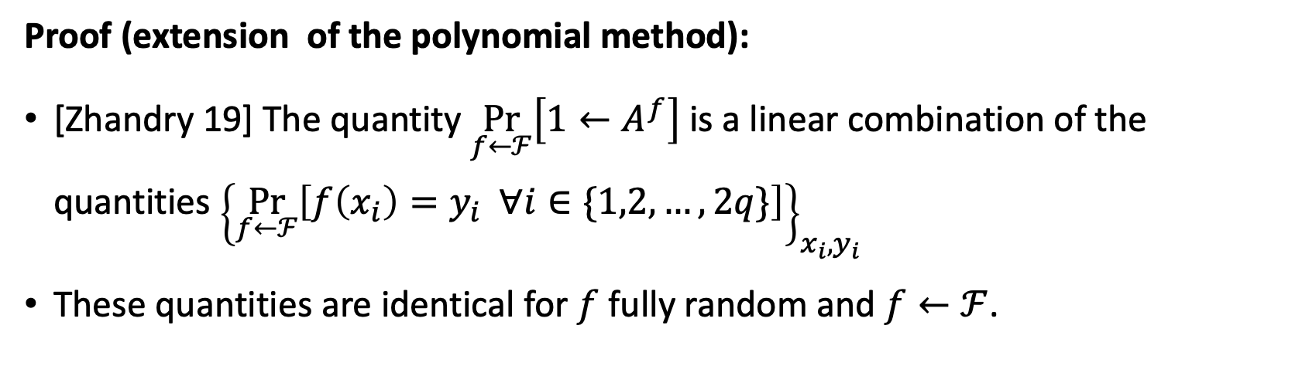
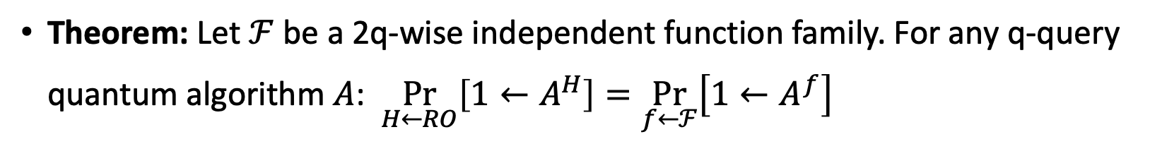
Tool 1: Simulating RO to a quantum adversary
Theorem: Let $ℱ$ be a 2q-wise independent function family. For any q-query quantum algorithm $A$: $\underset{H←RO}{Pr}\left[{1←A}^{H}\right]=\underset{f←ℱ}{Pr}\left[1←A^{f}\right]$
Proof (extension of the polynomial method):
[Zhandry 19] The quantity $\underset{f←ℱ}{Pr}\left[1←A^{f}\right]$ is a linear combination of the quantities ${\left\{\underset{f←ℱ}{Pr}\left[f\left(x_{i}\right)=y_{i} ∀i∈\{1,2,…,2q\}\right]\right\}}_{x_{i}, y_{i}}$
These quantities are identical for $f$ fully random and $f←ℱ$.
[Ronald de Wolf’s lecture notes, Chapter 11, https://arxiv.org/abs/1907.09415]
[Zhandry 19: https://eprint.iacr.org/2012/076, Theorem 6.1]

Slide 25


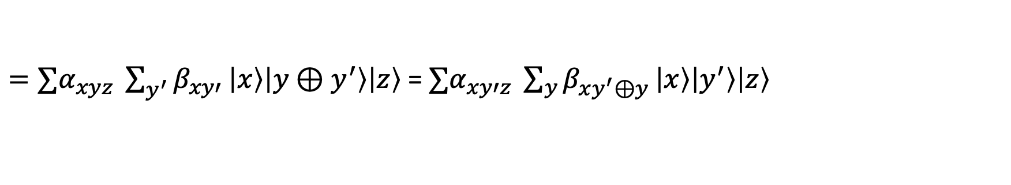



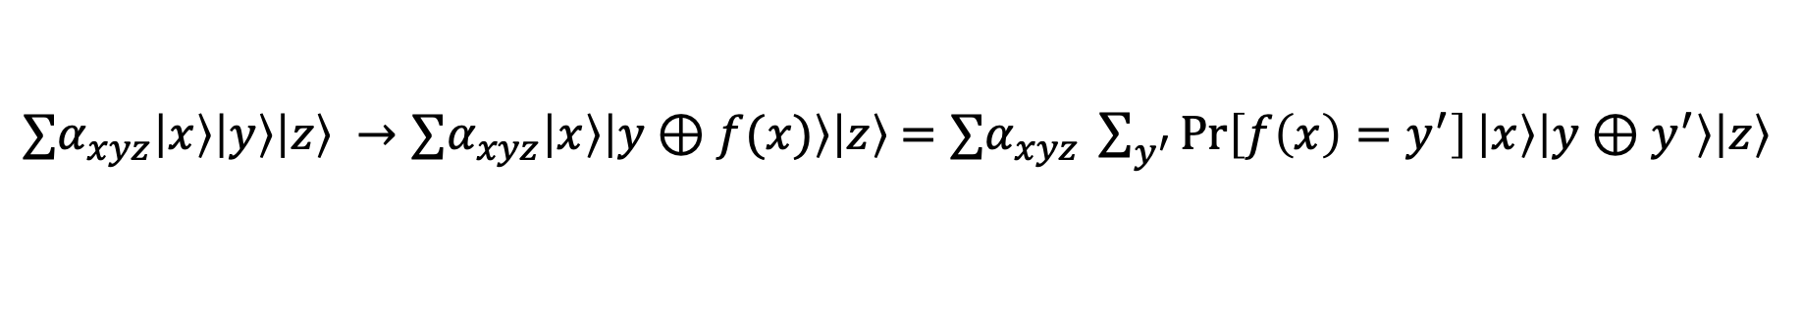

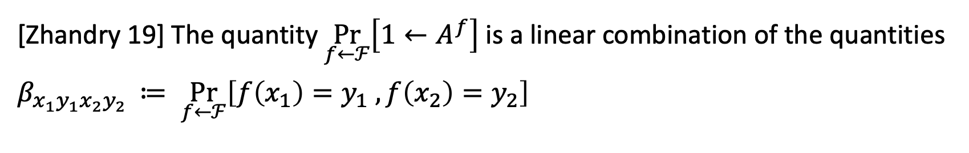





Tool 1: Simulating RO to a quantum adversary
[Zhandry 19] The quantity $\underset{f←ℱ}{Pr}\left[1←A^{f}\right]$ is a linear combination of the quantities $β_{x_{1}y_{1}x_{2}y_{2} }≔ \underset{f←ℱ}{Pr}\left[f\left(x_{1}\right)=y_{1} ,f\left(x_{2}\right)=y_{2}\right]$
$$|0⟩$$
$$|x⟩$$
$$|x⟩$$
$0/1$
$$O_{f}$$
$$|0⟩$$
$$A_{0}$$
$$|y⟩$$
$$|y⊕f(x)⟩$$
$$A_{1}$$
$$|0⟩$$
$$|z⟩$$
$$|z⟩$$
$∑α_{xyz}\left|x\right\rangle \left|y\right\rangle \left|z\right\rangle →∑α_{xyz}\left|x\right\rangle \left|y⊕f(x)\right\rangle \left|z\right\rangle$ $=∑α_{xyz} \sum_{y^{′}}{\operatorname{Pr}\left[f\left(x\right)=y^{′}\right]}\left|x\right\rangle \left|y⊕y^{′}\right\rangle \left|z\right\rangle$
$=∑α_{xyz} \sum_{y^{′}}{β_{xy′}}\left|x\right\rangle \left|y⊕y^{′}\right\rangle \left|z\right\rangle$ = $∑α_{xy′z} \sum_{y}{β_{xy^{′}⊕y}}\left|x\right\rangle \left|y^{′}\right\rangle \left|z\right\rangle$
[Ronald de Wolf’s lecture notes, Chapter 11, https://arxiv.org/abs/1907.09415]
[Zhandry 19: https://eprint.iacr.org/2012/076, Theorem 6.1]

Slide 26
Tool 1: Simulating RO to a quantum adversary
Theorem: Let $ℱ$ be a 2q-wise independent function family. For any q-query quantum algorithm $A$: $\underset{H←RO}{Pr}\left[{1←A}^{H}\right]=\underset{f←ℱ}{Pr}\left[1←A^{f}\right]$
Proof (extension of the polynomial method):
[Zhandry 19] The quantity $\underset{f←ℱ}{Pr}\left[1←A^{f}\right]$ is a linear combination of the quantities ${\left\{\underset{f←ℱ}{Pr}\left[f\left(x_{i}\right)=y_{i} ∀i∈\{1,2,…,2q\}\right]\right\}}_{x_{i}, y_{i}}$
These quantities are identical for $f$ fully random and $f←ℱ$.
[Ronald de Wolf’s lecture notes, Chapter 11, https://arxiv.org/abs/1907.09415]
[Zhandry 19: https://eprint.iacr.org/2012/076, Theorem 6.1]

Slide 27
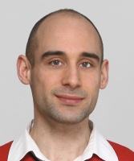

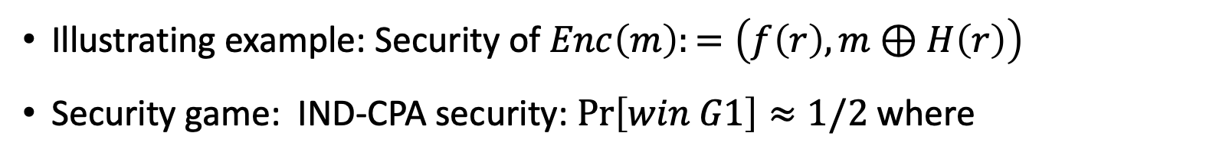
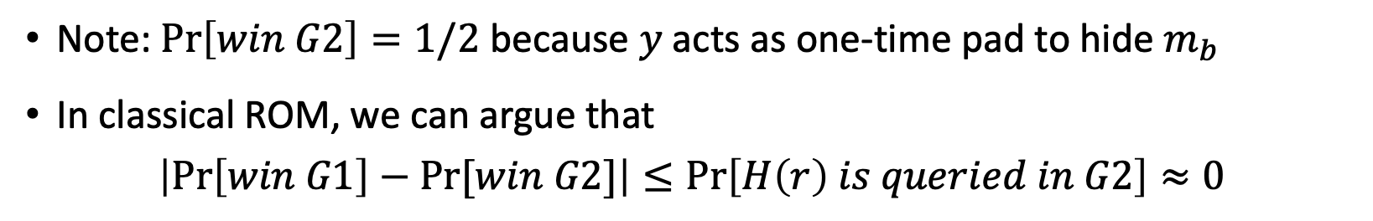
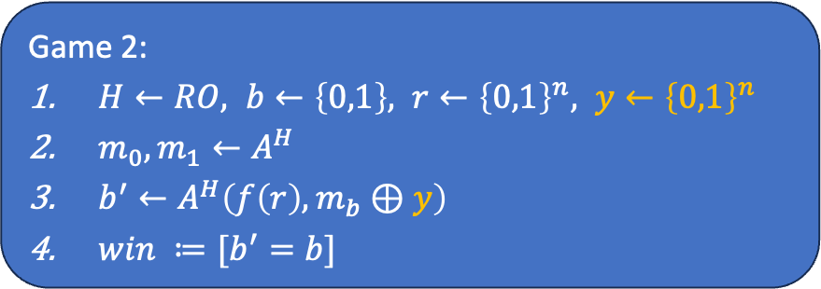
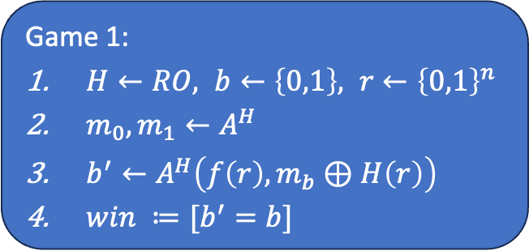
Tool 2: One-way to Hiding Lemma (O2H)
Illustrating example: Security of $Enc\left(m\right):=\left(f\left(r\right), m⊕H\left(r\right)\right)$
Security game: IND-CPA security: $\operatorname{Pr}\left[win G1\right]≈1/2$ where
Game 1:
$H←RO, b←\left\{0,1\right\}, r←{\left\{0,1\right\}}^{n}$
$m_{0},m_{1}←A^{H}$
$b^{′}←A^{H}\left(f\left(r\right), m_{b}⊕H\left(r\right)\right)$
$win ≔[b^{′}=b]$
Game 2:
$H←RO, b←\left\{0,1\right\}, r←{\left\{0,1\right\}}^{n}, y←{\left\{0,1\right\}}^{n}$
$m_{0},m_{1}←A^{H}$
$b^{′}←A^{H}\left(f\left(r\right), m_{b}⊕y\right)$
$win ≔[b^{′}=b]$
$$H:{\left\{0,1\right\}}^{n}→{\left\{0,1\right\}}^{n}$$
?
Note: $\operatorname{Pr}\left[win G2\right]=1/2$ because $y$ acts as one-time pad to hide $m_{b}$
In classical ROM, we can argue that
$\left|\operatorname{Pr}\left[win G1\right]−Pr⁡[win G2]\right|≤\operatorname{Pr}\left[H\left(r\right) is queried in G2\right]≈0$
Example from [Unruh 22: https://www.youtube.com/watch?v=YAIFGB4ryGE ]

Slide 28
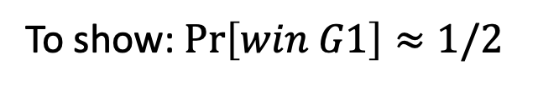
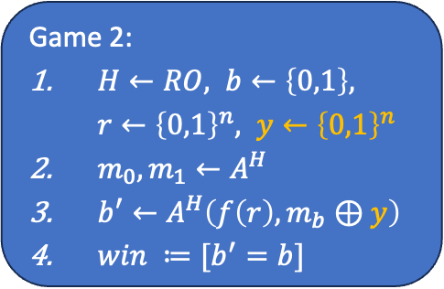
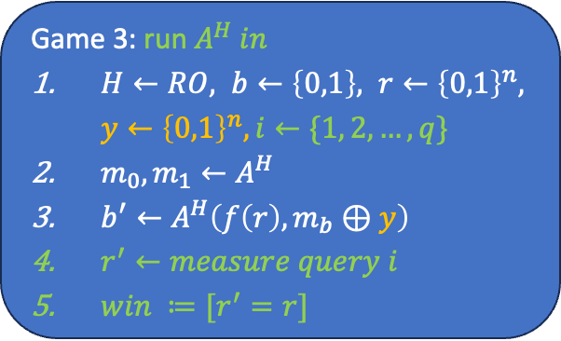
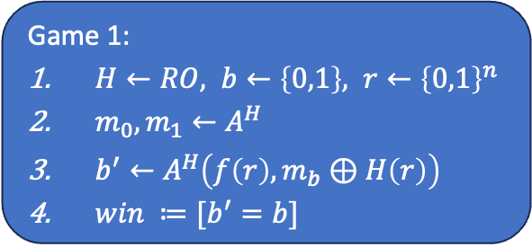
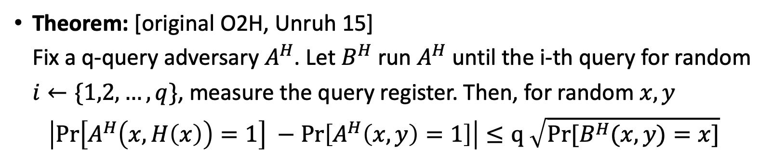
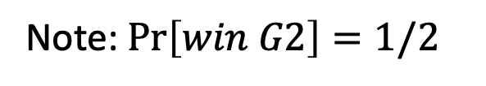
Tool 2: One-way to Hiding Lemma (O2H)
To show: $\operatorname{Pr}\left[win G1\right]≈1/2$
Note: $\operatorname{Pr}\left[win G2\right]=1/2$
Game 1:
$H←RO, b←\left\{0,1\right\}, r←{\left\{0,1\right\}}^{n}$
$m_{0},m_{1}←A^{H}$
$b^{′}←A^{H}\left(f\left(r\right), m_{b}⊕H\left(r\right)\right)$
$win ≔[b^{′}=b]$
Game 2:
$H←RO, b←\left\{0,1\right\}, r←{\left\{0,1\right\}}^{n}, y←{\left\{0,1\right\}}^{n}$
$m_{0},m_{1}←A^{H}$
$b^{′}←A^{H}\left(f\left(r\right), m_{b}⊕y\right)$
$win ≔[b^{′}=b]$
Game 3: run $A^{H} in$
$H←RO, b←\left\{0,1\right\}, r←{\left\{0,1\right\}}^{n}, y←{\left\{0,1\right\}}^{n}, i←\{1, 2, …, q\}$
$m_{0},m_{1}←A^{H}$
$b^{′}←A^{H}\left(f\left(r\right), m_{b}⊕y\right)$
$r^{′}←measure query i$
$win ≔[r^{′}=r]$
Theorem: [original O2H, Unruh 15]
Fix a q-query adversary $A^{H}$. Let $B^{H}$ run $A^{H}$ until the i-th query for random $i←\{1,2,…, q\}$, measure the query register. Then, for random $x, y$
$$\left|\operatorname{Pr}\left[A^{H}\left(x,H\left(x\right)\right)=1\right] −\operatorname{Pr}\left[A^{H}\left(x,y\right)=1\right]\right|≤q \sqrt{Pr⁡[B^{H}(x,y)=x]}$$
$$H:{\left\{0,1\right\}}^{n}→{\left\{0,1\right\}}^{n}$$
$$\left|\operatorname{Pr}\left[win G1\right] −\operatorname{Pr}\left[win G2\right]\right| ≤q \sqrt{\operatorname{Pr}\left[win G3\right]}≈0$$
[Unruh 15: https://eprint.iacr.org/2013/606.pdf]

Slide 29
What will you Learn from this Talk?
Classical Random-Oracle Model
Quantum Access
Three Tools:
    t-wise independent functions
    One-way to Hiding (O2H)
  Compressed oracles
Applications

Slide 30



Quantum: Warm-Up
CNOT gate
$$|0⟩$$
$$H$$
$$|0⟩$$
What is the resulting quantum state?
https://app.wooclap.com/QROM

Slide 31

Quantum: Warm-Up
CNOT gate
$$|0⟩$$
$$H$$
$$\frac{\left|00\right\rangle +|11⟩}{\sqrt{2}}$$
$$|0⟩$$
What is the resulting quantum state?
https://app.wooclap.com/QROM

Slide 32







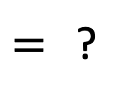


Quantum Circuit Identity
CNOT gate
$$\left|00\right\rangle ↦\left|00\right\rangle$$
$$\left|01\right\rangle ↦\left|01\right\rangle$$
$$\left|10\right\rangle ↦\left|11\right\rangle$$
$$\left|11\right\rangle ↦\left|10\right\rangle$$
$$\left|++\right\rangle ↦\left|++\right\rangle$$
$$\left|+−\right\rangle ↦\left|−−\right\rangle$$
$$\left|−+\right\rangle ↦\left|−+\right\rangle$$
$$\left|−−\right\rangle ↦\left|+−\right\rangle$$
$$H$$
$$H$$
$=$ ?
$$H$$
$$H$$
$$H$$
$$H$$
$$Z$$
https://app.wooclap.com/QROM

Slide 33
Quantum Circuit Identity
CNOT gate
$$\left|00\right\rangle ↦\left|00\right\rangle$$
$$\left|01\right\rangle ↦\left|01\right\rangle$$
$$\left|10\right\rangle ↦\left|11\right\rangle$$
$$\left|11\right\rangle ↦\left|10\right\rangle$$
$$\left|++\right\rangle ↦\left|++\right\rangle$$
$$\left|+−\right\rangle ↦\left|−−\right\rangle$$
$$\left|−+\right\rangle ↦\left|−+\right\rangle$$
$$\left|−−\right\rangle ↦\left|+−\right\rangle$$
$$H$$
$$H$$
$=$ ?
$$H$$
$$H$$
$$H$$
$$H$$
$$Z$$
https://app.wooclap.com/QROM

Slide 34





Quantum Circuit Identity
CNOT gate
$$\left|00\right\rangle ↦\left|00\right\rangle$$
$$\left|01\right\rangle ↦\left|01\right\rangle$$
$$\left|10\right\rangle ↦\left|11\right\rangle$$
$$\left|11\right\rangle ↦\left|10\right\rangle$$
$$\left|++\right\rangle ↦\left|++\right\rangle$$
$$\left|+−\right\rangle ↦\left|−−\right\rangle$$
$$\left|−+\right\rangle ↦\left|−+\right\rangle$$
$$\left|−−\right\rangle ↦\left|+−\right\rangle$$
$$H$$
$$H$$
$$=$$
$$H$$
$$H$$
When viewed “in the Hadamard basis”, the control and target of the CNOT are swapped!

Slide 35




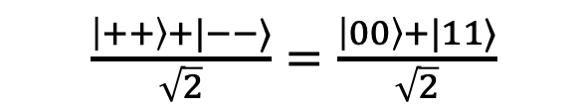



Quantum: Warm-Up Revisited
CNOT gate
$$|0⟩$$
$$H$$
$$\frac{\left|00\right\rangle +|11⟩}{\sqrt{2}}$$
$$|+⟩$$
$$H$$
$\frac{\left|++\right\rangle +|−−⟩}{\sqrt{2}}=$ $\frac{\left|00\right\rangle +|11⟩}{\sqrt{2}}$
$$|0⟩$$
$$|+⟩$$

Slide 36



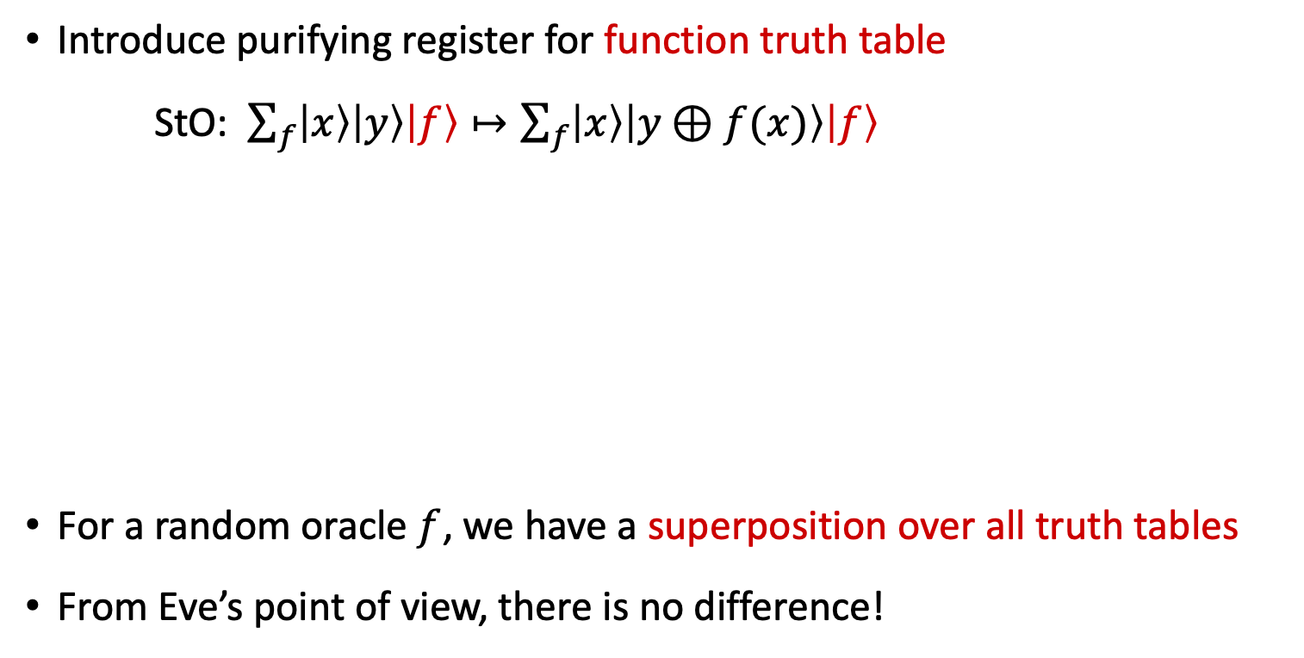











A Crucial Insight: Purification
Introduce purifying register for function truth table
StO: $\sum_{f}{\left|x\right\rangle \left|y\right\rangle \left|f\right\rangle }↦\sum_{f}{\left|x\right\rangle \left|y⊕f(x)\right\rangle \left|f\right\rangle }$
For a random oracle $f$, we have a superposition over all truth tables
From Eve’s point of view, there is no difference!
$$O_{f}$$
$$|x⟩$$
$$|x⟩$$
$$|x⟩$$
$$x=0$$
$$x=1$$
$$|x⟩$$
$$|y⟩$$
$$O_{f}$$
$$|y⊕f(x)⟩$$
$$|y⟩$$
$$|y⊕f(x)⟩$$
$$|f⟩$$
$$|f⟩$$
$$|f(0)⟩$$
$$|f(0)⟩$$
$$|f(1)⟩$$
$$|f(1)⟩$$
[Mark Zhandry 2018: How to Record Quantum Queries]

Slide 37




























Change of Viewpoint: Fourier Oracle
Standard Oracle
Fourier Oracle
$$x=0$$
$$x=1$$
$$|x⟩$$
$$x=0$$
$$x=1$$
$$|x⟩$$
$$|x⟩$$
$$x=0$$
$$x=1$$
$$|x⟩$$
$$|x⟩$$
$$|y⟩$$
$$H$$
$$H$$
$$H$$
$$H$$
$$|y⊕f(x)⟩$$
$$|η⟩$$
$$|η⟩$$
$$|η⟩$$
$$|f(0)⟩$$
$$H$$
$$H$$
$$|f(0)⟩$$
$$|0⟩$$
$$|η⟩$$
$$|0⟩$$
$$|f(1)⟩$$
$$H$$
$$H$$
$$|f(1)⟩$$
$$|0⟩$$
$$|0⟩$$
$$|η⟩$$
By making a query, Eve entangles herself with the truth table in a very clean way, when observed in the Fourier basis!
[Mark Zhandry 2018: How to Record Quantum Queries]

Slide 38








Compressing the Database
Fourier Oracle
Fourier Oracle (FO):
$\left|x\right\rangle \left|η\right\rangle \left|0^{n}⋯0^{n}\right\rangle \underset{→}{FO}|x⟩|η⟩|0^{n}⋯0^{n} η 0^{n}⋯0^{n}⟩$
Multiple FO queries “populate” the database
Compression: only keep track of the non-zero entries
$\left|x\right\rangle \left|η\right\rangle \left|D\right\rangle$ $\underset{→}{FO}\left|x\right\rangle \left|η\right\rangle \left|D∪(x,η)\right\rangle$
Allows efficient simulation of the random oracle to the adversary
$$x=0$$
$$x=1$$
$$|x⟩$$
$$x=0$$
$$x=1$$
$$|x⟩$$
$$|x⟩$$
$$|η⟩$$
$$|η⟩$$
$$|η⟩$$
$$|0⟩$$
$$|η⟩$$
$$|0⟩$$
$$|0⟩$$
$$|0⟩$$
$$|η⟩$$
[Mark Zhandry 2018: How to Record Quantum Queries]

Slide 39
What will you Learn from this Talk?
Classical Random-Oracle Model
Quantum Access
Three Tools:
    t-wise independent functions
    One-way to Hiding (O2H)
    Compressed oracles
Extensions and Applications

Slide 40
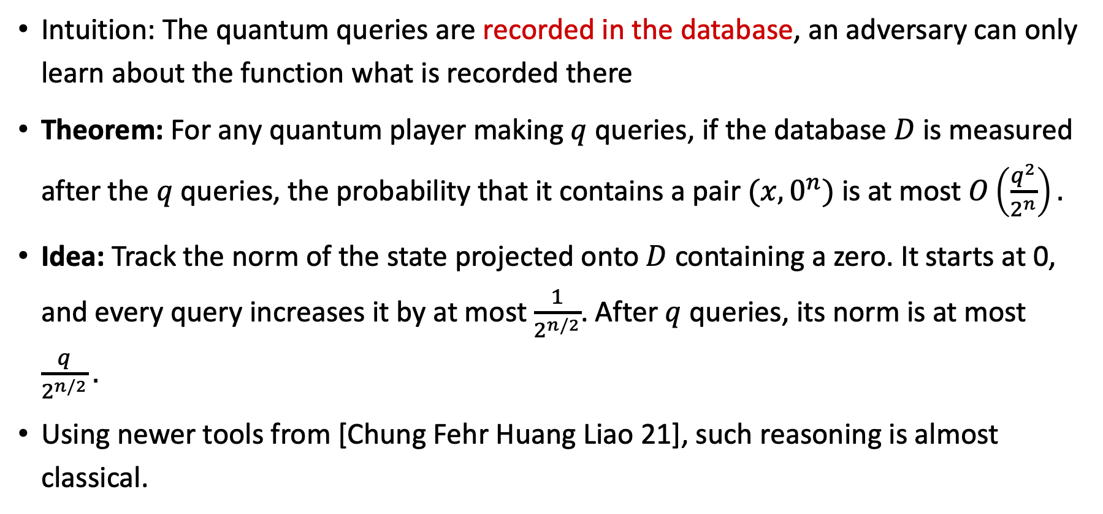
Query Lower Bounds
Intuition: The quantum queries are recorded in the database, an adversary can only learn about the function what is recorded there
Theorem: For any quantum player making $q$ queries, if the database $D$ is measured after the $q$ queries, the probability that it contains a pair $(x,0^{n})$ is at most $O\left(\frac{q^{2}}{2^{n}}\right).$
Idea: Track the norm of the state projected onto $D$ containing a zero. It starts at 0, and every query increases it by at most $\frac{1}{2^{n/2}}$. After $q$ queries, its norm is at most $\frac{q}{2^{n/2}}.$
Using newer tools from [Chung Fehr Huang Liao 21], such reasoning is almost classical.
[Mark Zhandry 2018: How to Record Quantum Queries,
Chung, Fehr, Huang, Liao 2021]

Slide 41
Extensions and More Advanced Tools
Tool 1: t-wise independent function families:
semi-constant distributions, small-range distributions, …
Tool 2: one-way to hiding
semi-classical O2H, many variants
Measure and reprogram tools for Fiat-Shamir [PhD thesis by Jelle Don 24]
Tool 3: compressed oracles
online extraction, (tight) adaptive reprogramming
compressed permutation oracles? Ideal-cipher model?
[Mark Zhandry 2018: How to Record Quantum Queries,
Chung, Fehr, Huang, Liao 2021]
[Ambainis Hamburg Unruh 18]

Slide 42
Numerous Applications
Query lower bounds for searching and (multi-)collisions in random functions
Fujisaki-Okamoto transformation (to build public-key encryption)
Fiat-Shamir transform (for digital signatures)
Indifferentiability
4-round Luby-Rackoff/Feistel construction
Succinct arguments
Separations between ROM and QROM
Adaptive reprogramming
…

Slide 43

Major Open Question: Compressed Permutation Oracles
How to lazy-sample a quantum-accessible random permutation both forwards and backwards?
Answer would yield indifferentiability of sponge construction used in SHA-3
$$Sim$$
Real:
Ideal:
Dist
Dist
[Czajkowski Majenz Schaffner Zur 19, Unruh 21, Unruh 24, ]

Slide 44
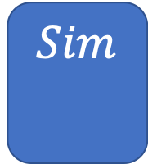

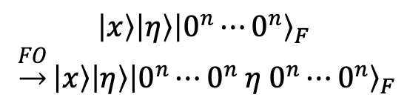
Summary
$$H:{\left\{0,1\right\}}^{∗}→{\left\{0,1\right\}}^{n}$$
$$H$$
Classical Random-Oracle Model
Quantum Access
Three Tools:
  t-wise independence
  One-way to Hiding (O2H)
  Compressed oracles
Extensions & Applications
$$\left|x\right\rangle \left|η\right\rangle {\left|0^{n}⋯0^{n}\right\rangle }_{F}$$
$\underset{→}{FO}\left|x\right\rangle \left|η\right\rangle {\left|0^{n}⋯0^{n} η 0^{n}⋯0^{n}\right\rangle }_{F}$
$$Sim$$

Slide 45
Thank you for your attention!
Questions

Slide 46
More Resources
detailed links and references at bottom of slides
2022 IPAM summer school: https://www.ipam.ucla.edu/programs/summer-schools/graduate-summer-school-on-post-quantum-and-quantum-cryptography
Dominique Unruh on quantum tools
2021: Quantum Techniques for Provable Security: https://quiques.huelsing.net/
Kai-Min Chung on compressed oracles, Kathrin Hövelmanns on O2H lemmas, …
2021: 11th BIU Winter School on `Cryptography in a Quantum World’: https://www.youtube.com/playlist?list=PL8Vt-7cSFnw2JZsskO0bzeO7FswokQC7-
Mark Zhandry on compressed oracles
2020: Simons institute: https://www.youtube.com/watch?v=LOtxqBJ6Qqk
Christian Majenz on attacking hash functions

