Slide 1
Challenges for research support
Sarah Jones
Digital Curation Centre
sarah.jones@glasgow.ac.uk
Twitter: @sjDCC
Dutch research support event, 22-23 September 2016, Rotterdam

Slide 2
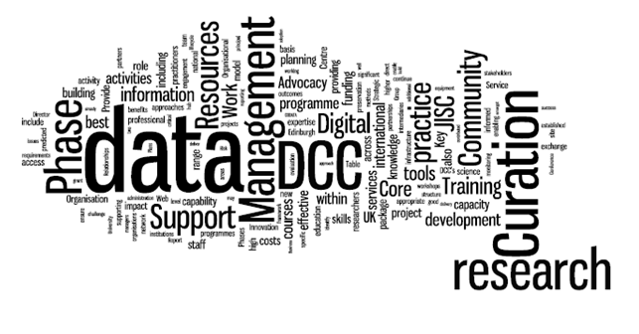
What is the Digital Curation Centre?
“a centre of expertise in digital information curation with a focus on building capacity, capability and skills for research data management across the UK's higher education research community”
www.dcc.ac.uk

Slide 3
Why are research data important to unis?
“If an institution spent A$10 million on data, what would be the return? The answer is: more publications; an increased citation count; more grants; greater profile; and more collaboration.”
Dr Ross Wilkinson, ANDS
www.ariadne.ac.uk/issue72/oar-2013-rpt
Notes:
Data as institutional crown jewels, special collections, the new oil...

Slide 4
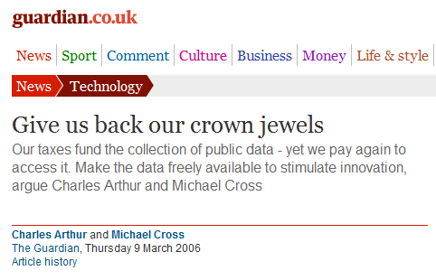
Research data: institutional crown jewels?
http://www.flickr.com/photos/lifes__too_short__to__drink__cheap__wine/4754234186

Slide 5
#1 – understanding the current position
Image CC-BY-NC-SA by Leo Reynolds www.flickr.com/photos/lwr/13442910354

Slide 6
How are researchers managing and sharing their data?
What tools are being used to share data and collaborate?
Who is providing support?
What gaps are there in services?
What is expected?
What are the pressure points?
What intelligence does the university hold in its business systems?

Slide 7
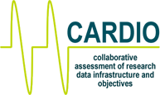
Several survey tools
Data Curation Profiles
http://datacurationprofiles.org
www.data-audit.eu
RDM Capability Maturity Model
www.ands.org.au/guides/capability-maturity
http://cardio.dcc.ac.uk

Slide 8
Commonalities in findings
E-infrastructures Austria-wide survey across 24 institutions with 3026 respondents
https://zenodo.org/record/34005#.V9qNX_krKUk
Recent DAF studies in UK across 6 institutions / groups gaining 1,185 responses
www.slideshare.net/JiscRDM/daf-survey-results-research-data-network

Slide 9
Highlights
Sharing driven by benefits not policies
Informal sharing methods – email, dropbox etc
Lack of clarity on data ownership or processes when staff leave
https://phaidra.univie.ac.at/detail_object/o:409446

Slide 10
Reasons for sharing

Slide 11
Informal methods for sharing

Slide 12
Location of research data

Slide 13
Low use of university services

Slide 14
#2 – decide what services you need
Image CC-BY-NC ‘Data centre’ by Bob Mical www.flickr.com/photos/small_realm/15995555571

Slide 15
DCC engagements with institutions
In 2011-13 we worked with 21 HEIs to increase RDM capability
Up to 60 days of effort per HEI drawn from a mix of DCC staff
Deployed DCC & external tools, new approaches & best practice
Support varies based on what each institution wants/needs
Lessons & examples were shared with the community
Follow-on programmes and consultancy work have continued this
www.dcc.ac.uk/community/institutional-engagements

Slide 16
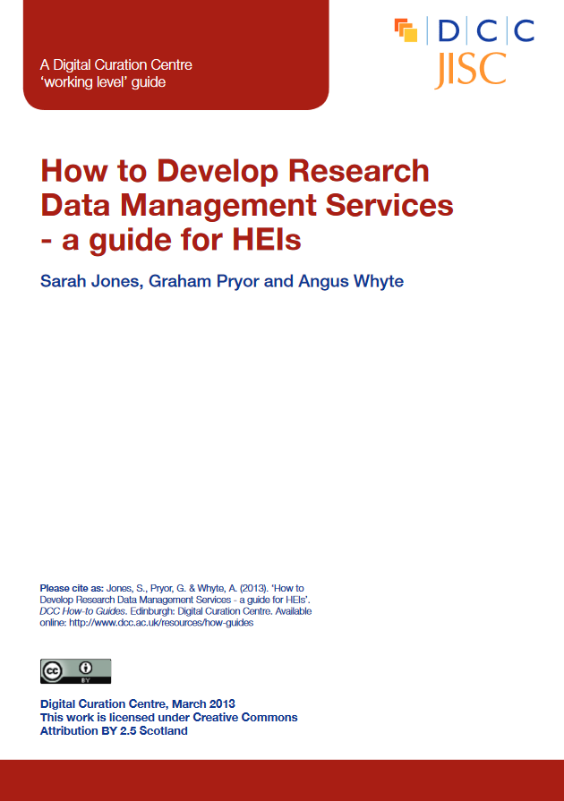
Components of RDM services
www.dcc.ac.uk/resources/how-guides/how-develop-rdm-services

Slide 17
Broader research support services
Ideas generation
Bidding for funding
Financial administration
Knowledge exchange and impact
Open access services
Reporting
…
Ideas
Grants
Projects
Reporting
Impact

Slide 18
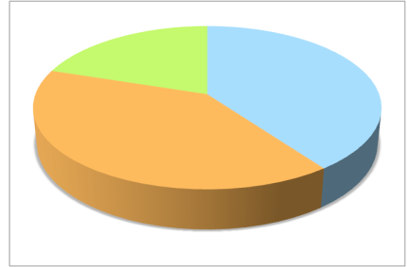
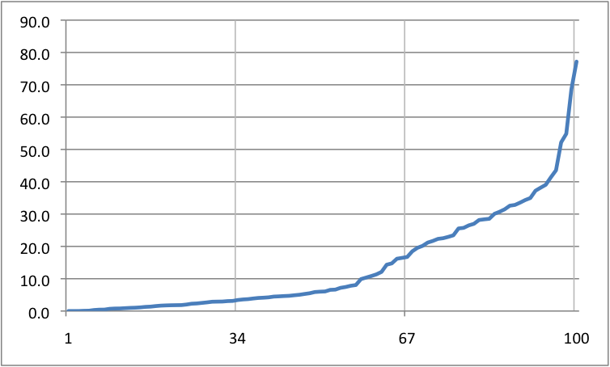
Annual RDM survey issued by DCC
60 UK Higher Education Institutions responded to DCC survey 2015, of 132 invited
Research-active institutions well represented
77%
Research income % of total
20%
3%
Percentiles
Income range percentiles - split into 3 groups across all 161 HEIs
Briefing and links to data: http://www.dcc.ac.uk/survey2015
Notes:
These figures come from HESA – the higher education statistics authority. Our own survey of UK institutions indicates that there is a huge range in size and research intensity across the board, so when you’re having a discussion about services it’s useful to bear in mind that what is sensible or appropriate in one context might not be in another. Example – automated systems for tracking research outputs.

Slide 19
Who has what in place?
Policy and strategy
Business planning
87%
13%
Data Mgmt Planning
50%
*
Data cataloguing
Managing active data
38%
40%
Data preservation
Governing access & reuse
18%
22%
63%
Skills training & consultancy
% indicating ‘rolling out’ or ‘embedding’ * referred to ‘access & storage systems’ in survey

Slide 20
Business planning
Understanding your institution is key:
What will persuade people to invest?
compliance, research benefit, being innovator
What level of detail is needed?
Who is the right-person to sign off?
Provide options to give panel more choice to approve

Slide 21
Secure data services
5 Safe Havens in Scotland, one being Grampian (DaSH)
Aim to decrease the risk to patient confidentiality whilst increasing the linkage of data from various sources
Safe setting: identifiable data on NHS servers; linked data on separate servers
Safe projects: need clear DMP and all study approvals in place
Safe people: access for approved and trained researchers only; researchers cannot access patient identifiers; sign a declaration on working practices; penalties for misconduct…
Safe outputs: no patient level data can be printed, copied or removed; outputs released after disclosure checks
www.slideshare.net/JiscRDM/grampian-safe-haven-research-data-network

Slide 22
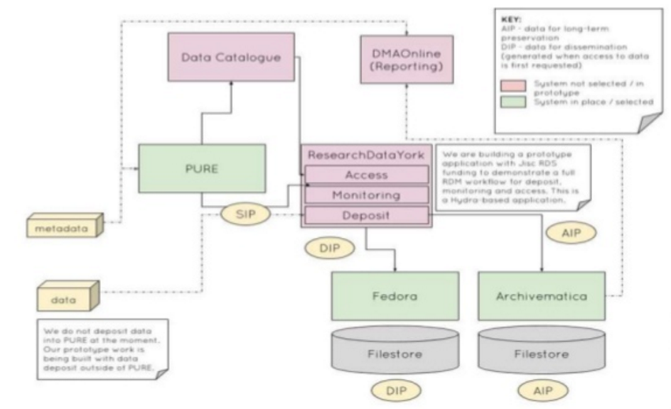
Digital preservation
Project to make Archivematica better for RDM and implement proof of concept at York and Hull. Aim to:
Pull metadata from PURE
Automatically initiate ingest by Archivematica
Package up data for long-term preservation
Provide a dissemination copy in repository
www.slideshare.net/JiscRDM/implementing-archivematica-research-data-network

Slide 23
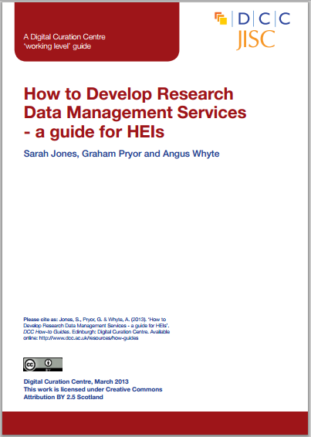
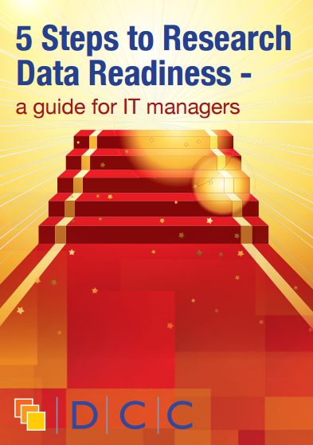
General guidance and support
Guide and case studies: www.dcc.ac.uk/resources/developing-rdm-services

Slide 24
#3 – balance the drivers for each actor
Image CC-BY ‘Balance’ by Christopher A Dominic www.flickr.com/photos/kestereverts/14333646903

Slide 25
Why manage data?
Funders mandate it
Risk losing funding for non-compliance
To make research easier
For research integrity and reproducibility
So you can reuse data or share it with others
Increases citations and impact
….
What will drive one group to act could cause another to disengage

Slide 26
Data Management Planning lessons
Have seen a more positive response from researchers in other countries where DMPs were encouraged rather than required
DCC suggest unis limit what they ask and focus on key bits of information they can actively use / tie to a benefit (initial tendency for very long templates)
Need to integrate into existing workflows and tools

Slide 27
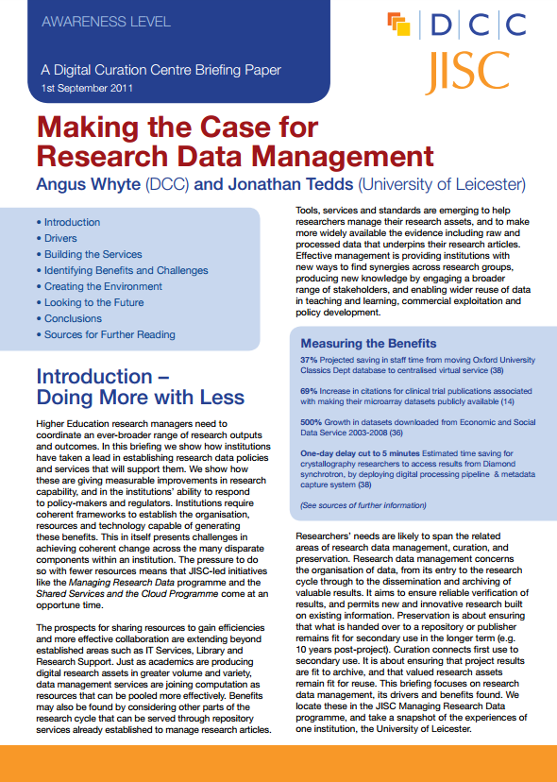
Making the case for RDM
Explains the drivers
Identifying benefits and challenges
Potential metrics for research support
Creating the support environment
www.dcc.ac.uk/resources/briefing-papers/making-case-rdm

Slide 28
#4 – secure broad-based input and buy-in
Image CC-BY-SA by Dawn Manser www.flickr.com/photos/dawnmanser/3532598208

Slide 29
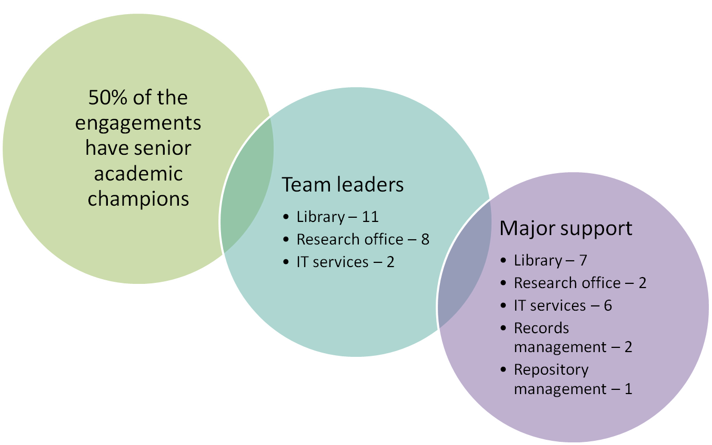
Roles of main participants in IEs
Notes:
Importance of senior champion
Overcoming in-fighting to ensure collaborative, team effort

Slide 30
Need many more services involved
IT
Library
Research office
Ethics
Archives
Records management
Lab managers / support staff
Bio-informaticians
Statistics
Computer scientists
Developers
Information analysts
Policy officers
Media services
Publishing advisors
HPC centres
Knowledge managers / knowledge exchange
Business intelligence
IPR officers
Legal affairs
Data services
Preservation experts
…

Slide 31
Importance of senior advocate(s)
DCC recommended that unis get a Pro-VC for research (or similar) to Chair working group
Useful to have a senior academic in your corner – hold sway with other researchers and influential in university decision-making processes
Individuals regularly move on, so need continual advocacy and lobbying of more than one champion
Some unis setting up networks of RDM champions

Slide 32
#5- define roles and responsibilities
Image CC-BY-SA by nosha www.flickr.com/photos/nosha/2466860959

Slide 33
A range of RDM job titles
Research Data Management Co-ordinator
Research Data Service Manager
Project Manager – Research Data Management
Research Archive Manager
Data and Services Developer
Research Support Librarian
Research Data Storage Architect
Research Librarian and Data Specialist
Senior Research Data Software Engineer
Data librarian
Data Scientist
Technical Data Officer
Research Data Manager
Scholarly Communications Manager
Research Information Analyst and Open Access Officer
Digital Record’s Officer

Slide 34
Data librarian – example 1
This post will be primarily dedicated to a project that aims to aggregate and open up, through both a graphical user interface and through open linked data.
You will need to be familiar with Windows and Unix file systems, at least at the level of file copying/moving/renaming on a large scale, and with the running of simple shell scripts and Windows batch files. You should also be familiar with databases and with XML, as well as possessing a working knowledge of existing library catalogue resources, bibliographic metadata and metadata standards. You will have good qualifications and/or experience working with metadata on a large scale and in an IT-related environment.

Slide 35
Data Librarian – example 2
In this post you will manage and develop the Library’s extensive collection of datasets, provide advice and training for their use to researchers, staff and students and ensure compliance with access requirements. You will work closely with the Research Support Services Manager and colleagues on initiatives to develop and implement a strategy to collect, store and curate primary data produced by researchers and build services to assist researchers with data management.
You will be educated to at least degree level or equivalent with experience of supporting research or managing subscribed resources. You should be an excellent communicator with strong organisational skills as well as a proven ability to relate to a wide range of users and academic colleagues. You will be able to initiate service developments as well as having the ability to work as part of a team. We are particularly interested in applications from candidates with experience of working with research data or that have a demonstrated interest in developing expertise in data curation and management.

Slide 36
Data librarian – example 3
We are looking to recruit a highly motivated individual to join a team to help establish and promote a pilot research data management service. A significant proportion of the work will involve advocacy and raising awareness and understanding of research data management issues amongst research and support staff across the University.
Essential requirements for the role include:
A sound understanding of the requirements for data management throughout the research lifecycle, including scholarly communication and digital curation in a university or research environment
Ability to explain complex information clearly to a wide variety of recipients
Knowledge of current technologies and standards such as institutional repositories and metadata
Experience of digital library applications in an HE environment
Ability to plan, develop and deliver services in a large scale organisation
Experience of managing projects and resources
The post requires a postgraduate qualification in Information and Library Management or equivalent and significant professional experience in an academic environment.

Slide 37
Building on existing roles
On-job training for existing liaison librarians and local IT staff
DIY training kit for librarians
http://datalib.edina.ac.uk/mantra/libtraining.html
23 research data things
https://rd-alliance.org/group/libraries-research-data-ig/outcomes/23-things-libraries-research-data-supporting-output
FOSTER open science training
www.fosteropenscience.eu

Slide 38
#6 – positioning support appropriately
Image ‘Pioneer signpost’ CC-BY-NC-ND by Spencer Goad www.flickr.com/photos/spgoad/12998899453

Slide 39
One stop shop
Collate details about support from various divisions
Make it easy to pull out the salient points
FAQ format
Visual representations
Case studies
Provide contact details
Raise awareness
www.gla.ac.uk/services/datamanagement
Notes:
Researchers don’t need to understand internal politics and divisions to know who’s responsible for what. They just need to be able to find the support they need.

Slide 40
Accessibility of difficult concepts
www.gla.ac.uk/media/media_195589_en.pdf

Slide 41
Flyers, awareness raising
Research Data Management
Research Data Service
Creating a data management plan
Finding and analysing data
Storing data
Synchronising data
Versioning software
Recording datasets using PURE
Sharing open data
Archiving data
Training
http://edin.ac/1Y5k8xf

Slide 42
But… different people want different things
“Please, individualise the support. Workshops are useless, emails with information are useless, brochures are useless, posters are useless.”
www.slideshare.net/JiscRDM/daf-survey-results-research-data-network

Slide 43
Localised support
Critical importance of having people with subject expertise
Issues:
Scalability
Coordination
Forum to share expertise and train
“It would be helpful to clarify the rules for storing anonymised data on cloud services. My departmental rules say this is never OK, however this seems to contradict University rules”

Slide 44
#7 – balance internal and external provision
Image ‘Internal’ CC-BY by Ben Salter www.flickr.com/photos/ben_salter/673078279

Slide 45
DIY or outsource services?
Conceive
Create
Analyse
Share
Preserve

Slide 46
Considerations to make
Prevailing institutional culture
Ability to manage contractors and set KPIs
Brokered deals or procurement support
Access to developer / technical expertise
Choice that keeps options open e.g. OS + delivery options
Possibility for regional collaborations

Slide 47
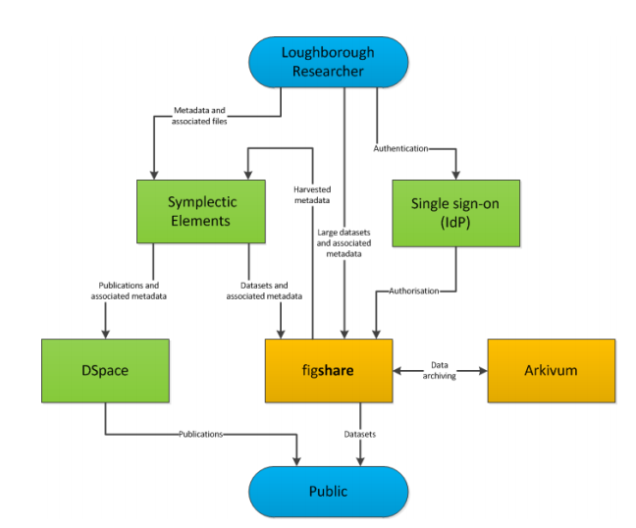
Loughborough example
University already had a publications repository (DSpace) and publications system (Symplectic Elements)
Arkivum could provide the data storage and preservation required, whilst figshare addressed the light-touch deposit process and discoverability of the research data
Collaboration with Arkivum and figshare to develop a repository to support Research Data Management
https://dspace.lboro.ac.uk/dspace-jspui/bitstream/2134/19443/1/RDMarticle.pdf

Slide 48
National service providers
www.jisc.ac.uk/rd/projects/research-data-shared-service

Slide 49
Mitigating risks
Pragmatic guidance to explain the risks of using third-party services, what not to do, and what terms are being agreed to
www.lse.ac.uk/intranet/LSEServices/IMT/guides/softwareGuides/other/usingDropboxCloudStorageServices.aspx

Slide 50
#8 - be agile
Image from www.positively-bobdylan.com/bob-dylan-news/the-times-they-are-a-changin-rocks-broadway

Slide 51
Don’t stand still or think the job is done
Repeat requirements gathering and gap analysis
Regular contact with user community
Continual advocacy, awareness raising, training…
Monitor trends / changes in landscape
More open data policies
Transition to FAIR data

Slide 52
Be open to new ideas
NIH plans to build a Commons to bring data and software layer together in common environment
Singular, virtual environment so data aren’t downloaded and worked on elsewhere then left on researchers own hard drive to rot
Issue credits to work in commons-compliant environment. Better than just funding kit at local unis and losing data.
www.slideshare.net/pebourne/making-biomedical-research-more-like-airbnb

Slide 53
#9 – link up systems
Image ‘Kogod Courtyard’ by Tim Evanson CC-BY-SA www.flickr.com/photos/timevanson/8348282333

Slide 54
A single platform for all things DMP
Agreed to converge on a single codebase, based on DMPonline with additional features from DMPTool
Bring together features and strengths of each tool
Co-manage, co-develop and issue joint roadmap
DMP Roadmap: https://github.com/DMPRoadmap

Slide 55
Potential integrations
API so plans can be created and statistics extracted
Using ORCIDs to push PI & award details into tool
Notifications about data creation to improve discovery
Publishing DMPs with data
Alerting repositories to planned deposit & vice versa
…..
https://indico.cern.ch/event/520120/contributions/2177900/attachments/1299358/1938982/DMPs_-_actionable_and_public.pdf

Slide 56
#10 – plan for sustainability
Image ‘Wind Farm UK’ by Richard:Fraser CC-BY-NC-ND www.flickr.com/photos/rfraser/7544912468

Slide 57
Plan for the long-term
Think beyond short-term funding to consider how to build these services into core provision
Measure impact, not just usage stats. Focus on a relationship with services and what you help users to accomplish
Know your user community
Continually engage to ensure you meet needs
Be agile to keep addressing current problems

Slide 58
So what’s stopping you? Get started!
Image ‘Go !!’ CC-BY-NC-ND by Cédric Fettouche www.flickr.com/photos/cedmars/5405223203

