Slide 1

De quantumcomputer in vogelvlucht
Christian Schaffner
Research Center for Quantum Software
Institute for Logic, Language and Computation (ILLC)
University of Amsterdam
Docentenbijeenkomst QuantumQuest, 16 September 2021

Slide 2

A little thought experiment…

Slide 3
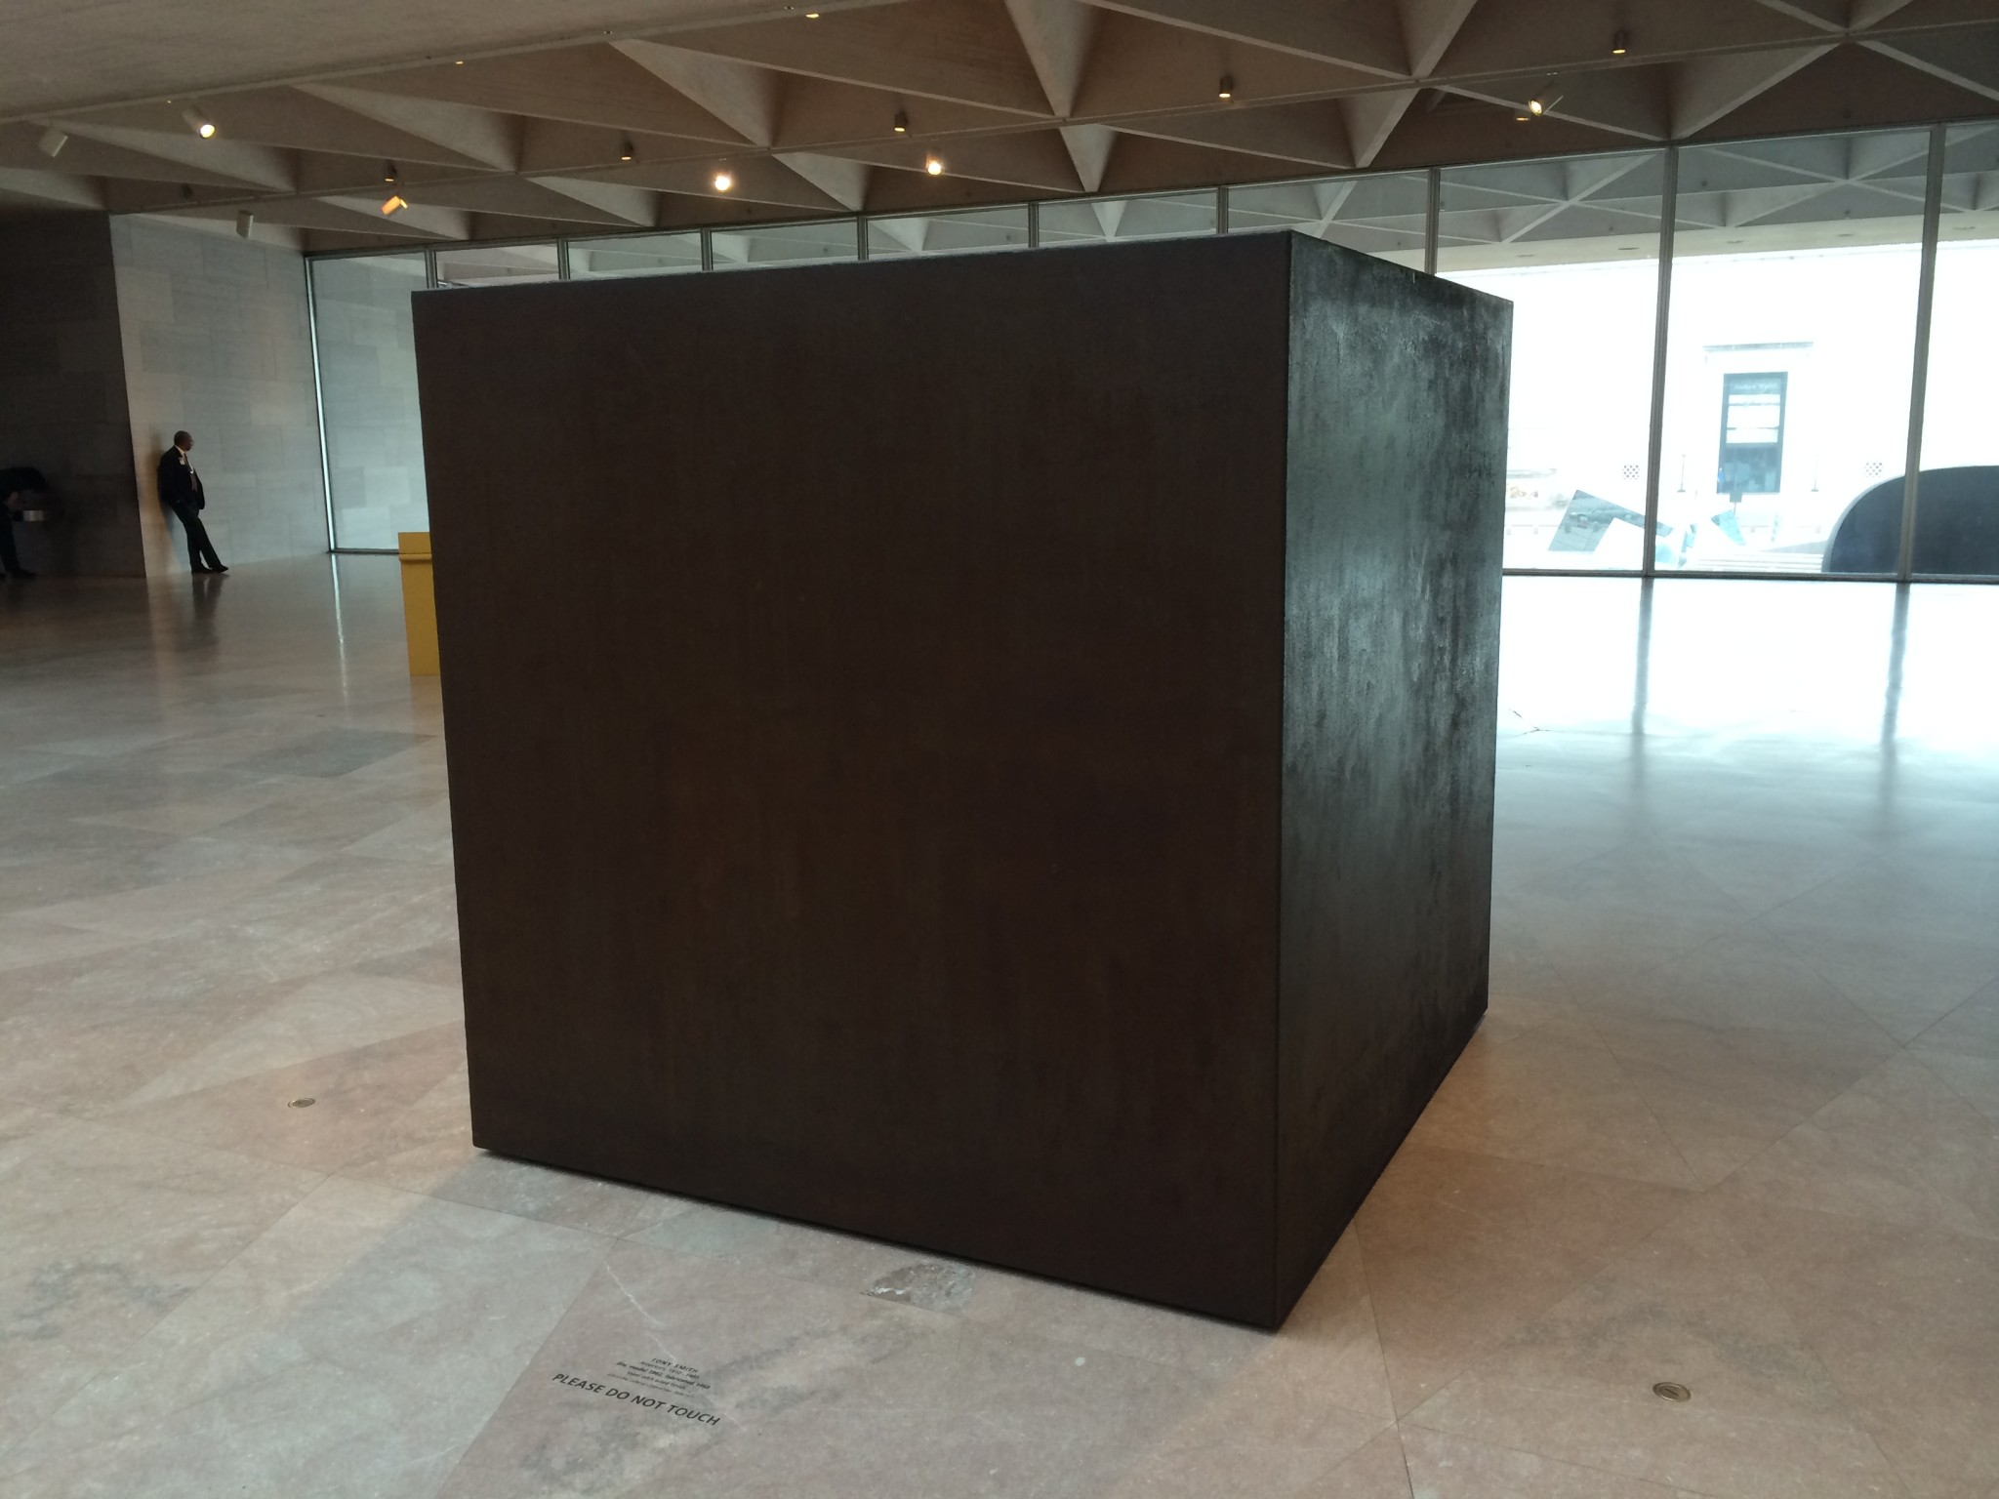
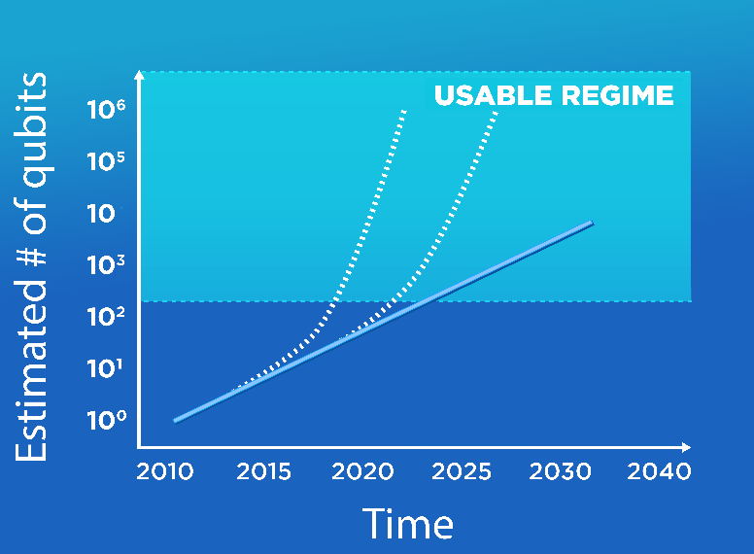


Quantum Computer
Quantum Computer
What are you going to do with it?
60-100 quantum bits now
200-1000 qubits in the next 5 years!

Slide 4
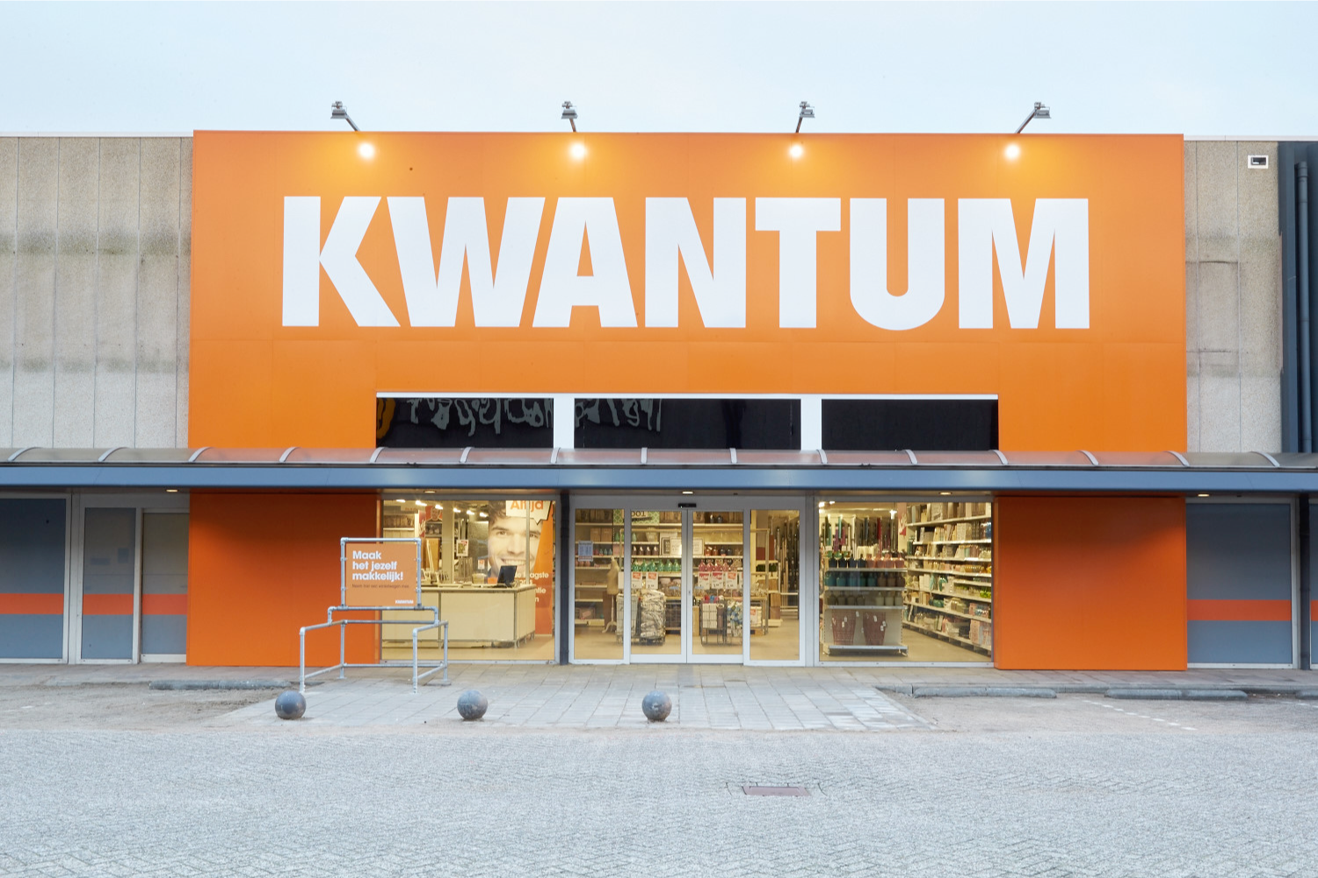
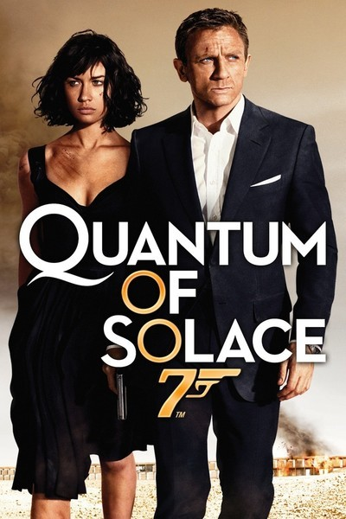
Notes:
Kwantum kennen die jongens natuurlijk niet,
Maar Britten houden vast van James Bond en hun eigen Britse merk sport cars, Quantum Sports Cars, QSC, Hier afgebeeld de sexy sunrunner https://en.wikipedia.org/wiki/Quantum_Sports_Cars

Slide 5
Quantum Physics

Slide 6
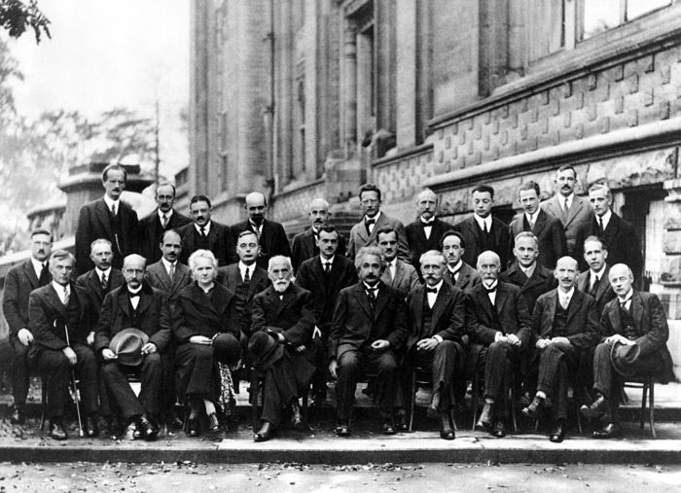
Solvay conference Brussels 1927
Dirac
Schrödinger
Pauli
Heisenberg
Planck
Curie
Lorentz
Einstein
Bohr
Notes:
Fifth Conference[edit]
Perhaps the most famous conference was the October 1927 Fifth Solvay International Conference on Electrons and Photons, where the world's most notable physicists met to discuss the newly formulated quantum theory. The leading figures were Albert Einstein and Niels Bohr. 17 of the 29 attendees were or became Nobel Prize winners, including Marie Curie, who alone among them, had won Nobel Prizes in two separate scientific disciplines.^{[3]}
This conference was also the culmination of the struggle between, on one side, Einstein and other scientific realists -- who wanted strict rules of scientific method as laid out by Charles Peirce and Karl Popper -- and on the other, Bohr and other instrumentalists, who wanted looser rules based on outcomes.^{[vague]} Starting at this point, the instrumentalists won, instrumentalism having been seen as the norm ever since,^{[4]} although the debate has been actively continued by the likes of Alan Musgrave.

Slide 7
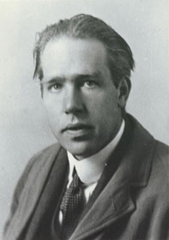
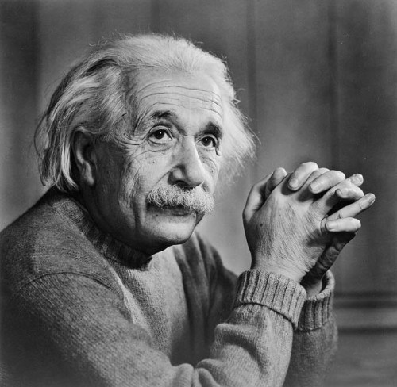
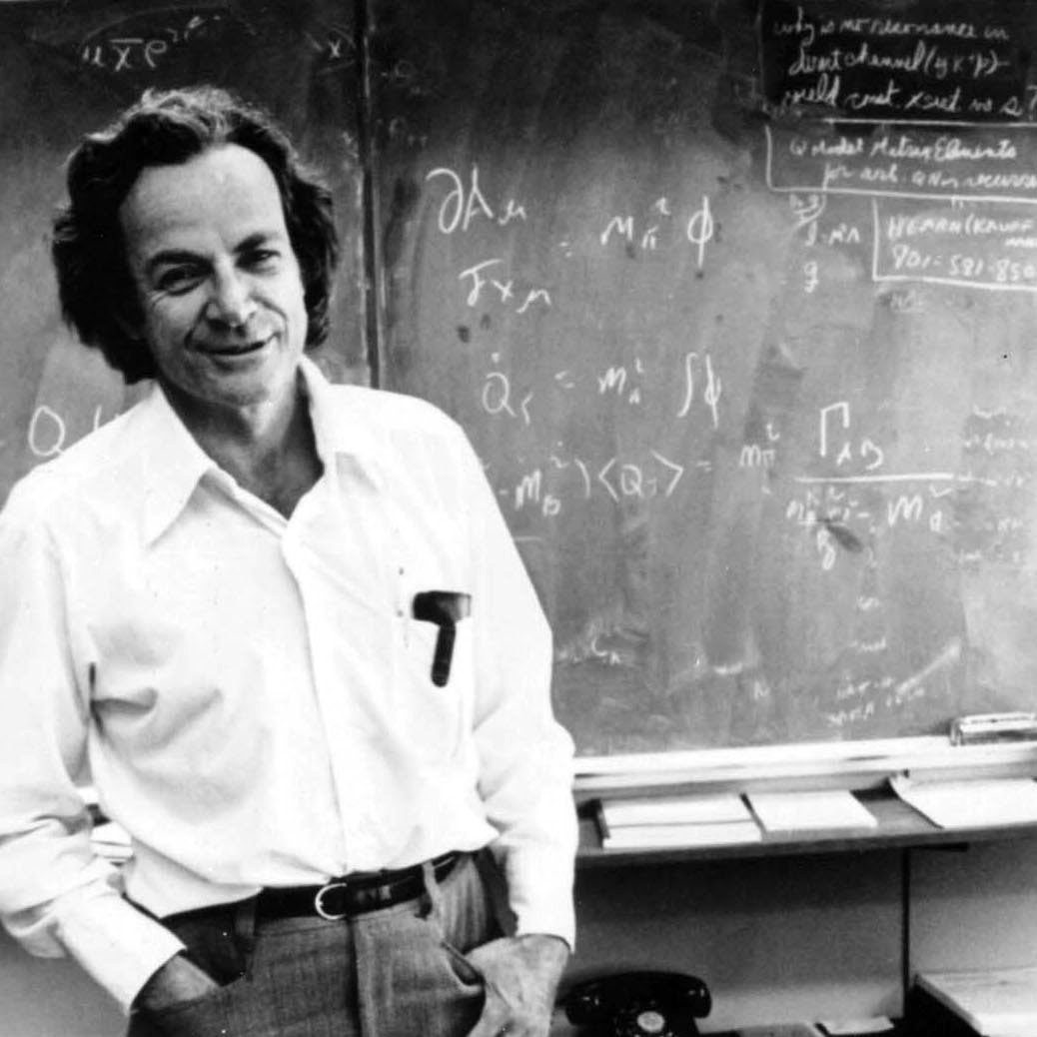
Quantum Physics
Niels Bohr:
“If quantum physics hasn’t profoundly
shocked you, you haven’t understood it yet.”
Albert Einstein:
“God does not play dice.”
Richard Feynman:
“I think I can safely say that nobody understands
quantum physics.”

Slide 8
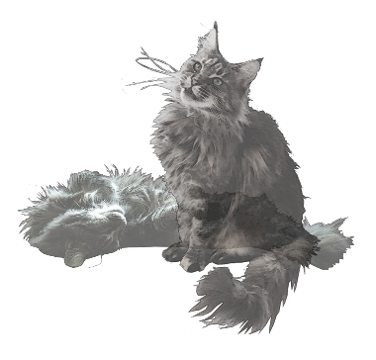
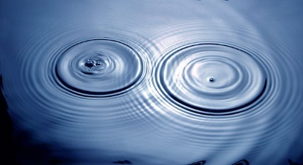
Quantum Physics
Superposition:
  Of different states
Interference:
  Of states
Entanglement:
  Of two or more physical systems

Slide 9
Quantum Physics
Superposition:
  Of different states
Interference:
  Of states
Entanglement:
  Of two or more physical systems

Slide 10
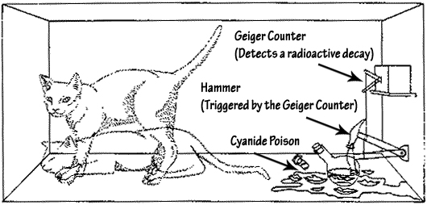
Superposition
An object in different states simultaneously:
- A photon can be at two positions at the same time
- Schrödinger’s cat: dead and alive
Experimentally verified:
- Small systems, such as photons
- Bigger systems, molecules…

Slide 11
“About your cat Mister Schrödinger…
I’ve got good and bad news.”

Slide 12
Superposition:
An experiment

Slide 13
Quantum Bit: Polarization of a Photon

Slide 14
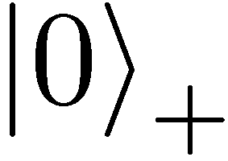
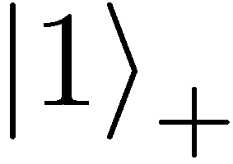
Qubit: Rectilinear/Computational Basis

Slide 15


Detecting a Qubit
No photons: 0
Alice
Bob

Slide 16
Measuring a Qubit
No photons: 0
Photons: 1
Alice
Bob
Measurement:
with prob. 1 yields 1
0/1

Slide 17
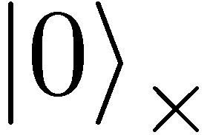
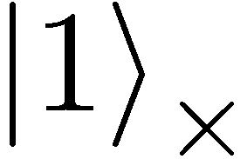

Diagonal Basis
Measurement:
with prob. ½ yields 0
=
0/1
with prob. ½ yields 1

Slide 18
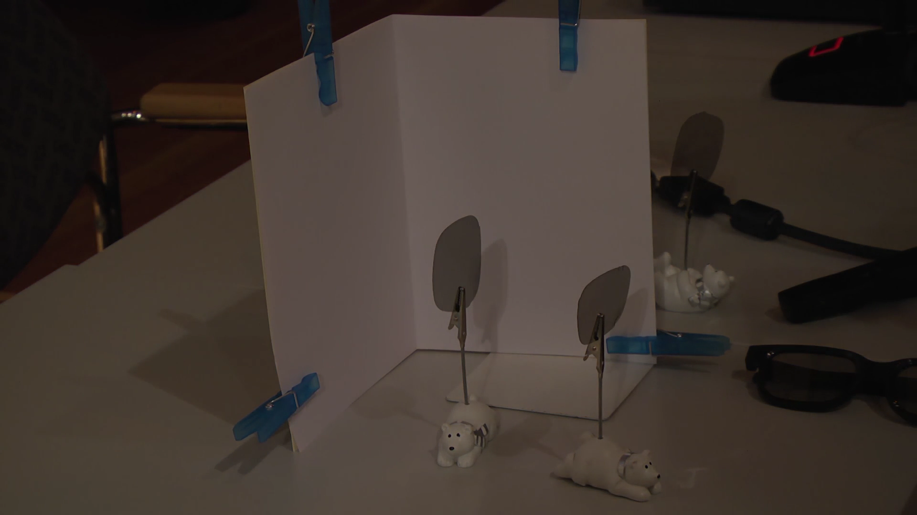
Video

Slide 19
Measuring Collapses the State
Measurement:
with prob. ½ yields 0
=
with prob. ½ yields 1
0/1

Slide 20
Measuring Collapses the State
=
=

Slide 21

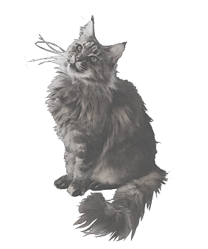
detector 1
collapse
superposition
detector 0

Slide 22
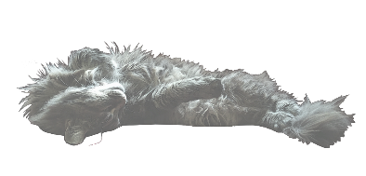
detector 1
collapse
superposition
detector 0

Slide 23
Quantum Physics
Superposition:
  Of different states
  Observation: collapse of the superposition
Interference
  Of an object in superposition
Entanglement
  Of two or more physical systems

Slide 24
detector 1
no superposition but: beamsplitter reflects 50% and transmits 50%?
detector 0

Slide 25
Mach-Zehnder interferometer
detector 1
50% detector 0 clicks
50% detector 1 clicks
mirror
detector 0
50%-50%
beamsplitter
mirror
classical reasoning

Slide 26
Mach-Zehnder interferometer
detector 1
detector 0
clicks
ALWAYS !!!
mirror
detector 0
mirror
When you perform the experiment

Slide 27
detector 1
detector 0
clicks
ALWAYS !!!
mirror
detector 0
superposition
interference
mirror
According to quantum mechanics

Slide 28
Quantum Physics
Superposition
  Of different states
  Observation: collapse of the superposition
Interference:
  Of an object in superposition
Entanglement:
  Of two or more physical systems

Slide 29
Entanglement
detector 1
detector 1
detector 0
detector 0

Slide 30
Entanglement
detector 1
detector 1
detector 0
detector 0
Left and right always the same detector!!

Slide 31
Quantum Physics
Superposition:
  Of different states
  Observation: collapse of the superposition
Interference:
  Of an object in superposition
Entanglement:
  Of two or more physical systems
  Correlations are classically impossible

Slide 32
Computer Science

Slide 33
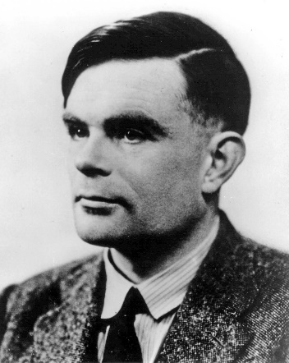
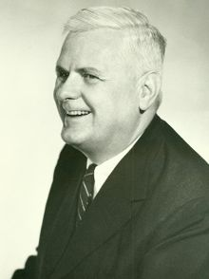
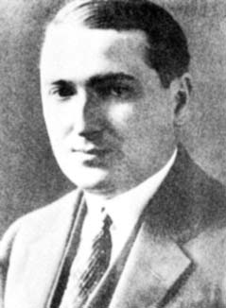
1936
Foundation of Computer Science
Alan Turing
(1912-1954)
Alonzo Church
(1903-1995)
Emil Post
(1897-1954)
Notes:
Alonzo Church (June 14, 1903 – August 11, 1995) was an American mathematician and logician who made major contributions to mathematical logic and the foundations of theoretical computer science. He is best known for the lambda calculus, Church–Turing thesis, proving the undecidability of the Entscheidungsproblem, Frege–Church ontology, and the Church–Rosser theorem. He also worked on philosophy of language (see e.g. Church 1970).
Emil Leon Post (/poʊst/; February 11, 1897 – April 21, 1954) was an American mathematician and logician. He is best known for his work in the field that eventually became known as computability theory.

Slide 34

A computer cannot calculate everything
Mathematic model of a computer:
Turing Machine
In the same paper from 1936 Turing demonstrated that not everything can be calculated on a computer
Stop problem

Slide 35
No quick solution for many applications
For many applications no quick programme is known:
- Longest way from Amsterdam to London
- All known solutions require exponential calculation time
Do quick solutions exist?
- Biggest unresolved problem of mathematics and computer science
- One of the 7 millennium questions of Clay Institute: “P versus NP”
92 billion
tonne rice
Exponential
growth
Chessboard with 300 tiles: 2³⁰⁰ rice grains
More than the number of atoms in the universe!

Slide 36
Quantum Computers

Slide 37

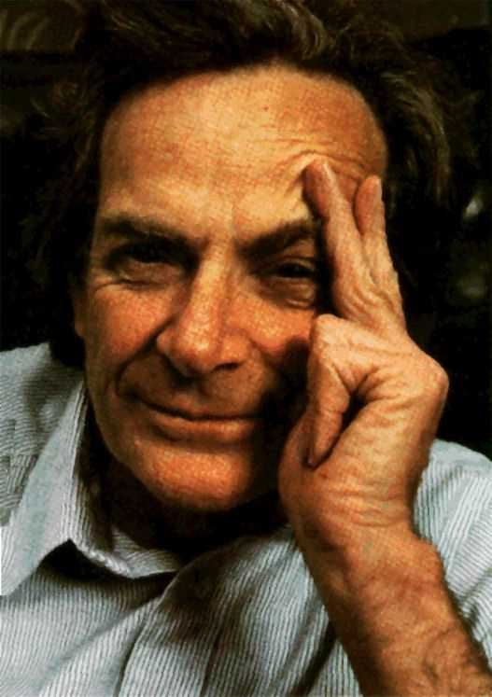
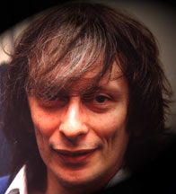
Quantum Physics
Computer Science
Alan
Turing
+
Alonzo
Church
Emile
Post
=
Quantumcomputer
Feynman
Deutsch

Slide 38

Quantum Bit
detector 1
Classical bit:
0 or 1
Quantum bit:
superposition of 0 and 1
or
detector 0
detector 1
superposition
detector 0

Slide 39



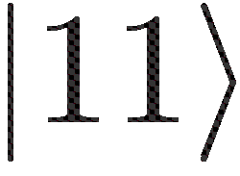
More qubits
1 qubit superposition of 2 states
2 qubits superposition of 4 states
3 qubits superposition of 8 states
4 qubits superposition of 16 states
5 qubits superposition of 32 states
6 qubits superposition of 64 states
300 qubits superposition of 2³⁰⁰ states
=

Slide 40
Quantum software:
fundamentally different
Qubit: superposition of 0 and 1
300 qubits: astronomical amount of parallel computation
How to get the answer out??
  - Measuring destroys computation!!
Quantum Program
  Use interference to cancel undesired
  computations
Does not always work!
Our focus: how can we optimally use the extra power!

Slide 41
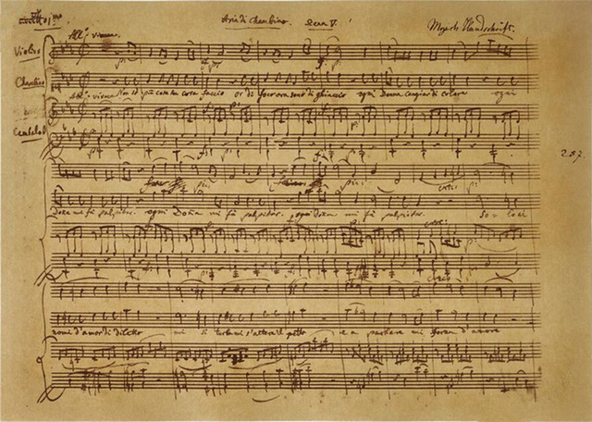
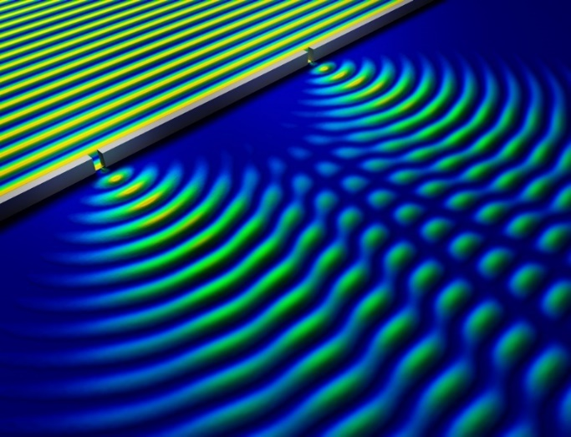
Quantum Programming is like Composing
Music
- Sound waves interfere
- Composer creates ‘beautiful’
interference of sound waves
Quantum Computer
- Qubits in superposition interfere
- Quantum programmer ensures
useful interference of qubit states
Notes:
https://phys.org/news/2014-05-nondestructive-method-quantum.html
Bron

Slide 42
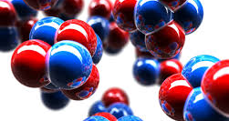
What can you do with it?
Factor big numbers [Shor]
  Breaks frequently used cryptography
Quantum cryptography [Bennett-Brassard-Ekert]
  Quantum-proof cryptography
Efficient communication
  Quantum internet, entanglement etc.
Simulation of nature
  Chemistry, material design, new medicines..
??????

Slide 43
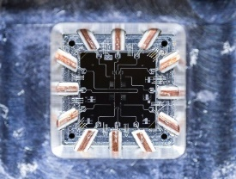
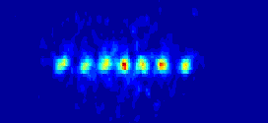
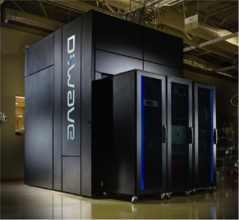
Progress Building Qubits
Many groups worldwide progress with building qubits
Solid state:
  IBM: 65, 2021: 127, 2022: 433, 2023: 1121
  31 Rigetti
  53 Google → 72
  56 China
  Fairly stable
Trapped ions:
  32 qubits Monroe
D-Wave:
  5000 qubits (not very stable)

Slide 44


The Future is Quantum
2015: Launch research center for quantum software
2020: launch network organization
2021: 615M€ for 7y for
Future need of a quantum-versed workforce

Slide 45
Questions?
christian.schaffner@quantum.amsterdam

