Slide 1
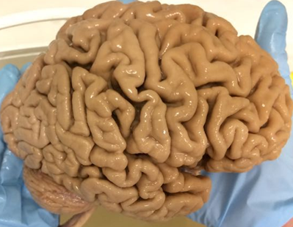
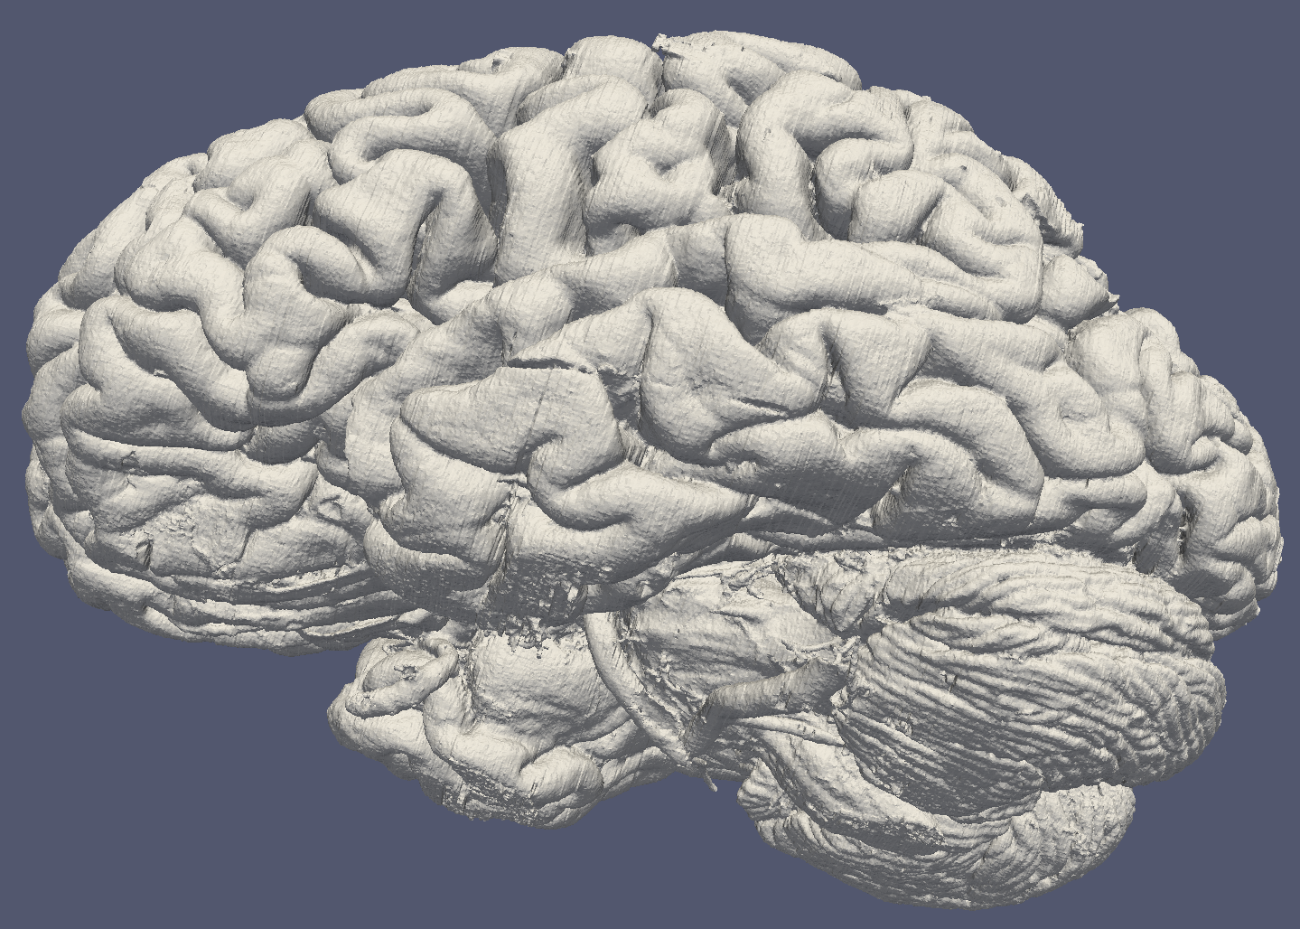
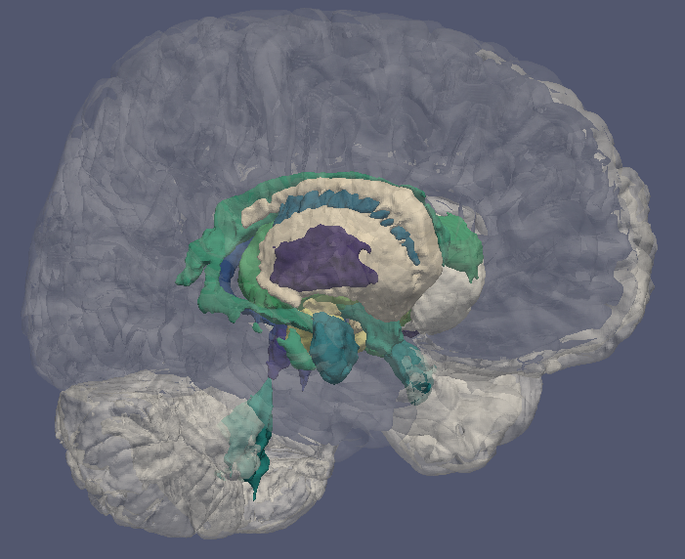
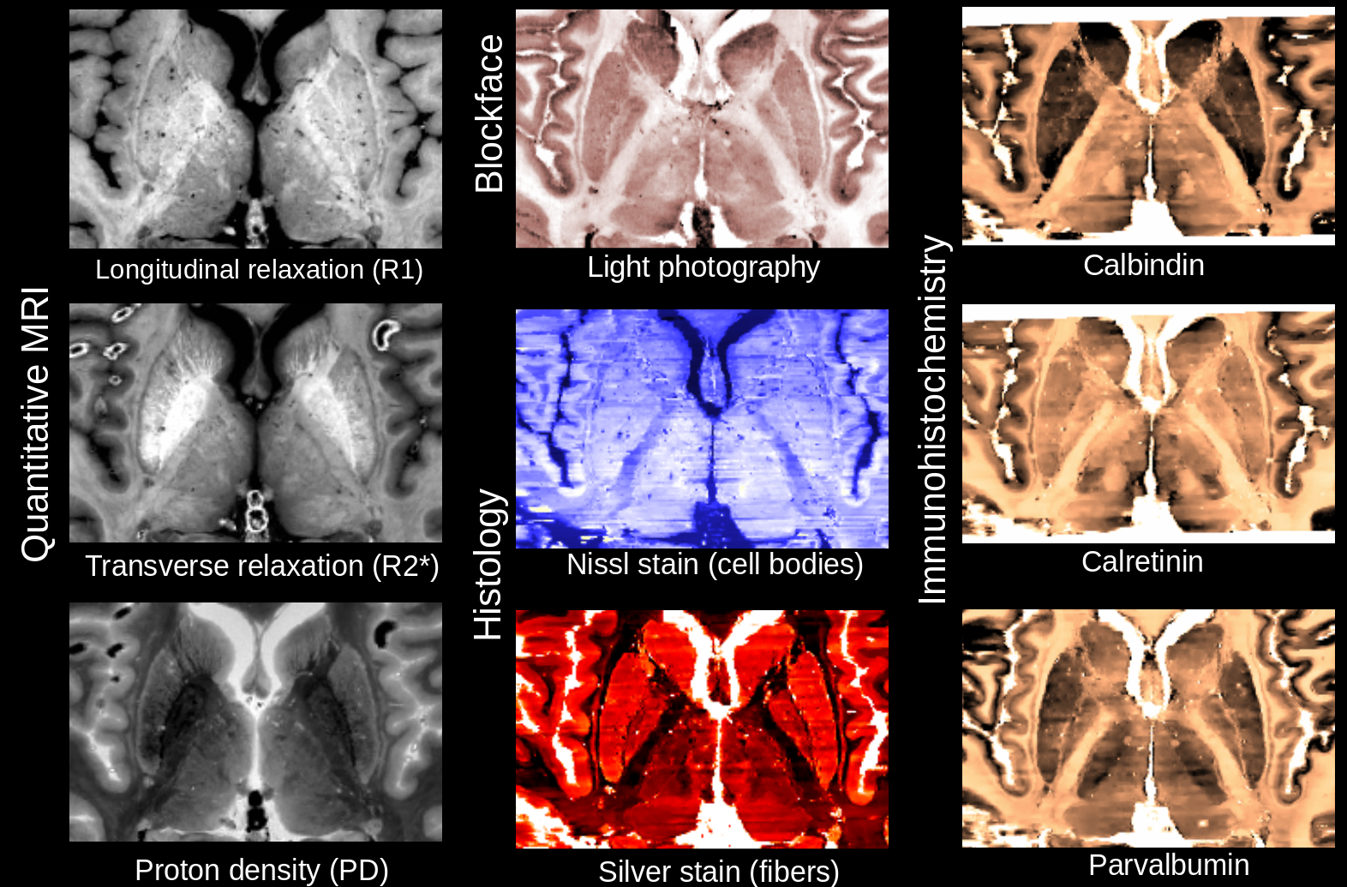
Exploring the AHEAD brains
together
Pilou Bazin
( : piloubazin)
2 brains
9 contrasts
parcellations
200+GB data
Visualization?
Delineations?
Collaborations?
[Alkemade, Bazin et al., 2022]

