Slide 1
(recent developments in)
Flavour Physics
Wouter Hulsbergen (Nikhef)
Slides prepared for the BND school 2023

Slide 2

Preliminary remarks
lectures aimed at non-experts!
“undemocratic” presentation
  experimental part focused on B-hadron physics
  missing a.o.: physics with kaons and D, electric-dipole moments, lepton-flavour violation, neutrinos, …
please interrupt!
  slides are more of ‘guideline’

Slide 3
Reference material
books
  Branco, Lavoura, Silva: “CP Violation”
  Bigi and Sanda: “CP Violation”
  …
lecture notes (from some of the greatest, certainly not a complete list)
  Y.Nir, “Flavour physics and CP Violation”, https://arxiv.org/abs/1605.00433
  R. Fleischer, “B Physics and CP Violation”, http://arxiv.org/abs/hep-ph/0210323v3
  A. Buras, “Flavour dynamics”, http://arxiv.org/abs/hep-ph/0101336v1
  A. Lenz, https://www.tp.nt.uni-siegen.de/~lenz/Lecture_Flav_2021pdf
  Y. Grossman and P. Tanedo: https://arxiv.org/abs/1711.03624
  N. Tuning, “CP Violation”, http://www.nikhef.nl/~h71/Lectures/2020/ppII-cpviolation-14022020.pdf

Slide 4
Course organization
4 lectures of 90 minutes
  ~60 minutes oral lecture 😅
  ~30 minutes exercises https://github.com/wouterhuls/FlavourPhysicsBND2023/
for the exercises need
  laptop, pen and paper
  access to Jupyter (your own installation, or Google Colab, SWAN, …)
ack’s: heavily borrowed from slides by Niels Tuning and Marcel Merk

Slide 5
Flavour physics lectures (4x45 minutes)
Flavour in the Standard Model
Neutral meson mixing
CP violation + experiments
Rare decays + recent developments
Let’s start with a few ‘Existential Questions” …

Slide 6
Existential questions
universe’s basic building blocks: electron, proton, neutron and neutrino
consider their masses
  neutrino: < 1 eV
  electron: 0.5 MeV
  proton: 938.27 MeV
  neutron: 939.57 MeV
why is the proton lighter than the neutron?
what if it would be heavier?
what if the electron were 4x heavier?

Slide 7
Existential questions
universe’s basic building blocks: electron, up-quark, down-quark and neutrino
consider their masses
  neutrino: < 1 eV
  electron: 0.5 MeV
  up-quark: 2.2 MeV*
  down-quark: 4.7 MeV*
why is the up-quark lighter than the down-quark?
what if it would be heavier?
what if the electron were 4x heavier?
See R.Cahn, The eighteen arbitrary parameters of the standard model in your everyday life Rev. Mod. Phys., Vol. 68, No. 3, (1996)

Slide 8
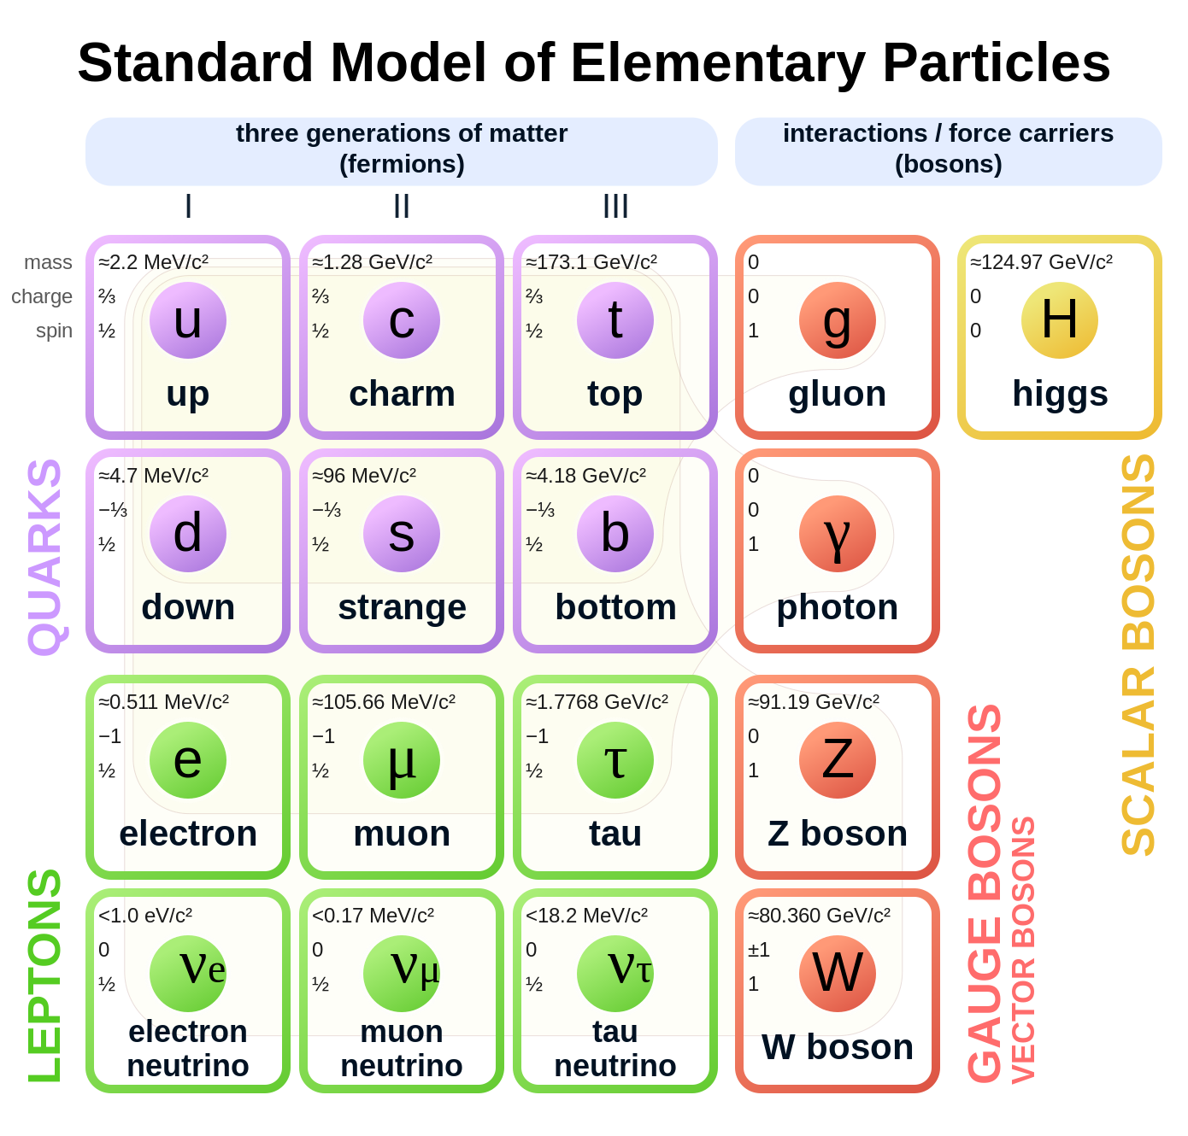
Existential questions
why are there three families? (Rabi, 1936: “who ordered that?”)
why are the mass-scales so different?
Notes:
if the electron would be the mass of the muon, electron capture would make hydrogen atom unstable
coupling constants are ‘running’ and affected by particle loops. if alpha_s were a fundamental quantity fixed at high energy,
then if the top quark were 10x lighter, the strong coupling constant would be different, and the proton 30% lighter.
so the masses of the other families also really matter.

Slide 9
Existential questions
weak interaction
quark mixing matrix
weak interaction
lepton mixing matrix
why is the CKM matrix almost diagonal?
  is there a relation between the mass hierarchy and the weak mixing?
why is mixing in the lepton sector so different?
  do neutrino masses have another source?

Slide 10
Existential questions
why do we live in a matter dominated universe?
observation:
SM prediction:
Notes:
we believe that ultimately these questions are all related

Slide 11
The Anthropic Principle?
“What we observe is biased by our own existence.” (Brandon Carter, ‘73)
for the science, see e.g. (reference only, I didn’t read them yet!)
  “The Anthropic Landscape of String Theory”, L. Susskind (2003)
  “The Emperor's Last Clothes?”, B. Schellekens (2008)

Slide 12
Explaining flavour?
may never be able to ‘understand’ the 25+ parameters of the SM
  understanding ‘why’ may be a matter of showing that from all the 10^500 string vacua ours is not an unlikely one
still want to understand the dynamic principles of our universe
  SM is not complete
    what is dark matter, energy, quantized gravity?
    what mechanism lead to a matter dominated universe?
  it is believed that electroweak symmetry breaking and flavour physics plays central role in some of these questions
so … let’s embark on a tour of “flavour physics”!

Slide 13

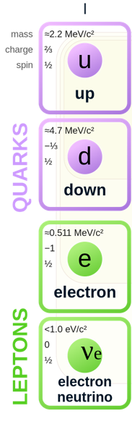
An AI view
“journey through land of flavour physics”
new gauge sectors with
hidden valley?
4th and 5th family?
a can of ‘milk’?

Slide 14
Flavour and the weak interaction
EM and strong interaction ‘conserve flavour’
only weak interaction allows for flavour-changing transitions
‘flavour physics’ is physics of the weak interaction and electro-weak symmetry breaking

Slide 15
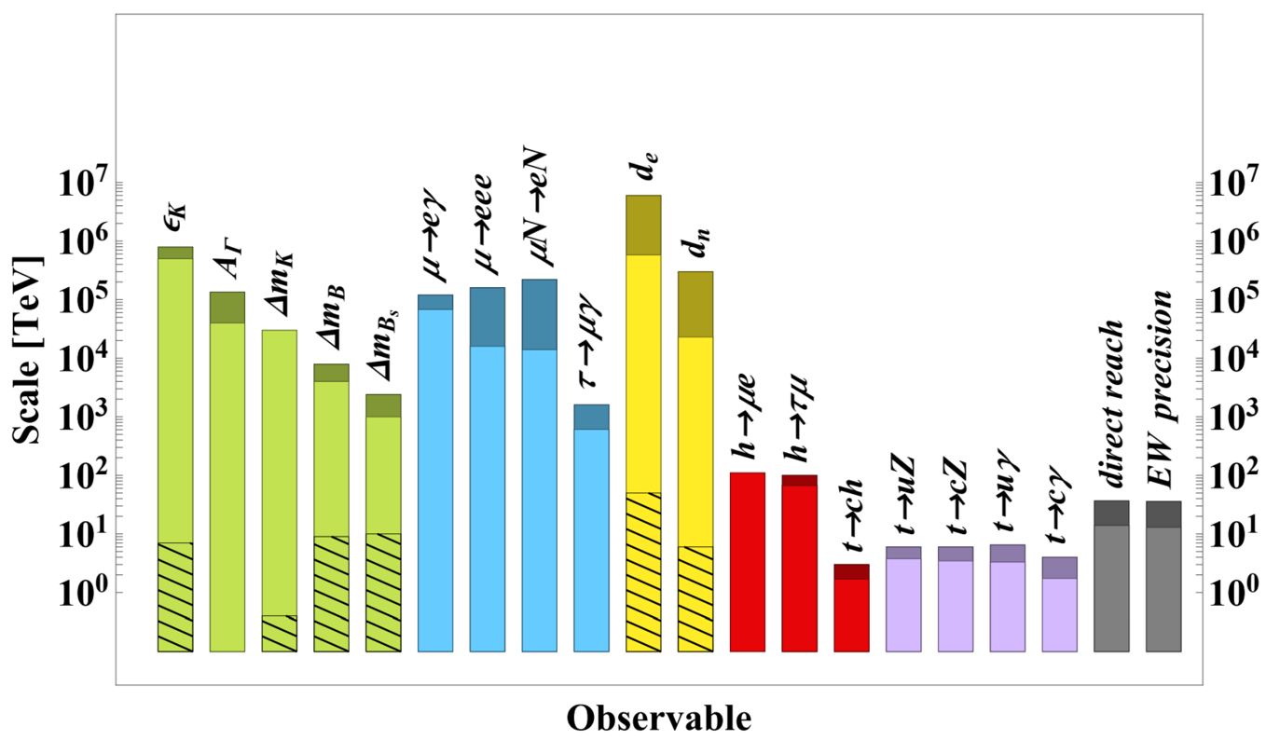
Why flavour physics?
flavour observables are very sensitive to new physics at higher mass scales
this holds in particular for ‘mixing’, ‘CP violation’ and ‘rare decays’
arXiv:1910.11775
LHC

Slide 16
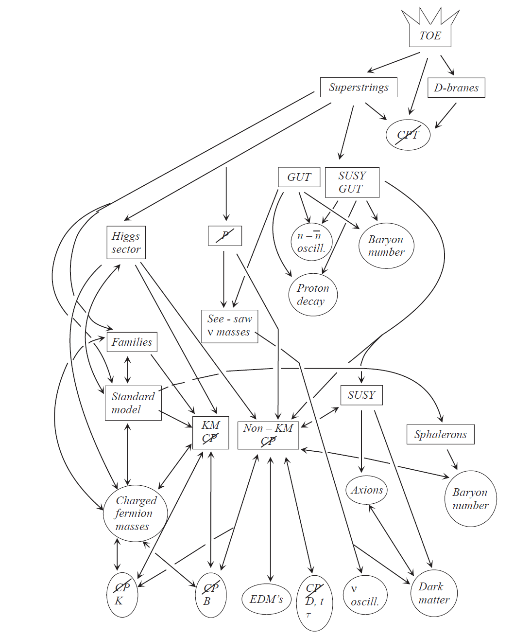
Flavour physics: It’s place in the theory landscape
These lectures
(slide: N. Tuning)

Slide 17
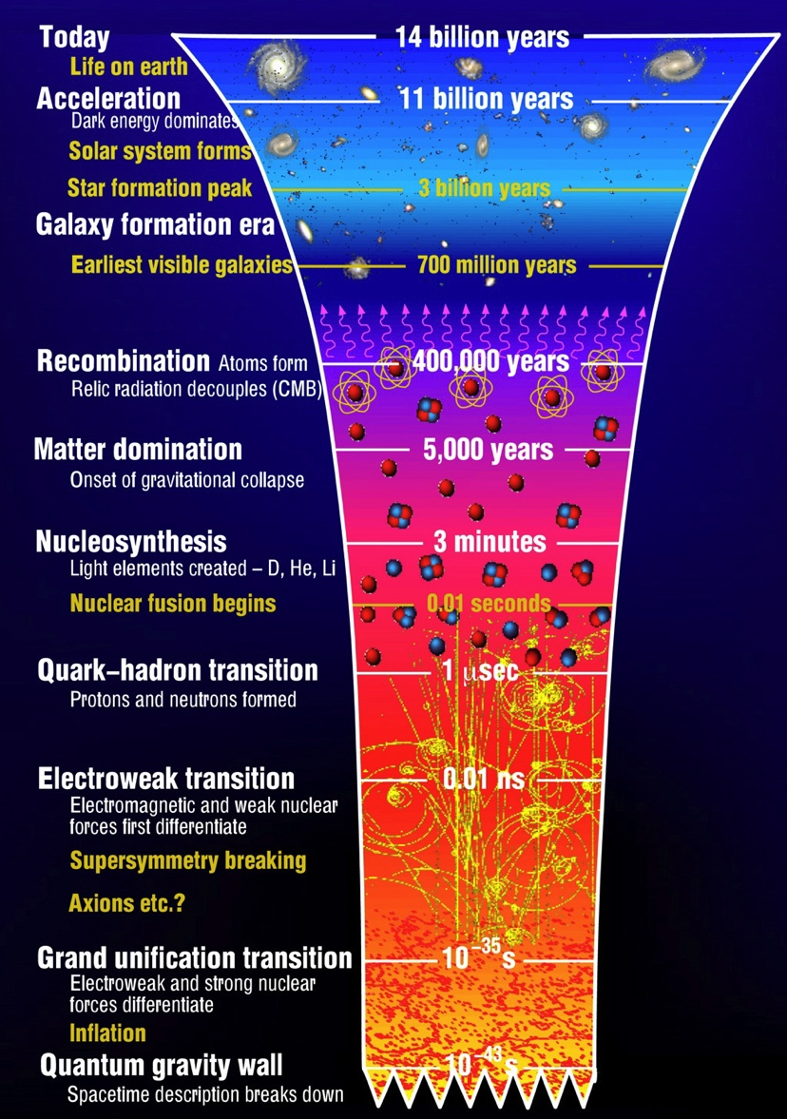
Flavour physics: It’s place in the history of the universe

Slide 18
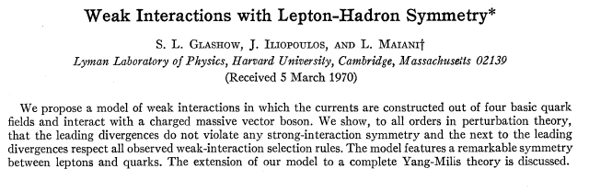
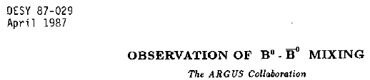


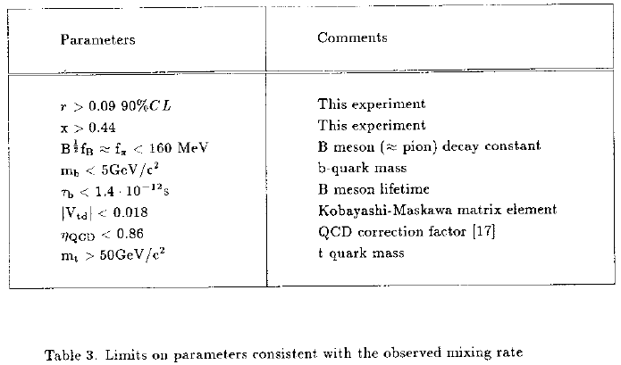
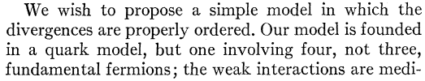
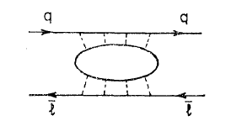

Flavour physics: a tool for discovery
GIM mechanism in K⁰→μμ
CP violation, K_{L}⁰→ππ
$B^{0}↔ \overline{B^{0}}$ mixing
Rare decay implies 2nd up quark
“discovery” of charm?
CP violation implies 3rd family:
“discovery” of bottom?
Mixing implies heavy quark:
“discovery” of top?
Glashow, Iliopoulos, Maiani,
Phys.Rev. D2 (1970) 1285
Christenson, Cronin, Fitch, Turlay,
Phys.Rev.Lett. 13 (1964) 138-140
ARGUS Coll.
Phys.Lett.B192:245,1987
(courtesy: N. Tuning)

Slide 19
Is flavour physics `complicated’?
less-intuitive concepts: imaginary phases, different bases, oscillations
difficult computations
  lot’s of Feynman diagrams
  bound states, non-perturbative QCD, approximate symmetries
very extensive phenomenology
  e.g. PDG full of decay modes (“Beetokaipaigamma…”)
  need to develop some intuition for what is interesting
-> aim: make you understand a little more on your next HEP conference!

Slide 20
discrete symmetries

Slide 21
Symmetries
Nobel Laureate T.D. Lee:
symmetry
unobservable
conserved quantity

Slide 22
Symmetries
symmetry
example of unobservable
A. permutation symmetries
continuous space time symmetries
discrete symmetries (C,P,T)
internal (or ‘unitary’) symmetries
absolute identity of particle
absolute position, orientation, time
handedness, direction of time,
definition of sign of charge
phase of a wave function
Emmy Noether: continuous symmetry (case B,D) → conservation law
Notes:
why are all electrons the same?

Slide 23
Discrete symmetries
suppose we watch some physical process.
can we determine unambiguously whether or not …
  we are watching the process where all charges are reversed ?
  we are watching the process through a mirror?
  we are watching the process in a film running backwards?
C: charge conjugation
P: parity transformation
T: time reversal
+
−

Slide 24
Discrete symmetries
classical theories invariant under C, P, T operations
  Newton mechanics, Maxwell electrodynamics, QM
  it is said these “conserve C, P, T symmetry”
CPT theorem:
“Lorentz invariant local quantum field theory
with a Hermitian Hamiltonian must obey CPT symmetry”
Notes:
Macroscopic: human body, left handed molecules etc.
Second law of thermodynamics

Slide 25
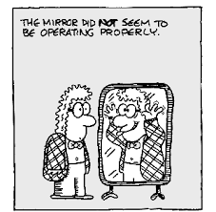
Parity transformation
parity transformation P: inversion of spatial coordinates
equivalent to: mirror transformation in one axis followed by 180-degree rotation
→ often depicted by ‘mirror’

Slide 26
Time evolution in Heisenberg picture
consider process:
time evolution:
time evolution operator

Slide 27
Time evolution of mirror process
now consider the process in the mirror:
process is ‘symmetric under P’ if applying parity transformation after time-evolution is leads to same result as applying it before
parity conservation:
P
time

Slide 28
parity quantum number
operator commuted with H → conserved quantum number
P and H have common set of eigenvectors
with definite value for quantum number ‘parity’
applying parity twice brings us back where we were:
eigenvalues are +1 and -1
parity even
parity odd
caveat: could add arbitrary phase factor

Slide 29
Is ‘parity’ a good quantum number?
general assumption until 1956: “laws of physics symmetric under parity”
in math:
well tested for electromagnetic and strong interaction (and gravity)
elementary particles must have ‘definite parity’
but do they?

Slide 30
The theta-tau puzzle
around 1950, observation of two weakly decaying states with different parity:
pion has odd parity →
theta has even parity
tau has odd parity
big puzzle: why do tau and theta have same mass and lifetime?
Lee & Yang in 1956:
simplest explanation: this is one and the same particle,
but weak interaction violates parity symmetry
quick experimental confirmation (Wu, Ledermann, …)

Slide 31
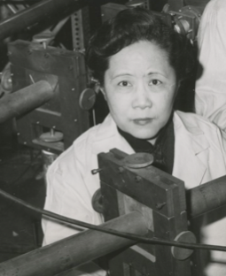
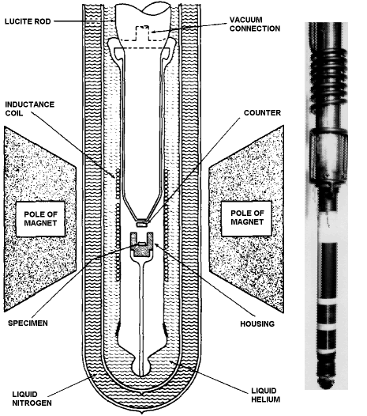
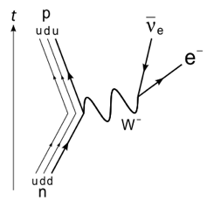
Wu experiment
Wu, 1956:
⁶⁰Co source in strong magnetic field
at very low temperatures, spins of Co atoms aligned with B-field
Wu found that electrons are preferentially emitted up or down, depending on direction of B-field

Slide 32
C and P symmetry in the weak interaction
10
weak interaction breaks C and P symmetry maximally
  W couples to left-handed particles and right-handed anti-particles
how about combined CP symmetry?
C
e⁺_{R}
e⁻_{R}
W⁺
W⁻
ν_{L}
ν_{L}
e⁺_{L}
e⁻_{L}
P
W⁺
W⁻
ν_{R}
ν_{R}

Slide 33
CP symmetry
“CP symmetry” for fundamental processes:
In 1964, Christenson, Cronin, Fitch and Turlay observed CP violation (CPV) in decays of neutral kaons
  can only properly explain their measurement tomorrow
important for our story
  CP violation is essential ingredient to understanding matter-anti-matter asymmetry in universe (“Sacharov Conditions”)
  in the SM it originates from non-trivial phases in Higgs Yukawa couplings

Slide 34
parity transformations of Dirac waves
now consider Dirac equation:
story is a bit more complicated, but one solution is:
Pauli-Dirac representation
with
consequence: in Pauli-Dirac representation
particles have even parity and anti-particles have odd parity

Slide 35
charge conjugation
C: given a process, replace every particle by its anti-particle and vice versa
defined at level of Dirac spinors, e.g. in Pauli-Dirac representation
constructed such that Cψ obeys the Dirac equation
only particles that are their own anti-particle have ‘definite C’ quantum number

Slide 36
C and P quantum numbers in the PDG
https://pdglive.lbl.gov
rotation symmetry
discrete symmetries
(without H_{weak})
SU(2) u <--> d symmetries
(without H_{EM} and H_{weak})

Slide 37
Discrete symmetry summary
discrete symmetries: C, P, T
CPT theorem: every reasonable theory obeys CPT symmetry
strong and EW interaction are C, P and T symmetric
weak interaction
  maximally violated P and C symmetry
  violates CP symmetry a little bit
matter and anti-matter differ at the fundamental level

Slide 38
(spatial) vectors and pseudo-vectors
vector: changes ‘direction’ under parity operation
  position
  velocity, momentum
  E-field
pseudo-vector: does not change direction under parity
  any ‘cross-product’ of vectors
  angular momentum
  B-field

Slide 39
spins in ⁶⁰Co decay process:
Parity
so … if direction of electron depends on direction of field,
then … weak interaction violates parity!

Slide 40
Flavour in the standard model

Slide 41
Building the Standard Model
ingredients to build renormalizable model
  choose gauge symmetries
  choose representation of matter fields under symmetries
  choose pattern of symmetry breaking
  add any other term that is renormalizable and does not break gauge invariance
will introduce these concepts on next slides, though not exactly in this order

Slide 42
Step 1: massless fermion matter fields
Dirac Lagrangian for set of massless fields
sum includes
  up quarks, down quarks, charged leptons, neutrinos
  3 generations (or ‘families’)
  3 versions of each quark (colour)
  independent left and right components for each field (“chiral theory”)

Slide 43
Step 2: introduce gauge symmetry
make doublets of the left-handed u/d fields
choose the gauge symmetry
choose the representation

Slide 44
gauge transformations
gauge transformation of Dirac fields
“U(1) hypercharge”
“SU(2) weak iso-spin”
“SU(3) color”
principle of local gauge invariance:

Slide 45
add covariant derivatives → gauge interactions
introduce the covariant derivative (local gauge invariance)
G,W,B: gauge (vector) fields
L,T,B: symmetry group generators
g_{s}, g, g’: universal coupling constants
identical for quark/leptons
(but some freedom in choosing Y)
identical for all generations:
flavour universality

Slide 46
add kinetic terms for gauge fields
add kinetic terms for gauge bosons to complete Lagrangian
free massless fermions
interaction terms
free massless gauge fields
up to this point fields are massless: mass terms break gauge invariance

Slide 47
mass terms?
Dirac mass terms are
break gauge symmetry because left- and right-handed components transform differently (‘chiral theory’)

Slide 48
Step 3: introduce symmetry breaking
add scalar complex doublet (4 real degrees-of-freedom)
representation under gauge group:
give it a Mexican-hat mass-term: this does not break symmetry
kinetic term
potential

Slide 49
Step 3: introduce symmetry breaking
choose parameters such that ground state has ‘broken symmetry’
μ² > 0
μ² < 0
symmetry broken by vacuum expectation value (“vev”)

Slide 50
Step 3: introduce symmetry breaking
from all possible ground states, choose one where $φ^{0}$ has v.e.v.
v: constant Higgs ‘vacuum expectation value’
h: dynamic real neutral scalar Higgs field
ξ: ‘eaten’ by SU(2) gauge bosons to give mass to W+, W- and Z

Slide 51
Step 4: add anything else allowed
add terms that
  do not break the gauge invariance
  are renormalizable
(this can be done before/after symmetry breaking: makes no difference)
two kinds
  “Higgs Yukawa interactions”
  “Majorana neutrino mass” (Weinberg operator; will skip this)

Slide 52
Adding Yukawa interactions
one example: for right-handed down quarks
needed to keep
Lagrangian hermitian
Yukawa coupling
(free complex parameter)
right-handed singlet
left-handed doublet
Higgs doublet
to make this work it is essential that Higgs doublet has Y = Y_{L} – Y_{R} = +1

Slide 53
Adding Yukawa interactions
all Yukawa terms (in compact form)
constraints from gauge symmetry:
  terms that ‘mix’ leptons and quarks break U(1)_{Y}
  terms that ‘mix’ families are fine!
note: it is traditional to leave ν_{R} term away (but not well motivated anymore!)

Slide 54
Yukawa terms after symmetry breaking
mass term
(but not diagonal)
Hqq coupling
mass terms proportional to Yukawa couplings and vev:

Slide 55
Mass eigenstates
up to now Lagrangian written in terms of ‘interaction eigen states’
  (have not been very consistent with the ‘superscript I’)
if we scatter particles, compute things in terms of ‘mass eigenstates’
  natural basis in QFT perturbation theory
this means for us: diagonalize mass terms in Lagrangian

Slide 56
Diagonalizing mass matrices
mass matrices
diagonalizing mass matrix is same as diagonalizing Yukawa matrices:
Higgs-fermion interactions are diagonalized simultaneously
two important SM predictions:
  Higgs-fermion interaction strength is proportional to mass
  no mixing of fermions from Higgs-fermion coupling:
  no “Higgs-induced flavour changing neutral coupling (“FCNC”)

Slide 57

Higgs FCNC
“$\overline{φ}φ$h” terms couples mass eigenstates:
NO
YES
d
d
s
d
no “Higgs induced flavour changing neutral couplings” (at tree level)

Slide 58
From your linear algebra course
complex matrix M can be decomposed as
U_{L} , U_{R}: unitary matrices
D: diagonal matrix
decomposition is not unique
  by changing phases column/row of U: can choose D real and positive
  by re-arranging rows/columns of U: can choose order of diagonal elements

Slide 59
Diagonalizing mass matrix
mass matrix:
diagonal, real, positive
mass term in Lagrangian:
with “mass basis”:

Slide 60

How does this affect weak couplings?
$$I$$
charged current
neutral current
neutral weak current, and strong, and hypercharge:
basis transformation has no effect!
weak current: ‘u-d’ mix affected by basis transformation

Slide 61

The $W^{+}$interaction term
insert mass basis
combine U_R and U_L
in last step defined ”CKM matrix”
unitary!

Slide 62

The $W^{−}$interaction term
playing the same game for W- vertex:
note Hermitian conjugate (important when we start to compute things)

Slide 63
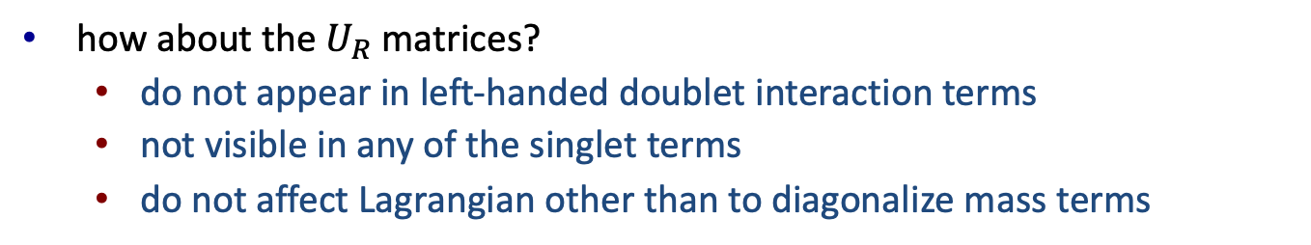
Other effects of basis transformation?
strong interaction, hypercharges, neutral W?
  these are all of the form
  no mix of up-down fields → not affected
how about the $U_{R}$matrices?
  do not appear in left-handed doublet interaction terms
  not visible in any of the singlet terms
  do not affect Lagrangian other than to diagonalize mass terms

Slide 64



Summary of flavour in the SM
start from Lagrangian with flavour universal and diagonal interactions
$𝓛_{W}= \frac{g}{\sqrt{2}}{u′}_{L} γ_{μ} W^{μ} {d′}_{L}$
add Higgs interaction that are not flavour universal (because we can
$𝓛_{H}$ $=Y_{ij}^{d}{ \left(\overline{u_{i}^{′}},\overline{d_{i}^{′}}\right)}_{L} \left({0 \atop v}\right){ d}_{jR}^{′} +Y_{ij}^{u} {\left(\overline{u_{i}^{′}}, \overline{d_{i}^{′}}\right)}_{L} \left({v \atop 0}\right) { u}_{jR}^{′}$
diagonalize the mass matrix (because we measure mass eigenstates)
$u_{i}={\left(V^{u}\right)}_{ij} u_{j}^{′}$
$d_{i}={\left(V^{d}\right)}_{ij} d_{j}^{′}$
result: W interaction mixes families

Slide 65
Unitary?
important assumption in this step:
flavour universality: all SU(2) quark multiplets must have same coupling g
if not, then V is not a unitary matrix:

Slide 66

”Down-quark rotation”
it is customary to represent basis transformation as rotation of down quark states
down quark states interacting with up quark mass eigenstates
down quark mass eigenstates
contrary to what you find in some texts, states on left are NOT interaction eigenstates: they are states interacting with up-quark mass eigenstates

Slide 67
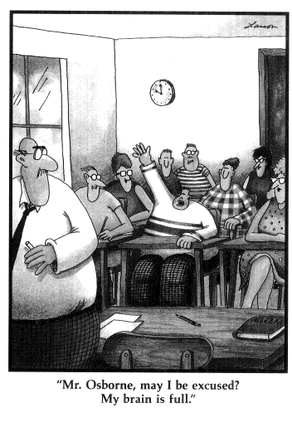

Slide 68
“Cabibbo-Kobayashi-Maskawa matrix”
1963
1973
Glashow, Illiapolous and Maiani

Slide 69
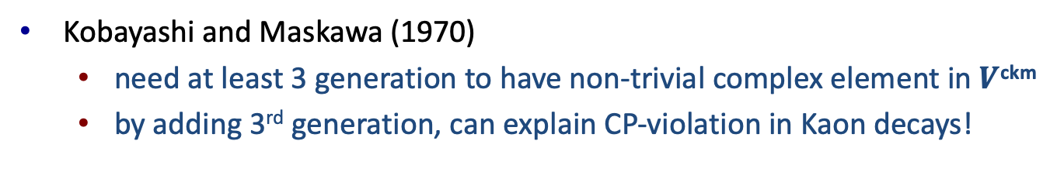
CP violation
$W^{+}$and $W^{−}$ terms represent CP-conjugate processes
CP
if $V_{ud}$is not real, then corresponding amplitudes have different coupling
Kobayashi and Maskawa (1970)
  need at least 3 generation to have non-trivial complex element in $V$^{ckm}
  by adding 3rd generation, can explain CP-violation in Kaon decays!

Slide 70
Flavour changing interactions
charged weak interactions leads to flavour transition through CKM matrix
we `measure’ CKM matrix by studying these interactions

Slide 71

Example: extracting Vus
Feynman diagram
measure branching fraction
compare to prediction to extract V_{us}
$$V_{us}^{∗}$$
main difficulty: quarks only appear in bound states!
→ theoretical developments in quark flavour physics are mostly about dealing with ‘hadronic effects’

Slide 72
The ‘Flavour Puzzle’
unexplained structure: CKM matrix is almost diagonal
remember: quark order is choice → ordered quarks by mass
are mass hierarchy and CKM hierarchy related?

Slide 73
CKM matrix parametrization
CKM matrix is 3x3 unitary matrix
how many physical parameters?
  generic unitary 3x3 matrix: 9 real parameters
  relative phase between quark fields unphysical: 4 parameters left
  usually parametrized with 3 angles and 1 complex phase
Kobayashi-Maskawa phase δ is (the) source of CPV in quark sector of SM

Slide 74
CKM matrix parameters
current values of parameters (actually 2015)
note:
  mixing angles are small
  complex phase is large

Slide 75
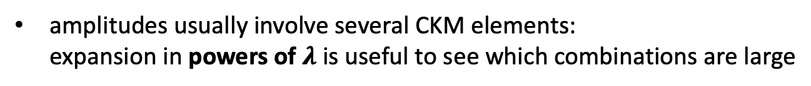
Wolfenstein parametrization
observed structure exploited by “Wolfenstein parametrization”
amplitudes usually involve several CKM elements:
expansion in powers of $λ$is useful to see which combinations are large

Slide 76
Unitary triangles
CKM matrix is unitary: leads to 6 ‘orthogonality relations’, e.g.
zero sum of three numbers represented by triangle in complex plane:
V_{cd} V_{cs}*
V_{td} V_{ts}*
homework exercise: surface
of all 6 unitary triangles is equal to Jarlskog invariant!
V_{ud} V_{us}*

Slide 77
The unitary triangle
only one of the 6 triangles has all sides of about equal sides:

Slide 78
The unitary triangle
it is customary to divide all sides by (-Vcd Vcb*):
apex of triangle corresponds
(almost) to Wolfenstein parameters
eta and rho

Slide 79
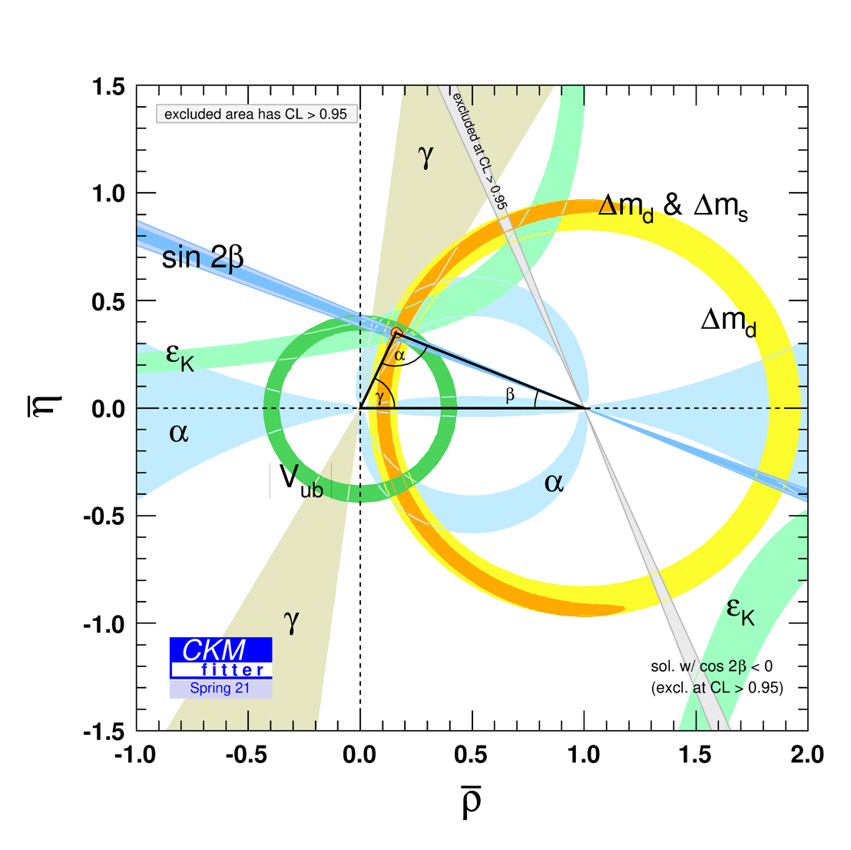
Testing the Standard Model
unitary triangle: visualize consistency of SM

Slide 80
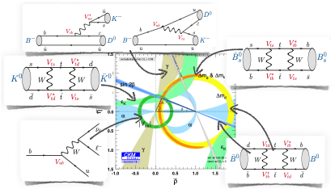
(from J. Zupan, 2019)

Slide 81
CP violation
simple relation between phases in Lagrangian and CP violation:
in the SM CP-violation in weak interaction, pre-dominantly between first and 3rd generation:
CP violating effects are small
because lambda is small

Slide 82
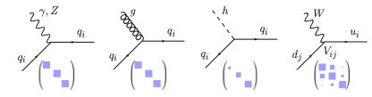
Summary of quark flavour in the SM
(J. Zupan, 2019)
long-lived particles
mixing
CP violation
…

Slide 83
How about leptons?
Yukawa term for leptons looks the same as for quarks:
after symmetry breaking, perform similar basis transformation, but …
customary: make different choice than for quarks
  (most) scattering experiments do not measure neutrino type
  choose charged-lepton mass matrix diagonal
  choose charged weak interaction diagonal
  → neutrino-mass matrix not diagonal

Slide 84
Choice of basis for lepton fields
quark basis choice
lepton basis choice
not diagonal
diagonal
diagonal
diagonal
diagonal
not diagonal
note: there is no physics in the choice of basis

Slide 85

The PNMS matrix
Pontecorvo-Maki-Nakagawa-Sakata matrix
states interacting
with charged lepton
mass eigenstates
mass eigenstates
completely different hierarchy from quark mixing matrix

Slide 86
Counting parameters in the SM
3 interaction coupling constants
1 Higgs vev
1 Higgs mass
10 quark yukawa couplings
6 quark masses
4 CKM matrix parameters
10 lepton yukawa couplings
3 charged lepton masses
3 neutrino masses
4 PNMS matrix parameters
18
7

Slide 87
Sakharov conditions (1967)
to create “net matter excess” need
  baryon number violating processes
  such that n(baryon) – n(anti-baryon) not constant
  C and CP violating processes
  because of CP is conserved then for the process in 1 the CP-conjugated process has the same rate
  non-thermal equilibrium
  because otherwise the reaction in 1 will be balanced by inverse reaction

Slide 88

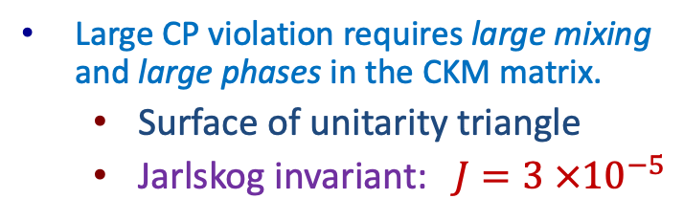

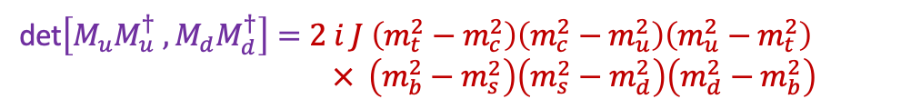
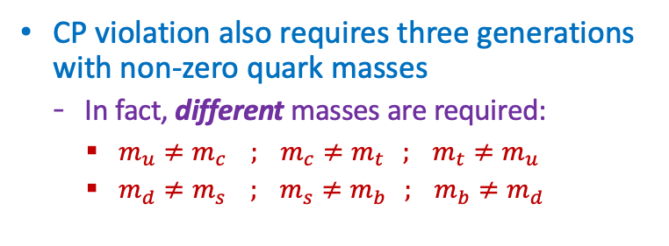
How large is CP violation?
27
Large CP violation requires large mixing and large phases in the CKM matrix.
  Surface of unitarity triangle
  Jarlskog invariant: $J=3 ×{10}^{−5}$
CP violation also requires three generations with non-zero quark masses
  In fact, different masses are required:
    $m_{u}≠m_{c} ; m_{c}≠m_{t} ; m_{t}≠m_{u}$
    $m_{d}≠m_{s} ; m_{s}≠m_{b} ; m_{b}≠m_{d}$
Jarlskog criterion (1987) for amount of CP violation:
det$\left[M_{u}M_{u}^{†} , M_{d}M_{d}^{†}\right]=2 i J \left(m_{t}^{2}−m_{c}^{2}\right)\left(m_{c}^{2}−m_{u}^{2}\right)\left(m_{u}^{2}−m_{t}^{2}\right)$
$× \left(m_{b}^{2}−m_{s}^{2}\right)\left(m_{s}^{2}−m_{d}^{2}\right)\left(m_{d}^{2}−m_{b}^{2}\right)$
$$M_{ij} =Y_{ij} v/\sqrt{2}$$

Slide 89
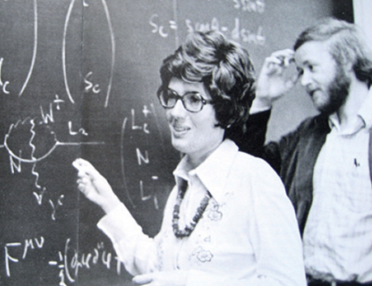
Jarlskog invariant
amount of CP violation can be represented by “Jarlskog Invariant”
no index summation
in standard parametrization:
~ 0.00003

Slide 90
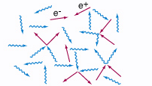
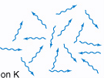
1,000,000,001
1
particles
universe cools down
1,000,000,000
anti-particles

Slide 91
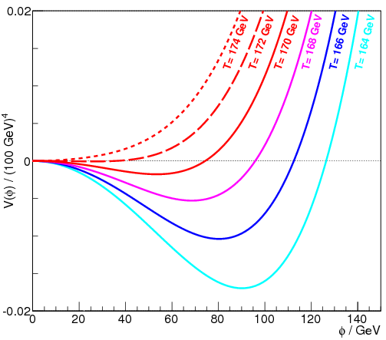
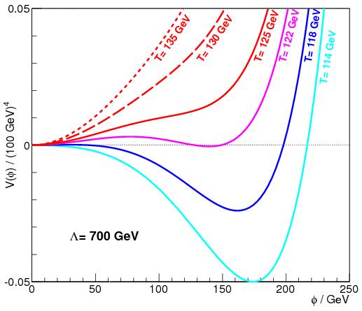
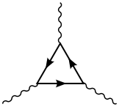
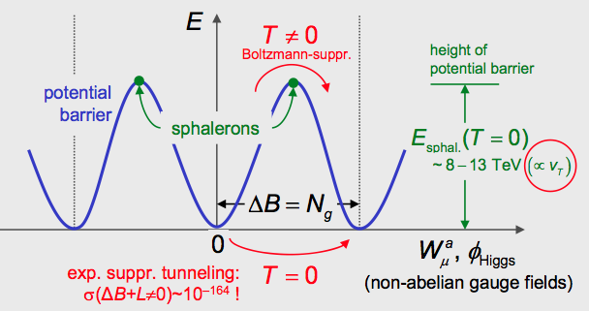
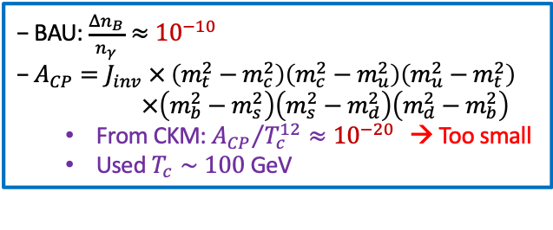
Baryogenesis Puzzle – Electroweak Baryogenesis?
30
Sacharov Conditions
  All present in S.M.
  Not Enough?
✔ Baryon Number Violation
✖ C and CP Violation
✔ Thermal non-equilibrium
✖
1st order
Adler-Bell-
Jackiw
‘t Hooft, PRL
37 (1976) 8
2nd order
SM
V
V
Axial Anomaly:
f
f
tunnel
f
Quantum anomaly
Weak Interaction
φ
Higgs Phase Transition
✔ Sphalerons
✖ 1st order?
• SM: M_{H} < ~70 GeV
• THDM: M_{H} ~ 125 OK
✖ CPV from CKM
  − BAU: $\frac{Δn_{B}}{n_{γ}}≈{10}^{−10}$
− $A_{CP}=J_{inv} × \left(m_{t}^{2}−m_{c}^{2}\right)\left(m_{c}^{2}−m_{u}^{2}\right)\left(m_{u}^{2}−m_{t}^{2}\right)$
$×\left(m_{b}^{2}−m_{s}^{2}\right)\left(m_{s}^{2}−m_{d}^{2}\right)\left(m_{d}^{2}−m_{b}^{2}\right)$
    From CKM: ${A_{CP}}/{T_{c}^{12}}≈{10}^{−20 }$ → Too small
    Used $T_{c}∼100$ GeV

Slide 92
Exercises
see README.md file at
now: exercises 1-4
this is probably too much for 30 minutes. proposal:
  make your pick
  at least try this simple workbook exercise: particledatatable.ipynb
  then I know if ‘technically’, we can run the more complicated workbooks as well
  https://github.com/wouterhuls/FlavourPhysicsBND2023/

