Slide 1

Quantum Cryptography
Christian Schaffner
Research Center for Quantum Software
Institute for Logic, Language and Computation (ILLC)
University of Amsterdam
Logic, Language and Computation
Monday, 24 September 2018

Slide 2
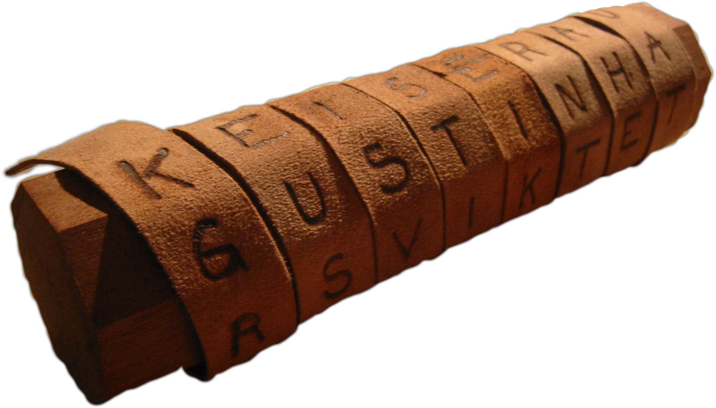
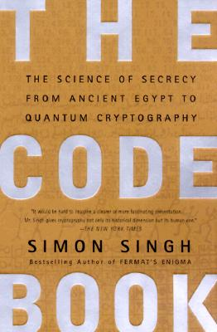
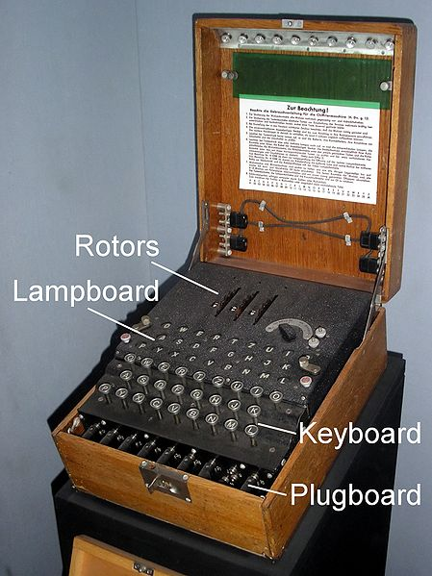
Classical Cryptography
3000 years of fascinating history
Until 1970: private communication was the only goal
Scytale
Enigma

Slide 3
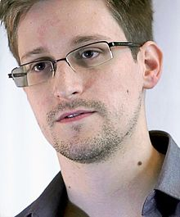
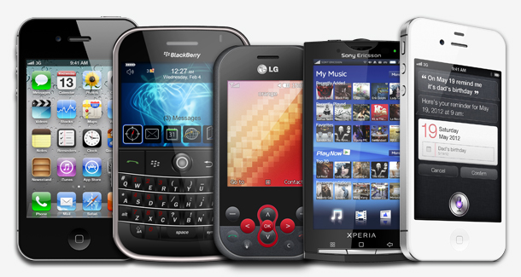
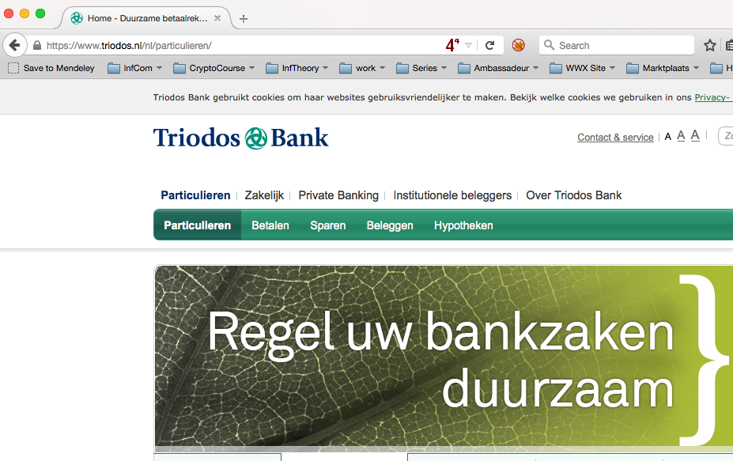
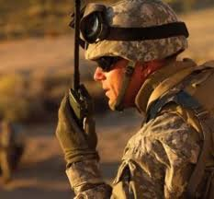
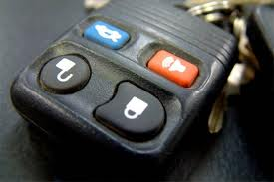
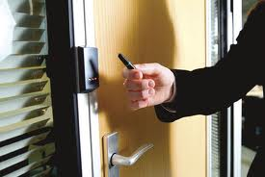
Modern Cryptography
Edward Snowden
is everywhere!
is concerned with all settings where people do not trust each other

Slide 4
What will you Learn from this Talk?
Classical Cryptography (& Politics)
Quantum Mechanics
Crypto Threat of Quantum Computing
Quantum Cryptography
Quantum Future

Slide 5
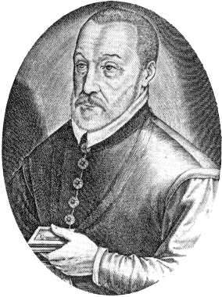
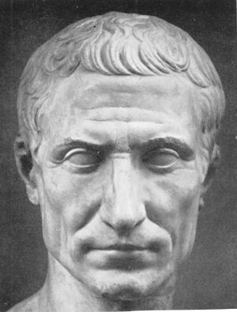

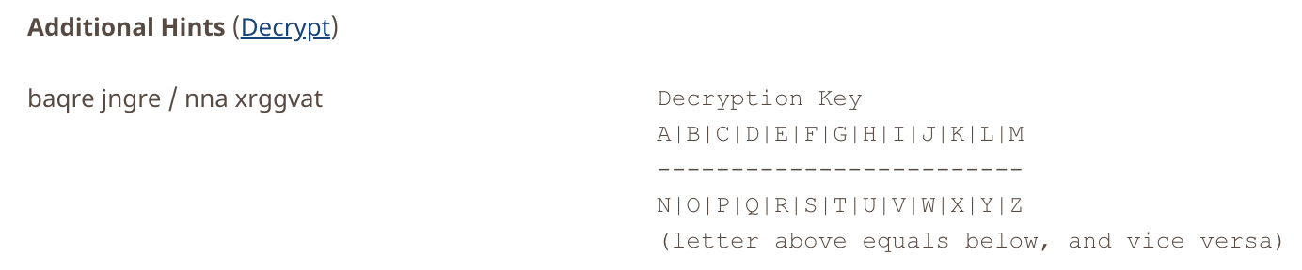
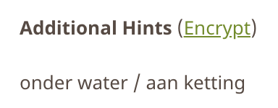
Ancient Cryptography
Blaise de Vigenère
Scytale
50 BC
1000 AD
2015 AD
500 BC
500 AD
1500 AD
Caesar Cipher (ROT4)
(variant still in use)

Slide 6
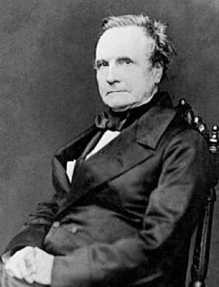
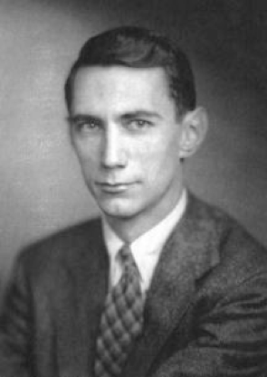
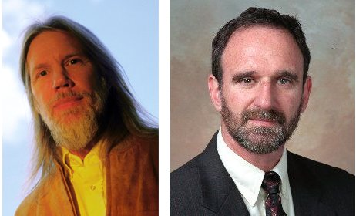
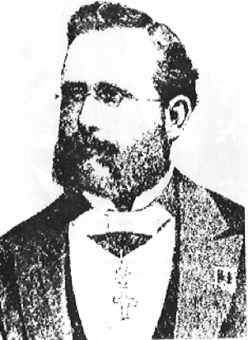
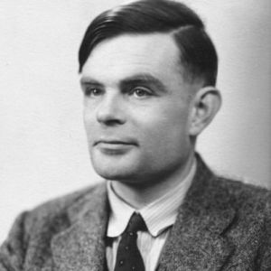

Ancient Cryptography
Charles Babbage
Claude Shannon
Diffie / Hellman
1850
1950
2015
1800
1900
1976
“a cryptographic system should be secure even if everything but the key is known to the adversary”
Enigma
Alan Turing
(The Imitation Game)
Auguste Kerckhoffs
Notes:
een systeem van versleuteling moet even veilig zijn, zelfs als alles behalve de sleutel over het systeem publiek bekend is

Slide 7
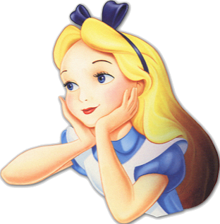

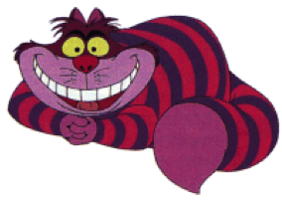
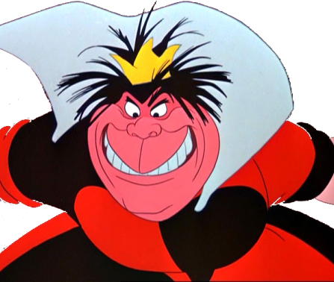
Secure Encryption
m = “I love you”
m = 0000 1111
Alice
Bob
k = ?
Eve
k = 0101 1011
k = 0101 1011
Goal: Eve does not learn the message
Setting: Alice and Bob share a secret key k

Slide 8
eXclusive OR (XOR) Function (exclusive disjunction)
x | y | x ⊕ y
0 | 0 | 0
1 | 0 | 1
0 | 1 | 1
1 | 1 | 0
Some properties:
  ∀ x : x ⊕ 0 = x
  ∀ x : x ⊕ x = 0
  ∀x,y : x ⊕ y ⊕ y = x
Notes:
quick check: please raise your hand if you have NOT seen this function before.
Please raise your hand if you HAVE seen this function before.
Now raise your hand if you have not raised your hand yet. For the people raising their hand now: you should seriously double-check the logic “axiom of the excluded middle”, asserting that either you HAVE seen this function before, or that you have NOT.

Slide 9
One-Time Pad Encryption
m = 0000 1111
c = m ⊕ k = 0101 0100
m = c ⊕ k = 0000 1111
Alice
Bob
k = ?
Eve
k = 0101 1011
k = 0101 1011
Goal: Eve does not learn the message
Setting: Alice and Bob share a key k
Recipe:
Is it secure?
x | y | x ⊕ y
0 | 0 | 0
0 | 1 | 1
1 | 0 | 1
1 | 1 | 0
m = 0000 1111
c = 0101 0100
k = 0101 1011
k = 0101 1011
c = m ⊕ k = 0101 0100
c ⊕ k = 0000 1111
c ⊕ k = m ⊕ k ⊕ k = m ⊕ 0 = m

Slide 10
Perfect Security
m = ?
c = m ⊕ k = 0101 0100
m = c ⊕ k = ?
Alice
Bob
k = ?
Eve
k = ?
k = ?
Given that c = 0101 0100,
  is it possible that m = 0000 0000 ?
    Yes, if k = 0101 0100.
  is it possible that m = 1111 1111 ?
    Yes, if k = 1010 1011.
  it is possible that m = 0101 0101 ?
    Yes, if k = 0000 0001
In fact, every m is possible.
Hence, the one-time pad is perfectly secure!
x | y | x ⊕ y
0 | 0 | 0
0 | 1 | 1
1 | 0 | 1
1 | 1 | 0

Slide 11
Problems With One-Time Pad
m = 0000 1111
c = m ⊕ k = 0101 0100
m = c ⊕ k = 0000 1111
Alice
Bob
k = ?
Eve
k = 0101 1011
k = 0101 1011
The key has to be as long as the message.
The key can only be used once.
Notes:
for encrypting internet traffic

Slide 12
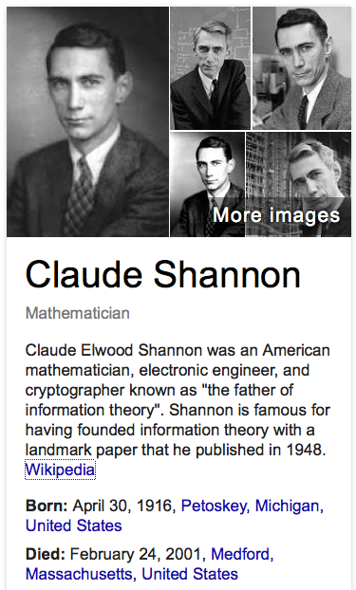
Information Theory
6 EC MoL course, given in 2nd block: Nov/Dec 2018
mandatory for Logic & Computation track
first lecture: Tuesday, 30 October 2017, 9:00
http://homepages.cwi.nl/~schaffne/courses/inftheory/2018/

Slide 13
Problems With One-Time Pad
m = 0000 1111
c = m ⊕ k = 0101 0100
m = c ⊕ k = 0000 1111
Alice
Bob
k = ?
Eve
k = 0101 1011
k = 0101 1011
The key has to be as long as the message.
The key can only be used once.
In practice, other encryption schemes (such as AES) are used which allow to encrypt long messages with short keys.
One-time pad does not provide authentication:
Eve can easily flip bits in the message
Notes:
for encrypting internet traffic

Slide 14
Symmetric-Key Cryptography
Alice
Bob
Eve
Encryption insures secrecy:
Eve does not learn the message, e.g. one-time pad
Authentication insures integrity:
Eve cannot alter the message
General problem: players have to exchange a key to start with

Slide 15
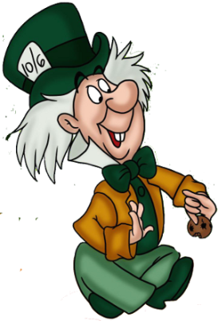
Public-Key Cryptography
Alice
Charlie
Bob
secret key
Eve
public key
Solves the key-exchange problem.
Everyone can encrypt using the public key.
Only the holder of the secret key can decrypt.
Digital signatures: Only secret-key holder can sign, but everyone can verify signatures using the public-key.

Slide 16
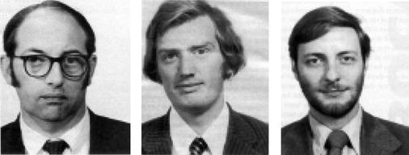


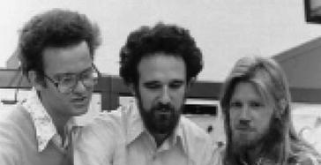
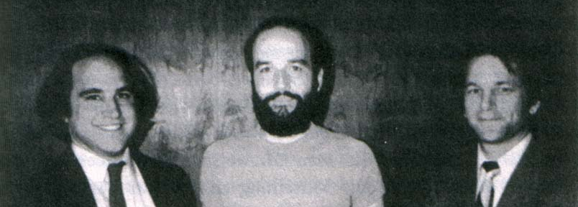
History of Public-Key Crypto
Early 1970s: invented in the „classified world“ at the
British Government Communications Head Quarters (GCHQ)
by Ellis, Cocks, Williamson
Mid/late 1970s: invented in the „academic world“
by Merkle, Hellman, Diffie, and Rivest, Shamir, Adleman (RSA)
Notes:
picture: http://link.springer.com/referenceworkentry/10.1007%2F978-1-4419-5906-5_210/fulltext.html#Fig2_210
James H. Ellis, Clifford C. Cocks, Malcolm J. Williamson (from left to right)
Ralph Merkle, Martin Hellman, Whitfield Diffie, (at Stanford)
and Ron Rivest, Adi Shamir, Leonard Adleman (at MIT)

Slide 17
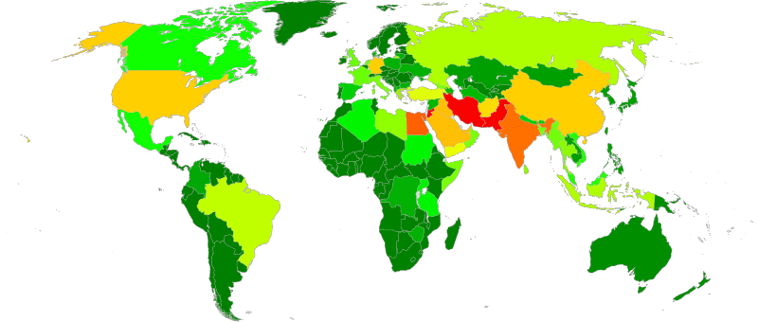
Politics of Cyberwar
Edward Snowden, former CIA and NSA employee,
now whistleblower and on (temporary) asylum in Russia
In 2013, he leaked many thousand top secret documents to various media, documenting
mass surveillance programs by secret services from all over the world
Notes:
heat map of where NSA data collection is performed. Screenshot of the https://en.wikipedia.org/wiki/Boundless_Informant big data analysis system

Slide 18
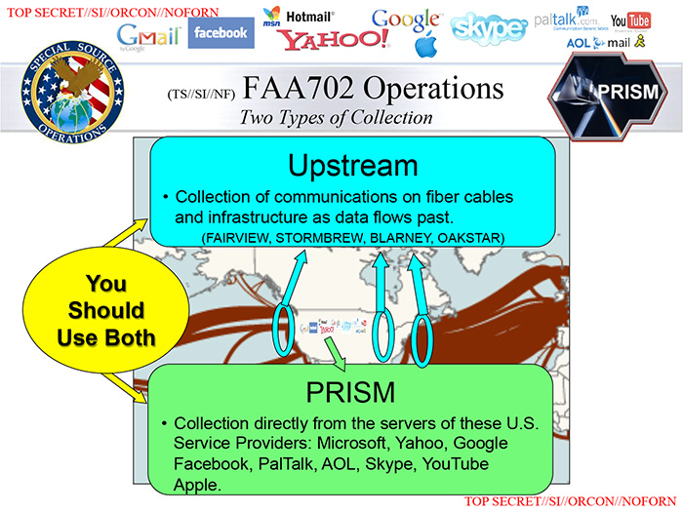
Politics of Cyberwar

Slide 19
Politics of Cyberwar
Methods:
  Break cryptography
  Influence industrial standards
  Pressure manufacturers to make insecure devices
  Infiltrate hardware and software (communication infrastructure, computers, smartphones etc.)
Why mass surveillance?
  Other than to combat terrorism, these surveillance programs have been employed to assess the foreign policy and economic stability of other countries, and to gather "commercial secrets“.

Slide 20
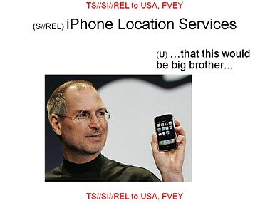
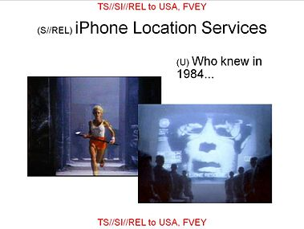
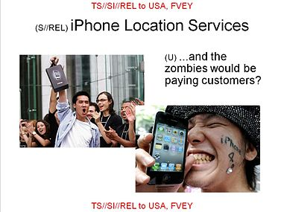

Why worry?
„I have nothing to hide“ is a very naive reaction.
Think about what your smartphone knows about you.
Think about what your smartphone does not know about you.
2014:
2016:
Notes:
when, where, with whom, how you look, websites visited, documents downloaded, pictures you posted

Slide 21
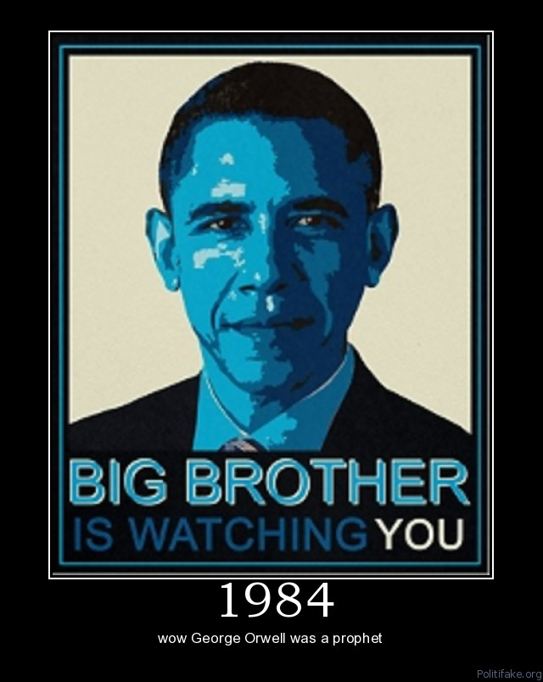
Why worry?
„I have nothing to hide“ is a very naive reaction.
Everyone‘s personal privacy is at stake!
George Orwell‘s surveillance state from his book 1984 is coming true...
"They (the NSA) can use the system to go back in time and scrutinize every decision you've ever made, every friend you've ever discussed something with, and attack you on that basis to sort of derive suspicion from an innocent life and paint anyone in the context of a wrongdoer." – Edward Snowden

Slide 22
Dutch Example: Dragnet Law
Law for the intelligence and security services
(Wet inlichten en veiligheidsdiensten, Wiv)
Accepted by parliament in 2017
Referendum initiated by (former) ILLC students
21 March 2018: (6.7 mio votes, participation 51%)
46.5% pro, 49.4% against, 4% empty
Cosmetic adjustments were done by parliament
Law is now in effect, allowing Dutch secret services to tap communication infrastructures of “bystanders”, store it for 3 years, share data with foreign services etc.
https://www.bitsoffreedom.nl/dossiers/sleepnet/
https://geensleep.net/

Slide 23
Cryptography and Logic
Crypto-Toolbox
electronic voting system
Encryption
Hash function
Signature
Key establishment
Cryptographic protocols for advanced tasks are built from basic building blocks
Problem: security proofs become very hard to verify
Solution:
  Logic provides formal methods to specify tools and task
  Use automatic proof checkers to verify security
Notes:
pictures from an overview presentation by Michael Backes: http://www.infsec.cs.uni-saarland.de/~backes/
http://www.zurich.ibm.com/security/publications/2004/BaPfWa2004aCryptoLibSlides.ppt

Slide 24
What will you Learn from this Talk?
Classical Cryptography (& Politics)
Introduction to Quantum Mechanics
Crypto Threat of Quantum Computing
Quantum Cryptography
Quantum Future

Slide 25

Quantum Bit: Polarization of a Photon
qubit as unit vector in $ℂ^{2}$

Slide 26
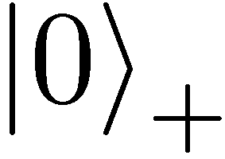
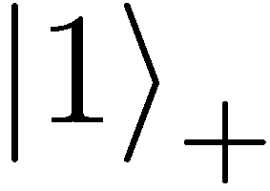
Qubit: Rectilinear/Computational Basis

Slide 27
Detecting a Qubit
No photons: 0
Alice
Bob

Slide 28
Measuring a Qubit
No photons: 0
Photons: 1
Alice
Bob
Measurement:
with prob. 1 yields 1
0/1

Slide 29
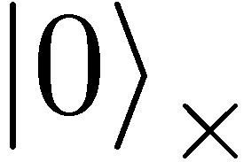
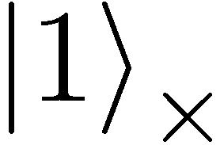

Diagonal/Hadamard Basis
Measurement:
with prob. ½ yields 0
=
with prob. ½ yields 1
0/1

Slide 30
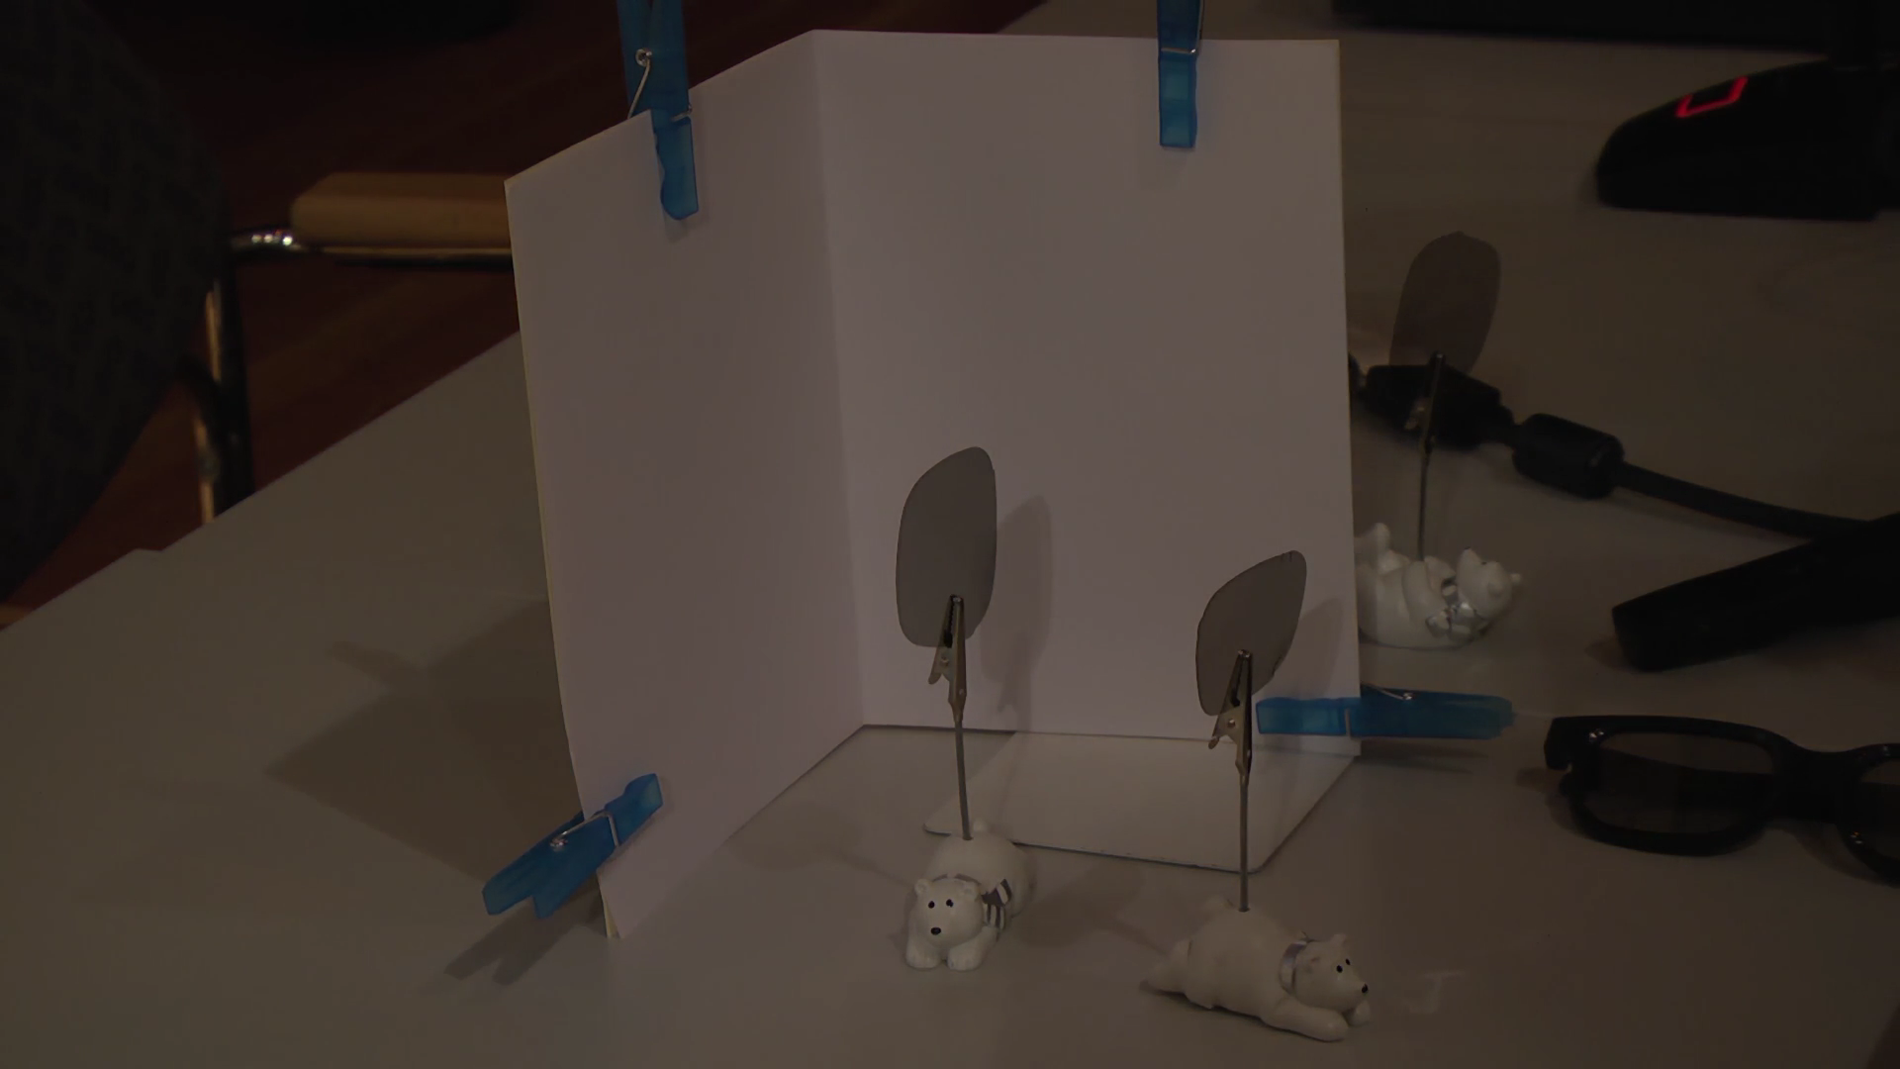
Video

Slide 31
Measuring Collapses the State
Measurement:
with prob. ½ yields 0
=
with prob. ½ yields 1
0/1

Slide 32
Measuring Collapses the State
=
=

Slide 33
Quantum Mechanics
+ basis
x basis
Measurements:
with prob. 1 yields 1
0/1
with prob. ½ yields 0
0/1
with prob. ½ yields 1

Slide 34
Demonstration of Quantum Technology
generation of random numbers
50%
50%
(diagram from idQuantique white paper)
no quantum computation, only quantum communication required

Slide 35
Quantum (Optics) Games
Single-player puzzle game: Laser Maze, beam bending logic game
Virtual game: http://quantumgame.io/

Slide 36
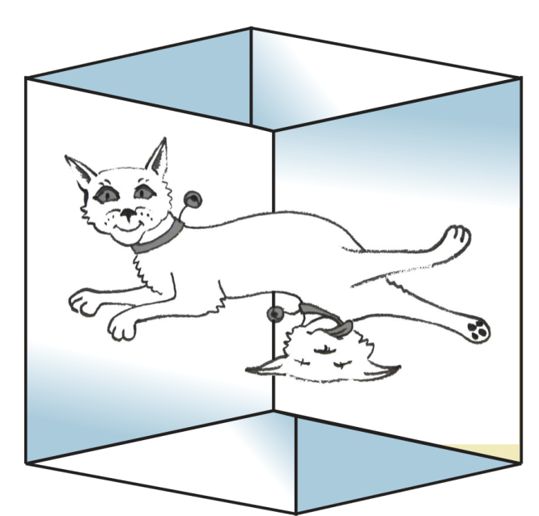

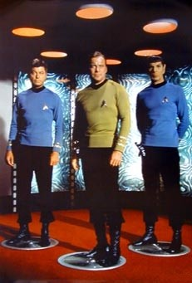
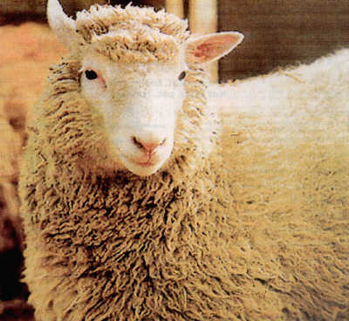
Wonderland of Quantum Mechanics

Slide 37
What will you Learn from this Talk?
Classical Cryptography (& Politics)
Introduction to Quantum Mechanics
Crypto Threat of Quantum Computing
Quantum Cryptography
Quantum Future

Slide 38
Quantum Computing
Classical bit: 0 or 1
Quantum bit: can be in
superposition of 0 and 1
Yields a (probably) more powerful computational model
=

Slide 39

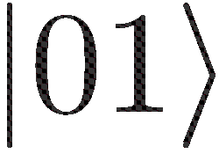
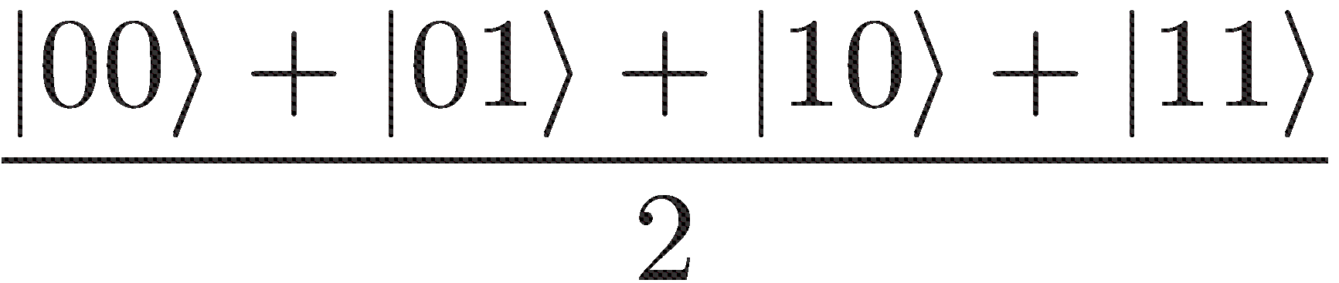
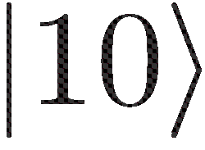
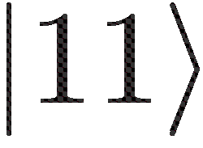
Many Qubits
=
1 qubit lives in a 2-dimensional space,
can be in a superposition of 2 states
2 qubits live in a 4-dimensional space,
can be in a superposition of 4 states
3 qubits can be in superposition of 8 states
n qubits can be in superposition of 2^{n} states
So, with 63 qubits, one can do
2⁶³ = 9223372036854775808 calculations simultaneously!
Problem: Measuring this huge superposition collapses everything and yields only one random outcome

Slide 40
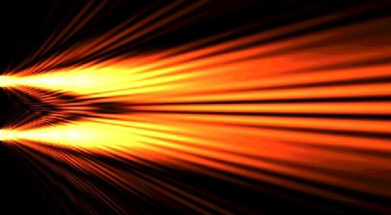
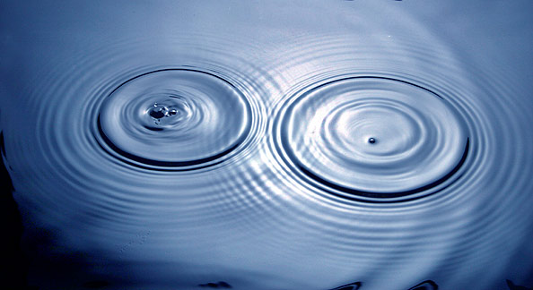
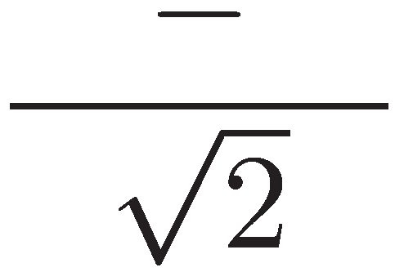
Quantum Computing
With n qubits, one can do 2^{n} calculations simultaneously
Problem: Measuring this huge superposition will collapse the state and only give one random outcome
Solution: Use quantum interference to measure the computation you are interested in!
=
Seems to work for specific problems only
Requires clever design of quantum algorithms and quantum software!

Slide 41
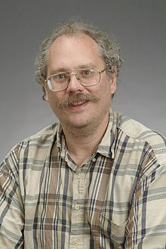
Quantum Algorithms: Factoring
[Shor ’94] Polynomial-time quantum algorithm for factoring integer numbers
15 = 3 * 5
27 = 3 * 3 * 3
31 = 1 * 31
57 = 3 * 19
91 = 7 * 13
173 = 1 * 173
RSA-100 = 1522605027922533360535618378132637429718068114961380688657908494580122963258952897654000350692006139 = 37975227936943673922808872755445627854565536638199 × 40094690950920881030683735292761468389214899724061
Notes:
RSA-100 tooke a few days to factor in 1991. It now takes about 1 hour on a standard laptop.

Slide 42
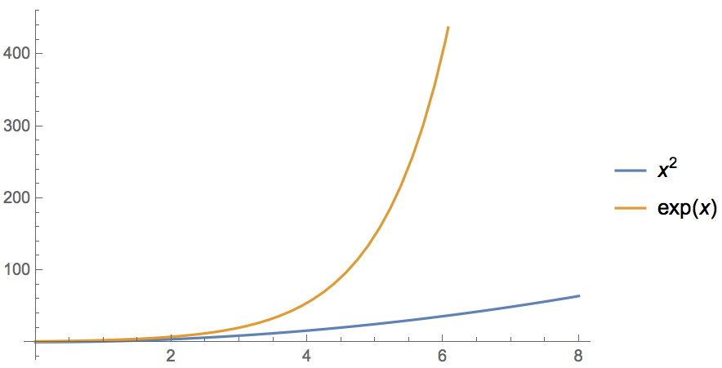
Quantum Computer breaks Public-Key Crypto
[Shor ’94] Polynomial-time quantum algorithm for factoring integer numbers
Classical Computer : Exponential time
Quantum Computer : Poly-time: n²
For a 600-digit number (RSA-2048)
    Classical: age of universe
    Quantum: few minutes
  Consequence: Large enough quantum computers break all currently used public-key cryptosystems!!!
Notes:
15 = 3 * 5
51 = 3 * 17
123 * 456 = 56088

Slide 43



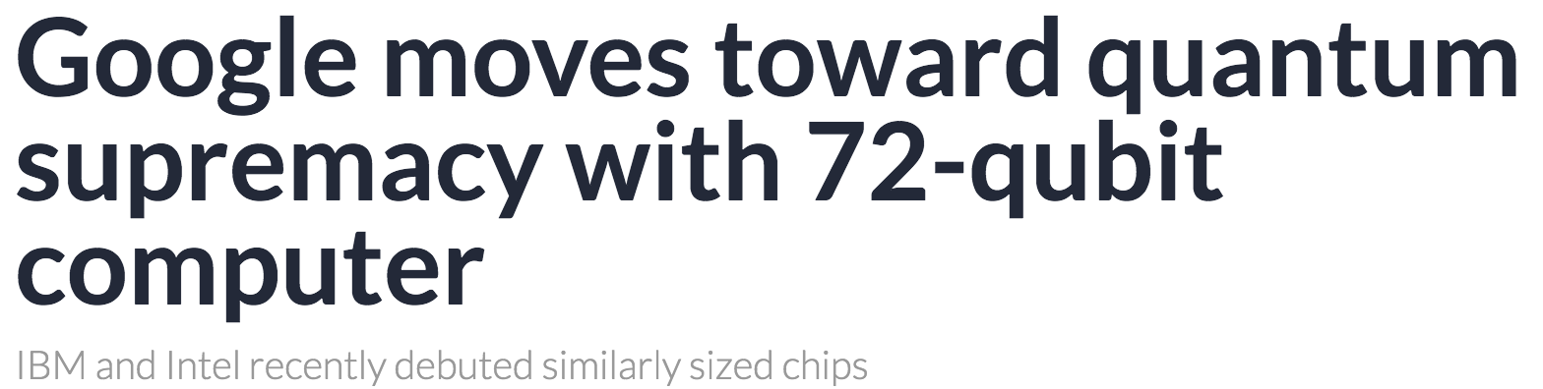
Can We Build Quantum Computers?
Possible to build in theory, no fundamental theoretical obstacles have been found yet.
Enormous technical challenge (control vs decoherence)
5 March 2018:

Slide 44


Conventional Quantum-Safe Cryptography
Wanted: new assumptions to replace factoring and discrete logarithms in order to build conventional public-key cryptography
[https://csrc.nist.gov/Projects/Post-Quantum-Cryptography ]
NIST “competition”: 82 submissions (23 signature, 59 encryption schemes)
Several submissions have already been broken and withdrawn
April 2018: First-round workshop in Florida
Expected: 3-5 years of crypto-analysis
New standards, world-wide adoption

Slide 45

Example: Lattice-Based Cryptography
For any vectors $v1,…,vn$in $ℝn$,
the lattice spanned by $v1,…,vn$
is the set of points
$L=\{a1v1+…+anvn| ai \text{integers}\}$
Shortest Vector Problem (SVP): given a lattice $L$, find a shortest (nonzero) vector
2v₁
v₁+v₂
2v₂
v₁
v₂
2v₂-v₁
2v₂-2v₁
0

Slide 46
Example: Lattice-Based Cryptography
v₂
v₁
3v₂-4v₁
0
Shortest Vector Problem (SVP): given a lattice, find a shortest (nonzero) vector
no efficient (classical or quantum) algorithms known
public-key encryption schemes can be built on the computational hardness of SVP

Slide 47
What will you Learn from this Talk?
Classical Cryptography (& Politics)
Introduction to Quantum Mechanics
Crypto Threat of Quantum Computing
Quantum Cryptography
Quantum Future

Slide 48
No-Cloning Theorem
U
Quantum operations:
?
?
?
Proof: copying is a non-linear operation

Slide 49

Quantum Key Distribution (QKD)
Alice
[Bennett Brassard 84]
Bob
k = ?
k = 0101 1011
Eve
k = 0101 1011
Offers a quantum solution to the key-exchange problem
Puts the players into the starting position to use symmetric-key cryptography (encryption, authentication etc.).

Slide 50
Quantum Key Distribution (QKD)
[Bennett Brassard 84]
0 1 1 1 0
0 0 1 1 0
k = 110
k = 110

Slide 51
Quantum Key Distribution (QKD)
?
?
?
?
?
[Bennett Brassard 84]
0 1 1 1 0
0 0 1 1 0
k = ?
k = 10
k = 10
Quantum states are unknown to Eve, she cannot copy them.
Honest players can test whether Eve interfered.

Slide 52



Quantum Key Distribution (QKD)
Alice
[Bennett Brassard 84]
Bob
Eve
technically feasible: no quantum computer required,
only quantum communication

Slide 53
What will you Learn from this Talk?
Classical Cryptography (& Politics)
Introduction to Quantum Mechanics
Crypto Threat of Quantum Computing
Quantum Cryptography
Quantum Future

Slide 54






Quantum Research in NL
QuTech: 135 Mio € , 50 Mio $ Intel
Nov 2017: Quantum Software Consortium, NWO 18.8 Mio € for 10 years

Slide 55



Quantum Research in EU
Starting 2018: 1 (or 2?) Bio. € flagship program on Q technologies

Slide 56











Quantum Research Worldwide
Waterloo, Singapore, Santa Barbara, China, …

Slide 57

Quantum Networks
2000km QKD backbone network between Beijing and Shanghai
first QKD satellite launched
in 2016 from China
Quantum entanglement allows to generate secure keys (like QKD)

Slide 58
Secure Computing in Quantum Cloud
Distributed quantum computing
Recent result: quantum homomorphic encryption allows for secure delegated quantum computation
https://quantumexperience.ng.bluemix.net
Y. Dulek, C. Schaffner, and F. Speelman, arXiv:1603.09717
Quantum homomorphic encryption for polynomial-sized circuits, in CRYPTO 2016, QIP 2017

Slide 59
What Have You Learned from this Talk?
Classical Cryptography
  Long history
  One-time pad
  Public-key cryptography
  Links to Logic and Politics
m = 0000 1111
c = m ⊕ k = 0101 0100
Alice
Bob
k = ?
Eve
k = 0101 1011
k = 0101 1011

Slide 60
What Have You Learned from this Talk?
Quantum Mechanics
  Qubits
  Quantum Computer
  Shor’s Algorithm
  No-cloning

Slide 61
Answers to the Quantum Threat
Conventional Post-Quantum Cryptography
Can be deployed without quantum technologies
Believed to be secure against quantum attacks of the future
Quantum Cryptography
Requires some quantum technology (but no large-scale quantum computer)
Typically no computational assumptions

Slide 62
Thank you for your attention!
Questions
http://www.qusoft.org/education/

