Slide 1




Quantum Computing & Cryptography
Christian Schaffner
Research Center for Quantum Software
Institute for Logic, Language and Computation (ILLC) University of Amsterdam
Landing Festival Berlin, 3 April 2019
Notes:
In het licht van recente experimentele successen en grote investeringen door o.a. Alphabet (voorheen Google), Microsoft, IBM en Intel is het realistisch dat er binnen 10-30 jaar een praktische quantumcomputer op de markt komt. Quantumcomputers kunnen exponentieel sneller algoritmes uitvoeren die aan de basis liggen van de meest gebruikte data-encryptiemethodes, zoals RSA.
Moeten we ons zorgen maken over een ‘cryptocalips’ wanneer de quantumcomputer er is? En hoe zit het met encryptiemethoden die tegen een quantumaanval bestand zijn, zoals post-quantum crypto en quantum key distribution? Zijn deze al op de markt en hoe moet uw organisatie hier mee aan de slag om optimaal voorbereid te zijn op de quantumtoekomst?

Slide 2
A little thought experiment...

Slide 3
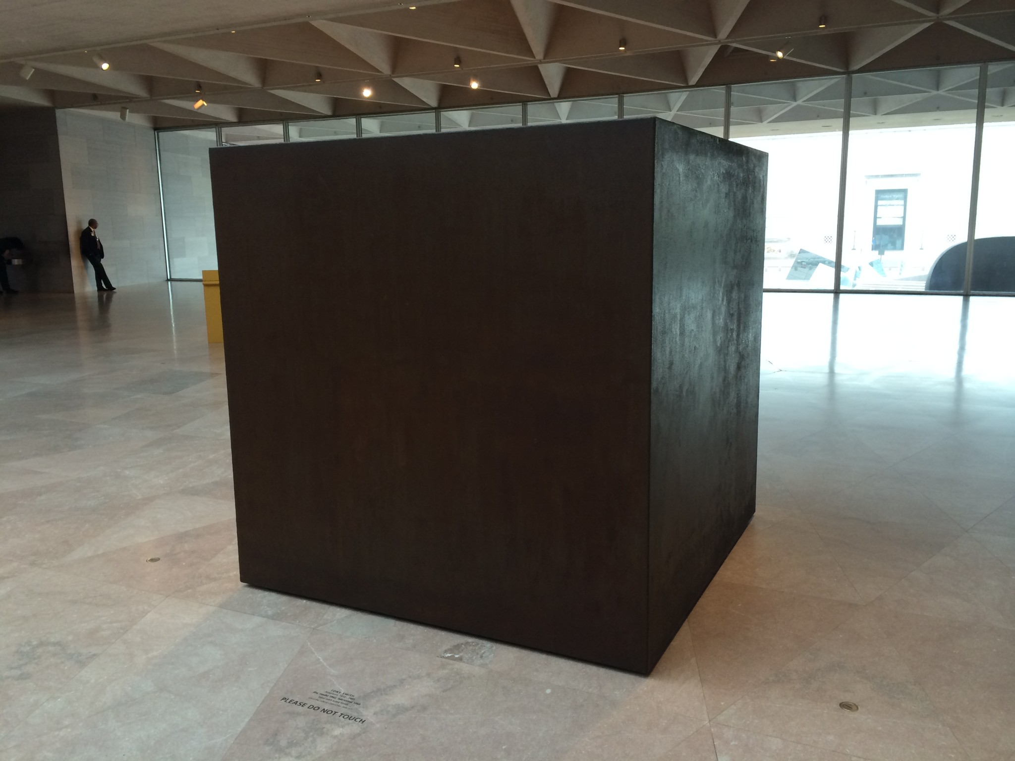
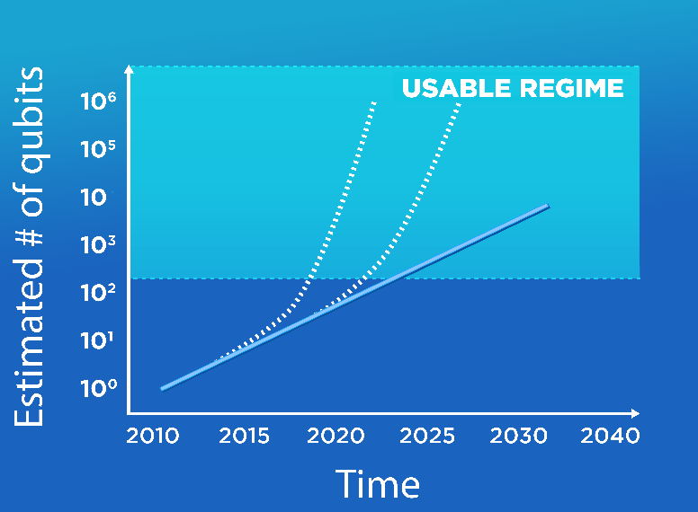


Quantum Computer
Quantum Computer
What are you going to do with it?
10-20 quantum bits now
50-100 qubits in the next 5 years!

Slide 4


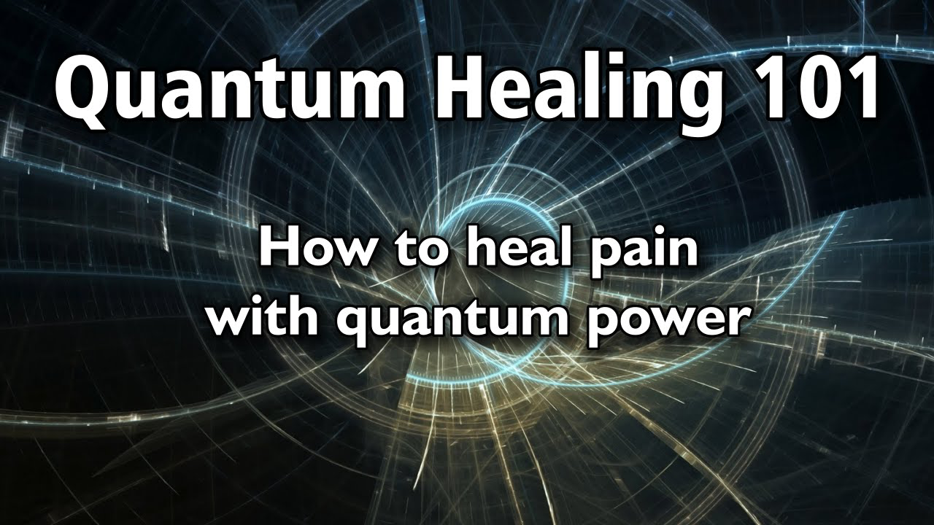
Notes:
Kwantum kennen die jongens natuurlijk niet,
Maar Britten houden vast van James Bond en hun eigen Britse merk sport cars, Quantum Sports Cars, QSC, Hier afgebeeld de sexy sunrunner https://en.wikipedia.org/wiki/Quantum_Sports_Cars

Slide 5
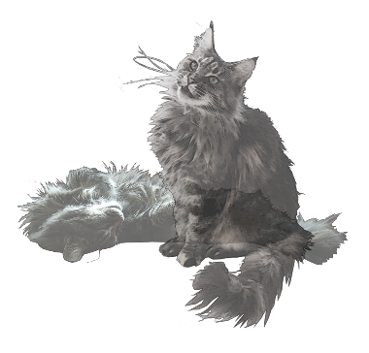
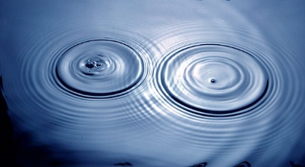
Quantum Physics
Superposition:
  Of different states
Interference:
  Of states
Entanglement:
  Of two or more physical systems

Slide 6
Quantum Physics
Superposition:
  Of different states
Interference:
  Of states
Entanglement:
  Of two or more physical systems

Slide 7
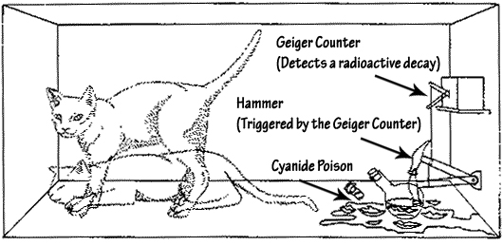
Superposition
An object in different states simultaneously:
  A photon can be at two positions at the same time
  Schrödinger’s cat: dead and alive
Experimentally verified:
  Small systems, such as photons
  Bigger systems, molecules…

Slide 8
Superposition: An experiment

Slide 9

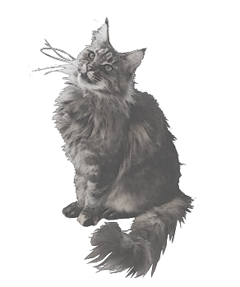
detector 1
collapse
superposition
detector 0

Slide 10
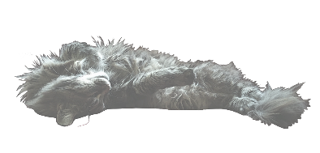
detector 1
collapse
superposition
detector 0

Slide 11
50% detector 0 clicks
50% detector 1 clicks
detector 1
detector 0

Slide 12
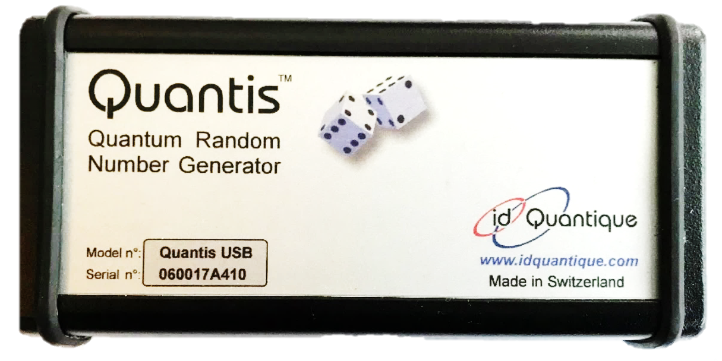
Random Number Generator
Swiss company:
id Quantique

Slide 13
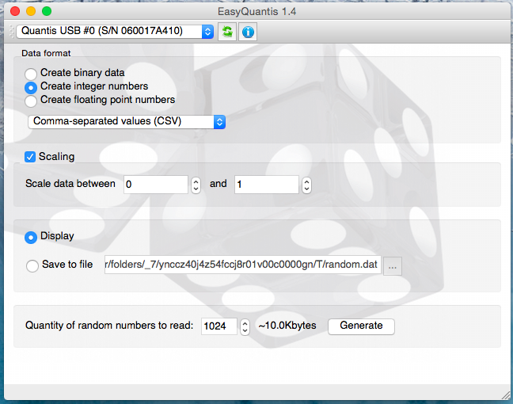

Slide 14
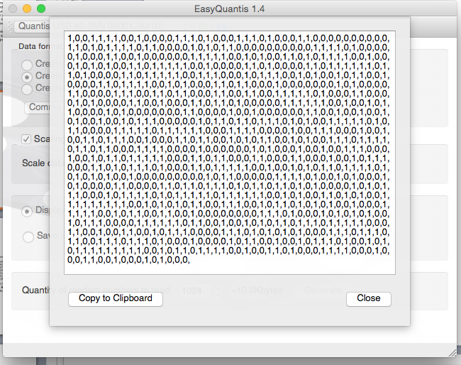

Slide 15
Quantum Physics
Superposition:
  Of different states
  Observation: collapse of the superposition
Interference
  Of an object in superposition
Entanglement
  Of two or more physical systems

Slide 16
detector 1
no superposition but: beamsplitter reflects 50% and transmits 50%?
detector 0

Slide 17
Mach-Zehnder interferometer
detector 1
50% detector 0 clicks
50% detector 1 clicks
mirror
detector 0
50%-50%
beamsplitter
mirror
classical reasoning

Slide 18
Mach-Zehnder interferometer
detector 1
detector 0
clicks
ALWAYS !!!
mirror
detector 0
mirror
When you perform the experiment

Slide 19
Try it yourself: http://quantumgame.io/
detector 1
detector 0
clicks
ALWAYS !!!
mirror
detector 0
superposition
interference
mirror
According to quantum mechanics

Slide 20
Quantum Physics
Superposition
  Of different states
  Observation: collapse of the superposition
Interference:
  Of an object in superposition
Entanglement:
  Of two or more physical systems

Slide 21
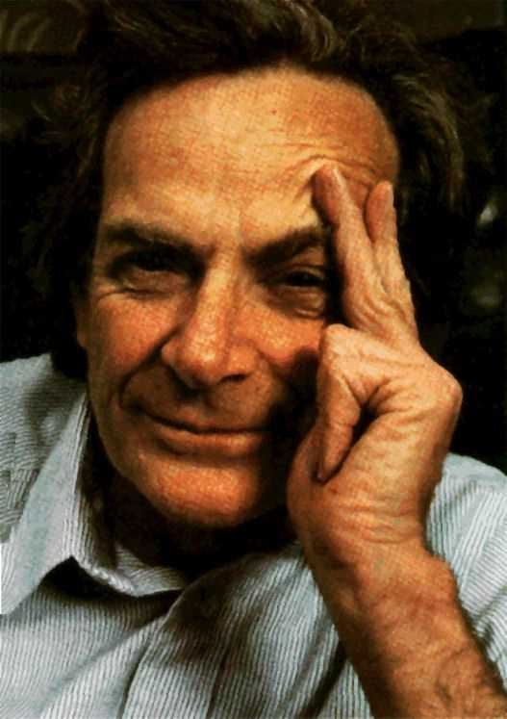
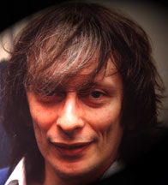
Quantum Physics
+ Computer Science =
Feynman 1981
Deutsch 1985
Video: Quantum Computers Animated

Slide 22

Quantum Bit (QuBit)
detector 1
Classical bit:
0 or 1
Quantum bit:
superposition of 0 and 1
or
detector 0
detector 1
superposition
detector 0

Slide 23
More Qubits
1 qubit superposition of 2 states
2 qubits superposition of 4 states
3 qubits superposition of 8 states
4 qubits superposition of 16 states
5 qubits superposition of 32 states
6 qubits superposition of 64 states
300 qubits superposition of 2³⁰⁰ states

Slide 24
Quantum Software: Fundamentally Different
Qubit: superposition of 0 and 1
300 qubits: astronomical amount of parallel computation
How to get the answer out??
  - Measuring destroys computation!!
Quantum Program
  Use interference to cancel undesired computations
Does not always work!
Our focus: how can we optimally use the extra power?

Slide 25
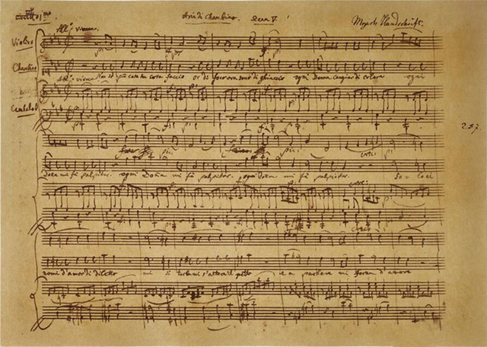
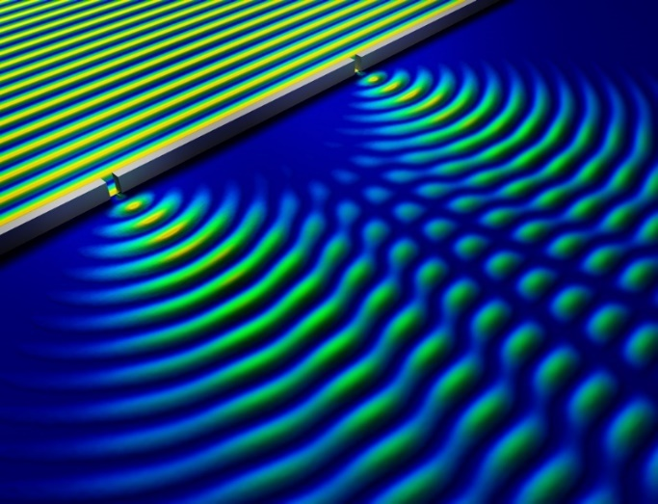
Quantum Programming is like Composing
Music
- Sound waves interfere
- Composer creates ‘beautiful’ interference of sound waves
Quantum Computer
- Qubits in superposition interfere
- Quantum programmer ensures useful interference of qubit
states
Notes:
https://phys.org/news/2014-05-nondestructive-method-quantum.html
Bron

Slide 26
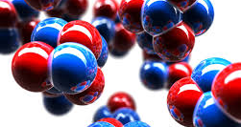
What can you do with it?
Simulation of nature
  Chemistry, material design, new medicines..
Efficient communication
  Quantum internet, entanglement etc.
Factorizing big numbers [Shor]
  Breaks frequently used cryptography
Quantum cryptography [Bennett-Brassard-Ekert]
  Cryptography using quantum communication
??????

Slide 27
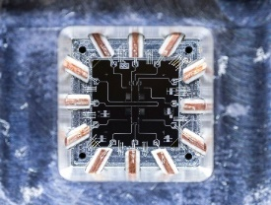
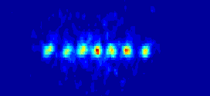
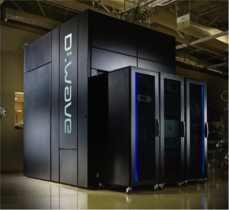
Progress In Building Qubits
Many groups worldwide progress with building qubits
Solid state:
  50 solid-state qubits IBM
  49 Intel
  50 Google → 72
  Fairly stable
Trapped ions:
  11 qubits Monroe
D-Wave:
  2048 qubits (not very stable)
Isolation
vs
Control
https://quantumcomputingreport.com/

Slide 28
What can you do with it?
Simulation of nature
  Chemistry, material design, new medicines..
Efficient communication
  Quantum internet, entanglement etc.
Factorizing big numbers [Shor]
  Breaks frequently used cryptography
Quantum cryptography [Bennett-Brassard-Ekert]
  Cryptography using quantum communication
??????

Slide 29
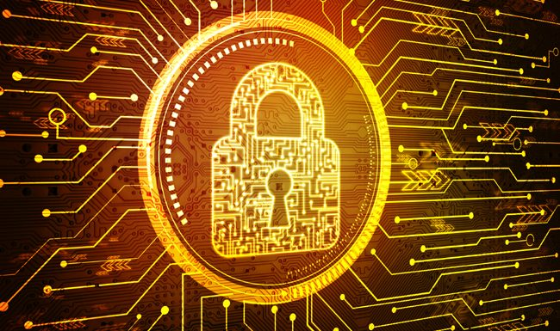
Cyber Security
“Cyber Security provides security, safety and privacy solutions that are vital for our economy including but not limited to critical infrastructures, smart cities, cloud computing, online services and e-government.”
Cloud computing
Internet of Things (IoT)
Payment systems, eHealth
Auto-updates – Digital Signatures
Secure Browsing - TLS/SSL
VPN – IPSec
Secure email – s/MIME, PGP
RSA, DSA, DH, ECDH, …
AES, 3-DES, SHA, …
based on slides by Michele Mosca

Slide 30
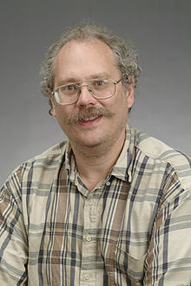
Quantum Algorithm for Factorization
Peter Shor 1994: efficient quantum algorithm for
factoring integer numbers
15 = 3 * 5
27 = 3 * 3 * 3
31 = 1 * 31
57 = 3 * 19
91 = 7 * 13
173 = 1 * 173
RSA-100 = 1522605027922533360535618378132637429718068114961380688657908494580122963258952897654000350692006139 = 37975227936943673922808872755445627854565536638199 × 40094690950920881030683735292761468389214899724061
Notes:
RSA-100 tooke a few days to factor in 1991. It now takes about 1 hour on a standard laptop.

Slide 31
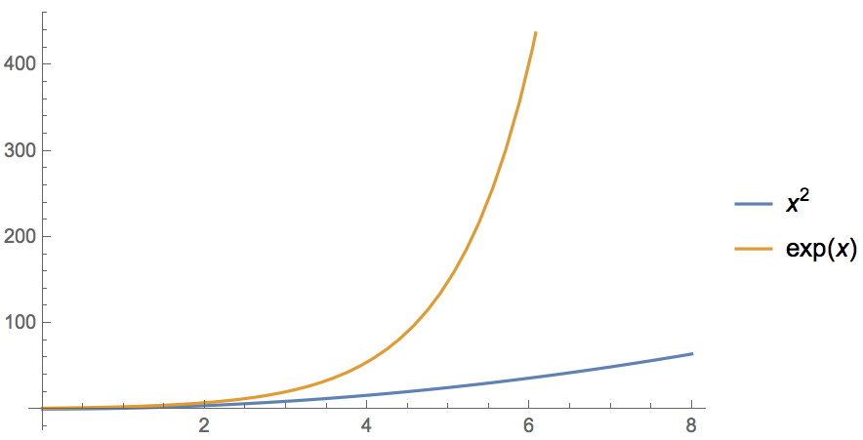
Quantum Computer Breaks Public-Key Crypto
Peter Shor 1994: efficient quantum algorithm for factoring integer numbers
For a 600-digit number (RSA-2048)
    Classical: age of universe (exponential time)
    Quantum: few minutes (polynomial time)
  Consequence: Large enough quantum computers break all currently used public-key cryptosystems!!!
Notes:
15 = 3 * 5
51 = 3 * 17
123 * 456 = 56088

Slide 32

Current Cryptography Under Quantum Attack
Security level systems | Conventional attacks | Quantum attacks
Symmetric-key encryption (AES-256) | 256 bits of security | 128 bits
Hash functions (SHA3-256) | 128 bits | 85 bits
Public-key crypto (key exchange, digital signatures, encryption) (RSA-2048, ECC-256) | 112 bits | ~ 0 bits
Products, services, businesses relying on security either stop functioning or do not provide expected levels of security!
Notes:
Ask who knows the difference between private and public key! Explain the advantage of public-key crypto

Slide 33
When Do We Need To Worry?
Depends on:
How long do you need to keep your secrets secure? (x years)
How much time will it take to re-tool the existing infrastructure? (y years)
How long will it take for a large-scale quantum computer to be built? (z years)
Theorem (Mosca): If x + y > z, then worry.
If x > z or y > z,
you are in big trouble!
y
x
z
secrets revealed
time
2019
2029 ?
slide by Michele Mosca

Slide 34
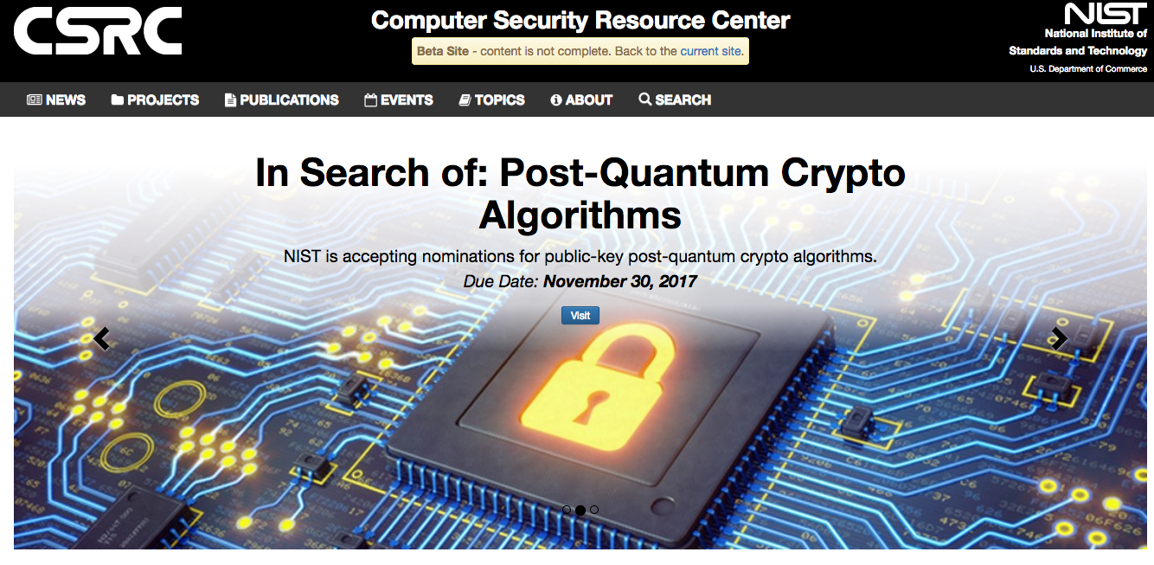
Conventional Quantum-Safe Cryptography
Conventional Quantum-Safe Cryptography
Wanted: new assumptions to replace factoring and discrete logarithms in order to build conventional public-key cryptography
[https://csrc.nist.gov/Projects/Post-Quantum-Cryptography ]
NIST “competition”: 82 submissions (23 signature, 59 encryption schemes)
Aug 2019: Second-round workshop in California
Expected: 3-5 years of crypto-analysis
New standards, world-wide adoption

Slide 35

The Future is Quantum: Governments
QuTech in Delft, NL: €135 million
€18.8 Mio for 10 years: Quantum Software Consortium
Germany: €650 million for quantum technologies
UK: £235 million five-year in quantum computing
Sweden: €100 million for 10 years for WACQT
EU Flagship: €1 billion and a duration of 10 years
US: $1.2 billion National Quantum Initiative Act
China: $1 billion initial funding for National Laboratory for Quantum Information Sciences
Canada, Australia, Singapore, …
https://sciencebusiness.net/news/eu-runs-catch-governments-pledge-more-cash-quantum-computing

Slide 36






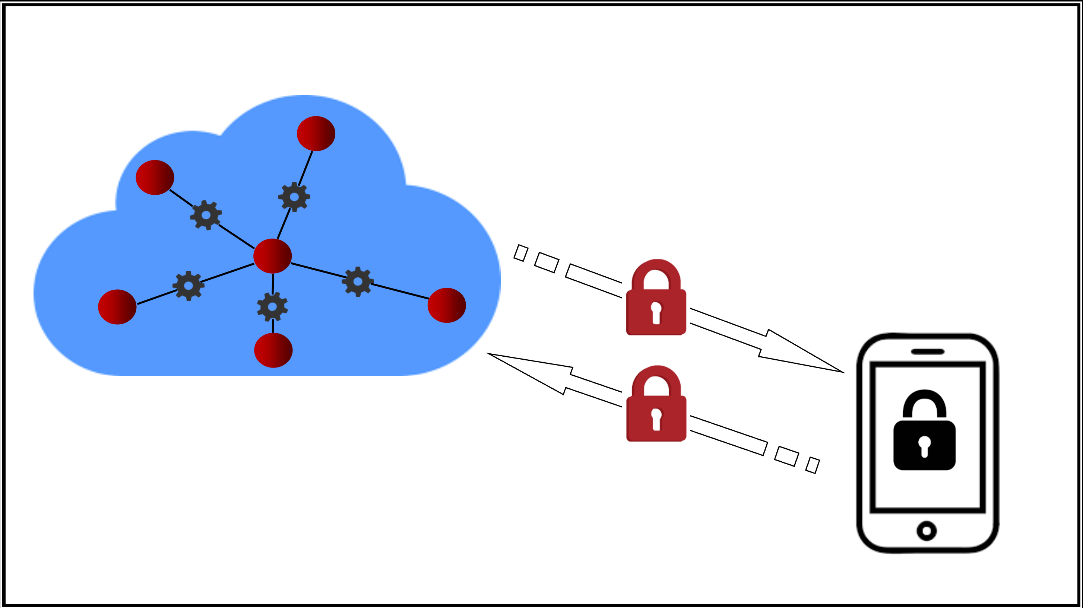







The Future is Quantum: Business
Quantum networks
Quantum cloud
Y. Dulek, C. Schaffner, and F. Speelman, arXiv:1603.09717
Quantum homomorphic encryption for polynomial-sized circuits

Slide 37
Summary
superposition
interference
Security systems | Standard attacks | Quantum attacks
Symmetric | 256 bits of security | 128 bits
Hash | 128 bits | 85 bits
Public-key | 112 bits | ~ 0 bits
y
x
z
secrets revealed
time
2019
2029 ?

Slide 38
Thank you for your attention!
“About your cat Mister Schrödinger…
I’ve got good and bad news.”
Get in touch: schaffner@qusoft.org

