Slide 1
Quantum Cryptography
Christian Schaffner
Institute for Logic, Language and Computation (ILLC)
University of Amsterdam
Research Center for Quantum Software
All material available on https://staff.science.uva.nl/c.schaffner/
IIT Delhi Workshop on Intro to Q Computing
Friday, 25 June 2021
Notes:
Title: Quantum Cryptography
Abstract: Cryptography is a fascinating research field with a long and intriguing history. Modern cryptography is ubiquitous in today’s digital society, as it can deal with any situation where parties do not trust each other. Recent progress in building quantum computers leads to new opportunities for cryptography, but also endangers existing cryptographic schemes. In this introductory talk, I will illustrate both aspects of this double-edged sword.

Slide 2
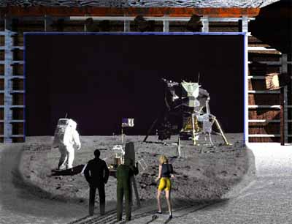
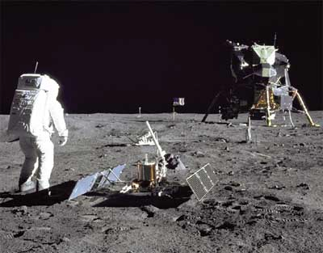
1969: Man on the Moon
The Great Moon-Landing Hoax?
NASA
How can you prove that you are at a specific location?
http://www.unmuseum.org/moonhoax.htm
Notes:
In 1969, man has first set foot on the moon, as you can see here on this picture sent around the world by NASA...
Or not? Maybe it was all just a “great moon-landing hoax”, as speculated on various conspiracy-theory websites on the internet?
One fascinating cryptographic question I want to study in my project is: “How can you prove that you are at a specific location?”
More about it later…

Slide 3
What will you learn from this Talk?
Classical Cryptography
Introduction to Quantum Mechanics
Quantum Key Distribution
Position-Based Cryptography

Slide 4
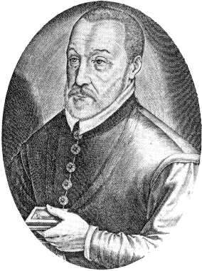
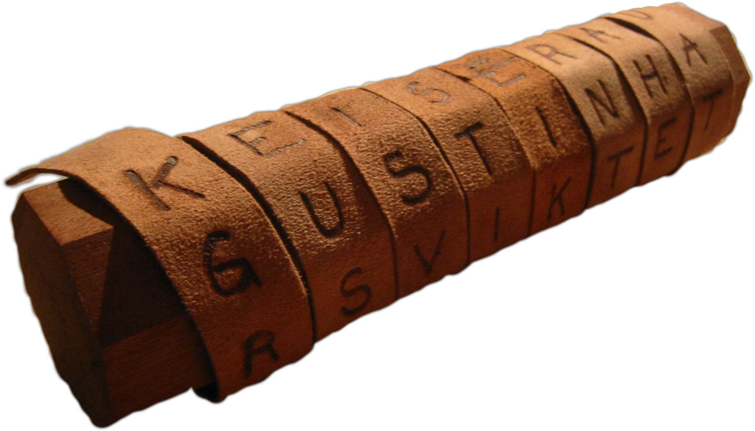
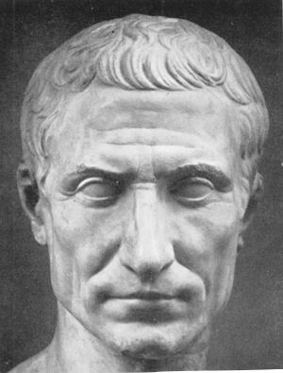

Ancient Cryptography
Blaise de Vigenère
Scytale
50 BC
1000 AD
2015 AD
500 BC
500 AD
1500 AD
Caesar Cipher (ROT4)
(variant still in use)

Slide 5
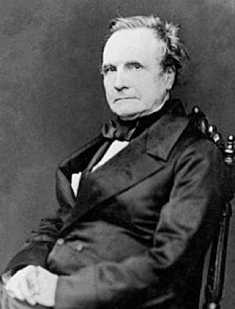
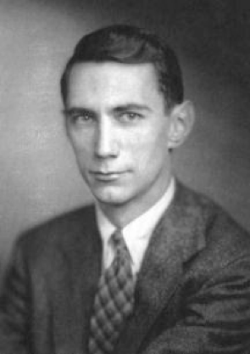
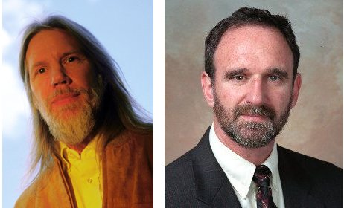
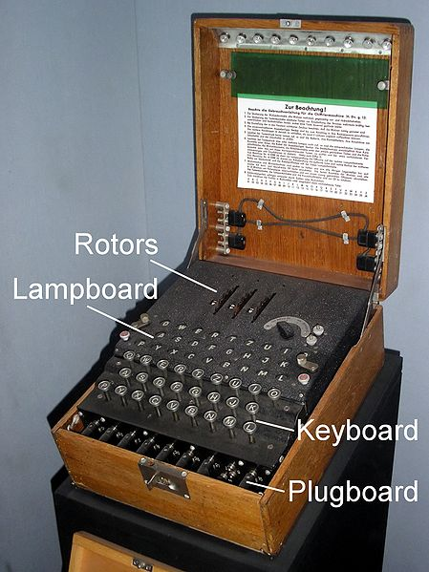
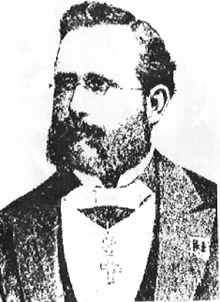
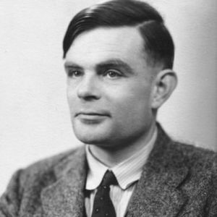

Ancient Cryptography
Charles Babbage
Claude Shannon
Diffie / Hellman
1850
1950
2015
1800
1900
1976
“a cryptographic system should be secure even if everything but the key is known to the adversary”
Enigma
Alan Turing
(The Imitation Game)
Auguste Kerckhoffs
Notes:
een systeem van versleuteling moet even veilig zijn, zelfs als alles behalve de sleutel over het systeem publiek bekend is

Slide 6
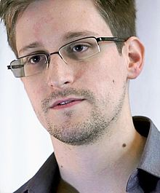
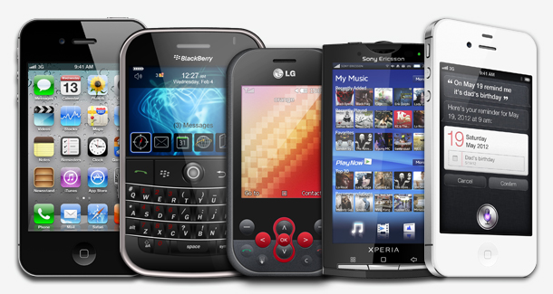
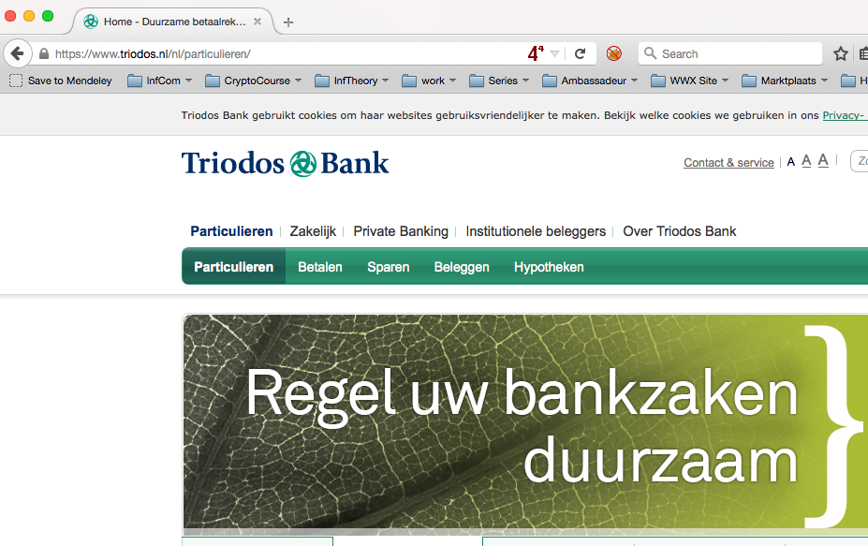
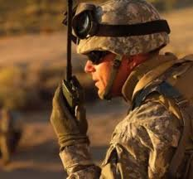
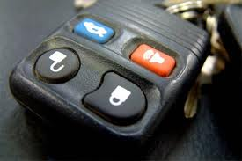
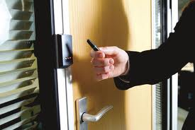
Modern Cryptography
Edward Snowden
is everywhere!
is concerned with all settings where people do not trust each other

Slide 7



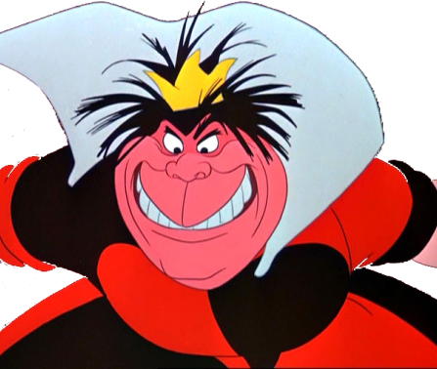
Secure Encryption
m = “I love you”
m = 0000 1111
Alice
Bob
k = ?
Eve
k = 0101 1011
k = 0101 1011
Goal: Eve does not learn the message
Setting: Alice and Bob share a secret key k

Slide 8
eXclusive OR (XOR) Function
8
x | y | x ⊕ y
0 | 0 | 0
1 | 0 | 1
0 | 1 | 1
1 | 1 | 0
Some properties:
  ∀ x : x ⊕ 0 = x
  ∀ x : x ⊕ x = 0
  ⟹ ∀ x,y : x ⊕ y ⊕ y = x
Notes:
quick check: please raise your hand if you have NOT seen this function before.
Please raise your hand if you HAVE seen this function before.
Now raise your hand if you have not raised your hand yet. For the people raising their hand now: you should seriously double-check the logic “axiom of the excluded middle”, asserting that either you HAVE seen this function before, or that you have NOT.

Slide 9
One-Time Pad Encryption
m = 0000 1111
c = m ⊕ k = 0101 0100
m = c ⊕ k = 0000 1111
Alice
Bob
k = ?
Eve
k = 0101 1011
k = 0101 1011
Goal: Eve does not learn the message
Setting: Alice and Bob share a key k
Recipe:
Is it secure?
x | y | x ⊕ y
0 | 0 | 0
0 | 1 | 1
1 | 0 | 1
1 | 1 | 0
m = 0000 1111
c = 0101 0100
k = 0101 1011
k = 0101 1011
c = m ⊕ k = 0101 0100
c ⊕ k = 0000 1111
c ⊕ k = m ⊕ k ⊕ k = m ⊕ 0 = m

Slide 10
Perfect Security
m = ?
c = m ⊕ k = 0101 0100
m = c ⊕ k = ?
Alice
Bob
k = ?
Eve
k = ?
k = ?
Given that c = 0101 0100,
  is it possible that m = 0000 0000 ?
    Yes, if k = 0101 0100.
  is it possible that m = 1111 1111 ?
    Yes, if k = 1010 1011.
  it is possible that m = 0101 0101 ?
    Yes, if k = 0000 0001
In fact, every m is possible.
Hence, the one-time pad is perfectly secure!
x | y | x ⊕ y
0 | 0 | 0
0 | 1 | 1
1 | 0 | 1
1 | 1 | 0

Slide 11
Problems With One-Time Pad
m = 0000 1111
c = m ⊕ k = 0101 0100
m = c ⊕ k = 0000 1111
Alice
Bob
k = ?
Eve
k = 0101 1011
k = 0101 1011
The key has to be as long as the message.
The key can only be used once, otherwise information might leak.
In practice, other encryption schemes (such as AES) are used which allow to encrypt long messages with short keys.
One-time pad does not provide authentication:
Eve can easily flip bits in the message
Notes:
for encrypting internet traffic

Slide 12
What will you Learn from this Talk?
Classical Cryptography
Introduction to Quantum Mechanics
Quantum Key Distribution
Position-Based Cryptography

Slide 13

Quantum Bit: Polarization of a Photon
qubit as unit vector in $ℂ^{2}$

Slide 14
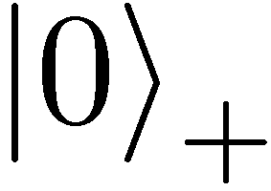
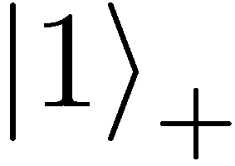
Qubit: Rectilinear/Computational Basis

Slide 15
Detecting a Qubit
No photons: 0
Alice
Bob

Slide 16
Measuring a Qubit
No photons: 0
Photons: 1
Alice
Bob
Measurement:
with prob. 1 yields 1
0/1

Slide 17
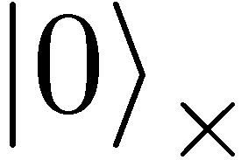
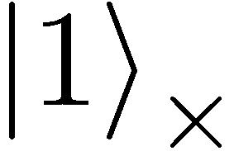

Diagonal/Hadamard Basis
Measurement:
with prob. ½ yields 0
=
with prob. ½ yields 1
0/1

Slide 18
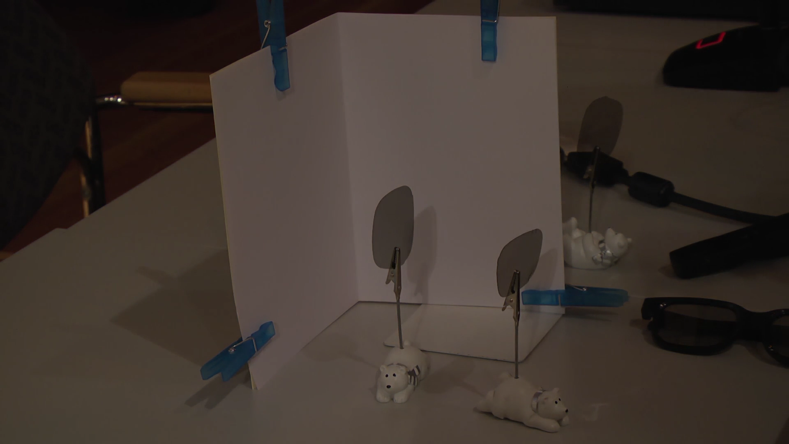
Video

Slide 19
Measuring Collapses the State
Measurement:
with prob. ½ yields 0
=
with prob. ½ yields 1
0/1

Slide 20
Measuring Collapses the State
=
=

Slide 21

Quantum Mechanics
+ basis
$×$ basis
Measurements:
Quantum operations:
U
with prob. 1 yields 1
H
0/1
with prob. ½ yields 0
0/1
with prob. ½ yields 1

Slide 22
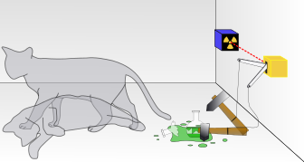
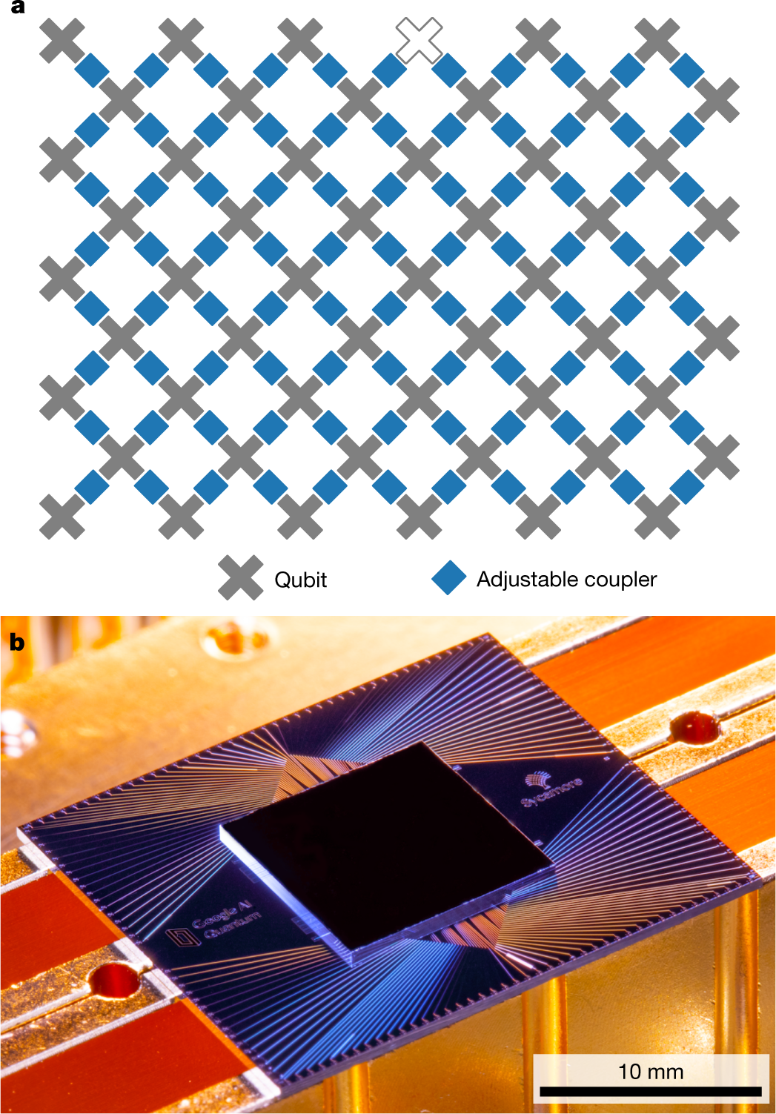

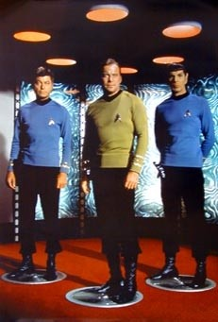
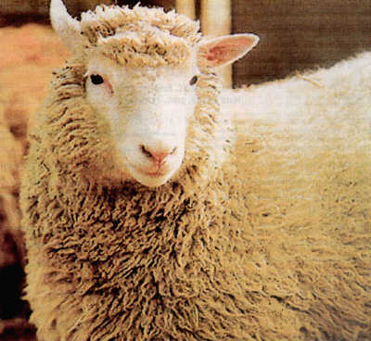
Wonderland of Quantum Mechanics
Notes:
better picture of Schroedinger’s cat

Slide 23
What will you Learn from this Talk?
Classical Cryptography
Introduction to Quantum Mechanics
Quantum Key Distribution
Position-Based Cryptography

Slide 24
No-Cloning Theorem
U
Quantum operations:
?
?
?
Proof: copying is a non-linear operation
Notes:
information vs disturbance trade-off

Slide 25
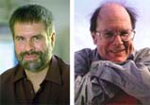
Quantum Key Distribution (QKD)
Alice
[Bennett Brassard 84]
Bob
k = ?
k = 0101 1011
Eve
k = 0101 1011
Offers a quantum solution to the key-exchange problem
Puts the players into the starting position to use symmetric-key cryptography (encryption, authentication etc.).

Slide 26
Quantum Key Distribution (QKD)
[Bennett Brassard 84]
0 1 1 1 0
0 0 1 1 0
k = 110
k = 110

Slide 27
Quantum Key Distribution (QKD)
?
?
?
?
?
[Bennett Brassard 84]
0 1 1 1 0
0 0 1 1 0
k = ?
k = 10
k = 10
Quantum states are unknown to Eve, she cannot copy them.
Honest players can test whether Eve interfered.

Slide 28
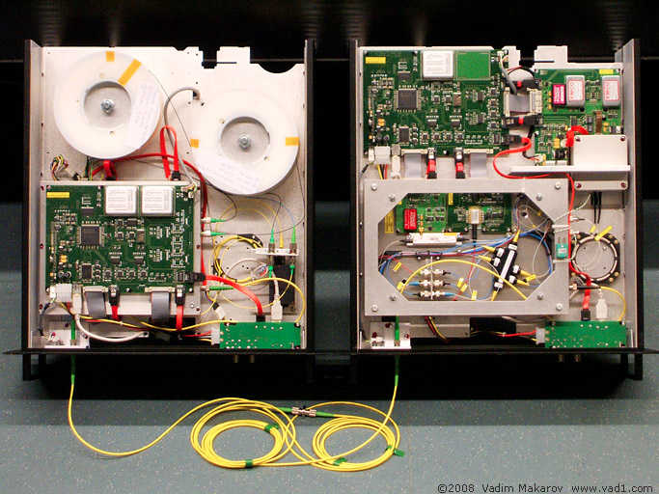

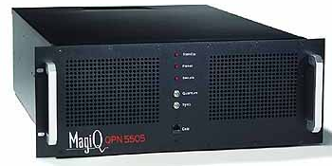
Quantum Key Distribution (QKD)
Alice
[Bennett Brassard 84]
Bob
Eve
technically feasible: no quantum computer required,
only quantum communication

Slide 29

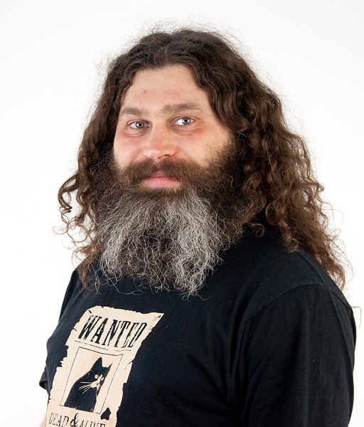
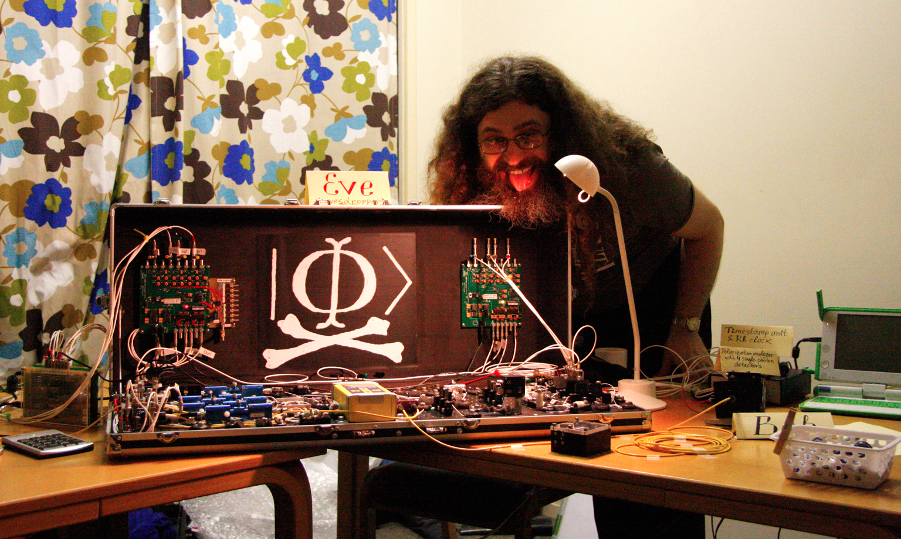
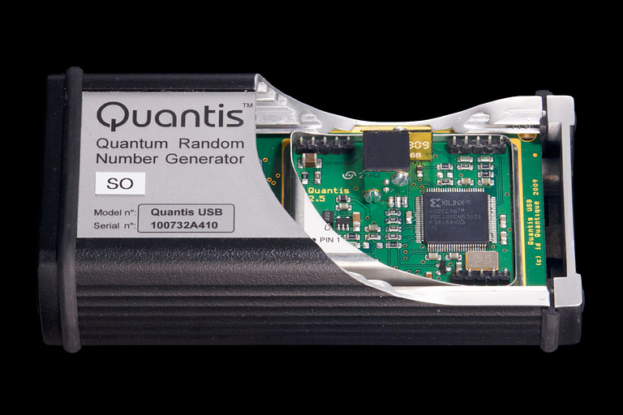
Quantum Hacking
e.g. by the group of Vadim Makarov (Quantum Hacking Lab, Moscow)

Slide 30
What will you Learn from this Talk?
Classical Cryptography
Introduction to Quantum Mechanics
Quantum Key Distribution
Position-Based Cryptography

Slide 31
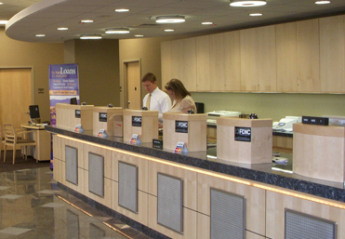
Position-Based Cryptography
Typically, cryptographic players use credentials such as
  secret information (e.g. password or secret key)
  authenticated information
  biometric features
Can the geographical location of a player be used
as cryptographic credential ?

Slide 32
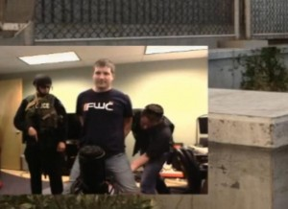
Position-Based Cryptography
Can the geographical location of a player be used as sole cryptographic credential ?
Possible Applications:
  Launching-missile command comes
  from within your military headquarters
  Talking to your embassy
  Pizza-delivery problem /
  avoid fake calls to emergency services
  …

Slide 33
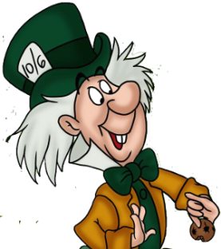


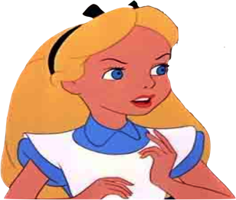

Basic task: Position Verification
Verifier1
Prover
Verifier2
Prover wants to convince verifiers that she is at a particular position
no coalition of (fake) provers, i.e. not at the claimed position, can convince verifiers
(over)simplifying assumptions:
    communication at speed of light
    instantaneous computation
    verifiers can coordinate

Slide 34




Position Verification: First Try
Verifier1
Prover
Verifier2
time
distance bounding [Brands Chaum ‘93]

Slide 35
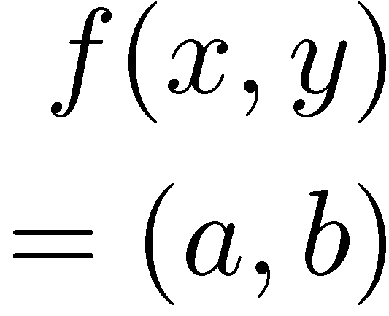


Position Verification: Second Try
Verifier1
Prover
Verifier2
position verification is classically impossible ! [Chandran Goyal Moriarty Ostrovsky 09]
Notes:
classical impossibility proof by [Chandran Goyal Moriarty Ostrovsky: CRYPTO ’09]

Slide 36


The Attack
copying classical information
this is impossible quantumly

Slide 37


Position Verification: Quantum Try
[Kent Munro Spiller 03/10]
?
?
?
Can we brake the scheme now?

Slide 38




Attacking Game
?
?
?
?
?
Impossible to cheat due to
no-cloning theorem
Or not?

Slide 39
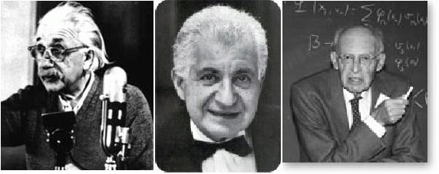
EPR Pairs
[Einstein Podolsky Rosen 1935]
prob. ½ : 0
prob. ½ : 1
EPR magic!
prob. 1 : 0
“spukhafte Fernwirkung” (spooky action at a distance)
EPR pairs do not allow to communicate
(no contradiction to relativity theory)
can provide a shared random bit

Slide 40
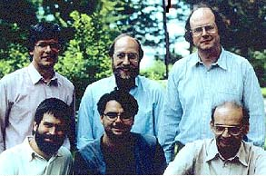
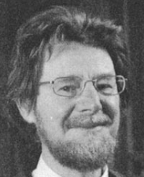




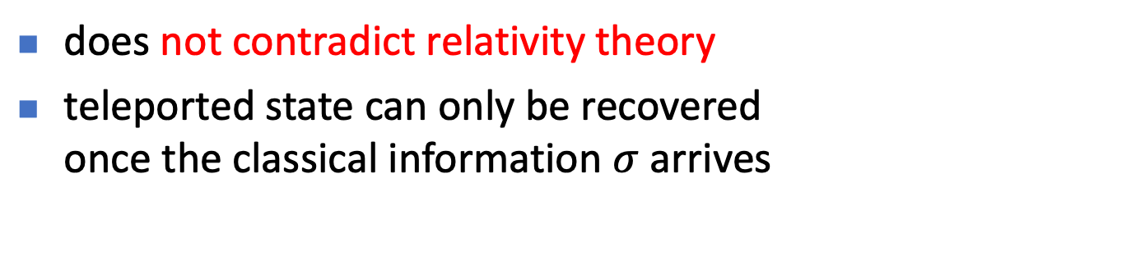
Quantum Teleportation
[Bennett Brassard Crépeau Jozsa Peres Wootters 1993]
?
[Bell]
?
?
does not contradict relativity theory
teleported state can only be recovered
once the classical information $σ$ arrives

Slide 41
Teleportation Attack
?
?
?
[Bell]
[Bell]
?
?
It is possible to cheat with entanglement !!
Quantum teleportation allows to
break the protocol perfectly.

Slide 42
No-Go Theorem
[Buhrman, Chandran, Fehr, Gelles, Goyal, Ostrovsky, Schaffner 2010] [Beigi Koenig 2011]
Any position-verification protocol can be broken using an exponential number of entangled qubits.
Question: Are so many quantum resources really necessary?
Does there exist a protocol such that:
  honest prover and verifiers are efficient, but
  any attack requires lots of entanglement
see https://staff.science.uva.nl/c.schaffner/positionbasedqcrypto.php for on overview

Slide 43

Relations to Different Research Areas
Garden-hose model connects position-based crypto with
complexity theory [Buhrman Fehr Schaffner Speelman 11]
various follow-up research: IBM ponder-this puzzle, SAT solvers, symmetry
[Chiu Szegedy Wang Xu 13]
Experimental problems: handle losses and measurement errors
Garden-hose techniques allowed us to build fully homomorphic quantum encryption [Dulek Schaffner Speelman 16]
Attacks on position-based crypto protocols relate to the holographic principle in quantum gravity [May Pennington Pérez-García Sorce 19]
Relation to mathematics, operator-space theory [Junge Kubicki Palazuelos Pérez-García 21]
Relation to programmable quantum processors [Kubicki Palazuelos Pérez-García 19]
Notes:
I’m maintaining a list of research results on my homepage

Slide 44
What Have You Learned from this Talk?
Classical Cryptography
Quantum Computing & Teleportation

Slide 45
What Have You Learned from this Talk?
Quantum Key Distribution (QKD)
Position-Based Cryptography

Slide 46


Thank you for your attention!
Questions
check http://arxiv.org/abs/1510.06120 for a survey about quantum cryptography beyond key distribution

Slide 48
Public-Key Cryptography
Alice
Charlie
Bob
secret key
Eve
public key
Solves the key-exchange problem.
Everyone can encrypt using the public key.
Only the holder of the secret key can decrypt.
Digital signatures: Only secret-key holder can sign, but everyone can verify signatures using the public-key.

Slide 49
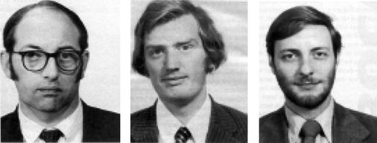


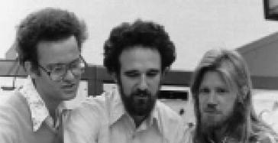
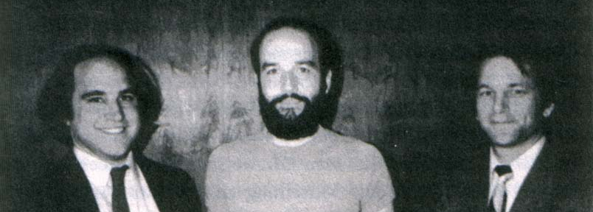
History of Public-Key Crypto
Early 1970s: invented in the „classified world“ at the
British Government Communications Head Quarters (GCHQ)
by Ellis, Cocks, Williamson
Mid/late 1970s: invented in the „academic world“
by Merkle, Hellman, Diffie, and Rivest, Shamir, Adleman (RSA)
Notes:
picture: http://link.springer.com/referenceworkentry/10.1007%2F978-1-4419-5906-5_210/fulltext.html#Fig2_210
James H. Ellis, Clifford C. Cocks, Malcolm J. Williamson (from left to right)
Ralph Merkle, Martin Hellman, Whitfield Diffie, (at Stanford)
and Ron Rivest, Adi Shamir, Leonard Adleman (at MIT)

Slide 50
Most General Single-Round Scheme
U
Let us study the attacking game

Slide 51
Impossibility Result by Distributed Q Computation
U
Any position-verification protocol can be broken
  using a double-exponential number of EPR-pairs
  [Buhrman Chandran Fehr Gelles Goyal Ostrovsky Schaffner 10]
  reduced to single-exponential [Beigi König 11]
Does there exist a protocol such that:
  honest prover and verifiers efficient
  any attack requires many EPR-pairs

Slide 52
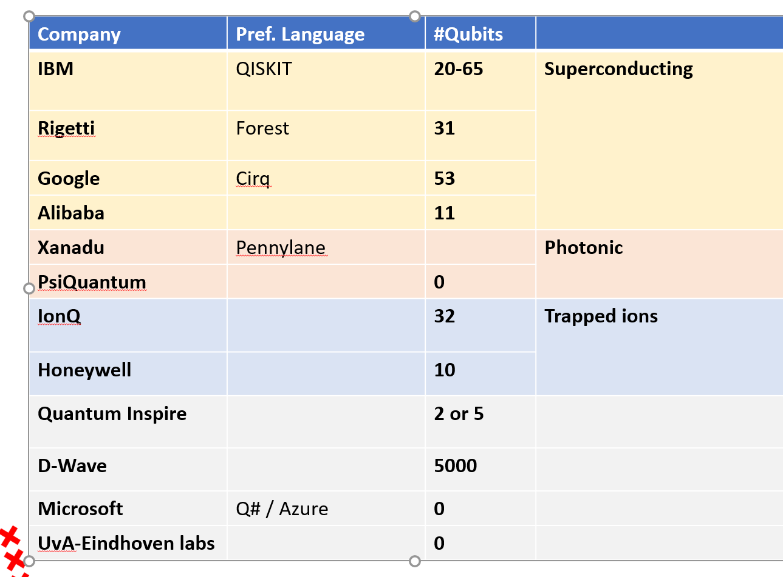
Can We Build Quantum Computers?
Possible to build in theory, no fundamental theoretical obstacles have been found yet.
Enormous technical challenge (control vs decoherence)

Slide 53

Example: Lattice-Based Cryptography
For any vectors $v1,…,vn$in $ℝn$,
the lattice spanned by $v1,…,vn$
is the set of points
$L=\{a1v1+…+anvn| ai \text{integers}\}$
Shortest Vector Problem (SVP): given a lattice $L$, find a shortest (nonzero) vector
2v₁
v₁+v₂
2v₂
v₁
v₂
2v₂-v₁
2v₂-2v₁
0

Slide 54
Example: Lattice-Based Cryptography
v₂
v₁
3v₂-4v₁
0
Shortest Vector Problem (SVP): given a lattice, find a shortest (nonzero) vector
no efficient (classical or quantum) algorithms known
public-key encryption schemes can be built on the computational hardness of SVP

