Slide 1
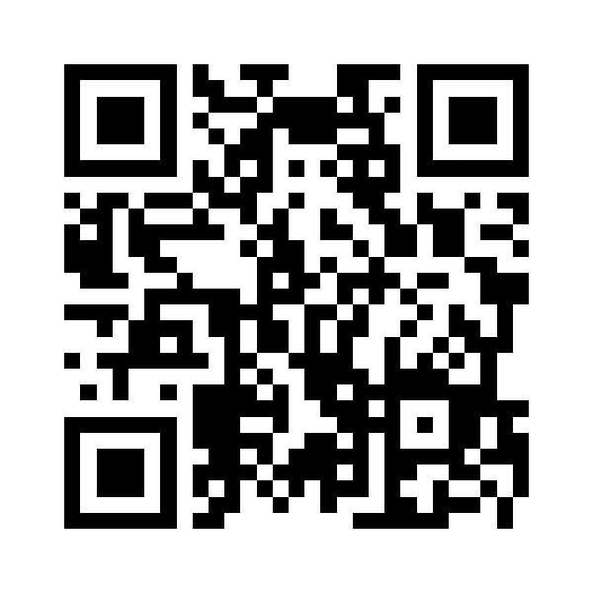
The Quantum-Random-Oracle Model
Christian Schaffner
Research Center for Quantum Software & Technology
Theory of Computing (TCS) group
Informatics Institute of University of Amsterdam
EHCI Workshop on Quantum Safe Communication
Friday, 13 January 2023
Goto https://app.wooclap.com/QROM for the quiz now!

Slide 2
What will you Learn from this Talk?
Classical Random-Oracle Model
Quantum Access
A Crucial Insight
Applications

Slide 3


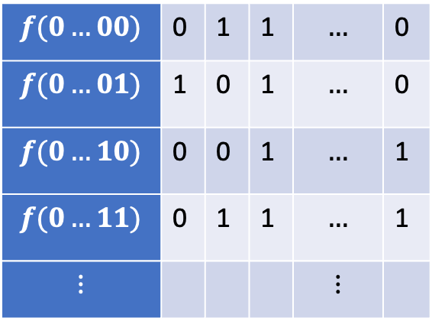
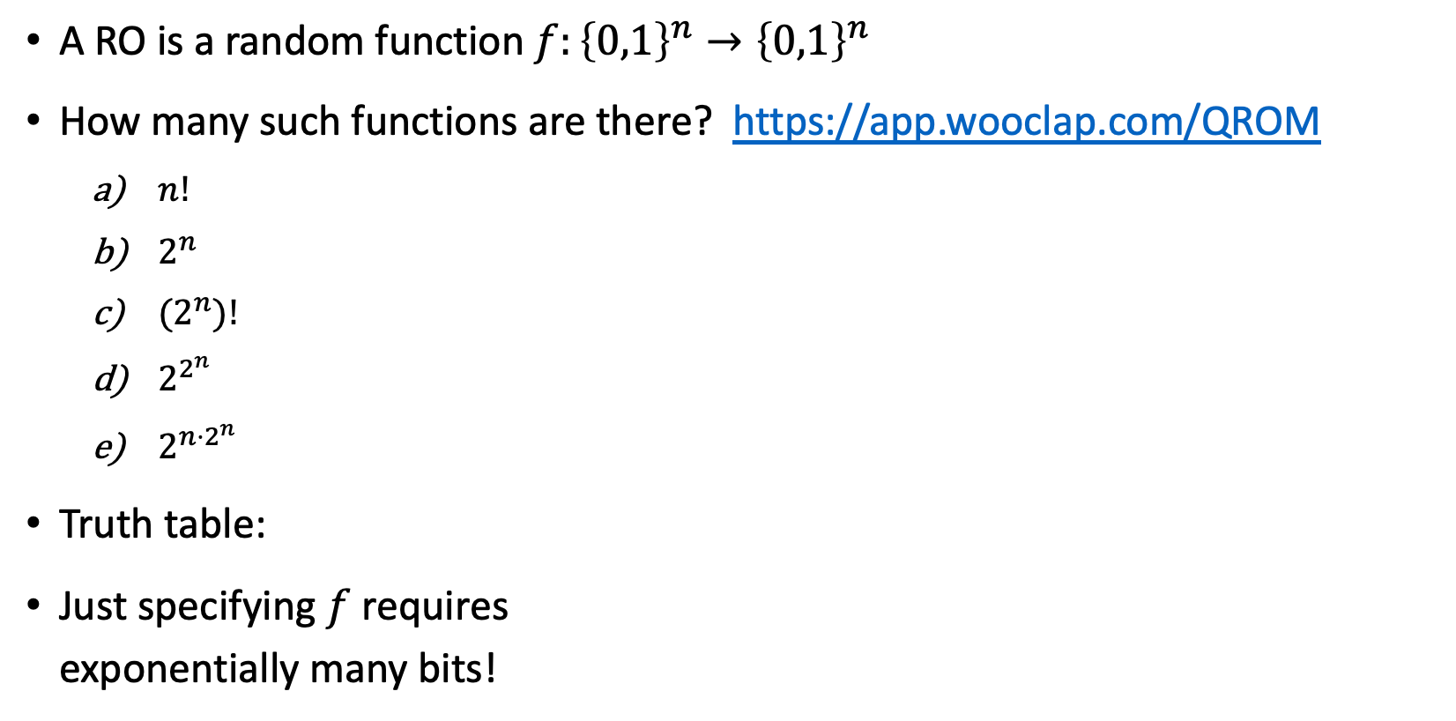
Random Oracle (RO)
A RO is a random function $f:{\left\{0,1\right\}}^{n}→{\left\{0,1\right\}}^{n}$
How many such functions are there? https://app.wooclap.com/QROM
  $n!$
  $2^{n}$
  ${(2}^{n})!$
  $2^{2^{n}}$
  $2^{n⋅2^{n}}$
Truth table:
Just specifying $f$ requires
exponentially many bits!
$n$ columns
$$f(0…00)$$ | 0 | 1 | 1 | $$…$$ | 0
$$f(0…01)$$ | 1 | 0 | 1 | $$…$$ | 0
$$f(0…10)$$ | 0 | 0 | 1 | $$…$$ | 1
$$f(0…11)$$ | 0 | 1 | 1 | $$…$$ | 1
$$⋮$$ |  |  |  | $$⋮$$
$2^{n}$ rows
Notes:
For n=6, 6*2^6 = 384, already more functions than atoms in the universe

Slide 4


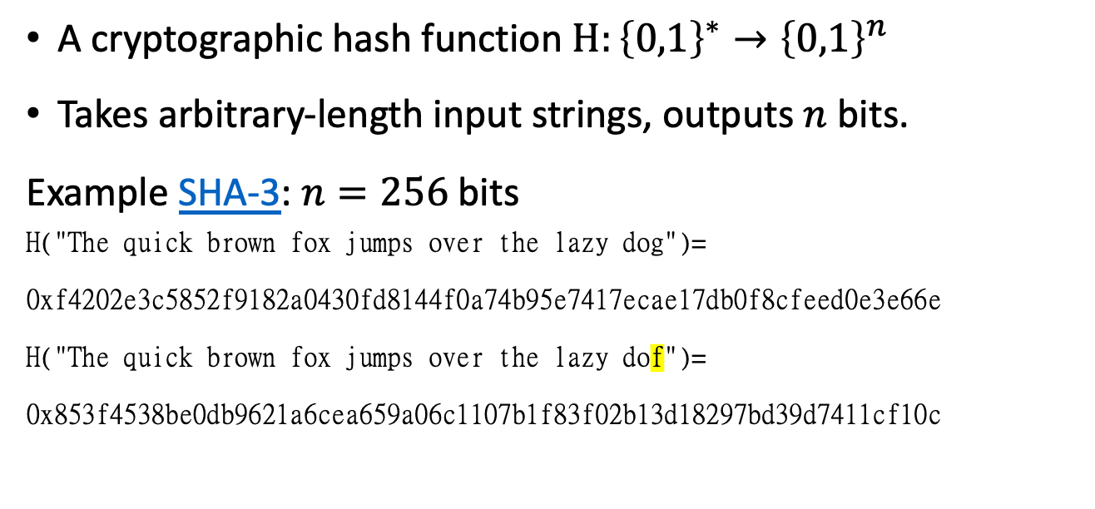
Hash Functions
A cryptographic hash function $H:{\left\{0,1\right\}}^{∗}→{\left\{0,1\right\}}^{n}$
Takes arbitrary-length input strings, outputs $n$ bits.
Example SHA-3: $n=256$bits
H("The quick brown fox jumps over the lazy dog")=
0xf4202e3c5852f9182a0430fd8144f0a74b95e7417ecae17db0f8cfeed0e3e66e
H("The quick brown fox jumps over the lazy dof")=
0x853f4538be0db9621a6cea659a06c1107b1f83f02b13d18297bd39d7411cf10c
$$H$$
An ideal hash function should behave as random oracle

Slide 5
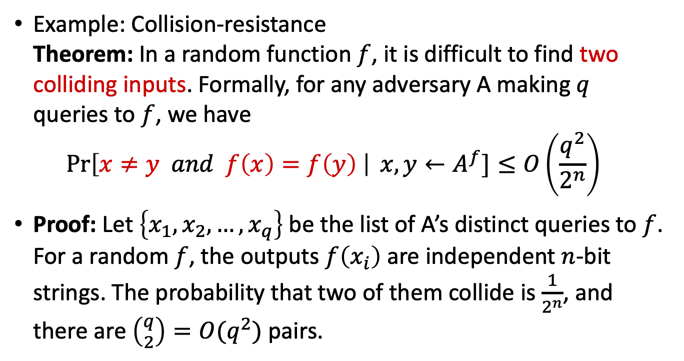
Hash Functions As Random Oracles
An ideal hash function should behave as random oracle
Example: Collision-resistance
Theorem: In a random function $f$, it is difficult to find two colliding inputs. Formally, for any adversary A making $q$ queries to $f$, we have
$\operatorname{Pr}\left[x≠y and f\left(x\right)=f\left(y\right) \right| x,y←A^{f}]≤O\left(\frac{q^{2}}{2^{n}}\right)$
Proof: Let $\left\{x_{1},x_{2}, …, x_{q}\right\}$ be the list of A’s distinct queries to $f$. For a random $f$, the outputs $f\left(x_{i}\right)$ are independent $n$-bit strings. The probability that two of them collide is $\frac{1}{2^{n}}$, and there are $\left({q \atop 2}\right)=O(q^{2})$ pairs.
$$H$$
Notes:
(infinitely) many collisions exist in hash functions, but they are hard to find

Slide 6




Digital Signatures
Alice
Bob
public key
Eve
secret key
Only secret-key holder can sign, but everyone can verify signatures using the public-key.

Slide 7
Digital Signatures
Alice
Bob
public key
Eve
secret key
Only secret-key holder can sign, but everyone can verify signatures using the public-key.
Very widely used:
Problems: expensive,
insecure against quantum attacks
[Bart Preneel @QCrypt 2014]
Notes:
Post-quantum crypto tries to solve the second problem by making it even more expensive!

Slide 8
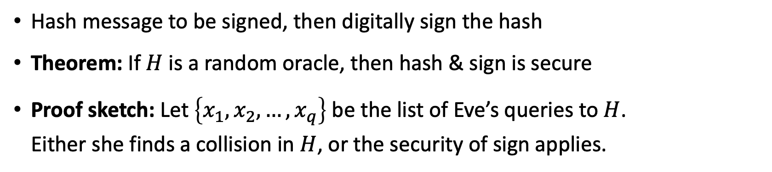

Hash & Sign
$$H$$
Alice
Bob
public key
Eve
secret key
Hash message to be signed, then digitally sign the hash
Theorem: If $H$ is a random oracle, then hash & sign is secure
Proof sketch: Let $\left\{x_{1},x_{2}, …, x_{q}\right\}$ be the list of Eve’s queries to $H$.
Either she finds a collision in $H$, or the security of sign applies.
Notes:
Post-quantum crypto tries to solve the second problem by making it even more expensive!

Slide 9

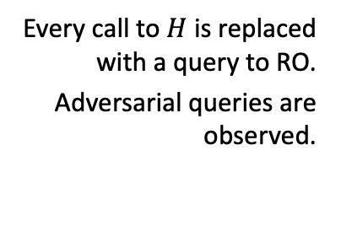


Random-Oracle Model (ROM)
Heuristic to model hash functions in cryptographic proofs
“knows $H$”
protocol
$$H$$
Informal description:
$$H:{\left\{0,1\right\}}^{∗}→{\left\{0,1\right\}}^{n}$$
protocol
Every call to $H$ is replaced with a query to RO.
Adversarial queries are observed.
Formal random-oracle model:
[Bellare Rogaway 93, slide by Dziembowski]
Notes:
Having an oracle is convenient, so that players do not need to be given access to an exponentially large random object
As long as adversary has not queried a particular input x, H(x) is independent and uniform

Slide 10

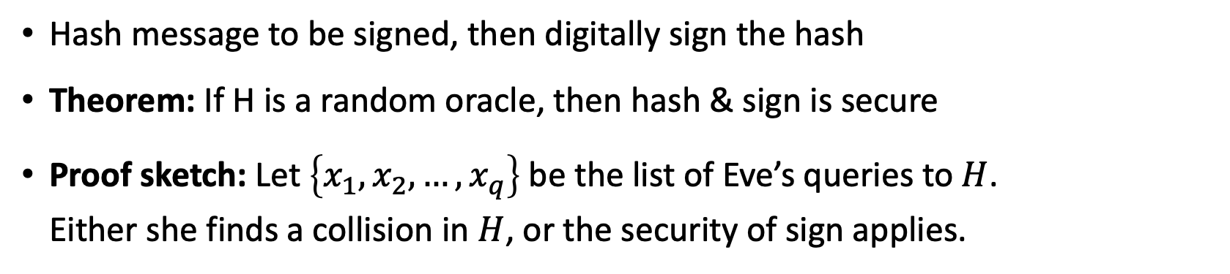
Hash & Sign in the Random Oracle Model
$$H$$
Alice
Bob
public key
Eve
secret key
Hash message to be signed, then digitally sign the hash
Theorem: If H is a random oracle, then hash & sign is secure
Proof sketch: Let $\left\{x_{1},x_{2}, …, x_{q}\right\}$ be the list of Eve’s queries to $H$.
Either she finds a collision in $H$, or the security of sign applies.
$$H:{\left\{0,1\right\}}^{∗}→{\left\{0,1\right\}}^{n}$$
Notes:
Post-quantum crypto tries to solve the second problem by making it even more expensive!

Slide 11



Criticism of the Random-Oracle Model (ROM)
There exists a digital signature scheme that is
secure in the ROM, but
not secure if RO is instantiated with any real hash function.
Very “artificial” example, no ”realistic” examples known
Common view: ROM proof is better than no proof
[Canetti Goldreich Halevi 98, slide by Dziembowski]
[Matthew Green: https://blog.cryptographyengineering.com/2011/11/02/what-is-random-oracle-model-and-why/ ]

Slide 12



Classical Random-Oracle Model in Practice
Digital Signatures: Fiat-Shamir Heuristic used by
CRYSTALS-Dilithium, FALCON
Public-Key Encryption: KEMs are often built using the Fujisaki-Okamoto transform
like in CRYSTALS-Kyber
Indifferentiability proofs
Etc.
Notes:
Post-quantum crypto tries to solve the second problem by making it even more expensive!

Slide 13
What will you Learn from this Talk?
Classical Random-Oracle Model
Quantum Access
A Crucial Insight
Applications

Slide 14


Quantum-Random-Oracle Model (QROM)
Post-quantum cryptography or quantum-safe cryptography studies quantum attackers on classical crypto.
Attacker can look up description of hash function on Wikipedia, then run it in superposition on her quantum computer
We need to allow attacker quantum (superposition) access to the random oracle
“knows $H$”
$$H:{\left\{0,1\right\}}^{∗}→{\left\{0,1\right\}}^{n}$$
[Boneh Dagdelen Fischlin Lehmann Schaffner Zhandry 11]

Slide 15

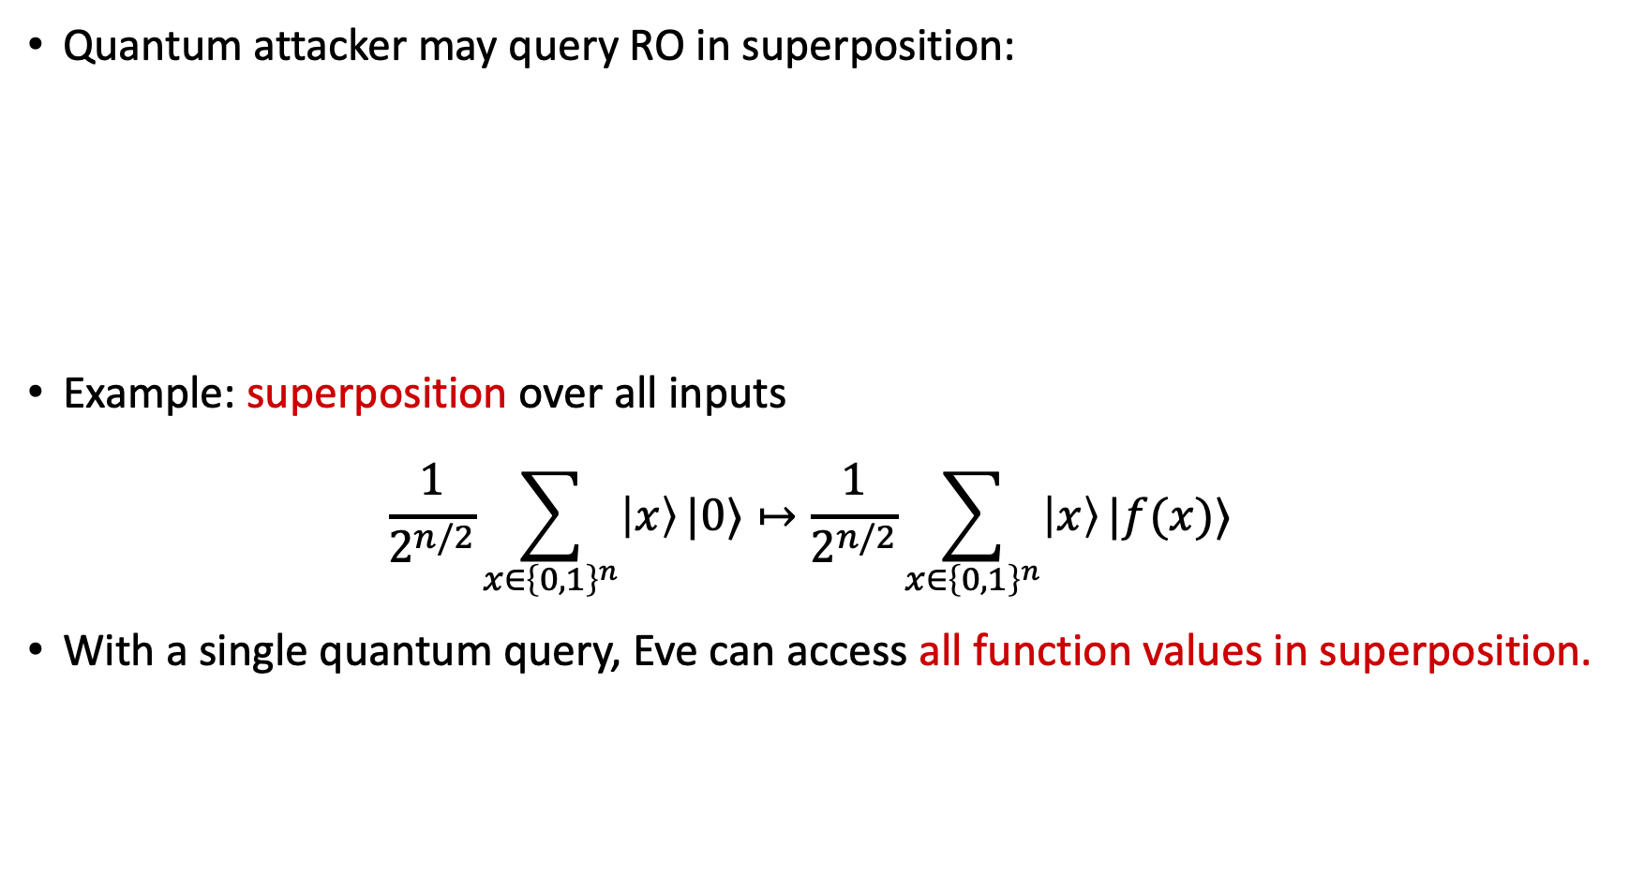





Quantum Superposition Access
Quantum attacker may query RO in superposition:
Example: superposition over all inputs
$\frac{1}{2^{n/2}}\sum_{x∈{\left\{0,1\right\}}^{n}}{\left|x\right\rangle }|0⟩↦\frac{1}{2^{n/2}}\sum_{x∈{\left\{0,1\right\}}^{n}}{\left|x\right\rangle }|f(x)⟩$
With a single quantum query, Eve can access all function values in superposition.
Standard oracle (StO): ${\left|x\right\rangle }_{X}{\left|y\right\rangle }_{Y}↦{\left|x\right\rangle }_{X}{\left|y⊕f\left(x\right)\right\rangle }_{Y}$
$$H:{\left\{0,1\right\}}^{∗}→{\left\{0,1\right\}}^{n}$$
$$|x⟩$$
$$|x⟩$$
$$O_{f}$$
$$|y⟩$$
$$|y⊕f(x)⟩$$

Slide 16
Trouble in the QROM
Many classical ROM proofs break down in the QROM
Efficient simulation: how to emulate a ROM towards an adversary
Adaptive programmability: depending on the adversary’s queries,
plant a challenge in the answer
Extractability: Simulator learns pre-images of adversary’s queries
Rewinding: replaying some hash values but changing some outputs
$$H:{\left\{0,1\right\}}^{∗}→{\left\{0,1\right\}}^{n}$$
protocol
[Boneh Dagdelen Fischlin Lehmann Schaffner Zhandry 11]

Slide 17
What will you Learn from this Talk?
Classical Random-Oracle Model
Quantum Access
A Crucial Insight
Applications

Slide 18



Quantum: Warm-Up
CNOT gate
$$|0⟩$$
$$H$$
$$|0⟩$$
What is the resulting quantum state?
https://app.wooclap.com/QROM

Slide 19

Quantum: Warm-Up
CNOT gate
$$|0⟩$$
$$H$$
$$\frac{\left|00\right\rangle +|11⟩}{\sqrt{2}}$$
$$|0⟩$$
What is the resulting quantum state?
https://app.wooclap.com/QROM

Slide 20







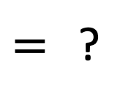


Quantum Circuit Identity
CNOT gate
$$\left|00\right\rangle ↦\left|00\right\rangle$$
$$\left|01\right\rangle ↦\left|01\right\rangle$$
$$\left|10\right\rangle ↦\left|11\right\rangle$$
$$\left|11\right\rangle ↦\left|10\right\rangle$$
$$\left|++\right\rangle ↦\left|++\right\rangle$$
$$\left|+−\right\rangle ↦\left|−−\right\rangle$$
$$\left|−+\right\rangle ↦\left|−+\right\rangle$$
$$\left|−−\right\rangle ↦\left|+−\right\rangle$$
$$H$$
$$H$$
$=$ ?
$$H$$
$$H$$
$$H$$
$$H$$
$$Z$$
https://app.wooclap.com/QROM

Slide 21
Quantum Circuit Identity
CNOT gate
$$\left|00\right\rangle ↦\left|00\right\rangle$$
$$\left|01\right\rangle ↦\left|01\right\rangle$$
$$\left|10\right\rangle ↦\left|11\right\rangle$$
$$\left|11\right\rangle ↦\left|10\right\rangle$$
$$\left|++\right\rangle ↦\left|++\right\rangle$$
$$\left|+−\right\rangle ↦\left|−−\right\rangle$$
$$\left|−+\right\rangle ↦\left|−+\right\rangle$$
$$\left|−−\right\rangle ↦\left|+−\right\rangle$$
$$H$$
$$H$$
$=$ ?
$$H$$
$$H$$
$$H$$
$$H$$
$$Z$$
https://app.wooclap.com/QROM

Slide 22





Quantum Circuit Identity
CNOT gate
$$\left|00\right\rangle ↦\left|00\right\rangle$$
$$\left|01\right\rangle ↦\left|01\right\rangle$$
$$\left|10\right\rangle ↦\left|11\right\rangle$$
$$\left|11\right\rangle ↦\left|10\right\rangle$$
$$\left|++\right\rangle ↦\left|++\right\rangle$$
$$\left|+−\right\rangle ↦\left|−−\right\rangle$$
$$\left|−+\right\rangle ↦\left|−+\right\rangle$$
$$\left|−−\right\rangle ↦\left|+−\right\rangle$$
$$H$$
$$H$$
$$=$$
$$H$$
$$H$$
When viewed “in the Hadamard basis”, the control and target of the CNOT are swapped!

Slide 23




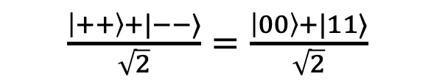



Quantum: Warm-Up Revisited
CNOT gate
$$|0⟩$$
$$H$$
$$\frac{\left|00\right\rangle +|11⟩}{\sqrt{2}}$$
$$|+⟩$$
$$H$$
$\frac{\left|++\right\rangle +|−−⟩}{\sqrt{2}}=$ $\frac{\left|00\right\rangle +|11⟩}{\sqrt{2}}$
$$|0⟩$$
$$|+⟩$$

Slide 24



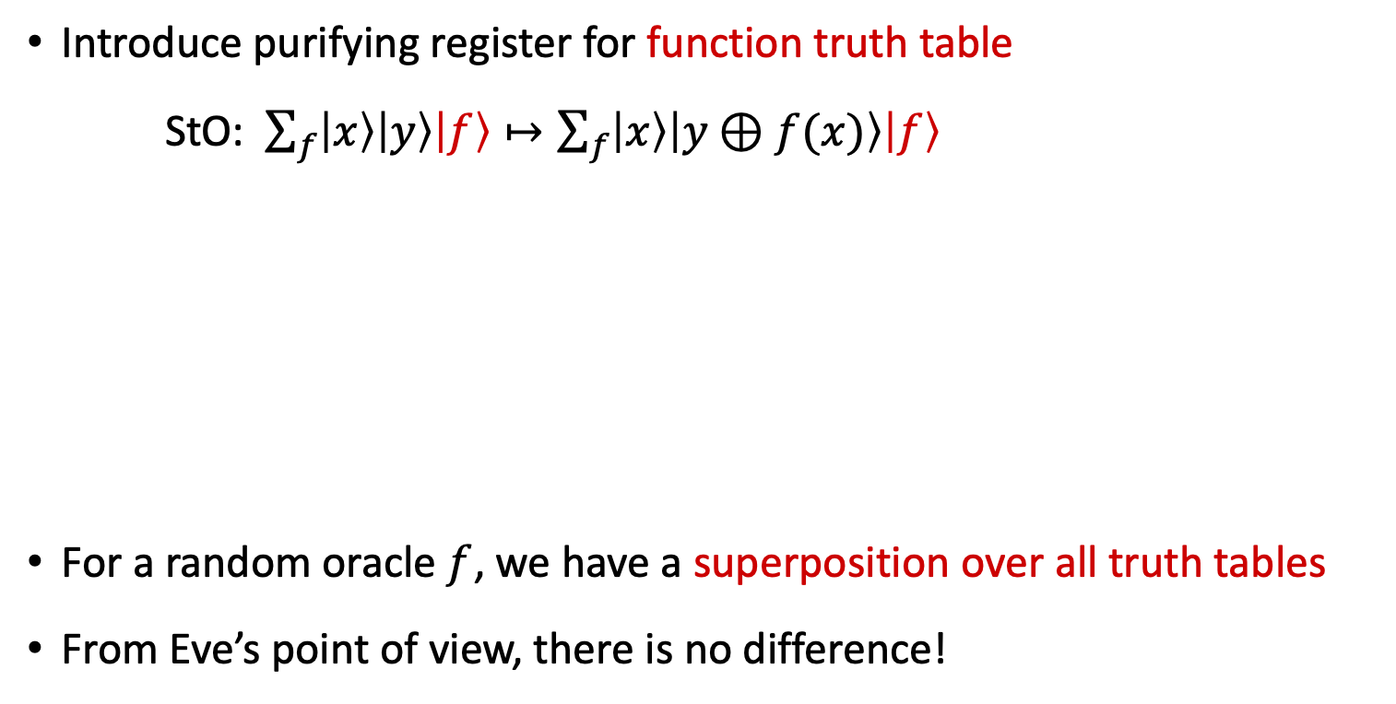














A Crucial Insight: Purification
Introduce purifying register for function truth table
StO: $\sum_{f}{\left|x\right\rangle \left|y\right\rangle \left|f\right\rangle }↦\sum_{f}{\left|x\right\rangle \left|y⊕f(x)\right\rangle \left|f\right\rangle }$
For a random oracle $f$, we have a superposition over all truth tables
From Eve’s point of view, there is no difference!
$$O_{f}$$
$$|x⟩$$
$$|x⟩$$
$$|x⟩$$
$$x=0$$
$$x=1$$
$$|x⟩$$
$$|y⟩$$
$$O_{f}$$
$$|y⊕f(x)⟩$$
$$|y⟩$$
$$|y⊕f(x)⟩$$
$$|f⟩$$
$$|f⟩$$
$$|f(0)⟩$$
$$|f(0)⟩$$
$$|f(1)⟩$$
$$|f(1)⟩$$
[Mark Zhandry 2018: How to Record Quantum Queries]

Slide 25




























Change of Viewpoint: Fourier Oracle
Standard Oracle
Fourier Oracle
$$x=0$$
$$x=1$$
$$|x⟩$$
$$x=0$$
$$x=1$$
$$|x⟩$$
$$|x⟩$$
$$x=0$$
$$x=1$$
$$|x⟩$$
$$|x⟩$$
$$|y⟩$$
$$H$$
$$H$$
$$H$$
$$H$$
$$|y⊕f(x)⟩$$
$$|η⟩$$
$$|η⟩$$
$$|η⟩$$
$$|f(0)⟩$$
$$H$$
$$H$$
$$|f(0)⟩$$
$$|0⟩$$
$$|η⟩$$
$$|0⟩$$
$$|f(1)⟩$$
$$H$$
$$H$$
$$|f(1)⟩$$
$$|0⟩$$
$$|0⟩$$
$$|η⟩$$
By making a query, Eve entangles herself with the truth table in a very clean way, when observed in the Fourier basis!
[Mark Zhandry 2018: How to Record Quantum Queries]

Slide 26








Compressing the Database
Fourier Oracle
Fourier Oracle (FO):
$\left|x\right\rangle \left|η\right\rangle \left|0^{n}⋯0^{n}\right\rangle \underset{→}{FO}|x⟩|η⟩|0^{n}⋯0^{n} η 0^{n}⋯0^{n}⟩$
Multiple FO queries “populate” the database
Compression: only keep track of the non-zero entries
$\left|x\right\rangle \left|η\right\rangle \left|D\right\rangle$ $\underset{→}{FO}\left|x\right\rangle \left|η\right\rangle \left|D∪(x,η)\right\rangle$
Allows efficient simulation of the random oracle to the adversary
$$x=0$$
$$x=1$$
$$|x⟩$$
$$x=0$$
$$x=1$$
$$|x⟩$$
$$|x⟩$$
$$|η⟩$$
$$|η⟩$$
$$|η⟩$$
$$|0⟩$$
$$|η⟩$$
$$|0⟩$$
$$|0⟩$$
$$|0⟩$$
$$|η⟩$$
[Mark Zhandry 2018: How to Record Quantum Queries]

Slide 27
What will you Learn from this Talk?
Classical Random-Oracle Model
Quantum Access
A Crucial Insight
Applications

Slide 28
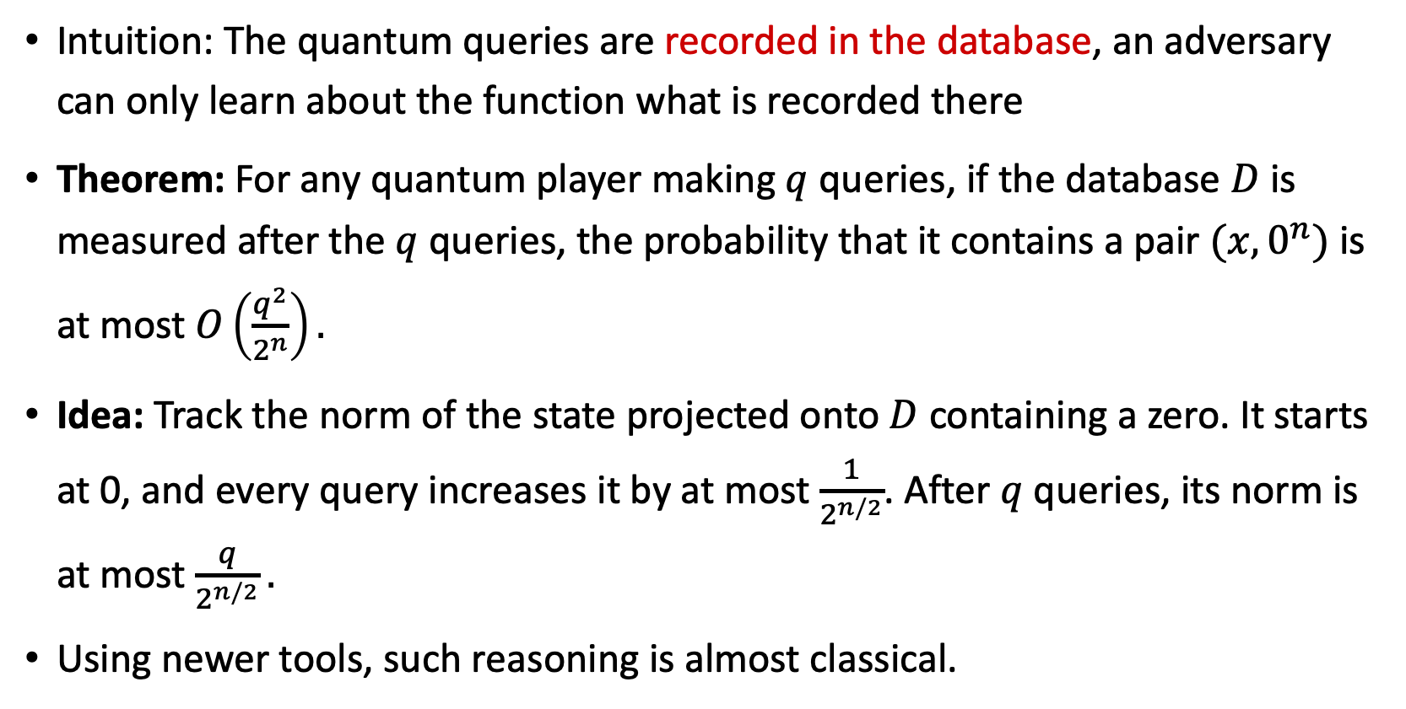
Query Lower Bounds
Intuition: The quantum queries are recorded in the database, an adversary can only learn about the function what is recorded there
Theorem: For any quantum player making $q$ queries, if the database $D$ is measured after the $q$ queries, the probability that it contains a pair $(x,0^{n})$ is at most $O\left(\frac{q^{2}}{2^{n}}\right).$
Idea: Track the norm of the state projected onto $D$ containing a zero. It starts at 0, and every query increases it by at most $\frac{1}{2^{n/2}}$. After $q$ queries, its norm is at most $\frac{q}{2^{n/2}}.$
Using newer tools, such reasoning is almost classical.
[Mark Zhandry 2018: How to Record Quantum Queries,
Chung, Fehr, Huang, Liao 2021]

Slide 29
Numerous Applications
Query lower bounds for searching and (multi-)collisions in random functions
Fujisaki-Okamoto transformation (to build public-key encryption)
Fiat-Shamir transform (for digital signatures)
Indifferentiability
4-round Luby-Rackoff/Feistel construction
Succinct arguments
Separations between ROM and QROM
Adaptive reprogramming
…

Slide 30

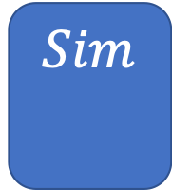

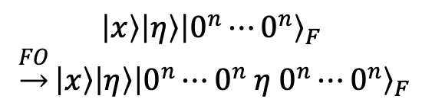
Summary
$$H:{\left\{0,1\right\}}^{∗}→{\left\{0,1\right\}}^{n}$$
Classical Random-Oracle Model
Quantum Access
A Crucial Insight
Applications
$$H$$
$$\left|x\right\rangle \left|η\right\rangle {\left|0^{n}⋯0^{n}\right\rangle }_{F}$$
$\underset{→}{FO}\left|x\right\rangle \left|η\right\rangle {\left|0^{n}⋯0^{n} η 0^{n}⋯0^{n}\right\rangle }_{F}$
$$Sim$$

Slide 31
Thank you for your attention!
Questions

