Slide 1


Quantum Cryptography (Beyond QKD)
Christian Schaffner
Research Center for Quantum Software
Institute for Logic, Language and Computation (ILLC)
University of Amsterdam
Centrum Wiskunde & Informatica
All material available on https://homepages.cwi.nl/~schaffne
Quantum Dummies @Simons
Friday, 17 April 2020

Slide 2
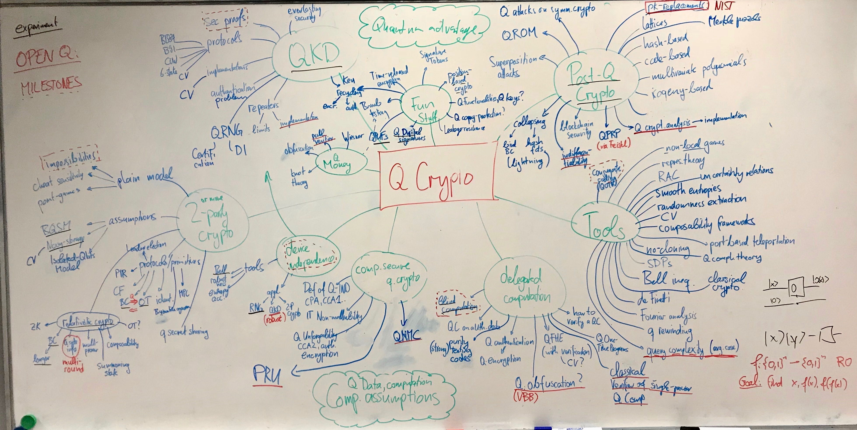
Notes:
Here’s everything I know about Q crypto

Slide 3
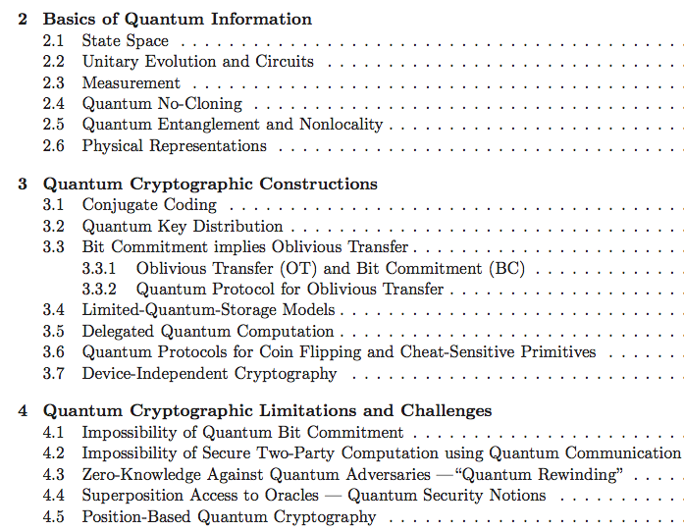
Quantum Cryptography Beyond QKD
survey article with
Anne Broadbent
aimed at classical cryptographers
http://arxiv.org/abs/1510.06120
In Designs, Codes and Cryptography 2016
[Broadbent Schaffner 16 in Designs, Codes and Cryptography]
Notes:
Why did they invite me?

Slide 4
QCrypt Conference Series
Started in 2011 by Christandl and Wehner
Steadily growing since then:
approx. 100 submissions, 30 accepted as contributions,
~300 participants in Montreal 2019. This year: Amsterdam
goal of the conference: represent the previous year’s best results on quantum cryptography, and to support the building of a research community
Trying to keep a healthy balance between theory and experiment
Half the program consists of 4 tutorials of 90 minutes, approximately 6 invited talks
[QCrypt 2020, organized by Amsterdam group]

Slide 5
Overview
[thanks to Serge Fehr, Stacey Jeffery, Chris Majenz, Florian Speelman, Ronald de Wolf]
Notes:
Started from an 10-year old mindmap from 2008, right after my PhD. Added new things, more tools

Slide 6
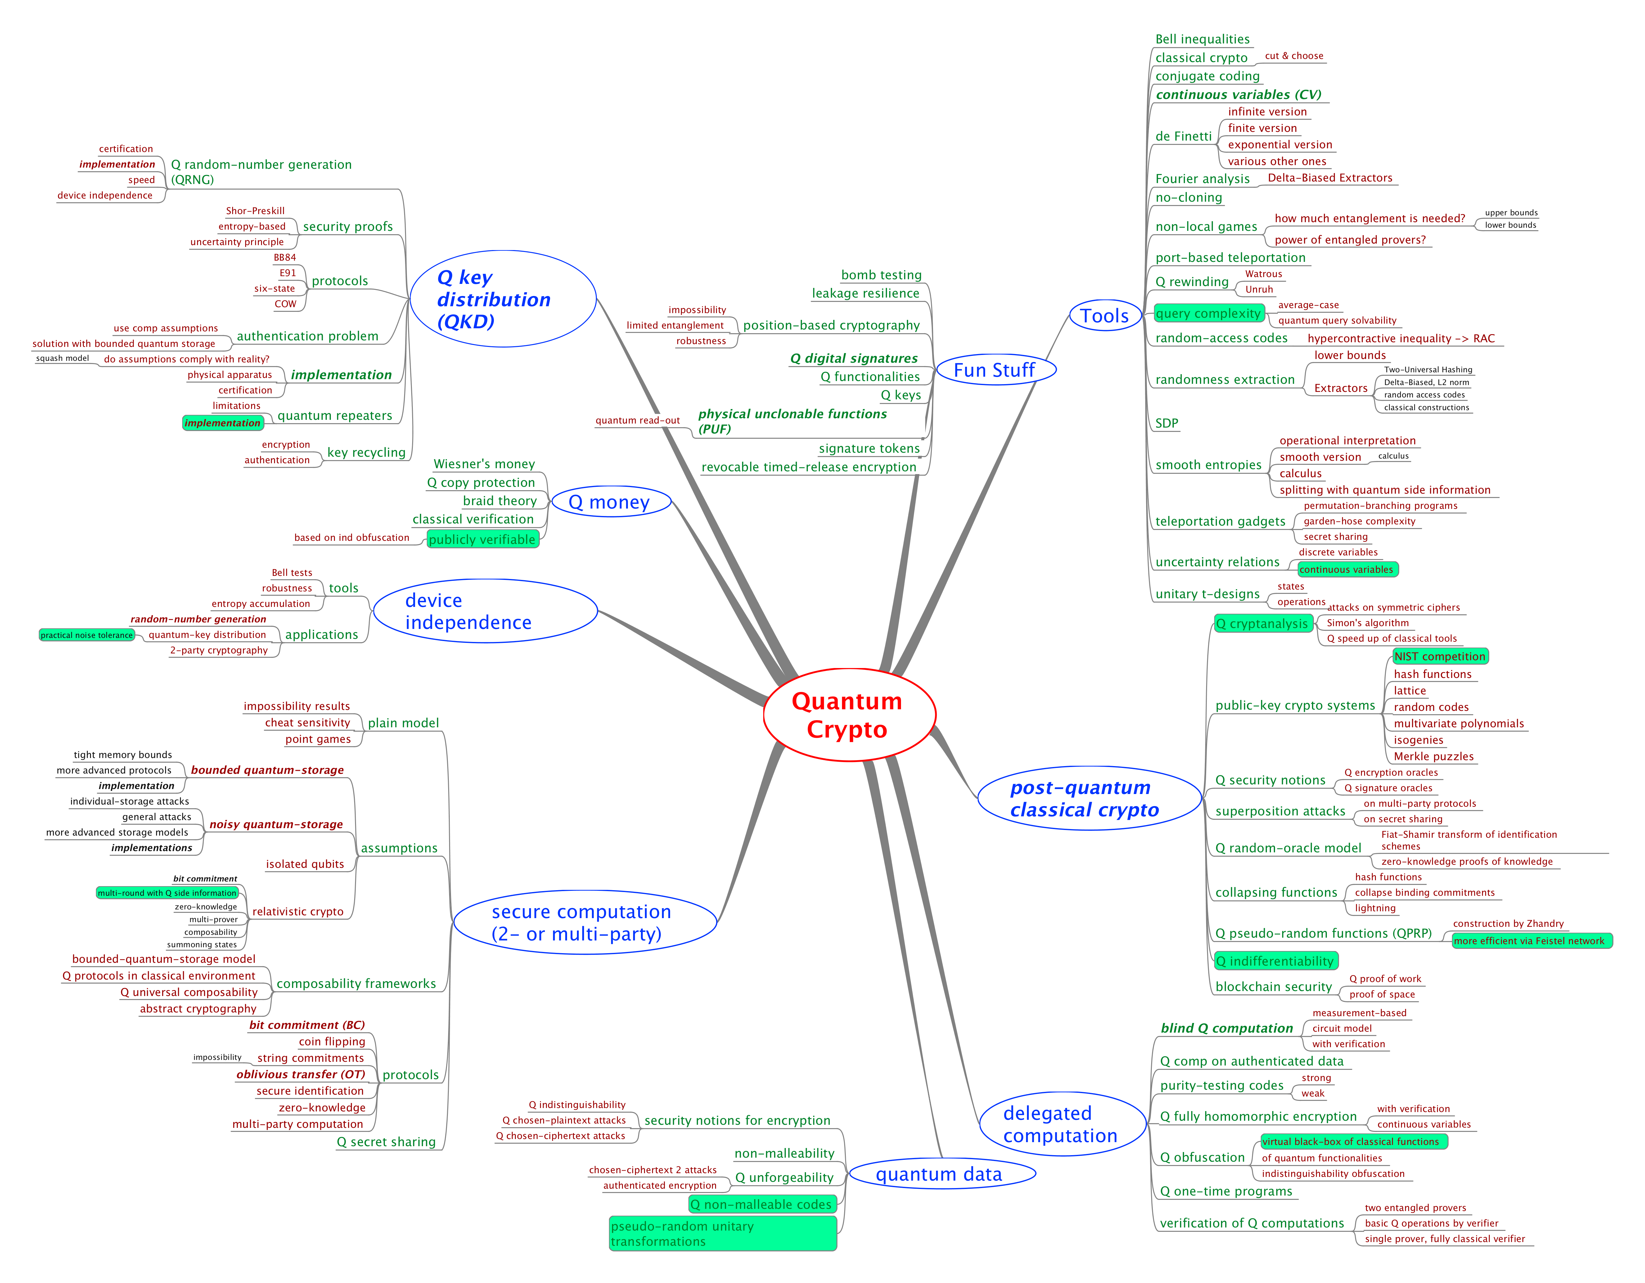
MindMap
Tools
Q advantage
experiments
Selection of
open questions
Fork me on github!
Post Q crypto
Q data
[from 2018! https://github.com/cschaffner/QCryptoMindmap]

Slide 7
MindMap
Tools
Q advantage
experiments
Selection of
open questions
Fork me on github!
Post Q crypto
Q data
[https://github.com/cschaffner/QCryptoMindmap]

Slide 8
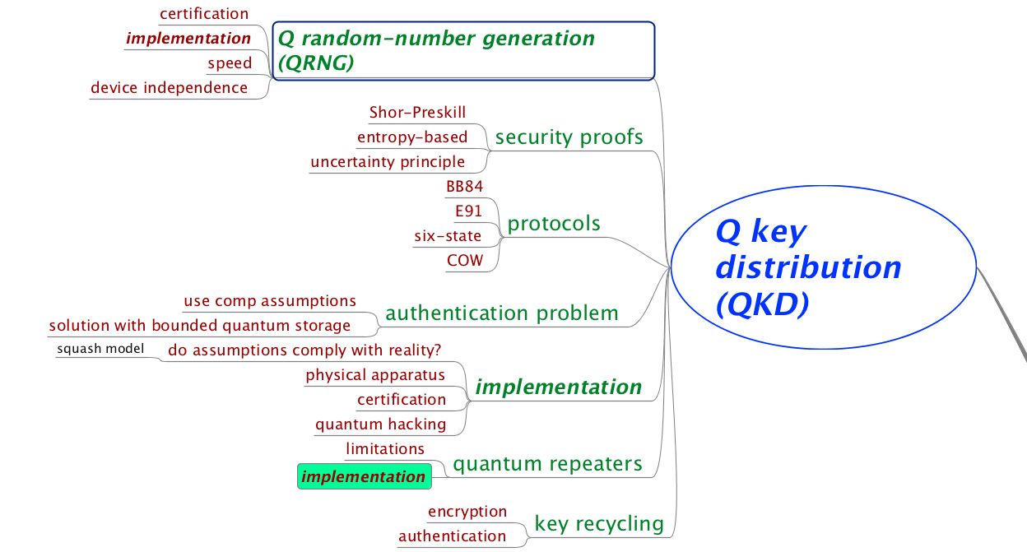
Quantum Key Distribution (QKD)

Slide 9
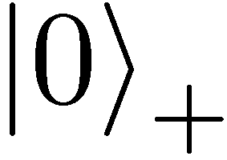
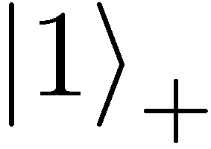
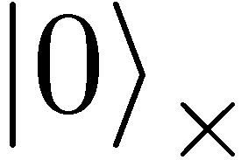
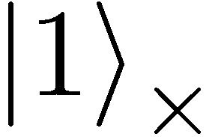
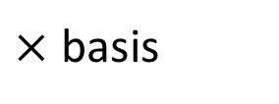
Quantum Mechanics
+ basis
$×$ basis
Measurements:
Quantum operations:
U
with prob. 1 yields 1
H
0/1
with prob. ½ yields 0
0/1
with prob. ½ yields 1

Slide 10
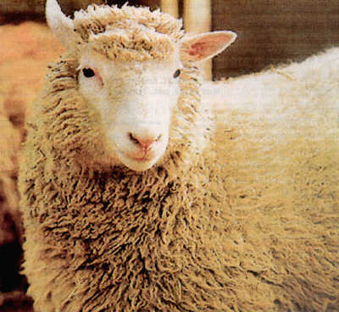
No-Cloning Theorem
U
Quantum operations:
?
?
?
Proof: copying is a non-linear operation
Notes:
information vs disturbance trade-off

Slide 11
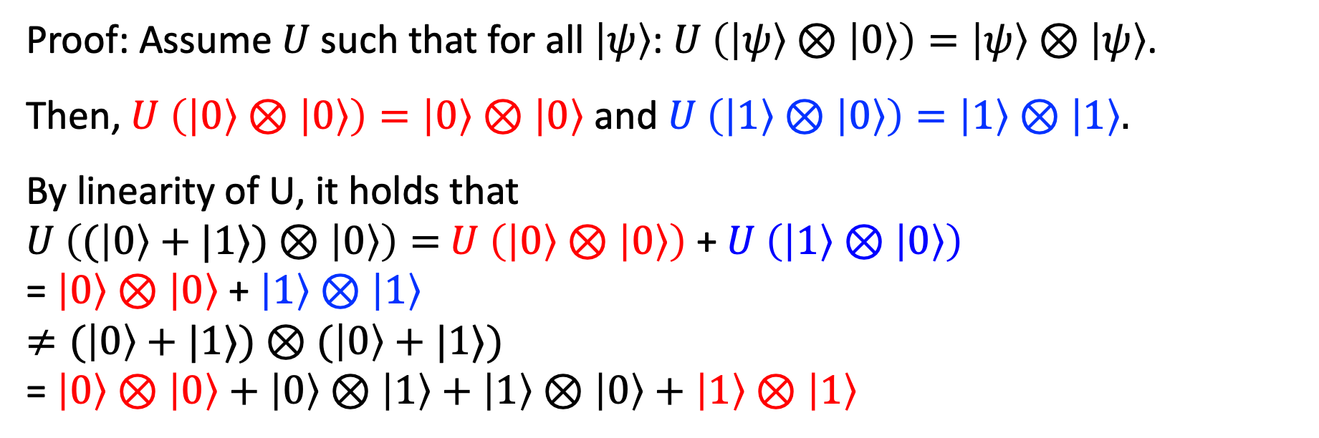
Proof of No-Cloning Theorem
?
?
?
Proof: Assume $U$ such that for all $\left|ψ\right\rangle$: $U \left(\left|ψ\right\rangle ⊗\left|0\right\rangle \right)=\left|ψ\right\rangle ⊗\left|ψ\right\rangle$.
Then, $U \left(\left|0\right\rangle ⊗\left|0\right\rangle \right)=\left|0\right\rangle ⊗\left|0\right\rangle$ and $U \left(\left|1\right\rangle ⊗\left|0\right\rangle \right)=\left|1\right\rangle ⊗\left|1\right\rangle .$
By linearity of U, it holds that
$U \left((\left|0\right\rangle +|1⟩)⊗\left|0\right\rangle \right)=$ $U \left(\left|0\right\rangle ⊗\left|0\right\rangle \right)$ + $U \left(\left|1\right\rangle ⊗\left|0\right\rangle \right)$
= $\left|0\right\rangle ⊗\left|0\right\rangle$ + $\left|1\right\rangle ⊗\left|1\right\rangle$
$≠(\left|0\right\rangle +|1⟩)⊗$ $(\left|0\right\rangle +|1⟩)$
= $\left|0\right\rangle ⊗\left|0\right\rangle +$ $\left|0\right\rangle ⊗\left|1\right\rangle +$ $\left|1\right\rangle ⊗\left|0\right\rangle +$ $\left|1\right\rangle ⊗\left|1\right\rangle$
Contradiction!
Notes:
information vs disturbance trade-off

Slide 12
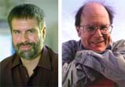


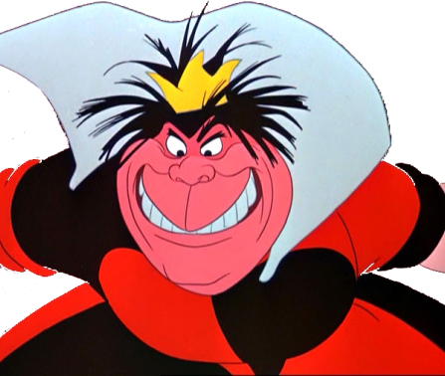
Quantum Key Distribution (QKD)
Alice
[Bennett Brassard 84]
Bob
k = ?
k = 0101 1011
Eve
k = 0101 1011
Offers an quantum solution to the key-exchange problem which does not rely on computational assumptions (such as factoring, discrete logarithms, security of AES, SHA-3 etc.)
Important caveat: classical communication has to be authenticated to prevent man-in-the-middle attacks
Notes:
add link to BB84

Slide 13
Quantum Key Distribution (QKD)
0 1 1 1 0
0 0 1 1 0
k = 110
k = 110
[Bennett Brassard 84]

Slide 14
Quantum Key Distribution (QKD)
?
?
?
?
?
0 1 1 1 0
0 0 1 1 0
k = ?
k = 10
k = 10
Quantum states are unknown to Eve, she cannot copy them.
Honest players can test whether Eve interfered.
[Bennett Brassard 84]

Slide 15
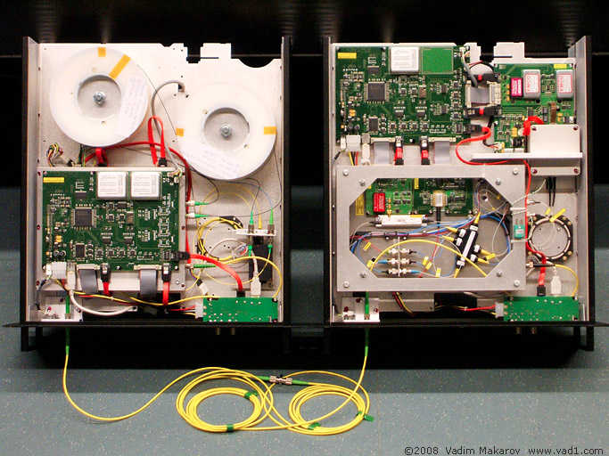

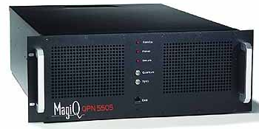
Quantum Key Distribution (QKD)
Alice
Bob
Eve
technically feasible: no quantum computer required,
only quantum communication

Slide 16

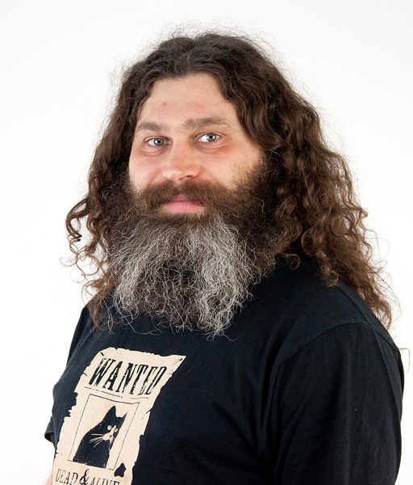
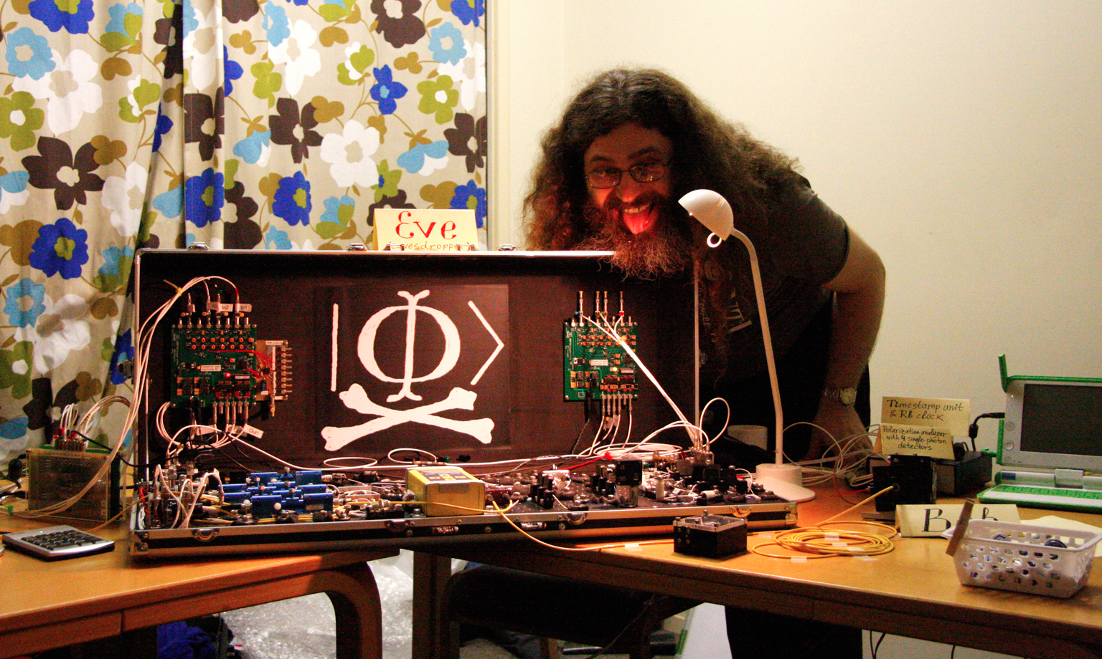
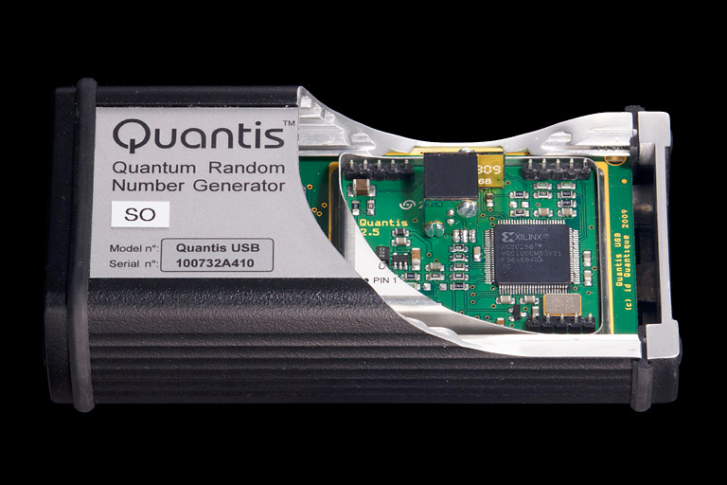
Quantum Hacking
e.g. by the group of Vadim Makarov (Quantum Hacking Lab, Moscow)

Slide 17
Quantum Key Distribution (QKD)
Alice
[Bennett Brassard 84]
Bob
k = ?
k = 0101 1011
Eve
k = 0101 1011
Three-party scenario: two honest players versus one dishonest eavesdropper
Quantum Advantage: Information-theoretic security is provably impossible with only classical communication (Shannon’s theorem about perfect security)
Notes:
add link to BB84

Slide 18
Quantum Key Distribution (QKD)

Slide 19
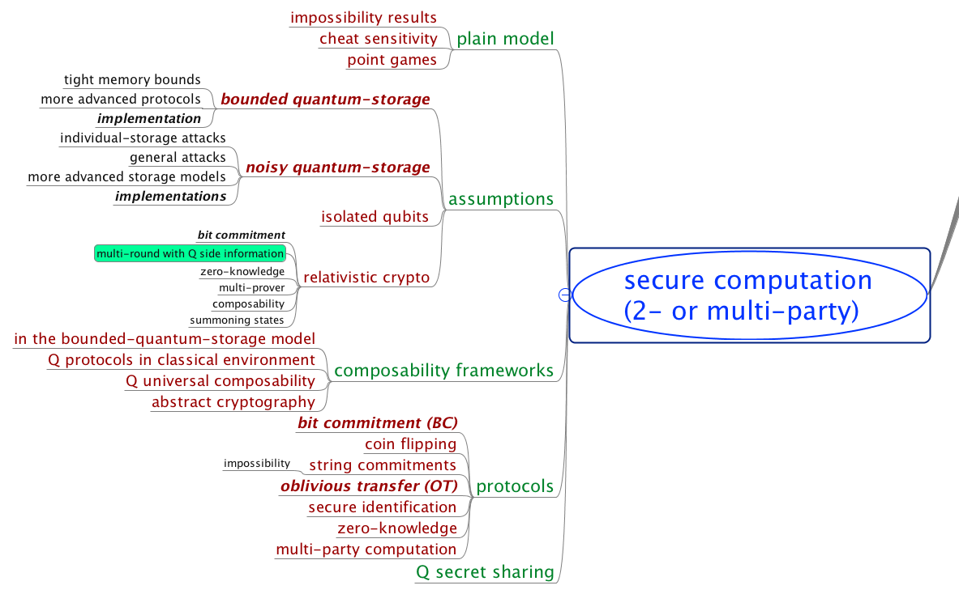

Slide 20
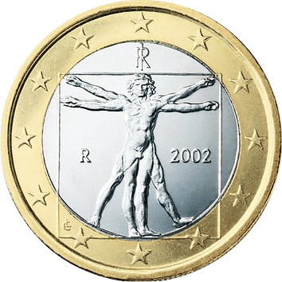



















Secure Two-Party Cryptography
Information-theoretic security
No computational restrictions
Correctness (both honest)
usefulness
Coin-Flipping
Bit Commitment
Oblivious Transfer
2-Party Function Evaluation
Multi-Party Computation
(with dishonest majority)
$$⇒$$
$$⇏$$
Security for honest Alice
quantum usefulness
$$⇒$$
$$⇏$$
$$⇒$$
usefulness
$$s_{0}$$
OT
$$c$$
$$⇒$$
$$⇒$$
$$s_{1}$$
$$s_{c}$$
Security for honest Bob
$$⇔$$
$$x$$
$$ℱ$$
$$y$$
$$f(x,y)$$
$$g(x,y)$$
[Blum 83, Kilian 88]

Slide 21
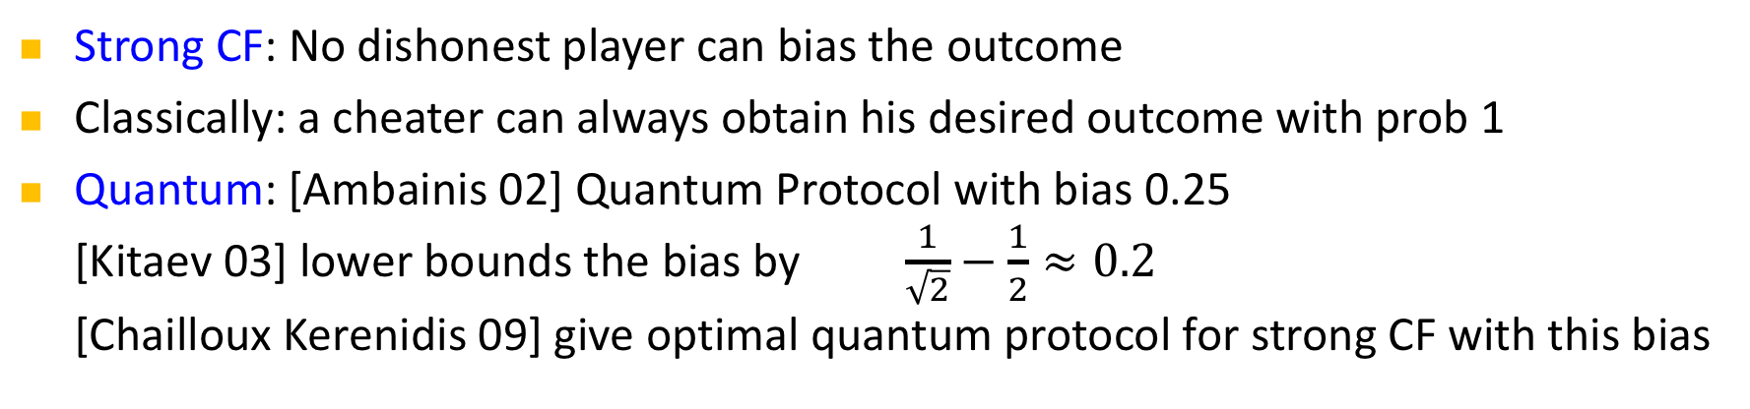
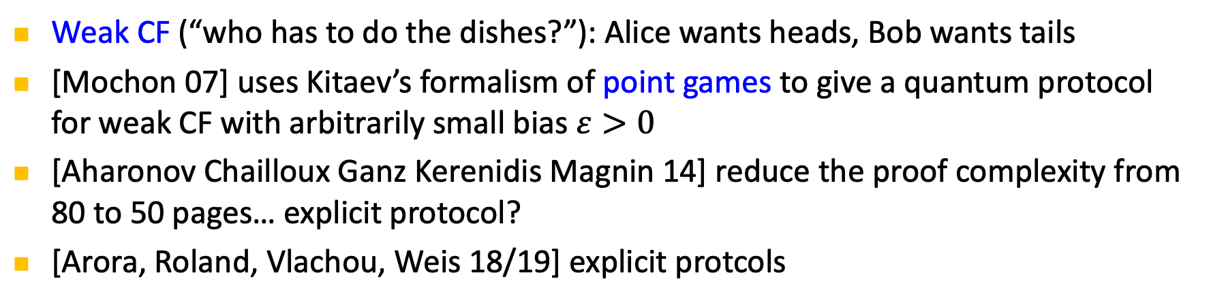
Coin Flipping (CF)
Strong CF: No dishonest player can bias the outcome
Classically: a cheater can always obtain his desired outcome with prob 1
Quantum: [Ambainis 02] Quantum Protocol with bias 0.25
[Kitaev 03] lower bounds the bias by $\frac{1}{\sqrt{2}}−\frac{1}{2}≈0.2$
[Chailloux Kerenidis 09] give optimal quantum protocol for strong CF with this bias
Weak CF (“who has to do the dishes?”): Alice wants heads, Bob wants tails
[Mochon 07] uses Kitaev’s formalism of point games to give a quantum protocol for weak CF with arbitrarily small bias $ε>0$
[Aharonov Chailloux Ganz Kerenidis Magnin 14] reduce the proof complexity from 80 to 50 pages… explicit protocol?
[Arora, Roland, Vlachou, Weis 18/19] explicit protcols

Slide 22
Bit Commitment (BC)
Two-phase (reactive) protocol:
a=0 or
a=1
commit
a = ?
Bob‘s
view
Hiding: even dishonest Bob does not learn a
Binding: dishonest Alice cannot change her mind
open
a
Classically: impossible
Quantum: believed to be possible in the early 90s
shown impossible by [Mayers 97, LoChau 97] by a beautiful argument (purification and Uhlmann’s theorem)
[Chailloux Kerenidis 11] show that in any quantum BC protocol, one player can cheat with prob 0.739. They also give an optimal protocol achieving this bound. Crypto application?
[Brassard Crepeau Jozsa Langlois: A quantum BC scheme provably unbreakable by both parties, FOCS 93]
Notes:
Going back to the original paper on quantum bit commitment [BCJL93], we note that a subtlety in the definition of the binding property is the origin of the false claim of security: while it is true that the protocol is such that Alice is unable to simultaneously hold messages that would unveil a commitment to b=0 and as b=1 (and thus, to be able to choose to open b=0 and b=1), this is insufficient to prove security, since in fact Alice is able to delay her choice of commitment until the very end of the protocol—at which point she can choose to open as either b = 0 or b = 1 (but not necessarily both at the same time!).

Slide 23


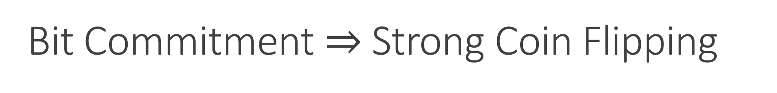











Bit Commitment $⇒$ Strong Coin Flipping
$$⇒$$
$$⇏$$
$$⇒$$
$$⇏$$
$$⇒$$
$$s_{0}$$
OT
$$c$$
$$s_{1}$$
$$s_{c}$$
$$⇒$$
$$⇒$$
$$x$$
$$ℱ$$
$$y$$
$$f(x,y)$$
$$g(x,y)$$

Slide 24
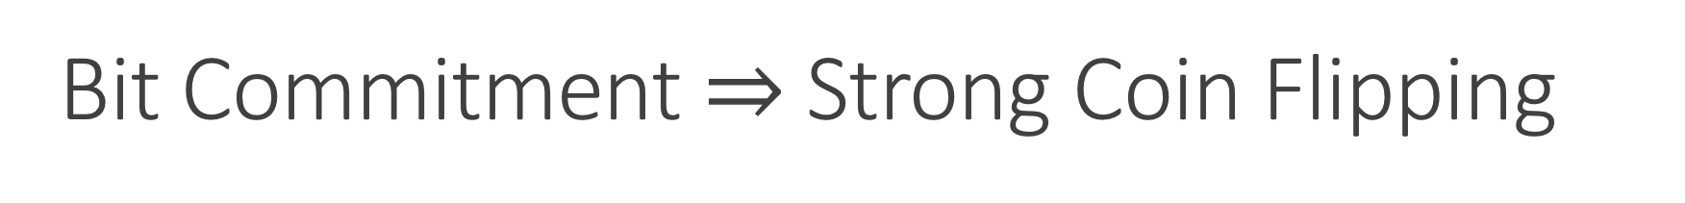
Bit Commitment $⇒$ Strong Coin Flipping
a=0 or
a=1
a
a
b=0 or
b=1
b
a = b
a ≠ b
[Blum 83]

Slide 25


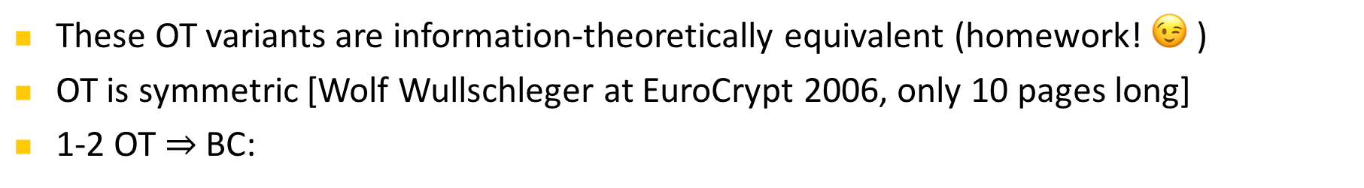

















Oblivious Transfer (OT)
1-out-of-2 Oblivious Transfer:
Rabin OT:
(secure erasure)
$$s_{0}$$
OT
$$c$$
$$s_{1}$$
$$s_{c}$$
Dishonest Alice does not learn choice bit
Dishonest Bob can only learn one of the two messages
$$s$$
ROT
$s$ / $⊥$
These OT variants are information-theoretically equivalent (homework! 😉 )
OT is symmetric [Wolf Wullschleger at EuroCrypt 2006, only 10 pages long]
1-2 OT $⇒$ BC:
$$r_{1}$$
$$c_{1}∈_{R}\{0,1\}$$
open
OT
$${a⊕r}_{1}$$
$$s_{c_{1}}$$
commit
$$r_{2}$$
OT
$$c_{2}∈_{R}\{0,1\}$$
$a=0$ or
$$a=1$$
$${a⊕r}_{2}$$
$$s_{c_{2}}$$
$${a, r}_{1},r_{2},…$$
$$r_{3}$$
OT
$$c_{3}∈_{R}\{0,1\}$$
$${a⊕r}_{3}$$
$$s_{c_{3}}$$
[Wiesner 68, Even Goldreich Lempel 85, Rabin 81]

Slide 26






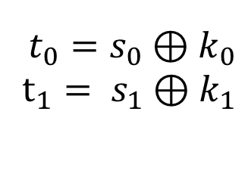
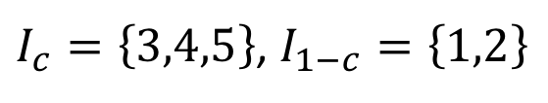



Quantum Protocol for Oblivious Transfer
$$s_{0}$$
$$c$$
OT
$$s_{1}$$
$$s_{c}$$
0 1 1 1 0
0 0 1 1 0
$$I_{0},I_{1}$$
$I_{c}=\left\{3,4,5\right\}$, $I_{1−c}=\left\{1,2\right\}$
$$f_{0},f_{1}$$
$${t_{0}=s}_{0}⊕k_{0}$$
$$t_{1}= s_{1}⊕k_{1}$$
$$k_{1}=f_{1}\left(110\right)$$
$$k_{0}=f_{0}(01)$$
$$k_{1}=f_{1}\left(110\right)$$
Correctness ✓
$$s_{1}=t_{1}⊕f_{1}\left(110\right)$$
[Wiesner 68, Bennett Brassard Crepeau Skubiszewska 91]

Slide 27
Quantum Protocol for Oblivious Transfer
$$s_{0}$$
$$c$$
OT
$$s_{1}$$
$$s_{c}$$
0 1 1 1 0
0 0 1 1 0
$$I_{0},I_{1}$$
$I_{c}=\left\{3,4,5\right\}$, $I_{1−c}=\left\{1,2\right\}$
$$f_{0},f_{1}$$
$${t_{0}=s}_{0}⊕k_{0}$$
$$t_{1}= s_{1}⊕k_{1}$$
$$k_{1}=f_{1}\left(110\right)$$
$$k_{0}=f_{0}(01)$$
$$k_{1}=f_{1}\left(110\right)$$
✓
$$s_{1}=t_{1}⊕f_{1}\left(110\right)$$
Security for honest Bob
[Wiesner 68, Bennett Brassard Crepeau Skubiszewska 91]

Slide 28




Quantum Protocol for Oblivious Transfer
$$s_{0}$$
$$c$$
OT
$$s_{1}$$
$$s_{c}$$
store all qbits
0 1 1 1 0
0 0 1 1 0
$$I_{0},I_{1}$$
$I_{c}=\left\{3,4,5\right\}$, $I_{1−c}=\left\{1,2\right\}$
$$f_{0},f_{1}$$
$$k_{1}=f_{1}\left(110\right)$$
$${t_{0}=s}_{0}⊕k_{0}$$
$$t_{1}= s_{1}⊕k_{1}$$
$$k_{1}=f_{1}\left(110\right)$$
$$k_{0}=f_{0}(01)$$
$$k_{0}=f_{0}(01)$$
Security for honest Bob ✓
Security for honest Alice
$$s_{1}=t_{1}⊕f_{1}\left(110\right)$$
$$s_{0}=t_{0}⊕f_{0}\left(01\right)$$
❌
[Wiesner 68, Bennett Brassard Crepeau Skubiszewska 91]

Slide 29


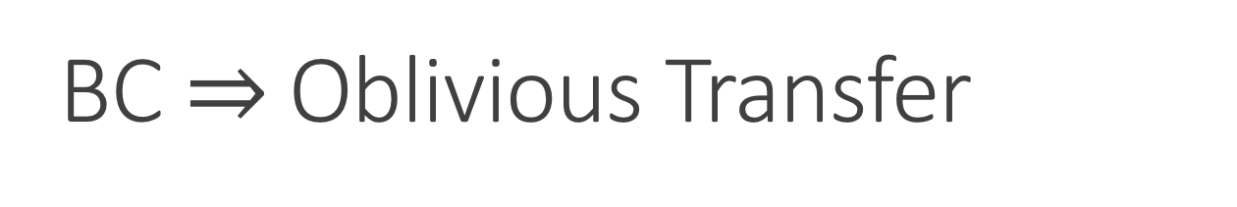


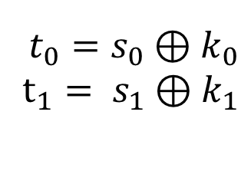

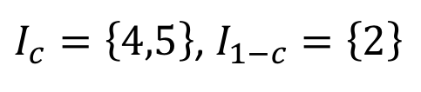


BC $⇒$ Oblivious Transfer
$$s_{0}$$
$$c$$
OT
$$s_{1}$$
$$s_{c}$$
0 1 1 1 0
0 0 1 1 0
0 0 1 1 0
0 1
$$I_{0},I_{1}$$
$I_{c}=\left\{4,5\right\}$, $I_{1−c}=\left\{2\right\}$
$$f_{0},f_{1}$$
$${t_{0}=s}_{0}⊕k_{0}$$
$$t_{1}= s_{1}⊕k_{1}$$
$$k_{1}=f_{1}\left(10\right)$$
$$k_{0}=f_{0}(1)$$
$$k_{1}=f_{1}\left(10\right)$$
$$s_{1}=t_{1}⊕f_{1}\left(10\right)$$
[Bennett Brassard Crepeau Skubiszewska 91, Damgaard Fehr Lunemann Salvail Schaffner 09, Unruh 10]

Slide 30
Limited Quantum Storage
$$s_{0}$$
$$c$$
OT
$$s_{1}$$
$$s_{c}$$
store all qbits
0 1 1 1 0
wait 1 sec
$$I_{0},I_{1}$$
$I_{c}=\left\{3,4,5\right\}$, $I_{1−c}=\left\{1,2\right\}$
$$f_{0},f_{1}$$
$${t_{0}=s}_{0}⊕k_{0}$$
$$t_{1}= s_{1}⊕k_{1}$$
$$k_{1}=f_{1}\left(110\right)$$
$$k_{0}=f_{0}(01)$$
$$k_{1}=f_{1}\left(110\right)$$
$$s_{1}=t_{1}⊕f_{1}\left(110\right)$$
[Damgaard Fehr Salvail Schaffner 05, Wehner Schaffner Terhal 09]

Slide 31












Summary of Quantum Two-Party Crypto
Information-theoretic security
No computational restrictions
Coin-Flipping
Bit Commitment
Oblivious Transfer
2-Party Function Evaluation
$$⇒$$
$$⇏$$
quantum usefulness
$$⇒$$
$$⇏$$
$$⇒$$
$$s_{0}$$
OT
$$c$$
$$⇒$$
$$⇒$$
$$s_{1}$$
$$s_{c}$$
$$x$$
$$ℱ$$
$$y$$
$$f(x,y)$$
$$g(x,y)$$
[Blum 83, Kilian 88]

Slide 32
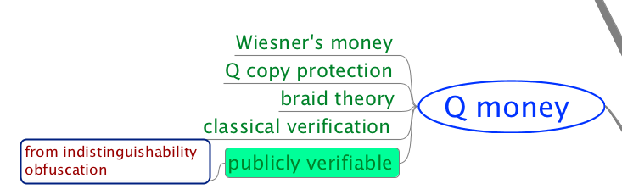
Quantum Money

Slide 33
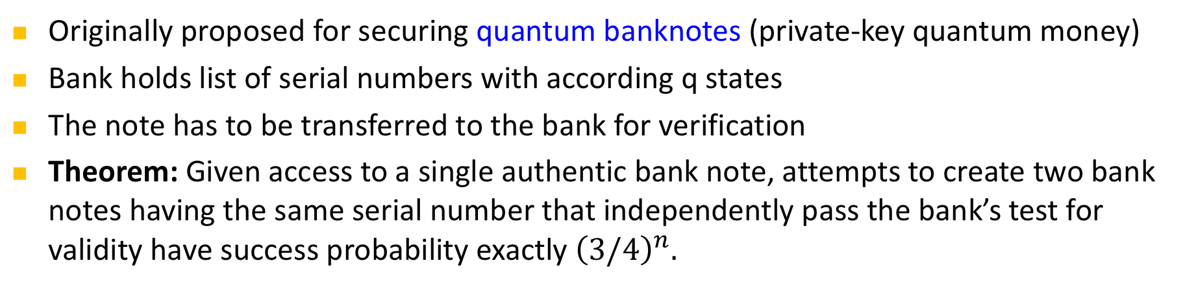
Conjugate Coding & Quantum Money
also known as quantum coding or quantum multiplexing
0 1 1 1 0
Originally proposed for securing quantum banknotes (private-key quantum money)
Bank holds list of serial numbers with according q states
The note has to be transferred to the bank for verification
Theorem: Given access to a single authentic bank note, attempts to create two bank notes having the same serial number that independently pass the bank’s test for validity have success probability exactly ${\left(3/4\right)}^{n}.$
[Wiesner 68, Molina Vidick Watrous 13]
Notes:
add link to BB84

Slide 34
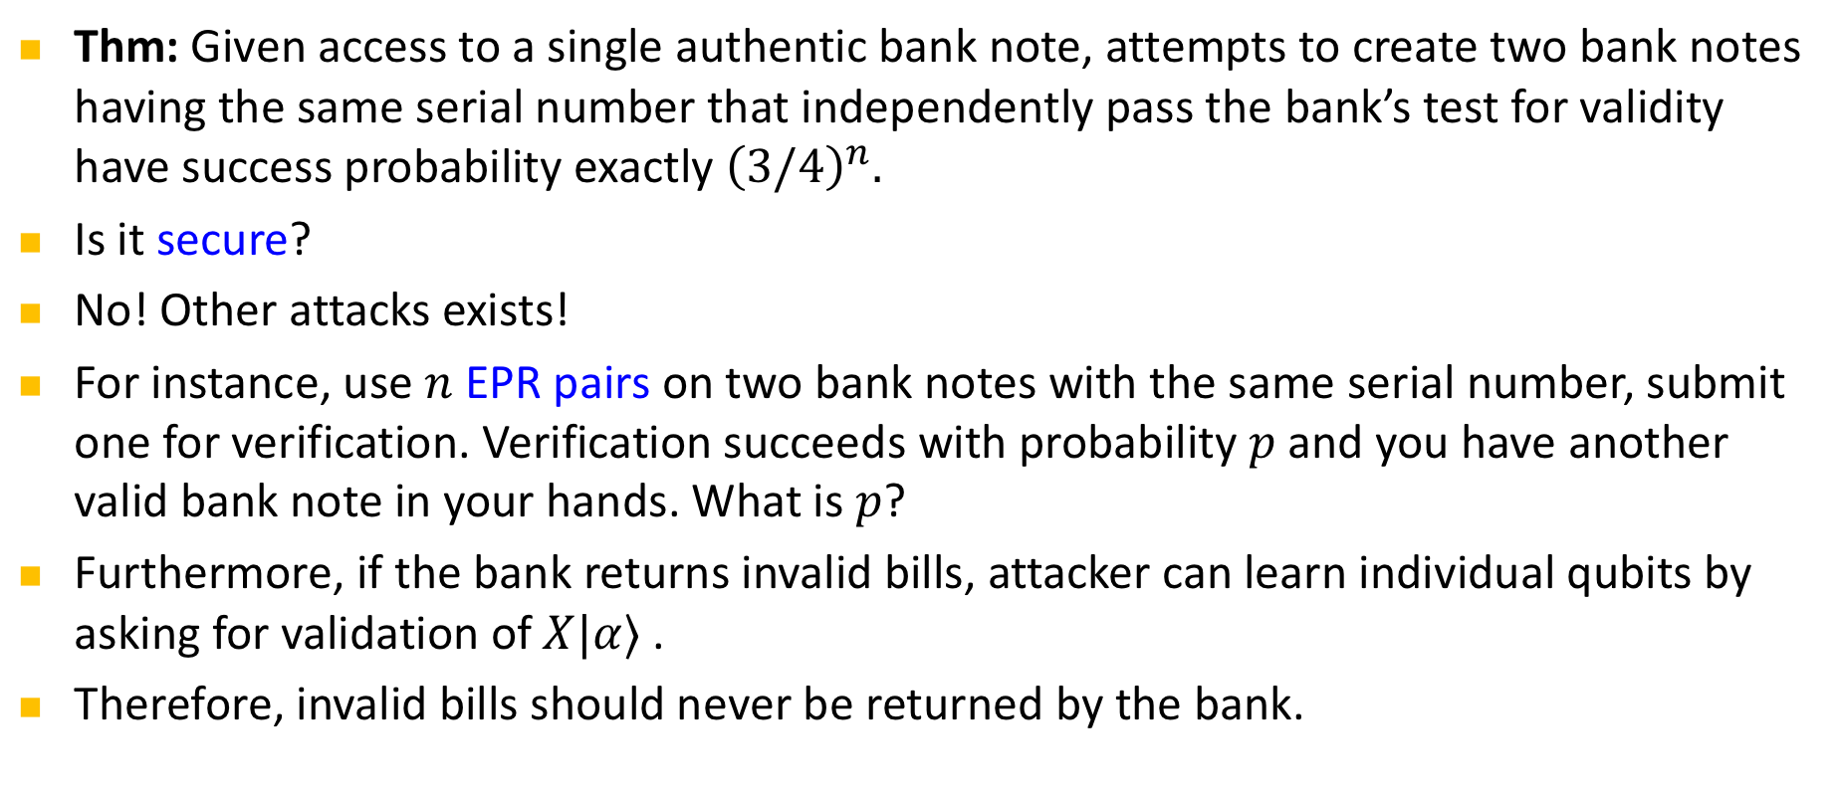
Quantum Money
Thm: Given access to a single authentic bank note, attempts to create two bank notes having the same serial number that independently pass the bank’s test for validity have success probability exactly ${\left(3/4\right)}^{n}.$
Is it secure?
No! Other attacks exists!
For instance, use $n$ EPR pairs on two bank notes with the same serial number, submit one for verification. Verification succeeds with probability $p$ and you have another valid bank note in your hands. What is $p$?
Furthermore, if the bank returns invalid bills, attacker can learn individual qubits by asking for validation of $X|α⟩$ .
Therefore, invalid bills should never be returned by the bank.
[Molina Vidick Watrous 13, Lutomorski 10]
Notes:
add link to BB84

Slide 35
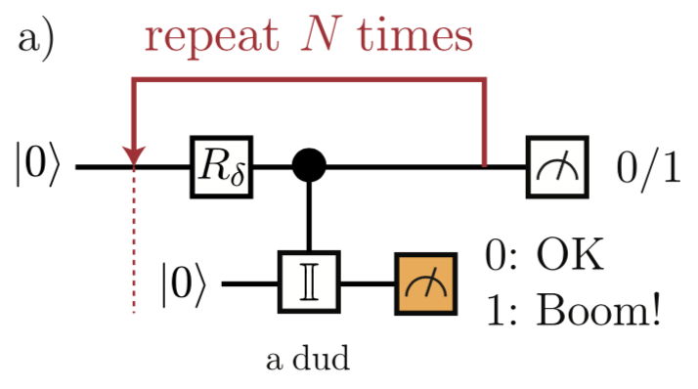
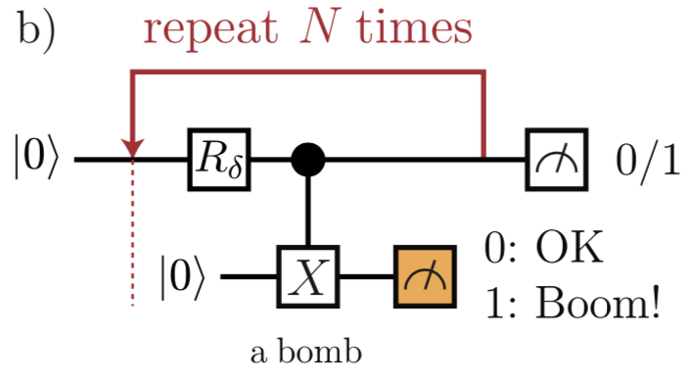
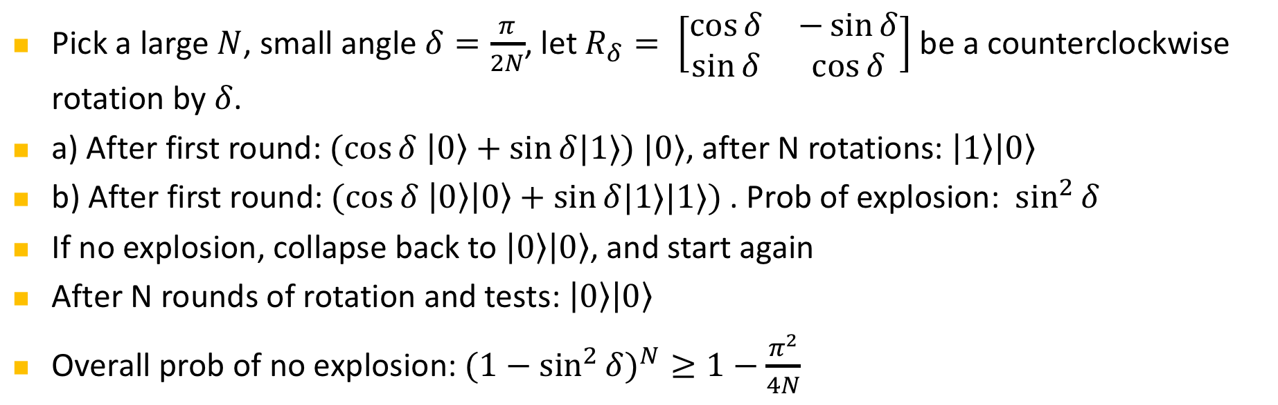
Elitzur-Vaidman’s bomb quality tester
Pick a large $N$, small angle $δ=\frac{π}{2N}$, let $R_{δ}= \left[\begin{matrix}\cos{δ} & −\sin{δ} \\ \sin{δ} & \cos{δ}\end{matrix}\right]$ be a counterclockwise rotation by $δ$.
a) After first round: $(cos{δ \left|0\right\rangle +\sin{δ|1⟩) |0⟩}}$, after N rotations: $\left|1\right\rangle \left|0\right\rangle$
b) After first round: $(cos{δ \left|0\right\rangle \left|0\right\rangle +\sin{δ|1⟩|1⟩) }}$. Prob of explosion: $\sin^{2}{δ}$
If no explosion, collapse back to $\left|0\right\rangle \left|0\right\rangle$, and start again
After N rounds of rotation and tests: $\left|0\right\rangle \left|0\right\rangle$
Overall prob of no explosion: ${{(1−sin}^{2}{δ)}}^{N}≥1−\frac{π^{2}}{4N}$
[Elitzur Vaidman 93, figures from Brodutch Nagaj Sattath Unruh 14]
Notes:
add link to BB84

Slide 36
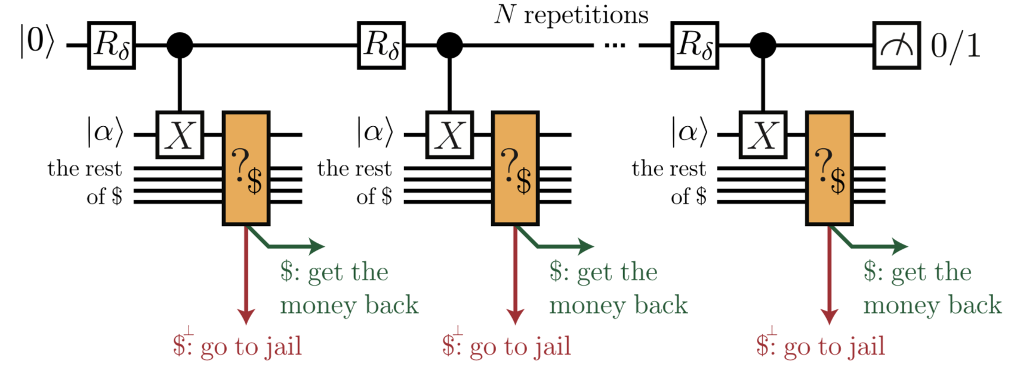
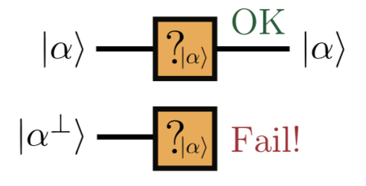
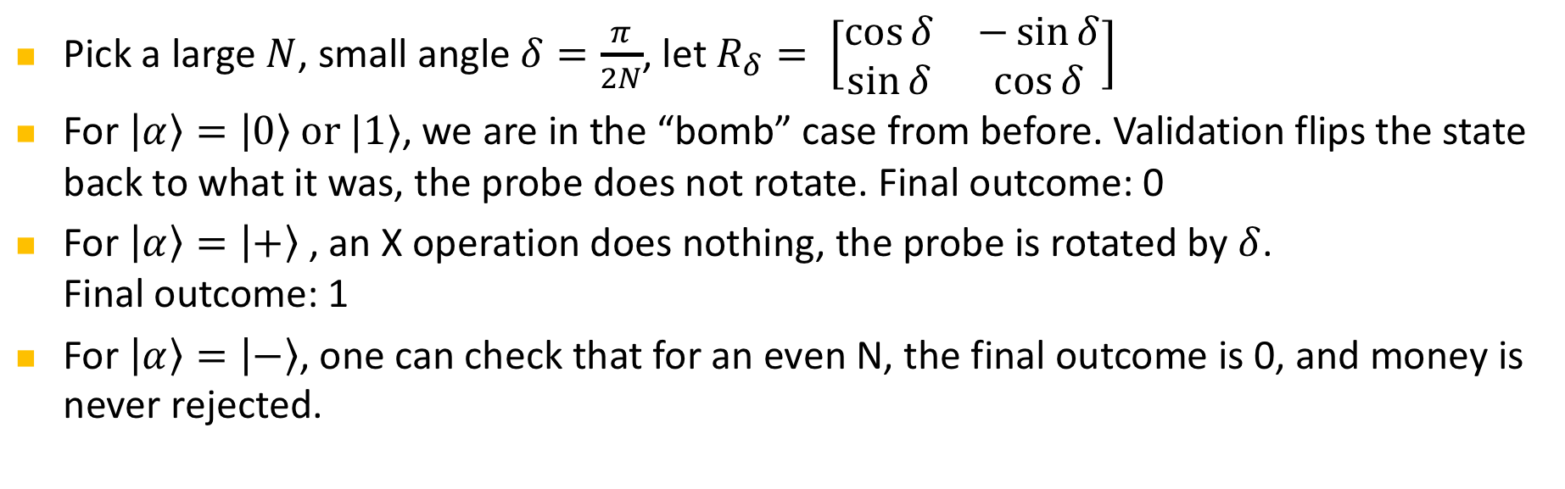
Bomb Testing to Counterfeit Q Money
Pick a large $N$, small angle $δ=\frac{π}{2N}$, let $R_{δ}= \left[\begin{matrix}\cos{δ} & −\sin{δ} \\ \sin{δ} & \cos{δ}\end{matrix}\right]$
For $\left|α\right\rangle =\left|0\right\rangle or |1⟩$, we are in the “bomb” case from before. Validation flips the state back to what it was, the probe does not rotate. Final outcome: 0
For $\left|α\right\rangle =\left|+\right\rangle$, an X operation does nothing, the probe is rotated by $δ$.
Final outcome: 1
For $\left|α\right\rangle =\left|−\right\rangle$, one can check that for an even N, the final outcome is 0, and money is never rejected.
[Brodutch Nagaj Sattath Unruh 14]
Notes:
add link to BB84

Slide 37
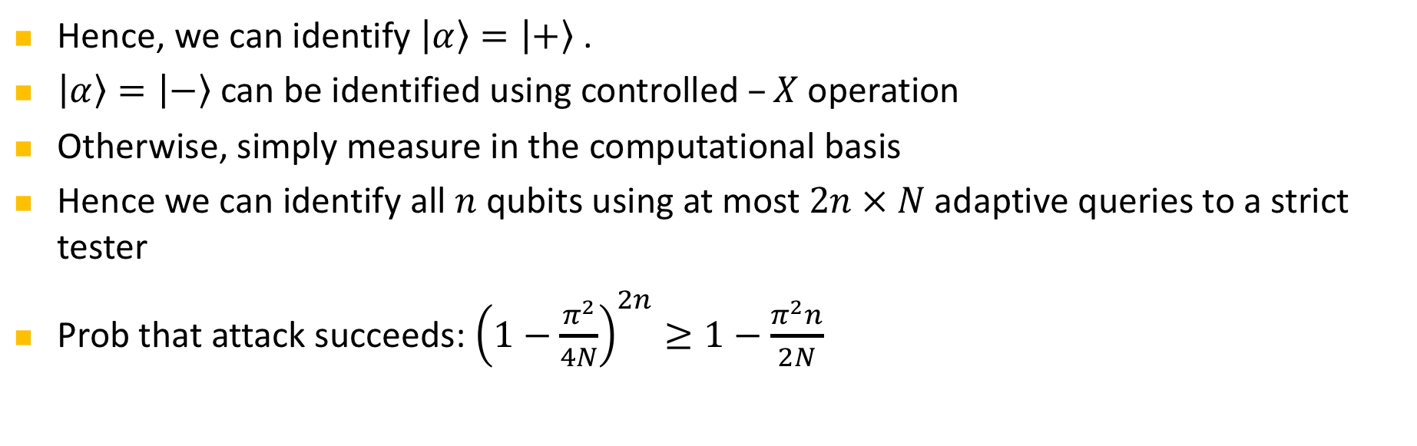
Bomb Testing to Counterfeit Q Money
Hence, we can identify $\left|α\right\rangle =\left|+\right\rangle$.
$\left|α\right\rangle =\left|−\right\rangle$ can be identified using controlled $–X$ operation
Otherwise, simply measure in the computational basis
Hence we can identify all $n$ qubits using at most $2n × N$adaptive queries to a strict tester
Prob that attack succeeds: ${\left(1−\frac{π^{2}}{4N}\right)}^{2n}≥1−\frac{π^{2}n}{2N}$
[Brodutch Nagaj Sattath Unruh 14]
Notes:
add link to BB84

Slide 38
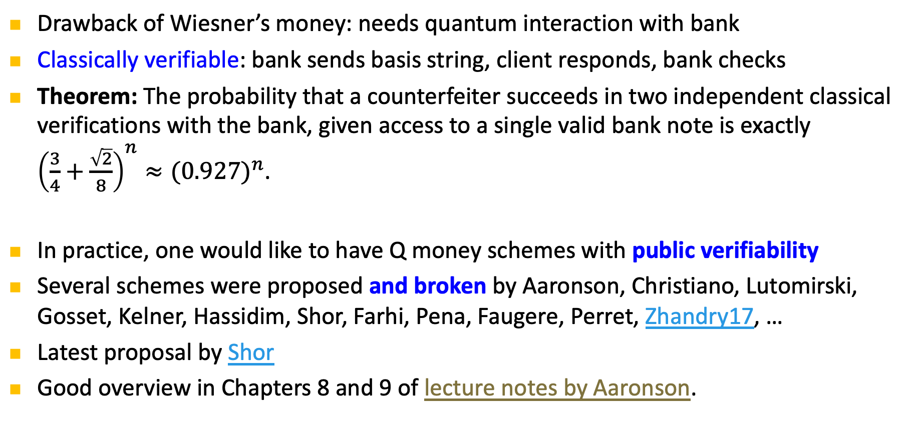
More practical Q Money
Drawback of Wiesner’s money: needs quantum interaction with bank
Classically verifiable: bank sends basis string, client responds, bank checks
Theorem: The probability that a counterfeiter succeeds in two independent classical verifications with the bank, given access to a single valid bank note is exactly ${\left(\frac{3}{4}+\frac{\sqrt{2}}{8}\right)}^{n}≈{(0.927)}^{n}$.
In practice, one would like to have Q money schemes with public verifiability
Several schemes were proposed and broken by Aaronson, Christiano, Lutomirski, Gosset, Kelner, Hassidim, Shor, Farhi, Pena, Faugere, Perret, Zhandry17, …
Latest proposal by Shor
Good overview in Chapters 8 and 9 of lecture notes by Aaronson.
[Molina Vidick Watrous 13, Aaronson 09, …]
Notes:
add link to BB84

Slide 39
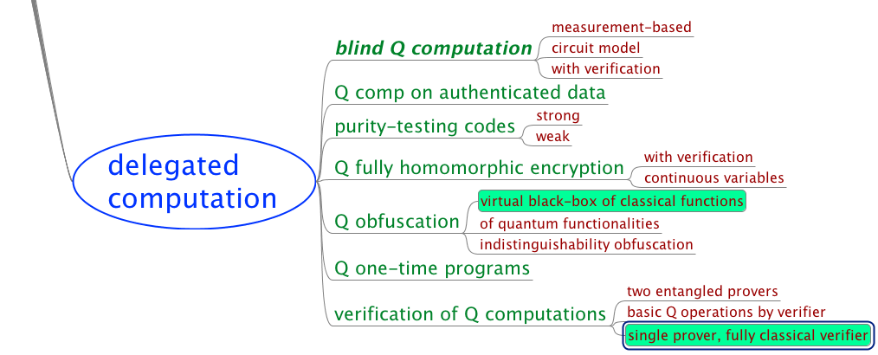
Delegated Q Computation

Slide 40
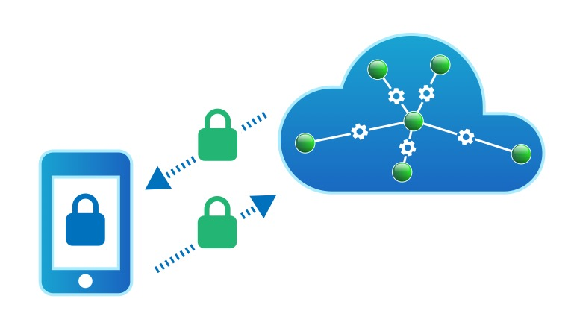
Delegated Computation
QCloud Inc. promises to perform a BQP computation for you.
How can you securely delegate your quantum computation to an untrusted quantum prover while maintaining privacy and/or integrity?
Various parameters:
  Quantum capabilities of verifier: state preparation, measurements, q operations
  Type of security: blindness (server does not learn input), integrity (client is sure the correct computation has been carried out)
  Amount of interaction: single round (fully homomorphic encryption) or multiple rounds
  Number of servers: single-server, unbounded / computationally bounded or multiple entangled but non-communicating servers
[Childs 05, …. see e.g. Broadbent 17 or Fitzsimons 16 for overviews and references]
Image: Tremani / TU Delft

Slide 41
Classical Verification of Q Computation
QCloud Inc. promises you to perform a BQP computation
How can a purely classical verifier be convinced that this
computation actually was performed?
Partial solutions:
    Using interactive protocols with quantum communication between prover and verifier, this task can be accomplished, using a certain minimum quantum ability of the verifier.
    [Fitzsimons Kashefi 17, Broadbent 17, AlagicDulekSpeelmanSchaffner17]
    Using two entangled, but non-communicating provers, verification can be accomplished using rigidity results [ReichardtUngerVazirani12]. Recently made way more practical by [ColadangeloGriloJefferyVidick17]
Indications that information-theoretical blind computation is impossible [AaronsonCojocaruGheorghiuKashefi17]
[see Broadbent 17 or Fitzsimons 16 for overview and more complete references]

Slide 42
Classical Verification of Q Computation
QCloud Inc. promises you to perform a BQP computation
How can a purely classical verifier be convinced that this
computation actually was performed?
[Mahadev18] Classical verification of Q Computations
[Mahadev18] Quantum fully homomorphic encryption
Verifiable quantum fully homomorphic encryption?

Slide 43
Delegated Q Computation

Slide 44
Black-Box Obfuscation
Idea: an obfuscator is an algorithm which rewrites programs, such that
efficiency is preserved;
input-output functionality is preserved;
output programs are hard to understand: “If something is efficiently learnable from reading the code, then it is also efficiently learnable purely from input-output behavior.”
“black-box obfuscation”
=
x
f(x)
x
f(x)
[Alagic Fefferman 16, slide by Gorjan Alagic, thanks a lot!]

Slide 45


Classical Obfuscation
Idea: an obfuscator is an algorithm which rewrites programs, such that
efficiency is preserved;
input-output functionality is preserved;
output programs are hard to understand: “If something is efficiently learnable from reading the code, then it is also efficiently learnable purely from input-output behavior.”
“black-box obfuscation”
Formal:
A black-box obfuscator O is an algorithm which maps circuits C to circuits O(C) such that:
efficiency-preserving:
functionality-preserving:
virtual black-box: for every poly-time A there exists a poly-time S such that
learn something by reading circuit
learn same thing from input-output
[Alagic Fefferman 16, slide by Gorjan Alagic, thanks a lot!]

Slide 46
Classical Obfuscation
Why care? Lots of applications:
Protecting IP: obfuscate before publishing (already done, but ad-hoc);
Secure patching: revealing what is being patched exposes unpatched machines;
Public-key crypto: private-key encryption → public-key encryption:
One-way functions: choose delta-function circuit, make obfuscator’s coins part of input;
FHE: encryption → fully-homomorphic encryption:
“top of the crypto scheme hierarchy”
Bad news: classical black-box obfuscation is impossible [Barak et al ’01].
Other definitions? “Computational indistinguishability” (first schemes proposed in );
universal circuit
[Alagic Fefferman 16, slide by Gorjan Alagic, thanks a lot!]

Slide 47
Quantum Obfuscation
A quantum obfuscator O is a (quantum) algorithm which rewrites quantum circuits, and is:
efficiency-preserving:
functionality-preserving:
virtual black-box: for every QPT A there exists a QPT S such that
quantum polynomial-time algorithm
construct a black-box quantum obfuscator (that outputs states that cannot be reused);
construct a computational indistinguishability quantum obfuscator (that outputs circuits);
[Alagic Fefferman 16, slide by Gorjan Alagic, thanks a lot!]

Slide 48
Delegated Q Computation

Slide 49
Thank you!
https://github.com/cschaffner/QCryptoMindmap
http://arxiv.org/abs/1510.06120
In Designs, Codes and Cryptography 2016
Thanks to all friends and colleagues that contributed to quantum cryptography and to this presentation.
Questions

